Slide 2
Cybersecurity
Best Practices
For [your organization’s name]

Slide 3
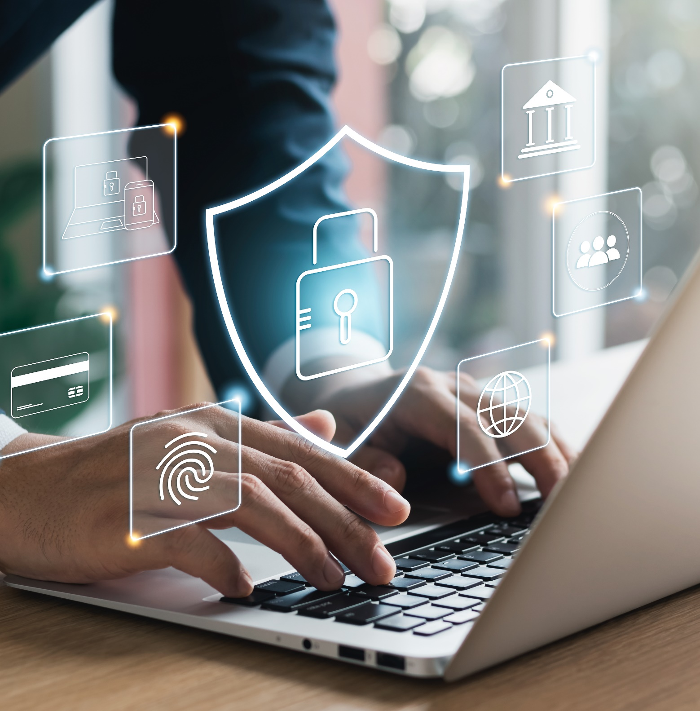
Roadmap
What Cybersecurity Awareness Month is and why [your organization’s name] should participate
Why cybersecurity matters
Where [your organization] stands regarding the cybersecurity best practices that CISA recommends for organizations that own, operate, supply, support, or otherwise connect with critical infrastructure

Slide 4
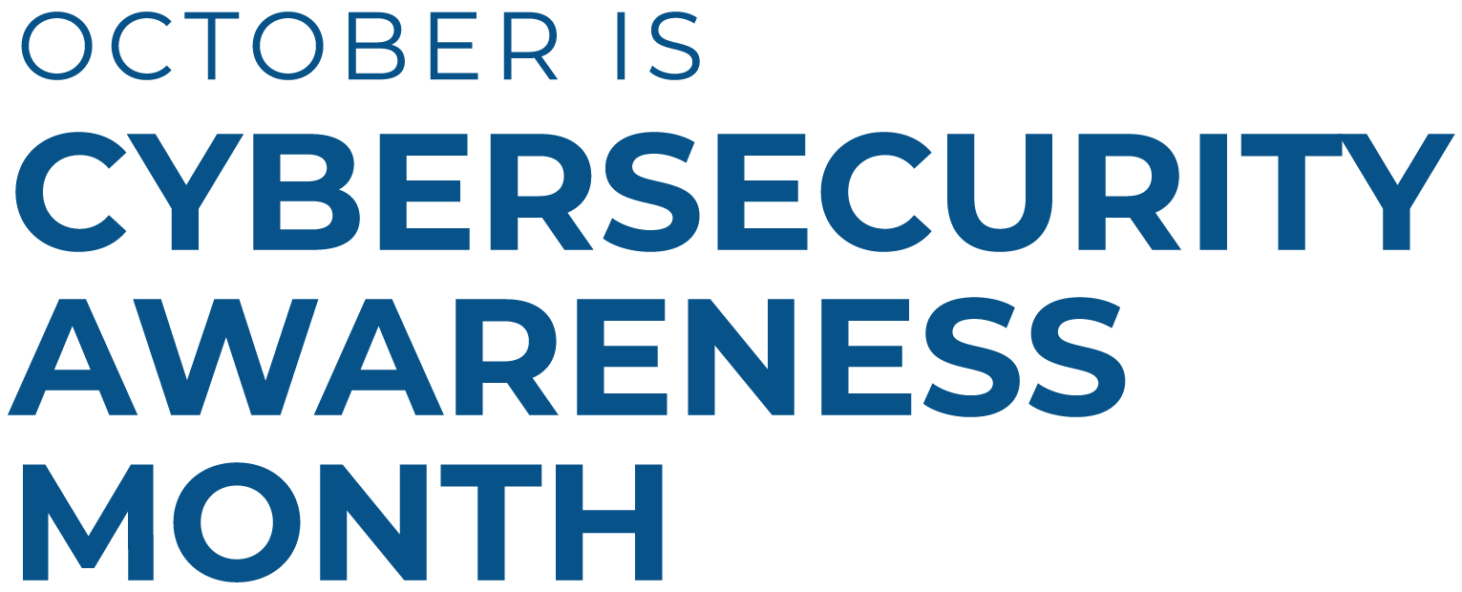

Slide 5

Cybersecurity Awareness Month
October is Cybersecurity Awareness Month! For over 20 years, this awareness campaign has highlighted the importance of taking regular action to reduce risks when online and using connected devices.
The 2026 theme is Securing the Next 250. This theme highlights the need to act now on cybersecurity, as cyber threats get faster and smarter—often driven by artificial intelligence-enabled attempts to find and take advantage of vulnerabilities.

Slide 6

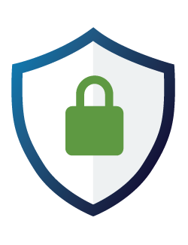
Why Cybersecurity Matters
Many organizations are directly or indirectly connected to critical infrastructure.
If an organization’s systems are compromised, it could disrupt essential services and impact public safety.

Slide 7
Create a Culture of Cybersecurity
Cybersecurity is a culture, not just a checklist.
A strong cybersecurity culture includes clear policies, regular employee training, and engagement from IT and leadership. It also means ensuring that partners and vendors follow strong security practices.
Do we have an organization-wide cybersecurity policy in place? Is it followed consistently?
Are we holding our partners and vendors to the same standards?
DISCUSSION

Slide 8

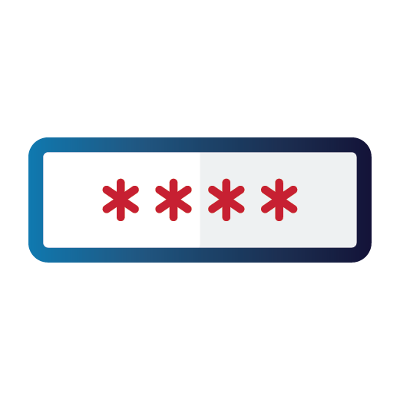


Four Cybersecurity Essentials
The following four practices are the foundation of organizational cybersecurity and should be as automatic as buckling a seatbelt:
Teach employees to avoid phishing
Recognizing and reporting suspicious emails and links may prevent cyber attacks.
Require strong passwords
Long, random, unique passwords make accounts harder to breach.
Require multifactor authentication
Adds an extra layer of protection if a password is compromised.
Update software
Keeps systems protected against known vulnerabilities.
Are we doing these things, and are they documented in our cybersecurity policy?
Is there room for improvement?
DISCUSSION

Slide 9


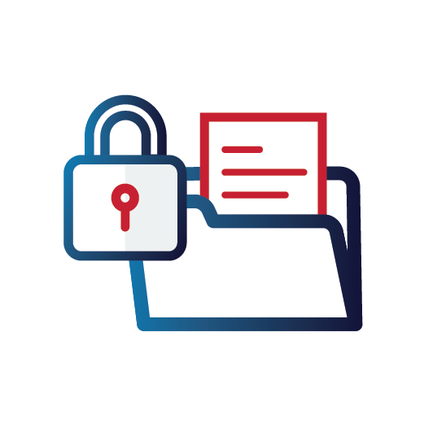
Level Up Our Defenses
Once the core protections are in place, we can strengthen our defenses with additional practices:
Use logging and monitoring
Helps detect suspicious activity early to prevent or limit damage.
Back up data
Ensures you can recover quickly from ransomware or data loss.
Encrypt data
Makes stolen data unreadable without the proper key.
Are we doing these things, and are they documented in our cybersecurity policy?
Is there room for improvement?
Are we doing these things, and are they documented in our cybersecurity policy?
Is there room for improvement?
DISCUSSION

Slide 10

Additional Practices
More ways to increase your cybersecurity:
Share cyber incident information with CISA
Early reporting helps protect other organizations and improves national defense.
cisa.gov/report
Migrate to a .gov domain (*for government organizations only)
Builds trust and improves security for public-facing services.
Check eligibility and learn more at get.gov
Are we doing these things, and are they documented in our cybersecurity policy?
Is there room for improvement?
Are we doing these things, and are they documented in our cybersecurity policy?
Is there room for improvement?
DISCUSSION

Slide 11
New Actions for 2026
New actions for 2026 (Cyber Performance Goals):
Have an Incident Response plan (IR) and use it! Organizations should develop, maintain, update, and regularly exercise IR plans for common threat scenarios such as ransomware attacks. Ensure drills are realistic and include all relevant stakeholders, such as organizational leadership and legal counsel, in addition to technical personnel. IR plans should be reviewed and drilled on an annual basis at a minimum.
Be prepared for system disruptions. Organizations should develop and execute plans to recover and restore service to critical assets or systems that might be impacted by a cybersecurity incident. Consider including the ability to execute mission essential functions without access to critical assets or even internet access (e.g., shift to paper-based operations, radio communications, etc.)
Do you have an incident response plan?
When was the last time your plan was tested and/or updated?
Do you know what to do during a major disruption without power
DISCUSSION

Slide 12
FINAL thoughtS
Cyber threats are getting faster and smarter. Artificial Intelligence is accelerating the rate at which hackers can find and take advantage of weak spots in our computer software and systems. Here are some key ways [YOUR ORGANIZATION] can protect itself:
Reduce vulnerabilities
Replace end-of-support devices
Recover quickly to sustain operations
How can our organization ensure that cybersecurity best practices are not just documented, but actively integrated into our daily operations and culture?
What challenges might we face in achieving this, and how can we overcome them?"
DISCUSSION

Slide 13
Promote Safer Online Practices
As an industry leader, it’s essential that [your organization’s name] helps our community by:
Encouraging our partners, vendors, and customers to follow cybersecurity best practices.
Using resources like those found in the Cybersecurity Awareness Month Toolkit to educate individuals.
Together, we can protect against online threats.
What collateral can we share with our community?
What social media platforms or communication channels can we use?
DISCUSSION

Slide 14
Resources & tools
CISA’s Cybersecurity Awareness Month web page includes free resources we can use:
Cybersecurity Awareness Month toolkit: Customizable tools to help our organization easily participate all month
Fact Sheets: Teach employees best practices they can use at work and on their personal devices
IT tools: Implement/strengthen the best practices with Cyber Hygiene Services, Logging Made Easy software and other tools and guidance
Shall we participate in Cybersecurity Awareness Month? Who will head it up?
Who can take the lead on updating our cybersecurity policies and procedures?
DISCUSSION

Slide 15
Next Steps
Directions: Use this slide to document any actions agreed upon in the meeting.
…

