Slide 1

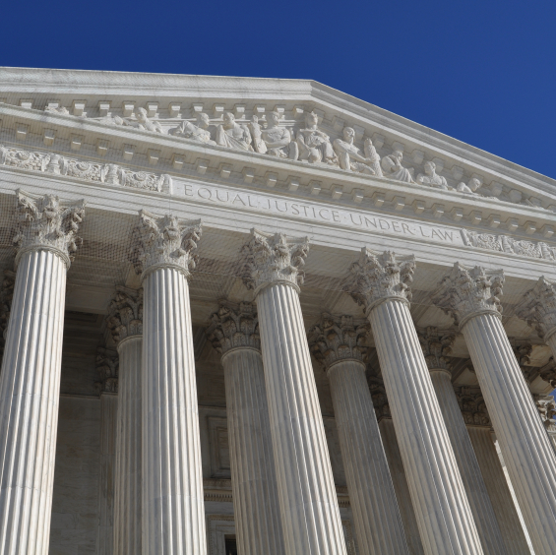

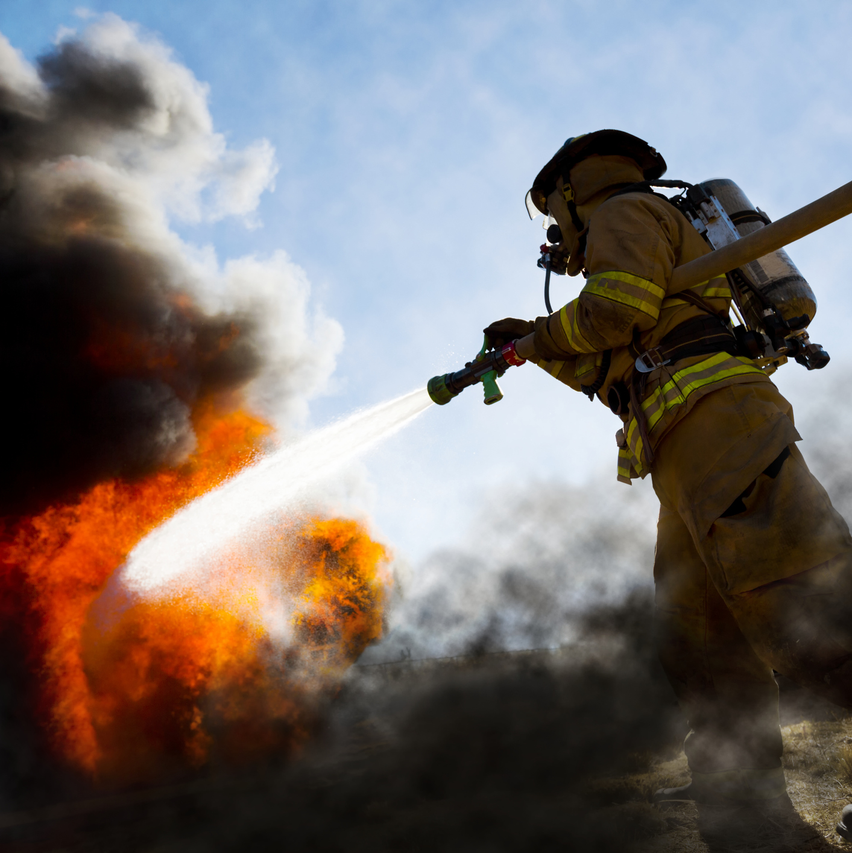
Opioid Settlement
Funding
A trustee playbook for pool and city risk reduction
Notes:
Opening / framing
Thank everyone for attending.
Frame the session around two hats. First, many attendees are pool trustees or governing board members with fiduciary responsibility for the pool. Second, many are also city managers, city employees, or local government leaders thinking about how this applies back home.
The main message is that opioid settlement funding is not just a public health funding stream. It can be a practical risk-control opportunity. About two-thirds of the discussion should stay focused on the pool/trustee lens: how pools can educate, influence, and support members so eligible dollars fund controls that reduce losses. About one-third should connect directly to the city steward lens: how a city can use the same concepts to strengthen its own public safety operations, responder readiness, wellness, and defensibility.
Invite questions throughout – best as a practical discussion because every state, pool, and local government may have a different allocation and approval structure.

Slide 2

Turning Opioid Settlement Funds into Sustainable Risk Management
Thursday, May 14th | 10:45am

Slide 3
What is the “national opioid settlement”?
Civil settlements + court-approved agreements + long-term payments.
Thousands of lawsuits by states, tribes, counties, and cities
  Alleged deceptive marketing and failures in oversight.
National agreements resolved large portions of litigation
  Payments over many years + injunctive relief (business practice changes).
Multiple settlements exist (not one single pot)
  Totals have grown as additional defendants settle.
Payments are distributed over many years
  Vary by agreement and state/local allocation.
For trustees: predictable member-accessible funding to support prevention controls.
For city stewards: a local opportunity to fund readiness without waiting on the pool.
Trustee Takeaway: This is member-accessible funding that can reduce pool loss drivers while strengthening each community’s public safety response.
Notes:
The national opioid settlement is a series of civil settlements and court-approved agreements, not a federal grant program. The lawsuits were brought by states, tribes, counties, cities, and other subdivisions alleging deceptive marketing and oversight failures by companies in the opioid supply chain.
For trustees, the practical point is not to litigate the past. The practical point is that many member entities now have access to a predictable funding stream that may be used for opioid abatement. That can include prevention, response, and operational readiness investments that reduce exposure.
For city stewards in the room, this may mean your own jurisdiction has a local share, a county-administered share, or access to a state program. The pool is not the applicant or recipient, but the pool can help members understand the opportunity and use funds in a way that is eligible, documented, and aligned with public safety risk reduction.

Slide 4
Why this money exists
the simple story
The opioid epidemic created:
  Massive public health + public safety costs
  Operational burden for cities and counties
Settlements created long-term payments for:
  Mitigation
  Response
  Recovery
  Prevention
Not general spending. Not a grant. Abatement funding—with rules.
Trustee Takeaway:
This is where fiduciary stewardship and community stewardship align—use the money to reduce harm, loss volatility, and defensibility risk.
Notes:
This slide tells the simple story behind the dollars. Communities bore a significant share of the operational and human costs of the opioid crisis: overdoses, emergency response, law enforcement response, death investigations, family impact, secondary trauma, and strain on local systems.
The settlements were created to support opioid abatement: mitigation, response, recovery, prevention, and related strategies. For public safety, abatement is not limited to naloxone or treatment programs. It can also include the operational systems that make safe response repeatable: policy, training, documentation, responder wellness, and readiness.
For trustees, this is a mission-aligned opportunity. Funding eligible controls can reduce harm in member communities while also reducing the frequency, severity, and defensibility issues that show up in pooled losses. For city stewards, the same investments make the city better prepared and better able to show that it acted responsibly.

Slide 5
Who led it—and where trustees can influence
Coordinated many state actions through State AG’s
Local governments (cities, counties, special districts) joined through state agreements and/or direct local litigation – eventually all rolled in together
Defendants varied by settlement
  Distributors, manufacturers, pharmacies, consultants, others
Result: multi-settlement landscape
  Not a single “one-and-done” deal
What matters now is where discretion lives:
  Mostly state and local government, not the pool
  Pools influence outcomes through member education, not by “applying”
Trustee Takeaway: Success is guiding city/county decision-makers toward eligible, high-impact controls—while respecting local authority.
Notes:
The litigation was led primarily by state attorneys general and local governments. Cities and counties were key participants either through state participation agreements or direct local litigation. Defendants varied across settlements, which is why this is not one single pot of money or one single set of timing rules.
The trustee point is important: pools generally do not control the local settlement dollars. But pools have an enormous opportunity to influence how those dollars are understood and prioritized. Trustees can help make member education a governance priority without directing a member’s local spending.
The city steward point is equally practical: if you serve in a city role, you may be closer to the actual approval path. You can ask: Where is our share? Who approves expenditures? What documentation is required? Can we connect an eligible abatement strategy to public safety loss drivers such as response readiness, exposure safety, training, wellness, and reporting?

Slide 6
Payments over many years
  Use restrictions (abatement / Exhibit E)
Reporting and oversight layers
  Local approval + procurement still apply
Compliance matters: document eligible use + outcomes
What trustees should notice:
  What is allowed?
  Who approves?
  What proof is needed later?
  Reporting/compliance requirements
Settlement Anatomy: What’s in it
Trustee Takeaway: Pools can be the “safe use” translator—eligible spend, simple documentation, and stronger defensibility.
Notes:
The settlement anatomy matters because good intent is not enough. Members need to understand the payment timeline, allowable-use restrictions, reporting expectations, and local procurement requirements. Exhibit E provides a baseline for allowable uses, but state and local rules may create additional layers.
Trustees should listen for three practical questions: What is allowed? Who decides? What proof will the member need later? A project may be substantively eligible but still fail internally if no one can explain the abatement connection or produce a simple record of the decision.
Pools can add value by translating complexity into usable tools: a member briefing, an eligibility explainer, a project menu, and documentation templates. For cities, the same discipline protects the local government from audit concerns, political criticism, and reputational risk.

Slide 7
Common Misconceptions (Myth vs. Reality)
“This is a grant program.”
  → It’s settlement abatement funding with allowable-use rules (Exhibit E + state/local guidance).
“It can only be used for treatment.”
  → Guidance has matured; new settlements and local processes may create fresh opportunities for risk control solutions.
“We can spend it on anything.”
  → Spending must align to allowable uses and may require documentation/reporting.
“If it’s local, the agency can buy directly.”
  → City approvals + procurement rules still apply.
“We have to apply to get it.” / “It’s competitive.”
  In most states, local dollars are already allocated; the work is prioritization and compliant use.
“All buckets work the same.”
  → Different buckets have different owners, timelines, and oversight.
Trustee Takeaway:
Pools can help members move from “we don’t think we can” to “we can fund eligible controls the right way.”
Notes:
This is one of the most important trustee education slides. Many members have already formed opinions based on outdated or incomplete information. Some think the money is a grant. Some think they were rejected once and the answer is final. Some think only health departments can use the money. Others assume that because the dollars are local, any department can buy directly.
The pool’s role is not to give legal advice or override local counsel. The pool’s role is to help members ask better questions and recognize eligible opportunities. The best trustee message is: do not treat confusion as a dead end. Treat it as a reason to create a simple playbook.
For city stewards, this slide is a reminder that local procurement, council approval, finance review, or committee review may still apply. The opportunity is real, but it has to be brought forward in a way that aligns with the allowed strategies and the jurisdiction’s approval process.

Slide 8
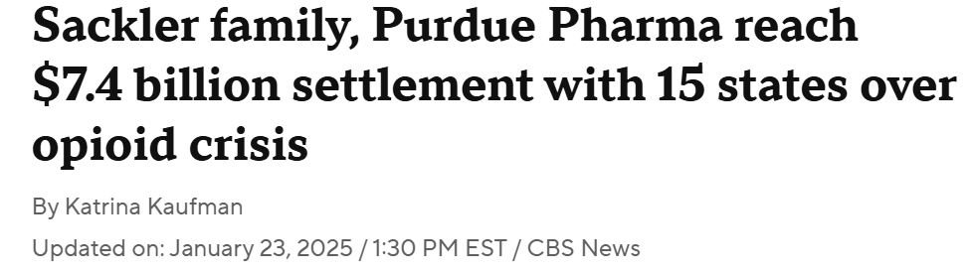
A Predictable Funding Stream for Multi-Year Risk Reduction
Predictable funding supports repeatable controls—not one-off purchases.
Opioid settlement funds are delivered through annual, recurring payments.
Payments are scheduled over a multi-year horizon; some major settlements extend up to 18 years.
Funding continues year after year, enabling long-term planning.
Local governments can plan policy refresh, recurring training, readiness checks, wellness supports, and documentation.
Total abatement resources can change as additional settlements are finalized.
Trustee Takeaway: Multi-year dollars support sustainable loss-control adoption—policy + training + documentation + wellness—at both the pool and city level.
Notes:
The multi-year nature of settlement payments is important because risk control works best when it is repeated. A one-time purchase may help, but sustainable loss reduction usually comes from policy currency, recurring training, readiness checks, wellness resources, and documentation discipline.
For trustees, this is where settlement funding connects to long-term pool stability. If members use recurring abatement dollars to strengthen public safety controls year after year, the pool benefits through reduced volatility and better claim defensibility.
For city stewards, the multi-year structure creates planning confidence. Instead of viewing settlement dollars as a small one-time award, local leaders can create a phased plan: year one education and policy, year two training and tracking, year three wellness and evaluation, and so on. The key is to make the plan eligible, documented, and tied to opioid abatement outcomes.

Slide 9
How Opioid Settlement Funds Were Allocated
Impact-Based Framework
  National formulas were designed to reflect opioid impact, not equal distribution.
  Allocations considered population alongside indicators of opioid harm and exposure.
  Core Data Inputs
Factors included overdose death rates, opioid prescription volume, and historical opioid distribution—meant to approximate scale and severity.
State-Controlled Distribution
  States determine how settlement dollars flow to counties, cities, and agencies, often using their own blend of population and impact measures.
City Steward Lens
  Your city may have a defined share, but the approval path may sit with finance, already council, manager, or a committee.
Trustee Takeaway: Variation is why members need a trusted interpreter—this is a direct value-add opportunity for the pool.
This explains why allocations vary—and why trustees can help members ask the right local questions.
Notes:
Allocations were not simply divided equally. National formulas attempted to account for opioid impact, including population and measures such as overdose deaths, prescription volume, and opioid distribution. Then states made their own choices about how dollars would flow locally.
For trustees, this variation explains why members are confused and why a national answer rarely works. A pool’s value is to help members navigate the state and local structure in which they actually operate.
For city stewards, the question is often not whether your city was affected; the question is where your city’s dollars or access points sit. It may be a city allocation, a county-controlled allocation, a state-administered program, or a local committee. City leaders can use this slide to start the internal conversation with finance, the city manager’s office, public safety, HR, and legal counsel.

Slide 10
Why Members Get Confused – And Where Trustees Add Value
Same settlement baseline, different state and local choices
States choose the split
  State • local • special buckets
AG / legislature sets oversight model
Local governments may add controls
Committees • mini-grants • finance/procurement review
Pool educational value:
Who decides?
What’s allowed?
What proof is needed?
How does spend reduce losses?
Trustee Takeaway: Reducing confusion increases eligible utilization on controls that lower member risk and pool losses.
Notes:
This slide makes the complexity tangible. The baseline settlement framework may be common, but states chose different splits and oversight models. Then local governments may add their own rules: committees, applications, procurement thresholds, council approvals, or departmental review.
Trustees should see this as a member-service opportunity. If members are confused, settlement dollars may remain unused or may be used only in narrow ways that miss high-impact public safety controls. Pools can reduce friction by creating a consistent framework: who decides, what is allowed, what documents to keep, and how to tie a request to loss drivers.
For city stewards, this is also an internal implementation playbook. The same questions can be asked inside your own jurisdiction: who owns the funds, who influences priorities, what public safety risks are most urgent, and what documentation would make the request defensible?

Slide 11
How Local Governments Receive Their Share
Most states distribute local shares by formula.
Many publish local allocation exhibits.
“Not competitive” means jurisdictions usually are not competing for their share.
But priorities compete internally: public health • fire/EMS • law enforcement • courts • HR
Key step: city leadership controls approvals and procurement.
Each state used a distribution approach for its “local bucket.”
Trustee Takeaway:
Settlement funds can pay for high-risk controls—pools can help leaders see the opportunity and city stewards can bring it home.
Notes:
The local bucket is often the most direct route because the dollars have already been assigned to a city or county. That does not mean there is no process. It means the challenge is often prioritization and approval rather than competing for a new grant.
For trustees, the strategic move is to educate city and county leaders before local priorities are locked in. If the only voices at the table are treatment providers or public health departments, important public safety risk controls may be missed. Those other priorities may be valid, but public safety readiness is also part of abatement when properly tied to allowed strategies.
For city stewards, this is where action happens. Identify the local bucket, understand who approves expenditures, and frame the request around abatement, not simply equipment or training. The stronger the connection between allowed use, operational need, and documentation, the easier it is to defend the spend.

Slide 12
Why the Local Bucket is the Fastest Path to Action
Funds are typically organized into multiple “buckets,” each with different owners and processes.
Why We Focus on the Local Bucket
Already allocated to the city
Local decisioning; no competitive grant
Faster action on approved uses
Clearest path to fund high-risk controls
Links pool priorities to city action
LOCAL
Assigned to the jurisdiction
More discretion
STATE
State priorities
Longer cycle
OTHER / SPECIAL
Varies by state
Trustee Takeaway:
Local settlement funds give cities flexibility to invest in high-risk drivers—policy, training, readiness, wellness, and documentation—that affect claims, premiums, and community trust.
Notes:
This slide focuses the audience on why the local bucket is usually the fastest path to action. State programs may be valuable, but they often involve longer cycles, competitive applications, or state priorities. Special-purpose buckets vary. The local bucket can move faster because local leaders can connect the dollars to specific local operational needs.
For trustees, the local bucket is where pool influence can be most practical. A pool cannot dictate the decision, but it can provide members with examples, eligibility language, a risk-control menu, and documentation support. That shortens the distance between awareness and action.
For city stewards, this means you may not need to wait for a separate grant. If the city or county already has a share, the conversation becomes: what eligible controls should be prioritized, who needs to be in the room, and what evidence will show the investment was tied to opioid abatement?

Slide 13
Why Risk Pools Should Care
Public safety drives high-severity pooled risk
Incidents create volatility for pooled programs
Settlement dollars can fund controls members struggle to budget for
Pools can guide eligible, defensible spending
Better controls → fewer/severe incidents + stronger defensibility
City lens: safer responders, stronger community trust
Trustee Takeaway:
This is a rare chance to fund loss prevention with non-premium dollars and align the pool’s mission with member community outcomes.
Notes:
This is the core trustee case. Public safety exposures are often among the highest-severity exposures in a pool. A single critical incident, policy failure, training gap, documentation gap, or wellness-related performance issue can create claim volatility and reputational damage.
Settlement dollars create a rare opportunity to fund controls that members often struggle to budget for: current policies, recurring high-risk training, FTO modernization, performance visibility, responder wellness, and documentation systems. These are the types of controls that make safe practice repeatable and provable.
For city stewards, the same controls protect the community. Better readiness can reduce harm to residents, improve responder safety, increase consistency, strengthen trust, and make the city more defensible when decisions are scrutinized. The pool and city interests are aligned here.

Slide 14
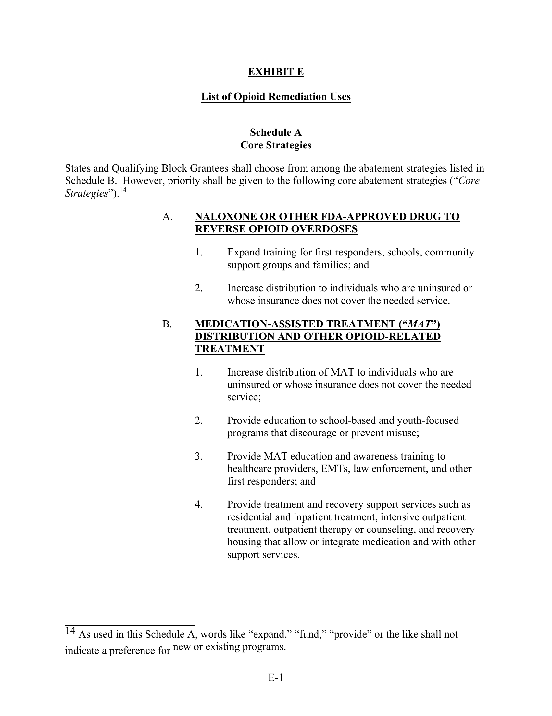
Exhibit E: What the Money Can Be Used For (and Why)
Exhibit E defines allowable uses of opioid settlement funds — preventing the money from becoming general budget and establishing what qualifies as opioid remediation.
Applies across states as a baseline guardrail
Defines what qualifies, not who receives funds
Defines strategies, not shopping lists
Notes:
Exhibit E is the baseline guardrail for allowable opioid remediation uses. The key point for trustees is that Exhibit E defines what kinds of uses may qualify; it does not decide who gets money or who approves a request. That is determined through state and local structures.
A common mistake is to treat Exhibit E as a shopping list. It is better understood as a strategy list. That matters because risk-control investments may be eligible when they enable or support a permitted abatement strategy.
For cities, this means a request should not simply say, 'We want to buy training' or 'We want to update policy.' It should say how the investment supports overdose response readiness, first responder safety, prevention, harm reduction, data/reporting, public education, or another approved strategy. The more explicit the connection, the better.

Slide 15
Why Exhibit E Exists (and Why States Tighten It)
Exhibit E sets the floor
  Baseline allowable-use guardrail
    Broad abatement strategies
  States may tighten
    Narrower categories
    Extra approvals / reporting
  Locals may tighten further
    Committees
    Internal prioritization
    Department-level controls
Ask: What strategy does this enable? What proof will we keep?
Notes:
Exhibit E sets the floor, not the ceiling. States can be narrower, and local governments can add internal controls. That is why one member may get approval for a project while another member in a different state—or even a different county—may face additional review.
Trustees should encourage members to respect local rules while not giving up too quickly. The right question is not 'Can we buy this product?' The better question is 'What approved strategy does this enable, and what documentation would make the connection clear?'
For city stewards, this framing is useful in conversations with finance, legal, public health, city management, or elected officials. It keeps the proposal grounded in abatement rather than appearing like a general budget request.

Slide 16
Exhibit E Is A STRATEGY LIST – Not a Product List
Core Strategies (Primary Abatement Categories)
  Treatment
  Recovery
  Harm reduction
  Prevention
Outcome-focused strategies — not purchasing instructions.
Other Recognized Strategies (Also Eligible)
  First-responder support
  Public education & awareness
  Data, planning, and evaluation
  Community-based prevention efforts
Operational safety and readiness
What This Means in Practice
  Strategies include the enablers that make response safer and more consistent:
  Overdose response readiness
  Fentanyl exposure safety
  Policy and training that standardize safe response
  Wellness and operational readiness for first responders
Trustee Takeaway:
If an investment enables a permitted strategy and reduces exposure, it may be eligible—even if it doesn’t look like a traditional “program.”
Notes:
This slide reframes Exhibit E as a strategy list. Treatment, recovery, harm reduction, and prevention are core categories. But the broader recognized strategies include first responder support, public education, data, planning, evaluation, and community-based prevention.
For trustees, the opportunity is to help members see that operational enablers can matter. Safe overdose response requires policies, training, PPE procedures, documentation, supervision, and wellness support. Those things may not look like traditional treatment or recovery programs, but they can support abatement outcomes.
For city stewards, the practical takeaway is to write the request in terms of outcomes and strategy. Do not lead with the vendor or product. Lead with the operational risk: overdose response, fentanyl exposure, inconsistent documentation, responder wellness, or training gaps. Then connect the proposed investment to the relevant abatement strategy.

Slide 17
First Responders Are Explicitly Included in Exhibit E
This is where “abatement” meets operational risk reduction.
Safety & Exposure
  Fentanyl precautions
  PPE + procedures
Training & Readiness
  Overdose response readiness
  Documentation & protocols
Wellness & Resiliency
  Peer support
  Secondary trauma mitigation
Governance & Accountability
Tracking, reporting, repeatable proof
Trustee Takeaway: These are high-frequency / high-severity controls that influence claims defensibility, responder readiness, and community outcomes.
Notes:
First responders are an important bridge between opioid abatement and risk reduction. Law enforcement, fire, EMS, dispatch, and other frontline personnel experience the crisis operationally. They respond to overdoses, secure scenes, administer or support naloxone, handle fentanyl exposure concerns, document incidents, interact with families, and manage the emotional aftermath.
For trustees, first responder readiness is a direct loss-control issue. Policies, procedures, training, documentation, and wellness are not soft supports. They are controls that can reduce harm and improve claim defensibility.
For city stewards, this is also about service quality and public trust. A city that supports responder safety and readiness is better positioned to respond consistently, protect employees, and explain its decisions under scrutiny.

Slide 18
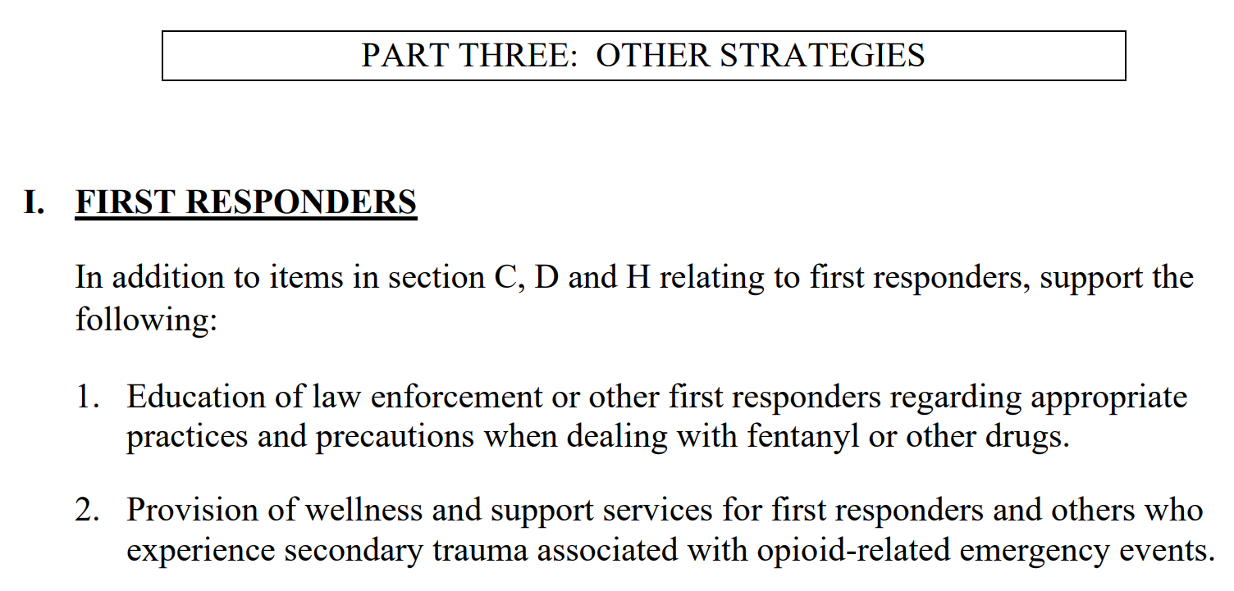
Secondary Trauma: Why It Matters for Readiness and Risk
Repeated trauma can affect performance, decision-making, retention, and public interactions.
Exhibit E recognizes first responders as secondary victims.
Wellness and peer support tied to opioid response burden are readiness controls.
Trustee Takeaway: Wellness investments can reduce preventable incidents, stabilize staffing, and limit long-tail exposure.
Notes:
Secondary trauma deserves specific attention because opioid response is not a single event for many responders. Repeated exposure to overdoses, deaths, family trauma, child welfare concerns, and death notifications can affect performance, judgment, retention, and interactions with the public.
For trustees, secondary trauma can become risk exposure. It may contribute to burnout, mistakes, poor decision-making, use-of-force escalation, absenteeism, or turnover. Wellness and peer support should be framed as readiness controls, not just employee benefits.
For city stewards, protecting responders protects the city’s ability to serve the community. A wellness investment connected to opioid response burden can support retention, decision-making, morale, and public trust. The city should document the connection between the opioid response burden and the wellness or peer-support strategy.

Slide 19
Eligible Public Safety Investments That Reduce Risk
Policy + Procedures (Keep Current + Test Regularly)
Maintain up-to-date, jurisdiction-ready policy/procedure standards
Document distribution + acknowledgments to reduce “outdated training” liability
Online Training (CE-Eligible + High-Risk Topics)
Test/validate understanding (scenario-based drills or daily reviews)
Courses that support CEU requirements and recurring high-risk training needs
Opioid response, de-escalation, exposure safety, and other high-risk areas
Assignment + Completion Tracking (Proof, Not Promises)
Centralized assignment, completion, and acknowledgment records
Dashboards/exports to support audits, QA, and claims defensibility
Field Training (FTO) Modernization
Digital observation/evaluation workflow that documents coaching and progress
Standardizes field readiness and reduces training-related exposure
Performance Visibility & Early Flags
Leadership reporting to spot trends and risk signals early
Supports proactive intervention and accountability
Wellness & Resiliency Supports
Confidential resources + program support (peer support / secondary trauma)
Strengthens readiness and reduces burnout-driven risk
Program-level controls:
policy + training + tracking + wellness + governance proof.
Trustee Takeaway:
These fund high-risk controls that make safe practice repeatable and provable—policy currency, recurring training, readiness testing, wellness, and documentation.
Notes:
This slide brings the concept down to the program level. The most valuable public safety investments are often not one isolated purchase. They are combinations of controls that make safe practice repeatable: current policy, recurring training, completion tracking, field supervision, performance visibility, wellness support, and documentation.
For trustees, this is the menu that connects settlement funding to loss prevention. These are the areas that can reduce frequency, severity, and defensibility issues. They also help members prove that they trained, communicated, tracked, supervised, and followed up.
For city stewards, the same menu can become a city action plan. Start with the highest-risk operational gaps: overdose response readiness, fentanyl exposure protocols, training completion, documentation quality, supervisor visibility, and responder wellness. Then map those gaps to allowed abatement strategies and local approval requirements.

Slide 20
How Trustees Activate Settlement Funds
Educate decision-makers
  Board/member briefing
  Manager + finance + police/fire + HR session
  Myth-busting FAQ
  What-to-fund checklist
Provide a Risk Control Menu
  Policy + training + documentation
  Exposure safety + response readiness
  Wellness + resiliency
  Field training modernization
  Performance visibility
Give ready-to-submit tools
  Justification template
  Documentation checklist
  Sample one-page request
Trustee Takeaway:
Pools have direct access to decision-makers—and city stewards in this room can activate the same playbook locally. Lexipol can support any step.
Notes:
This is the action slide. Trustees can activate the opportunity by treating it as a board-level member-service priority. That does not mean the pool decides how a city spends settlement dollars. It means the pool equips members to make informed, eligible, defensible decisions.
The first lever is education: brief city and county leaders, chiefs, HR, finance, and training leads. The second lever is a risk-control menu that translates settlement language into practical member projects. The third lever is making action easy with templates: justification language, documentation checklists, sample submissions, and simple talking points.
For city stewards, this is the same playbook you can take home. Identify the bucket, find the approver, bring the right people together, connect the need to abatement, and document the decision. The goal is to turn available dollars into prevention, readiness, wellness, and defensibility.

Slide 21
Q&A:
Turning Settlement Funds into Risk Reduction
Notes:
Use the Q&A to pull out both perspectives. For trustees, ask: What can the pool do to educate members? What are our highest public safety loss drivers? How can we help members use non-premium dollars for eligible controls?
For city stewards, ask: Where do our local settlement dollars sit? Who approves spending? What public safety controls are underfunded? What documentation would our finance, legal, or council leaders need?
Keep bringing questions back to the practical framework: eligible strategy, local decisioning, documentation, and risk-control impact.

Slide 22
Research Starting Points
NLC-RISC Trustees Conference page
nationalopioidsettlement.com
opioidsettlementguides.com
KFF Health News: Tracking the Opioid Settlement Cash
Opioid Settlement Tracker
Marco DeLeon
Chief Industry Officer, Lexipol
MDeLeon@Lexipol.com
940-594-8262
Notes:
Close by pointing people to research starting points. Encourage attendees to use official settlement resources, state-specific guidance, local allocation exhibits, and settlement tracking tools. Remind them that national sources are starting points; the final answer often depends on state and local rules.
End with the central message: settlement dollars are intended for opioid abatement, but abatement includes the operational capabilities that make response safer, more consistent, and more defensible. Trustees can help members see the opportunity. City stewards can bring the opportunity home and turn it into action.

