Slide 1

The Power of AND
Thursday, May 14th | 9:30am

Slide 2
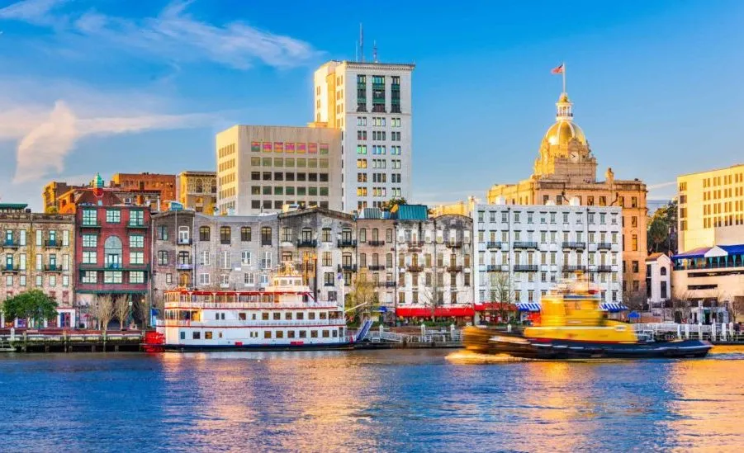

Slide 3
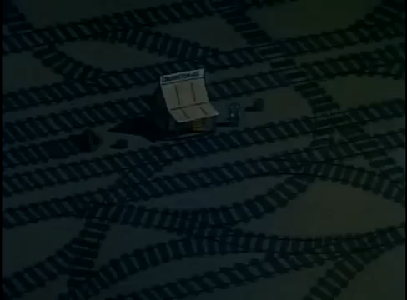

Slide 4


Slide 5

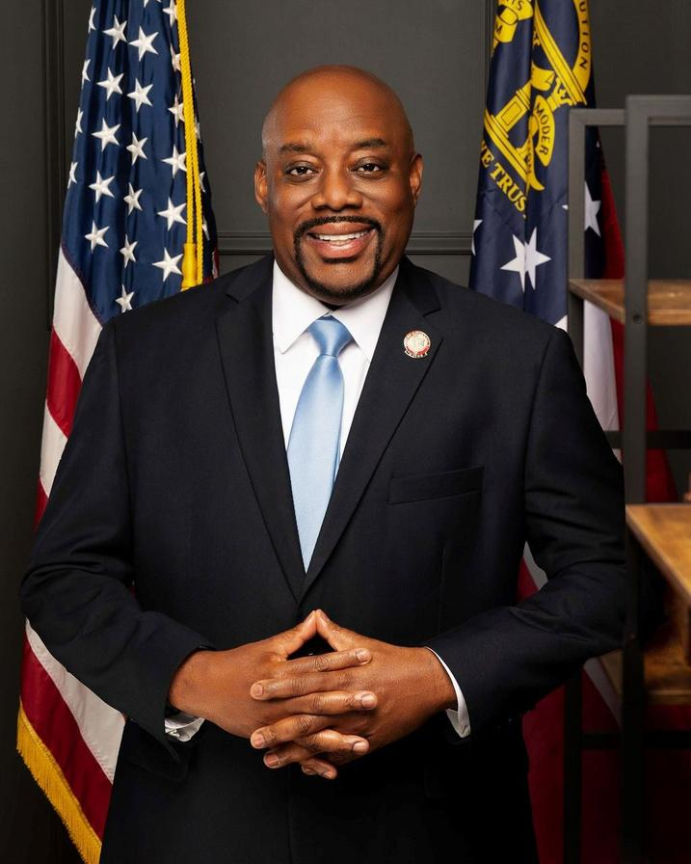
INCLUSIVE LEADERSHIP FOR A STRONGER SAVANNAH

Slide 6




Leadership is Not Either/Or
Van R. Johnson, II | Mayor, Savannah, GA

Slide 7
Leadership is Not Either/Or
Growth AND Preservation
Safety AND Justice
Tradition AND Innovation
Van R. Johnson, II | Mayor, Savannah, GA

Slide 8
The Problem
with OR

Slide 9

The Problem
with OR
Communities move forward with AND
OR polarizes
OR divides

Slide 10

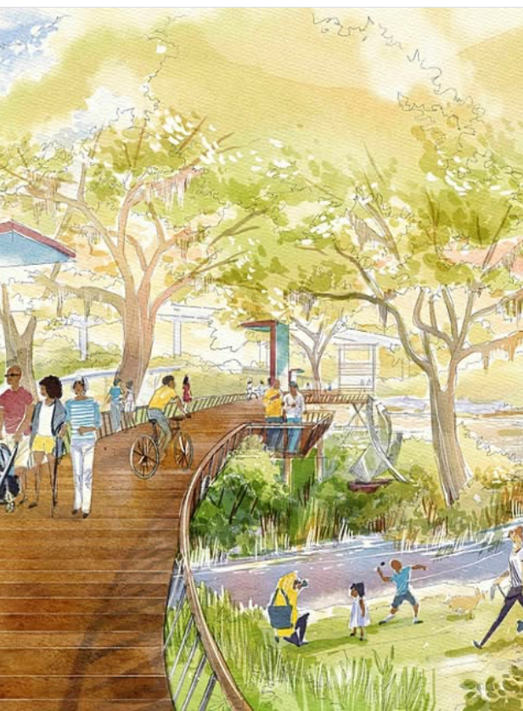

What AND Means
Van R. Johnson, II | Mayor, Savannah, GA

Slide 11
What AND Means
Connecting People
Connecting Ideas
Connecting Solutions
Van R. Johnson, II | Mayor, Savannah, GA

Slide 12
Inclusive Leadership
Van R. Johnson, II | Mayor, Savannah, GA

Slide 13

Inclusive Leadership
I hear you AND I hear them
Move forward AND bring people with us
Van R. Johnson, II | Mayor, Savannah, GA

Slide 14
The Language of Trust
Van R. Johnson, II | Mayor, Savannah, GA

Slide 15
The Language of Trust
I understand, BUT divides
I understand, AND connects
Van R. Johnson, II | Mayor, Savannah, GA

Slide 16
Partnership Solutions

Slide 17
Partnership Solutions
Government AND Community
Business
AND Neighborhoods
Youth
AND Experience

Slide 18
Leading with AND in Government
Van R. Johnson, II | Mayor, Savannah, GA

Slide 19
Leading with AND in Government
Results AND Relationships
Today’s Needs AND Tomorrow’s Investment
Van R. Johnson, II | Mayor, Savannah, GA

Slide 20
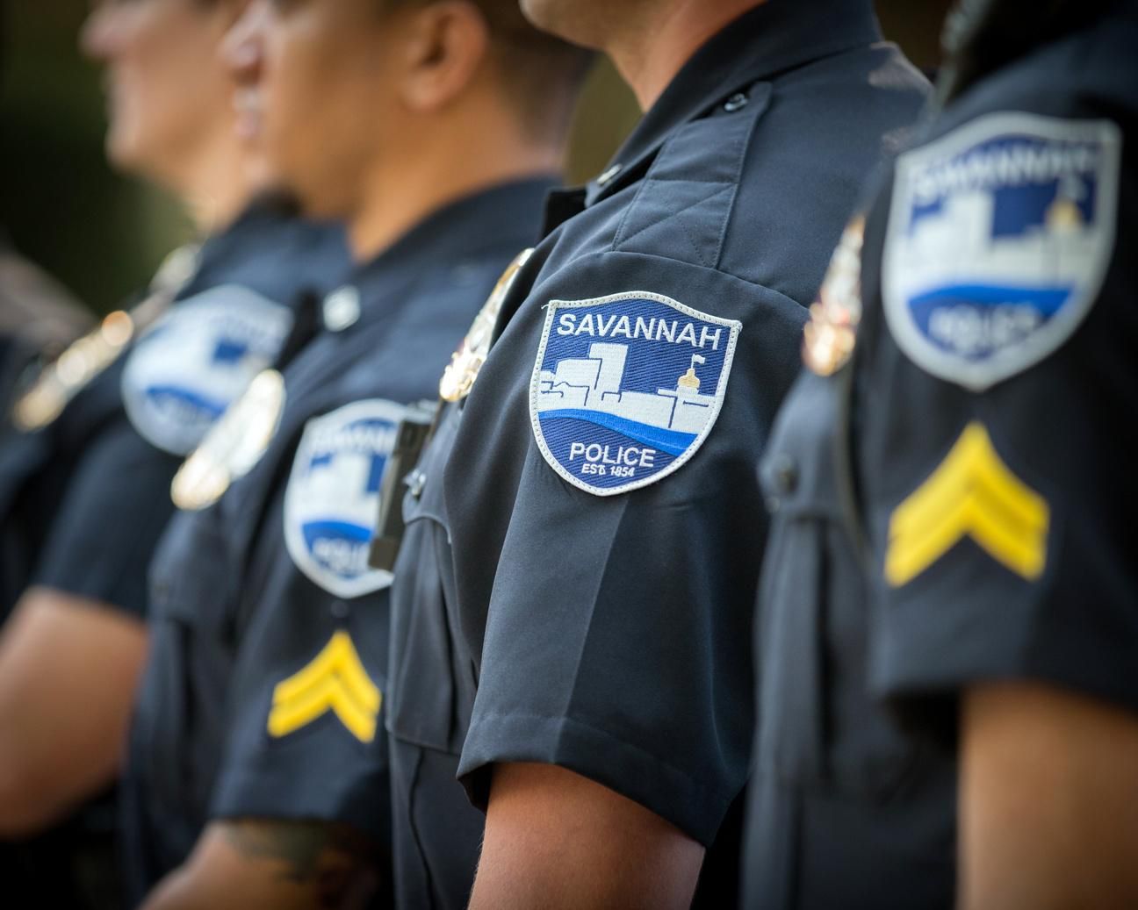
Public Safety is AND
Support Law Enforcement
AND
Build Community Trust
Van R. Johnson, II | Mayor, Savannah, GA

Slide 21
Savannah’s Future
Economic Growth AND Quality of Life
Tourism AND Neighborhood Stability
Van R. Johnson, II | Mayor, Savannah, GA

Slide 22
Leading Through Tension
Van R. Johnson, II | Mayor, Savannah, GA

Slide 23
Leading Through Tension
Disagree AND Stay Connected
Acknowledge AND Act
Van R. Johnson, II | Mayor, Savannah, GA

Slide 24
Shared Responsibility
Van R. Johnson, II | Mayor, Savannah, GA

Slide 25
Shared Responsibility
No One Solves It Alone
Public Sector AND Private
Sector AND Community
Van R. Johnson, II | Mayor, Savannah, GA

Slide 26
Savannah’s Opportunity
Van R. Johnson, II | Mayor, Savannah, GA

Slide 27
Savannah’s Opportunity
Historic AND Innovative
Rooted AND Rising
Van R. Johnson, II | Mayor, Savannah, GA

Slide 28
Leadership Challenge
Van R. Johnson, II | Mayor, Savannah, GA

Slide 29
Leadership Challenge
Where are you choosing OR
When AND is possible?
Van R. Johnson, II | Mayor, Savannah, GA

Slide 30
Lead With AND
Van R. Johnson, II | Mayor, Savannah, GA

Slide 31
Lead With AND
Conviction AND Humility
Excellence AND Compassion
Van R. Johnson, II | Mayor, Savannah, GA

Slide 32
The Future of Savannah and Your Future…
Van R. Johnson, II | Mayor, Savannah, GA

Slide 33
The Future of Savannah and Your Future…
Connecting AND Including
AND Solving Together
Van R. Johnson, II | Mayor, Savannah, GA

Slide 34


THANK YOU
AND
BE GREAT!
Van R. Johnson, II | Mayor, Savannah, GA

