Slide 1

Skills for Disagreeing Better - Lessons from Braver Angels
Thursday, May 14th | 2:15pm

Slide 2
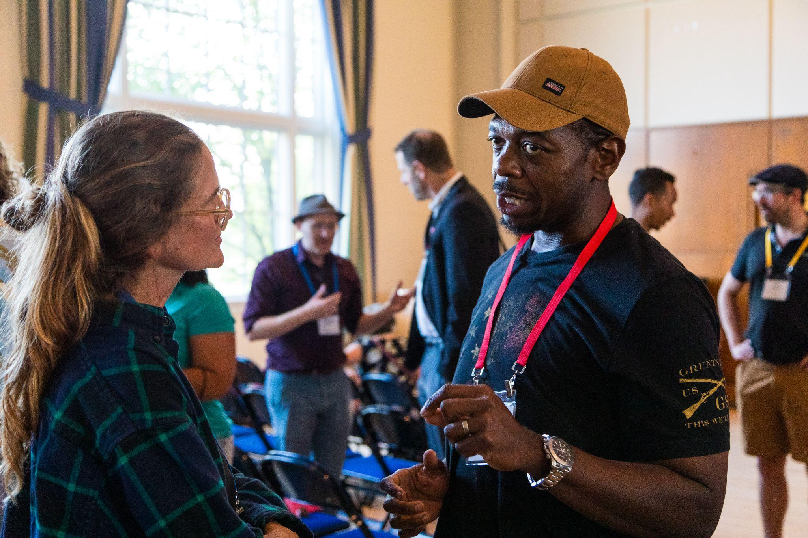


Skills for Disagreeing Better
Denise Chiavetta
State Coordinator
Braver Angels of Georgia
NLC-RISC
Trustees Conference
May 14, 2026
© Braver Angels 2023
Notes:
MOD1
Does anyone here feel the tension in the air around politics? Any one having difficulty discussing politics with family and friends? Do you just avoid it?
Well, we NEED TO TALK ABOUT POLITICS - it is essential to a functioning country. We face significant challenges both a home and abroad - we AS A COUNTRY - need to talk about how we handle those challenges. America needs to better than what we are doing today!
My name is Denise Chiavetta.
Do you and your fellow Trustees face significant challenges
Share I see it in every Braver Angel workshop and encounter. We are here to share a ‘mini-experience’ of what we see in those encounters. AND - we will ask to PARTICIPATE in a brief experience to show you what it feels like. Don’t worry - it is FUN and SAFE (and brief!)
photo link
https://drive.google.com/file/d/1Zs2GSbw24hs2SJt5MRCB6qdeH6t7Gtxz/view?usp=sharing
See TIME TRACKER - HERE

Slide 3

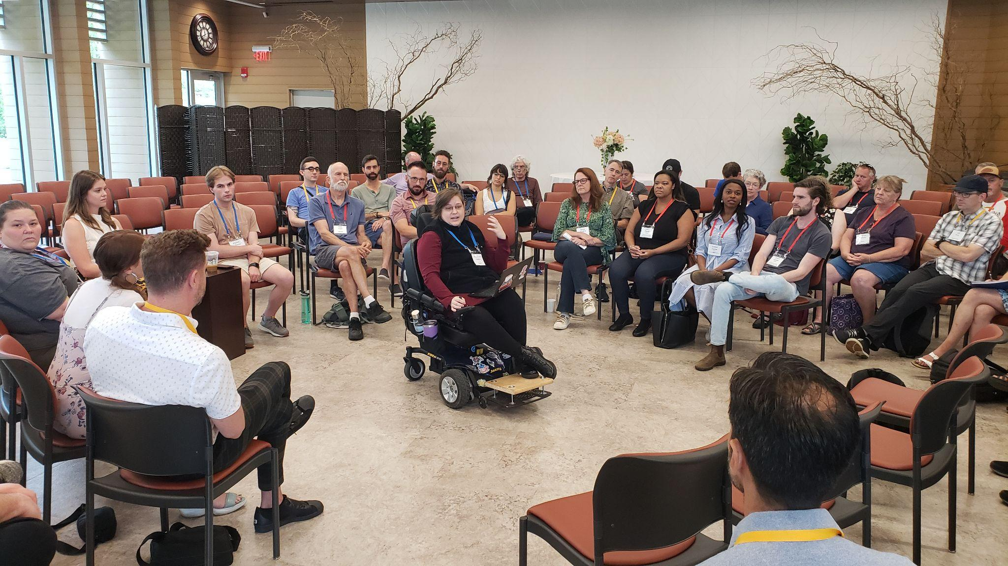

Desired Outcomes
Awareness of the impact of polarization
Experience of skill building in an abbreviated format
Awareness of Braver Angels as an organization and our offerings
Notes:
MOD1 - 10:04
Cover the points on the slide
Photo link
https://drive.google.com/file/d/1HCaNqOscQkJCI75F9DhsQb_4XaoR1gFN/view?usp=sharing

Slide 4
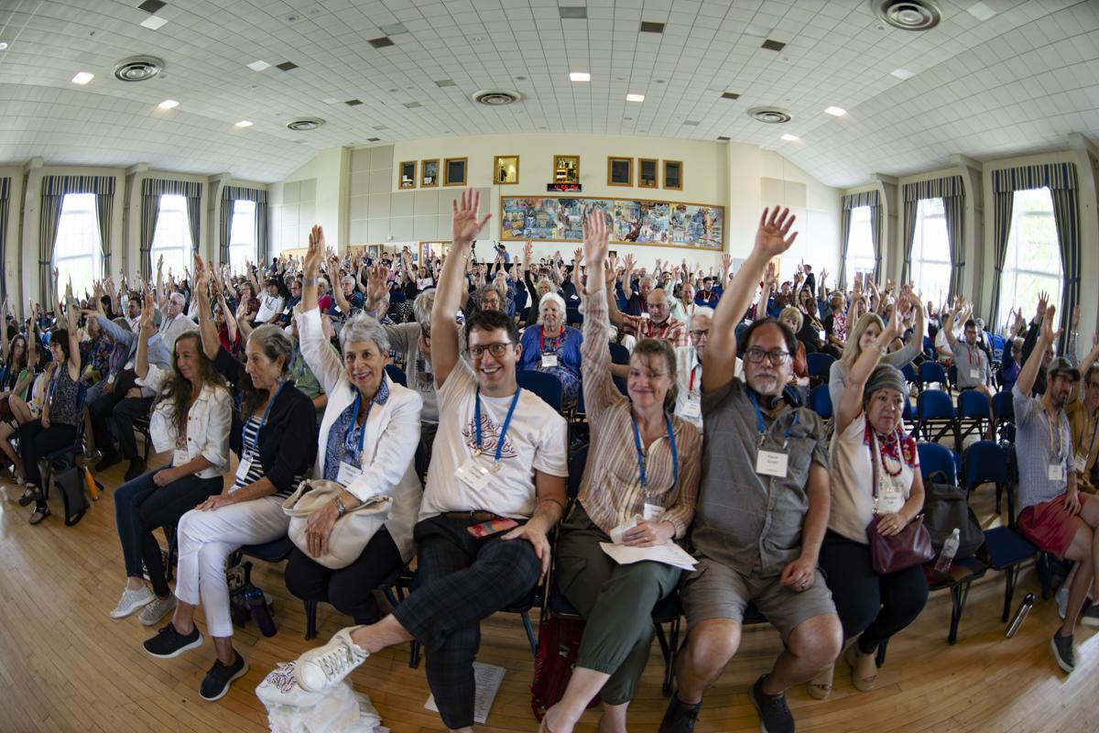
Agenda
  The problem of polarization
  Sample skill-building workshop structure
  “Mini-experience”
  Braver Angels as an organization
Notes:
MOD1 10:05
Cover the points on the slide
Photo link
https://drive.google.com/file/d/1U05QOhZUo9UvTh_mc5-eSjlxqdXhI4sD/view?usp=sharing

Slide 5
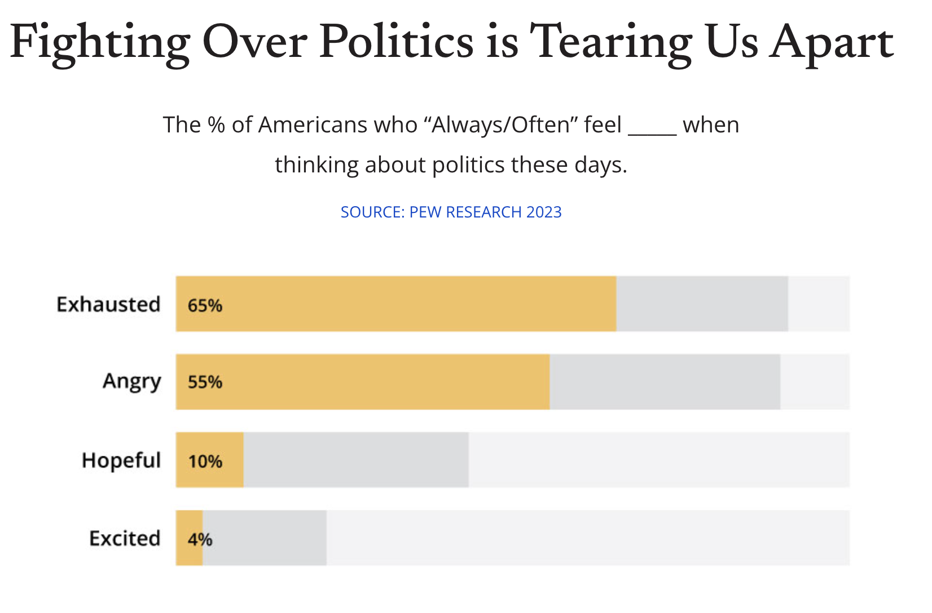
The Problem of Polarization
“I feel like my point of view is unwelcome”
“It seems like there is no place for my faith in public”
“I have lost closeness I used to have with friends or family”
“I don’t feel comfortable sharing my views”
Notes:
MOD1 10:06
Disagreement alone is not bad. Differences are what make life exciting and interesting. It’s when we turn our differences into stereotyping, hatred, disdain, distrust - that can hurt us. That becomes polarization.
.
Polarization is a phenomenon when people feel more negatively, even hatred, toward others who differ on issues, hot topics, group affiliation, and/or political parties. Sadly, we see polarization with political parties and attitudes about specific issues– affecting schools, religious denominations, colleges, civics organizations, businesses, hospitals. It can affect families and friends.
Think about how divisive mask wearing was during the height of pandemic. Disagreement often turned into anger and hatred – not about the virus, but about people who held positions so strongly - hatred was directed toward others who felt differently from each other.
It’s okay to disagree with someone’s ideas or beliefs, but polarization is when we take those differences in ideas and turn them into distrust and hatred of the other PERSON.
NOTE THE QUOTES ARE A BUILD
Recent research by one of the nation’s foremost research groups shows that Americans are exhausted when thinking about politics. And if they are not exhausted -they are angry.
There were several personal statements of note in this study - here are some examples:
Click thru the points

Slide 6
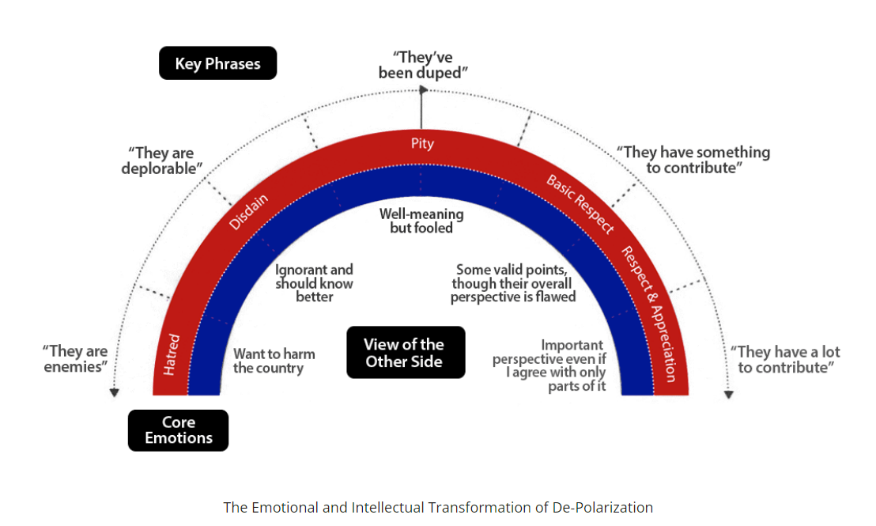

DE-polarizing begins with “Know Thyself”
Notes:
This is a diagram we use at Braver Angels, it comes from our Depolarizing Within workshop.
In the red area are the emotions
At the top are key phrases we might hear, say, or think.
And in the middle are the views of the “other”
Our goal is to move ourselves clockwise on this diagram. It’s not always easy. As I mentioned, it takes practice. But from my perspective, the personal benefits are so valuable. The invitation is to see people with a different ideological grounding as human beings have an important perspective even it I disagree with it.

Slide 7
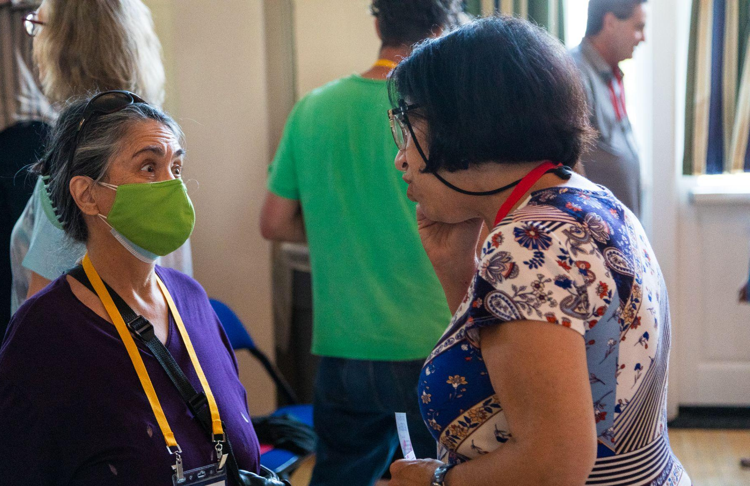
How is polarization making your conversations across differences difficult today?
Notes:
MOD1 10:08
Set up the question and then a 5 minute popcorn share (or until no shares….)
Photo link
https://drive.google.com/file/d/1kByfYQ60JJ-_xs0UQjW4VSG1S97I_CTz/view?usp=sharing

Slide 8
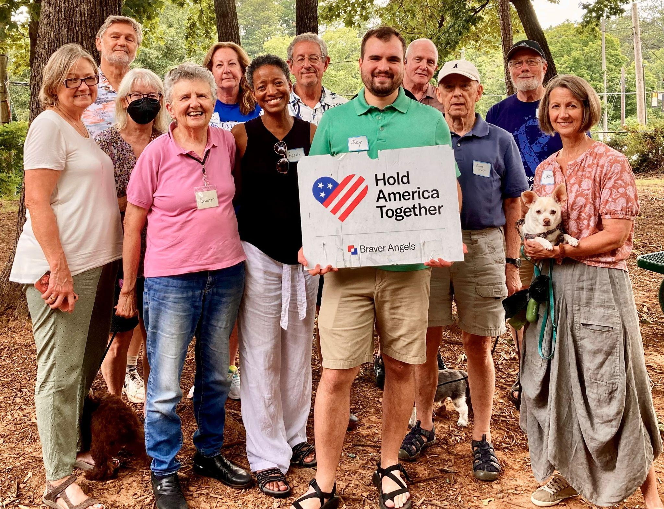
Key Principles from Braver Angels’ “Depolarizing from Within” Workshop
Notes:
MOD2 10:13
While we will not take the time to go through the exercises in our Depolarizing from Within workshop, I will share two key principles I’ve hinted at that underly our workshops

Slide 9
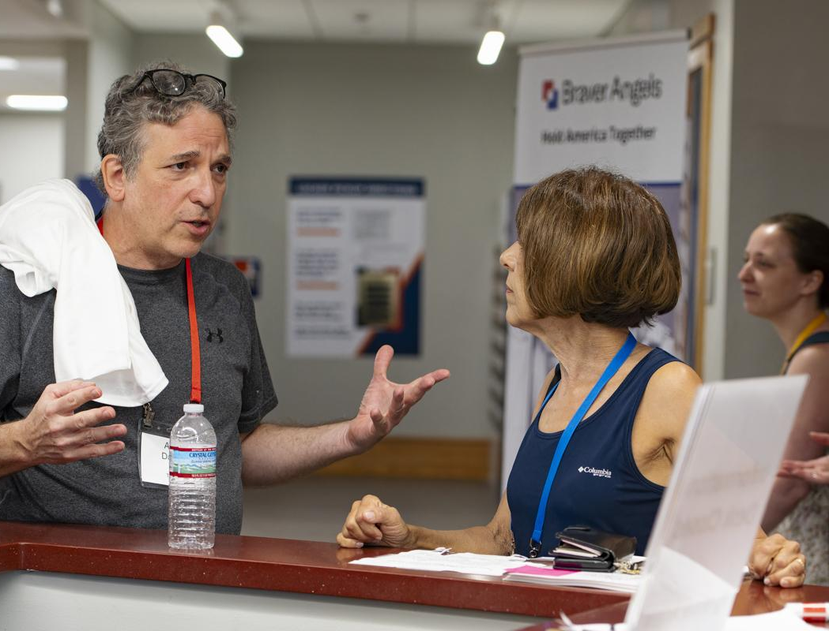
#1
Aim for Listening to Understanding Rather than Changing Someone’s Mind
Notes:
MOD2 10:14
#1 - Aim for understanding rather than changing someone’s mind
This involves two people understanding each other’s positions and their rationales for holding them. It means that you could summarize the other’s view in a way they would recognize as correct.
This focuses on the real issues and it often reveals areas of overlap or agreement.
Photo link
https://drive.google.com/file/d/1ELB6JigMcGk3KOsYTb3Vz9ZPFyq2vV2d/view?usp=sharing

Slide 10
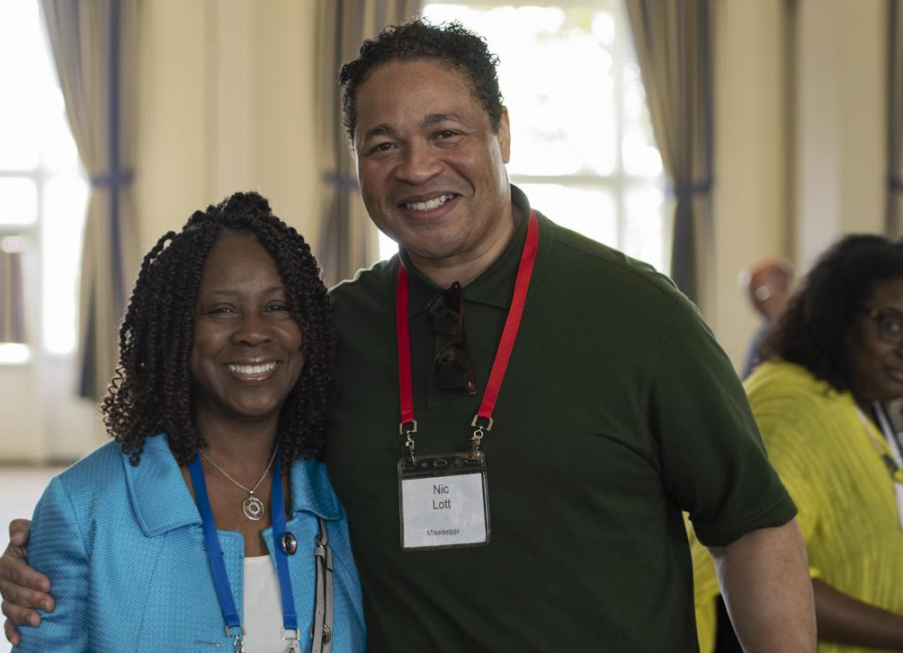

#2
Connect First
Then
Share your Perspective
Notes:
MOD2 10:16
#2 - Connect First, Then Share Your Perspective.
Disagreements often go this way: You say up, I say down. You say left, I say right. You say it’s money well spent. I say we can’t afford it. The result is impasse or escalation.
Instead start with some version of “I get that you see this as….” Or “If I understand your position, your concern is that…. Did I get that right?
Photo link
https://drive.google.com/file/d/1lRaHcJaarF7_BbVJpZanIy5GiqlZPObb/view?usp=sharing

Slide 11
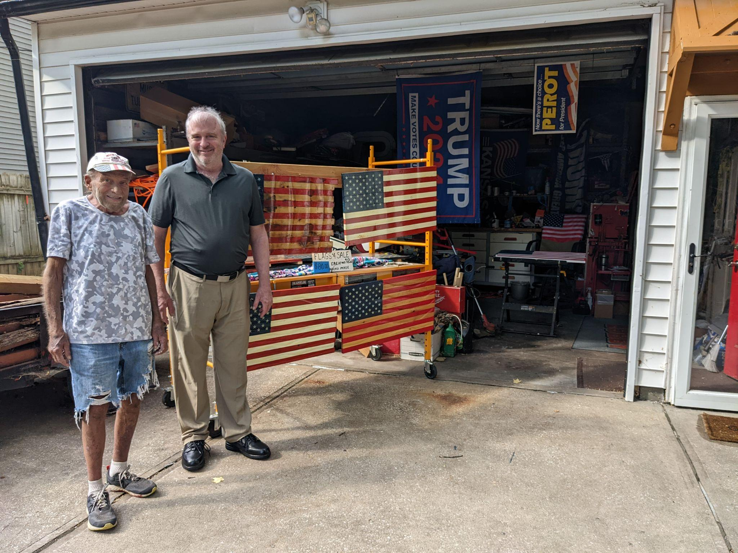
Essential
Skills
Notes:
MOD1 10:18
We will now cover three essential skills which enable the delivery of the key principles. Then, we will practice ONE of them
But before we do that, let me tell you about the picture. The person on the right, without the hat is a member of BA in Virginia and he leans fairly blue. He ran out of gas one day (and with a dead cellphone) right in front of this house! CAREFULLY he approached the house to see if he could use the phone. The gentleman in the hat actually offered to drive him to the local gas station. By using the skills we talk about today, these two people found COMMON GROUND in terms of wanting to leave a better country to their children -- of the pain of losing family and friends to polarized conversation. In essence - these two showed the power of the BA WAY - even when one of the pair had not even taken a workshop! These skills can have the same effect in YOUR LIFE too - they have in MINE - they have in MOD2S…..

Slide 12

LAPP Skills
Part 1: Listen to Understand
Listen
Acknowledge/Agree
Make sure you’ve made the other person feel heard.
Part 2: Speaking Up
Pivot
Perspective
Notes:
SLIDE 15: 0:45:00 → 1 min → 0:46:00 LAPP OVERVIEW
MOD: CONTINUE SHARE SCREEN
LAPP Skills – Here’s an overview of the skills we are going to learn.
When someone says something that bothers you (stereotypes a friend or group, or something that you don’t agree), using these LAPP skills may give you a real chance to have a productive conversation about a topic instead of an argument.
LAPP Stands for
Part 1: Listen to Understand and Acknowledge what you heard
L- Listen
A -Acknowledge (Agree when you can.)
Make sure you make the person feel heard before you share your views.
Part 2: Speaking Up
Pivot
Perspective

Slide 13
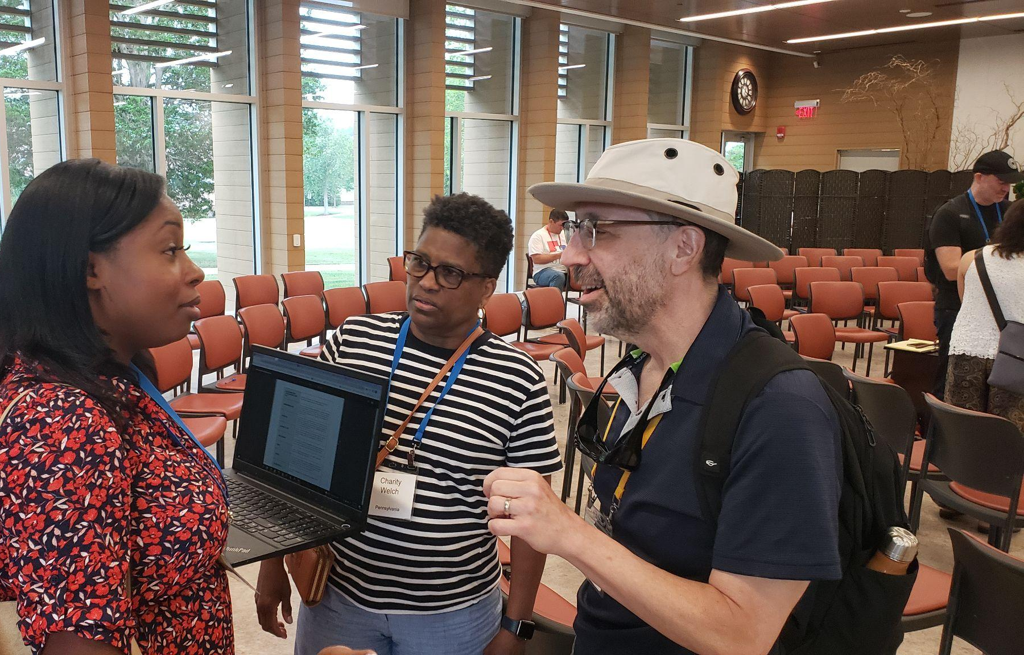
Acknowledge
Notes:
MOD1 10:20
Acknowledge the other person’s view and the strength of their feelings about the issue.
“I hear you on….” “I get that this issue is really important to you.”
Note that acknowledge can be about the content of what the person says, the intensity of their feelings about the issue, or both.
A brief paraphrase of the person’s view goes a long way for them to feel heard. “For you, this issue is about personal responsibility and not something the government should get involved in.” “If I understand you right, this is a public health and safety issue that the government has a responsibility to regulate. Did I get that right?”
Wait for the other person to affirm that you understand their point. Sometimes you didn’t capture what they were saying, and they clarify. Listen and acknowledge again before moving on to the next skills.
A question: why is this hard to do when someone disagrees with you? [Popcorn share. Make sure this point gets made: It’s tempting to not really listen but instead prepare your counterargument.].
Photo Link
https://drive.google.com/file/d/17lugHx3ZPQZkKBu4vyZe0MVpJUmS2wdx/view?usp=sharing

Slide 14
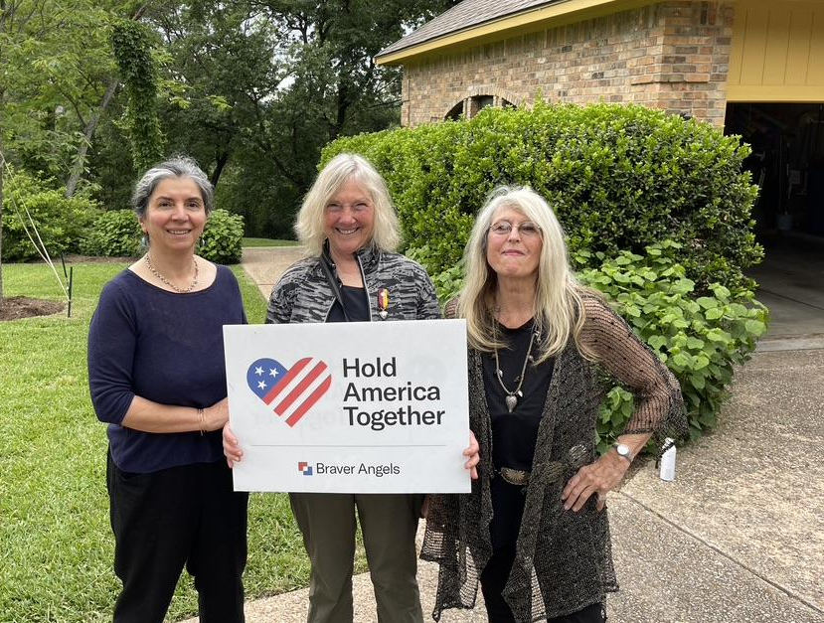
Agree
Notes:
MOD1 10:22
Agree (find something to agree with, if possible)
Listen not just for what you disagree with or how the other person is wrong, but for what you agree about, even if it’s just a small part of what the other person has said.
If nothing else, you might recognize a common value, aspiration, or concern.
Examples: “I agree there are risks that funds could be misused in this program.”
“I’m with you on this being a serious problem that needs to be addressed.”

Slide 15
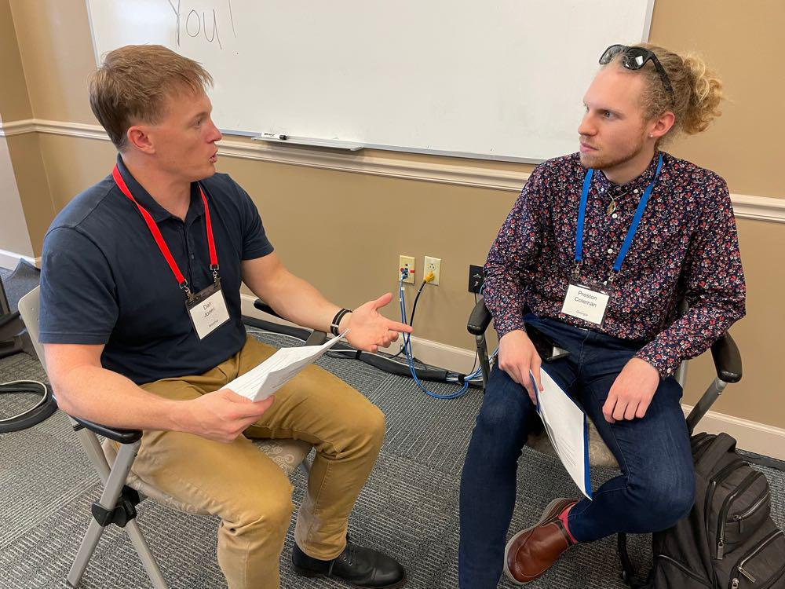
Perspective
Notes:
MOD1 10:23
Now you’re ready to share your perspective. Some key elements include:
Use “I” statements instead of “Truth” statements.
“This is how I see it,” or “I believe the law requires us to…,” instead of, “The reality is…” or “That is against the law….”
Using I statements makes you come across as personal, not as a policy wonk or bureaucrat.
If useful, share your source or sources of information on the issue, while acknowledging that they may differ from the other person’s sources.
“I’m basing this on the Attorney General’s report on the current crime rate. I understand that you’re seeing something different where you live.”
“I’ve been meeting with people in the community to get their perspectives.”
Try to incorporate something you heard the other person say in your perspective statement– some concern, value, or belief.
“We both want a safe community,” Or “It sounds like we both believe in parent involvement in their children’s education.”
Avoid jargon expressions and empty platitudes that tend to turn off people of different political persuasions like, “That’s a CDC mandate,” or “Robert’s Rules of Order” doesn’t allow it.”
Avoid negative labels and name-calling like “communist” or “racist.”
If you want to continue the conversation, end with an invitation such as, “What is your reaction to what I’ve said?” Then repeat the skills, looking for increasing clarification of areas of agreement and disagreement.

Slide 16
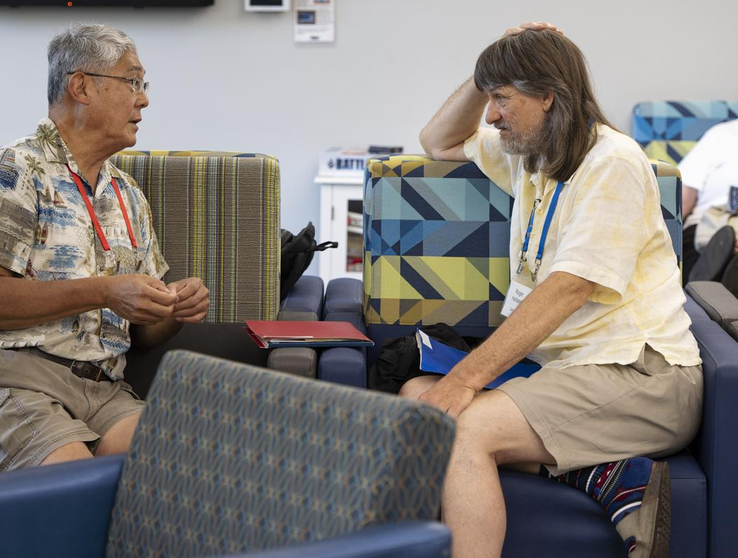
Skills+Practice
Agree
Notes:
MOD2 10:25
Okay, now we are going to have a mini-experience involving ONE of the skills we just discussed - AGREE.
All three skills are well supported by research.
The challenge is to practice them in the face of strong disagreement about important matters.
To review:
Listen not just for what you disagree with or how the other person is wrong, but for what you agree about, even if it’s just a small part of what the other person has said.
If nothing else, you might recognize a common value, aspiration, or concern. Examples: “I agree there are risks that funds could be misused in this program.”
“I’m with you on this being a serious problem that needs to be addressed.”
I am going to read two different viewpoints on policing and public safety. For the one that’s farther from your own viewpoint, listen carefully not just for not just for how the other person is wrong, but for what you agree about, even if it’s just a small part of what the other person has said.

Slide 17
Agree
Practice
Prompt 1
For Low-Income, High-Density Housing:
Home prices are sky high. Working people simply can’t afford the American Dream: owning their own home. I want that golf course to be high-density housing. That way, people can live and work in our city. It will give them a chance to build equity rather than pay rent. Besides, golf courses guzzle up water for those rich people who can actually afford the game. Those selfish, “NIMBY“- not in my backyard people are only thinking of themselves. Sure, they talk a good line of helping people get homes, but not when it affects their community. How hypocritical!
Notes:
MOD2 10:27
Read the prompt

Slide 18

Agree
Practice
Prompt 2
Against the Low-Income, High-Density Housing:
Did you hear about turning that golf course into 3,100 housing units on 193 acres? That’s 16 units per acre. That’s significantly higher than most suburban and even urban communities. That land is currently designated as open space, protected by a voter-approved initiative. Why can’t leaders and developers follow the people’s vote? Their big profits and greed are the key motivators for this project, not the working class. If they really wanted good housing, they wouldn’t pack them in like sardines. Think of all the added traffic and air pollution. There’s got to be a better way.
Notes:
MOD2 10:29
Read the prompt

Slide 19
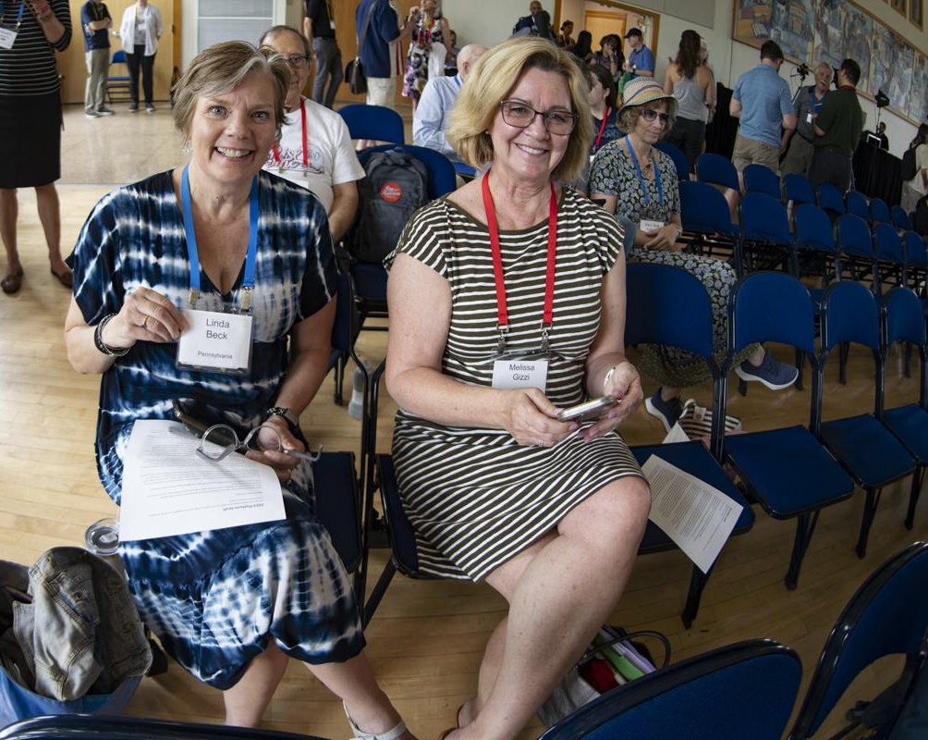
Agree
Practice
Write down - word for word
Pair and read
Discuss how statement reflected the SKILL of agreeing
Notes:
MOD2 10:31
Again, write down an agree statement word for word for the prompt MOST DIFFERENT from your position on the issue.
You will probably only need a sentence or two, and be careful not to add your own perspective. I will give you a couple of minutes. [After a couple of minutes, watching the group to see if most are finished - go back and display the prompts as they develop their answers - say 30 sec per prompt]
When I say “go,” please pair with a person to your right or left and then take turns reading your AGREE statement.
Then discussing how your statements reflected the skills of Agreement. Just a couple of minutes here. Okay, go.
(3 minutes in their pairs. (Any longer and they will start discussing policy)
Popcorn share, with the moderator affirming and sometimes gently correcting. When someone shares a good agree statement first ask the group to say what was good about it.
If the skillshare requires correcting, do that yourself by first finding something good about it, and then offering a corrective. (Example: you did a good agree statement and then went on to offer your own perspective without waiting for the person to affirm that you got it.]

Slide 20
Write an AGREE statement for the prompt that is MOST DIFFERENT from your own position
Home prices are sky high. Working people simply can’t afford the American Dream: owning their own home. I want that golf course to be high-density housing. That way, people can live and work in our city. It will give them a chance to build equity rather than pay rent. Besides, golf courses guzzle up water for those rich people who can actually afford the game. Those selfish, “NIMBY“- not in my backyard people are only thinking of themselves. Sure, they talk a good line of helping people get homes, but not when it affects their community. How hypocritical! | Did you hear about turning that golf course into 3,100 housing units on 193 acres? That’s 16 units per acre. That’s significantly higher than most suburban and even urban communities. That land is currently designated as open space, protected by a voter-approved initiative. Why can’t leaders and developers follow the people’s vote? Their big profits and greed are the key motivators for this project, not the working class. If they really wanted good housing, they wouldn’t pack them in like sardines. Think of all the added traffic and air pollution. There’s got to be a better way.
Notes:
MOD210:37
((Have this slide up for the personal reflection time as well as the pair time…..))

Slide 21
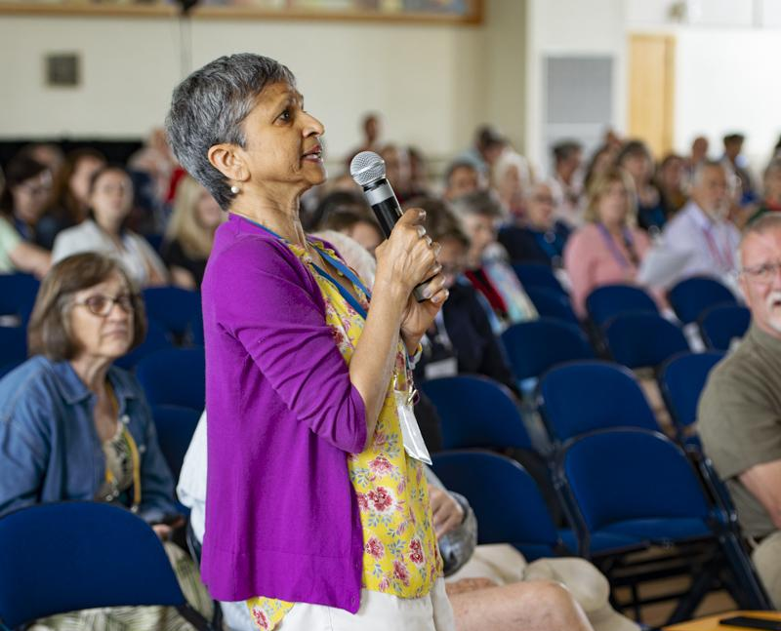
Group Share - Agree
Notes:
MOD1 10:37
(Popcorn share with the group - 5 minutes - comment if possible on recognizing a common value, aspiration, or concern as part of
CONNECTING, ACCURATELY DISAGREEING, FOCUSING ON POLICY NOT MOTIVE, BEING CONSISTENT)
Photo link
https://drive.google.com/file/d/1l-Cc7UHSF42Wex3rBQtk6MUK9KU5ZAOG/view?usp=sharing

Slide 22
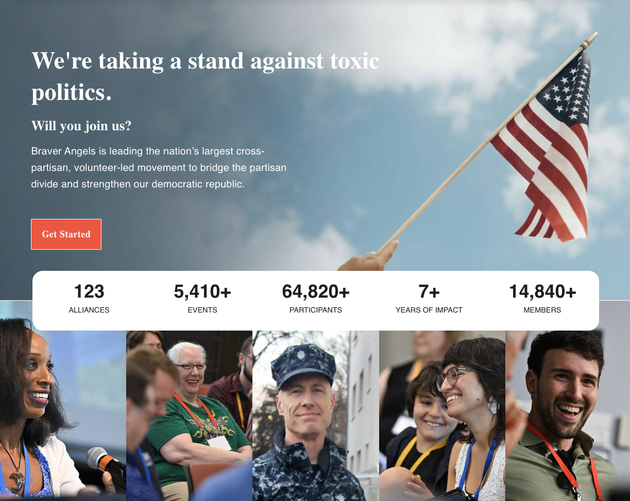
Notes:
MOD2 10:42
Braver Angels (braverangels.org/) is a national citizens organization bringing Americans together to bridge the partisan divide and strengthen our democratic republic. Embracing values of respect, humility, honesty, and responsible citizenship, our goal is not to change people’s views of issues, but to change their views of each other.
The Braver Angels Pledge
As individuals, we try to understand the other side’s point of view, even if we don’t agree with it.
In our communities, we engage those we disagree with, looking for common ground and ways to work together.
In politics, we support principles that bring us together rather than divide us.
Braver Politics
An initiative of Braver Angels, Braver Politics fosters opportunities for elected officials and their staff to develop the skills and commitment to work together in goodwill across political differences. We envision American political institutions remade in the spirit of citizenship, common purpose, and trust between voters and the officials they elect.

Slide 23
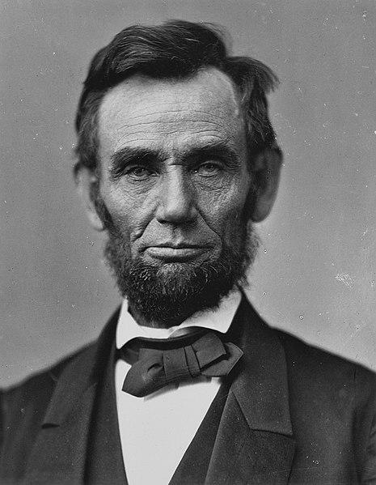
“I do not like that man. I must get to know him better.”
Notes:
Remember the adage that says when you point one finger at someone else, there are three pointing back at you? That’s what drives me to work with Braver Angels.
Some may scoff at this or scorn our attempts to feel better about and build relationships with those on the other political side. Some may even openly act against coming together.
(Click) But, I will leave you with the quote from Abraham Lincoln that I shared at the beginning. And I hope you have a greater appreciation of his wisdom:

Slide 24
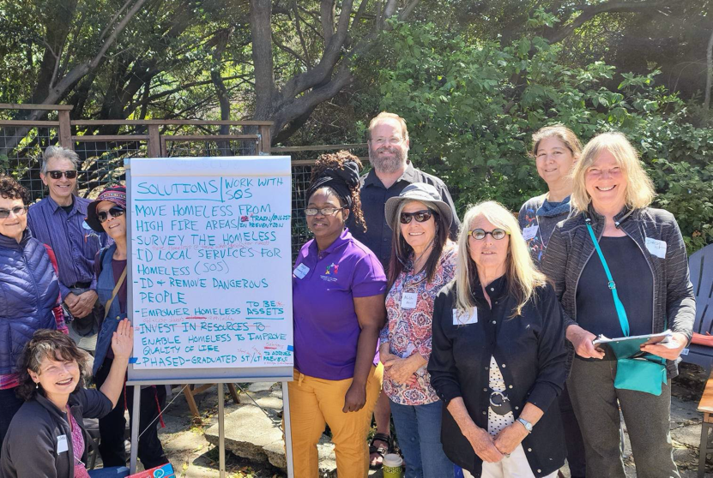
Offerings to address polarization
Workshops
Debates
Collaborative Action
Book/Film Club
Notes:
MOD1 10:47
BA has a range of experiences tailored to address polarization - ranging from:
Experience Workshops which generate connection and understanding between Reds and Blues through exercises designed to help participants clarify disagreements, reduce stereotyped thinking, and discover common values.
Skills workshops which workshops equip participants with the tools needed to communicate in a constructive, empathetic way
and better navigate difficult political conversations with the people in their lives.
Braver Angel Debates which are an opportunity to explore controversial issues through a parliamentary format, which encourages everyone to share their perspectives, ensures civility in disagreement, and strives for learning for all.
Collaborataive Action which allow a wide range of citizens to explore and agree upon solutions for local issues.
Book/Film Clubs which use Braver Angel principles to maximize viewpoint diversity in discussing and exploring works in print and film.

Slide 25
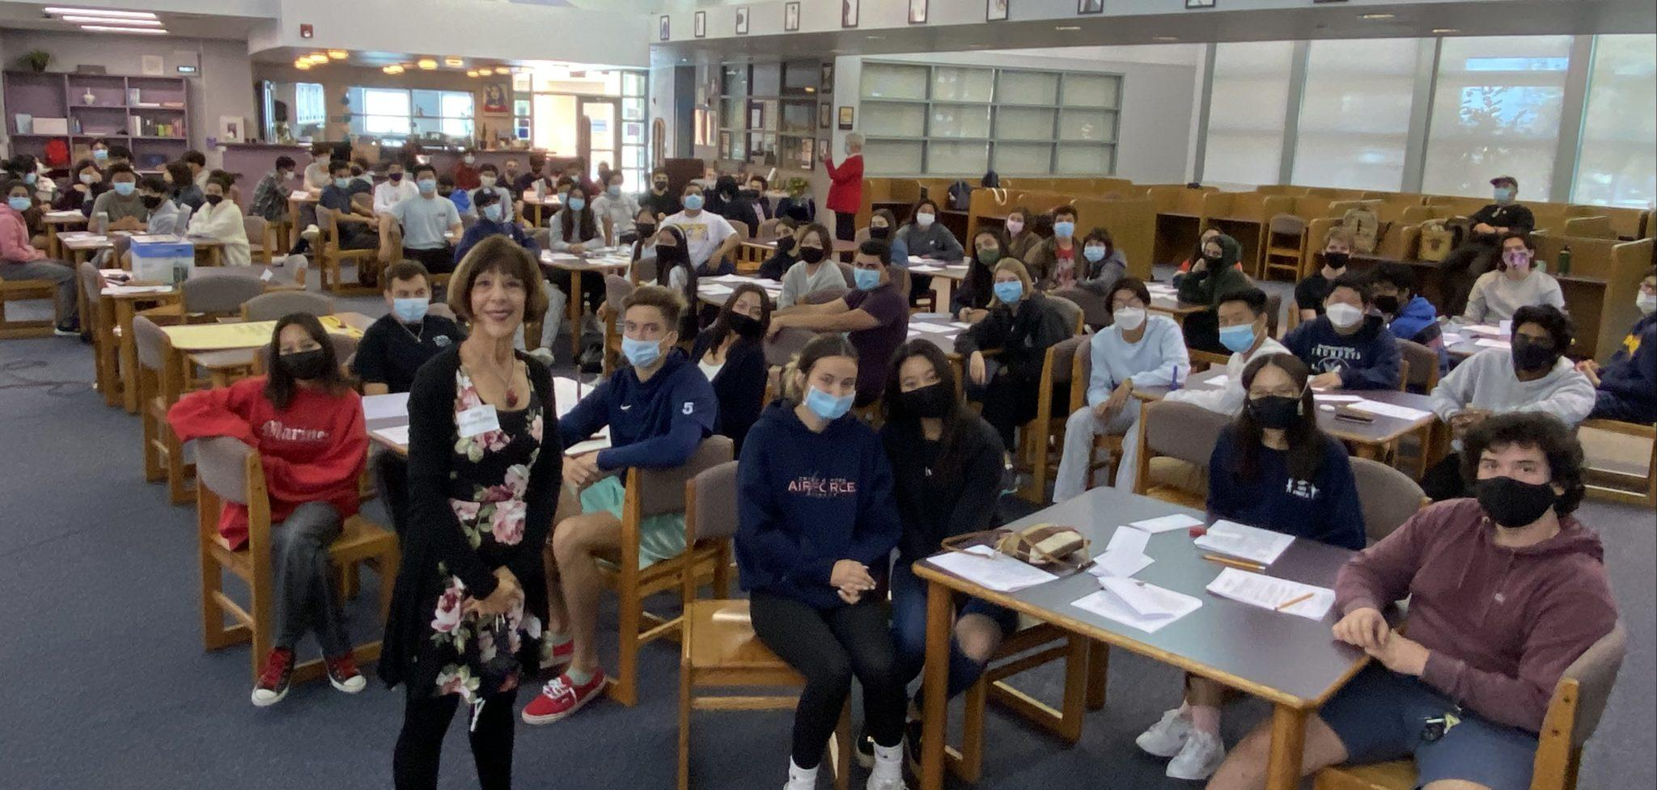
Offerings
Braver Education
  College
  High School
  Administration
  Public Boards
MOD1
Notes:
MOD110:49
The Braver School Communities initiative engages high school and middle school students, parents, teachers, staff, administrators, and school board members in bridge-building efforts.

Slide 26
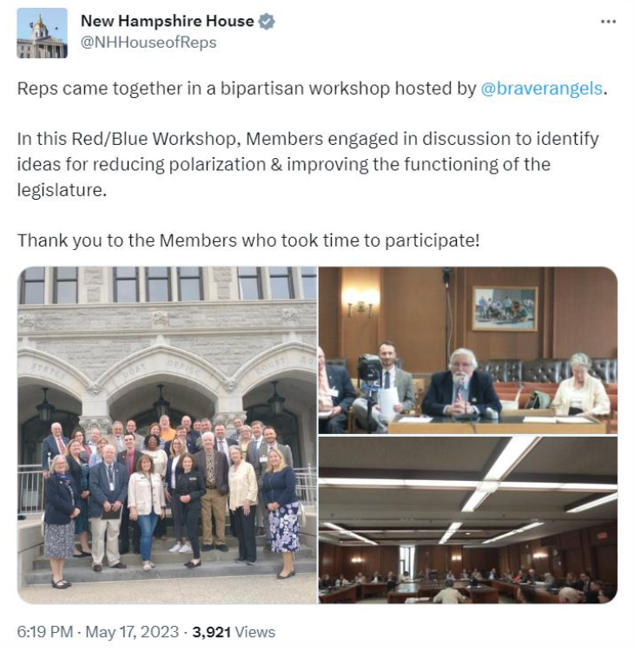
Offerings
Braver Politics
  Elected Representatives
  Government Professionals
Notes:
MOD1 10:51
Through Braver Politics, we’re helping local, state, and national legislators bring open dialogue and a collaborative work ethic to their deliberative bodies through our specially-developed programs, including workshops, debates, and town halls.
Of note, is a recent post from the Speaker of the House in the state of New Hampshire

Slide 27
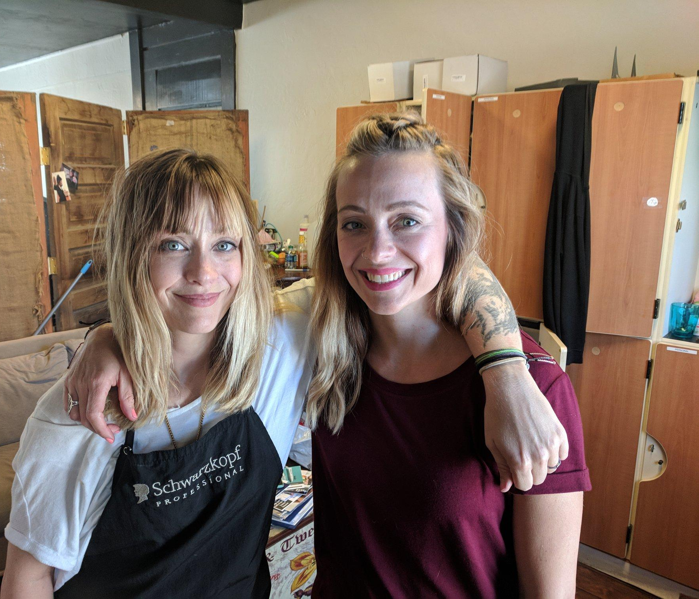
Check Out
“How do you hope to use these skills in your life?”
Notes:
MOD2 11:01- 3 mins or until until we start Q+A
Check out: “How do you hope to use these skills in your life?”
Brief moment of reflection.
With a small group, ask everyone to respond.
In larger groups, put them in pairs and then ask for a few people to report out.
If you are short on time, skip the breakouts and ask for a few to share.

