Slide 1

NLC-RISC
New Trustees Workshop
Thursday, May 14th | 8:00 am
Notes:
Open Slido on browser

Slide 2
Do not edit How to change the design
Join at slido.com #3276391
The Slido app must be installed on every computer you’re presenting from

Slide 3
Do not edit How to change the design
From 1 to 5, what is your energy level today?
The Slido app must be installed on every computer you’re presenting from

Slide 4
Do not edit How to change the design
Using an emoji - what was your first job?
The Slido app must be installed on every computer you’re presenting from

Slide 5
Do not edit How to change the design
How many years have you been a pool Trustee?
The Slido app must be installed on every computer you’re presenting from

Slide 6
Do not edit How to change the design
What is your title at your municipality?
The Slido app must be installed on every computer you’re presenting from

Slide 7
Do not edit How to change the design
Please share any topics you hope to discuss or learn about today.
The Slido app must be installed on every computer you’re presenting from

Slide 8
About NLC-RISC
Notes:
Overview of your pool – when formed, coverages offered, number of members – All panelists
League/pool relationship
Governance & Staffing structures
Differences from insurance companies – All panelists
What makes these functions in a public entity risk pool different from those in traditional insurance companies?
Loss Control - Ian
How do you identify risks or trends among member entities?
Can you give examples of the types of services or programs loss control provides to members?
Claims - Lynn
What types of claims are most common for municipal entities?
How does the claims team balance supporting members with managing costs for the pool?
Underwriting - Halie
What types of information or data do underwriters review when evaluating risk? Explain experience mod
What are some unique underwriting challenges in the public sector?
Competition & Success of Pooling – All panelists
Where do they see the value of pooling in today’s market/environment?
What is the success of pooling today and looking ahead?
Where do we need to be focused.

Slide 9

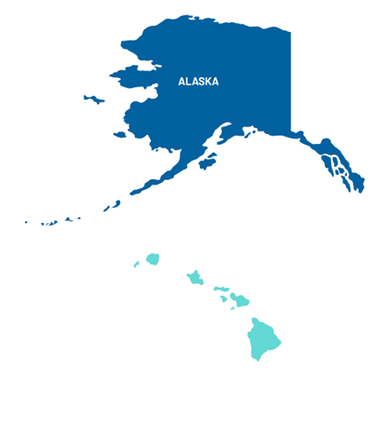
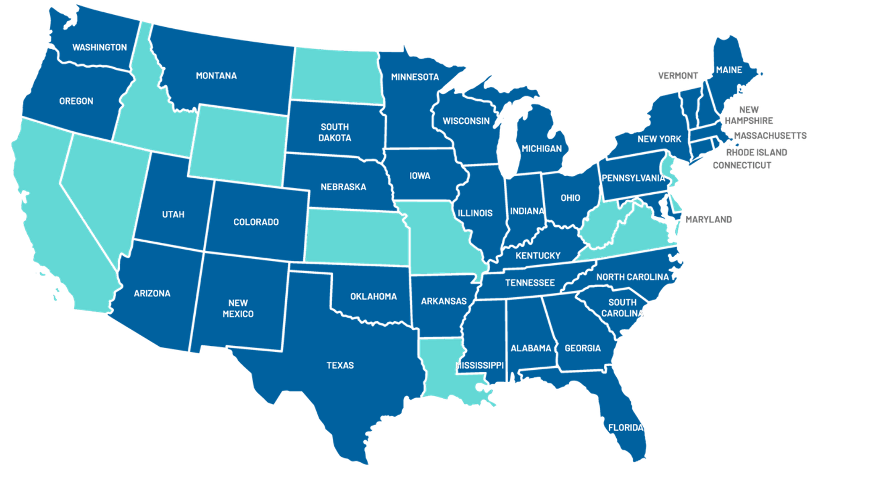

NLC-RISC Membership:
Formed in 1982
Program of the National League of Cities
NLC-RISC members are risk pools endorsed by their state league
38 members across the United States
8 members represented on Board of Directors
4 State League Directors
4 Pool Administrators
Notes:
What is RISC?
Who do we serve?
What do we offer?

Slide 10

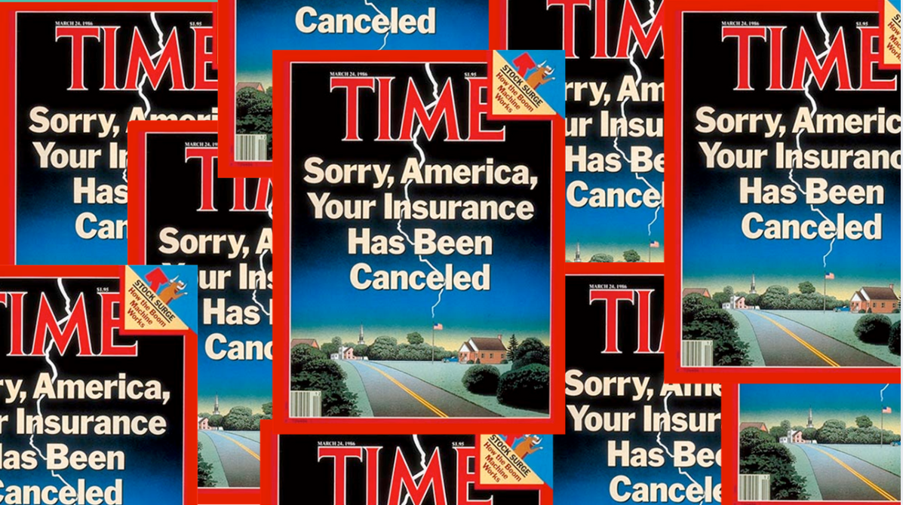
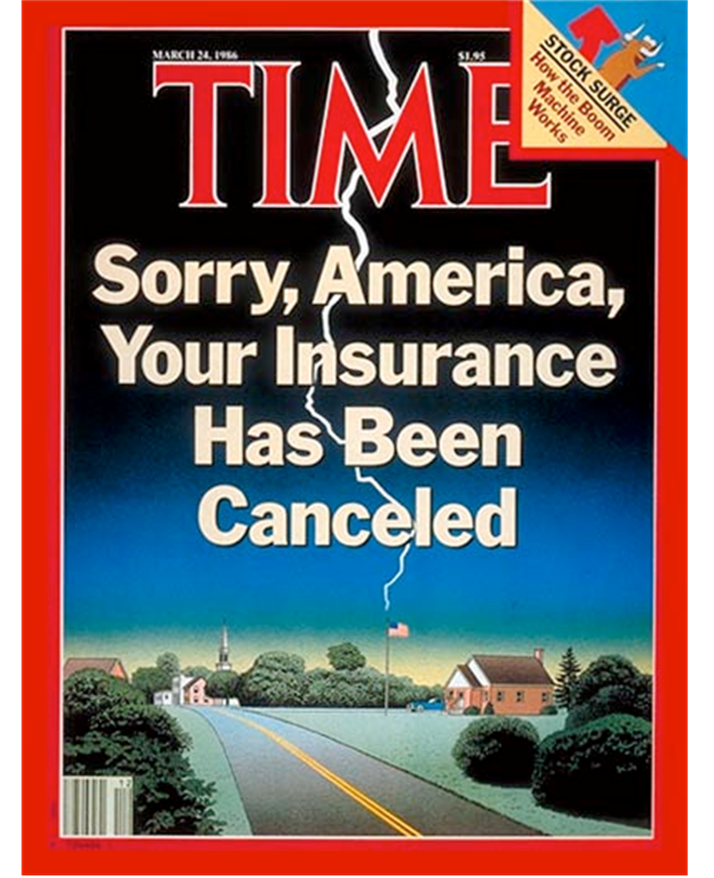
Why were pools created?

Slide 11
Risk Pools:
United approach to risk management
Promote loss control, financial stability, information-sharing, and collaboration between their members
State League Risk Pools:
Member-owned, Member-driven
Endorsed by their state municipal league
Leverage collective efforts to respond to the unique needs of their member cities, towns, and villages
Notes:
Why and how pools were formed
State league involvement
Coverages provided by pools, including unique coverages that meet the needs of members
Include health pools
Comparison to commercial market
Regulation
some are highly regulated by insurance dept, some have oversight by SOS office, etc.
Roles of Pool Boards

Slide 12
Panel Discussion
Notes:
Overview of your pool – when formed, coverages offered, number of members – All panelists
League/pool relationship
Governance & Staffing structures
Differences from insurance companies – All panelists
What makes these functions in a public entity risk pool different from those in traditional insurance companies?
Loss Control - Ian
How do you identify risks or trends among member entities?
Can you give examples of the types of services or programs loss control provides to members?
Claims - Lynn
What types of claims are most common for municipal entities?
How does the claims team balance supporting members with managing costs for the pool?
Underwriting - Halie
What types of information or data do underwriters review when evaluating risk? Explain experience mod
What are some unique underwriting challenges in the public sector?
Competition & Success of Pooling – All panelists
Where do they see the value of pooling in today’s market/environment?
What is the success of pooling today and looking ahead?
Where do we need to be focused.

Slide 13
Small Group Discussion

Slide 14
Make the most of your
conference experience!
New(er) Trustees Activities
Connect With
Peers
Networking Opportunities
Learn Best
Practices
Stay
Connected
New Trustees Workshop (you’re here!)
Receptions and meals - talk to someone new!
Attend sessions
Attend events
Make a Conference Connection & save contact information
Connect with other attendees on LinkedIn
Learn something new at a session; jot a few notes to take back each day
Ask questions
Exchange ideas with your peers
Post on App & Social #risctrustees26
Check conference app for resources
Sign-up for the RISC eNews
Learn more at risc.nlc.org
Notes:
Mentor Program Notes: Opportunity for RISC-member staff who are new to pooling or to a specific functional area to meet informally and learn from a more experienced peer from a different pool
Benefits mentors as well as mentees
Builds connections, insights, information-sharing, and collegial networks among RISC member pools and their staffs

Slide 15
Do not edit How to change the design
What is your key takeaway from this session?
The Slido app must be installed on every computer you’re presenting from

Slide 16
Do not edit How to change the design
On a scale of 1–5, how helpful was this session?
The Slido app must be installed on every computer you’re presenting from

Slide 17
Thank you!
Learn more & connect with us:
risc.nlc.org
Follow NLC-RISC on LinkedIn
#nlcrisc #RISCstaff

