Slide 1

Navigating Pool Finance: Planning, Risk & Strategy
Thursday, May 14th | 1:00pm

Slide 2

Chris Krepcho
Chief of Insurance & Financial Services
Florida League of Cities

Slide 3
Join at slido.com
#1318085

Slide 4
What comes to mind when you hear the term 'insurance pool'?

Slide 5

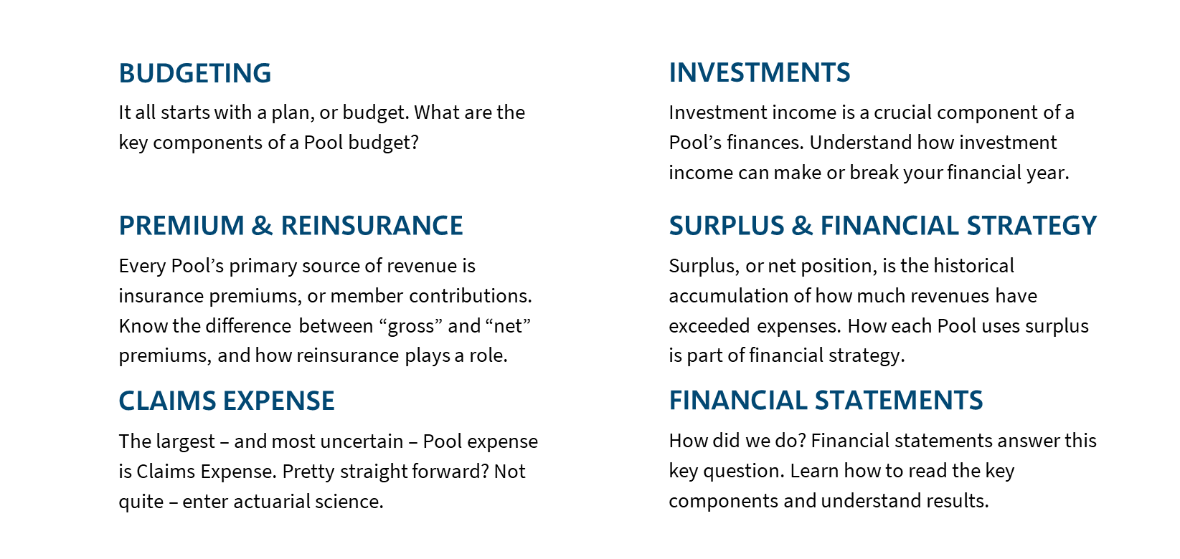

Slide 6


KEY TERMS
Net income
REINSURANCE
Total Revenues (both Operating and Non-Operating) less Total Expenses.
Insurance for insurance companies. Used to transfer risk.
Claims reserves
The unpaid amount (or liability) of the Pool’s claims. While it is a liability, it is also an asset as it is included in the Pool’s investments.
premium
surplus
“Gross” premium is the total amount of premium (or “contributions”) collected from members. “Net” premium is the amount of premium retained by the Pool. Net premium = Gross premium less Ceded Reinsurance premium, or the amount of premium the Pool pays to its reinsurers to transfer risk.
Also known as Net Position, it is the accumulation of Net Income over time. It can also be calculated as Total Assets less Total Liabilities.
dividend
Return of premium to members.

Slide 7
Which key term do you find most challenging to understand?

Slide 8


Slide 9

BUDGETING
DIFFERENT FROM MUNICIPAL BUDGETS
Unlike many municipal budgets, many Pool budgets are not balanced. It is common for budgeted income to be negative or positive.
Based on rates you set
The Pool’s budgeted revenues will largely depend on the insurance rates established by the Board of Trustees.
What’s the strategy
The budget tells you what the Pool’s strategy is. Is the Surplus more/less than adequate? How important is Investment Income to year-end results?

Slide 10
BUDGET EXAMPLES
 | Positive Net Income | Negative Net Income | Percent of Total
Revenues:
Gross Premium (Contributions) | 100,000,000 | 90,000,000
Investment Income | 5,000,000 | 5,000,000
Total Revenues | 105,000,000 | 95,000,000
Expenses:
Claims Expense | 60,000,000 | 60,000,000 | 60%
Reinsurance | 10,000,000 | 10,000,000 | 10%
Administration | 20,000,000 | 20,000,000 | 20%
Other | 10,000,000 | 10,000,000 | 10%
Total Expenses | 100,000,000 | 100,000,000
Net Income | 5,000,000 | (5,000,000)
Claims Expense + Reinsurance expenses = 70-75% of total expenses
Administration and Other expenses typically =
25-30% of total expenses
Strategy: Premiums to cover expenses. Investment Income is “gravy” and surplus growth strategy.
Strategy: Spending surplus to offset rates, improve services, or member dividends.

Slide 11
BUDGET EXAMPLES
Gross Premium 100,000,000
Ceded Reinsurance (10,000,000)
Net Premium 90,000,000
Gross Premium is the total premiums anticipated to be collected from members, which is based on insurance rates.
Ceded Reinsurance is the insurance expense purchased to protect the Pool from catastrophic losses. The more risk the Pool retains, the lower the reinsurance (and vice-versa).
Net Premium is the Pool’s retained premium after paying reinsurance.
 | Positive Net Income | Negative Net Income | Percent of Total
Revenues:
Gross Premium (Contributions) | 100,000,000 | 90,000,000
Investment Income | 5,000,000 | 5,000,000
Total Revenues | 105,000,000 | 95,000,000
Expenses:
Claims Expense | 60,000,000 | 60,000,000 | 60%
Ceded Reinsurance | 10,000,000 | 10,000,000 | 10%
Administration | 20,000,000 | 20,000,000 | 20%
Other | 10,000,000 | 10,000,000 | 10%
Total Expenses | 100,000,000 | 100,000,000
Net Income | 5,000,000 | (5,000,000)

Slide 12
MORE ON REINSURANCE
LIABILITY
$1,000,000
Member’s Per-Claim Limit
Reinsurer’s Share = $750,000 xs $250,000
REINSURANCE
RETENTION
Reinsurance, put simply, is insurance for insurance companies.
Designed to protect Pools from catastrophic loss.
Also referred to as Excess of Loss Insurance or Stoploss Insurance.
Can be 100% pass-through, like Cyber reinsurance.
A Pool’s retention is the dollar threshold amount, usually per claim, where the Pool transfers the risk to a reinsurer.
The selection of the retention largely depends on the line of coverage (Workers Compensation vs. Liability vs. Health), as well as the Pool’s surplus position.
Retentions should increase over time due to inflation, especially for Health insurance.
Pool’s Share (or Retention)
$250,000

Slide 13
What do you think is the biggest challenge in managing claims expenses?

Slide 14
BUDGET EXAMPLES
 | Positive Net Income | Negative Net Income | Percent of Total
Revenues:
Gross Premium (Contributions) | 100,000,000 | 90,000,000
Investment Income | 5,000,000 | 5,000,000
Total Revenues | 105,000,000 | 95,000,000
Expenses:
Claims Expense | 60,000,000 | 60,000,000 | 60%
Ceded Reinsurance | 10,000,000 | 10,000,000 | 10%
Administration | 20,000,000 | 20,000,000 | 20%
Other | 10,000,000 | 10,000,000 | 10%
Total Expenses | 100,000,000 | 100,000,000
Net Income | 5,000,000 | (5,000,000)
Pools are in the insurance business, so naturally the largest expense is Claims Expense.
Claims Expense represents only the portion of losses retained by the Pool.
Losses that impact the Pool’s reinsurers are not captured on the Pool’s financials. Rather, these losses are captured on the reinsurer’s financials.

Slide 15
HOW IS CLAIMS EXPENSE CALCULATED?
Short Answer: by the Pool’s Actuary (usually independent)
Full Story:
The Actuary analyses historical claim estimates by the Pool’s claims adjusters and compares those estimates to the final claim payments. The Actuary then “develops” the known losses using a factor based on the historical analyses. Finally, the Actuary adds in an IBNR (Incurred But Not Reported) estimate for claims that have not yet been reported to the Pool.

Slide 16
CLAIMS DEVELOP OVER TIME
WORKERS COMPENSATION
The second knee surgery is more complex and will cost $25,000 in medical costs. Back pain treatment for 6 weeks will cost $3,000. Now, the officer is not expected to return to work until March 31, 2025.
Revised Claim Estimate of $58,000:
Medical Costs $40,000
Lost Time Wages 18,000
The Pool’s policy and financial year is Jan 1 – Dec 31 (calendar year).
The claim estimate for the 2024 year of $22,000, while accurate at year-end, is now going to cost 264% more.
This type of claim development is natural and inherent to the nature of injuries.
On December 15, 2024, a Police Officer injurs his knee during foot pursuit of a suspect while jumping over a fence. Medical costs for knee surgery are anticipated to be $15,000 and the officer is anticipated to be out of work for six weeks.
Initial Claim Estimate of $22,000:
Medical Costs $15,000
Lost Time Wages 7,000
The officer begins experiencing back pain in early January 2025, which was not present before the incident. Additionally, the first knee surgery did not correct the injury and another knee injury becomes necessary in February.

Slide 17
Claims Estimates
Work Comp = $16.7M
Property = $9.1M
Actuarial Factors
WC = 1.2x
Liability = 1.8x
Claims Expense
WC = $20M
Health = $20M
Liability = $5.6M
Health = $19M
Property = 1.1x
Health = 1.05x
Liability = $10M
Property = $10M
$50,400,000 of Claims Estimates becomes $60,000,000

Slide 18


Slide 19

INVESTMENTS
Investment policy
Set by the Board, the policy governs the Pool in allowable investments and allocation thresholds. Some Pools only invest in Fixed Income (Bonds), and others further diversify to Equities (Stocks).
WHAT’S BEING INVESTED
Because of claims development, premiums collected in one year will not be needed immediately to pay the full amount of claims for many years to come. This “float” on premiums, along with the Pool’s surplus, is invested in markets and yields a return.
Make or break the year
Many Pools factor in a conservative rate of return for investments when contemplating rates and, in turn, premiums. This means that Premiums + Investment Income are anticipated to cover claims expenses. A good (or bad) investment market can make (or break) your financial year. Think of 2022 versus 2024.

Slide 20


Slide 21
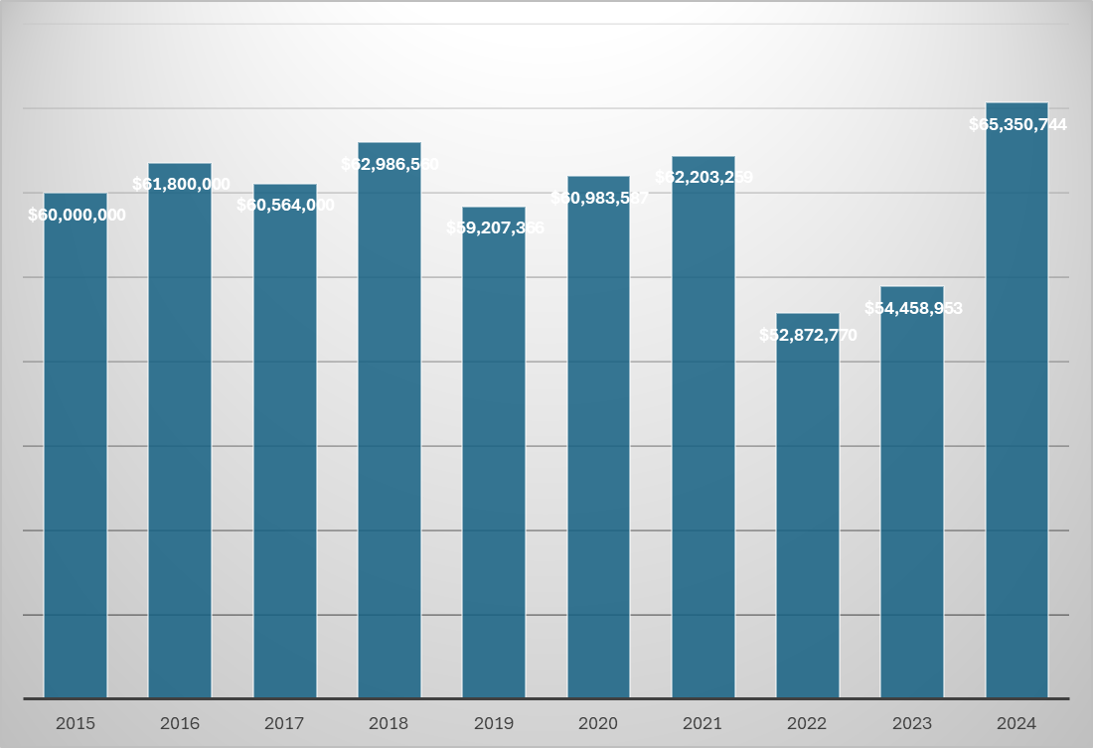
SURPLUS
Surplus is also known as “net position” and is the accumulation of revenues in excess of expenses (or net income).
Surplus will be volatile over time. Claims activity and investment markets cannot be predicted with certainty.
Unfavorable investment year, primarily due to rising interest rates impacting Fixed Income market.
Strong investment year for both Fixed Income and Equity markets.

Slide 22
SURPLUS STRATEGY
Using Membership Capital to Help Members
OFFSET RATES
Improve services
Increase retentions
Using surplus to offset rate increases to members. Can be dangerous in the long-term, as “catching up” to actuarially sound rates compounds each year.
Add or enhance member programs and services, including loss prevention; additional coverages; safety grants; higher limits; etc.
With surplus growth, a Pool may re-consider the risk it retains vs. passes to reinsurers. Over time, retaining risk leads to further surplus growth.
Surplus may also be used to support Dividend programs, where a designated amount of premium is returned to members.

Slide 23

Pool financial statements not only show you how well the Pool performed against the budget, but also can inform you on the financial strategy of the Pool.
Let’s take a look…

Slide 24
BALANCE SHEET
 | 2023 | 2024 | $ Change
Assets:
Investments | 19,500,000 | 23,500,000 | 4,000,000
Other Assets | 1,500,000 | 2,500,000
Total Assets | 21,000,000 | 26,000,000
Liabilities:
Claims Reserves (Current) | 3,800,000 | 4,600,000
Claims Reserves (Noncurrent) | 8,100,000 | 8,500,000
Other | 800,000 | 1,300,000
Total Liabilities | 12,700,000 | 14,400,000
Total Net Position (Surplus) | 8,300,000 | 11,600,000 | 3,300,000
Here, Investments growth drove Surplus growth. Without it, Surplus would have decreased from year-to-year.
Current Claim Reserves is the portion of reserves expected to be paid in one year. Noncurrent reserves is greater than one year. The two numbers combined is the Pool’s total claim liability.
[Total Assets] – [Total Liabilities] = Net Position (“Surplus”)
If the Pool were to shut down operations at FYE 2024, there would be $11.6m remaining after paying out claims

Slide 25
INCOME STATEMENT
The Income Statement is organized like the Budget, except it is organized into “Operating” (< 1 yr) vs. “Nonoperating” (> 1 yr).
Operating Income shows how well the Pool performed without reliance on Investment Income.
Non-Operating Revenues (or Investment Income) can be significant to overall Net Income results. Here, Investment Income represented 141% and 91% of Net Income for 2023 and 2024, respectively.
Imagine if Investment Income was (3,100,000) for 2024. Net Income = (2,790,000).
 | 2023 | 2024 | $ Change
Operating Revenues:
Gross Premium (Contributions) | 7,700,000 | 8,900,000 | 1,200,000
Other | 10,000 | 10,000
Total Operating Revenues | 7,710,000 | 8,910,000 | 1,200,000
Operating Expenses:
Claims Expense | 4,300,000 | 4,500,000 | 200,000
Reinsurance | 1,200,000 | 1,400,000 | 200,000
Administration | 2,400,000 | 2,600,000 | 200,000
Other | 100,000 | 100,000 | -
Total Operating Expenses | 8,000,000 | 8,600,000 | 600,000
Operating Income / (Loss) | (290,000) | 310,000
Total Non-Operating Revenues (Investment Income) | 1,000,000 | 3,100,000 | 2,100,000
Net Income (Surplus Change) | 710,000 | 3,410,000
Operating
Non-Operating

Slide 26
Summary
BUDGETING
INVESTMENTS
Demonstrates your Pool’s plan and strategy for the upcoming fiscal / policy year, and the reliance on Investment Income for overall results.
Investment earnings on your Surplus and Claims Reserves, known as Non-Operating Income, Is key to your overall results. Investment income can make or break your financial year.
PREMIUM & REINSURANCE
Setting rates and premium adequacy are crucial to operating results. Reinsurance spend, and corresponding retentions, are also key to balancing risk transfer and surplus utilization.
SURPLUS
Overall, Surplus will be volatile each year but should grow over time. Surplus can be used to increase retentions, enhance member services, offer dividends, and offset rates (carefully).
CLAIMS EXPENSE
Claims expense cannot be predicted with certainty. Claim development is normal. Some years, your Pool’s expected loss experience will be better than forecasted; other times, it will be worse than forecasted.
FINANCIAL STATEMENTS
Understanding your financial statements can help you (a) identify the Pool’s Operating vs. Non-Operating performance and (b) compare actual results to your budget.

Slide 27
Audience Q&A

