Slide 1

Mission‑Ready Capital:
Ensuring Your Pool Can Protect Communities for the Long Haul
Susanlisa Kessler, FCAS
Chief Actuary
NLC Mutual Insurance Company
NLC-RISC Trustees
Clearwater, FL
May 15, 2026
NLC-RISC Trustees Conference
Savannah, GA

Slide 2
What role do you play in ensuring your pool’s long-term financial health?
?
?
?
?
?
?
?

Slide 3
Trustees are tasked with ensuring financial strength and stability through their stewardship
Financial Stability for Member Protection
What does this look like for a public entity risk pool?

Slide 4
Capital Adequacy Reviews provide a way to measure a pool’s capital against the risks it faces
Capital = Surplus = Net Position = Net Assets = Fund Balance
Surplus = Assets – Liabilities
What are a Pool’s Assets and Liabilities?

Slide 5
Pool Insurance Basics
Pools collect contributions from Members and set aside a large portion of those funds to pay future claims.
Expenses
Surplus
Contributions
Reserves for Future Claims

Slide 6
Pool Insurance Basics
These Reserves + Surplus are invested and become Assets.
Surplus
Reserves for Future Claims

Slide 7
Pool Insurance Basics
These Reserves are also recorded as a Liability because they will be paid to Members as claims emerge.
Reserves for Future Claims

Slide 8
Capital Adequacy Basics
Pool Surplus = Pool Assets – Pool Liabilities
Pools hold the surplus for “just in case”.
Capital Adequacy Reviews give a better understanding of Sufficient Surplus for “just in case” for your pool.
“Just in case the economy takes a downturn”
“Just in case there’s a catastrophe”
“Just in case interest rates rise”
“Just in case immunities are weakened”

Slide 9
Capital Adequacy Basics
Pool Surplus = Pool Assets – Pool Liabilities
Pools hold the surplus for “just in case”.
Capital Adequacy Reviews give a better understanding of Sufficient Surplus for “just in case” for your pool.
“Just in case our Assets are smaller than expected”
“Just in case our Liabilities are bigger than expected”

Slide 10
Public Entity Pool Risks
Capital Adequacy Analysis attempts to quantify the risks an organization faces, test if a Pool’s Surplus is sufficient to protect against them, AND ensure the Pool can continue to protect members going forward.
Standard Insurance Risk Categories:
Asset Risk
Reserve Risk
Underwriting Risk
Catastrophe Risk
Operational Risk
Credit Risk

Slide 11
Public Entity Pool Risks
Standard Insurance Risk Categories:
Asset Risk – market fluctuations, interest rate changes, etc.
Reserve Risk – uncertainty in future claim costs due to loss trends, development of facts in case, etc.
Underwriting Risk – risk that premiums collected are insufficient to cover claims and expenses
Catastrophe Risk – earthquakes and other natural catastrophes as well as systemic casualty events
Operational Risk – system failures, fraud, human error, etc. that interrupt business or drain capital
Credit Risk – risk of default in member assessment payments or uncollectable reinsurance

Slide 12
Public Entity Pool Risks
Capital Adequacy Analysis attempts to quantify the risks an organization faces, test if a Pool’s Surplus is sufficient to protect against them, AND ensure the Pool can continue to protect members going forward.
Standard Insurance Risk Categories:
Asset Risk
Reserve Risk
Underwriting Risk
Catastrophe Risk
Operational Risk
Credit Risk
“Just in case our Assets are smaller than expected”

Slide 13
Public Entity Pool Risks
Capital Adequacy Analysis attempts to quantify the risks an organization faces, test if a Pool’s Surplus is sufficient to protect against them, AND ensure the Pool can continue to protect members going forward.
Standard Insurance Risk Categories:
Asset Risk
Reserve Risk
Underwriting Risk
Catastrophe Risk
Operational Risk
Credit Risk
“Just in case our Liabilities are bigger than expected”

Slide 14
Some Capital Adequacy Analysis Types
Regulatory Rules-Based Approaches
Factor-Based Methods
Scenario Testing & Stress Testing
Dynamic Financial Models

Slide 15
Capital Adequacy Analysis Types
Regulatory Rules-Based Approaches – using prescribed formulas/factors developed by insurance regulators. Example Risk-Based Capital (RBC) requirements that calculate minimum capital
Factor-Based Methods – apply industry benchmarks and rules of thumb, such as capital-to-premium ratios or capital-to-reserve mulitples derived from historical experience.
Scenario Testing & Stress Testing – evaluate impact to capital under specific adverse conditions like a major catastrophe, economic recession, etc.
Dynamic Financial Models – more sophisticated simulation techniques that run thousands of scenarios using probability models to evaluate capital under different claims and investment conditions resulting in capital impact over various return periods

Slide 16
Capital Adequacy Analysis Types
Regulatory Rules-Based Approaches – using prescribed formulas/factors developed by insurance regulators. Example: Risk-Based Capital (RBC) requirements that calculate minimum capital
Regulators us Risk-Based Capital (RBC) formulas to evaluate the strength of capital for insurance organizations.
Minimum RBC ratio of 200% is set to signal financial health
+ Easy to Calculate
+ Recognizes some correlation between risks
+ Useful to compare Year-over-Year for a stable organization
Not a good fit for evaluating the dynamic risk pools face
Not useful to compare between companies due to different lines of business and size of assets.

Slide 17
Capital Adequacy Analysis Types
Factor-Based Methods – apply industry benchmarks and rules of thumb, such as capital-to-premium ratios or capital-to-reserve multiples derived from historical experience.
An example of a Rule of Thumb is a 3-to-1 Net Premium-to-Surplus ratio
This advises a Pool should write Net Premiums < 3x its surplus.
+ Easy to Calculate
Not a good fit for evaluating the dynamic risk pools face
Does not take into account the benefits of diversification or the additional cost of correlation of risk
Not based in an evaluation of a pool’s specific mix of business or individual risk circumstances

Slide 18
Capital Adequacy Analysis Types
Scenario Testing & Stress Testing – evaluate impact to capital under specific adverse conditions like a major catastrophe, economic recession, etc.
Example:
For a coastal state pool, what would be the impact on the capital if a CAT 5 hurricane comes ashore in the area with the highest member concentration?
What would be the impact on the capital if an economic recession drove member bankruptcies and invested assets to drop dramatically?
+ Test realistic events and inform pool strategic response including optimizing reinsurance structures, exposed limits, etc.
Not easy to calculate and impossible to evaluate all scenarios

Slide 19
Capital Adequacy Analysis Types
Dynamic Financial Models – more sophisticated simulation techniques that run thousands of scenarios using stochastic probability models to evaluate capital under different market, claims, economic, and investment conditions resulting in an estimate of capital impairment over various return periods
+ Provides a customized analysis reflecting the Pool’s specific book
+ Allows consideration of multiple scenarios
+ Considers the correlation between risks and recognizes benefit of diversification of lines of business written and investments.
Complicated to develop, uses sophisticated tools
Difficult to explain

Slide 20
Capital Adequacy Analysis
Considerations for Trustees
The Approaches that are easiest to calculate do not always give the most reliable answer.
The Approaches that are complicated require care in setting up the model to reflects the realities facing the Pool.
Multiple Approaches provide a sensibility check
Rely on the Experts for their technical expertise, BUT insist they explain the results

Slide 21
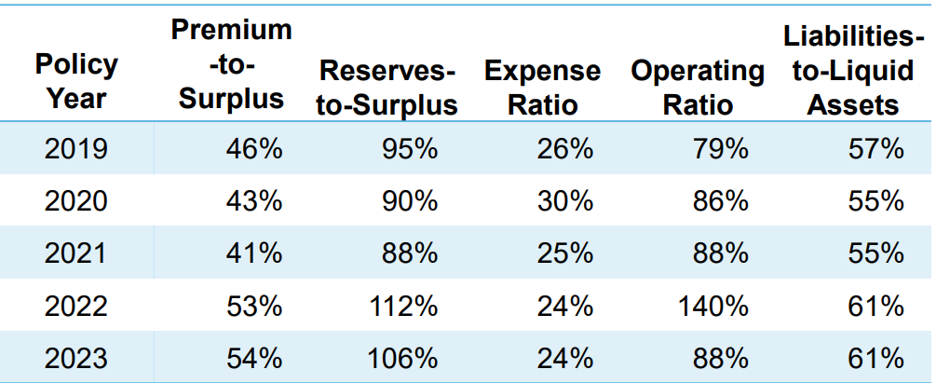
Capital Adequacy Analysis
Trustee Considerations
Output from a Capital Adequacy Analysis could look like this:
Minimum Capital Required = 25,000,000
Change in Surplus (-) is Impairment
Return Period | Percentile | 2025
1 in 2 | 50.00% | 8,580,000
1 in 20 | 95.00% | 2,310,000
1 in 100 | 99.00% | (1,100,000)
1 in 200 | 99.50% | (2,320,000)
1 in 250 | 99.60% | (2,740,000)
1 in 500 | 99.80% | (5,940,000)
OR THIS:
OR THIS:
BUT…

Slide 22
Capital Adequacy Analysis
Trustee Considerations
BUT…
This output is not an “answer”. The Pool has to apply its own judgement and policies onto this output. Some Examples of this:
Minimum Capital Required = 25,000,000
Change in Surplus (-) is Impairment
Return Period | Percentile | 2025
1 in 2 | 50.00% | 8,580,000
1 in 20 | 95.00% | 2,310,000
1 in 100 | 99.00% | (1,100,000)
1 in 200 | 99.50% | (2,320,000)
1 in 250 | 99.60% | (2,740,000)
1 in 500 | 99.80% | (5,940,000)
OR THIS:
OR THIS:
Target Premium to Surplus Ratio = 50%
Target = 3x Minimum Required Capital

Slide 23
Capital Adequacy Analysis
Trustee Considerations
Capital Adequacy Analysis is an important tool that helps Trustees ensure
Financial Stability for Member Protection
Pools should rely on expertise AND use their own judgment and policies to get the most out of this tool

Slide 24
Q & A
?
?
?
?
?
?
?

Slide 25

Susanlisa Kessler serves as Chief Actuary for NLC Mutual Insurance Company.
She has over 25 years of experience in specialty, professional, and cyber lines pricing, reserving, and data governance at industry leaders AXIS and AIG. She most recently served as Head of Data Governance & Data Quality at AXIS, where she worked with executives across the organization to prioritize and implement solutions to improve consistency and reliability of data.
Susanlisa applies her passion for data and actuarial analysis to help NLC Mutual and its members improve their data-driven insights and decision-making.
Susanlisa earned her Bachelor of Arts degree in Mathematics from Rutgers University and is a Fellow of the Casualty Actuarial Society.
Susanlisa Kessler, FCAS
skessler@nlcmutual.com
Direct Dial 202-626-3057

