Slide 1

Investments for Risk Pools: Preserving Capital While Pursuing Return
Friday, May 15th | 11:15am

Slide 2
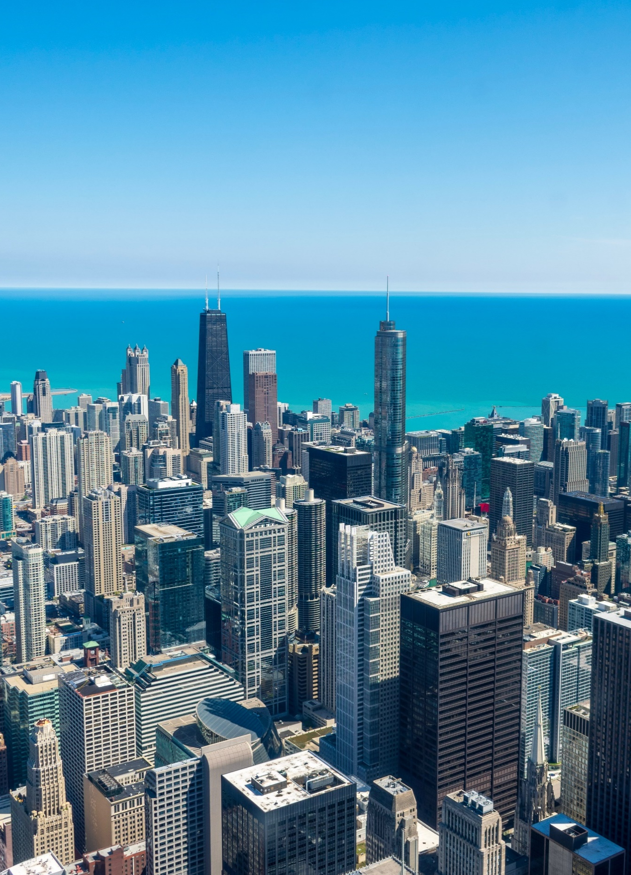


presentation to
  Trustees Conference
May 15, 2026

Slide 3


Today We Will Cover 3 Topics
Aligning Investment Strategy
Under-appreciated Risks
Broad Market Views
3

Slide 4
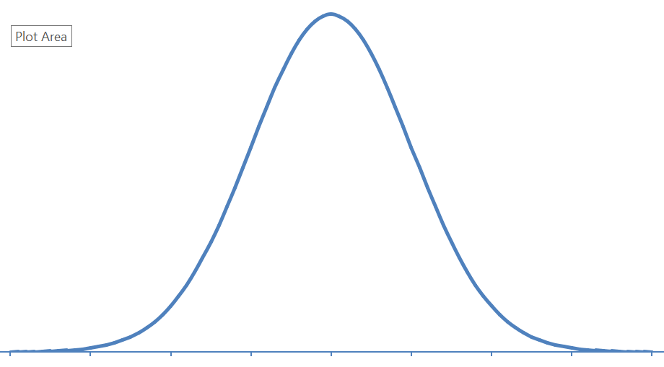
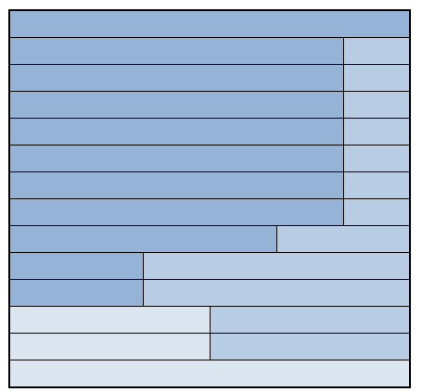
Investments Are One Part Of The Picture
Investment Portfolio
Risk Management Services
Funding Levels
NET POSITION
Reinsurance Structure
Regulatory Landscape
Product Mix
Risk Management includes an effort to monitor and manage risk, but does not imply low or no risk.
4

Slide 5
Typical Investment Asset Classes
Asset Class | Typical Allocation | Goal
Investment Grade Bonds | 70% - 100% | Stability, liquidity, income
Equities | 0% - 20% | Long term net position growth
High Yield & Bank Loans | 0% - 20% | Income enhancement
Other | 0% - 5% | Varies
The asset classes shown may not be appropriate for all clients. The typical allocation represents possible holdings for P&C insurers and risk pools and is subject to change on a variety of factors including portfolio size, risk pool net position, and client preferences.
5

Slide 6
2 Risk Pool Portfolios Tell a Story
 | Sample Portfolio 1 | Sample Portfolio 2
Average Maturity (bonds) | 7.9 | 3.5
Net Market Yield (bonds) | 5.13% | 4.06%
Expected Annual Long-Term Returns | 5.32% | 4.25%
Source: AAM, Clearwater Analytics. Data as of 12/31/2025. There is no guarantee the above results will be achieved. Investing involves many risks, including the possibility of losses. Past performance is not an indicator of future results. Market Yield is net of actual fees. Portfolios were chosen to represent variations within client portfolios based on a variety of factors including state statues, liability profiles, and possible liquidity needs. The expected returns shown are hypothetical, not derived from actual trading, and do not reflect income received by an actual portfolio. Expected returns are derived using indices as proxies for each asset class and are based on current index yields and historical index performance. Indexes are unmanaged and are not directly investable; actual client portfolios do not invest directly in an index. Please refer to the Hypothetical Performance Disclosures for important additional information, including definitions of underlying indices corresponding to each asset class. Expected return figures presented are hypothetical future projections of annualized returns over a full market cycle commencing at the date of the “asset assumptions as of” and based on the asset weightings shown. These projections are not performance results of any actual portfolio and are presented net of expected weighted fees.
6

Slide 7
Downside
Financial Crisis = 12 months ended 2/28/09; COVID = 3 months ended 3/31/20; 2022 Inflation = 9 months ended 9/30/22
Source: S&P Capital IQ Pro, Bloomberg, AAM Asset Allocation Model. Results shown are hypothetical, not guaranteed, and are not the result of actual trading. Hypothetical portfolio characteristics are based on a variety of factors and assumptions that may not reflect actual market conditions or portfolio management decisions. Expected returns, yields, volatilities and other characteristics are derived using indices as proxies for each asset class and are based on current index yields and historical index performance. Indexes are unmanaged and are not directly investable; actual client portfolios do not invest directly in an index. Please refer to the Hypothetical Performance Disclosures slide at the end of this deck for important additional information, including definitions of underlying indices corresponding to each asset class. These projections are not performance results of any actual portfolio and are presented net of expected weighted fees. Past performance is not indicative of, nor does it guarantee, future results. The Net Expected Return reflects the index returns representing each of the asset classes shown in the sample portfolios for the periods shown on the graph.
7

Slide 8
Yield Helps Cushion Net Position
Source: AAM, Clearwater excluding portfolios used for short term liquidity only. The yield is shown net of the highest fee charged to the government risk pool clients shown. There is no guarantee the above results will be achieved. Investing involves many risks, including the possibility of losses. Past performance is not an indicator of future results.
8

Slide 9
What Are The Key Risks
 | Investment Grade Bonds | Equities | High Yield Bonds
Interest Rate Risk | Varies - Can Be High | Limited | Limited
Credit Risk | Limited | N/A | High
Price Volatility | Limited | High | Modest
Liquidity Risk | Low | Low | Limited
All investments have risk
Investment grade bonds stabilize the portfolio
Risks are an estimate by AAM. Subject to change and are not guaranteed.
9

Slide 10
A Risk That Can be a Reward
Duration – sensitivity to portfolio to changes in interest rates
  Aligned with maturity
  Longer = more yield and more price volatility
Duration can provide an opportunity
  Top Priority: align liability and portfolio cash flows
  Modeling required
10

Slide 11
Liquidity – The Underutilized Risk
Liquidity - Convert investments to cash quickly without impacting the value
Unlikely to need all the value of your portfolio
Consider illiquid investments to add yield
Private placements – can potentially add 0.5% - 1.0% of yield
Commercial Mortgage Loans – Can potentially add 1.0% - 1.25% of yield
Add moderate amounts
Yields shown are estimates and will vary over time. These yields are not guaranteed. Source: AAM, Muzinich, Affinius.
11

Slide 12
Captives – A Hot Topic
  Insurance Company
  Primary Purpose – Finance Risk
What is a Captive?
  Regulated Under Special Legislation
12

Slide 13
Captives – Can Provide Flexibility
Why Use a Captive?
Protection against hard markets
Capacity
Investment flexibility
Invest like insurance companies
Start simple
Build complexity over time
13

Slide 14
Unpredictability of War
Iran conflict resolution?
Will take time for oil & gas to return to normal
Greater impact in Europe & Asia
Brent Crude Oil priced in 30-minute increments. Source: Bloomberg
14

Slide 15
Shrugging Off the Risks?
Lasting Peace?
Inflation Concerns
Source: Standard & Poors’, Bloomberg, as of 4/30/26
Source: Bloomberg 4/30/26
15

Slide 16
AAM’s Economic Views
CONSENSUS FORECAST & AAM VIEWS AT A GLANCE
 | Consensus | AAM View
Real GDP Growth¹ (2026 % Change) | 2.0% | Risks skewed to the downside
Job Growth (2026 Monthly Average) | 46k | At or below consensus
Consumer Price Index (Year End 2026) | 3.1% | At or above consensus
Fed Funds Rate (# of 25bp rate cuts in 2026) | 1 | In line with consensus
Sources: AAM / Consensus estimates are as of 4/1/2026 and are a combination of Bloomberg Estimates and Blue Chip Financial Forecasts.
Consensus forecast for GDP growth represents the Q4/Q4 change. Consensus forecasts for CPI, Fed Funds and 10-year Treasury represents the Q4 2026 average. Outlooks are subject to change should market condition warrant.
16

Slide 17
Thank You!
My Contact Information:
Dan Byrnes
CEO
312-845-2328
Dan.byrnes@aamcompany.com
17

Slide 18
Hypothetical Performance Disclosures
FOR PROFESSIONAL CLIENTS USE ONLY
Certain hypothetical portfolio characteristics and results included in this presentation were derived using market indices. In these instances, expected returns, volatilities, and correlations on modeled portfolios are derived from current yields, historical returns, volatilities, and correlations on indexes corresponding to each asset class, are net of expected fees (including 3rd party and vehicle-specific fees where applicable), and include reinvestment of interest and dividends.
Indexes corresponding to the indicated asset classes are as follows:
  IG Bonds – Int Duration / Bloomberg Intermediate Aggregate. This is a broad-based flagship benchmark consisting of investment grade, USD-denominated fixed-rate taxable bonds with maturities <10yrs
  IG Bonds / Bloomberg Aggregate. . This is a broad-based flagship benchmark consisting of investment grade, USD-denominated fixed-rate taxable bonds
  Convertible Bonds / Zazove IIG Composite. This is a composite of managed USD-denominated convertible bond portfolios with an objective of achieving equity-like returns over a full market cycle with lower downside volatility. The portfolios can invest in BB3 or better securities while maintaining an overall weighted averaged credit quality of BBB3 or better
  Equity – Domestic / Russell 3000. This is composed of 3000 large US companies, by market cap, representing approximately 98% of the investable US equity market
  Equity – EAFE / MSCI EAFE. This is a free-float-weighted equity index covering issuers in non-US developed markets in Europe, Australasia, Israel, and the Far East
  Equity – Emerging Market / MSCI Emerging Market. This is a free-float-weighted equity index covering large- and mid-cap issuers across emerging markets. It represents approximately 85% of investable equities in each country
  HY Bonds – ICE BofA BB-B US Cash Pay Constrained Index. This includes US high yield corporate fixed income securities rated BB1 – B3 based on an average Moody’s, S&P, and Fitch, with a maximum of 2% exposure to any single issuer
  Bank Loans / Credit Suisse Leveraged Loan. This index represents tradable, USD-denominated senior secured non-investment-grade loans
  These indexes may not be available in the future and cannot be directly invested in. Actual client portfolios do not invest directly in indexes and therefore may have different results than those shown.
Expected yields represent weighted average annualized expected periodic receipt of contractual principal and interest and expected amortization of purchase premium/discount from the indicated “asset data as of” date over the life of the underlying securities. Expected yield does not reflect potential for market value fluctuation. Actual results may vary.
Hypothetical performance has inherent limitations and should not be relied upon as an indicator of future results. Actual outcomes may differ materially from projections, and there is no guarantee that any stated return will be achieved. Hypothetical results do not reflect investment decisions made in real time or the impact of actual market, economic, or trading conditions. The projections that are presented are shown for illustrative purposes only and do not represent the results of any actual portfolio. There are often material differences between hypothetical forecasts and actual performance. Investing involves risk, including the potential for loss. Past performance is not indicative of future results.
99.5% VaR metric is the projected investment return in scenario approximately 2.58 standard deviations below expected mean return. Actual results may vary.
18

