Slide 1

Governmental Tort Liability: What to Know and What to Watch
Thursday, May 14th | 1:00pm

Slide 2

GOVERNMENTAL TORT LIABILITY WHAT TO KNOW AND WHAT TO WATCH
David J. MacMain, Esq. MacMain Leinhauser PC West Chester, Pennsylvania dmacmain@macmainlaw.com 484-318-7106 www.macmainlaw.com

Slide 3
PRESENTATION OVERVIEW
STATE TORT LIABILITY AND IMMUNITIES
FEDERAL LIABILITY
TOP 10 AREAS OF FOCUS

Slide 4
STATE TORT LIABILITY AND IMMUNITIES

Slide 5
STATE TORT IMMUNITY
How does liability and immunity work?
- Immune unless fits within an exception?
- Narrow areas where claims can be brought?
- Governmental function (immune vs. proprietary function (not immune)?
- Ministerial action?
- No liability for discretionary function?

Slide 6
DAMAGES CAP ?
ALASKA and ARIZONA – NO cap
COLORADO - $350,000 per claimant; $900,000 per occurrence
CONNECTICUT – NO cap
GEORGIA - $500,000 per person; $700,000 per occurrence
MARYLAND - $400,000 per person; $800,000 per occurrence
MASSACHUSETTS - $100,000 per person
MICHIGAN – NO cap
PENNSYLVANIA - $500,000 per occurrence
SOUTH CAROLINA - $300,000 per person; $600,000 per occurrence

Slide 7
VARIOUS ISSUES TO CONSIDER
Does purchase of insurance waive or set the cap?
Right of subrogation / Collateral source?
Fee-shifting/recovery of counsel fees?
Punitive damages barred?
Punitive damages covered and/or coverable?
Set formula or off-set for wrongful conviction claims?
Immunities to employee?
What if incident occurs in another state?
Constitutional challenges?

Slide 8
COMPARISON OF STATE VS. FEDERAL
PENNSYLVANIA
Limited to 9 exceptions
NO recovery of fees
Damages Cap
NO Punitives
FEDERAL/§1983
Unlimited liability
Recovery of Fees
NO Cap
Punitives

Slide 9
PROCEDURAL ISSUES
Statutory Notice?
Statute of Limitations?
Right-to-Know
Freedom of Information Act

Slide 10
VENUE?
Remove to Federal Court? (30 days)
Jury Pool
Judiciary

Slide 11

Perception video
Convenience store

Slide 12
FEDERAL LIABILITY

Slide 13
FEDERAL LIABILITY- 42 U.S.C. § 1983
Allows persons whose constitutional rights have been violated to seek monetary damages.

Slide 14
FEDERAL LIABILITY
INDIVIDUAL
1- Violation
MONELL
1- Violation
2- Policy, practice, or custom
3- Causation

Slide 15
POLICY, PRACTICE OR CUSTOM
1- Written policy officially adopted by the municipality's lawmaking body, or;
2- Policy may be established by the showing of a single act of municipal official with final policy-making authority, or;
3- Show a pattern of omissions or failure to act on the part of the municipality which reaches the level of “gross negligence” which indicates “deliberate indifference” for individuals’ constitutional rights.

Slide 16
TYPES OF CLAIMS

Slide 17
UNREASONABLE “SEIZURE”
Mere Encounter = Nothing
Investigatory Detention = Reasonable Suspicion
Arrest = Probable Cause

Slide 18
UNREASONABLE “SEIZURE”
WARRANT ALWAYS PREFERRED!
Consent
Hot Pursuit
Exigent Circumstances
Community Caretaking
Domestic Violence

Slide 19
UNLAWFUL ARREST
Did probable cause exist at the time of arrest to support the arrest?

Slide 20
ARREST WARRANT
If the arrest is made pursuant to a warrant, officers are insulated from liability.
Warrant for the arrest of John Doe

Slide 21
Plaintiff must prove more than negligence or that “the wrong guy was arrested”

Slide 22
Acquittal and/or dismissal of charges in the underlying criminal matter is irrelevant
“The Constitution does not guarantee that only the guilty will be arrested.”

Slide 23
APPROVAL BY PROSECUTOR
If the arrest is pre-approved by a prosecutor, officers are insulated from liability. Kelly v. Carlisle, 622 F.3d 248 (3rd Cir. 2010)

Slide 24
RELEASE-DISMISSAL AGREEMENTS
We do hereby release the municipality of ..

Slide 25
USE OF FORCE
Whether an officer’s use of force was unnecessary and excessive is determined under an objective reasonableness test which is based upon totality of the circumstances.

Slide 26
IN DETERMINING THE REASONABLENESS OF FORCE, THE FACT FINDER CONSIDERS:
Whether the suspect poses an immediate threat to the safety of the officer or others;
Whether the suspect is actively resisting arrest;
Extent of injury inflicted; and
The relationship between the need and amount of force used.

Slide 27

PERCEPTION VIDEO DAD IN CAR

Slide 28
WORDS MATTER
Slang
Cop- Talk
Nicknames
Profanity
Empathy/calm

Slide 29
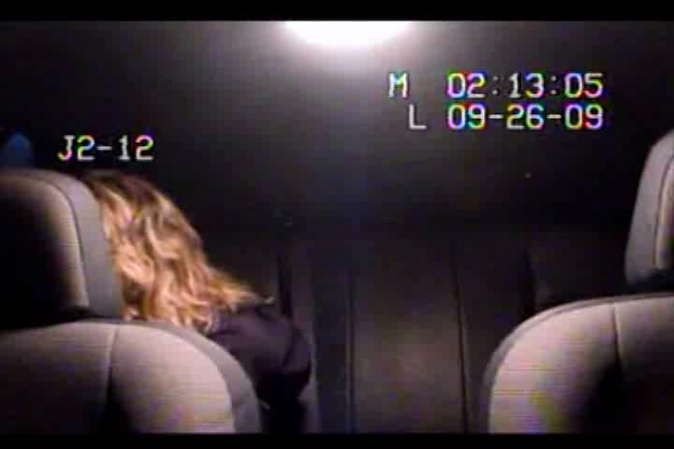
TASER VIDEO

Slide 30
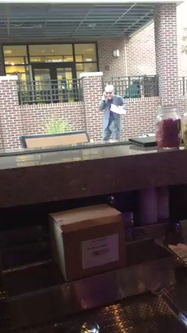

Slide 31
POLICE PURSUIT

Slide 32
CLAIMS ARISING FROM DETENTION AT POLICE STATION

Slide 33
DENIAL OF MEDICAL ATTENTION
Arrestee must prove that he had a “serious” medical need and that the officers were deliberately indifferent to this serious medical need.

Slide 34
FAILURE TO PREVENT SUICIDE
Plaintiff must show that police officials “knew or should have known” of the decedent’s suicidal intent and were either “reckless or intentionally indifferent” to that knowledge

Slide 35
“HOT” ISSUES
ADA
Suicide by Cop
Mental Health/Special Needs
Eradication or elimination of immunity?
No knock warrants
Choke-holds

Slide 36
QUALIFIED IMMUNITY
“Good-Faith Defense”
“…shielded from liability for civil damages insofar as their conduct does not violate clearly established statutory or constitutional rights of which a reasonable person would have known”

Slide 37
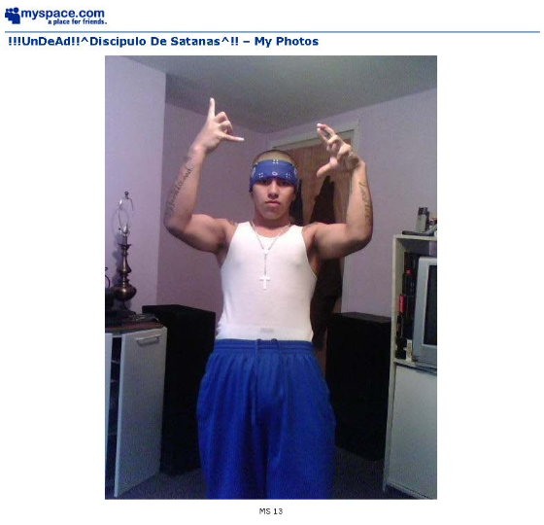
SOCIAL MEDIA

Slide 38
TOP 10 AREAS OF FOCUS

Slide 39
1. VIRAL VIDEOS
Control narrative
No “no comment”

Slide 40
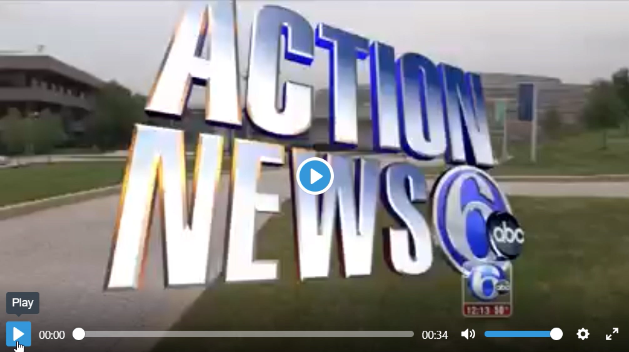

Slide 41
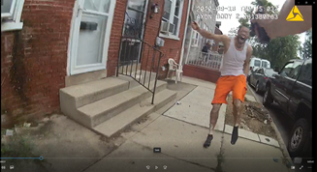

Slide 42
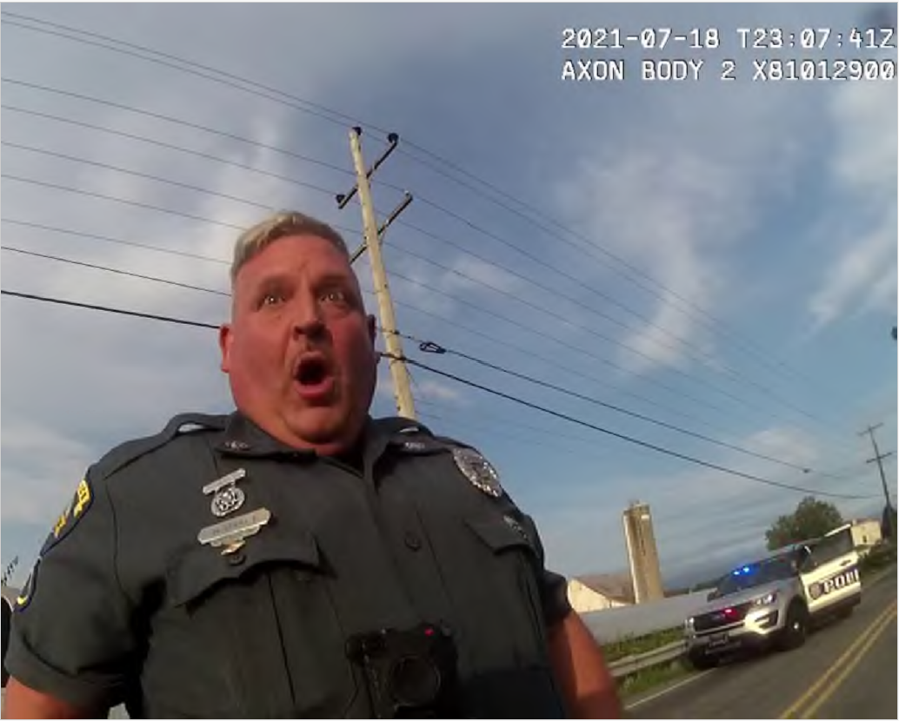

Slide 43

2. FIRST AMENDMENT AUDITORS
Videotaping Of Officers

Slide 44
3. MENTAL HEALTH/ADA
Arrestee/ inmate
Officers

Slide 45
4. WRONGFUL CONVICTION
Innocence project
Law school
Big firms
“Reform” prosecutors

Slide 46
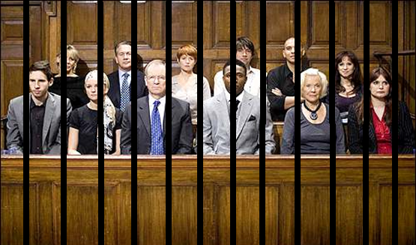
WHAT IS A DAY/MONTH/YEAR IN JAIL WORTH?

Slide 47
5. MORE SOPHISTICATED PLAINTIFF’S COUNSEL
Social Justice
Lucrative
Fee shifting / 1988

Slide 48
6. LITIGATION FUNDING
Discoverable ?
Who controls litigation ?

Slide 49
7. GOOD DEFENSE COUNSEL
Financial pressure
AI
Work-life Balance
Billing Guidelines
Rates

Slide 50
8. RISK AVOIDANCE
Settle, settle, settle
Higher settlements
Less trials
Less trial lawyers

Slide 51
9. BUILD RELATIONSHIPS AND NETWORK
Before Crisis Hits
Community Buy-In
Different Views & Perspectives

Slide 52
10. LEADERSHIP MATTERS
Chief
Supervisors
Shift Supervisors
Officers
Future Hires

Slide 53
GOVERNMENTAL TORT LIABILITY WHAT TO KNOW AND WHAT TO WATCH
David J. MacMain, Esq. MacMain Leinhauser PC West Chester, Pennsylvania dmacmain@macmainlaw.com 484-318-7106 www.macmainlaw.com

