Slide 1

Federal Legislative and
Legal Update
Thursday, May 14th | 10:45am

Slide 2
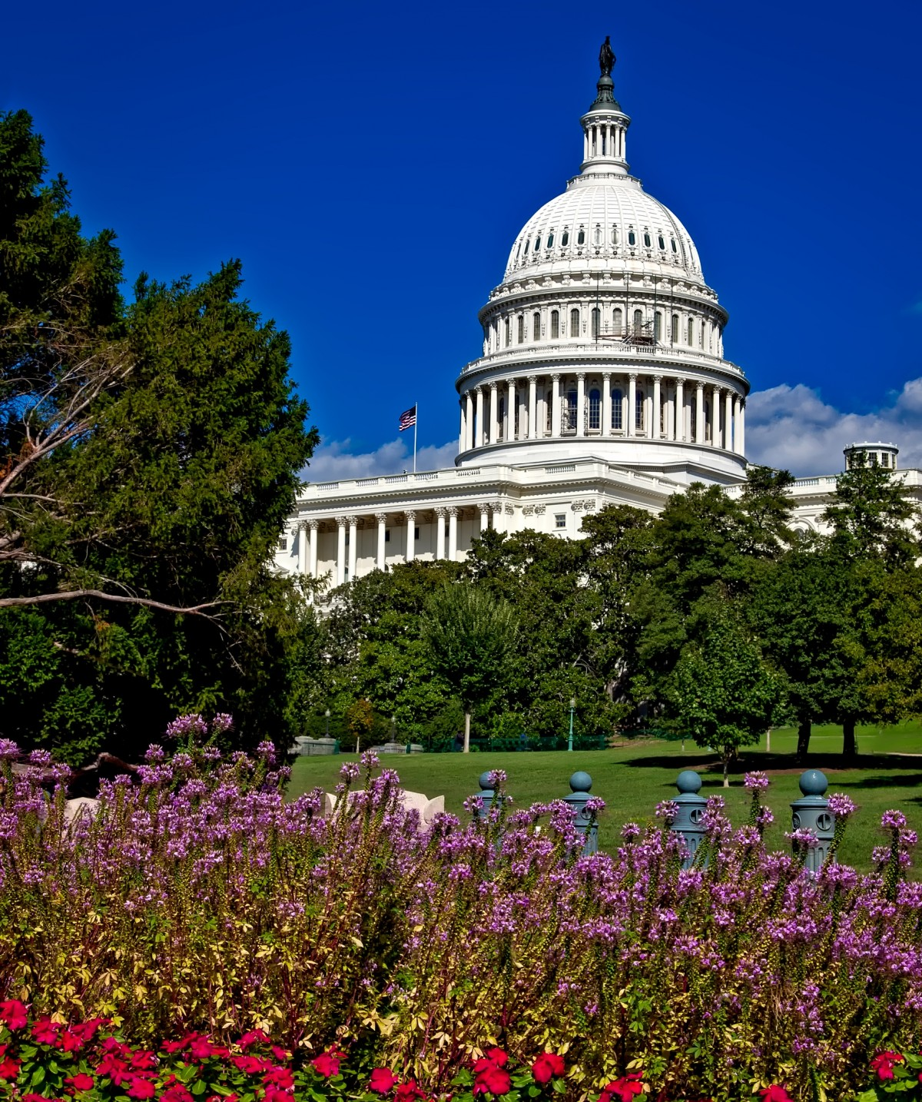
Federal Legislative and Legal Update
2026 NLC-RISC Trustees Conference
Savannah, Georgia

Slide 3


Stephanie Martinez-Ruckman
Legislative Director, Human Development
National League of Cities
Gwinn Hall
Senior Associate General Counsel
Georgia Municipal Association

Slide 4
Agenda
Legal Update
Legislative Update
Q&A

Slide 5
Legal Update

Slide 6


NLC-RISC Legal Update
May 14, 2026
PRESENTED BY
Gwin Hall
Senior Associate General Counsel
Georgia Municipal Association

Slide 7

Agenda
United States Supreme Court Cases
Emerging Areas of Concern
Existential Threats
GIRMA PTSD Fund

Slide 8
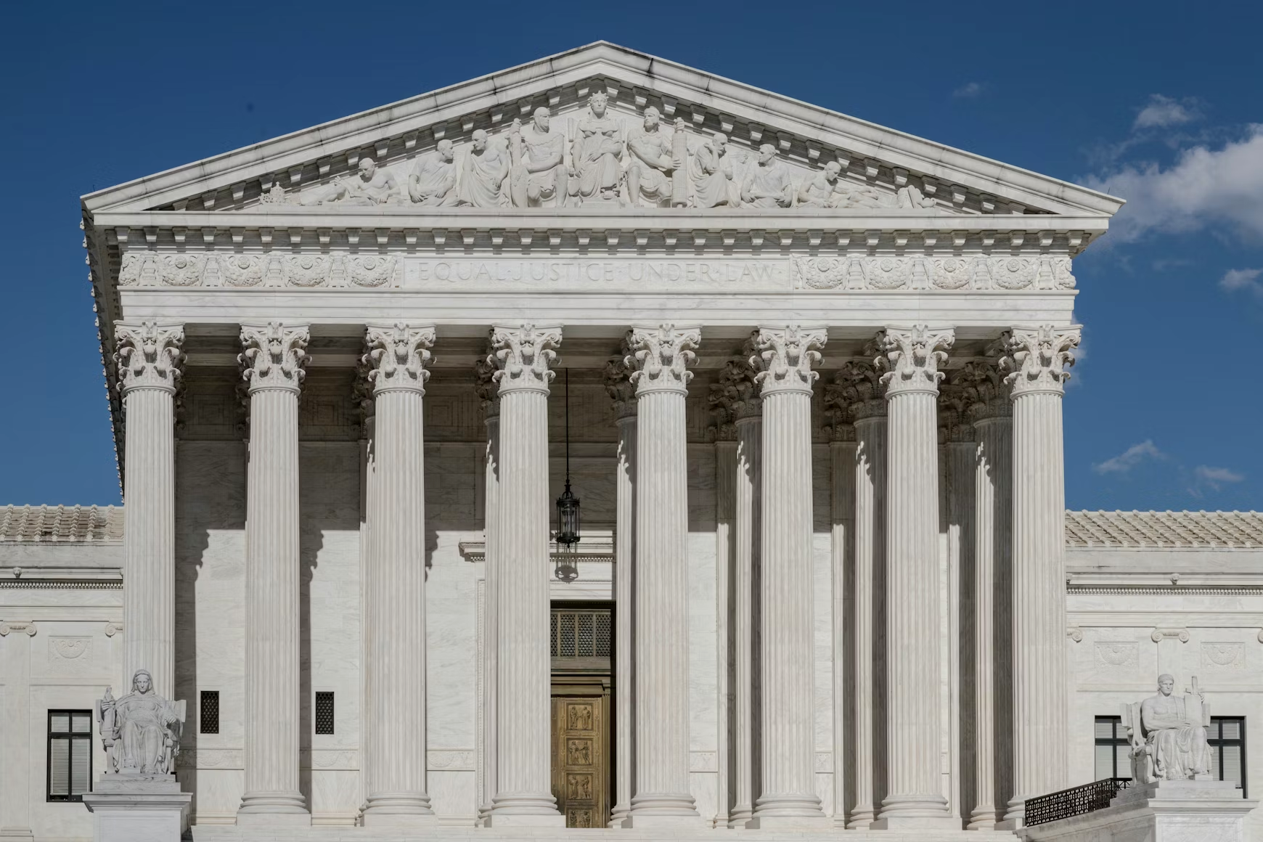
U.S. Supreme Court Update
Supreme Court 2024-25 Term Case Highlights
  Trump v. Casa (universal injunction)
  Barnes v. Felix (law enforcement / Fourth Amendment)
  Bauer v. Marks (qualified immunity)
Supreme Court 2025-26 Term Highlights
  Law Enforcement Cases
  Pung v. Isabella County (property tax foreclosure)

Slide 9

Trump v. Casa, 145 S. Ct. 2540

Slide 10
Trump v. Casa
President Trump signed an Executive Order ending birthright citizenship.
Lawsuits filed by a group of states, individual plaintiffs, and non-profits, alleging the EO violates the 14th Amendment’s Citizenship Clause.
The lower courts in each case entered a “universal injunction,” barring executive officials from applying the EO to anyone.
The federal government appealed to the Supreme Court on the question of universal injunctions only – it did not appeal the merits ruling on the question of the constitutionality of the EO.

Slide 11
Trump v. Casa
Supreme Court holding (6-3):
  Denied universal injunction in cases by or on behalf of individuals.
  Federal courts can only provide “complete relief” to the parties before them.
Left open the possibility that a universal injunction might be necessary to provide complete relief in certain circumstances.
Noted that a universal injunction may be necessary in this case to provide complete relief to the states but remanded to the lower courts to determine if a narrower injunction would be appropriate.
Noted that class actions are still available to litigants.
Notes:
prohibiting enforcement of the Executive Order against the child of an individual pregnant plaintiff will give that plaintiff complete relief: Her child will not be denied citizenship. And extending the injunction to cover everyone similarly situated would not render her relief any more complete. So the individual and associational respondents are wrong to characterize the universal injunction as simply an application of the complete-relief principle. The inquiry is more complicated for the state respondents, because the relevant injunction does not purport to directly benefit nonparties. Instead, the District Court for the District of Massachusetts decided that a universal injunction was necessary to provide the States themselves complete relief. As the States see it, their harms—financial injuries and the administrative burdens flowing from citizen-dependent benefits programs—cannot be remedied without a blanket ban on the enforcement of the Executive Order. Children often move across state lines or are born outside their parents’ State of residence. Given the cross-border flow, the States say, a “patchwork injunction” would prove unworkable for the provision of certain federally funded benefits. The Government retorts that even if the injunction is designed to benefit only the States, it is “more burdensome than necessary to redress” their asserted harms, see *835 Califano v. Yamasaki, 442 U.S. 682, 702, 99 S.Ct. 2545, 61 L.Ed.2d 176, and that narrower relief is appropriate. The Court declines to take up these arguments in the first instance. The lower courts should determine whether a narrower injunction is appropriate, so we leave it to them to consider these and any related arguments. Pp. 2556 – 2559.
Universal injunctions not supported by history or the Judiciary Act of 1789.
First instance of a universal injunction was in 1963 (DC Court)
Sometimes non-parties benefit from the “complete relief” though they may not be the intended recipients.
“Complete relief” is not a guarantee but is the maximum a court can provide.

Slide 12
Trump v. Casa
Implications for local governments:
  Could affect cases involving termination of federal grants or conditions on grants that in the past may have resulted in universal injunctions.
  Now, local governments can only get relief if 1) they sue; 2) their State sues and seeks relief on behalf of its political subdivisions; 3) possibility of class actions.
Notes:
*APA vacatur is left open under the opinion. In some cases, courts may vacate or set aside an unlawful agency action, which may end up looking like a nationwide injunction.
Cities in states not participating in lawsuits against the government will not get the benefit of a stay. Could still be subject to liabilities associated with gvt. Action that might not be lawful
After this case, the individual plaintiffs applied for and were granted class status in federal district court.
The states who sued continued their case in the 9th circuit court of appeals. Suit was not to assert rights of citizens but related to the financial impact on the states of not treating certain children as citizens, which would impact federal funding relating to children. 9th circuit court injunction was universal due to confusion that could stem from children being treated as citizens in one state but not another and moving from state to state, leading to the new state not being certain about funding for federal benefits. Case has been appealed to the S. Ct.; S.Ct. will review related case, Trump v. Barbara.

Slide 13
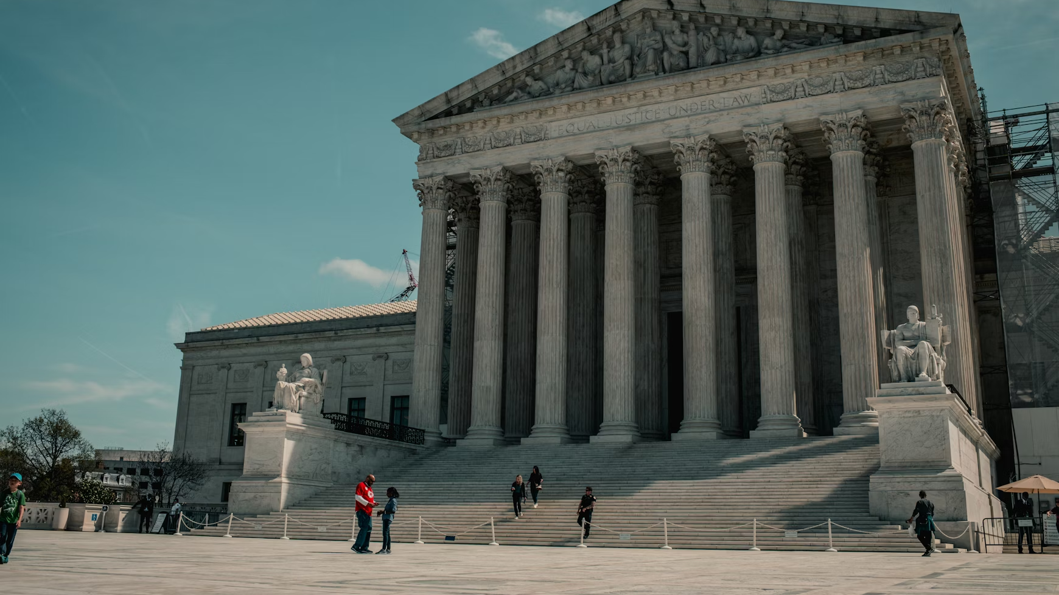
Barnes v. Felix, 145 S. Ct. 1353
Excessive Force and Qualified Immunity

Slide 14
Barnes v. Felix
Facts
Officer Felix initiated a traffic stop for a vehicle with suspected toll violations.
  Asked for license and proof of insurance
  Barnes said he might have the documentation in his trunk; opened trunk
  Felix told Barnes to get out of the vehicle
  Barnes opened the car door but turned the car back on.
As the car started moving forward, Felix jumped onto the car’s doorsill.
Felix shouted at Barnes not to move and fired twice into the car, hitting Barnes.
Barnes stopped the car but died from his injuries.

Slide 15
Barnes v. Felix
Issue: Whether courts should apply the “moment of the threat” doctrine when evaluating an excessive force claim under the Fourth Amendment.
Moment of Threat Doctrine:
  “The excessive-force inquiry is confined to whether the officers or other persons were in danger at the moment of the threat that resulted in the officers’ use of deadly force.”
  “Any of the officers’ actions leading up to the shooting are not relevant for the purposes of an excessive force inquiry ….”
Notes:
Case itself goes against the officer but it can cut the other way. Also the Kavenaugh concurrence about how dangerous stops are for law enforcement

Slide 16
Barnes v. Felix
5th Circuit Court of Appeals:
Found there was no constitutional violation because the officer did not draw his weapon until Barnes turned the car back on.
Reasoned that the officer’s actions prior to the moment the threat occurred justifying deadly force including that he “jumped onto the door sill” had “no bearing on the officer’s ultimate use of force.”
Held that the “moment of threat occurred in the two seconds before Barnes was shot. At that time, [Officer] Felix was still hanging onto the moving vehicle and believed it would run him over, which could have made Officer Felix reasonably believe his life was in imminent danger.”
Notes:
The 5th circuit “narrowed the test in deadly force cases, holding that the inquiry there is ‘confirmed to whether the [officer] was in danger at the moment of the threat that resulted in the ‘officer’s] shooting.”

Slide 17
Barnes v. Felix
Supreme Court holding (9-0):
Rejected the “moment of threat” doctrine, concluding the proper test is the “totality of circumstances” test.
  The events leading up to the use of force are relevant to the totality of the circumstances.
Court highlighted that in some cases, prior events may help prove the officer’s actions were reasonable.
Notes:
, e.g., Plumhoff v. Rickard- facts involved a more than five minute “dangerous car chase” that preceded the deadly shooting

Slide 18
Barnes v. Felix
Totality of the Circumstances Test:
Factors courts should consider, include
  the “severity of the crime,”
  “actions the officer took during the stop, such as giving warnings or otherwise trying to control the encounter,” as well as;
  the “stopped person’s conduct” including the “nature and level of the threat he poses.”
The Court cautioned, the totality of the circumstances test “has no time limit.”
  But, the “situation at the precise time of the shooting will often be what matters most.”

Slide 19

Bauer v. Marks – Remanded
Excessive Force and Qualified Immunity

Slide 20
Bauer v. Marks
Involved a police officer’s use of a less lethal projectile during a violent protest in Minneapolis in the aftermath of the murder of George Floyd.
The 8th Circuit found the officer was not entitled to qualified immunity despite riotous conditions and a fellow officer being attacked by the individual whom the less-lethal projectile struck.
The Supreme Court remanded this case in light of Barnes.
  Signals that the 8th Circuit may not have properly applied the “totality of the circumstances” test.
On remand, the 8th Circuit held there were questions for the jury to consider to determine if qualified immunity was appropriate.
Notes:
Bauer is not a “moment of threat” doctrine case.
On remand, the trial court denied the Officer Bauer’s motion for summary judgment based on qualified immunity. The 8th Circuit agreed with the trial court on the grounds that there were fact issues that a jury needed to consider to determine if qualified immunity was appropriate.

Slide 21
Supreme Court 2025-2026 Term (Merits Docket)
Law Enforcement: Case v. Montana
Zorn v. Linton
Smith v. Scott
Chatrie v. United States
Tax Foreclosure / Finances: Pung v. Isabella County
Notes:
Other cases relating to election law, executive power & administrative agencies, tariffs & birthright citizenship, second amendment and preemption (next term)

Slide 22

Case v. Montana, 146 S.Ct. 500 (2026)
Probable Cause/ Emergency Aid

Slide 23
Case v. Montana
Facts:
Police entered the house to provide emergency aid to Case after a suicide threat.
Police found Case in a closet with an object that looked like a gun.
An officer thought Case was going to shoot him and shot Case in the stomach. Another officer found a gun nearby.
Case was charged with assaulting a police officer.
Case asked trial court to exclude evidence law enforcement obtained after they entered his house since they didn’t have a warrant.
Notes:
Police officers were aware of prior suicide attempts and on one prior occasion thought Case was trying to goad police into shooting him.
Police see empty gun holster and what could have been a suicide note on the table.
Jury found Case guilty; Montana Supreme Court upheld jury verdict.

Slide 24
Case v. Montana
Supreme Court decision (9-0):
Holding: The Fourth Amendment allows police officers to enter a home without a warrant/probable cause if they have an “objectively reasonable basis for believing” that someone inside is seriously injured or imminently threatened by injury; that standard was met here.
Probable cause is for criminal investigations; this was an emergency aid situation
But, the “emergency aid” exception to the warrant/probable cause requirement does not authorize police to search the premises beyond what is reasonably needed to deal with the emergency while maintaining the officers’ safety.
Notes:
Provides more certainty and will decrease liability for law enforcement.

Slide 25

Zorn v. Linton, 146 S.Ct. 926 (2026)
Excessive Force/ Qualified Immunity

Slide 26
Zorn v. Linton
Facts:
Group of protestors who staged a sit-in during the January 2015 inauguration of then-Governor Shumlin (VT).
  Officers informed the protestors that the capitol was closed to the public.
  Ms. Linton kept her arms interlocked with fellow protestors.
Officer Zorn put her in a rear wristlock and repeatedly asked her to standup.
  He warned he would use more pain compliance and she did not stand. He then put pressure on her wrist to make her stand.
  She fell back on the floor, had to be lifted up and carried outside.
She sued claiming excessive force.

Slide 27
Zorn v. Linton
District Court:
Granted qualified immunity reasoning it was not clearly established at the time of the encounter that lifting Linton while putting pressure on her wrist violated the 4th Amendment.
2nd Circuit Court of Appeals:
Denied qualified immunity relying on Amnesty America v. West Hartford, 361 F. 3d 113 (2004), to conclude that it was clearly established that the “gratuitous use of a rear wristlock on a protester passively resisting arrest constitutes excessive force.”

Slide 28
Zorn v. Linton
Supreme Court Holding (6-3)
Reversed:
Held the Amnesty case did not clearly establish the law.
  The officer in Amnesty did not give warnings and the facts involved other allegations of excessive force.
Notes:
a summary reversal is where the Court reverses the lower court without merits briefing or oral argument. It is quite unusual but they do it occasionally. This is the first time they’ve done it for QI purposes in about 5-6 years but for awhile, they were doing this 1-2 times a term in QI cases.

Slide 29

Smith v. Scott, Remanded
Excessive Force/ Qualified Immunity

Slide 30
Smith v. Scott
Facts:
Smith was in mental distress and called 911. After coming out of his apartment, he had a pipe and a knife which he immediately handed over when asked by officers. He also indicated he had schizophrenia.
Officers sought to bring him in for a mental health and safety hold and pulled him to the ground.
He had complied with all orders until this point, but he resisted once on the ground and they put bodyweight force on his back and neck to get him into handcuffs, which took 1-2 minutes.
They then turned him on his side at which point he was still responsive.
A few minutes later, he became unresponsive and after paramedics arrived, he was pronounced dead.

Slide 31
Smith v. Scott
9th Circuit Court of Appeals:
Denied qualified immunity, finding the officers violated the 4th Amendment in applying deadly force without sufficient justification.
Relying on a 2003 9th Circuit case, the court found the law was clearly established such that “any reasonable officer should have known that bodyweight force on the back of a prone, unarmed person who is not suspected of a crime is constitutionally excessive.”

Slide 32
Smith v. Scott
Supreme Court remanded on April 20, 2026, for further consideration in light of Zorn.
The action does not tell us why the Supreme Court disagreed with the 9th Circuit or how the lower court should apply Zorn.
It merely implies that the lower court misapplied the law and should review the case again in light of Zorn.

Slide 33
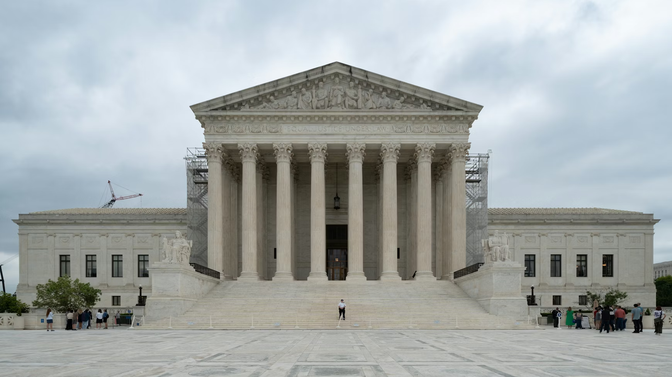
Chatrie v. United States – Pending
Geofence Warrant

Slide 34
Chatrie v. United States
Facts: A man robbed a bank in Richmond, VA, in 2019. When the investigation stalled, law enforcement served a “geofence warrant” on Google, directing it to provide location data for cell phone users who were near the bank at the time of the robbery.
Geofencing is a location-based service that creates a virtual, software-defined boundary around a physical geographic area using GPS, RFID, Wi-Fi, or cellular data.
Based on the data provided, law enforcement obtained warrants to search two residences linked to Chatrie, where they found almost $100,000 of the stolen cash, a gun, and demand notes

Slide 35
Chatrie v. United States
Issue: Whether a warrant directing Google to provide location data for cellphone users who were near a particular place during a particular period of time - a “geofence warrant” - violated the Fourth Amendment.
Implications:
Geofence warrants have the potential to be important tools in solving crimes / identifying suspects.
There are privacy concerns on the other side.
Notes:
Robbery amount was almost $200,000.

Slide 36
Chatrie v. United Statess
District Court:
District court judge agreed the warrant didn’t have the probable cause or specificity the 4th Amendment requires but allowed the government to use the evidence on the grounds it acted in good faith.
4th Circuit Court of Appeals
4th Circuit Court of Appeals held the government had not conducted a “search” for 4th Amendment purposes because Chatrie could not reasonably expect two hours’ worth of location data – which he voluntarily let Google have – be kept private.
Notes:
Chatrie sued saying the geofence warrant that led to the search violated the Fourth Amendment.

Slide 37
Chatrie v. United States
U.S. Supreme Court - Oral Argument April 27, 2026
Questions about whether Chatrie’s act of turning location sharing on was a consent to sharing location with the government.
  Voluntary act of turning location sharing on
  But there are several steps required to turn it off
Questions as to whether anyone as a reasonable expectation of privacy in their public observable movements
  vs. using geofencing to learn identities of everyone at a church
Concern about allowing government to search other digital media stored with Google without a warrant
  Public location vs. private thoughts

Slide 38

Pung v. Isabella County, Pending
Tax Sales

Slide 39
Pung v. Isabella County
Facts
Petitioner had a $2,200 unpaid real estate tax debt. Isabella County foreclosed in June 2018. Foreclosure sale yielded ~$76,000.
Petitioner sued alleging a taking and excessive fines violation.
The district court ordered the County to pay the petitioner the excess equity after retaining the amount necessary to satisfy the debt. But the petitioner argued that he was entitled to the fair market value ($194,000) minus the tax debt, not the lower auction price that was actually paid.

Slide 40

Pung v. Isabella County
Issues:
Whether the 5th Amendment Takings Clause requires local governments to use the auction sale price or the fair market value of a property to determine the amount of surplus from a tax sale that must be returned to the delinquent taxpayer; and
Whether the forfeiture of real property worth far more than needed to satisfy a tax debt but sold for a fraction of its real value constitutes an excessive fine under the 8th Amendment.
Notes:
If the Court agrees with Mr. Pung that the surplus is determined based on the fair market value, the foreclosure auction price will no longer function as a safe harbor. Local gvts and tax sale bidders may face exposure measured against actual market value—not the amount paid in at the time of the tax sale.

Slide 41
Pung v. Isabella County
Tyler v. Hennepin County Refresher (2023 U.S. Supreme Court Case)
The Court held that the county violated the Takings Clause by keeping the surplus equity (above the amount of the tax debt) in a condominium that it foreclosed on and sold after the homeowner failed to pay her property taxes.
    Taxpayers have a constitutionally protected property interest in the surplus amount.
The Court did not address how the amount of the surplus should be determined.
  True fair market value vs. auction price at foreclosure sale
Notes:
Tyler v. Hennepin County centered on a lawsuit brought forth by Geraldine Tyler, who owed Hennepin County, Minnesota $15,000 in unpaid property taxes, interest and penalties for a condo she did not reside in. She received a statutorily prescribed notice of foreclosure, failed to answer, and then never tried to redeem the property during the 3-year period allowed by the state. She also did not seek to repurchase the property. After the county sold the condo for $40,000 and kept the proceeds above and beyond Tyler’s $15,000 debt, Tyler sued, arguing that she was owed the $25,000 surplus under the Fifth Amendment’s Taking Clause, which bars the government from taking private property for public use without adequately compensating the property owners, as well as the Eighth Amendment’s ban on excessive fines.
The court did not reach the excessive fines question. (But Justices Gorsuch and Jackson would have likely found this to be an excessive fine as well). BUT, since Tyler, lower courts have seen a good bit of litigation challenging past foreclosures.

Slide 42

Implications for Local Governments
Could result in huge financial losses for counties if they must reimburse former property owners for difference between fair market value and tax debt, rather than the actual sales price and tax debt.
Who decides fair market value? How is it decided? Will lead to more litigation and costs.
Local governments are not realtors and are not in the business of getting the best price for a home that is foreclosed on.
Notes:
Implications for Local Governments and Tax-Lien Investors (from Nelson Mullins article)
Justice Kagan’s questioning of the Solicitor General focused on what a market-value ruling could mean. Speaking on behalf of the United States, Mr. Liu explained the dire results of such a ruling in Mr. Pung’s favor:
JUSTICE KAGAN: So what would it mean if we said that the measure was fair market value with respect to foreclosure sales?
MR. LIU: It would spell the end of tax sales in America. Every tax sale is necessarily going to yield less than fair market value.
If the government is nevertheless required to reimburse the taxpayer—taxpayer as if the sale yielded fair market value, then every tax sale is going to end up costing the government money, and it won't be long before governments simply stop conducting tax sales altogether.
And at the end of the day, who does this hurt?
It hurts other taxpayers who are actually paying their taxes because the shortfall has to come from real taxpayers.
In a similar vein, if the Court adopts a fair-market-value rule:
Valuation Exposure Increases. Counties could face liability for the difference between market value and tax debt—even if the property sold for far less. This liability could also extend to tax-lien investors with the winning bid at the tax sale.
Procedural Reforms May Follow. Governments may need to implement additional safeguards to approximate market value—such as minimum bid requirements, appraisal thresholds, or surplus-return mechanisms calibrated to appraised value rather than sale proceeds. This could turn government officialsinto real estate marketing and valuation experts despite having no experience in those fields.
Section 1983 Litigation Will Expand. Plaintiffs will frame claims not merely as surplus-retention cases, but as undervaluation takings claims. This could mean additional class actions and an increase in attorney-fee awards for plaintiffs’ counsel nationwide.

Slide 43
Pung v. Isabella County
6th Circuit Court of Appeals:
Taking claim: the court ruled that a plaintiff whose property is foreclosed on and sold at public auction for failure to pay taxes is not entitled to recoup the fair market value of the property.
Excessive fines question: the court held that the law does not punish property owners for failing to pay their taxes, instead, “its aim is to encourage the timely payment of property taxes.” Therefore, the tax forfeiture scheme did not fall within the Eight Amendment’s excessive fines ambit.

Slide 44
Pung v. Isabella County
United States Supreme Court – Oral Argument Feb. 25, 2026
Noted historical precedence of tax sales/foreclosures and using auction price, not fair market value
  BFP v. Resolution Trust Corporation (Justice Scalia 1994)
Expressed concern that if use fair market value, the non-delinquent taxpayers would have their taxes used to compensate the delinquent taxpayer after the sale
Could remand for consideration on the fairness of the auction/process, possibility of recouping tax debt through personal property before real property, due process considerations
Notes:
Court didn’t seem overly sympathetic to Mr. Pung. Said he should have paid his taxes.
Scalia opinion: " A foreclosure sale alters market conditions and can lower a property's selling price. ”
As Jackson commented, it “seems like real unfairness” to “the rest of the American people, that we are paying you because you didn’t pay your taxes and the government had to foreclose on your house.”

Slide 45
Emerging Issues
Automated License Plate Readers (“ALPR”)
  Cases against cities in Virginia and California
  Criminal cases against individuals/law enforcement officers for misuse
Lawsuits over wrongful incarceration
  Local governments sued over missteps in investigations/prosecutions years ago
Negligent hiring
Notes:
Minor Doe v. Best Academy (Feb. 2025)

Slide 46
Existential Threats
Nuclear verdicts
  Prejudgment interest
Inflation
  Medical care
  Building materials
Weather Patterns
  Increased damage to infrastructure
Third Party Cases
Notes:
Third-party claims are brought by third parties who do not have a direct relationship with the insurance company, and who allege that the insurer’s policyholder caused their damages.

Slide 47
Georgia First Responder PTSD Program
Ashley Wilson Act (GA Law)
Provides supplemental benefits for first responders diagnosed with duty-related PTSD
Address danger of untreated PTSD
Support early treatment and continued service as a 1st responder​
Expand on Office of Public Safety Support law (free peer counseling)​
  Same definitions of first responders as Office of Public Safety Support law​
  Same focus on privacy as Office of Public Safety Support law
Provide financial benefits to promote early diagnosis and treatment of occupational PTSD​
No disruption of medical health insurance, which is required to pay for treatment of mental health care on parity with other medical care​
Notes:
many first responders are very skeptical about talking to someone, especially about how traumatic events have impacted them, so we try to eliminate that fear by explaining that the communications [with OPSS peer counselors] are privileged, like the communications between a lawyer and a client or a doctor and a patient.” ​
Privacy Requirements:
​
The benefits shall be administered in a manner designed to ensure that first responders are able to obtain the lump sum benefit . . . in a confidential manner similar to receiving mental health benefits under an employer sponsored major medical health plan or employee assistance program, or, for the disability benefit . . . in a confidential manner similar to receiving other employer sponsored disability benefits involving mental health issues.”​
“In no event shall information solely about an individual’s diagnosis, claims, or benefits be used for any employment action.”​
“Information that could reasonably be used to identify individuals making claims or who have made claims or who have received benefits under this Code section shall be treated as sensitive mental health information and, absent express authorization by the individual, shall only be used and shared for administration of benefits, underwriting, and for purposes of aggregation and de-identification or for purposes of compliance with Article 4 of Chapter 18 of Title 50 or other applicable laws. ​
​
“Communications, in any form, between such individuals and the administrator or ​insurer of the benefits shall be confidential and privileged.”​

Slide 48
Georgia First Responder PTSD Program
Who Is Eligible?
Communication Officer
Emergency Medical Professional
Highway Emergency Response Operator
Firefighter
Jail Officer
Correctional Officer
Emergency Medical Technician
Juvenile Correctional Officer
Probation Officer
Peace Officer (including law enforcement officers with the DNR)
Notes:
just as the Court emphasized the car chase was relevant in Plumhoff
, which would help the officers argue the reasonableness of the seizure

Slide 49
Georgia First Responder PTSD Program
Key Definitions
Traumatic Event - The Act defines a Traumatic Event as an actual or threatened death, serious injury , or act of sexual violence.
Eligible First Responder - The Act defines Eligible First Responder as a first responder who experienced or was exposed to a traumatic event during the normal course of performing regular occupational or volunteer duties on behalf of a public entity.
Qualified Diagnostician - The Act defines Qualified Diagnostician as psychiatrists, psychologists, and physicians who are duly authorized to practice in Georgia and are certified in a medical specialty appropriate for trauma related mental health diagnoses.

Slide 50
Georgia First Responder PTSD Program
Required Benefits (once per lifetime):
​
Lump-Sum Benefit - The first is a $3,000 lump-sum benefit paid following diagnosis of occupational PTSD by a qualified diagnostician. ​
Disability Benefit - The second is a long-term disability benefit if a qualified diagnostician determines that the eligible first responder is no longer able to perform their duties as a first responder due to their PTSD diagnosis:​
The disability benefit begins 90 days following a first responder’s inability to continue regular occupational or volunteer duties as a first responder due to the covered condition, despite receipt of appropriate treatment. ​
The disability benefit is paid monthly for up to 36 months.​
Paid first responders receive 60% of their monthly pay to a maximum of $5,000 per month.​
Volunteer first responders receive $1,500 per month.​
Notes:
The Act requires two once-per lifetime benefits

Slide 51
Georgia First Responder PTSD Program
Local government response:
GMA and ACCG insurance programs offer coverage for Georgia cities and counties
  Through interlocal risk management agencies (GIRMA and IRMA)
  Insured by MetLife
  First Responders submit their claims for benefits directly to MetLife and do not need to inform the employer​
GIRMA First Responder PTSD Program – 339 members
2025 Claims
  Lump Sum Benefit: 109 received; 99 approved (GIRMA and IRMA combined)
  Long Term Disability Benefit: 2
Notes:
Administration and Billing:
The rating basis for the PTSD coverage is based on the number of eligible first responders. ​
The information required for coverage is requested twice a year (in September for the first half of the year, and April for the second half of the year).
Entities provide GIRMA certain data points for all eligible employed or volunteer first responders
Members are billed bi-annually for the cost of the PTSD coverage

Slide 52

CONTACT US
EMAIL
ghall@gacities.com
WEBSITE
WWW.GACITIES.COM

Slide 53
Legislative Update

Slide 54
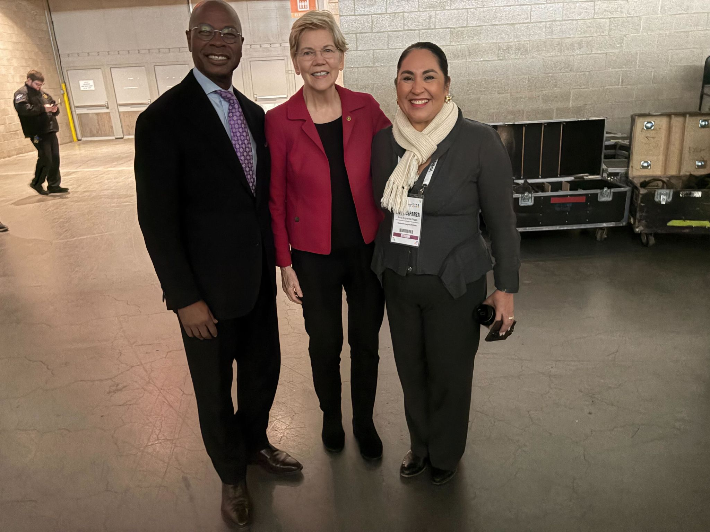
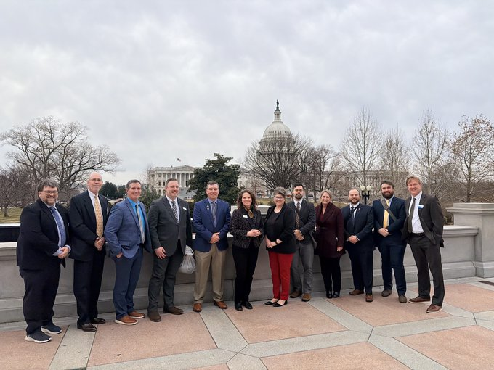
State of Play
Midterm Elections & Congressional Calendar
Federal Budget & Executive Actions
Priority Legislation in Congress
Notes:
.

Slide 55
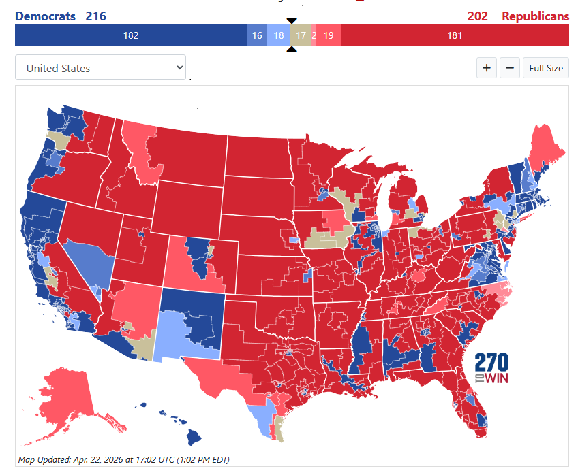
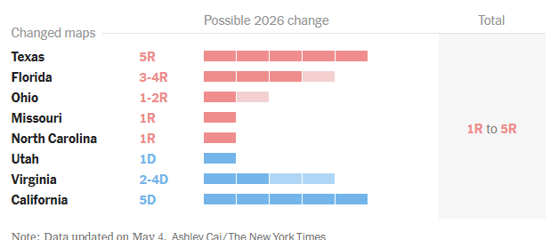
House Midterm Elections
Notes:
435 Congressional Districts
Current 218-212
18 seats are needed for a majority (when there are no vacancies)

Slide 56
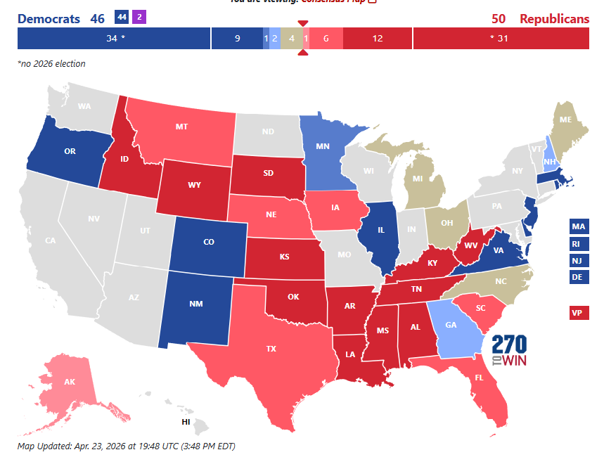
Senate Midterm Elections
Notes:
The U.S. Senate has 53 Republicans and 47 Democrats (including two independents).
There are 35 seats up in 2026 - including special elections in Florida and Ohio - of which 22 are held by Republicans.
Democrats can retake control with a net gain of four seats.

Slide 57

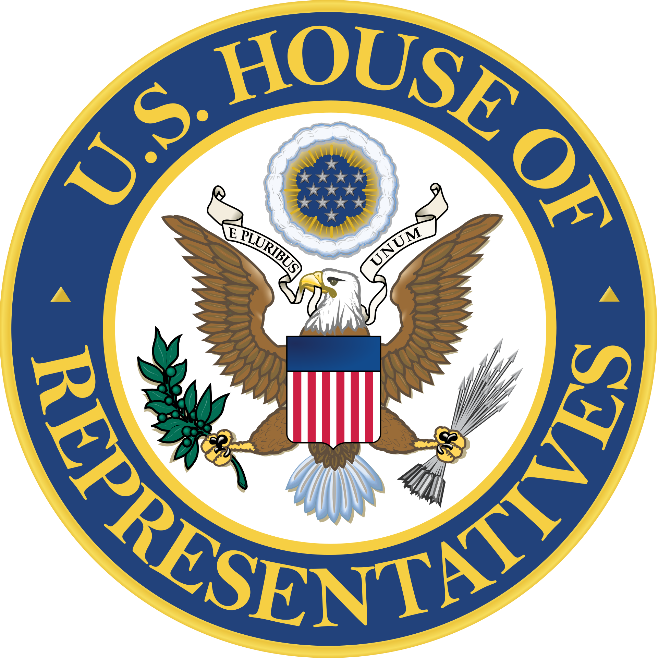
Congressional Calendar
59 legislative days before midterms
81 legislative days before start of 120th Congress
45 legislative days before midterms
65 legislative days before start of 120th Congress
Notes:
Senate
MIDTERMS - 6 more in May, 19 in June, 15 in July, 5 in August, 12 in September, 2 in October
120th - 8 days in November, 14 in December
House
MIDTERMS – 5 more in May, 14 in June, 10 in July, 1 in August, 14 in September, 1 in October
120th - 9 days in November, 11 in December

Slide 58
Fiscal Year 2027 Appropriations
Stage | Status | Notes
President’s Budget Released | ✔ Complete | FY27 budget published by OMB.
House Subcommittee Markups | ✔ In progress | Active schedules and amendment trackers posted.
House Full Committee Markups | ⏳ Ongoing | Some bills may advance soon; none completed for FY27 yet.
House Floor Votes | ❌ Not yet scheduled | No FY27 appropriations bills listed on the House floor calendar.
Senate Markups | ❌ Not yet underway | No FY27 Senate appropriations activity published.
Conference Negotiations | ❌ Not started | Requires passage of bills in both chambers.
Final Votes & Enactment | ❌ Months away | No FY27 bills have reached voting stage.

Slide 59


Federal Budget & Executive Actions
Executive Actions Tracker Federal Budget Tracker

Slide 60
Disaster Relief and FEMA Reform
FEMA Review Council draft report, initially expected for public review in December 2025, was extended to March 25 and then again to May 29, 2026
FEMA Act of 2025 (H.R. 4669)
Streamlines delivery of public assistance and reduces burdensome requirements
Improves flexibility in federal cost-share adjustments
Enhances mitigation support
Clearer appeal and communication processes for local applicants
Better staffing and surge capacity within FEMA
Notes:
DHS Shutdown
Now that most of DHS is funded again, there will be a considerable backlog for DHS staff to address as they work through not only the FY 2026 FEMA and State and Local Homeland Security grants, but also the FY 2025 grants from last year.
What it means for local governments: Delays in grant awards and reimbursements, slower federal technical assistance and coordination, and continued uncertainty for local budgeting and planning.
Longest government shutdown in U.S. history ended, but major DHS operational and grant backlogs remain.
Next FEMA Review Council meeting is on May 7
This meeting will be led by the Secretary of Homeland Security and the Secretary of War. The meeting will include: (1) remarks from Senior leadership, (2) remarks and updates from Council leadership, (3) a presentation of the draft final report from the Final Report Subcommittee, (4) a presentation of a summary of public comments made to the Council, (5) Council deliberations, and (6) a public vote on the draft final report.
FEMA Act – NLC support – House
Senate – waiting for FEMA Review Council report – expected by end of month (or could be delayed for 30-60 days)

Slide 61
National Flood Insurance Program
On February 3rd, the President signed legislation extending the National Flood Insurance Program (NFIP authorization until September 30, 2026
NFIP Retroactive Renewal and Reauthorization Act of 2025 (H.R. 5848)
Extends the National Flood Insurance Program through at least December 31, 2026, or for five years, aiming to prevent lapses during government shutdowns.
Key goals include limiting annual premium increases to 9%, implementing affordability vouchers, expanding mitigation, and reforming the Risk Rating 2.0 system.
National Flood Insurance Program Reauthorization and Reform Act of
2025 (NFIP-RE Act - H.R. 5484)
Provides a long-term, five-year authorization for the NFIP, aiming to stabilize the program through 2026.
It proposes to cap annual premium increases (around 9%), establish affordability vouchers, increase mitigation investments, and enhance risk rating transparency.
Notes:
Since the end of fiscal year 2017, there have been 35 short-term NFIP reauthorizations (extensions). Congress has relied on these temporary extensions, often attached to larger funding bills, to keep the program operational after its long-term authorization expired. The NFIP is currently authorized until September 30, 2026
Frequent Short-Term Fixes: These 35+ extensions reflect a pattern of temporary measures rather than a long-term reauthorization.
Lapses: Despite these extensions, the program has experienced several short-term lapses in authorization, including in January 2018, February 2018, March 2024, and late 2025.
Impact: These lapses and frequent extensions create uncertainty for homeowners and lenders, with potential to halt thousands of real estate transactions daily
The program’s authority to provide new flood insurance contracts and borrow funds from the Treasury is currently set to expire on September 30, 2026
NLC has endorsed the NFIP-RE Act, H.R. 5484. However, the Senate has yet to take action on legislation providing a long-term reauthorization.
Key Provisions of 2025 Reauthorization Proposals
Extension and Stability: Extends NFIP authority to sell and renew policies, aiming to avoid the recurring short-term extensions that cause, on average, over 1,300 property sales to be impacted daily.
Retroactive Renewal: Ensures that if the program lapses during a government shutdown, policyholders can renew without penalty once operations resume.
Affordability Controls: Proposes capping rate increases and creating means-tested vouchers for low- and middle-income policyholders.
Risk Rating 2.0 Reforms: Increases transparency for FEMA's risk-rating methodology and potentially offers third-party reviews.
Debt Management: Proposes freezing interest payments on the $20.5 billion+ NFIP debt to Treasury.
Status
As of late 2025 and early 2026, these bills are in the House, aimed at providing long-term certainty as the program faces potential expiration. A similar extension passed in early 2026 kept the program running through September 30, 2026.

Slide 62
Cybersecurity
Cyber Incident Reporting for Critical Infrastructure Act of 2022 (CIRCIA)
Requires Cybersecurity & Infrastructure Security Agency (CISA) within DHS to issue regulations requiring “covered entities” (including local governments) to report certain cyber incidents.
NLC filed comments in 2024 on proposed rules.
CISA announced it was postponing finalization to gather stakeholder feedback through listening sessions.
Listening sessions were cancelled due to lapse in DHS funding; new dates have not yet been announced.
Notes:
The proposed CIRCIA rule could have a major impact on the operations of local governments. Local governments will be required to determine if they qualify as a covered entity, understand the requirements for compliance, and develop the staff capacity to adequately collect the information required in a complete report, which is substantial. Because of this potentially sweeping impact, NLC offers several concerns and suggestions around the definitions of several terms within the rule.

Slide 63
Transportation
The Federal Aviation Administration (FAA) is ramping up the approvals for Beyond Visual Line of Sight (BVLOS) drone operations which is now expanding commercial uses at scale in the United States.
  Many local first responders use drones and have expanded BVLOS approvals
  These communities may now find a busier airspace in the lower altitude, which may increase risk of local operations both in the sky and for the public on the ground.
To counteract bad actors, the FAA has stood up a Drone Expedited and Targeted Enforcement Response (DETER) program to protect the safety and security of the U.S. airspace against unsafe operations.
  The program provides a path for law enforcement partners to notify the FAA of drone violations in real time, but local law enforcement should be aware of their limitations in enforcing.

Slide 64
Autonomous Vehicles
Since 2017, Congress has been debating federal autonomous vehicle (AV) policy that would allow for greater adoption of vehicles that do not conform with current Federal Motor Vehicle Safety Standards (FMVSS), such as not having a steering wheel.
  NLC has worked with state and local government partners as well as other allies to block AV legislation that would:
    1) increase liability for local governments due to AVs operating on their roads
    2) ensure safe operations on streets in their current condition
    3) protect the public
Safely Ensuring Lives Future Deployment and Research In Vehicle Evolution (SELF DRIVE) Act of 2026 (H.R. 7390)
Congress is once again considering a preemptive bill in the House Energy and Commerce Committee, which was forwarded to the Full Committee by a roll call vote of 12 yeas – 11 nays.
With expanded exemptions federally, as well as state-enabling legislation, AVs are creating operational issues and requiring city intervention by first responders and transportation staff.

Slide 65
PFAS
In 2024, EPA finalized a rule designating some PFAS chemicals as hazardous substances under CERCLA. In Sept. 2025, EPA called on Congress to provide statutory liability protection for municipal “passive receivers.”
PFAS Municipal Liability Protection (H.R. 1267)
NLC seeking a narrow exception from Congress so that municipal drinking water, wastewater and stormwater utilities and landfills are not held liable for contamination that they neither caused nor contributed to.
Notes:
EPA finalized a rule designating some PFAS chemicals as hazardous substances under CERCLA (aka the Superfund Law).
In Sept. 2025, EPA announced that it would keep that hazardous designation in place.
Additionally, Administrator Zeldin said, “EPA intends to do what we can based on our existing authority, but we will need new statutory language from Congress to fully address our concerns with passive receiver liability.”
Therefore,
NLC urges Congress to pass legislation that would provide legal and financial liability protection for local governments that did not cause or contribute to PFAS contamination in the community.
HR 1267 is a bipartisan bill that provide municipal liability protection for drinking water and wastewater systems.
Legislation has not been introduced in the Senate this Congress, but Sen. Capito, chair of the S. Environment and Public Works Committee, has said that PFAS liability protection for water utilities is a key priority for her.
NLC also support liability protection for other “passive receivers” such as landfills, as well as for municipal services that were federally mandated to use PFAS-containing firefighting foam, such as municipal airports and fire departments.
BACKGROUND – WHY IS CERCLA DESIGNATION PROBLEMATIC?
CERCLA designation imparts liability to entities involved in the generation, transport, arrangement, and disposal of PFOA or PFOS that then enters the environment. Liability under CERCLA is retroactive, joint and several, and strict, meaning that any one entity can be held liable for the full cost of cleaning up a contaminated site, regardless of when the contamination occurred or whether it was negligent. It opens up the door to third party lawsuits against local governments.

Slide 66
Q&A

