Slide 1

Fatigue — The
Hidden Risks
Friday, May 15th | 10:00am

Slide 2
Effects of Fatigue: Evidence to Date
Stephen James PhD
Elson S. Floyd College of Medicine

Slide 3
Vila
Tired Cops
2000
Vila, James & James
ONR
2009
James & Vila
RCMP
2015
James & James
Ottawa Police
2018
James & James
CDC NISOH
2019
James & James
NIJ Seattle
2022
Hesketh, Taylor, James & James Oscar Kilo
2020
Notes:
The formal investigation of police fatigue started in the mid 1990’s with Dr. Bryan Vila. Dr. Vila was an LA Sheriff's Office gang sergeant in the 1970s, who went on to be the first police chief in Micronesia. He also worked for the FBI before becoming an academic and leading police scholar. He became invested in the topic of fatigue due to his personal experience, when he was tired, he wasn’t the type of cop he wanted to be. His fuse was short and his tolerance for his community members low.
Dr. Vila became the Director of Crime Control at the National Institute for Justice where he started to invest in police fatigue research.
In 2006 Dr. Vila created a research lab at Washington State University to study the effects of fatigue on police and military performance. Drs. Lois and Stephen James joined that lab in 2007, and 2008 respectively.
Dr. Vila retired in 2015 leaving the Drs. James to carry on the research he started 20 years before.
The Drs. James now work across the US, Canada, and the UK conducting research and developing training with the goal of reducing risk and liability to police officers while improving their health and performance.

Slide 4

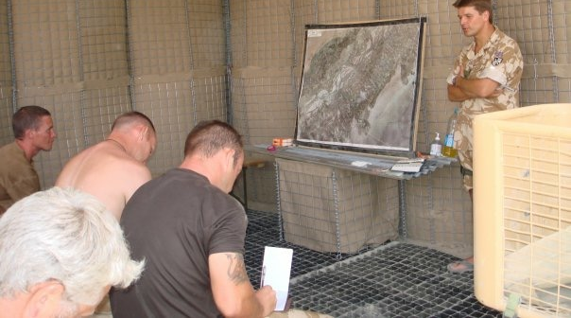
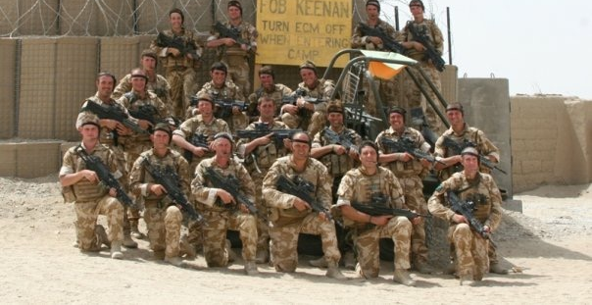


Slide 5
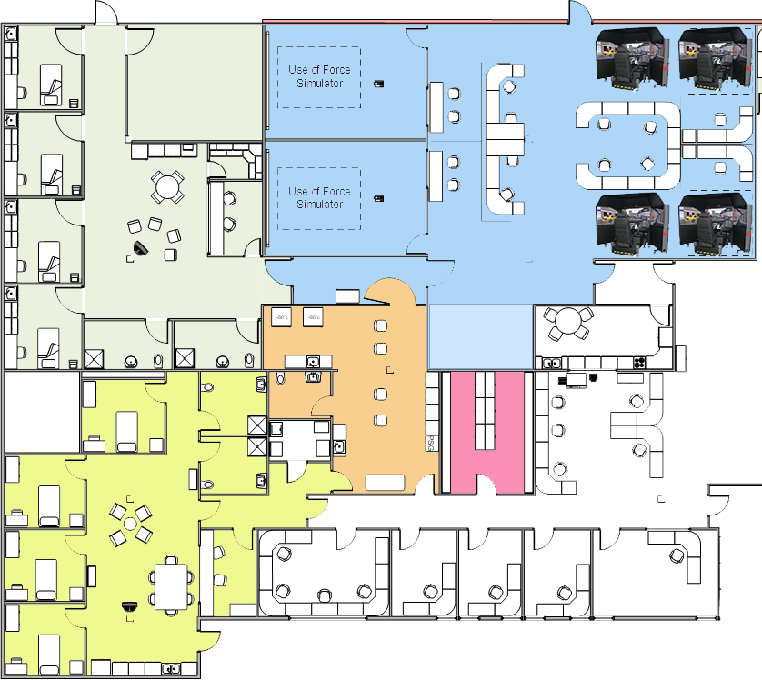

Slide 6
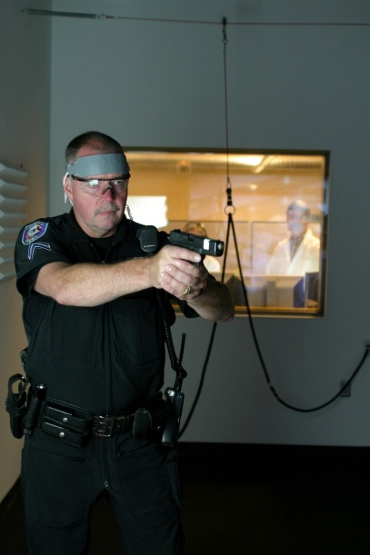
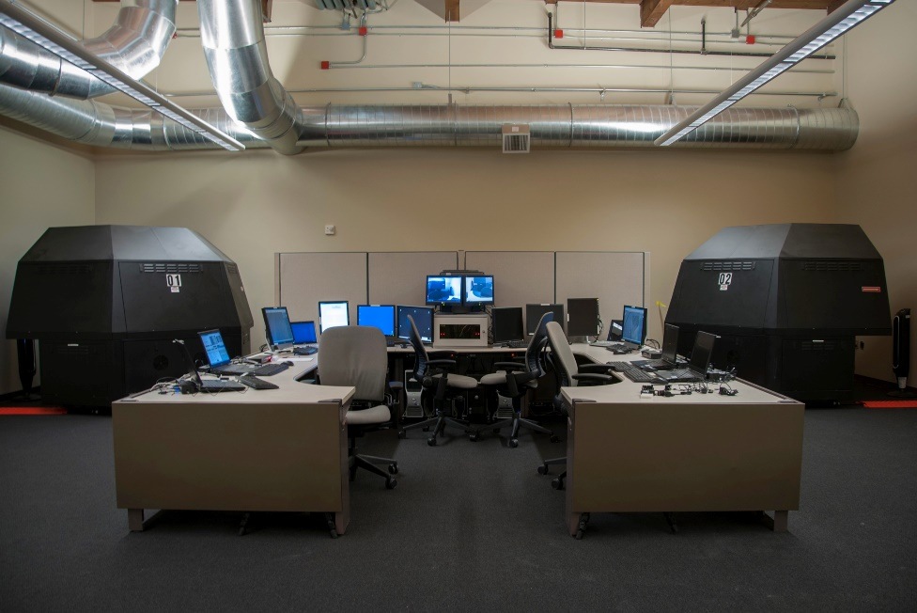
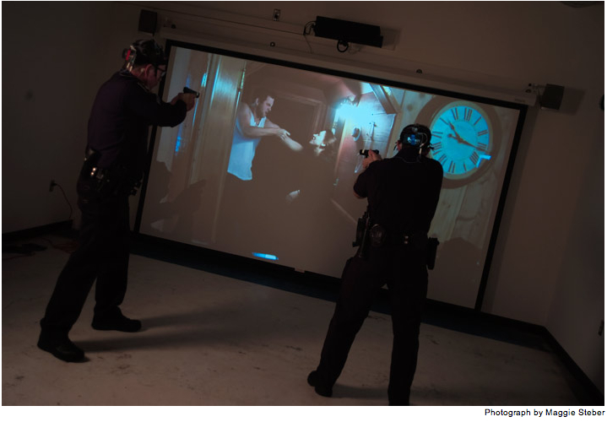
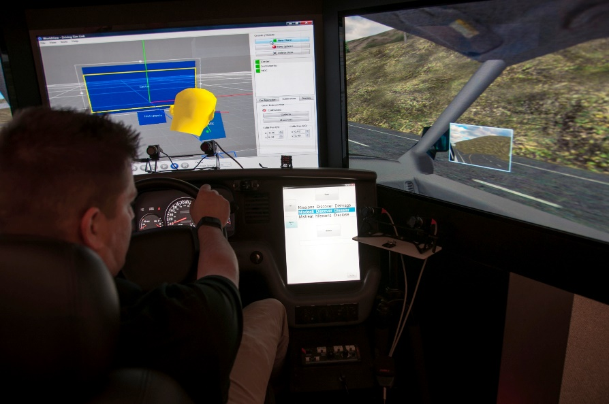
Simulated Hazardous Operational Tasks Lab

Slide 7
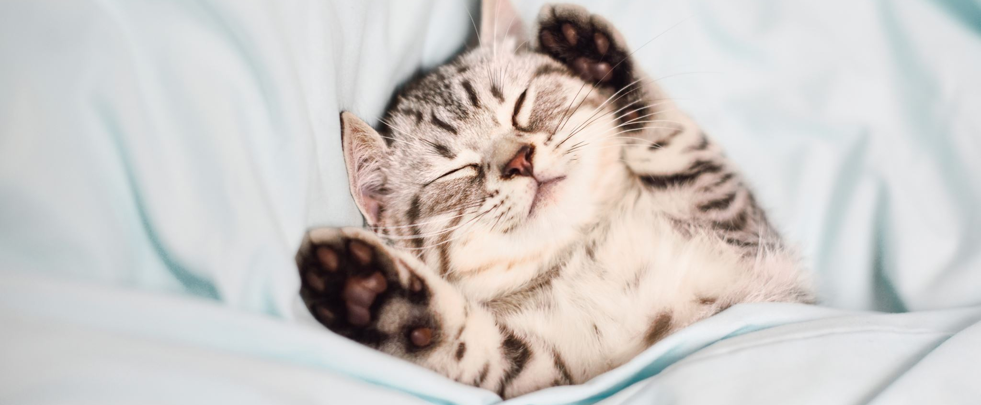
Are you happy with your sleep?

Slide 8
Procedure
Leadership
IA
Trust
Oversight
Law
Compstat
EIS
Education
Policy
Training
Public Satisfaction
Job Satisfaction
KPIs
Supervision
Mentoring
Hiring
Crime Rates

Slide 9
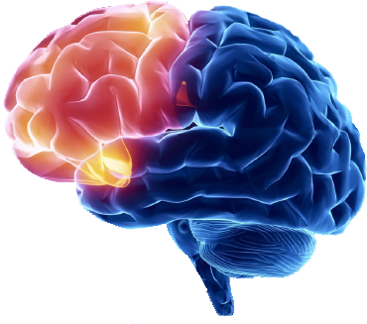
Problem solving
Motor planning
Judgment
Sexual Behavior
Planning
Personality
Anticipation
Limitation
Speaking
Organization
Self-monitoring
Attention
Emotional expression
Concentration
Inhibition of behavior
Mental flexibility
Awareness of abilities
Initiation
Notes:
Mental flexibility
Initiation

Slide 10
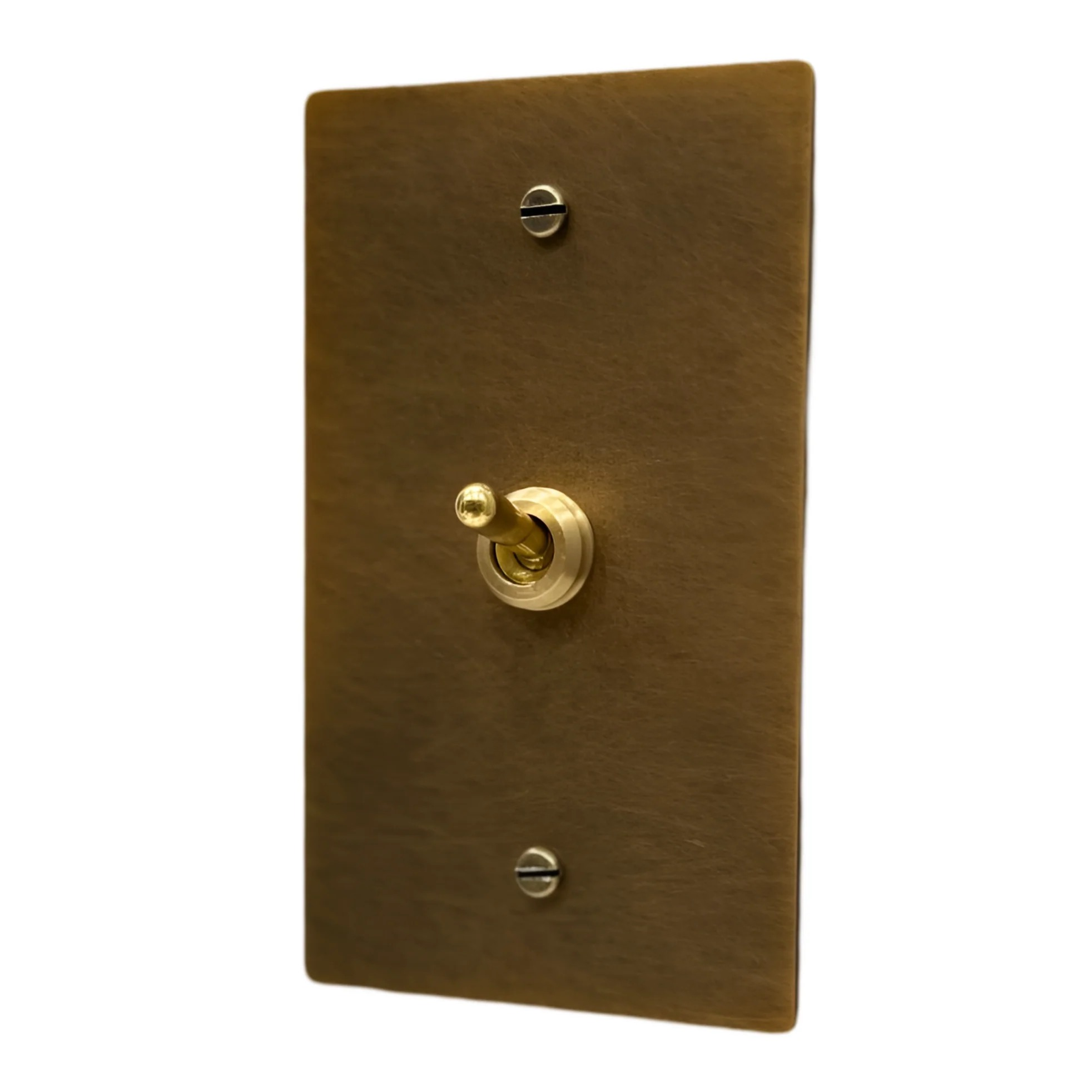

Slide 11
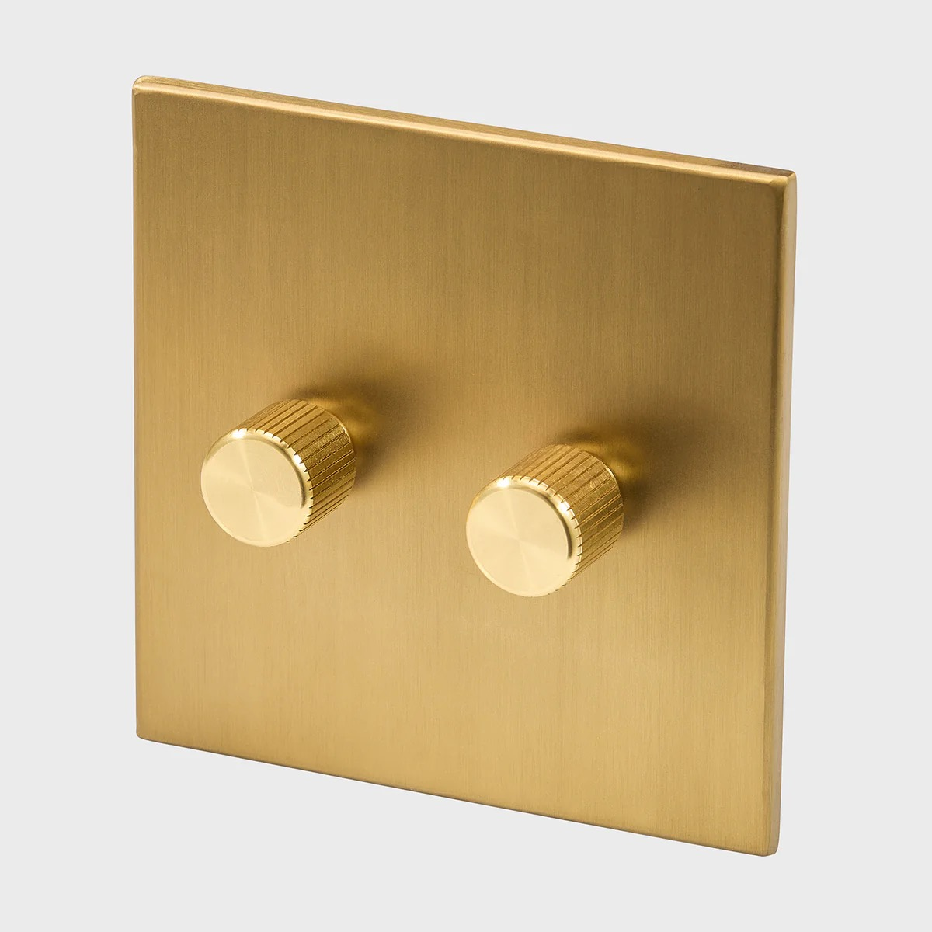

Slide 12

24 hours of wakefulness
17 – 19 hours of wakefulness
BAC = 0.05
BAC = 0.10

Slide 13
Effects of Fatigue on Skills Needed for Driving
Fatigue | 17-19 Hours Awake | 24 Hours Awake
Reaction Time Speed | ↓ 9% | ↓ 16%
Reaction Time Accuracy | ↓ 225% | ↓ 680%
Dual Task Speed | ↓ 10% | ↓ 20%
Hand Eye Coordination | ↓ 10% | ↓ 53%
Object Tracking | ↓ 7% | ↓ 57%
Vigilance Speed | ↓ 14% | ↓ 42%
Vigilance Accuracy | ↓ 14% | ↓ 40%
Vigilance False Alarms | ↑ 55% | ↑ 326%
Spatial Memory | ↓ 13% | ↓ 30%
Tiredness | ↑77% | ↑150%
Alcohol | 0.05 BAC | 0.10 BAC
Notes:
Studies have modelled the impact of fatigue on performance degradation and compared it to alcohol impairment. By looking at the comparative effects of fatigue and alcohol on alertness, cognition, hand-eye-coordination, and task speed accuracy, the impact on driving safety can be predicted. These studies found that being awake for between 17-19 hours resulted in fatigue impairment equivalent to a .05 blood alcohol content, approaching the legal limit. Being awake for 24 hours resulted in a fatigue impairment equivalent to a .10 blood alcohol content, over the legal limit for driving.
Being awake for 24 hours and then driving is not unusual for shift workers, especially if they pick up extra shifts or overtime hours. While fatigue and alcohol are both detrimental for driving performance there are two other things to consider. The first is that, unlike drunk driving, the impact of fatigue on driving performance is not linear or predictable. This means that while each unit of alcohol impairs performance by a particular amount, fatigue is not as predictable in how it will affect you. When driving while drowsy you’ll be fine, and you’ll be fine, and then you’ll be asleep. You’ll come out of your microsleep and if nothing changed in your environment (for example no bend in the road or stop sign) you’ll have gotten away with it. So unfortunately it’s self reinforcing. We convince ourselves that it’s not a big deal, and just push through to get home. But what if you have one of those microsleeps when there is a bend in the road, or a stop sign, or a child runs across the street? Nothing is worth the potential impact of drowsy driving, so if you feel yourself nodding off when you are driving, pull over, lock your car, and sleep for even 10 minutes.
References:
Williamson, A. M., & Feyer, A. M. (2000). Moderate sleep deprivation produces impairments in cognitive and motor performance equivalent to legally prescribed levels of alcohol intoxication. Occupational and environmental medicine, 57(10), 649-655.

Slide 14


Slide 15
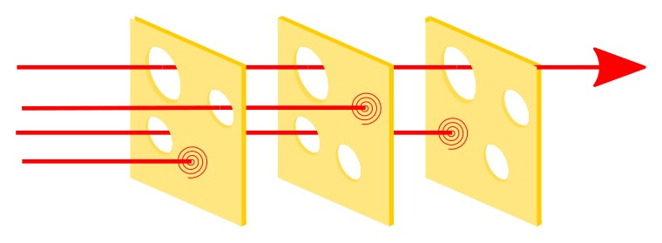
Training
Policy
Law

Slide 17
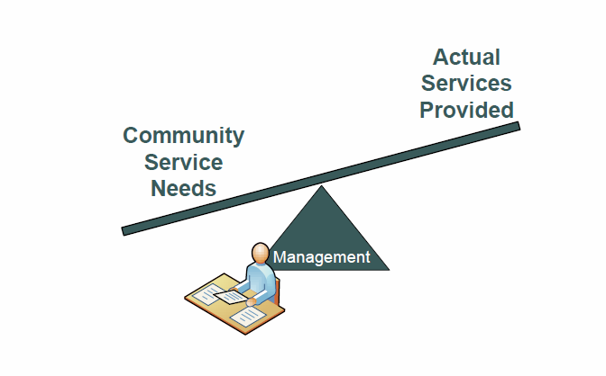


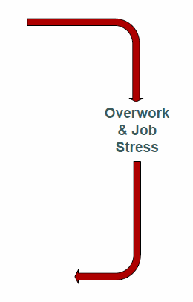
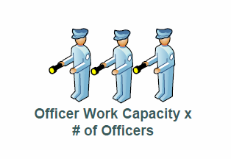
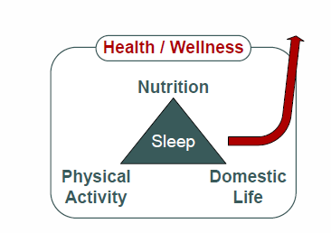
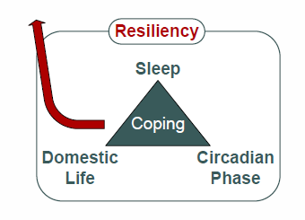
Managing Police Fatigue

Slide 18
Driving

Slide 19
Driving Safety - Drowsy Driving
of general public have fallen asleep while driving
within the past month
of police believe drowsy driving is as dangerous as drunk driving
of police have fallen asleep while driving
1 or 2 times per month
Wheaton et al., 2014; AAA Foundation, 2004; Rajaratnam et al., 2011
Notes:
Being tired can lead to serious safety concerns, for example impaired driving. 85% of officers report drowsy driving despite almost all believing it is as dangerous as drunk driving. Even more alarming, half of officers report having fallen asleep at the wheel.
Over the last 20 years, motor vehicle collisions have been the leading cause of ON DUTY death in law enforcement. Some years, felonious assault exceeds collisions, but on average, it is collisions.
Drowsy driving has been a casual factor in many police involved collisions.
References:
Wheaton, AG., Shults, RA., Chapman, DP., Ford, ES., Croft, JB. (2014) Drowsy Driving and Risk Behaviors—10 States and Puerto Rico, 2011-2012. CDC Morbidity and Mortality Weekly Report (MMWR); 63:26:557-562.
AAA Foundation for Traffic Safety. 2004. Survey of US and Canadian police officers about the public’s drowsy driving behavior; www.aaafoundation.org/pdf/PoliceDD.pdf.
Rajaratnam SM, Barger LK, Lockley SW, Shea SA, Wang W, Landrigan CP, O'Brien CS, Qadri S, Sullivan JP, Cade BE, Epstein LJ, White DP, Czeisler CA; (2011) Harvard Work Hours, Health and Safety Group. Sleep disorders, health, and safety in police officers. JAMA. 306(23):2567-78.

Slide 20
Officer-Involved Vehicle Collisions in California
80.7% clear weather conditions
89.3% dry road surface
59.0% during daylight hours
28.9% under streetlights
74.9% non-intersections
98.0% had not been drinking
California Highway Patrol Form 555
2000 – 2009
(N=35,840)
75.6% ruled officer’s fault
Wolfe, S. E., Rojek, J., Alpert, G., Tiesman, H. M., & James, S. M. (2015). Characteristics of officer-involved vehicle collisions in California. Policing: An International Journal, 38(3), 458-477
Notes:
A study from California looked a decade of data on officer-involved vehicle collisions, every collision involving a police officer in the state for a 10-year period, to try and understand some of the commonalities or causal factors.
You can see from this list that on average the driving conditions were good – clear weather conditions, sufficient lighting, adequate road surfaces, and that situational factors such as intersections were not a causal factor. Neither thankfully was drunk driving.
However, in 76% of all officer-involved vehicle collisions the crash was ruled the officers’ fault by California Highway Patrol. Although the “cause of collision” per reporting was typically listed as something like “drove off the road” or “hit a lamp post,” fatigue was speculated to be the cause of the cause in many instances.
References:
Wolfe, S. E., Rojek, J., Alpert, G., Tiesman, H. M., & James, S. M. (2015). Characteristics of officer-involved vehicle collisions in California. Policing: An International Journal, 38(3), 458-477

Slide 21
Drowsy Driving Risk Factors
> one job
working nights
x 2
x 14
driving 1 to 2 hours
awake 15 to 19 hours
x 7
x 10
< 4 hours of sleep
awake 20 or more hours
x 20
x 63
Epworth sleepiness scale score > 15
x 18
Stutts, J.C., et al. (2003) Driver risk factors for sleep-related crashes, Accident Analysis & Prevention 35(3) 321-331
Notes:
Factors that increase the risks of drowsy driving are working more than one job (including moonlighting).
Longer commutes predict drowsy driving, with commutes over one hour being problematic.
Getting less than 4 hours of sleep and then driving increases drowsy driving risks by 20 times!
Being routinely sleepy during waking hours has a similar effect (with an Epworth score of over 15).
These factors are most pronounced for night shift workers, which is a risk factor in and of itself for drowsy driving.
Being awake for over 15 hours makes you 10 times, and being awake more than 20 hours makes you 63 times more at risk from drowsy driving.
References:
Stutts, J.C., et al. (2003) Driver risk factors for sleep-related crashes, Accident Analysis & Prevention 35(3) 321-331

Slide 22
Driving
Use of Force

Slide 23

Use of Force Performance
Compared to day shift officers, those on night shifts were:
Quicker to fire their weapons
(F=9.46 df=1,825, p=.002)
Had faster reaction times to first hit
(F=8.91 df=1,814, p=.003)
Fired more shots
(F=712.79 df=1,8254, p<.000)
Similar significant findings were found for officers during the fatigued condition
N = 80, patrol officers, 5 years +, 931 scenarios
Notes:
The impact of fatigue extends beyond driving safety. Washington State University (WSU) conducted a series of lab studies using force option simulation with a sample of 80 patrol officers with at least 5 years of patrol experience, all from Spokane Police Department.
These studies showed that night shift officers who are fatigued tended to be quicker to fire their weapons and fire more shots than day shift or well rested officers. From a marksmanship perspective this might not seem like a problem, but fatigue also makes officers more prone to error, for example accidently shooting an unarmed suspect.
The researchers speculate that fatigue reduces the threshold for moralistic decision making. In other words, officers who are tired require less evidence that shooting is the appropriate course of action than well rested officers. Fatigue also impairs threat perception, or the ability to distinguish between actual threat (for example a suspect pulling out a weapon) and perceived threat (for example a suspect pulling out a wallet that is mistaken for a weapon).

Slide 24
Driving
Use of Force
Reports & Testimony

Slide 25

Effects of Fatigue on Memory
Fatigue impairs memory sourcing during cognitive testing
(e.g. could remember what was said, but not who said it)
Implications for report writing
Notes:
Another area in which fatigue resulted in performance impairment for officers in the WSU lab study was memory. There is a test called the “item and source memory test” where officers listen to a series of words, said in either a male or a female voice. Although fatigue does impair the item (what was said), the bigger impact is on the source (who said it). Officers are likely to forget who said what when they are particularly tired.
This has implications for report writing, and also for court testimony. There is often a belief that if an officer’s recall of an incident is inaccurate then deception must be the cause. Research shows however that this is not necessarily the case – fatigue can cause officers to forget or mis-remember details of an encounter, even a critical encounter.

Slide 26
Driving
Use of Force
Reports & Testimony
Citizen Complaints

Slide 27
Night Shift and Citizen Complaints
Riedy, Dawson, & Vila (2019) U.S. police rosters: Fatigue and public complaints, Sleep, Volume 42, Issue 3
Notes:
Data from Dr. Bryan Vila’s “Tired Cops” study, which essentially launched the study of police fatigue, show that officers who work night shifts, who work more overtime hours, and who receive less sleep are more likely to receive citizen complaints than well rested officers who are not overworked. In the chart on the left, the shift types are as follows:
O = Shifts Other than Night
N = Night Shift
CN = Daytime Court followed by Night Shift
NN = Two Consecutive Nights
NCN = Night Shift, followed by Daytime Court, followed by Night Shift
The average peak FAID score refers to a mathematical score predicting risk from work hours and fatigue. The "danger zone" cuttoff is 80, so you can see that working two consecutive nights, or working a night shift followed by daytime court appearance followed by another night shift is particularly problematic. The chart on the right shows the increased risk of getting a citizen complaint based on the FAID score – so for example, with a FAID score of 80, an individual is 5 times more likely to get a complaint than an individual with a FAID score of zero.
Reference:
Riedy, Dawson, & Vila (2019) U.S. police rosters: Fatigue and public complaints, Sleep, Volume 42, Issue 3

Slide 28
Driving
Use of Force
Reports & Testimony
Citizen Complaints
Investigations

Slide 29
Risks Associated with Type of Shift
Notes:
Studies looking at the risks of fatigue on shift worker safety and performance have found that not all shift workers are affected equally. The chart on the right shows that day shift workers are less at risk for making a mistake than evening shift workers, who in turn are less affected than night shift workers.
This should make sense when you think about sleep and fatigue, because typically day shift workers get more sleep and are less fatigued than evening or night shift workers. Even if night shift workers get sufficient sleep, they have the additional challenge of sleeping at a time when it isn’t natural for humans to sleep (during the day), which can negatively affect sleep quality, or how good the sleep they are getting actually is.
In the chart on the left, performance efficiency scores are inversely related to risk of making a mistake. You can see that during the day, efficiency scores are typically above "0" suggesting that most people are at higher efficiency (and lower risk of error) during the day. At night however, performance efficiency is below 0, suggesting lower efficiency and greater risk of mistake. The most dangerous time is about 3am. You'll also notice a dip about 2pm during the day.

Slide 30
Risk Associated with Length of Shift and Consecutive Shifts
Take home:
It appears that 4 consecutive 10-hour shifts are
the best from a risk management perspective
Notes:
Safety and performance concerns aren’t just limited to the different types of shift (for example day vs. night). Risk of making a mistake also adds up over consecutive shifts. You are more at risk for accident or injury on your second shift, then third shift, then fourth shift etc. The fourth shift especially, you are about 35% more likely to make a mistake or be in an accident that you are on your first shift.
Another important consideration for fatigue risk is shift length. After about 8 hours the risks start to increase. At hour 10 you’re about 12% more likely to make a mistake or be in an accident compared to hour 8. At hour 12 your risk is increased from hour 8 by about 27%.
Does this mean that all shifts should be 8 hours? Not necessarily, because remember that risks start to increase with consecutive shifts. So, the 5th 8 hour shift could be as problematic as the 4th 10 hour shift. It’s for this reason that departments often favor a 10-hour shift length, but it’s important to keep an eye on overtime, because after 10 hours on shift (and especially after 12 hours on shift) the risks start to increase alarmingly.

Slide 31
Liability - Predicted Performance
Hours on Shift
Notes:
This chart come from a study of nurses working 12 hour day and 12 hour night shifts (either 7am to 7pm or 7pm to 7am). Although the study is with nurses, it's very relevant here. The score on the left (the "SAFTE" score) is another measure of predicted altertness, and the higher the better. Less than 80 is the equivalent of a 0.05% BAC. Less than 70 is the equivalent of a 0.08% BAC.
The green bars represent day shift workers in the study and the red bars represent night shift workers. In this case three consecutive 12 hour shifts were worked.
You can see that day shift workers largely retained their performance level, while night shift workers got progressively worse, consistently getting into the 0.05% BAC equivalent range after about 8 hours, and on second and third night shifts getting into the 0.08% BAC equivalent range (which is high risk for accident, injury or error) after about 10 hours on duty.

Slide 32
Sleep & Athletic Performance
Success Stories
Recovery
Notes:
Another professional group that takes sleep and fatigue management very seriously is athletics. Dr. Lois and Stephen James have worked with multiple different athletic teams across multiple different sports on jet lag management, fatigue monitoring, sleep hygiene education, and fatigue countermeasures.

Slide 33




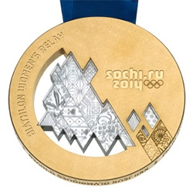
Success Stories
2014 Winter Olympics
Notes:
Another professional group that takes sleep and fatigue management very seriously is athletics.
Drs. Lois and Stephen James have worked with multiple different athletic teams across multiple different sports on jet lag management, fatigue monitoring, sleep hygiene education, and fatigue countermeasures.
To date they’ve worked with four teams who’ve won Olympic gold medals, as well as teams excelling at National and collegiate levels.
Focusing on fatigue management allows you to access your full potential.

Slide 34
Sleep Recovery in Athletes
Sleep extension can positively affect:
reaction times,
mood,
sprint times,
tennis serve accuracy,
swim turns,
kick stroke efficiency, and
increased free throw and 3-point accuracy
Banking sleep (sleep extension prior to night of intentional sleep deprivation before sporting event) is a new concept that may also improve performance
Vitale, et al (2019) Sleep Hygiene for Optimizing Recovery in Athletes: Review and Recommendations, Int J Sports Med 2019; 40(08): 535-543
Notes:
The negative effects of sleep deprivation cannot be overstated to athletes. To battle sleep deprivation, athletes may seek supplements with potentially serious side effects; improving sleep quality however is simple and effective, benefiting not only athlete health but also athletic performance.
The benefits of sleep and fatigue reduction for athletes have clear implications for policing as well, mainly improved reaction times, performance, and mood.
Sleep extension is the concept of extending your sleep post exertion – for example if you have a period of extended work hours, try to get as much recovery sleep as possible.
Another concept that is becoming popular in athletics that has implications for policing is “banking sleep” or the idea of sleep extension prior to a known period of performance (or sleep restriction such as night shifts). This means getting as much sleep as possible before going on shift in anticipation of fatigue prevention.

Slide 35
Sleep & Health
Mental Health
Cardiovascular Health
Metabolic Health
Cancer Risks

Slide 36

Notes:
Pillars of health include exercise, diet and sleep. Arguably sleep is the most critical, because regardless of how well you eat and work out, if you don’t sleep enough you will not receive the benefits of the others (such as weight loss, strength building, or disease risk reduction).

Slide 37
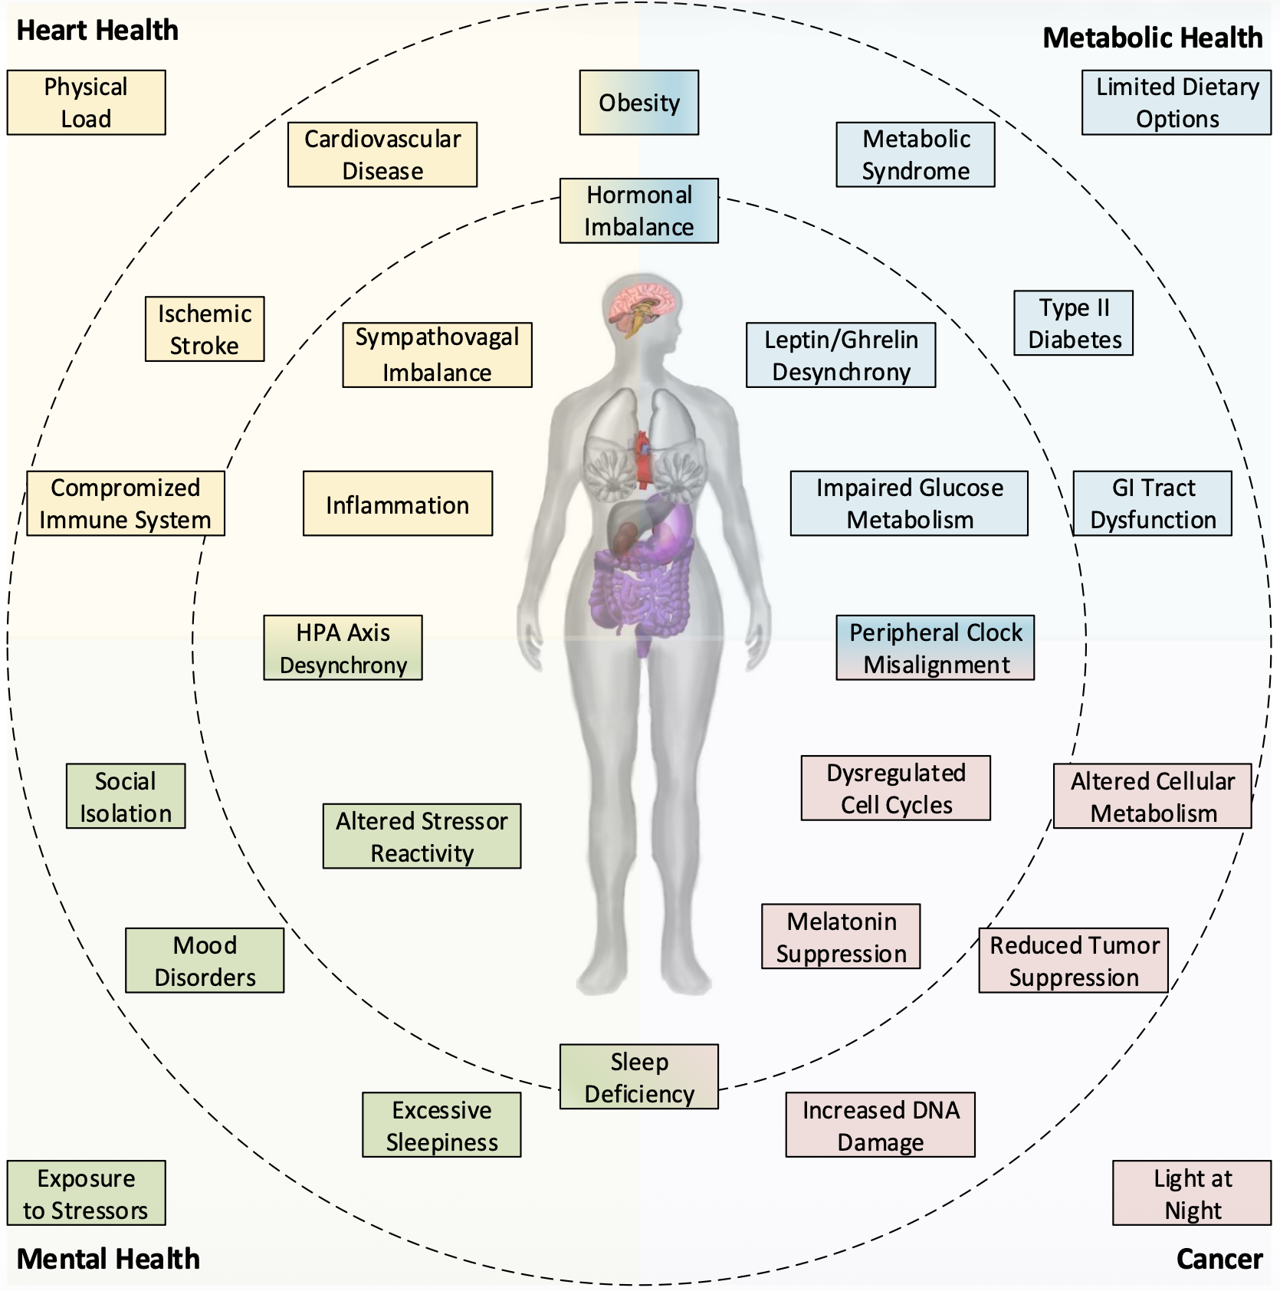
Notes:
The mechanisms by which shiftwork and sleep restriction lead to increased risk of disease are complex, but to keep with our previous discussion of the autonomic nervous system lets focus on the bottom left quadrant of this diagram.
In the inner circle you see the actual body mechanisms that get disrupted, in this case HPA axis desynchrony and altered stressor reactivity, which essentially means we start to experience a sympathetic / fight or flight response with little or no actual threat. This can lead to social isolation as either we withdraw, or others withdraw from us, mood disorders such as depression, anxiety, or PTSD, and excessive sleepiness due to the sleep restriction associated with hypervigilance. These are all depicted in the middle circle.
Outside the circles then are the external factors that contribute to the problem, in the case of policing exposure to stressors, operational such as interaction with victims, organizational such as lack of supervisory support, or shift work related such as lack of adequate sleep. All of these contribute to risk of mental illness in the long term.
Reference:
James, S. M., Honn, K. A., Gaddameedhi, S., & Van Dongen, H. P. (2017). Shift work: disrupted circadian rhythms and sleep—implications for health and well-being. Current sleep medicine reports, 3, 104-112.

Slide 38
Fatigue Training Can Promote Mental Health
(Data from RCMP Fatigue Training Study)
Notes:
Fatigue management training, such as you are receiving right now, can have a significant impact on your health and wellness! A study conducted with the Royal Canadian Mounted Police found that training on sleep hygiene, strategic napping, and fatigue countermeasures improved the quantity and quality of sleep for its members.
Satisfaction with sleep increased, as did motivation to improve sleep. Symptoms of insomnia decreased, as did fatigue. The actual amount of sleep officers received increased by 18 minutes per night during the work week, and 25 minutes per night during time off.
Members reported a decrease in headaches and in neck, back, or spine pain after the training. They also reported increased satisfaction with general health, and increased their frequency of getting exercise.
Symptoms of depression, anxiety and PTSD were reduced following training. Members reported feeling less tired, and had less difficulty controlling their temper, which had follow on impacts for police-community relationships.
Reference:
James, L., Samuels, C. H., & Vincent, F. (2018). Evaluating the effectiveness of fatigue management training to improve police sleep health and wellness. Journal of occupational and environmental medicine, 60(1), 77-82.

Slide 39
Mental Health
Effects on Domestic Life
Fatigue reduces domestic quality of life:
Increased arguments
Decreased affection
Increased strain & dysfunction
Notes:
Fatigue has a detrimental effect on domestic life and general quality of life. This includes increased arguments, decreased affection, increased dysfunction, increased risk of divorce, and decreased sex life.

Slide 40
Break Out

Slide 41
From Risk to Resilience: Practical Strategies to Address Fatigue in Public Safety Organizations
Friday, May 15th | 11:15am

Slide 42
Mitigating the Effects of Fatigue: Evidence to Date
Stephen James PhD
Elson S. Floyd College of Medicine

Slide 43
Liability - Predicted Performance
Predictable is preventable
Notes:
Gordan Graham is the co-founder of LEXIPOL, the largest risk management firm utilized by policing. His motto – “predictable is preventable”. It’s important to know the risks, both at the individual level and for the agency, to prevent mistakes.
If you do a self-check and recognize you’re too fatigued to perform safely, you need to notify your supervisor.
Supervisors, you need to be mindful of your officers and their fatigue and modify their work tasks accordingly to keep them safe (not to mention the community).
For example, if you have an extremely fatigued officer, pair them up with another officer for that shift so the fatigued officer doesn’t have to drive.
Agencies, consider putting into place a fatigue management policy that modifies work tasks according to fatigue level.

Slide 44
Liability - Predicted Performance
Increase Supervision
Emergency Only
STOP
FATIGUE
Self-Check
Increase Supervision
Emergency Only
Good to Go
Self-Check
Increase Supervision
LIABILITY
Notes:
A good rule of thumb is that as fatigue increases, and the job task being performed has increased liability by nature (for example dealing with a volatile public), increased measures need to be taken to self monitor, increase supervision, or cease action.
So, if an officer is well rested and responding to a low liability risk encounter, they are good to go. If either fatigue or encounter liability risk increases, self monitoring or increased supervision will be necessary.
If both fatigue and encounter risk of liability are high, then officers should only be working in emergencies (for example responding to riots). At a certain point, if officer fatigue and encounter liability risk are extreme, then actions need to be ceased for public and officer safety.
It’s important to have the bravery to tell your supervisor if you believe you are at risk from lack of sleep and fatigue. This can be a difficult thing to do, and leading the way in this is the profession of aviation, who takes fatigue risks very seriously.

Slide 45
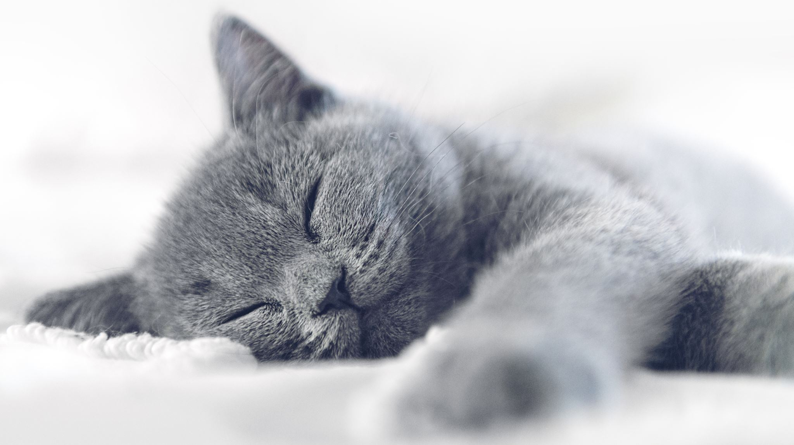
The Science of Sleep
Sleep Cycles
Circadian Rhythms
The Two Process Model
Sleep Dept

Slide 46
Phases of Sleep
Alpha (falling asleep)
Theta (lightly asleep)
REM (dream sleep)
Delta (phase 3 and 4: deeply asleep)
Sleep cycle ~ 100 minutes
Typically takes about 20-30 minutes to reach Delta
Amount of time spent in REM increases as the night goes on and need for deep sleep decreases
Notes:
The structure of sleep is split into distinct phases. The first phase is alpha, which is really the stage of falling asleep. If someone were to snap their fingers while you were in this phase, you would immediately wake, and likely be unaware that you were even sleeping. The next phase of sleep is theta, which is light sleep. We usually are in theta for about 20 to 30 minutes, before moving to the next phase. If we awake from theta, we are not typically groggy.
The third and forth phases of sleep are delta, or deep sleep, sometimes called slow wave sleep. During delta we are deeply asleep, and if we are awoken from this phase we experience sleep inertia, which is grogginess and disorientation. From delta we transition into Rapid Eye Movement or “REM” sleep, sometimes called dream sleep, because this is the phase of sleep where we dream. During REM we are typically paralyzed to prevent us from acting out our dreams, except our eyes, which flit back and forth.
The disruption of this paralysis can occur in sleep walkers for example. Another disruption is when people awaken from a dream and the paralysis takes a few seconds to wear off, which can be extremely alarming if you aren’t aware of what’s going on. From REM sleep we transition up into alpha again (sometimes actually waking up and sometimes not), and so the cycles continue throughout the night.
A full sleep cycle takes about 100 minutes, and as the night goes on and our need for deep restorative sleep is met we start to spend more and more time in REM sleep and less time in Delta. As REM sleep is much easier to wake from that Delta, that explains why it is common for us to experience more nighttime awakenings in the latter part of our sleep period.

Slide 47
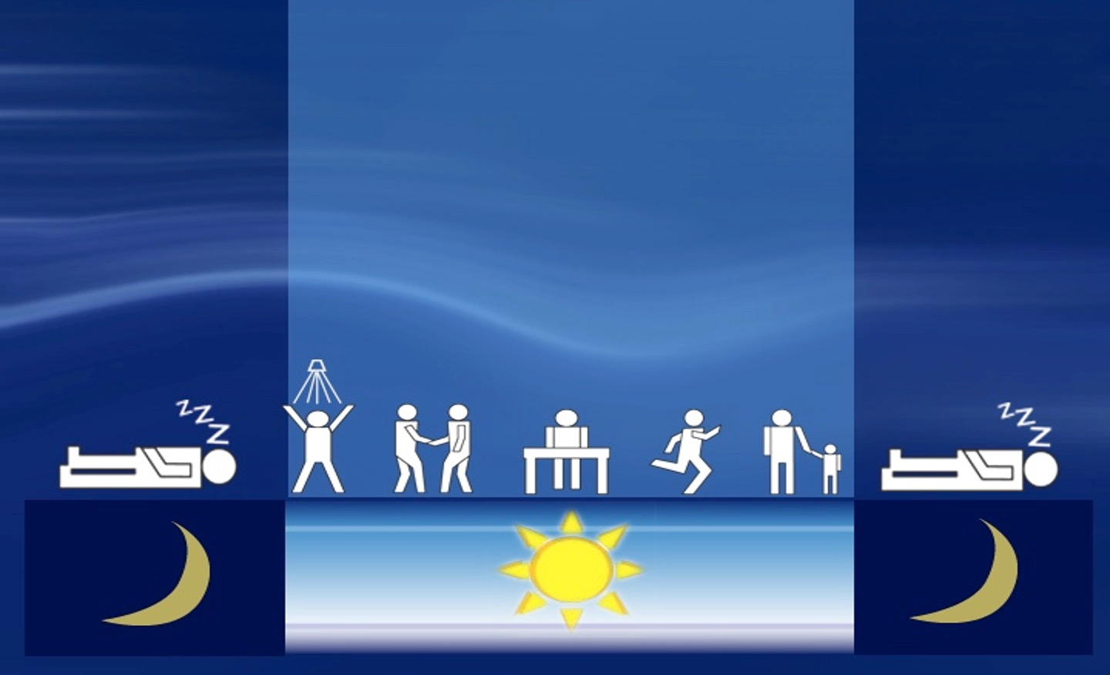
Circadian Rhythms
Body Temperature
Growth Hormone
Notes:
Circadian rhythms drive us to sleep at night and be awake during the day. We are biologically designed to be up with the sun, our body temperature is higher during the day, and our growth hormone is higher at night.

Slide 48

Alertness Highs and Lows
Alert
Drowsy
Midnight
Noon
Midnight
Notes:
Our circadian rhythms result in predictable highs and lows in alertness. Our alertness increases as the morning goes on to a high about 10-11am, then it dips in the early afternoon before rising again in the evening (6pm or so), then dropping to an ultimate low around 3am.

Slide 49
The Two Process Model – Day Shift
Notes:
One model stands above the others in its ability to explain the timing, process, and structure of sleep, and that is the two process model of sleep. This model states that our sleep and wake cycle is dominated by two things.
The first is sleep homeostasis, which is the drive to sleep or sleep pressure that builds over every hour awake. This drive is only satiated by deep or delta sleep, which alleviates the pressure and returns us to baseline or equilibrium. Sleep pressure is alleviated at about a one to two ratio, in other words one hour of sleep is needed for every two hours awake. This explains why most of us are designed to sleep for 8 hours and be awake for 16 hours throughout a 24 hour period.
The second is circadian rhythm, which is our biological clock, synchronized with the sun, and explains the timing of our sleep. We are biologically designed to sleep during the night and be awake during the day.

Slide 50
The Two Process Model – Night Shift
Notes:
The joint functioning of these two processes (sleep homeostasis and circadian rhythms) explains why night shift workers sometimes get off shift, but despite extreme sleep pressure find it hard to fall asleep in the morning because their sleep homeostasis or drive for sleep is being interrupted by their circadian rhythm (their bodies telling them that it is morning so time to be awake).

Slide 51
Sleep Potential Based on Time to Bed
Duration in Hours
Smiley, 1998
Notes:
Illustrated here are the average sleep times that are achievable based on when you getting to sleep – if you are going to bed between 7am and 11am for instance it is difficult to get more than four uninterrupted hours.

Slide 52
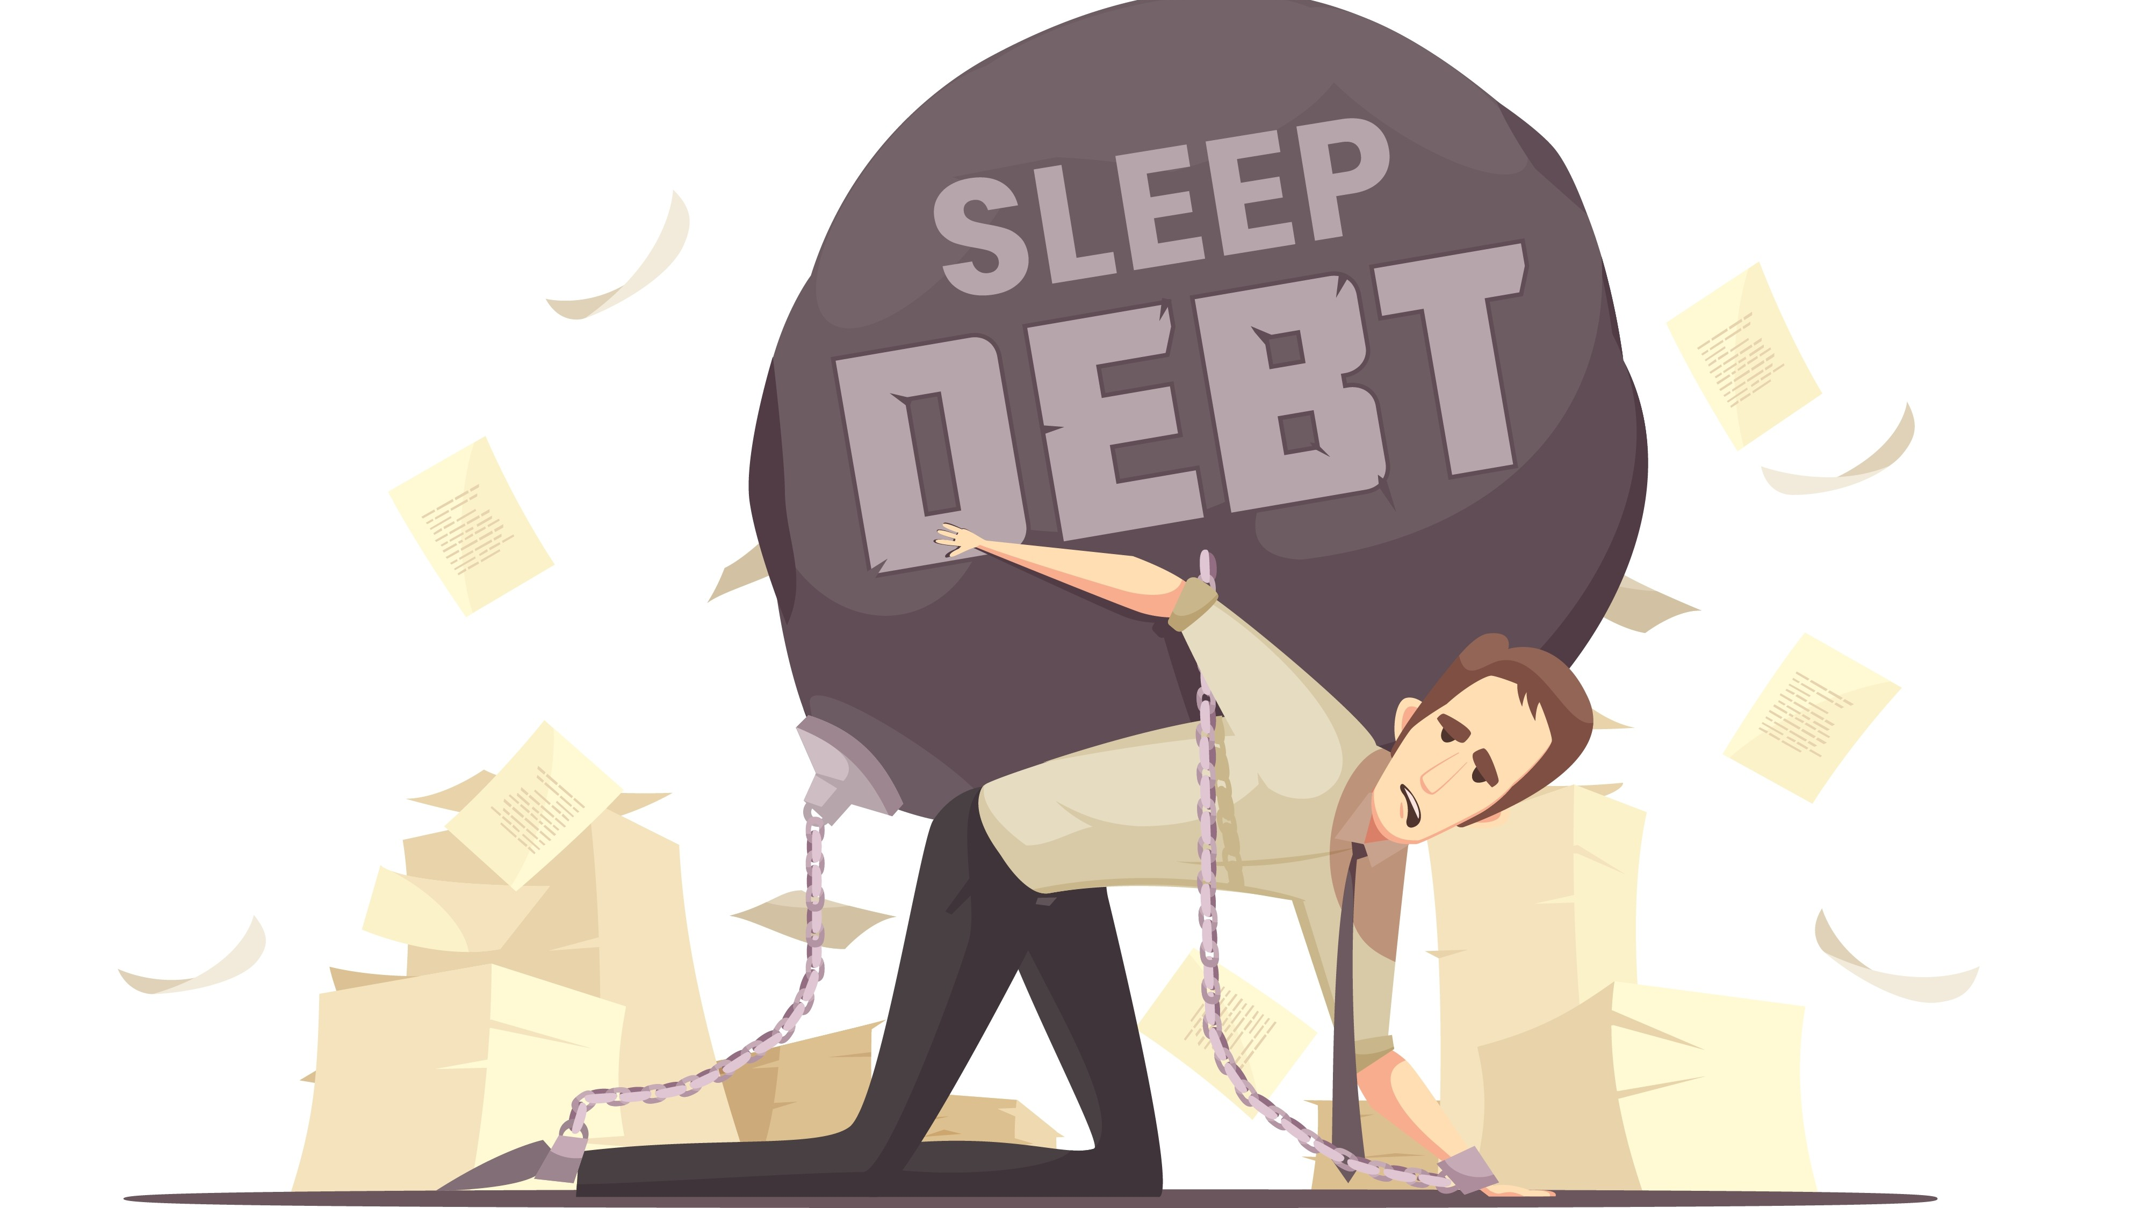
Notes:
It’s important to monitor sleep dept and pay it back when possible. Sleep dept is the concept that if you do not get enough sleep one night, the next night you are going to owe it back. You do not owe it back exactly. In other words, if you typically sleep for 8 hours per night, one night you just sleep for 4 hours, the following night you don’t have to sleep for 12 hours. Try to pay it back by half, so in that example, try to sleep for as close to 10 hours as possible to return to equilibrium.
If you have a series of nights where you are getting insufficient sleep, it’s important to monitor and pay it back when you have a series of days off or the ability to sleep in. If you don’t, if you ignore sleep dept, you might not feel its effects, but you are increasing your risk of long term disease and reducing your life span. It is critically important not to ignore these risks. Furthermore, you are increasing your immediate risks of accident, injury, or error.

Slide 53
Do the math…
7 hours
night before
+
6 hours
last night
=
safe
13 hours

Slide 54
Baseline
Sleep Restriction
Recovery
Belenky et al. 2003

Slide 55

Sleep Hygiene
Environment
Light & Light Therapy
Alcohol/Nicotine

Slide 56
Environment
Dark
Light proof blinds or curtains
Below 100 lux
Mask?
Consider night light to rest room, etc.
Quiet
Ear plugs?
White noise / fan
Cold
65º
Fan / moving air
Establish a routine
When adequate sleep quantity is not possible, stick to a routine
Monitor “sleep debt” and catch up
Time to wind down after shift
Notes:
Creating a good sleep environment is often called “sleep hygiene.” Simply put sleep hygiene means to create the best possible sleep conditions, that allow you to make the most of your sleep opportunity or time in bed. Monitoring sleep dept and catching up is part of that. Also, creating a routine by going to bed and waking up at approximately the same time each day. Of course if you are a night shift worker this isn’t feasible (providing you want to switch back to a normal sleep wake schedule during your time off). However it is still possible to establish an on duty routine, a transition routine, and an off duty routine and stick to that.
It’s also important to allow sufficient time to wind down and relax after shift before getting to bed. During this time try to find something to do that relaxes you, whether that is listening to music, reading a book, or watching a non-stimulating show.
Perhaps most important, keep your bedroom cool, dark, and quiet! Try to have your bedroom a couple of degrees cooler while you sleep than you would typically want your house temp while you are awake. If you wake and are cold add an extra blanket. Keeping your bedroom dark is critically important for good quality sleep. This might be challenging, especially for day sleepers, so it’s a good idea to invest in some high quality black out blinds. Keeping your bedroom quiet is also important. Of course with children and pets this can be nearly impossible, at which point it’s a good idea to play around with different types of ear plugs until you find some that you find comfortable enough to sleep with.

Slide 57
Light Therapy
Light exposure for 30 mins upon waking
Consider purchasing a SAD light therapy box ~ $30
Light avoidance for 30 mins before bed
Limit technology before bed
No TV, laptop, iPad, etc. in the bedroom
Use the “night shift” feature to reduce blue light before sleep
Consider changing bulbs in your house
Notes:
A useful tool for both sleep hygiene and managing fatigue is light therapy. This is the concept of exposing yourself to bright light when you want to wake up, and avoiding light when you want to sleep. The most effective way of doing this is with sunlight. If however this isn’t an option (for example if you are waking up in the evening before going on shift, or if it is a cloudy day) then a solution is to purchase a light box. These are often called Seasonal Affective Disorder or “SAD” light boxes, and are designed to boost mood as well as alertness. Get 20-30 minutes of exposure when you want to wake up or feel alert. This doesn’t mean you have to stare directly into it, but keep the box near you as you go about your waking routine. For night shift workers an option is to get 20-30 minutes of light in anticipation of the ultimate low in alertness (around 3am). The opposite strategy is then employed when trying to prepare for sleep – light avoidance. One way of doing this is by wearing dark glasses, for example to avoid sunlight on the way home after a night shift. The big caveat there is to make sure you aren’t increasing your risk of drowsy driving! But if you aren’t driving, or you do not feel at all drowsy, dark glasses can help block sunlight to make it easier to fall asleep when you get home.
It is important to limit technology before bed. This is for several reasons. One is the light level that is emitted by your smart phone and other hand held devices. To this point it is important to activate the “shift worker” mode in your devices, where you can specify a particular time frame after which the light level emitted by your devices changes to a lower, warmer, less alerting light. It is not just the light emitted however that is alerting. Social media, games on your phone, or streaming videos can be arousing in and of themselves, so no hand held devices for at least 30 minutes before trying to sleep. TV is a bit different because of the light levels, and the fact that we typically don’t watch TV from such a close proximity. However, it’s good practice to avoid particularly stimulating shows or movies right before going to bed.

Slide 58
Alcohol/Nicotine
Limit alcohol before bed, especially hard liquor
We might think alcohol can help us sleep?
At low doses alcohol is a stimulant, at high doses a depressant
As we sleep the alcohol dissipates and becomes a stimulant again
This forces us to wake early and disrupts out normal sleep cycles
Limit tobacco before bed
Nicotine is a stimulant, refraining from nicotine before bed shows reduced sleep latency (time to fall asleep)
Notes:
Another principal of sleep hygiene is to limit alcohol, tobacco and caffeine before bed. Alcohol has an interesting relationship with sleep. In smaller amounts it acts as a stimulant, in larger amounts in acts as a sedative. However, as the alcohol wears off it becomes a stimulant again. This means that alcohol can be good at getting us to fall asleep, but it’s terrible at keeping us asleep. If you have had a bit too much to drink in the evening, and find yourself wide awake at 2pm, that is why!
Caffeine and tobacco are both stimulants, and should be avoided after about 4pm for night sleepers. Of course tobacco should be avoided completely for health reasons, but for the purposes of sleep, evening tobacco is especially problematic.

Slide 59
Caffeine Management
Beverage | Caffeine
8 ounce cup of coffee | 95 – 200mg
8 ounce energy drink | 70 – 100mg
12 ounce soda | 35 – 45mg
8 ounce cup of tea | 14 – 60mg
Notes:
Perhaps the best known and most widely employed fatigue countermeasure is caffeine. This can come from coffee, soda, energy drinks, or chewing gum.
Be aware that sodas can have great deal of sugar in them, and energy drinks can have harmful substances such as taurine in them, so try to limit your consumption of those.
It’s important to be strategic about caffeine consumption. Know how much caffeine is in whatever you are consuming!

Slide 60
Caffeine Management
Limit your caffeine consumption to no more than about 300 mg to 400 mg per day
three to four cups (8-oz) of coffee
If you are pregnant or nursing should consume less caffeine or avoid it altogether
High blood pressure or other heart problems should avoid high levels of caffeine
It is best if you avoid caffeine in the late afternoon and in the evening
The FDA and the American Academy of Sleep Medicine advise consumers to avoid powdered pure caffeine
Notes:
If you routinely consume a lot of caffeine, it will not be as effective in giving you an alerting boost when you really need it to. So, if you simply like the taste of coffee but don’t need the alerting boost, consider substituting for decaf.
Especially for night shift workers, this means that if you have a cup of coffee in the early hours of the morning it will actually work at giving you a boost, because you are managing your caffeine tolerance.

Slide 61
Caffeine Management
400 mg of caffeine taken 6 hours before sleep
Caffeine reduced sleep by more than 1 hour
If experienced over multiple nights, may have detrimental effects on daytime function
Drake C, Roehrs T, Shambroom J, et al Caffeine effects on sleep taken 0, 3, or 6 hours before going to bed. J Clin Sleep Med. 2013;09(11):1195–1200
Notes:
Consuming caffeine too close to trying to sleep can reduce your sleep time by over an hour. If you routinely consume caffeine close to trying to fall asleep (within 6 hours) it can also have detrimental effects on your daytime function.

Slide 62

The Power of Napping – Duration
Two types of Nap:
20 minutes Power Nap
usually prevents going into deep sleep, good for a quick “top up” and will not interfere with your main sleep period
90 minutes Restorative Nap
full sleep cycle, also should avoid being woken from deep sleep, better for restoring performance, but might interfere with your main sleep period
Notes:
The next thing to consider is how long to nap for. There are two main types of nap, with quite specific lengths. The first is a restorative nap, which is about 90 minutes long. This is the approximate duration of a sleep cycle, rotating through alpha (falling asleep), theta (lightly asleep), delta (deeply asleep), and REM (dream sleep). This is important because if you sleep for 90 minutes, you are likely to avoid waking up from delta, resulting in sleep inertia, which is the miserable feeling of grogginess and disorientation upon waking. Sleeping for a full sleep cycle is certainly restorative, but be aware that it could impact your ability to fall asleep until later that night, unless you are sleep restricted, in which case you should still be able to fall asleep at your regular time.
The second type of nap is a power nap, which is to sleep for no more than 20 minutes. Although this does not seem like much time, it is sufficient to give you a top up boost that could push you through. Again, the timing is particularly important, because you are likely to wake up before you go into delta or deep sleep, again, preventing sleep inertia. Many people favor a 40 minute nap, which is actually one of the worst nap lengths as are you are quite likely to wake from delta or deep sleep, especially if you are sleep deprived.

Slide 63
Get screened for sleep disorders
Get screened by a sleep physician (via family doc referral) if you can’t get enough sleep…
…or feel tired even after sleeping long enough to be rested
Many shift workers screen positive for sleep disorders:
Obstructive Sleep Apnea
Moderate-severe insomnia
Shift work disorder
Notes:
If you think you have a sleep problem – if you sleep "enough" (over 8 hours) and still feel exhausted, if you can't sleep even when you have the opportunity to do so, or if your day-to-day functioning is impaired by sleepiness, consider getting screened for a sleep disorder. Many officers have them, and they are treatable and covered by insurance.

Slide 64
Policies to Support Fatigue Management

Slide 66
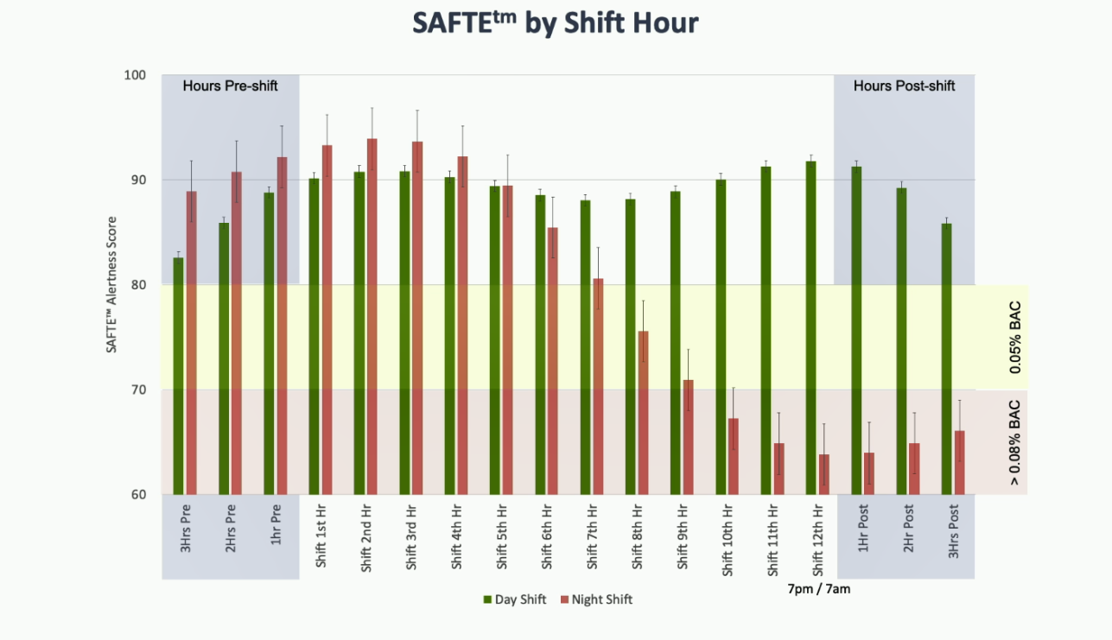
Liability - Predicted Performance
Notes:
Let’s review the predicted alertness score by Shift Hour graph. There are a few practical implications we can draw from it.
First, when we need night-shift officers to work additional hours, it is safer to bring them in early than to hold them over. If you hold them over, you’re prolonging the time in which they are operating at a highly fatigued state (in the 0.08% BAC zone).
Conversely, it’s safer to hold a day-shift officer over than it is to bring that officer in early. This is because if you bring an officer in too early, he or she won’t be able to go to sleep early enough to compensate for the earlier start.
Finally, as the Delaware State Police have done, consider modifying work assignments based on officers’ levels of fatigue. For example, consider pairing up your night-shift officers halfway through their shift, when fatigue typically begins to degrade their performance (dropping into the 0.05% BAC zone).
Reference:
James, L., James, S. M., Wilson, M., Brown, N., Dotson, E., Edwards, C., & Butterfield, P. (2021). “Sleep Health and Predicted Cognitive Effectiveness of Nurses Working 12-Hour Shifts: An Observational Study.” International Journal of Nursing Studies. https://www.sciencedirect.com/science/article/abs/pii/S0020748920301516.

Slide 69
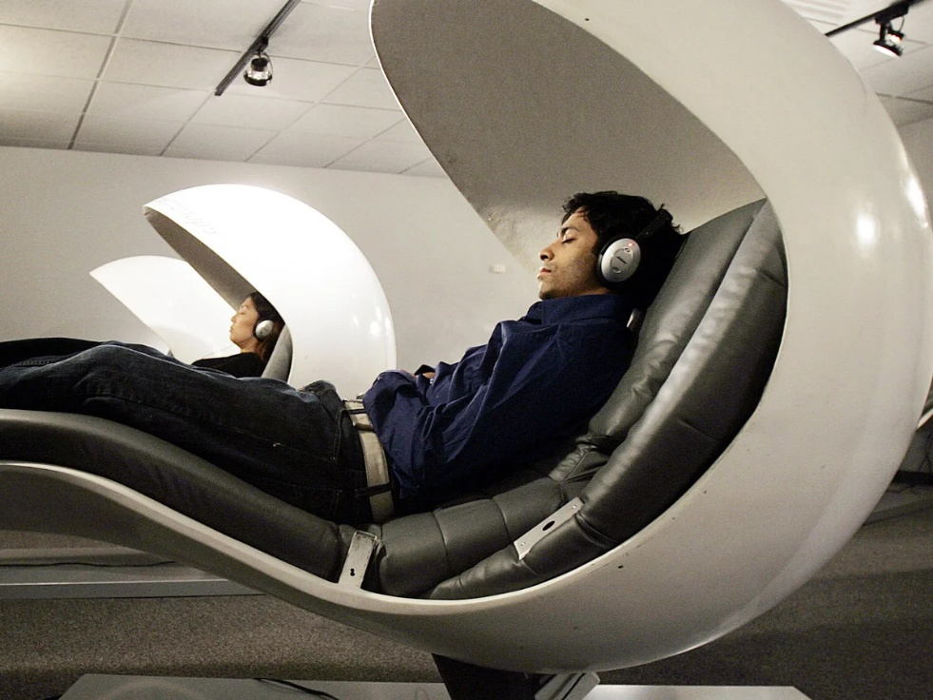
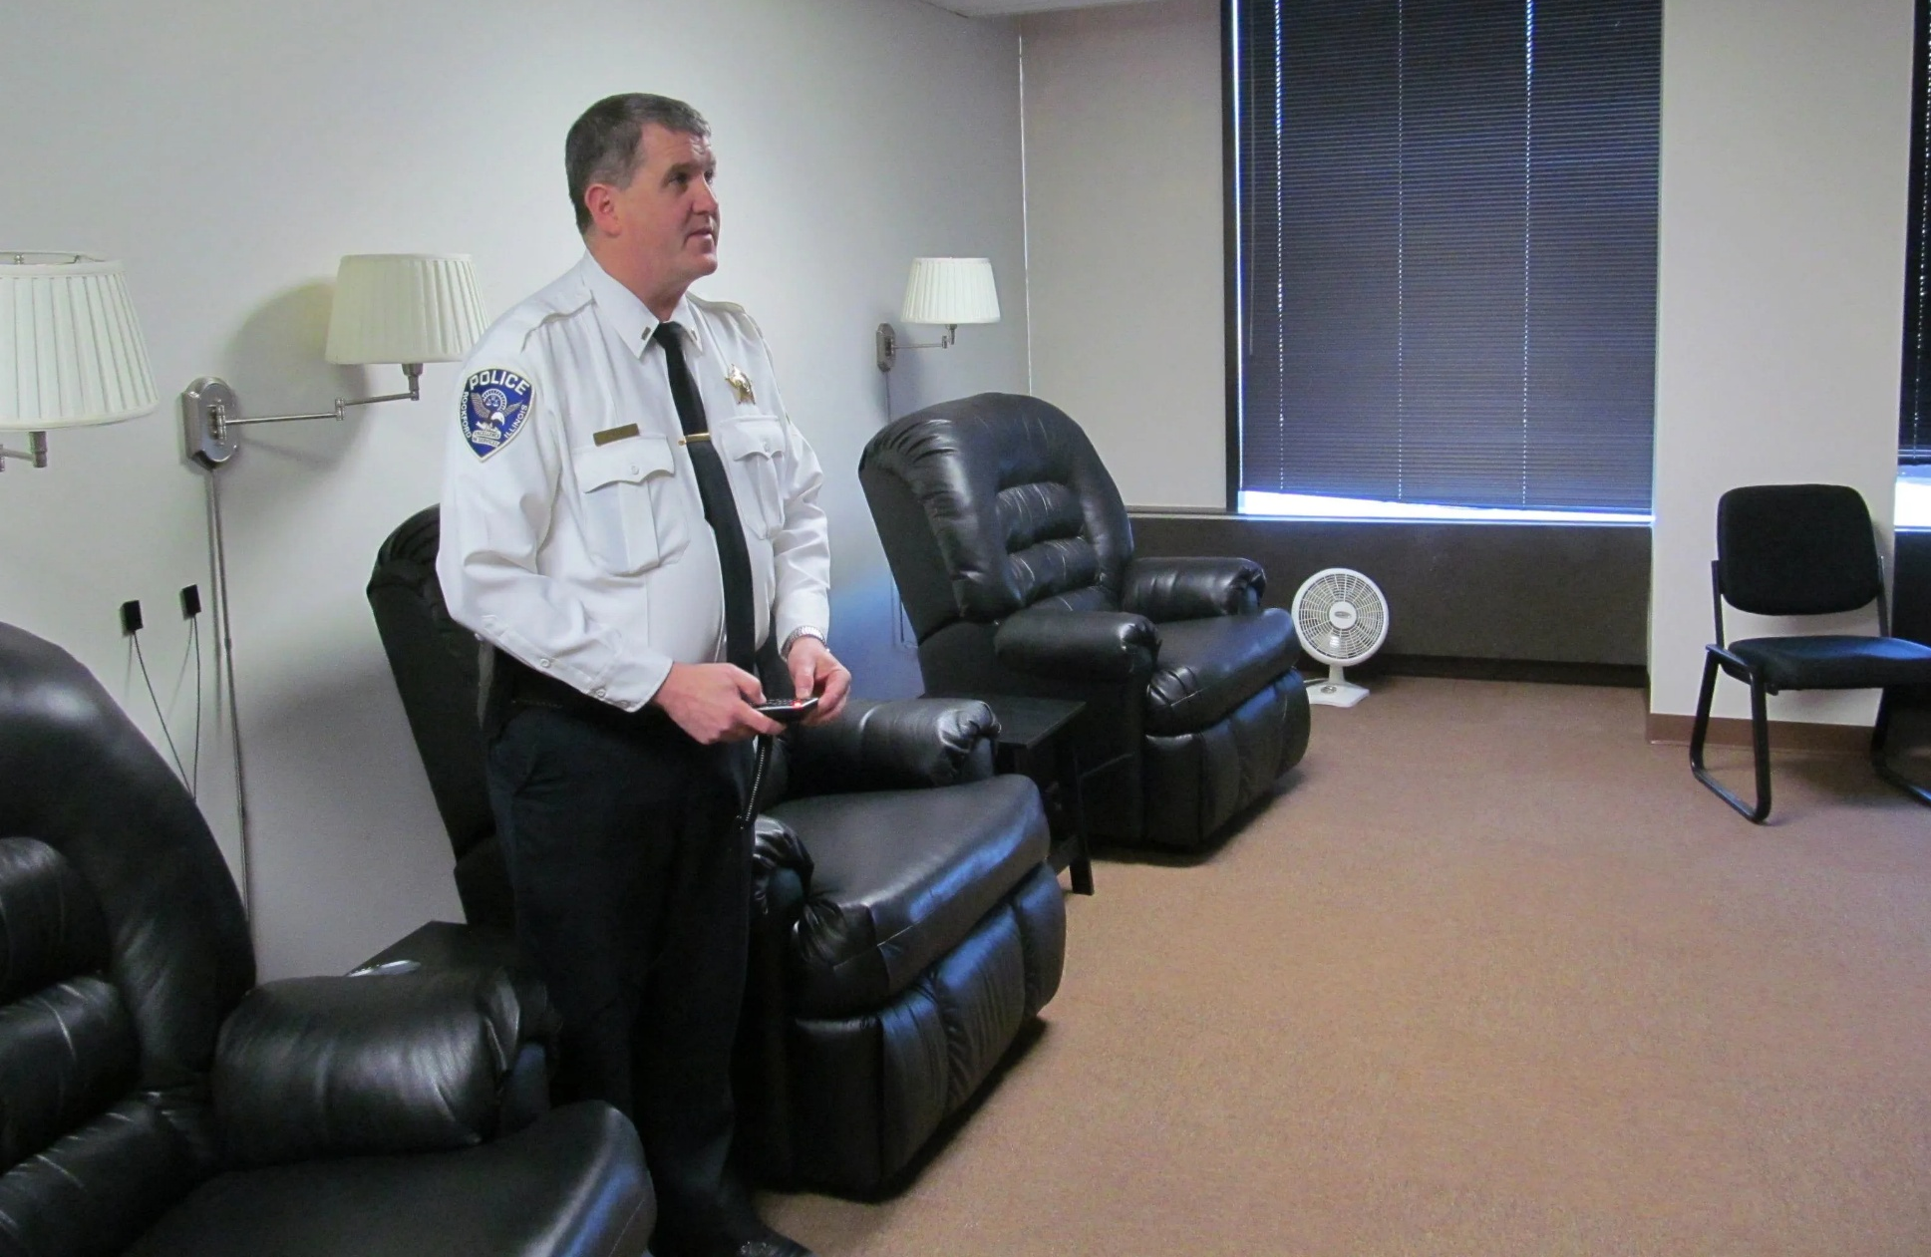
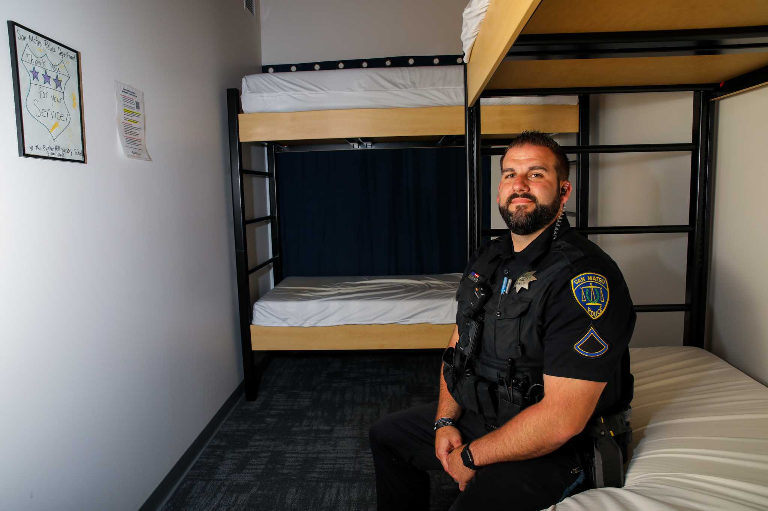
Restorative Rest Policies

Slide 70
Fatigue Management Policy
Delaware State Police

Slide 71

stevejames@wsu.edu

Slide 72
Stephen James, PhD
Dr. S James received his doctorate in Criminology and Criminal Justice in 2015 from Washington State University with a focus on police performance. Steve is an Associate Professor in the WSU Elson S. Flyod College of Medicine. Steve, as the Principal Investigator, has be awarded $5.8m of grant funded research and published 50 peer reviewed abstracts, articles, and book chapters. He is a member of the Homeland Security Human Factors Engineering Technical Advisory Group and a member of the advisory board of Lexipol Inc. Steve is also an active consultant for the National Police Institute.
Steve was a member of the Trinity College Boxing Team; the team won the British & Irish Intervarsity Boxing Tournament all four years of his participation. He also was a member of the Trinity College Rugby Team (3rds).
Prior to becoming an academic Steve spend 23 years in the British Army as an infantry solider (10 years enlisted) and officer (13 years commissioned). Steve served in several elite units focusing primarily on counter-terrorism operations. He completed nine combat tours and severed in Cyprus, the Former Yugoslavia, Northern Ireland, and Afghanistan.

