Slide 1

Data Center Risks & Impact on Communities
Friday, May 15th | 11:15am

Slide 2
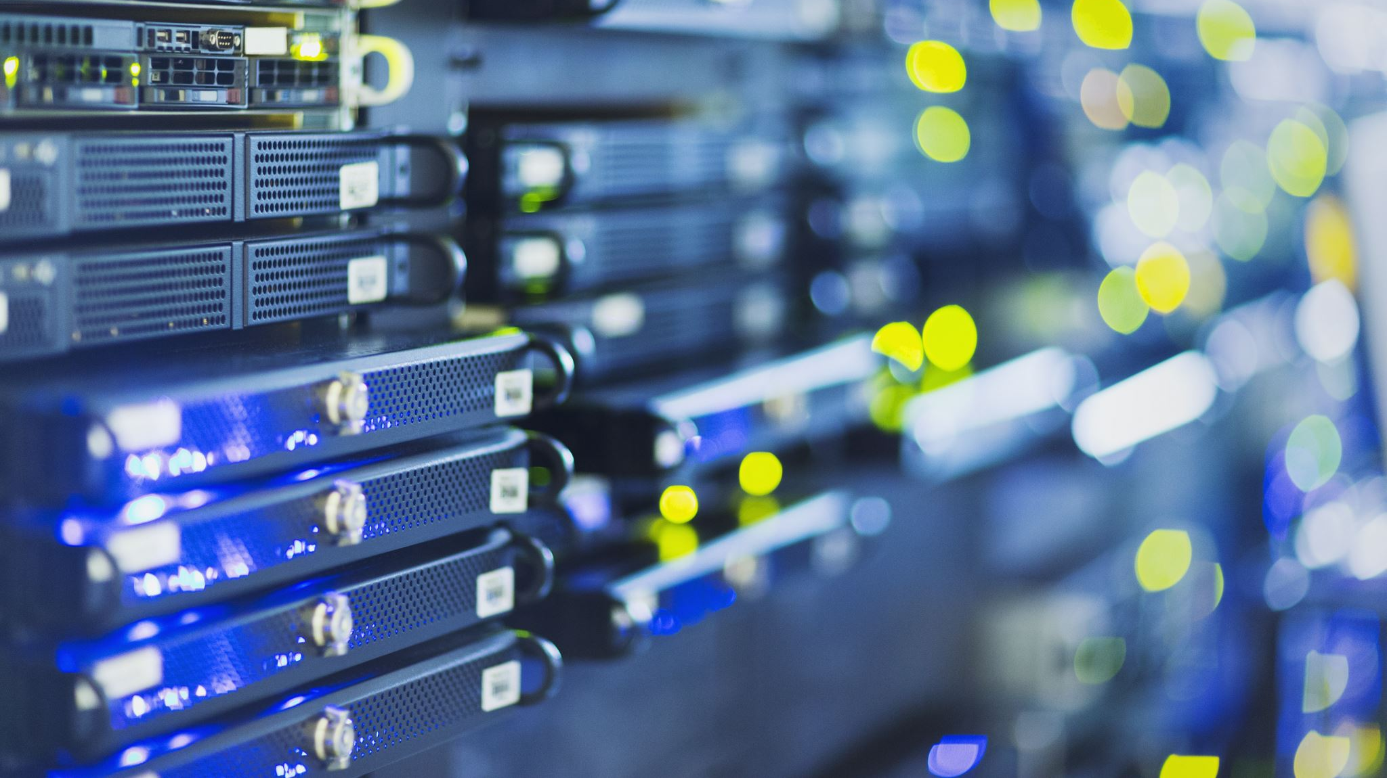

Data Center Risks and Impacts on Local Communities
Data Center Risks & Impact on Communities
Data Center Risks & Impact on Communities
Kate Stoll, PhD
AAAS Center for Scientific Evidence In Public Issues
May 15, 2026
Notes:
Title: Data Center Risks & Impact on Communities
Description: Data center construction in the U.S. has grown rapidly in recent years and growth is expected to continue to meet demands for digital infrastructure and AI expansion. The push and urgency to build data centers are coming from a national level, but much of the decision making on data centers takes place locally. This session will explore how data centers impact energy, water, air, and local economies, and how communities are approaching the opportunities and risks posed by data centers. The AAAS Center for Scientific Evidence in Public Issues is a non-partisan, non-advocacy, non-profit organization with the mission to connect scientific evidence with decisionmakers at all levels of government.

Slide 3


World’s largest multidisciplinary science society dedicated to advancing science, serving society
100K
90+
250
Members
Countries
Affiliate organizations

Slide 4



Our mission
By building trusted relationships between scientists and policymakers at all levels of government, we make it easier for decision makers to access and use scientific information.
Nonpartisan
Network Building
Trusted Partner
Non-advocacy
www.aaas.org/epicenter
Notes:
Non-advocacy
Independent = we don’t have a horse in the race
Our funding is nearly all philanthropic—this work is supported by the Gordan and Betty Moore Foundation.

Slide 5


OUR RESOURCES
National League of Cities
and AAAS Center for Scientific Evidence in Public Issues teamed up to create a series of fact sheets about data centers:
Understanding Data Centers
Environmental Impacts
Community Strategies
Key Questions
www.aaas.org/programs/epi-center/datacenters

Slide 6
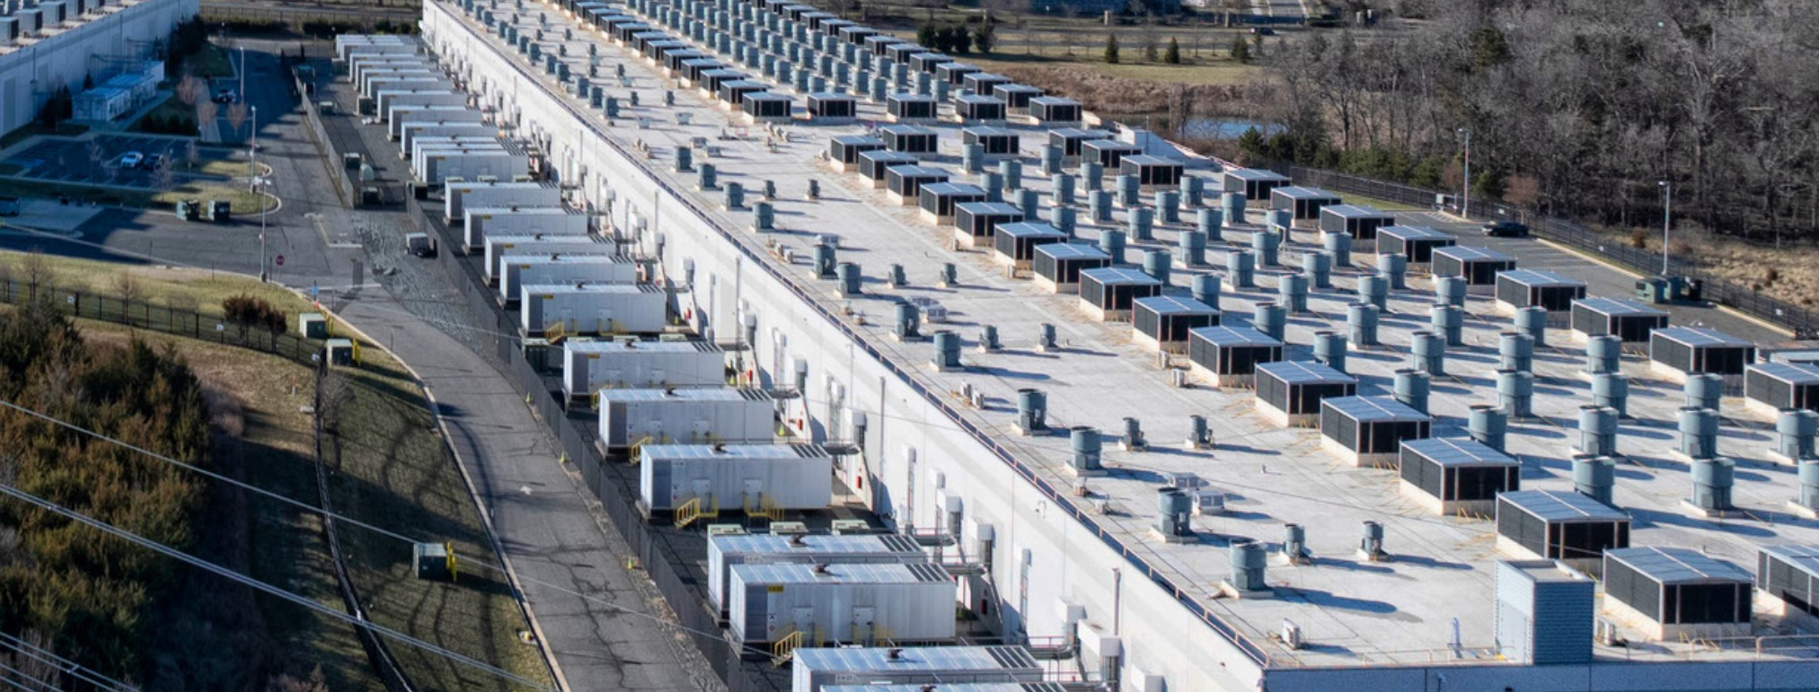
Why talk about data centers?
Notes:
What is a data center? Why do we need them?/What do they do?
Data centers are the physical infrastructure underpinning data storage, cloud computing, artificial intelligence, and other internet applications like streaming video.
Most data centers house data storage systems and servers (connected computers) capable of vast numbers of calculations and computing applications.

Slide 7
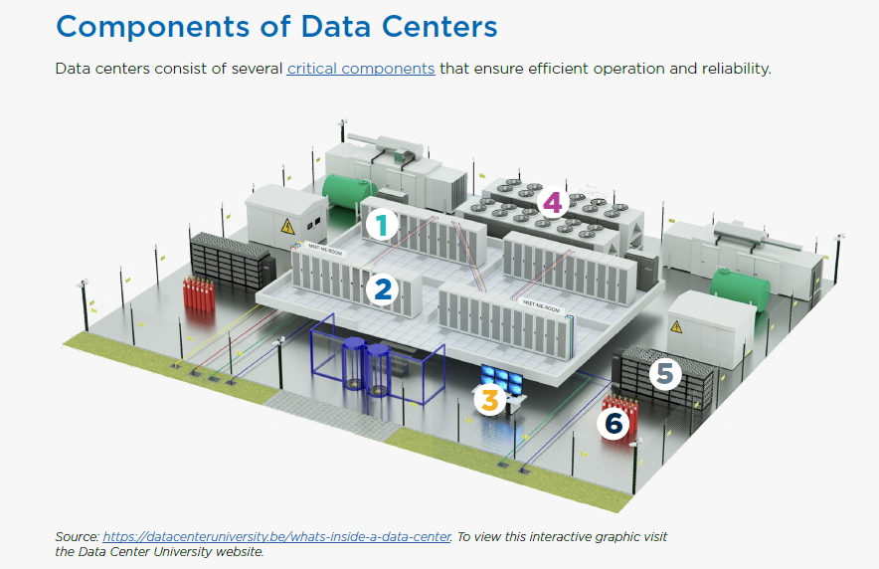
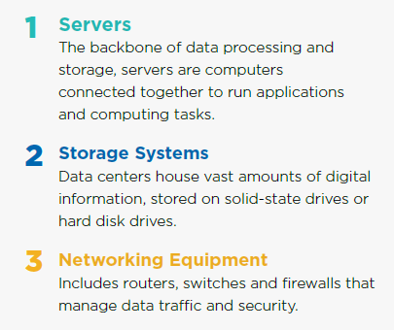
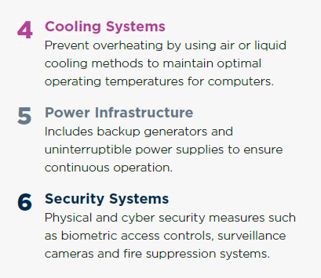
Notes:
Let’s “open the hood” and talk about the major components in all data centers.

Slide 8
Not All Data Centers are The Same
Size: Hyperscale (100MWatt to GWatt and 100k to million(s) of square feet) vs. smaller/average data centers (<100MWatt and 20k-100k square feet)
Function: AI, cloud computing, cryptocurrency mining, data storage, streaming, etc.
Ownership: enterprise (single owner) vs. co-location/multi-tenant vs. single tech company
Electricity draw and footprint is vastly different. Hyperscale data centers owned by big players (AWS, Microsoft, Google, etc.)
  100MW can power ~80,000 U.S. homes in a year. (CRS)
Electricity intensity and flexibility varies
Flexibility varies, influence varies
Source: IBM

Slide 9
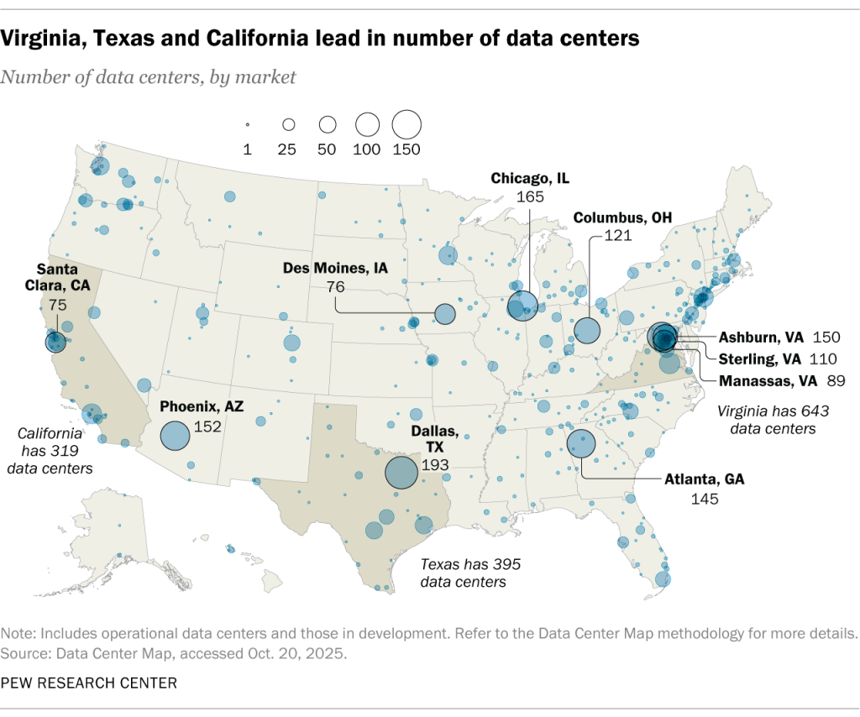
Where are data centers located?
More than half of hyperscale data centers are in the U.S.

Slide 10
Growth of Data Centers and their Energy Consumption
Why? Consumer use of AI is growing, and higher energy demand of AI services compared to cloud services.
Source: Shehabi et al. 2024, LBNL-2001637
Notes:
DOE reported that data centers accounted for about 4% of all US electricity consumption in 2023, or the equivalent to the average annual consumption of 14 million households. That’s expected to double or triple by 2028.
Why does AI use so much more energy? Specialized GPUs for AI. Advanced “reasoning” requires more computing power.
Each query to a large language model may use 2.9 Wh, enough to keep a light bulb on for 20 min or ~10 times more than a Google search. (Averaged across query lengths, and AI models, etc.) Higher for video or image generation than text generation. And averaged across data centers in many locations! Approximate--take this with a grain of salt.

Slide 11
Data Center Considerations (Risk Themes)
Energy
Water
Air
Economics
Public sentiment

Slide 12
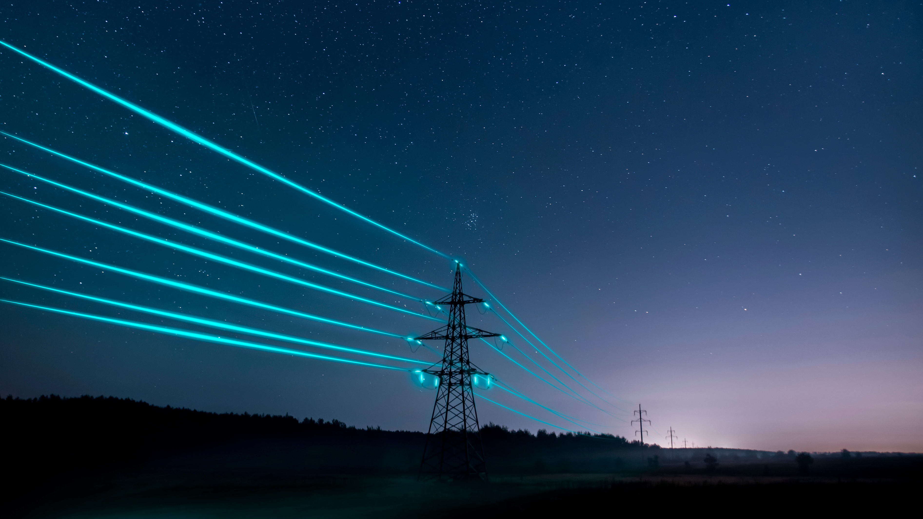
Energy
Source of energy
  Emissions
  Backup generation
  Air quality
Energy efficiency
Peak energy demand, impact on utilities
Energy infrastructure
  Power grid, power quality
  Energy prices
Notes:
Pay attention to peak power demand—usually the hottest months of the year—that’s when power and water systems are most stressed. The annual power consumption is important too, but the peak power consumption is when problems occur.

Slide 13
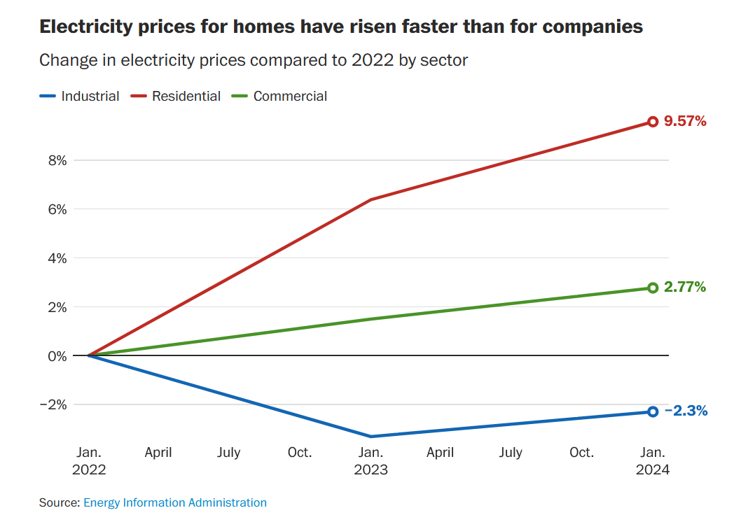
Electricity Prices
Infrastructure build out costs
Costs are spread amongst all utility customers.
Rate negotiations for big contracts
Future electricity load is hard to forecast.
Risk of overbuilding or underbuilding
Notes:
Caution: I have not seen empirical evidence to show that data center growth is the CAUSE of electricity price increases overall. There are many reasons why electricity consumption is going up. Rates are complicated and depend upon local and regional variables.

Slide 14

Water
On Site Water Consumption
~40% of data center energy is used for cooling
Evaporative cooling is most common—consumes water to dispel heat
A 100-megawatt U.S. data center would consume roughly the same amount of water as 2,600 households (IEA).
Water is often sourced from municipal tap
Reporting transparency
Water quality, treatment
Notes:
The chips in data centers must maintain a cool temperature to work.
~40% of data center energy is used for cooling – this is a rough average across different data centers, with different cooling technologies and geographical locations.
Water withdrawal does not equal water consumption (evaporation).
Reporting transparency – water consumption is rarely reported.
Like the growth in power use by data centers, water consumption is also anticipated to grow in the coming years. “…the total annual onsite water consumption by U.S. datacenters in 2028 could double or even quadruple the 2023 level, reaching approximately 150–280 billion liters and further stressing the water infrastructures.” Li et al 2025. Making AI less thirsty https://dl.acm.org/doi/10.1145/3724499.

Slide 15
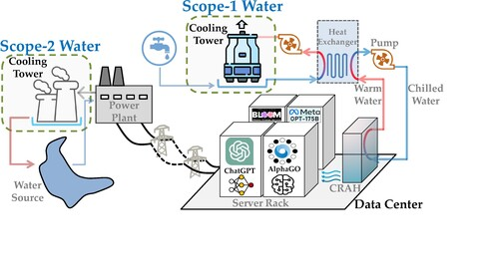
Off Site Water Consumption
Many power plants also use water for cooling, and can account for the majority of water consumption by data centers.
Water energy nexus
Water efficient cooling techniques (like closed loop cooling) require more electricity.
Peak demand in hottest months
Location matters
Source: Li et al. 2025. Making AI Less Thirsty
Notes:
Many power plants also use water for cooling.
Nuclear, natural gas, etc. The type of cooling at the power plants can make a big difference in how much water is consumed (evaporated).
As of 2021, scope 2 or off site, represented 2/3 of water consumption by data centers.
Water energy nexus
Water efficient cooling techniques at the site of the data center (like closed loop cooling) require more electricity.
Remember to consider the offsite water consumption by power plants.
It’s possible that even if you use water efficient cooling systems at the site of the data center, you will still consume more water overall if the power supplying the data center evaporates water for cooling at the plant site.
Timing matters – pay attention to peak demand in the hottest months
There may be benefits of using more water to cool during peak power demand, including decreased grid stress and energy savings (and therefore emissions savings).
Geographical location matters—temperature in each season, water scarcity, etc.

Slide 16

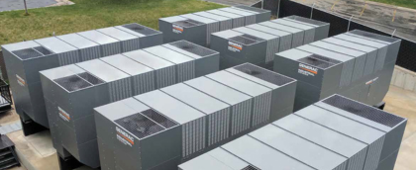
Air Quality
On-site generation is often diesel generators
Emit NOx, SO2, and PM 2.5 fine particulates
Off site sources – power plants (if fossil fuel)
Notes:
Data centers need 24/7 power, so many of them have on site generators to ensure continuous and redundant power.

Slide 17
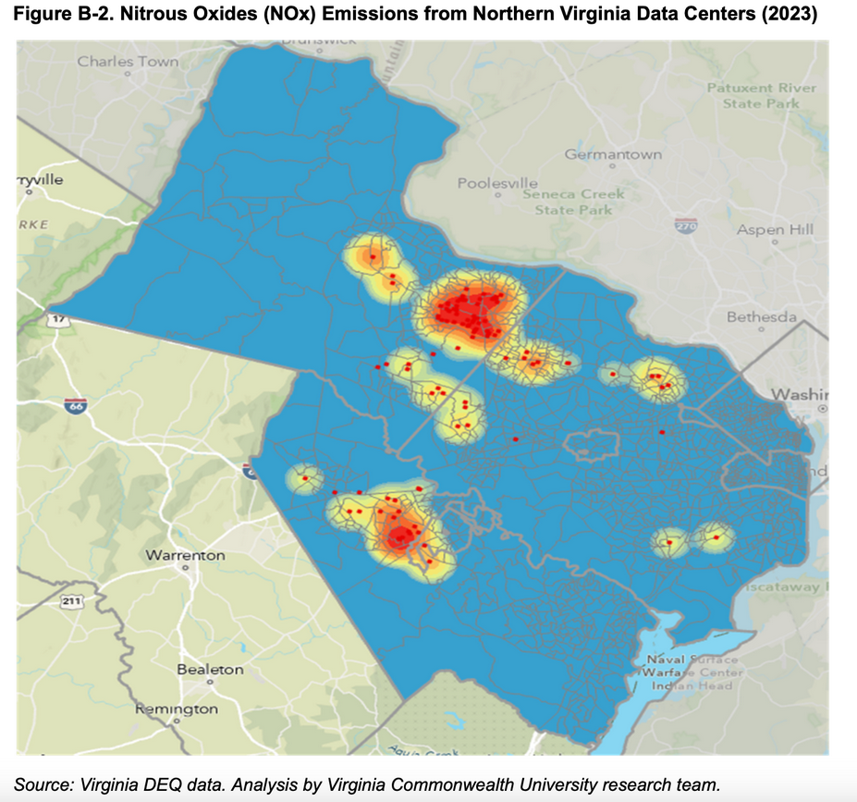
Air Pollution is Often Concentrated
Historically in Disadvantaged Communities
Map courtesy Damian Pitt/Virginia Commonwealth University research team)
Notes:
Map courtesy Damian Pitt/Virginia Commonwealth University research team)

Slide 18
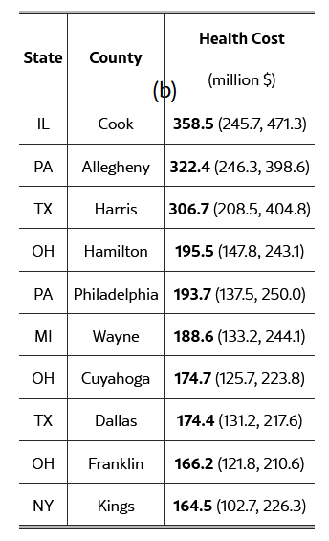
Health Costs of Poor Air Quality
Top Ten US Counties Total Health Cost
By Data Centers 2019-2023
NOx, SO2, PM2.5 (fine particulate matter) contribute to asthma, heart disease, lung cancer, premature births
All contribute to public health burden and loss of economic productivity (missed work/school, ER visits, medical costs, etc.) which can be estimated as health costs.
Source: Han Y. et al. 2025

Slide 19

Economics
Tax revenue
  Property tax +/- capital assets tax
Tax abatements
  42 states offer full or partial sales tax incentives to data center operators
Job creation
  4 out of 5 jobs are construction (~18 months)
  1 out of 5 jobs are operations (ongoing)
Economic development via infrastructure investments
Source: UVA Cooper Center
Notes:
In some counties, only real property taxes (land and buildings) apply to data centers. In others, business personal property taxes (the capital assets–such as the servers and other equipment inside the data center) are also applied. Business personal property taxes can account for the largest share of data center taxation because servers and other computing equipment inside the facility have high capital value.
How many permanent jobs are created by data centers?
4 out of 5 jobs are construction
1 out of 5 jobs are operations (ongoing)

Slide 20
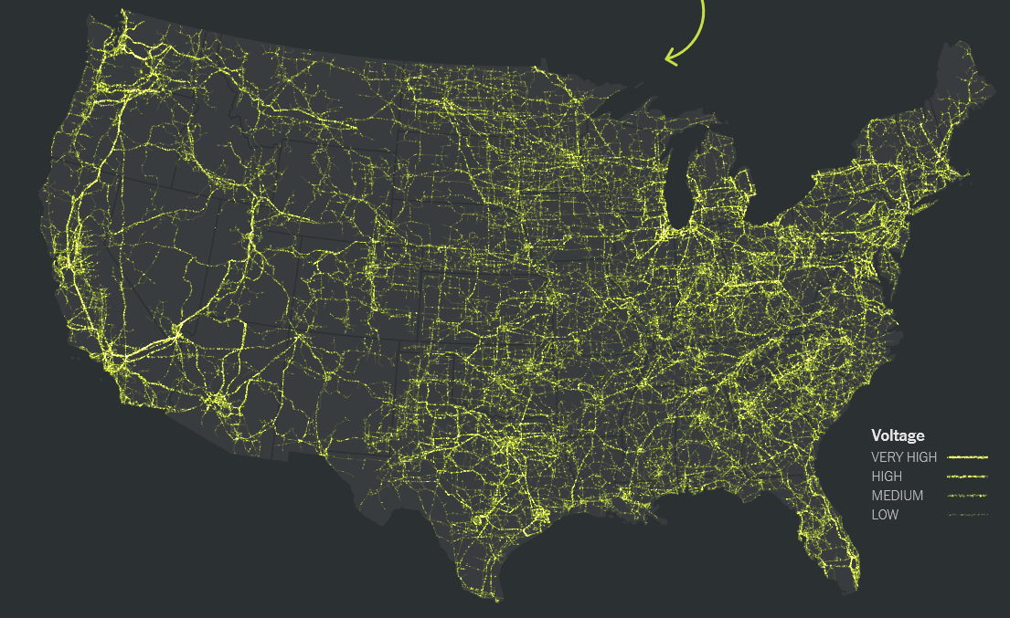
AI Boom or Bust: Implications for the Grid
Bust → risk stranded assets
Boom → risk of missing the boat on infrastructure investments
  Overdue grid upgrades
  Fiber optic cables/digital connection
Source: New York Times

Slide 21
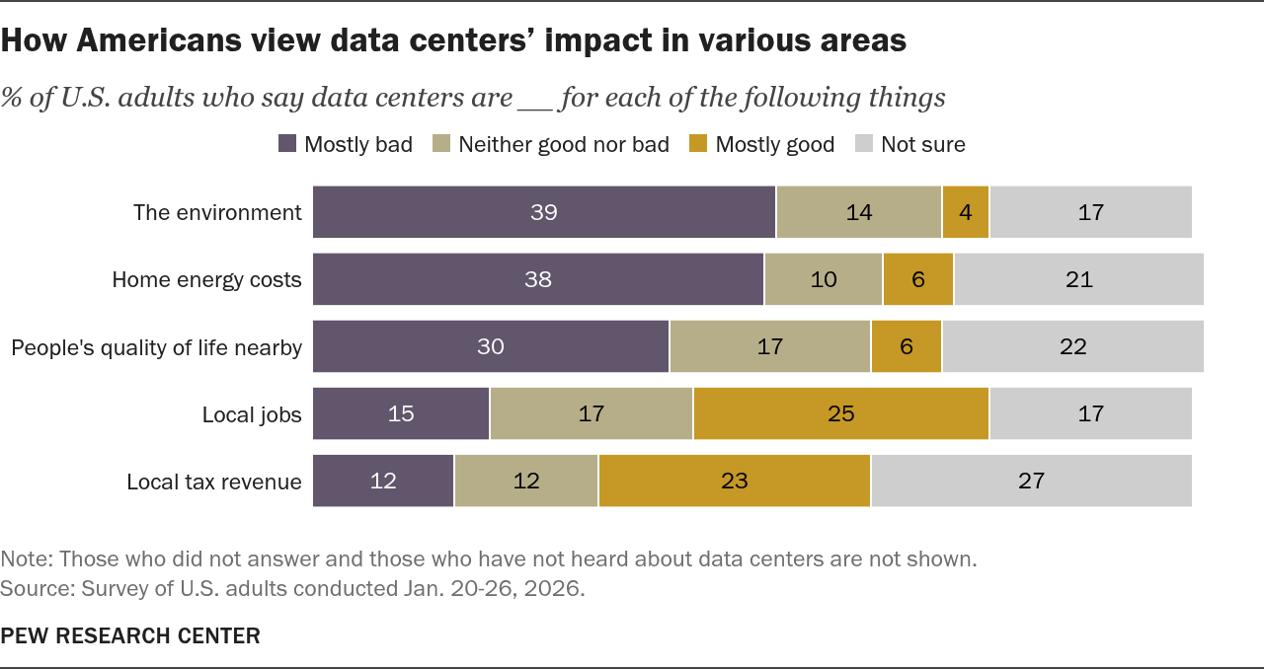
Public Sentiment
Additional considerations:
Noise and light impact quality of life for near neighbors
Property value
Community aesthetics
Transparency
Source: Pew Research Center
Notes:
Considerations beyond those already discussed (energy, water, air quality, electricity prices etc.)

Slide 22
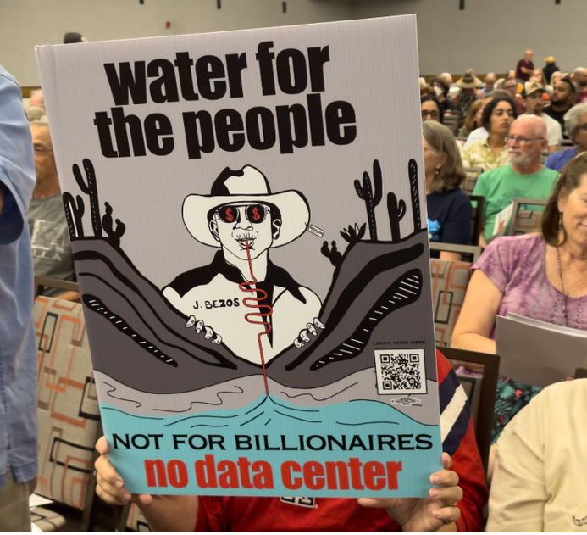
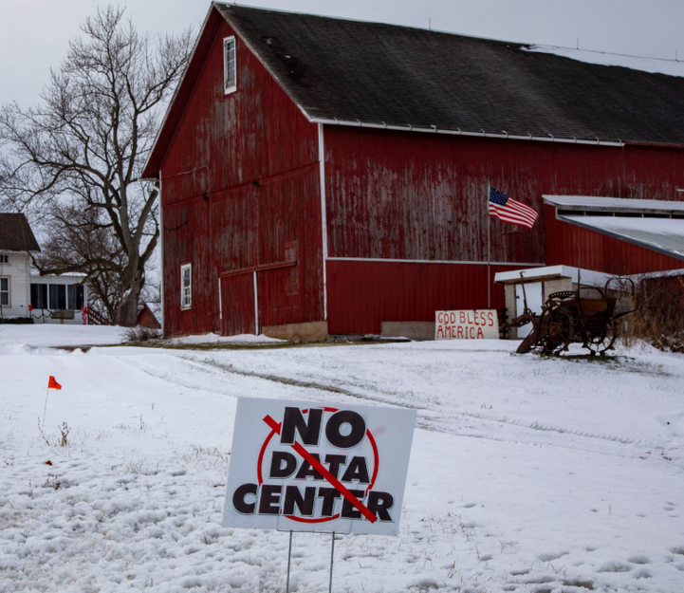
Community Pushback
Photo by: Jim West/UCG/Universal Images Group via Getty Images
Photo by: Wild Horizons/Universal Images Group via Getty Images

Slide 23

National and Global Issue with Local Control
Global companies driving urgent growth
National push to advance AI capacity for global competitiveness
Local control
  Interconnection requests
  Siting, Zoning
Local impacts
Notes:
Can we be smart about where to prioritize data center siting that meets community expectations and strategically considers energy sources, water scarcity, air quality, transmission capacity, and equity?

Slide 24
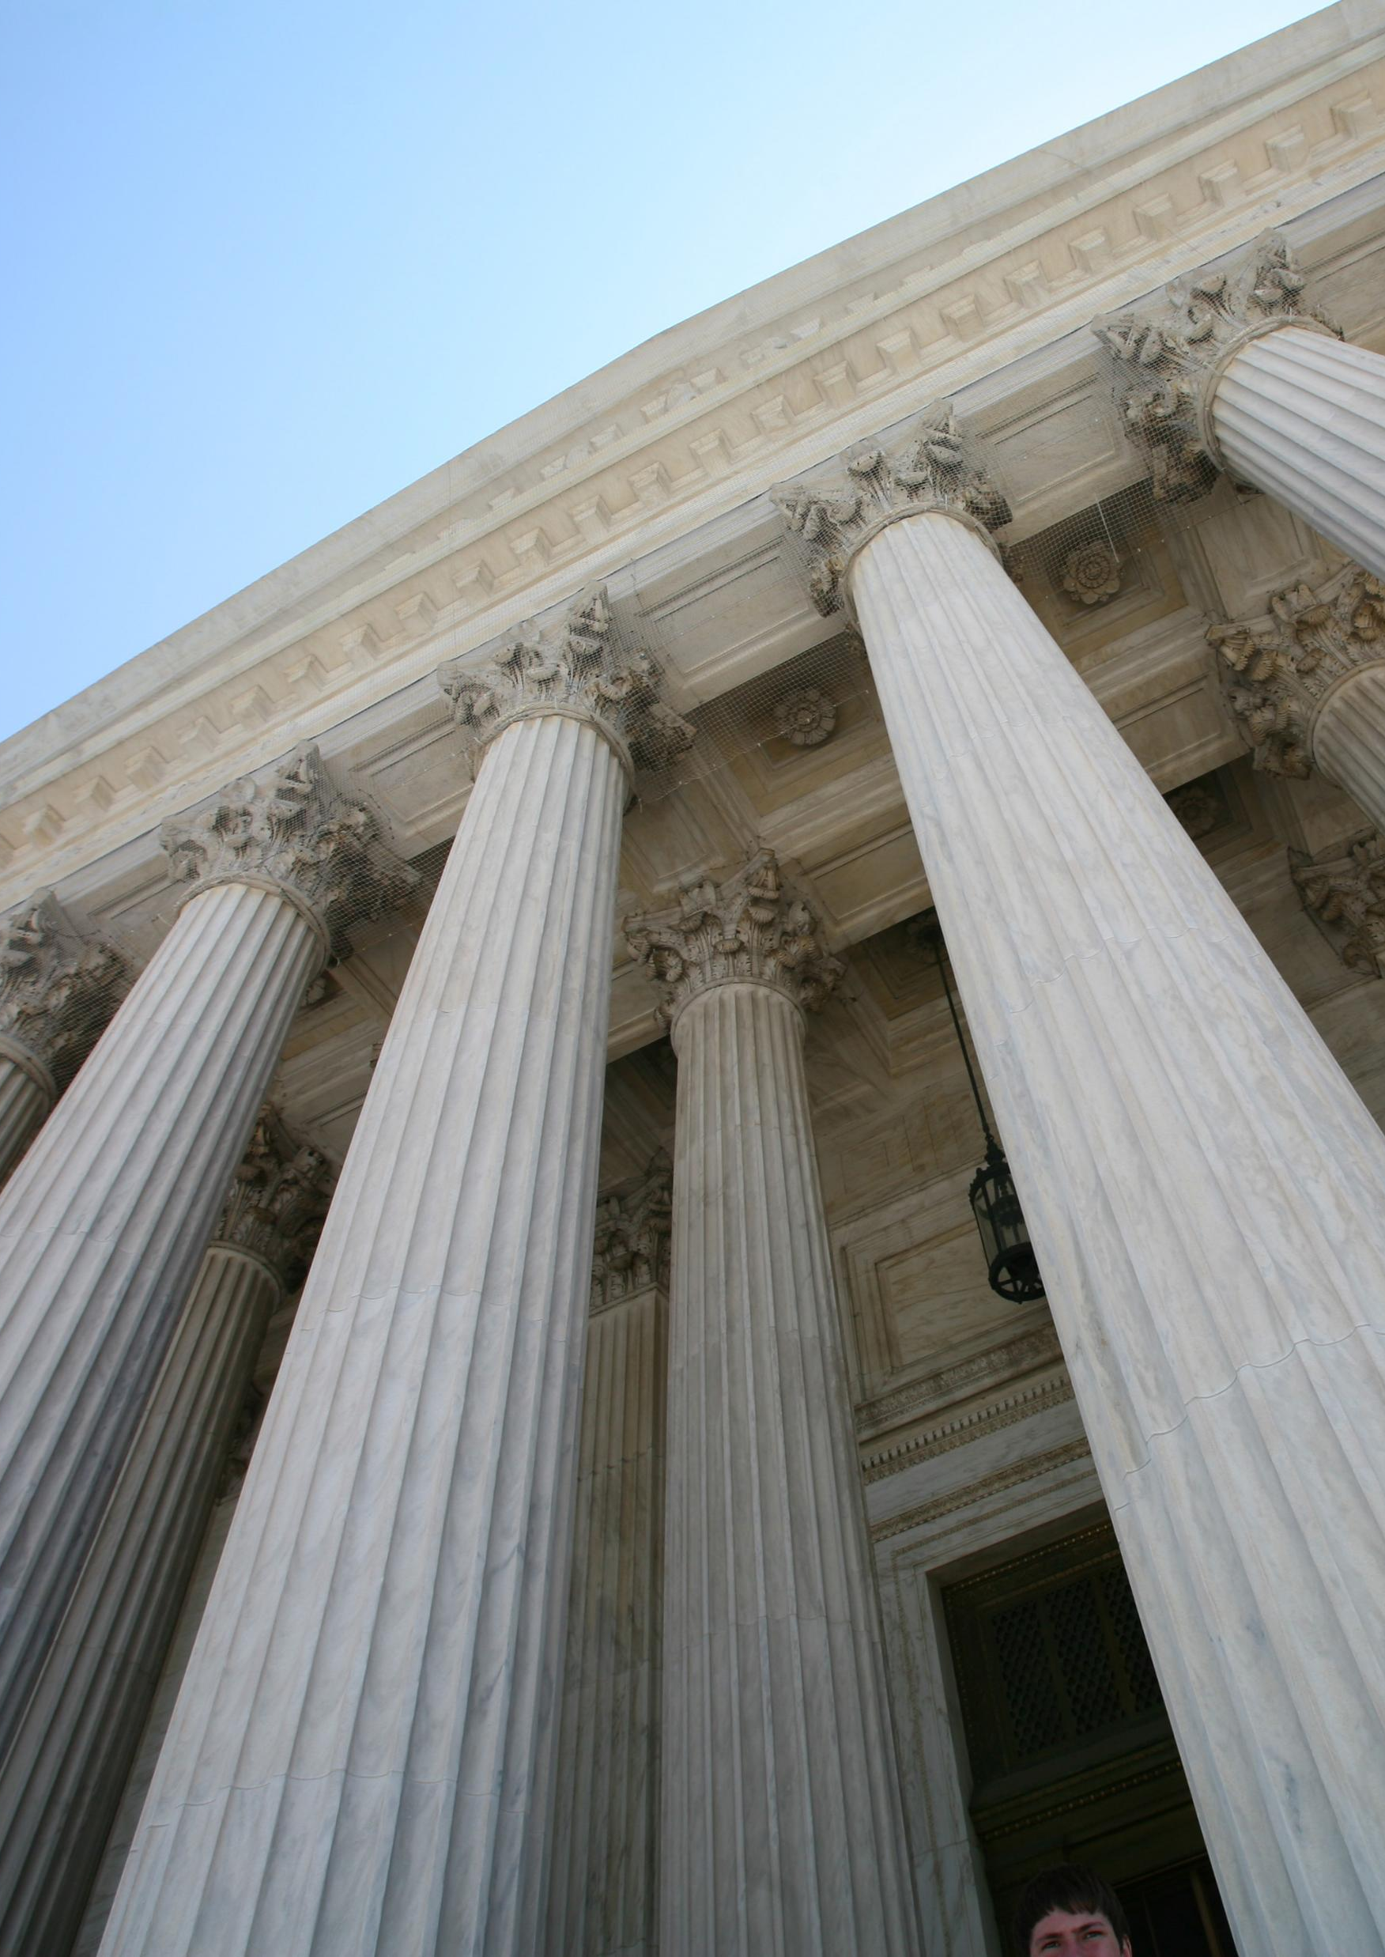
How are local and state policymakers responding?
Local
  Shifting DC approvals from “by-right” zoning to “by-condition zoning”
  Setting energy and water efficiency benchmarks and reporting via ordinance or CBA
  Community benefits agreements regarding economic development
State
  Tax structures, incentives tied to benchmarks or transparency
  Environmental permitting and monitoring
  Electricity rates, tariffs, PUC oversight

Slide 25

Solutions?
Technical
  AI sustainability standards (IEEE)
  Energy efficiency best practices for data centers (NREL)
  Water-smart cooling, water reuse (EPA)
  Co-location with renewable energy and battery backup (within reason)
  Informed location choices
Policy
  Rebalance information asymmetries
  Requires transparency—water too!
  Zoning and Permitting, ordinances tied to efficiency benchmarks, jobs, transparency
  Enforcement of environmental regs
  Early community engagement , CBAs
  Tax policy
  Who pays for grid build out? Water buildout and treatment?

Slide 26
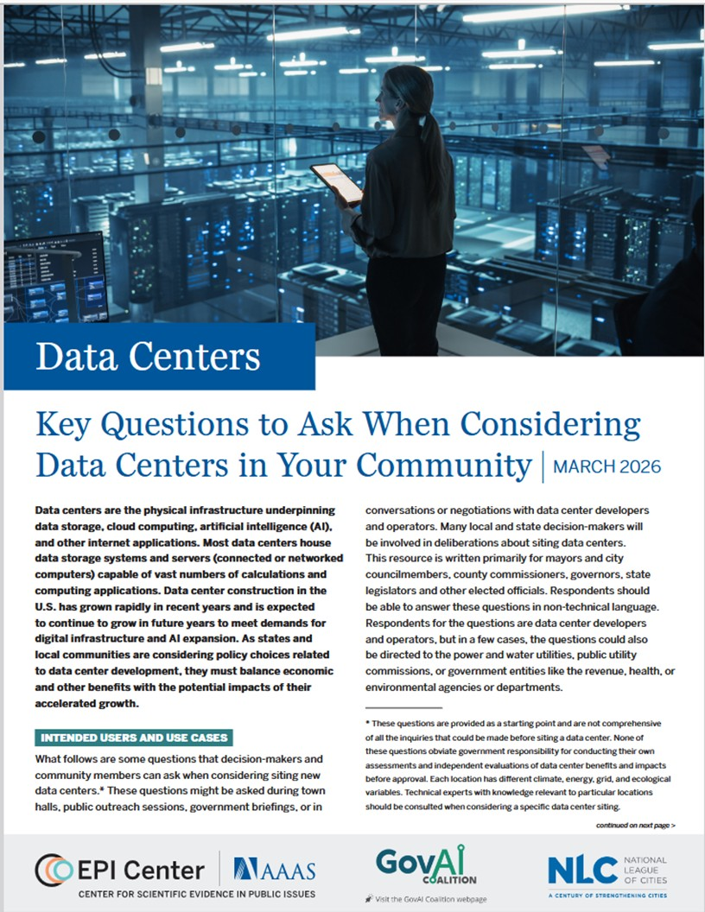

Key Questions to Ask When Considering Data Centers in Your Community
Notes:
We are created a list of evidence-based questions to ask about technically complex issues can decrease the information asymmetry between local leaders and data center operators. How can communities reap the benefits of data centers and manage the risks?

Slide 27
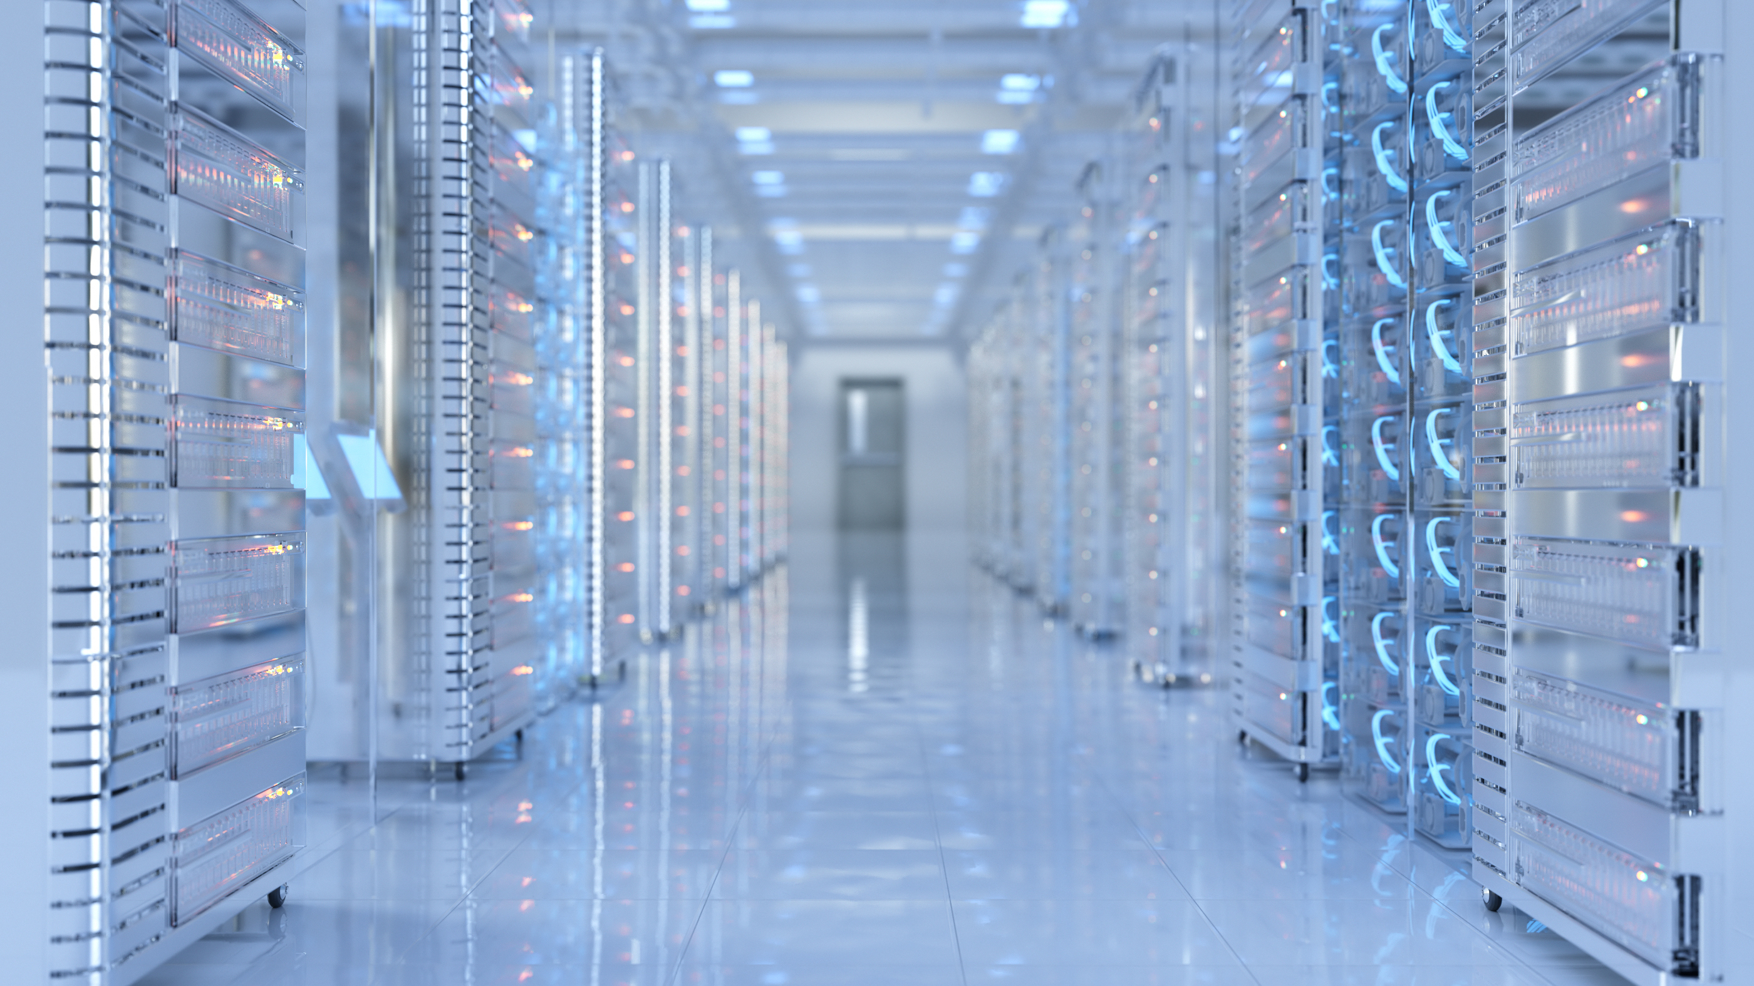
Thank you
Kate Stoll, Project Director
AAAS Center for Scientific Evidence in Public Issues (EPI Center)
kstoll@aaas.org

Slide 28
Select Resources
Data Center FAQs by UVA Cooper Center https://www.coopercenter.org/GLDC-faqs
Ferreira, J. et al. (Jan. 2025) “Economic, Fiscal and Energy-related Impacts of Data Centers in the Great Lakes Region” https://www.coopercenter.org/data-centers-great-lakes
Li, P. et al. (2025). Making AI Less “Thirsty”: Uncovering and Addressing the Secret Water Footprint of AI Models. Communications of the ACM, 68(7), 54 – 61. https://dl.acm.org/doi/10.1145/3724499.
Ren. S, and Wierman, A. Mitigating the Public Health Impacts of Data Centers. Harvard Business Review. Nov. 5, 2025. https://hbr.org/2025/11/mitigating-the-public-health-impacts-of-ai-data-centers
AAAS EPI Center https://www.aaas.org/programs/epi-center/datacenters

