Slide 1

Considerations and Tools for Healthcare Pool Success
Thursday, May 14th | 2:15pm

Slide 2




Stress to Strategy
------------------------------------------------------------
Considerations & Tools for Managing Health Plan Stress
Gregory Carlton, RHU, ChHC, CLU, ChFC
Allied Advisors Group LLC / Acclaim Health Analytics LLC

Slide 3
Agenda
Large Group Stress Point Survey
Leadership Stress
Medical vs Pharmacy Stress Scoring
Turning Information into Impact
Strategy Process & Key Performance Zones
Using Data to Drive Decisions
Point-Solution Management
Fiduciary Action Plan

Slide 4
Stress Point Survey

Slide 5
Stress Survey - Top 10 Stress Points
01
Medical Cost Trend
02
Specialty Pharmacy & GLP-1s
Near-double-digit for 3rd straight year
Rx trend 10–12%; 50%+ spend is specialty
03
OBBBA Legislative Compliance
04
Self-Funded Migration
HSA, FSA, Medicaid & tariff ripple effects
Stop-loss hardening; actuarial rigor required
05
Third-Party Advisor Value
06
AI & Technology Disruption
Renewal-cycle model is obsolete
40% of HR leaders using AI in benefits
07
Mental Health Integration
08
Multi-Gen Workforce Complexity
Behavioral claims up 45–80%; C-suite gap
80% cite talent; 2/3 struggle to meet all gens
09
Fertility & Family Benefits
10
Financial Stress & Literacy
22-pt jump in preventive care for women
Only 35% rate financial wellbeing positively

Slide 6
2026 Plan Financial Stress Points Survey
International Foundation of Employee Benefit Plans • Survey of 150 Large Employer-Sponsored Health Plan Sponsors
PRIMARY REASON FOR COST INCREASE
10%
Median
Expected
Cost Increase
SPECIALTY DRUG COST DRIVERS
Among plans citing specialty/costly Rx as primary driver (n=34, multi-select)
59%
50%
21%
GLP-1
Cancer Drugs
Cell &
Gene Therapy
Source: International Foundation of Employee Benefit Plans (IFEBP) | 2025–2026 reporting period | n=150 unless noted

Slide 7
Leadership Stress

Slide 8
Leadership Stress
HR vs CFO
ISSUE
HUMAN CAPITAL VIEW
FINANCE VIEW
High Deductibles
Hurts morale & recruitment
Controls premium growth
Narrow Networks
Employee access complaints
Lower unit costs
Specialty Drugs
Care delays hurt employees
Budget killers
PBM Rebates
Confusing to explain
May not lower net cost
GLP-1 Coverage
Equity & wellness
Massive unbudgeted spend
Each issue represents a genuine tradeoff — not a right or wrong answer.

Slide 9
Stress Scoring

Slide 10
Medical Plan Stress Points
Medical Score | 81% · Grade B
KPI
Your Value
Benchmark
Better When
Status
Total Medical PMPM Cost ($)
$380
$450
Lower
GREEN
Annual Medical Trend (%)
7.2%
6.0%
Lower
YELLOW
ER Visits per 1,000
20
21
Lower
GREEN
Inpatient Admits per 1,000
4
4.60
Lower
GREEN
Readmission Rate per 1,000
1.00
0.60
Lower
RED
Preventive Visit Rate per 1,000
50.40
47
Higher
GREEN
% In-Network Spend
98.0%
90.0%
Higher
GREEN
Avoidable ER % (if available)
20.0%
20.0%
Lower
GREEN
Medical Score
81% Grade
B | Status

Slide 11
Pharmacy Plan Stress Points
Pharmacy Score | 39% · Grade D/F
KPI
Your Value
Benchmark
Better When
Status
Total Pharmacy PMPM Cost ($)
$151
$110
Lower
RED
Annual Pharmacy Trend (%)
11.0%
8.0%
Lower
RED
Generic Dispensing Rate (GDR)
80.0%
90.0%
Higher
YELLOW
Specialty % of Rx Spend
38.0%
35.0%
Lower
YELLOW
Brand Rate (Brand Scripts %)
20.0%
10.0%
Lower
RED
Formulary Compliance %
92.0%
90.0%
Higher
GREEN
Specialty via Preferred Channel %
92.0%
90.0%
Higher
GREEN
Rebate Guarantee Realization %
85.0%
95.0%
Higher
YELLOW
Pharmacy Score
39% Grade
D/F | Status
6

Slide 12
The Strategy

Slide 13

Information → Insights → Impact

Slide 14
KPIs Key Performance Indicators

Slide 15

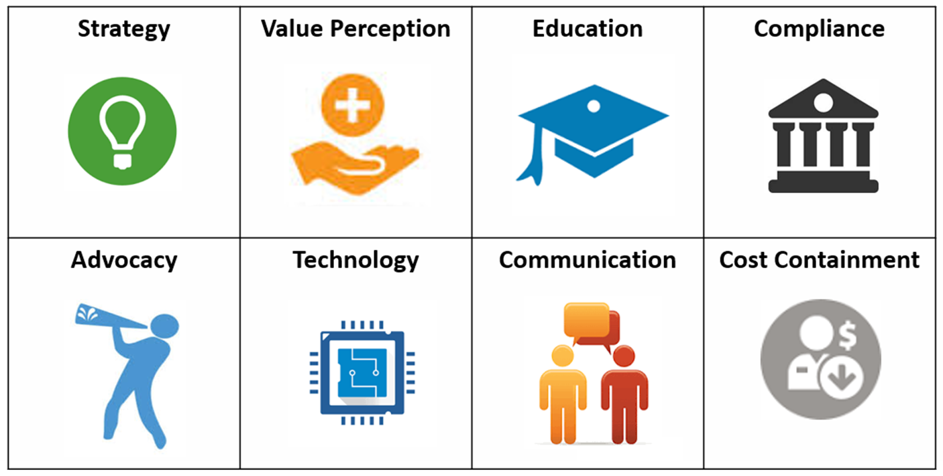
Key Performance Zones

Slide 16
Data-Driven Decisions

Slide 17
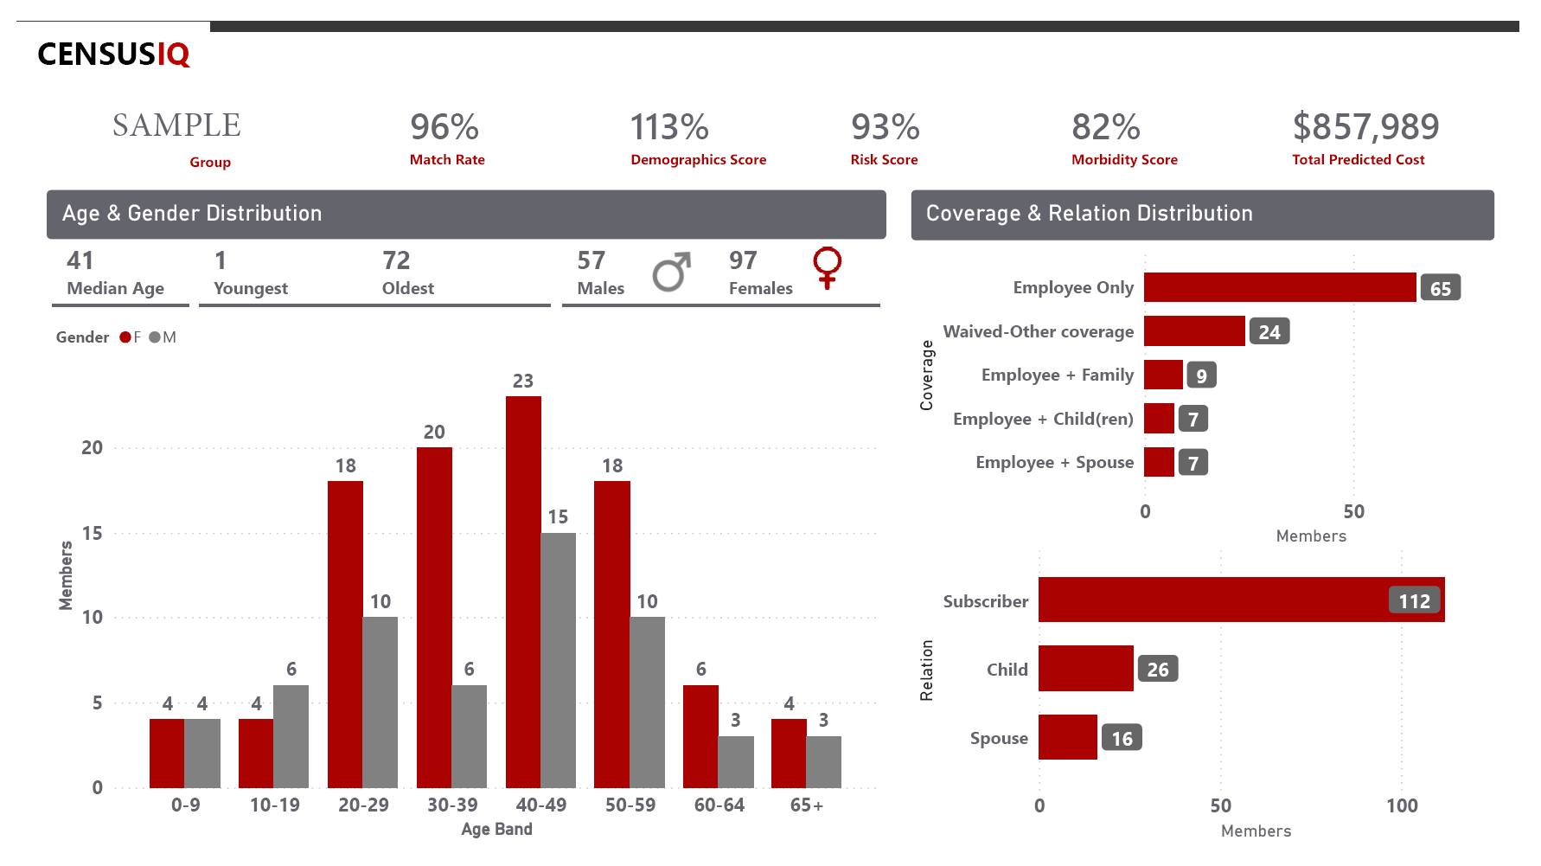
Measuring Risk & Stress with Limited Data

Slide 18

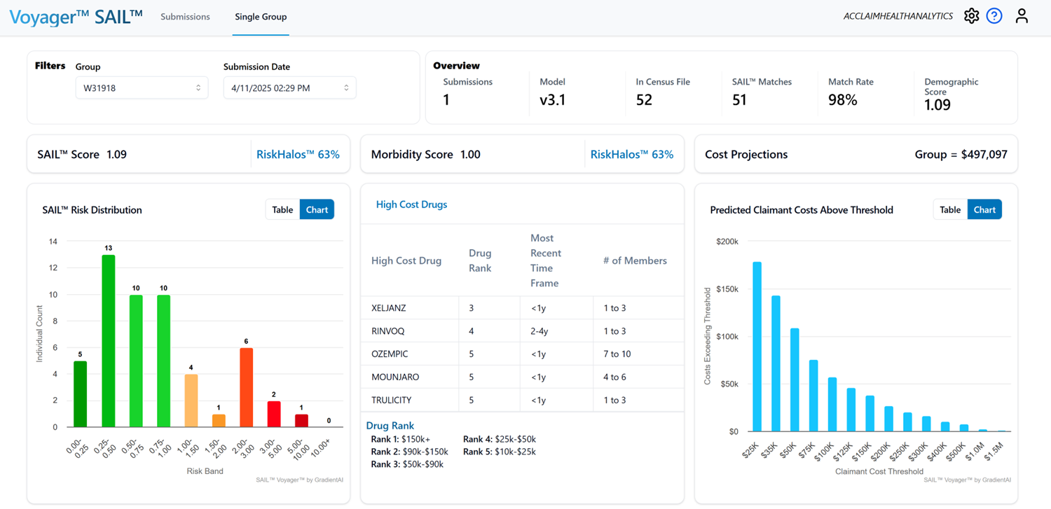
Measuring Risk & Stress with Limited Data

Slide 19


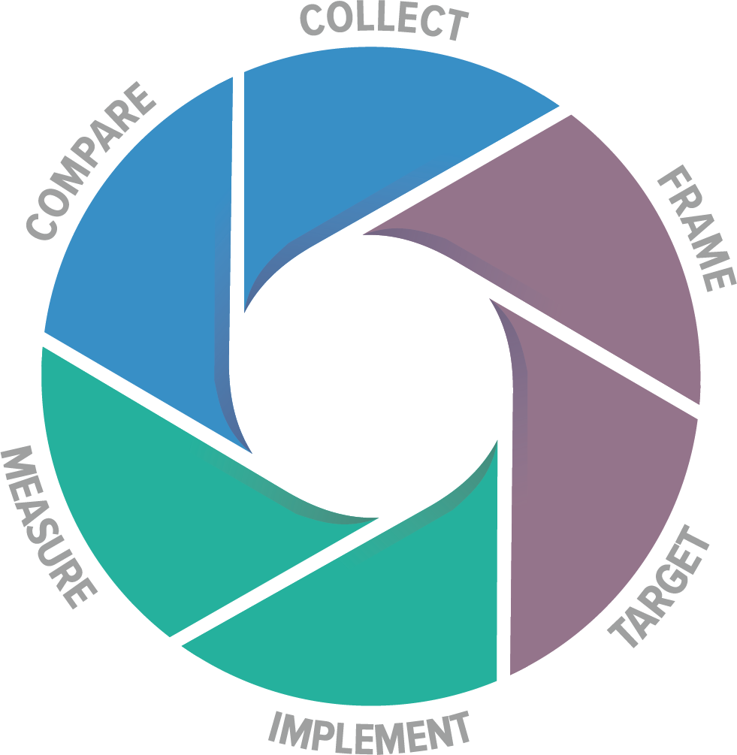











From Stress to Strategy – Data Process
Source
Unified Record
Plan Gap Analysis
Solution
Analytics Partner
Healthcare Navigation
Plan
Data
TPA
Federal & State Programs
Direct Primary Care
Employer Data
MSK
Diabetes
Imaging
PBM
Cancer
Enriched
Data
Diabetes
MSK
G. I.
Target members for point solutions
Navigate members to the appropriate point solutions
Point Solution provides data on engaged members to validate ROI.

Slide 20
Point-Solution Management

Slide 21


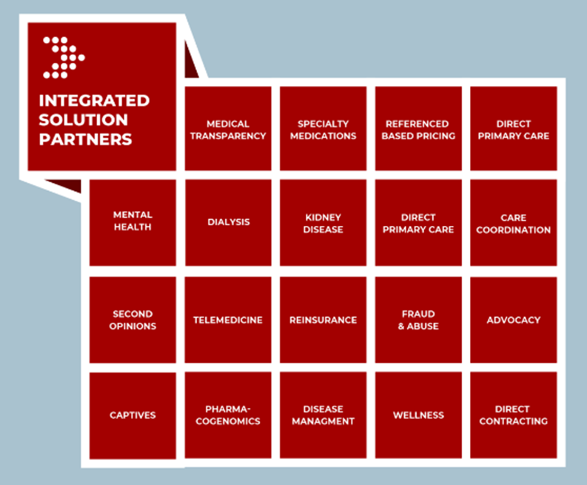
Data is Driving Decisions
Copyright © 2023
21

Slide 22

























Slide 23





















Slide 24



BENEFIT STRATEGY INTELLIGENCE
Point Solution Overload
Vendor Fatigue Is Breaking Employer Benefits Strategy
THE PROBLEM
50%
Plan Sponsors Are at a Breaking Point
of large employers manage
10+ vendor relationships
<10%
"9 out of 10 employer clients are overloaded — every day someone is in their ear selling something. Once these programs are rolled out, they don't know where real ROI is coming from."
— Zane Burke, CEO, Quantum Health
of employees consistently
use any given solution
88%
plan to change their health
vendor partnerships

Slide 25



BENEFIT STRATEGY INTELLIGENCE
Point Solution Overload
Vendor Fatigue Is Breaking Employer Benefits Strategy
CONSEQUENCES
HR spends up to
1/3 of time on
vendor management
~33%
Plan to Bundle Services
Multiple vendors
claim credit for
the same outcomes
46%
Already Made Changes
Low engagement—
members forget
portals exist
74%
Analytics = Performance

Slide 26
Fiduciary Action Plan

Slide 27
Fiduciary Action Plan
PLAN FIDUCIARY PROCESS
Understand your responsibilities and create a documented, repeatable fiduciary process
01
Own Your Data
02
Understand
03
Benchmark
Plans must own and control their data — independent of medical and pharmacy vendors. Transparency enables accountable healthcare procurement.
Understand the plan data. Know what it’s says about population health, utilization patterns, and cost drivers. See the bigger story.
Benchmark the plan population and opportunities against comparable plans in its market to identify gaps and priorities.
04
Take Action
05
Measure
06
Document
Take targeted action on the opportunities identified through the fiduciary process and data — clinical, financial, and vendor levers.
Measure the results of all actions taken. Check outcomes against targets and adjust interventions where appropriate.
Organize, time-stamp, and securely store all fiduciary procurement materials to ensure compliance and audit readiness.
↻
REPEAT THE PROCESS
The fiduciary cycle is continuous — regularly revisit each step to reinforce accountability, optimize plan performance, and fulfill your obligations as plan fiduciaries.

Slide 28

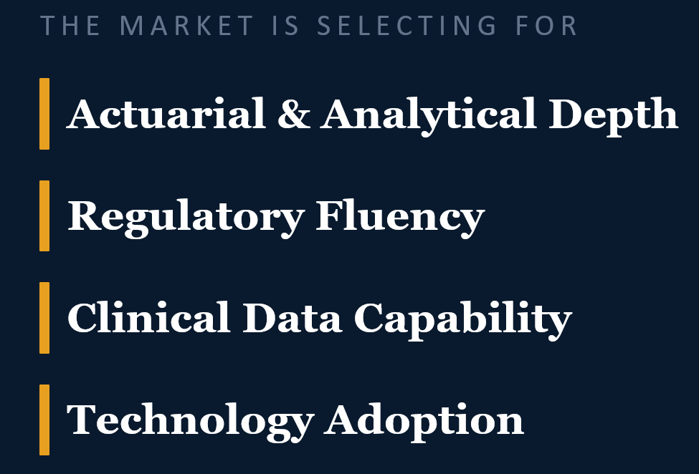

Slide 29

THANK YOU

Slide 30
NLSC Risk Conference | 2026
References & Bibliography
Sources directly cited within the presentation or providing foundational research support for data, statistics, and legislative references presented.
Slide 3
Mercer LLC
Slide 4
International Foundation of Employee Benefit Plans (IFEBP)
National Survey of Employer-Sponsored Health Plans, 2024
2025–2026 Employee Benefits Survey — Cost Drivers & Specialty Drug Report
New York, NY. Near-double-digit medical trend for third consecutive year; cost trend benchmarks in stress-scoring analysis.
Brookfield, WI. n = 150 large employer-sponsored health plans. Primary cited data source for cost driver and specialty Rx charts.
Slide 3
Drug Channels Institute
Specialty Pharmacy and GLP-1 Drug Trend Report, 2025
Slide 16
Quantum Health / Burke, Zane (CEO)
Rx trend 10–12%; specialty as 50%+ of total plan drug spend; GLP-1 utilization and cost projections.
Direct Executive Quotation — Employer Point-Solution Overload
Slide 3
U.S. Congress, 119th Session
Dublin, OH. Quoted directly in presentation. Quantum Health 2024 Employer Health Trend Report underpins vendor saturation statistics.
One Big Beautiful Bill Act (H.R. 1), 2025 — OBBBA
Slide 16
Business Group on Health
Legislative reference: HSA, FSA, Medicaid modifications, and tariff ripple effects on employer-sponsored benefit plans.
2025 Large Employers' Health Care Strategy Survey
Slide 3
Society for Human Resource Management (SHRM)
Washington, DC. Vendor management burden; % employers managing 10+ relationships; data analytics prioritization rates; bundling intent.
HR Technology & AI in Benefits Administration Survey, 2024
Alexandria, VA. 40% of HR leaders using AI in benefits administration; multi-generational workforce complexity metrics.
Slide 17
U.S. Department of Labor — EBSA
Slide 3
Blue Cross Blue Shield Association (BCBSA)
Employee Retirement Income Security Act of 1974 (ERISA), 29 U.S.C. §§ 1001–1461
Health of America Report: Behavioral Health Trends, 2024
Washington, DC. Plan fiduciary obligations, duty of prudence, and documentation requirements underpinning the six-step fiduciary framework.
Chicago, IL. Behavioral claims growth of 45–80% across commercial populations; C-suite mental health benefit gap analysis.
Slide 3
Kaiser Family Foundation (KFF)
Other Partner References found at:
Women's Health Survey & Preventive Care Access Report, 2024
www.navmd.com www.alliedadvisorsgroup.com www.acclaimhealthanalytics.com
www.springbuk.com www.gradientai.com www.Innovu.com
San Francisco, CA. 22-percentage-point increase in preventive care utilization among women; fertility benefit coverage data.

