Slide 1

Board Member to Brand Ambassador: Explaining the Value of Municipal Risk Pools
Thursday, May 14th | 10:45am

Slide 2

NLC-RISC Trustees Conference
Board Member
TO
BRAND AMBASSADOR
Communicating the Value of Your Risk Pool
Suzie Paulson & Caylee Bohannan

Slide 3

Why
THIS MATTERS
Board Members:
01
Answer Questions
02
Advocate for the Pool
Municipal pools provide strong value—but aren’t always easily understood. Board members play a critical role in how our story is understood and shared.
03
Explain the Pool’s Value

Slide 4

REALITY
The
What We Heard from Board Members:
Most feel somewhat comfortable explaining pooling, value, and changes.
Many are not frequently asked—but want to be prepared.
There is strong interest in being able to communicate clearly.

Slide 5
CHALLENGE
The Communication
“ITS NOT INSURANCE… BUT IT KIND OF IS.”
Pooling is often misunderstood—and that makes communication more challenging.
Many audiences default to thinking in terms of traditional insurance
Pooling requires a different way of thinking and explaining value
Changes—like premium adjustments or updates—can be difficult to communicate clearly without simple messaging

Slide 6
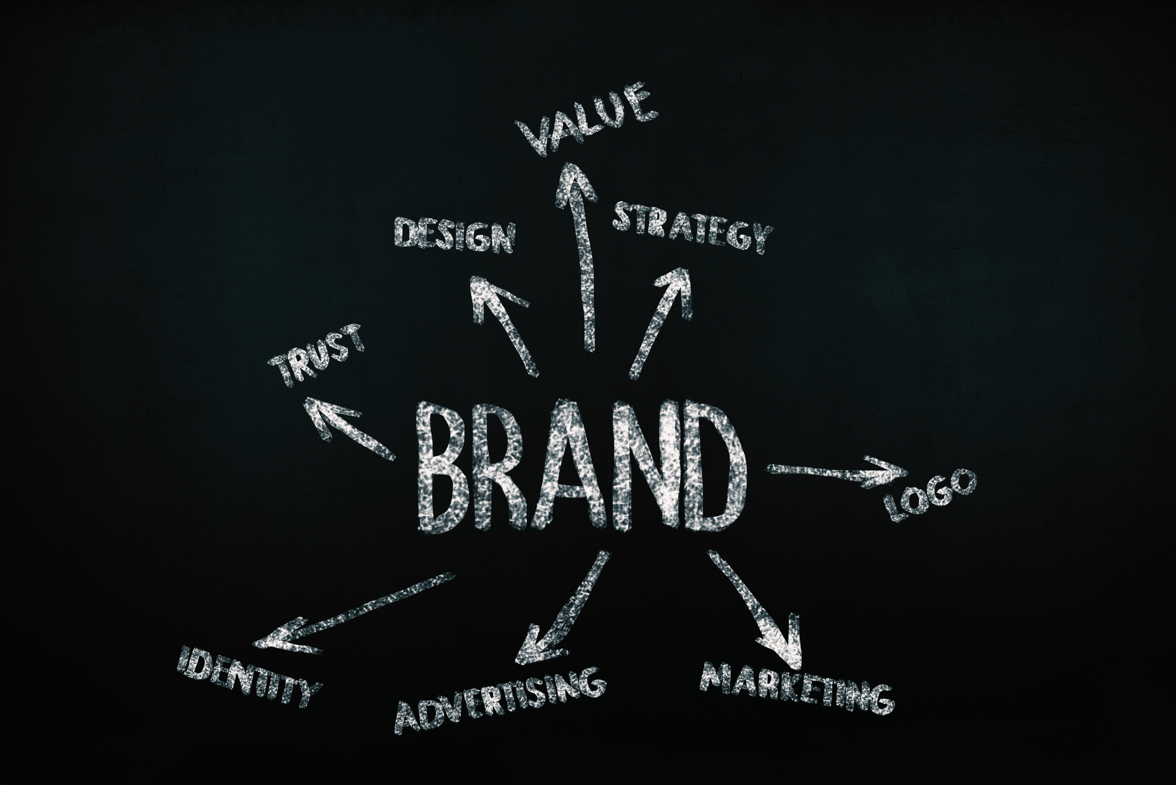
WHAT IS A BRAND
Ambassador?
01
Speaks Confidently About the Pool
02
Shares Consistent, Clear Messaging
03
Uses Real Examples and Experiences
04
Reinforces Value in Everyday Conversations

Slide 7

EXECUTIVE DIRECTOR’S
Role
Board Members Rely On:
Clear Explanations from Staff
If we don’t give the board the words, they will hesitate to speak.
Ongoing Reminders
Consistent Messaging

Slide 8

HOW BOARD MEMBERS
Succeed
01
Simple, Clear Talking Points
02
Short, Easy-to-Use Materials
03
Real-World Examples (Claims, Training, etc.)
04
Ongoing Connection with Staff

Slide 9

GIVING THE BOARD
The Words
NOT LONG EXPLANATIONS
NOT TECHNICAL DEFINITIONS
SIMPLE, REPEATABLE WAYS TO EXPLAIN VALUE—ESPECIALLY IN CHANGE

Slide 10
Simple Ways to
EXPLAIN POOL VALUE

Slide 11
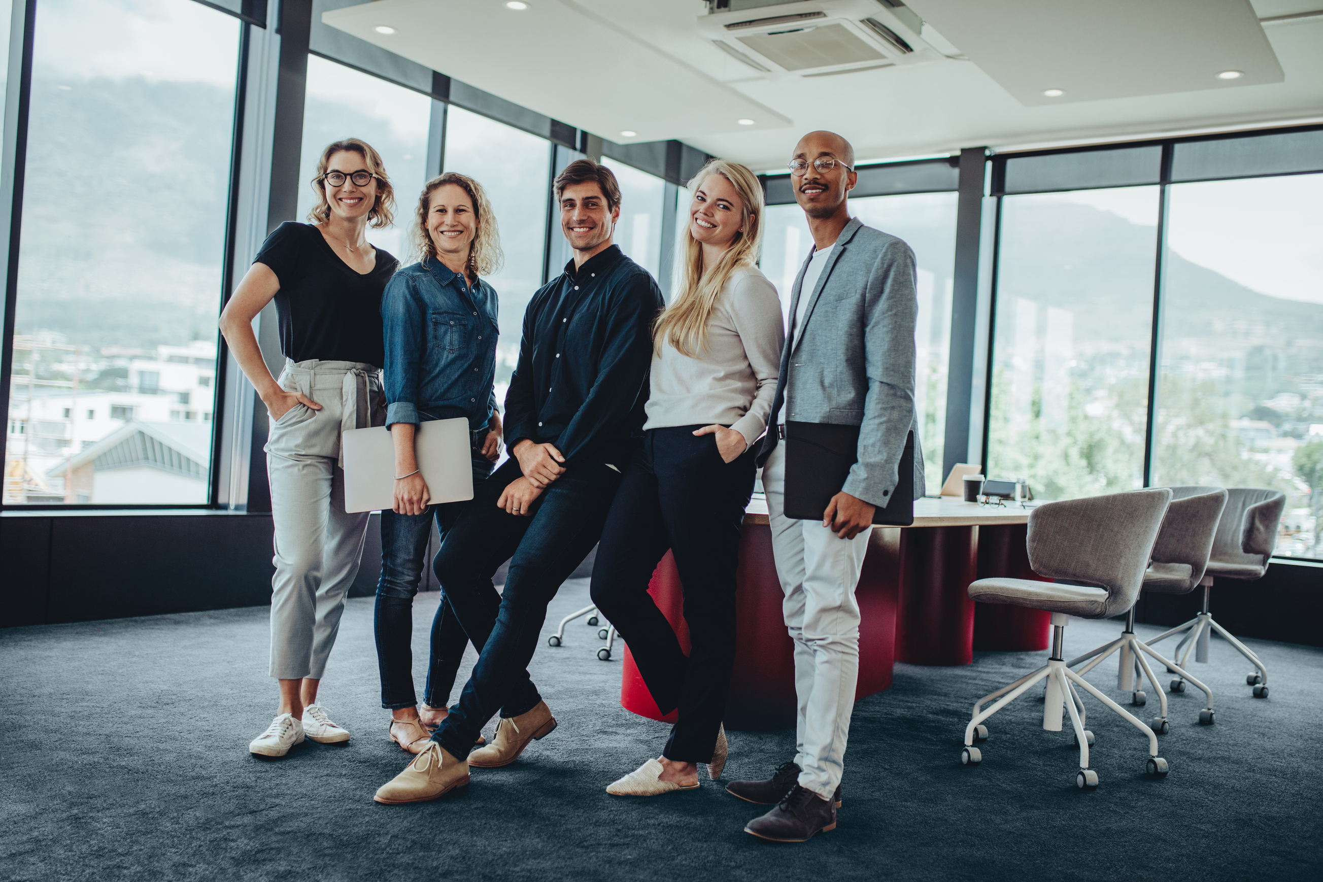
MEMBER
Owned
Board members are elected/appointed municipal leaders
No shareholders or pressure to generate profit for outside investors
Members have a say in: coverage decisions, programs offered, strategic direction
Policies and services are designed specifically for municipalities

Slide 12

STRONGER
Together
Risk sharing means losses are spread across many members
No single city carries the full burden of a major claim
Pools are more stable over time and less reactive to insurance market swings and sudden premium spikes
Collective knowledge means members benefit from: shared experiences, best practices, and lessons learned across the pool
Pools are proactive vs reactive

Slide 13
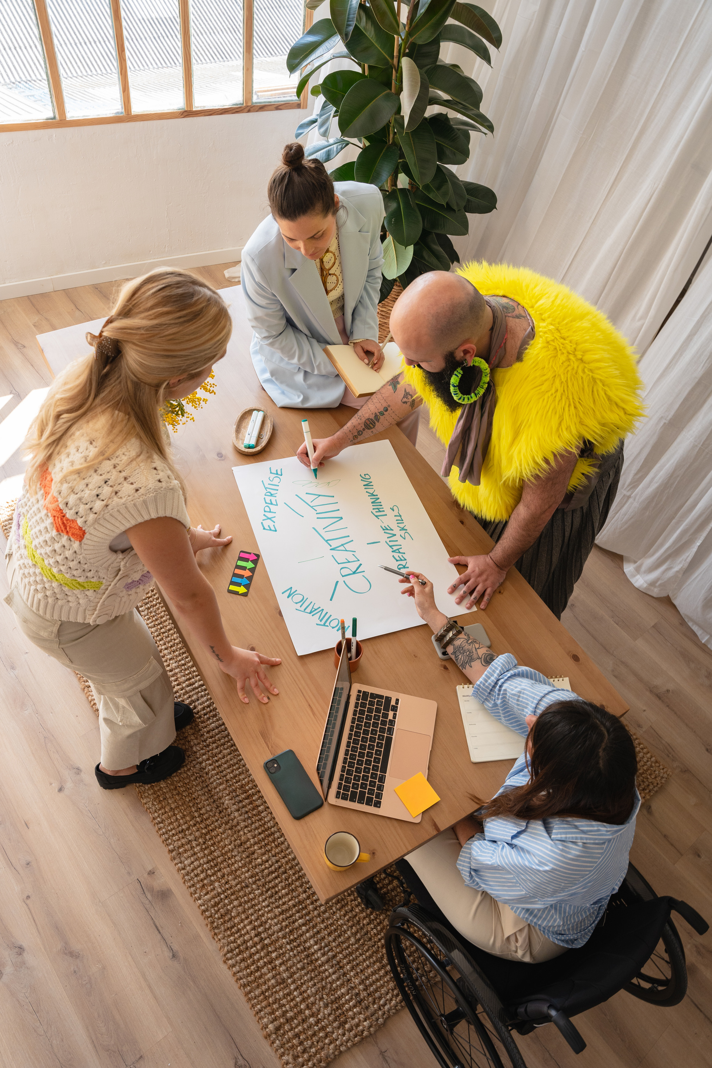
COMMUNITY
Focused
Everything the pool does is designed to support and strengthen communities—not generate profit.
01
03
REINVESTMENT MODEL
PREVENTION FOCUS
Dollars stay within the pool
Reinvested into: training programs, grants, & resources
Helping municipalities avoid losses in the first place
Safer employees, safer communities
02
04
BEYOND INSURANCE
LOCAL IMPACT
Pools provide: HR support, law enforcement training, safety programs, leadership development, etc.
Stronger municipalities = better services
Financial stability protects taxpayers & public resources

Slide 14

WHEN IT
Matters Most
WHEN PREMIUMS INCREASE
WHEN SERVICES CHANGE
WHEN MEMBERS ASK “WHY”
WHEN COMPARED TO COMMERCIAL

Slide 15

REAL CONVERSATION
Example
Scenario: Premiums have increased and members are considering going out to bid.
Less Effective:
“Rates went up because of claims and the market…”
Stonger Response:
“I understand the concern—but what makes this different is that we’re part of a member-owned pool, not just buying insurance. We’re sharing risk together, which gives us stability, and the value we receive goes beyond coverage—it supports our entire organization and community.“

Slide 16

REAL CONVERSATION
Example
Scenario: Someone asks “What do we actually get besides coverage?”
Less Effective:
“They offer some trainings and services…”
Stonger Response:
“Coverage is just one piece. We also get training, risk management support, and resources that help prevent losses—not just pay for them. That’s a big difference from traditional insurance.”

Slide 17

REAL CONVERSATION
Example
Scenario: Someone asks “Why did services change?”
Less Effective:
“That’s just what the pool decided…”
Stonger Response:
“Because the pool is member-owned, changes are made to stay sustainable and continue providing value long-term—not to increase profit. The goal is always to support members effectively.”

Slide 18

REAL CONVERSATION
Example
Scenario: Someone asks “Why are we paying for others’ losses?”
Less Effective:
“That’s just how pooling works…”
Stonger Response:
“That’s actually the strength of pooling—we share risk. No one entity carries a major loss alone, which creates more stability for everyone over time.”

Slide 19
WHY THIS APPROACH
Works
HELPS COMMUNICATE VALUE—NOT JUST INFORMATION
KEEPS MESSAGING CONSISTENT
REINFORCES VALUE IN REAL MOMENTS
BUILDS CONFIDENCE
HELPS BOARD SPEAK NATURALLY

Slide 20
Board members don’t need more information—
they need simple, confident ways to explain value when it matters most.

Slide 21
NLC-RISC Trustees Conference
THANK
You
“If we’re not clearly communicating this message, we’re missing an opportunity.”

