Slide 1

Transitioning to an Electric Future
Wednesday, October 29th | 10:45 AM

Slide 2
Transitioning to an Electric Future
electric equipment and vehicles
Lawrence J. Bohlen
Deputy Executive Director
Local Government Insurance Trust

Slide 3
Introduction
Transitioning to electric power equipment and vehicles requires a shift in safety protocols to address new hazards, particularly regarding batteries and electricity, while eliminating risks associated with traditional internal combustion fueled by gas and oil

Slide 4
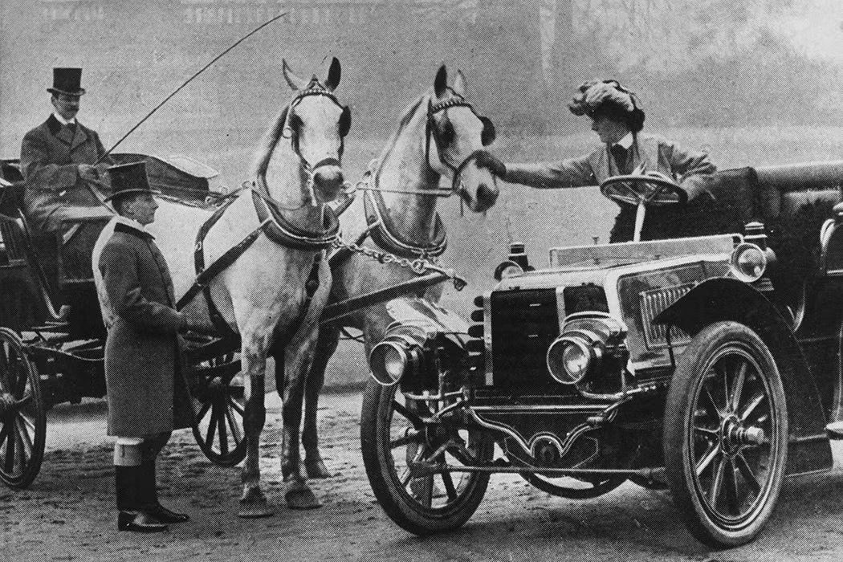
Change is always Happening

Slide 5
safety concerns for electric equipment & Vehicles
Electrical hazards
Battery and fire safety
Reduced hazards when switching from gas equipment and vehicles
Ensuring a safe transition
Special considerations for fleet vehicles and management

Slide 6
Unique Risks
Fire Risk
Battery Safety
Segregation of assets

Slide 7


Slide 8
Battery Safety
Li-ion batteries, and the things they power, are the safest technologies available today if used with proper safety protocols
Consumers and users are often lost in the jargon of thermal runaway, spontaneous ignition, battery management system, and find themselves in a quagmire of ambiguity around facts, figures, science and commercial interests which impacts decision making
As with any new technology, it is important that best practices and safety standards the deployment and use of the right combination of battery chemistry, cell design and battery management system to minimize risks of such incidents

Slide 9
Lithium-ion battery hazards
Flammable
Lithium is an alkali metal that reacts with water. To prevent a reaction with moisture in ambient air, it must be encased in a compatible substance such as oil. Lithium is flammable and can spontaneously ignite. However, lithium compounds in Li-Ion batteries differ from pure lithium metal and tend to be more stable.
Health hazard
Most incidents with lithium batteries happen when the battery’s shell is damaged, and the lithium is exposed to air/moisture. As mentioned above, lithium compounds in Li-Ion batteries tend to be more stable, though they can still be corrosive, irritating, or toxic, depending on the exact chemistry of your battery.
High voltage
Short circuits and electrical shock can cause injury, blindness, death, and damage equipment permanently. They can cause excess heat, fire, and arcing – where energy ‘jumps’ through the air to a nearby conductive material. This is especially dangerous with batteries that supply continuous strong currents.

Slide 10
Before working with Batteries
Review the manufacturer’s Safety Data Sheet
Ensure that a written protocol/procedure, including safety information, is available to all personnel involved
Make sure your batteries, chargers, and associated equipment are tested by an appropriate test standard (e.g., UL 2054) certified by a Nationally Recognized Testing Laboratory (NRTL), and rated for their intended uses
Inspect batteries for signs of damage before each use: bulging, hissing, leaking, or smoking
Do not use the battery if it displays any of these characteristics.
Remove watches, metal rings, and other metal jewelry when working with or near large batteries or power supplies. If the metal from your jewelry contacts with a terminal, you become part of the circuit. Depending on the battery's power, effects can vary from a small electric shock to burns or even electrocution
Verify that appropriate fire response and spill cleanup materials are available, including the following:
  Eye wash station
  Appropriate Fire extinguisher
  Non-conductive vessel

Slide 11
Current Battery Safety Challenges
What Causes Battery Fires and Potential Explosions?
Li-ion battery fires are never spontaneous but caused by either physical damage or because the batteries have exceeded their safe operating temperature which is possible if there was a catastrophic simultaneous failure of the battery management and thermal management systems
Proper charging procedures and maintenance are the key to safe operations

Slide 12

Not a Chew toy

Slide 13
Simple Math
The bigger the battery the more power…
The longer it will take to charge
The more powerful the charger the faster the charge
Within the manufactures specs

Slide 14
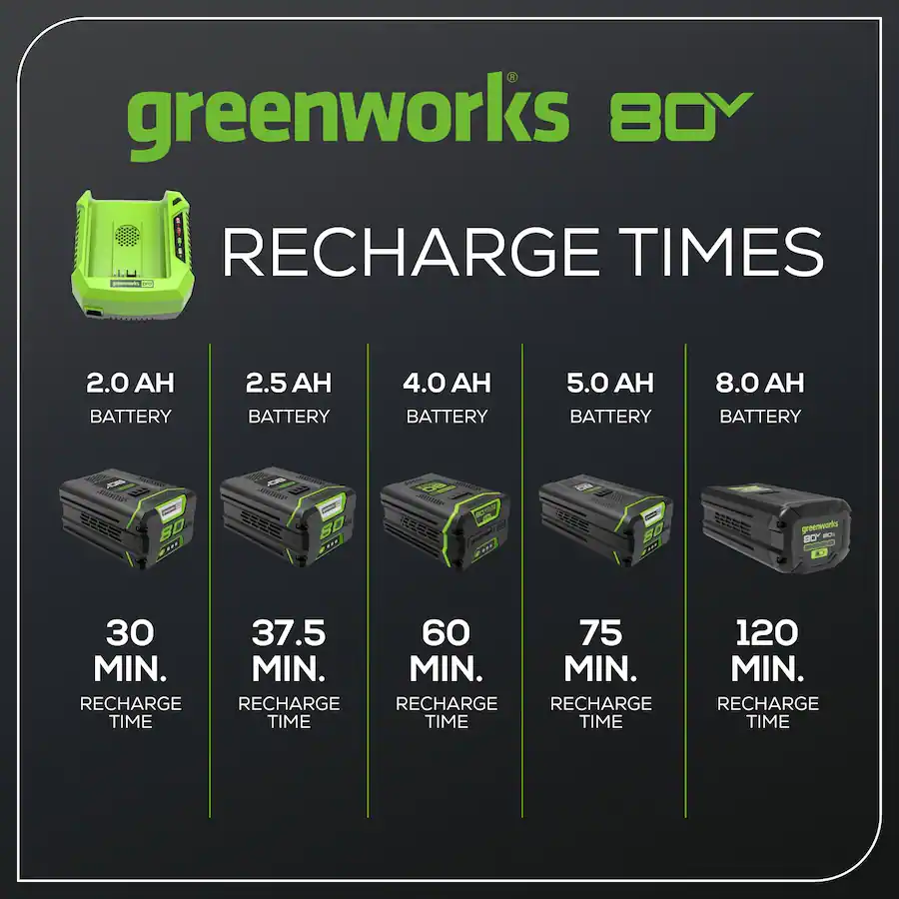
AH: Ampere Hour

Slide 15
Charging Batteries
Rechargeable batteries cannot be recharged at arbitrary rates. The fire/explosion potential increases when you charge or discharge a battery faster than the manufacturer recommends. The maximum charging rate on some types of batteries is limited by the speed at which active material can diffuse through a liquid electrolyte. The designated charging circuit must be correctly designed and constructed to handle the possible maximum load when charging
Only use chargers provided and approved by the manufacturer
Charge on non-conductive, non-combustible surfaces
Remove devices and batteries from the charger once fully charged
Prevent arcing by turning the charger off before disconnecting the battery

Slide 16
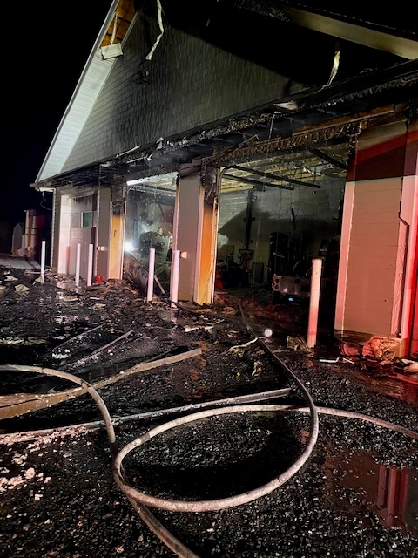
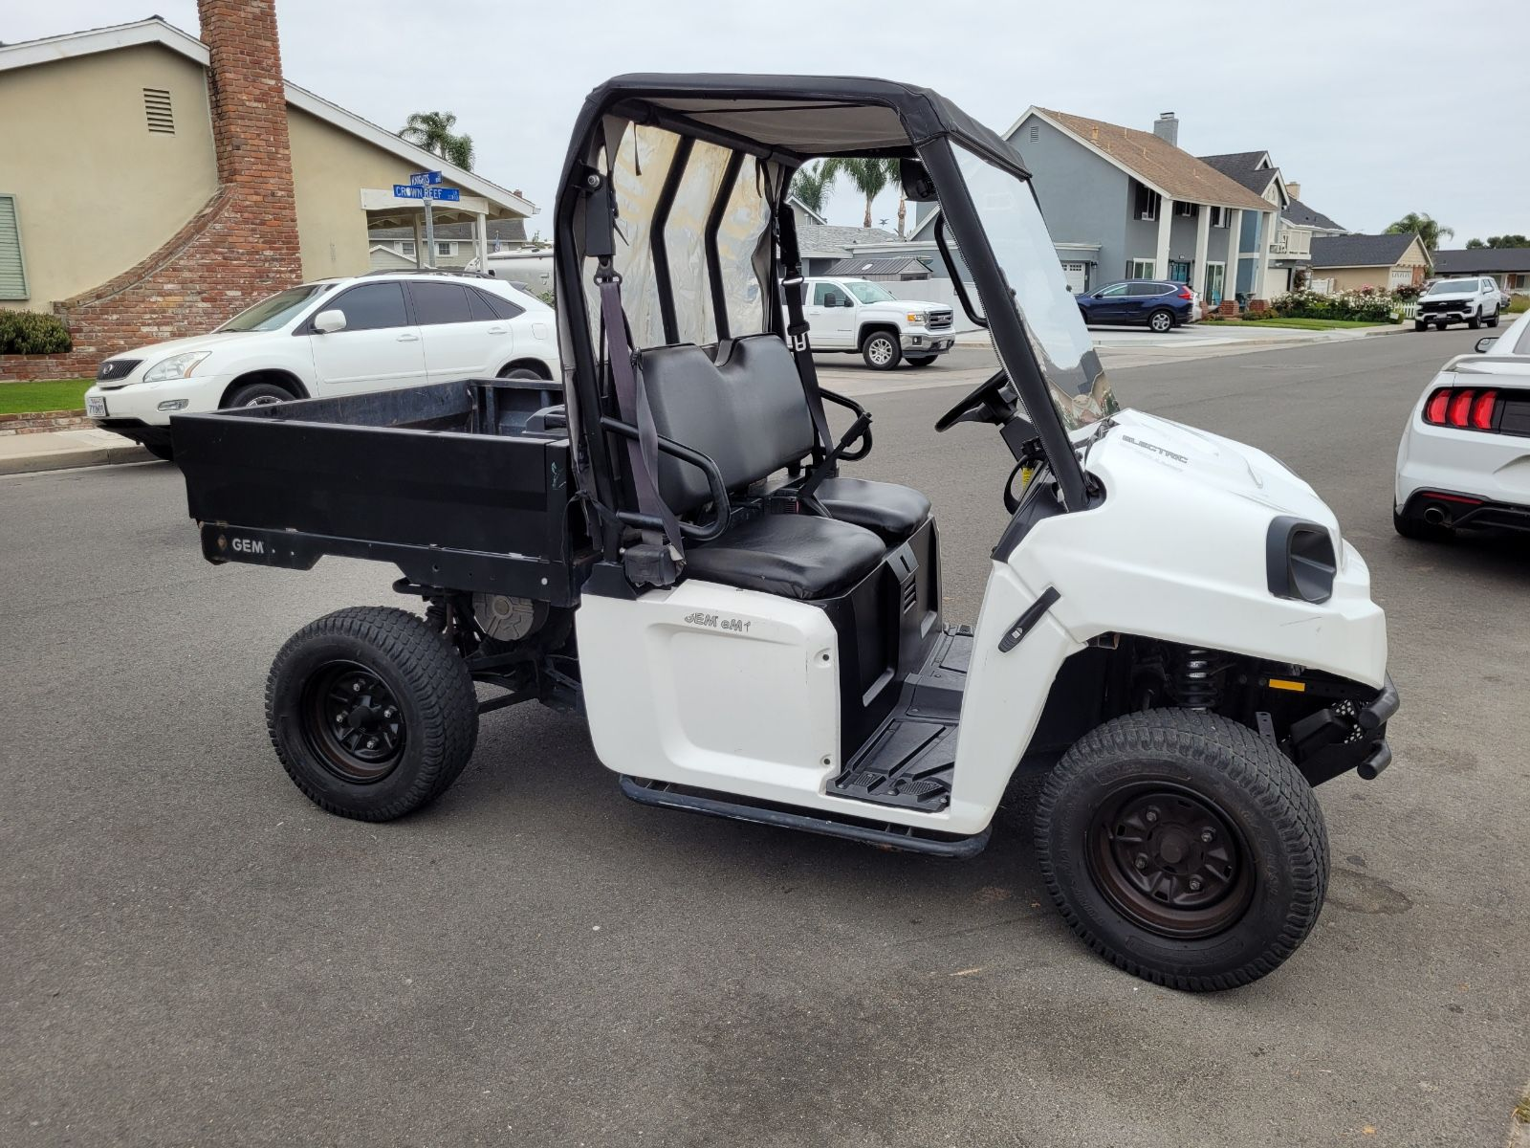
Close to Home

Slide 17
Storing Batteries
Store batteries in a dry, cool location with stable temperatures, away from direct sunlight
If applicable, use a LiPo safe bag, which helps contain heat and flames that result if a Li-Ion battery combusts during charging or while in storage
Keep the storage area clear of flammable and combustible storage
Store batteries disconnected from devices when not in use
Do not store batteries in direct contact with other batteries

Slide 18
Disposing of Batteries
Do not put lithium-ion batteries in the trash
Do not put discarded batteries in piles
Follow your waste and recycling guidelines for disposal of Li On batteries and other similar waste
Reacting and leaking batteries are considered hazardous waste

Slide 19
Stop using the device or battery
If you:
You notice an odor
The battery is visibly corroded or otherwise compromised
The battery is overheating.
The battery is hissing or making odd noises
The battery is bulging, swollen, leaking or changes shape in any way
If you notice any of the above, immediately move it away from any flammable or combustible materials and place it in a non-conductive vessel (e.g., ceramic pot) or non-conductive surface and allow it to react fully

Slide 20
Establishing Charging Needs and Options
Selecting the proper equipment and vehicles should be the preliminary step in gauging the amount of charging equipment needed
Factors to keep in mind:
The equipment/vehicle provider will typically offer several charging options and even specific equipment/provider recommendations
All-electric vehicles that drive more than 100 miles in a day may require DCFC (fast charging) for in-shift recharging
When evaluating equipment vendors, consider networking options. A networked charging system is connected to the internet and sends data, such as information on frequency of use, to the network services provider (i.e., charging network) and/or fleet administrator. Networked systems provide customer support to the fleet and allow the fleet to monitor and analyze charger use
Charging equipment down time can equate to equipment/vehicle down time, which can greatly impact operations

Slide 21
Installing Infrastructure
Establishing Charging Needs and Options
Working With Your Utility
Determining Charging Site Location
Project Planning
Implementation and Training

Slide 22
Working with Your Utility
It's important to work with the local utility early in the process to confirm charging requirements (in both the short and long term, considering future expansion), understand the resulting electrical demand (and any impacts on electricity pricing), and determine whether electrical upgrades may be needed at the charging site
The entity should work with the utility (and vehicle and equipment providers) to analyze electricity and charging-time needs by plotting electricity-use and time requirements for all equipment and fleet EVs. This will help in assessing electrical upgrade needs and choosing the appropriate number and type of charging units
Understand the impacts of greatly increased electricity consumption, especially when work equipment and several vehicles need to be charged simultaneously at high charging rate

Slide 23
Determining Charging Site Location
Site selection should include the following factors:
The number and type of charging units required in both the near and long term: If considering expansion of the number of equipment/vehicles beyond the initial deployment, consider adding extra circuits, electrical capacity, and conduit from the electrical panel to support future charger installations. It's less expensive to add this extra capacity up front vs. upgrading in the future
Metering: Consider Installing separate meters for the equipment/EVs to track their electricity usage separately. This may help you get a special electricity rate from the utility
Equipment proximity to electrical infrastructure: The further this distance, the more complicated and expensive the installation will be
Equipment proximity to a wireless internet connection, if a networked station is planned
Convenience: Equipment and EV parking should be convenient to users, but keep in mind that EVs can be parked for hours at a time for charging

Slide 24
Project Planning
The project plan should include the following:
Convening the project team: Work with the utility, equipment/vehicle provider, and charging equipment vendor to get their input to the project plans, costs, and logistics. An important logistic to consider is timing the purchase and installation of charging equipment with the delivery of vehicles (which can be especially slow/complicated for local gov. entities). Consider the project needs from the perspective of each of the following:
Establishing a charging plan, including networking requirements, electricity rate implications, and equipment ownership responsibilities
Selecting a construction contractor to bring the construction perspective to the team
Understanding codes and standards (/codes_standards.html): Charging station installations must comply with local, state, and national codes and regulations and be completed by a licensed electrical contractor
Establishing project costs, logistics, and timelines: Consider the condition and location of existing electrical equipment, which will determine the complexity of the required electrical installation

Slide 25
Implementation and Training
The final step is engineering and construction, including permitting and inspections. At this point, it may be advisable to develop charging guidelines (or an actual policy) for equipment users/drivers and staff. It's also advisable to develop a training plan for all personnel involved with battery care, equipment/vehicle usage , and even first responders in the area who may be called to the fleet location in an emergency
Personnel will need to be trained in repairing and maintaining the equipment and vehicles, both during and after the warranty period
Operations staff will need to be trained on charging logistics, which can be more complicated when many EVs and charging stations are involved
Equipment operators and EV drivers will need to be trained in the use and charging of the equipment batteries or vehicle, and this should include "refresher" training (especially when the drivers drive both EVs and non-electric vehicles)

Slide 26
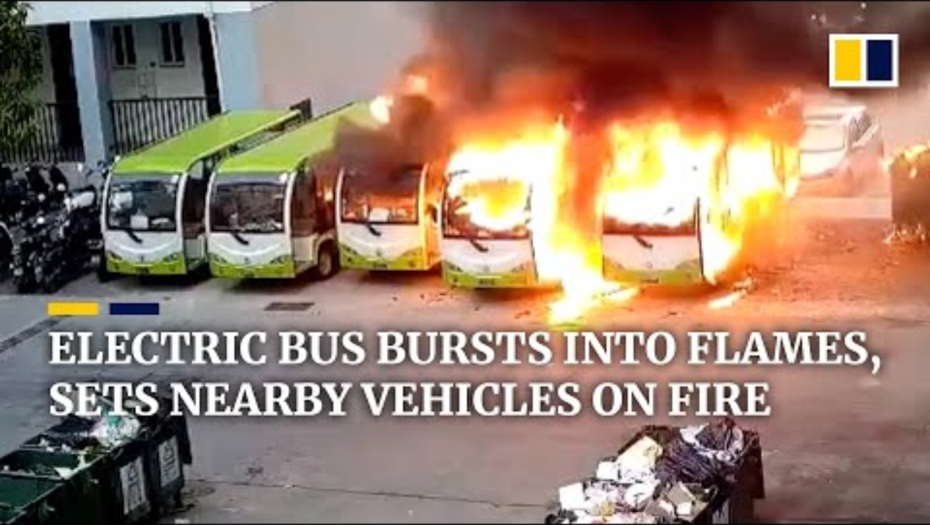
EV Fire Risks and Challenges

Slide 27
Impact on Local Governments
Cost
Transitioning Time
Development of New Infrastructure
New Operational & Safety Protocols
Finding a Qualified EV Consultant

Slide 28
Electric Vehicles for Fleets
Electric vehicles (EVs) can fulfill many daily driving needs, making them an excellent application for fleet usage. They offer many benefits and can fill roles in light-duty, medium/heavy-duty (MD/HD), and even off-road applications
However, the unique fleet environment presents considerations beyond that of the everyday consumer/driver

Slide 29
Fleet Benefits
Lower Costs
Performance
Reduced Maintenance
Flexibility
Meeting Fuel/Environmental Requirements

Slide 30
Lower Costs
EVs offer high fuel economy, which translates to lower operating cost. Light-duty all-electric vehicle Operation and Maintenance (O&M) averages about
3 cents per mile according to the U.S. General Services Administration
EVs achieve their best fuel economy during stop-and-go driving conditions typical of many fleet applications. Electricity prices are also less volatile than those of gasoline/diesel, making it easier to predict fuel costs over time

Slide 31
Performance
EVs can match or surpass the performance of their conventional counterparts, and they're much quieter. They produce maximum torque and smooth acceleration from a full stop, which can be especially useful when hauling heavy loads
Other flexible features include providing power for auxiliary applications

Slide 32
Reduced Maintenance
EVs typically require less maintenance than conventional vehicles
Less “down time”
Greater economy over time

Slide 33
Flexibility
EVs can fuel at fleet facilities or public stations
Facility charging enables EVs to charge overnight and during idle times

Slide 34
Selecting Fleet EVs
Driving/Duty Requirements
Applicable Mandates or Policies
Cost Considerations
Vehicle Selection

Slide 35
Driving Duties/Requirements
A fleet should first determine the vehicle's specific operating needs to be met, as these have an impact on the vehicle's range. Factors to consider:
Daily driving requirements (routes/miles, stop-and-go vs. highway driving, etc.) Fleet Electric Vehicle Implementation Checklist
Environmental factors like weather (e.g., extreme cold) and terrain (such as mountain driving
The vehicle's route, opportunities for charging, dwell times, and the availability of/potential demand for public charging stations (and the associated cost for charging there)
OEM vehicle maintenance and support

Slide 36
Cost Considerations
The project budget should include available funding in the short and long term to account for capital and ongoing costs, as well as available incentives for vehicles and charging infrastructure. In addition to federal and state incentives
A fleet may be eligible for incentives from the State, federal government or
utility provider

Slide 37
Vehicle Selection
Identify available vehicles that could meet the fleet's needs
Electrified repowers are also available for MD/HD vehicles, which can add even more options. These can be new vehicles where the OEM uses an authorized company to electrify the powertrain while maintaining the factory OEM warranty

Slide 38
Vehicle Selection
Once a vehicle(s) is identified, the fleet should work with the vehicle provider(s) to verify:
Vehicle availability and cost. Public fleets will need to determine if a candidate vehicle is available through their specific procurement procedures
The vehicle's charging needs and charging equipment options for the number of vehicles needed
Warranties, especially pertaining to batteries and their replacement
Vehicle maintenance and support, and the availability of local servicing. This should include a service agreement that outlines who will perform maintenance both during and after the warranty period and how (and by whom) your service technicians will be trained in this
Driver training if offered by the provider

Slide 39
Resources
https://www.transportation.gov/rural/ev/toolkit/planning-resources
https://afdc.energy.gov/vehicles/electric_fleets.html
https://greeningthegrid.org/news/ev-fleets-resources-now-available

Slide 40
Questions?

Slide 41

Thank you!

