Slide 1

Stanley v. City of Sanford:
The Supreme Court’s Impact on Municipal Liability for Claims of Disability Discrimination in Retirement Benefits
Tuesday, October 28th | 1:45 PM

Slide 2


Stanley v. City of Sanford:
The Supreme Court’s Impact on Municipal Liability for Claims of Disability Discrimination in Retirement Benefitsisrimition in Retirement Benefits
Jessica C. Conner, B.C.S.
Board Certified in Appellate Practice
BENTO, ESQ.

Slide 3
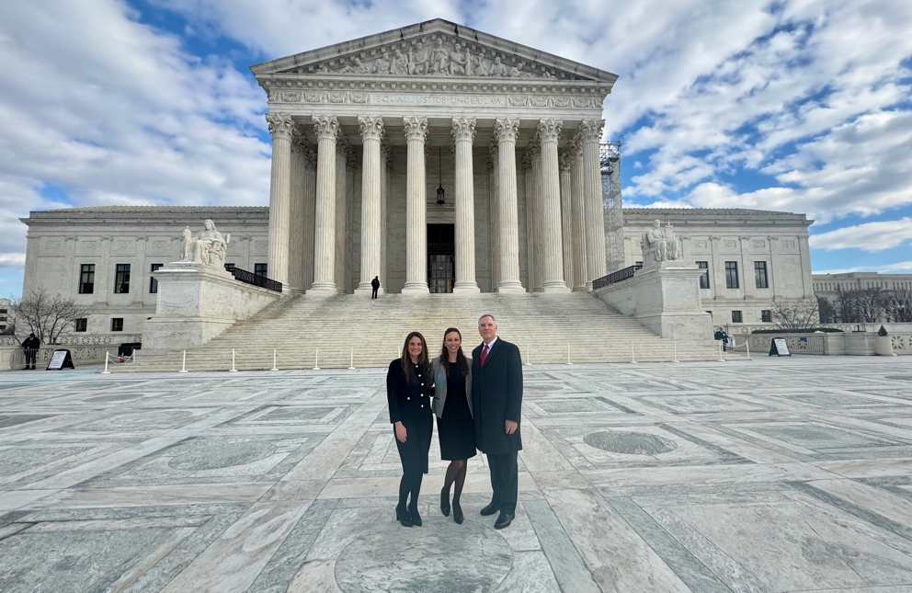
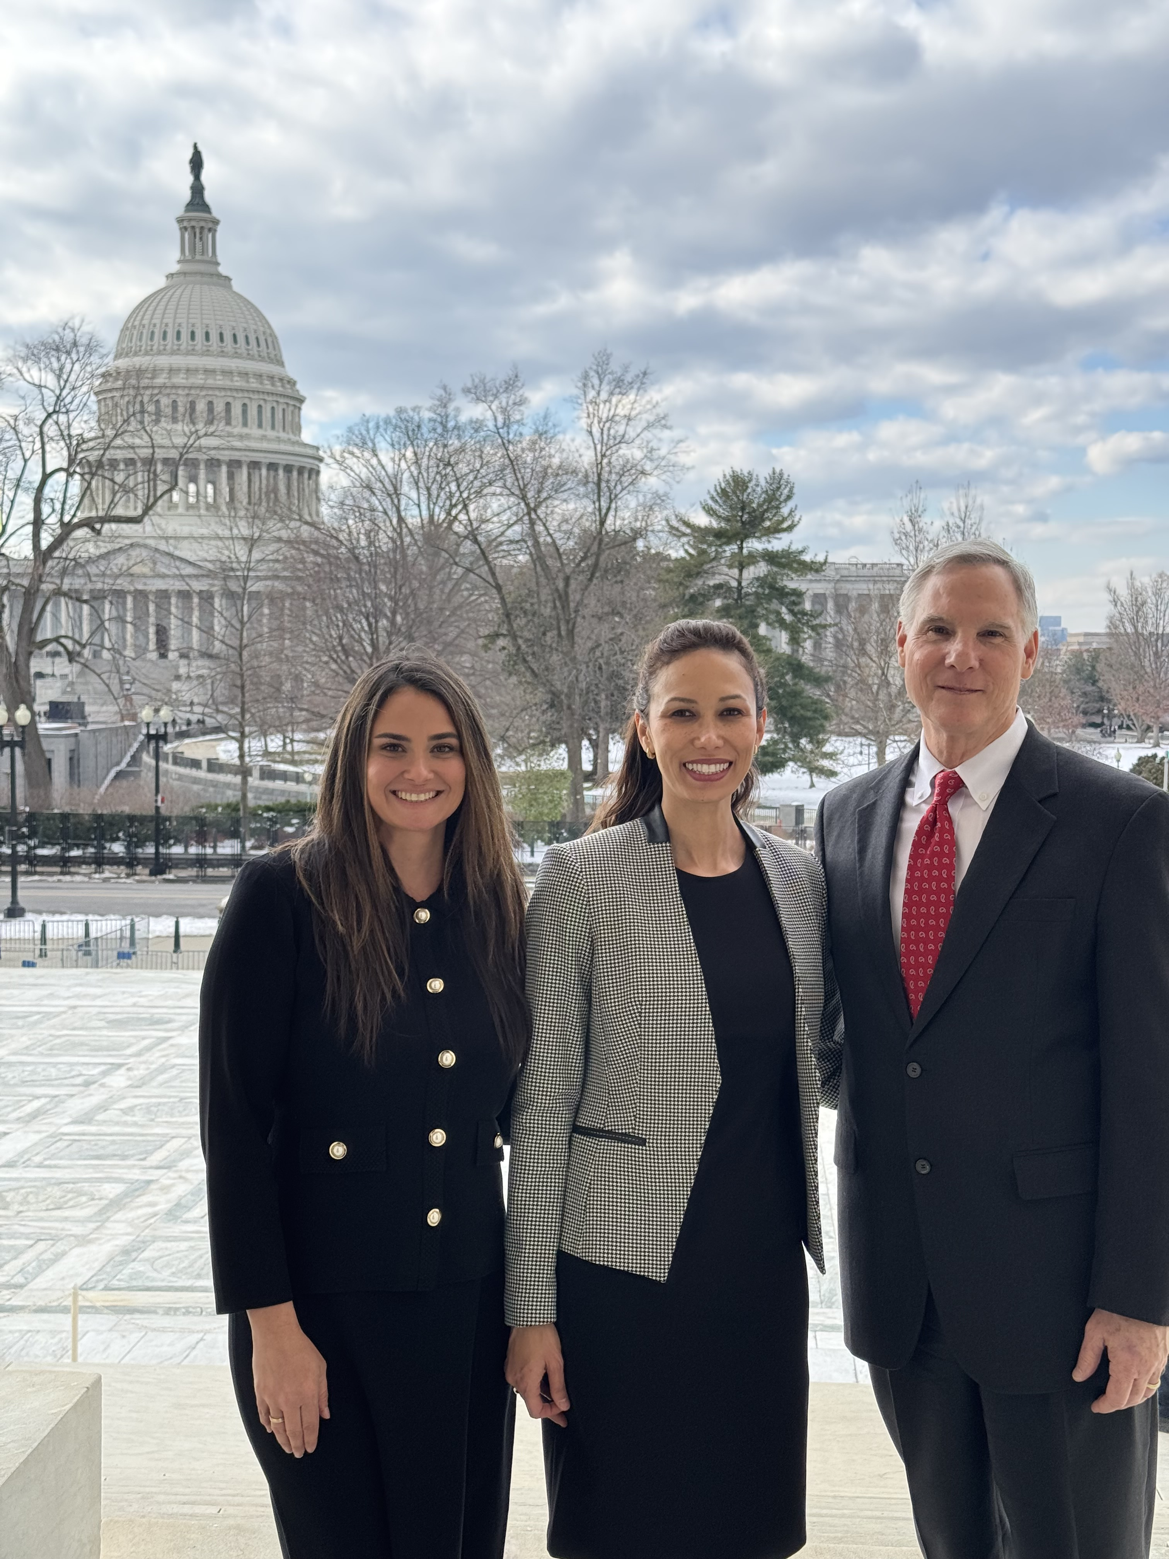
Stanley v. City of Sanfordntiment Benefits

Slide 4

FACTS OF THE CASE
Plaintiff was a firefighter hired in 1999.
17 years later, she developed Parkinson’s in 2016.
In 2018, she retired early under a disability retirement plan.
The plan provided lesser benefits than a service retirement plan.
She sued the City alleging disability discrimination under the Americans with Disabilities Act (ADA).

Slide 5
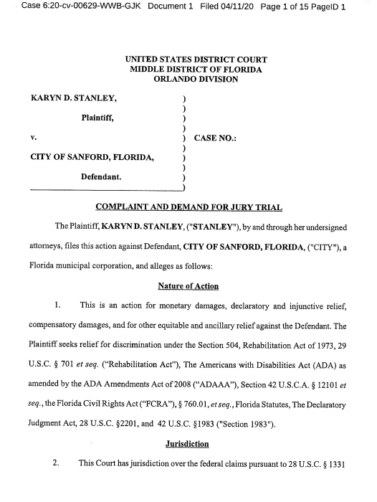
THE COMPLAINT
She sued in a federal court in Florida.
1999 Retirement Policy | 2003 Retirement Policy
Health insurance to age 65: 25-year retirees employees who retire early due to total disability No health insurance: Retirees with less than 25 years and not totally disabled | Health insurance to age 65: 25-year retirees Health insurance for 2 years after retirement: employees who retire early due to total disability No health insurance: Retirees with less than 25 years and not totally disabled

Slide 6

THE COMPLAINT
City publicly announced the 2003 policy change.
Ordinance
Human Resources Manual
Plaintiff’s counsel argued it was done in secrecy.

Slide 7
THE COMPLAINT
2018: Plaintiff retires early after 20 years.
Alleges she learned of the 2003 change for the first time.

Slide 8
THE COMPLAINT
She claimed she was entitled to the same subsidy as 25-year retirees even though she only worked for 20 years.
She argued the reason she was denied the same benefit as 25 year retirees was because of her disability
The City argued that the reason she was treated differently was not due to her disability but her failure to serve for 25 years.
If she had served 25 years she would have received the full subsidy despite her disability.

Slide 9
THE TIMELINE
DURING EMPLOYMENT:
1999: hired
2003: retirement plan change
2016: Parkinson’s diagnosis
2018: retires early, disability pension
POST-EMPLOYMENT:
2018 - 2020: receives health insurance subsidy for 24 months
Nov. 2020: health insurance subsidy ends (alleged discriminatory act)
She argued that when the subsidy ended in 2020—two years after she retired—the City discriminated against her in violation of the ADA.

Slide 10
THE TEXT OF THE ADA
Under the ADA, it is only unlawful to discriminate against a qualified individual because of disability.
“Discriminate” = to treat worse
A “Qualified Individual” is someone who can perform the essential functions of the job that such individual holds or desires.
So, the ADA prohibits treating a person who can perform the job they hold or desire, worse just because they have a disability.

Slide 11
THE MOTION TO DISMISS
The City argued Plaintiff was not a “qualified individual” at the time the subsidy stopped and so she was not entitled to sue under the ADA.
At the time of the alleged discrimination, she could not perform the job she held or desired.
totally disabled and
no longer employed.

Slide 12
THE MOTION TO DISMISS
We argued to the trial court that it was bound to follow the case law of the Eleventh Circuit Court of Appeals interpreting the language in the ADA to mean that a totally disabled former employee cannot sue under the ADA for discrimination occurring post-employment when they are no longer “qualified individuals.”

Slide 13
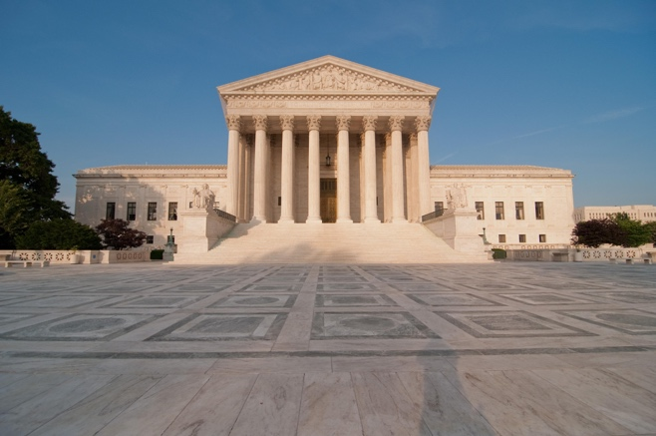
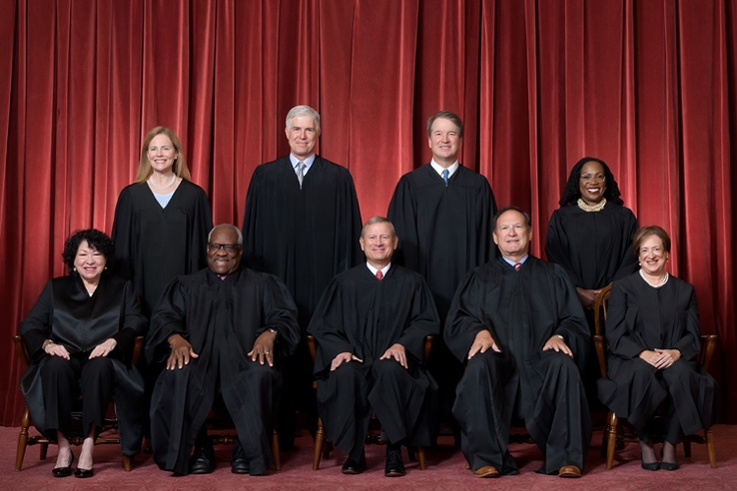



Federal Court System
U.S. Supreme Court
11th Circuit Court of Appeals
Intermediate courts of appeal
(13 courts)
Middle District of Florida
94 trial courts

Slide 14
Plaintiff’s aRGUMENT:
Plaintiff argued that trial court should ignore the 11th Circuit’s caselaw and follow the law of other Courts of Appeal.
The Second and Third Circuits interpreted the ADA to allow retirees to sue for discrimination occurring post-employment.

Slide 15
REMEMBER:
Under the ADA, a “Qualified Individual” is someone who can perform the essential functions of the job that such individual holds or desires

Slide 16
Plaintiff’s Argument:
Under Second and Third Circuit caselaw, the present tense language in the ADA was not important.
They argued there was no way Congress intended the 11th Circuit’s interpretation where an employer could do to an employee the day after retirement what it could not do the day before.
They found the ADA language was ambiguous as to whether one must be a QID at the time of the discriminatory act. And therefore, they chose the interpretation that would most fit with the purported purpose of the ADA.

Slide 17
TRIAL COURT DISMISSES Plaintiff’s ADA CLAIM
Trial court adheres to 11th Circuit case law and dismisses the claim.
Because Plaintiff only alleged that the discrimination occurred post-employment in 2020 when Plaintiff was no longer a qualified individual, she could not state a claim under the ADA.

Slide 18
Appeal to 11th Circuit Court of Appeals
11th Circuit affirms dismissal

Slide 19
Plaintiff Petitions the Supreme Court
U.S. Supreme Court

Slide 20

Supreme Court Jurisdiction
Discretionary jurisdiction
7,000 – 8,000 petitions per year.
Takes approximately 80 cases.
Only the most important issues:
Circuit Split
(Conflict in the law)

Slide 21

Supreme Court Jurisdiction
ISSUE: Can plaintiffs sue for Post-Employment Discrimination under the ADA?
CIRCUIT SPLIT:
6th, 7th, 9th & 11th Circuits | 2nd & 3rd Circuits
No | Yes

Slide 22

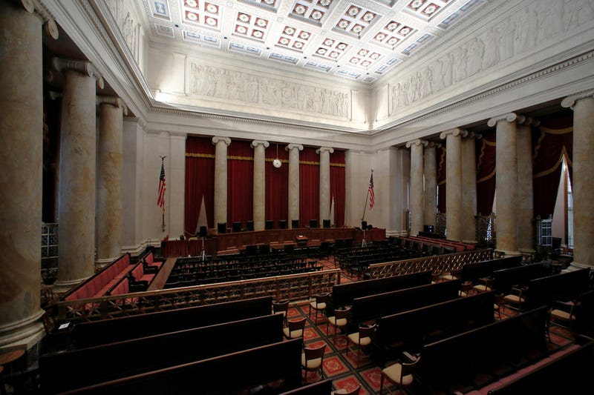
Oral Argument: 1/13/25

Slide 23
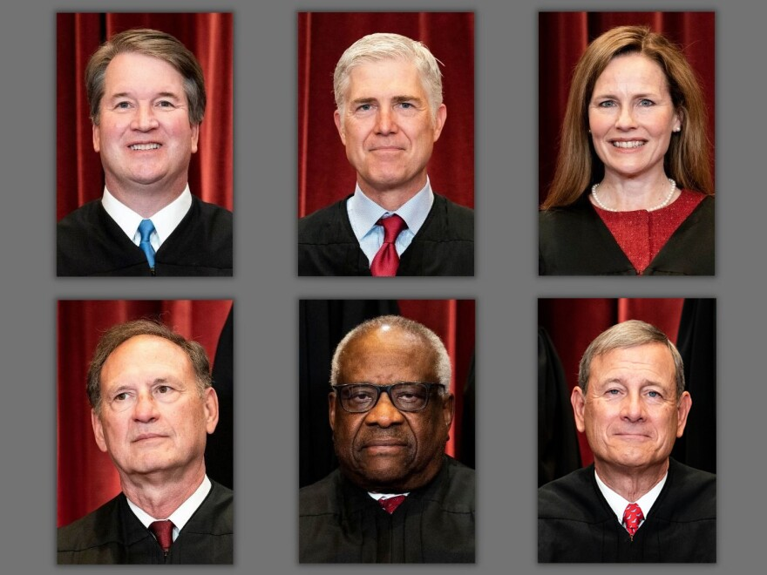
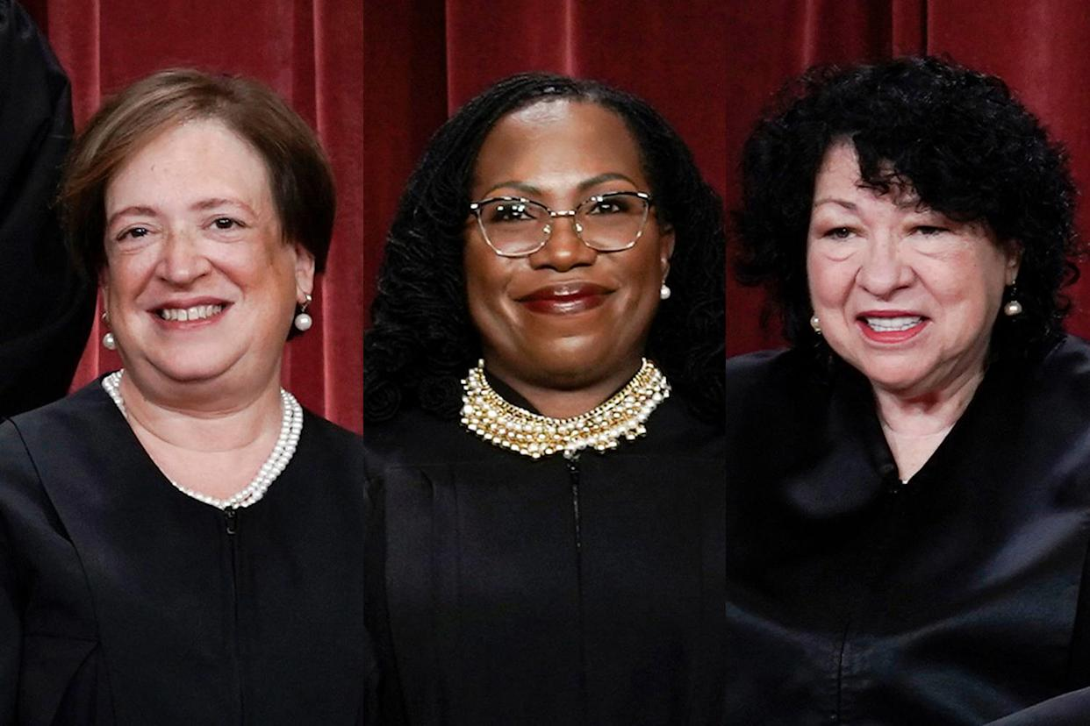
Oral Argument: 1/13/25
9 Justices
Must convince 5 to win

Slide 24
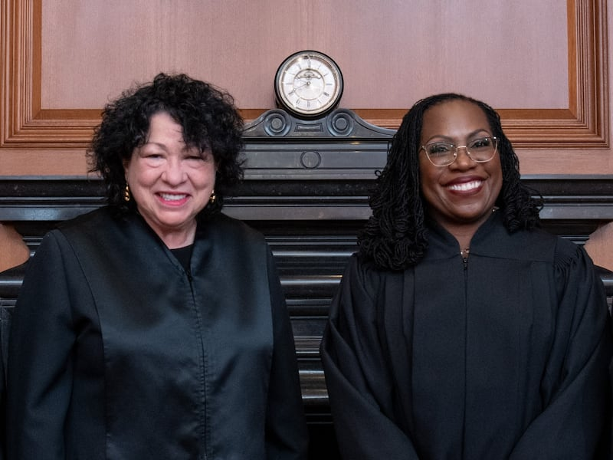
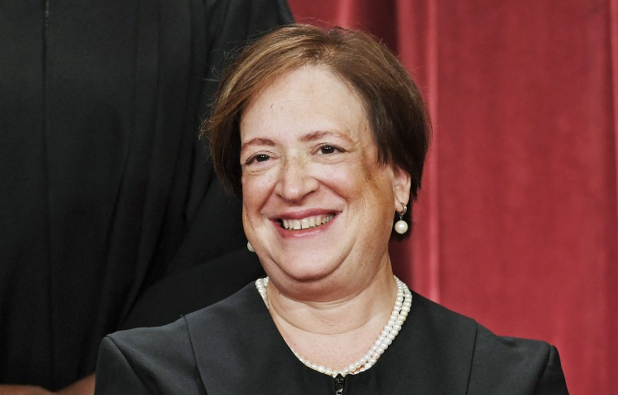
6/19/25 Opinion: 7-2 for the City
Dissent in favor of Stanley
Majority in favor of City

Slide 25
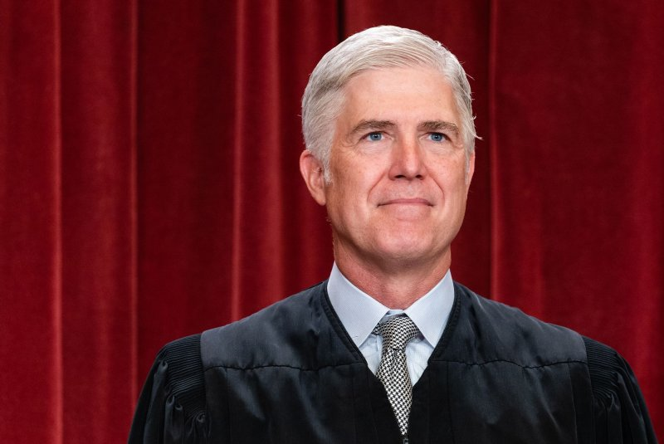
6/19/25 Opinion
Justice Gorsuch writing for the majority held:
Under the ADA, “a plaintiff must plead and prove that she held or desired a job, and could perform its essential functions…at the time of an employer’s alleged act of disability-based discrimination.”
Because Plaintiff alleged she was totally disabled, could not perform, and was retired at the time of the alleged discrimination (when City stopped paying in 2020), she could not state a claim under the ADA.

Slide 26
THE TIMELINE
DURING EMPLOYMENT:
1999: hired
2003: policy change
2016: Parkinson’s diagnosis
Nov. 1, 2018: retires early, disability pension
POST-EMPLOYMENT:
Nov. 2, 2018 – Nov. 2, 2020: receives health insurance subsidy for 24 months
Nov. 3, 2020: health insurance subsidy ends
So if she had alleged that at sometime between her 2016 diagnosis and 2018 retirement that she was subjected to the 2003 policy, maybe that would have sufficed. Instead, she said she was not discriminated against until post-employment.

Slide 27

Effect on lower courts
RESOLVED THE CIRCUIT SPLIT:
ESTABLISHED THE LAW OF THE LAND:
A plaintiff must be a “qualified individual” at the time of the discriminatory act – not at the time of the lawsuit.

Slide 28

Misinformation
Many have misreported the decision
Claim that retirees can never sue under the ADA

Slide 29
Effect on lower courts
RETALIATION CLAIMS | DISCRIMINATION CLAIMS
In all circuits, a plaintiff can sue for post-employment retaliatory acts | Cannot sue for post-employment discriminatory acts
e.g., an employee complains about discrimination. The employee quits and starts looking for a job elsewhere. The employer, in retaliation for complaining about discrimination, gives a bad referral to a new employer. That is a retaliatory act that occurs post-employment when no longer QID and it is actionable. Whether a plaintiff is a QID is irrelevant for a retaliation claim. | But have to be QID to sue for discrimination – think about why this makes sense. Employers must be able to fire employees who cannot perform the job, with or without a reasonable accommodation, due to their disability.

Slide 30

Practical Impacts
Does this mean that employers should wait until a disabled employee retires to take away their pension?
Of course, not.
Morally wrong and could result in liability under other laws, if not the ADA.
(Equal Protection Clause, Breach of Contract, ERISA, Fraud claims)

Slide 31
Practical Impacts
Discrimination Post-Employment:
No ADA claim – not QID when retired
Equal Protection Clause claim Cannot treat similarly situated people differently.
Breach of contract – in Florida, if your right vests before retirement, then it is a breach to take it away after retirement.
ERISA

Slide 32
Budgetary Concerns
Cities are faced with legitimate budgetary concerns.
Can they change plans before retirement?
May not be a breach of employment contract – no vested right yet
But could be an ADA violation – because now the person is employed and able to do the job (i.e. QID) at the time of the alleged discrimination (the policy change). Stanley failed to allege this.

Slide 33
But what if Stanley had alleged the discrimination was during employment?
Her claim still would have failed because the City’s policy change was not on the basis of disability. It was based on years of service. The ADA only prohibits discrimination on the basis of disability.

Slide 34
Budgetary Concerns
Changes before retirement:
Can change retirement policies to cut costs so long as not on the basis of disability. Can reduce benefits based on years of service.
Disability retirement plans can provide lower benefits than service retirement plans.
The ADA does not require service retirement plans and disability retirement plans to provide the same level of benefits because they are two separate benefits which serve different purposes.
Morgan v. Joint Admin. Bd., Retirement Plan, 268 F.3d 456, 459 (7th Cir. 2001): “On the one hand, a normal retiree will get a larger pension than a disability retiree because he has more years of service. On the other hand, a worker who becomes totally disabled can obtain benefits with only nine and a half years of service. He gets a smaller pension, but gets it sooner, maybe much, much sooner, in which event he may…be treated better than a normal retiree.”

Slide 35
Guiding Principles
Plans can offer different levels of benefits.
The ADA requires only that persons with disabilities have the opportunity to receive the same benefits as non-disabled officers who have given an equivalent amount of service.
So whether an employee has a disability or not, if they meet the criteria of a plan (work 25 years) they can receive the benefits.

Slide 36
Plans that do NOT violate the ADA
The service retirement plan allows employees with 20 or more years of service to retire at 50 percent of their highest annual pay. Meanwhile, the disability retirement plan provides benefits of only 45 percent of highest pay.
The service retirement plan provides periodic increases (e.g., annual cost-of-living increases), but the disability benefits remain fixed.
The service retirement plan disregards outside income, but the disability retirement plan offsets benefits with outside earnings.

Slide 37
Plans that do NOT violate the ADA
The ADA does not require employers to offer disability retirement plans at all, regardless of whether they offer service retirement plans. An employer that only offers a service retirement plan does not violate the ADA, as long as the plan treats persons covered by the ADA the same as all other employees.

Slide 38
Plans that violate the ADA
An employer requires those covered by the ADA who qualify for both a service retirement and disability retirement plan to take the disability benefit, which is less advantageous.
An employer requires those covered by the ADA to serve 30 years to obtain a service retirement benefit, but requires those not covered by the ADA to serve only 25 years.
An employer provides those covered by the ADA who take disability retirement a benefit equal to 33 percent of their highest pay, but provides all others with a benefit equal to 50 percent of their highest pay.

Slide 39
Plans that violate the ADA
An employer gives those covered by the ADA who earn a service retirement benefit a cost-of-living increase every three years, but gives all others a cost-of-living increase every year.
An employer excludes from the disability retirement plan an employee who otherwise meets the plan's criteria, but has a particular disability.

Slide 40
Take-aways:
WRONG | CORRECT
Former employees can never sue for discrimination under the ADA | Former employees (retirees, terminated employees, those who quit) can sue for ADA discrimination if the discrimination occurred while a qualified individual during employment. Former employees can sue for retaliation that occurs post-employment because don’t have to be QID to claim retaliation.

Slide 41
Take-aways:
WRONG | CORRECT
Employers can take away retirement benefits so long as they do it post-employment. WRONG Disability retirees are entitled to the exact same benefits as for service retirees | Employers who take away retirement benefits post-employment based on animosity towards the disabled will still be liable for a variety of claims (breach of contract, Equal Protection, ERISA). CORRECT Service and disability retirement plans do not have to be the same because they are not the same – serve different purposes.

Slide 42
THANK YOU!
Jessica C. Conner, B.C.S.
Board Certified in Appellate Practice
BENTO, ESQ.

