Slide 1

Seamless Data, Smarter Risk: Archipelago’s AI-Driven Risk Transformation for Utah Local
Governments Trust
Monday, October 27th | 11:00 AM

Slide 2

Seamless Data, Smarter Risk: Archipelago’s AI-Driven Risk Transformation for Utah Local
Governments Trust
Oct. 27, 2025
Notes:
Entities: pool managers, members, and super pools

Slide 3
The Pooling Problem
Many pools still use Excel for managing their SOV
Pools have their own in house-built systems which are becoming outdated. Moving to Origami or another platform can be expensive and painful
Pool members also use excel to manage their SOV or have antiquated RMS in place that doesn’t interact with pool RMS

Slide 4
The New Way
Centralized Data Management: Replace outdated systems with a unified platform for real-time SOV updates and management.
Automated Data Validation & Alerts: AI flags data errors and reduces manual vetting for administrators and members.
Enhanced Data Insights: Generate advanced reports, highlights priorities, and uses "Pre-Check" for key areas.
Integration Capabilities: Connects seamlessly with platforms like Origami to streamline data exchange and reduce duplication.
Data Enrichment: Enhance data quality through document uploads and bulk enrichment with third-party reports.
Valuation Outliers: Benchmark building valuations against third-party data for accurate assessments.
Seamless Pool to Broker Workflow: Provide brokers with direct access to pool data for faster, easier submissions.

Slide 5
Utah Case Study
The Challenge
A large pool with 600 members relied on a self-built system for managing member applications and risk data, leading to: ✔ Disconnected & inconsistent data ✔ Manual processes for appraisers & claims adjusters ✔ Inefficiencies in broker submissions
The Solution
With Archipelago, Utah Government Trust: ✅ Centralized all data into one single database ✅ Enabled appraisers to upload data directly, enriching quality & completeness ✅ Provided brokers with direct access to pool data for faster, easier submissions ✅ Enriched data which resulted in 40% AAL reductions
Long-Term Goal
Scale data-driven decision-making across all members
Enable continuous data enrichment for better underwriting outcomes

Slide 6
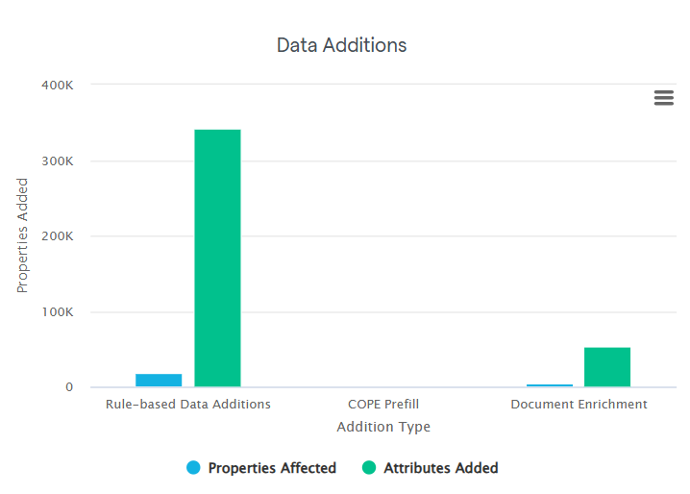
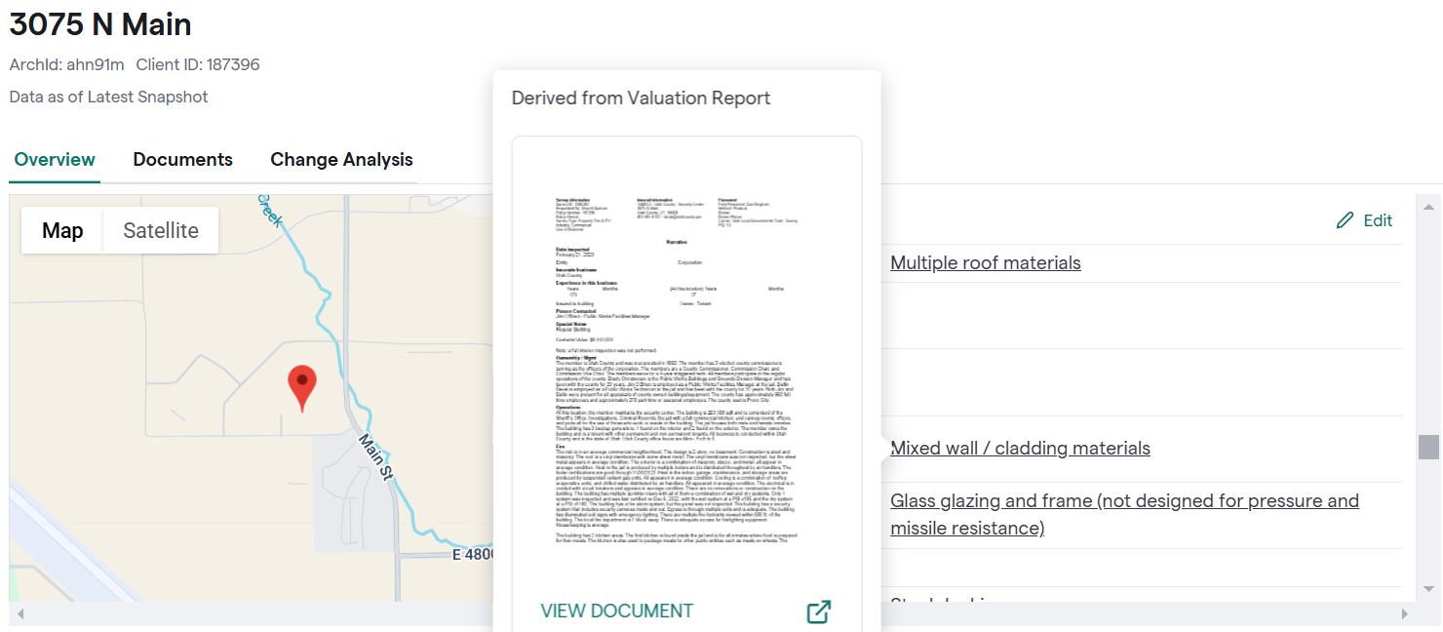
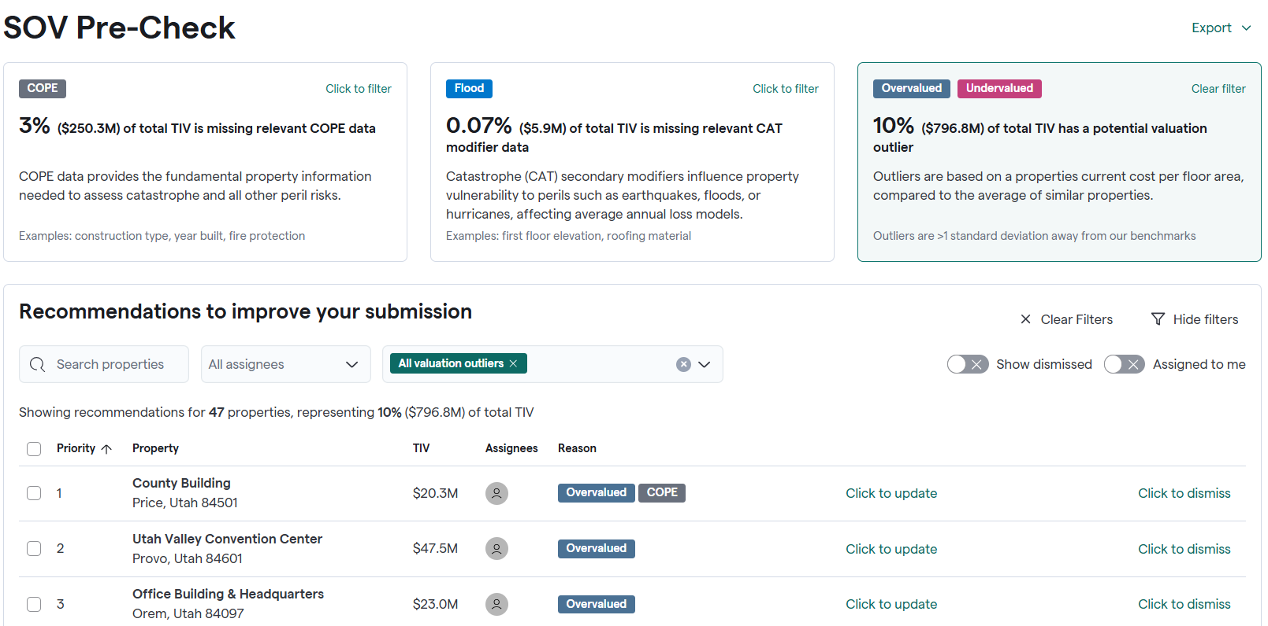
Immediate Impact to Utah LGT
341,000+ data points added via Archipelago Transformations and COPE Prefill
+9,000 documents provided to enrich 53,700+ data points
47 locations flagged as potential valuation outliers (>1 σ from benchmarks) or missing CAT modifiers

Slide 7
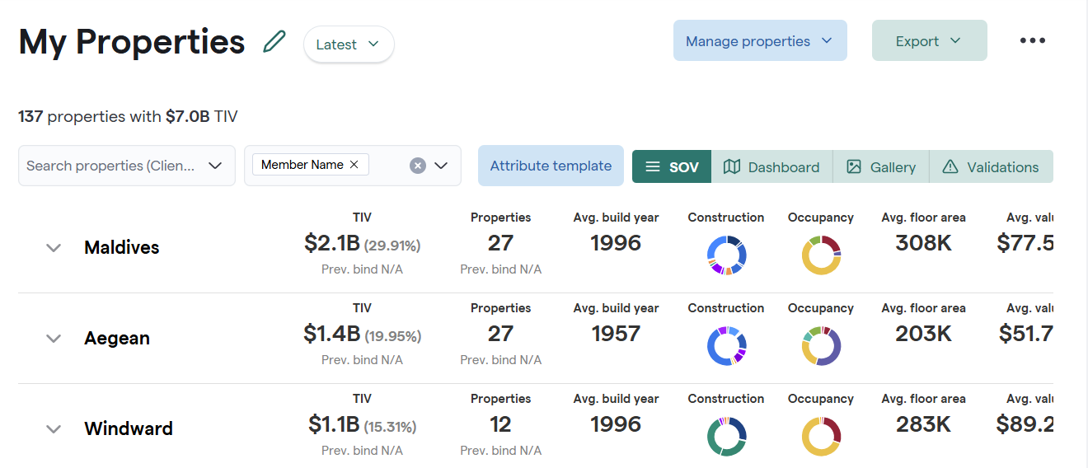
Member Overview
Pool managers can easily view summary statistics by member over time / drill down.

Slide 8
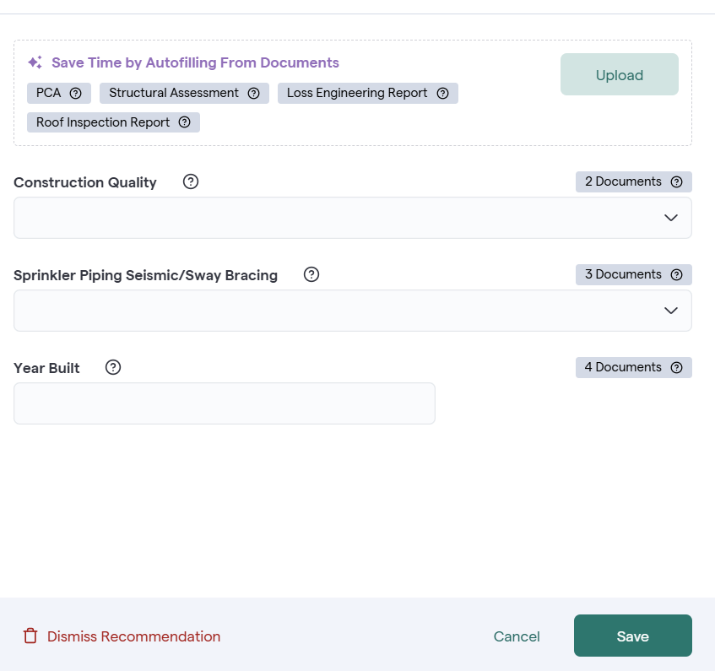
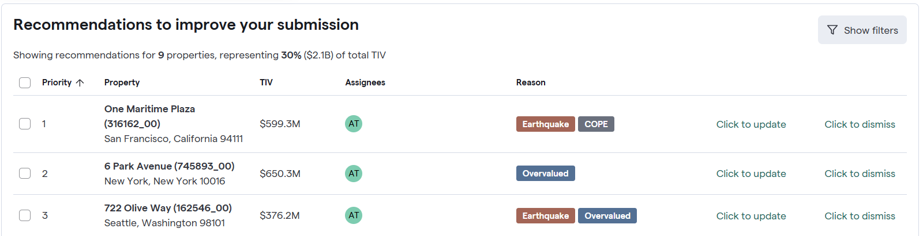
Recommendations
Pool managers and members can review and address Archipelago recommendations to improve data by document upload or providing values if known.

Slide 9
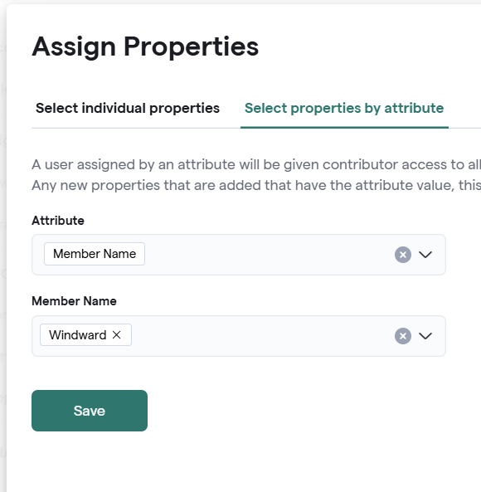
Archipelago Member Access
Pool manager account admins can manage and grant member access utilizing a simple rule-based setup to grant permission to view and manage member properties.

Slide 10
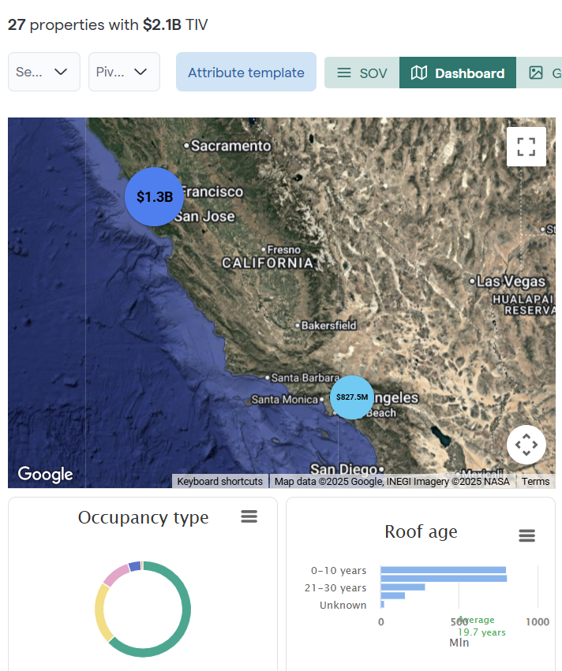
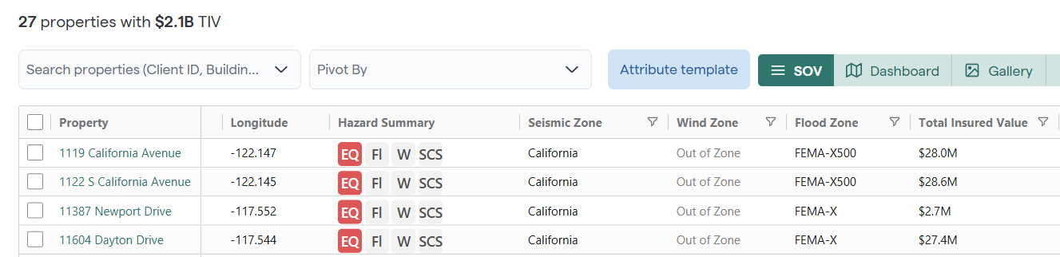
Member Analytics
Members see Archipelago's flexible grid with search and pivot as well as analytics, all filtered to only their properties.

Slide 11
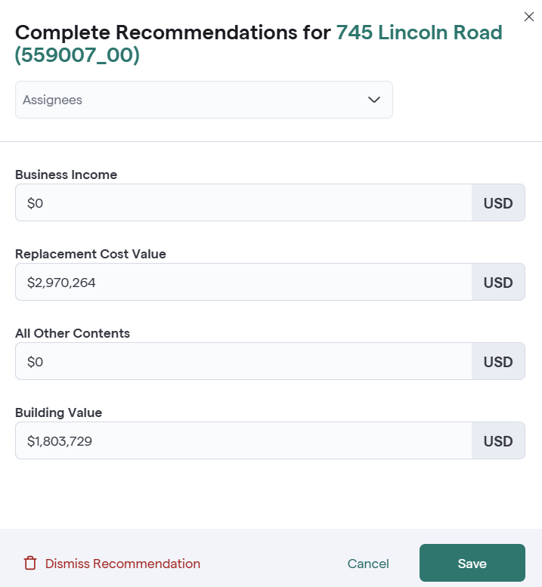
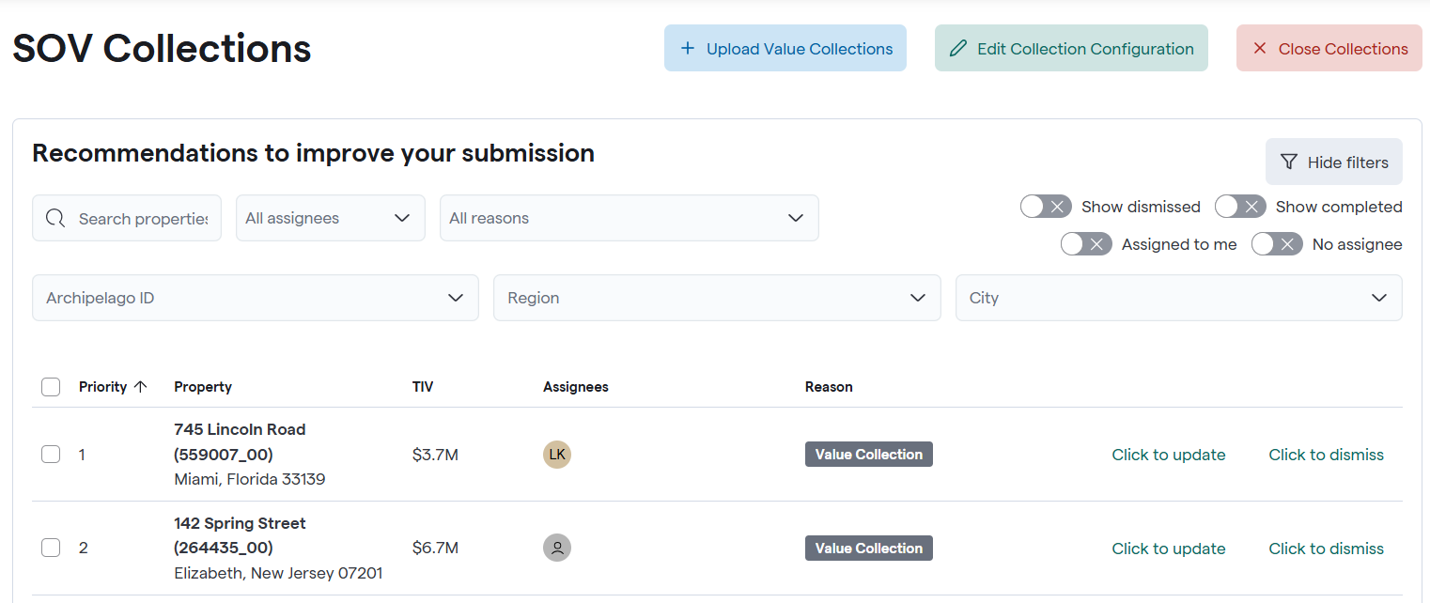
Value Collections
Schedule, manage and collect annual submission data from your members via a simple intuitive Archipelago UX. Members provide updates either in app or via an excel based worksheet.

Slide 12
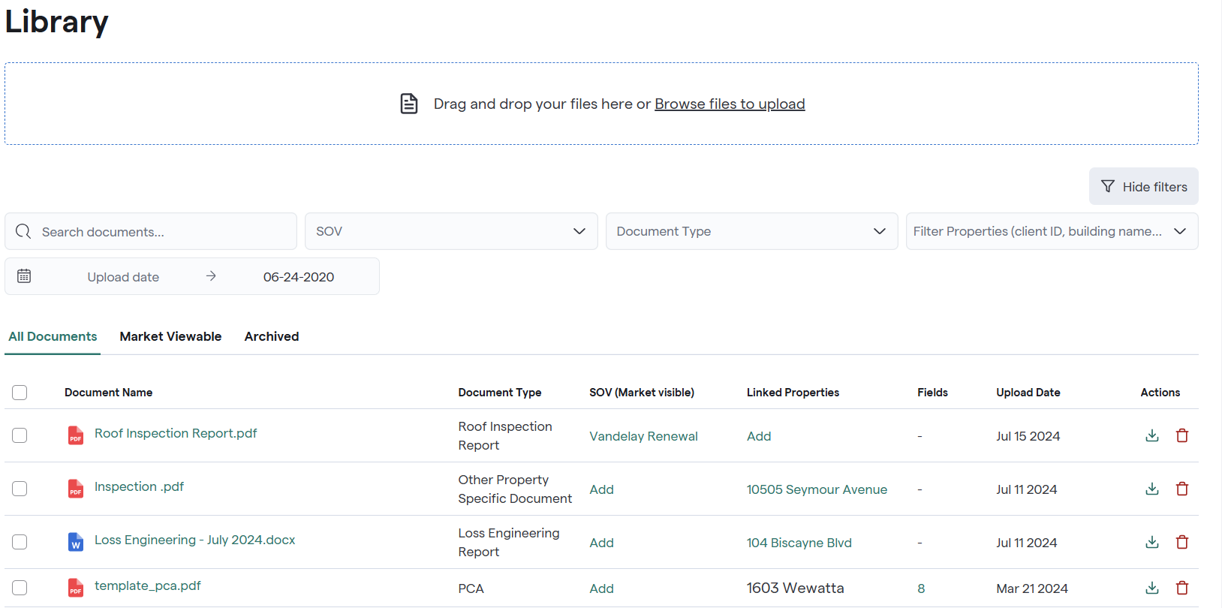
Library – Document Management
Archipelago can also create and update properties using AI from many document types:
Valuation Reports
Property Condition Assessments
Loss Engineering Reports
Roof Inspection Reports
Structural Drawings
Seismic Inspections

Slide 13







Integrations
For pools with existing RMS systems, Archipelago provides bidirectional synch capabilities.
Origami Connector
Custom RMIS Integration to Archipelago API
File Import and Export
Snowflake Private Data Shares

Slide 14
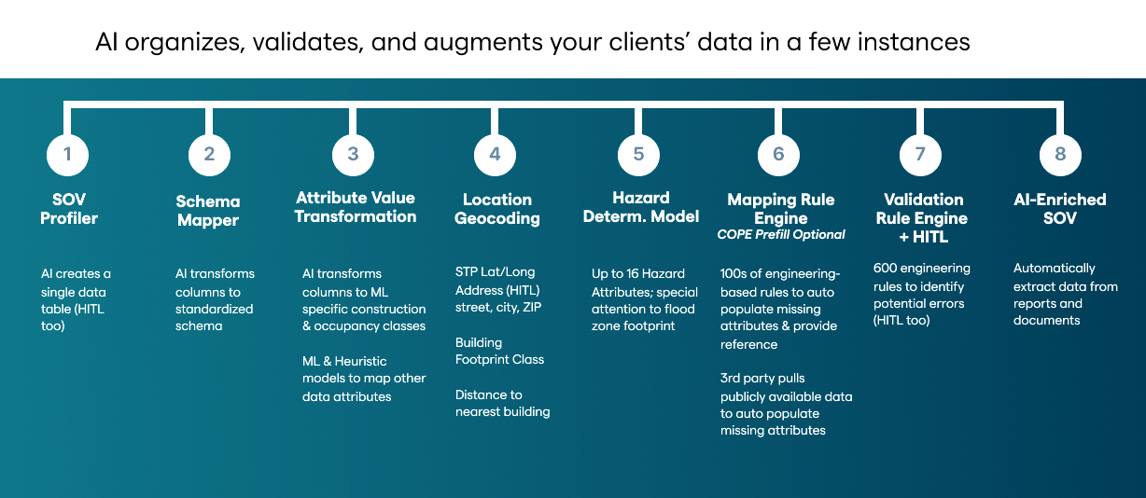
Data Enrichment for Pools
With Archipelago, enriching your data is effortless:
Just drag and drop your SOV—AI will organize, validate, and enhance it.
Get smart suggestions for key renewal attributes and upload documents as needed.
Your improved SOV is ready to share with your pools.

Slide 15




Data Pathogens
Data Latency
Data (in)Accuracy
Chasing SOV data leads to out of date information
Location, COPE, and valuation data may be provided, but is it accurate? What is its provenance?
Data (in)Completeness
Data Formatting
SOVs are often missing salient COPE or 2nd Modifiers information, and even when provided, it is often “ambiguous”
“Every” SOV is formatted differently, making it hard to triage, validate, and use for UW processes
15

