Slide 1

Reimagining Healthcare for Tomorrow: Market Challenges & Emerging Trends
Tuesday, October 28th | 10:15 AM

Slide 2
Medical Stop-loss &
Captive Insurance
NLC-RISC Staff Conference
October 2025 | Annapolis, Maryland

Slide 3
Introductions
The Challenge
Captives & Employee Benefits
Case Studies
Agenda

Slide 4
Today’s Challenge
Healthcare Costs Rising: Healthcare spending outpaces GDP, driving premiums as employers adopt self-funding and captives. Current Medical trend + 8% / Rx + 12%
Lack of sufficient Primary Care: Improper financial incentives have led to a crisis in availability and effectiveness in delivering quality value-based care
Pharmacy Impact: Questionable PBM practices, high demand for GLP-1 weight loss drugs, and specialty medications intensify cost pressures. Transparency, data, and contract leverage are key
Mental Health Needs: Employers address the growing demand for services, but stigma, lack of insurance, and access to professionals hinder employee access
Gender Gap in Health: Women’s health coverage lags behind men's, highlighting disparities in spending
Multi-Generational Workforce: Preferred methods of access and longer working lives increase complexity; voluntary benefits fill coverage gaps
Notes:
NOTE TO PRABAL: This is what we see nationally. Opportunity to open for what pools are seeing in their state and with their local government members.

Slide 5
Market Outlook
Employers are responding to the increased need for mental and behavioral health services yet challenged due to network availability and stigma
  Primary care services are likely to be under pressure soon given decreased availability
An increasing interest in Women’s Health has uncovered a profound gender gap between women’s health coverage and spending and men’s health
The span and complexity of a multi-generational workforce, employers turn to voluntary benefits to fill the coverage gaps and identify new plans and communication options
For employers with population shifts and financial constraints projections may require quarterly updates instead of annual
Leave benefits that allow employees to take time off from work for various reasons are increasingly becoming a factor in recruitment and retention
Increase in medical stop loss trend

Slide 6


Medical and Pharmacy Trend
MEDICAL (7-8%) | PHARMACY (10-12%)
General price inflation for goods/services Developments in medical technology and new treatments Changes in claims utilization (e.g., increases in chronic conditions, mental health) Regulatory changes Reduced payment from Medicare and Medicaid, providers look to commercial market to recoup expenses Contracting Provider consolidation, contract renewals / negotiations | Drug price inflation GLP-1 utilization and expansion Increase in specialty drugs / biologics Impact of new drugs and treatments Regulatory changes New to market drugs expected to have notably higher prices in response to Inflation Reduction Act

Slide 7
MSL Advantage
Creation of a Medical Stop Loss Cell
Formation of MSL Advantage
  Est. in 2021
  Coverage offered January 1, 2022
Demographics:
  Four founding health pool members
  43,000 total employee lives
Medical Stop Loss:
  Pool specific retentions range from $1M - $3M
  Captive layer retention ranges from $500,000-$750,000 above pool retention
  Excess coverage above MSLA purchased through the commercial market’
Coverage Provided:
  Individual stop loss above pool retentions
  Aggregate stop loss on captive retained losses
  Aggregate sop loss on individual pool retained losses (as needed)

Slide 8
Addressing The High Cost of Healthcare

Slide 9
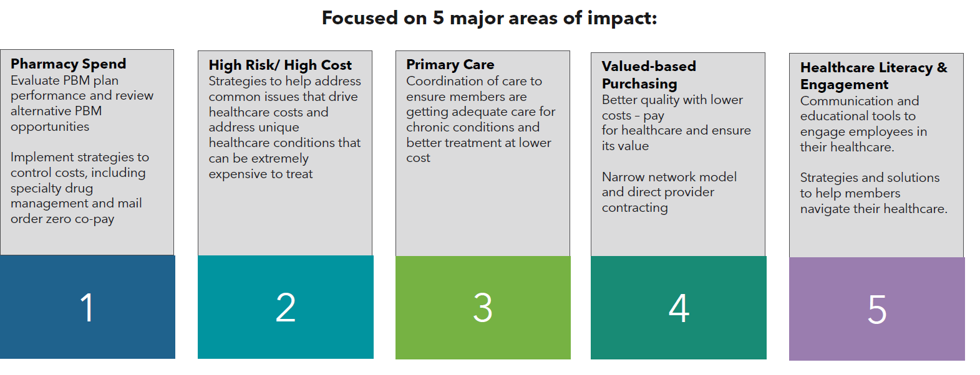
Major Impact Areas
Innovative, data driven, advanced strategies and solutions that are scalable, customized and mitigate costs for better employer and member outcomes.

Slide 10
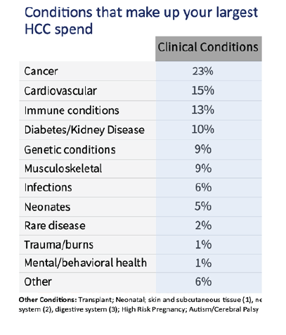
High Cost Claimants Example
Across our portfolio, we are generally seeing top 1% of members have representing over 30% of all medical expenses
Sources:
Table: National Alliance of Healthcare Purchaser Coalitions: 2024 How Employers Address HCC

Slide 11
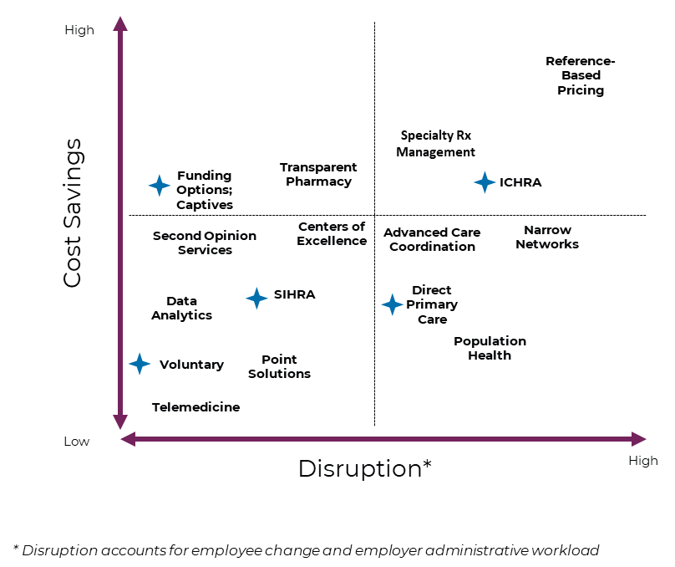
The Balance of Change

Slide 12
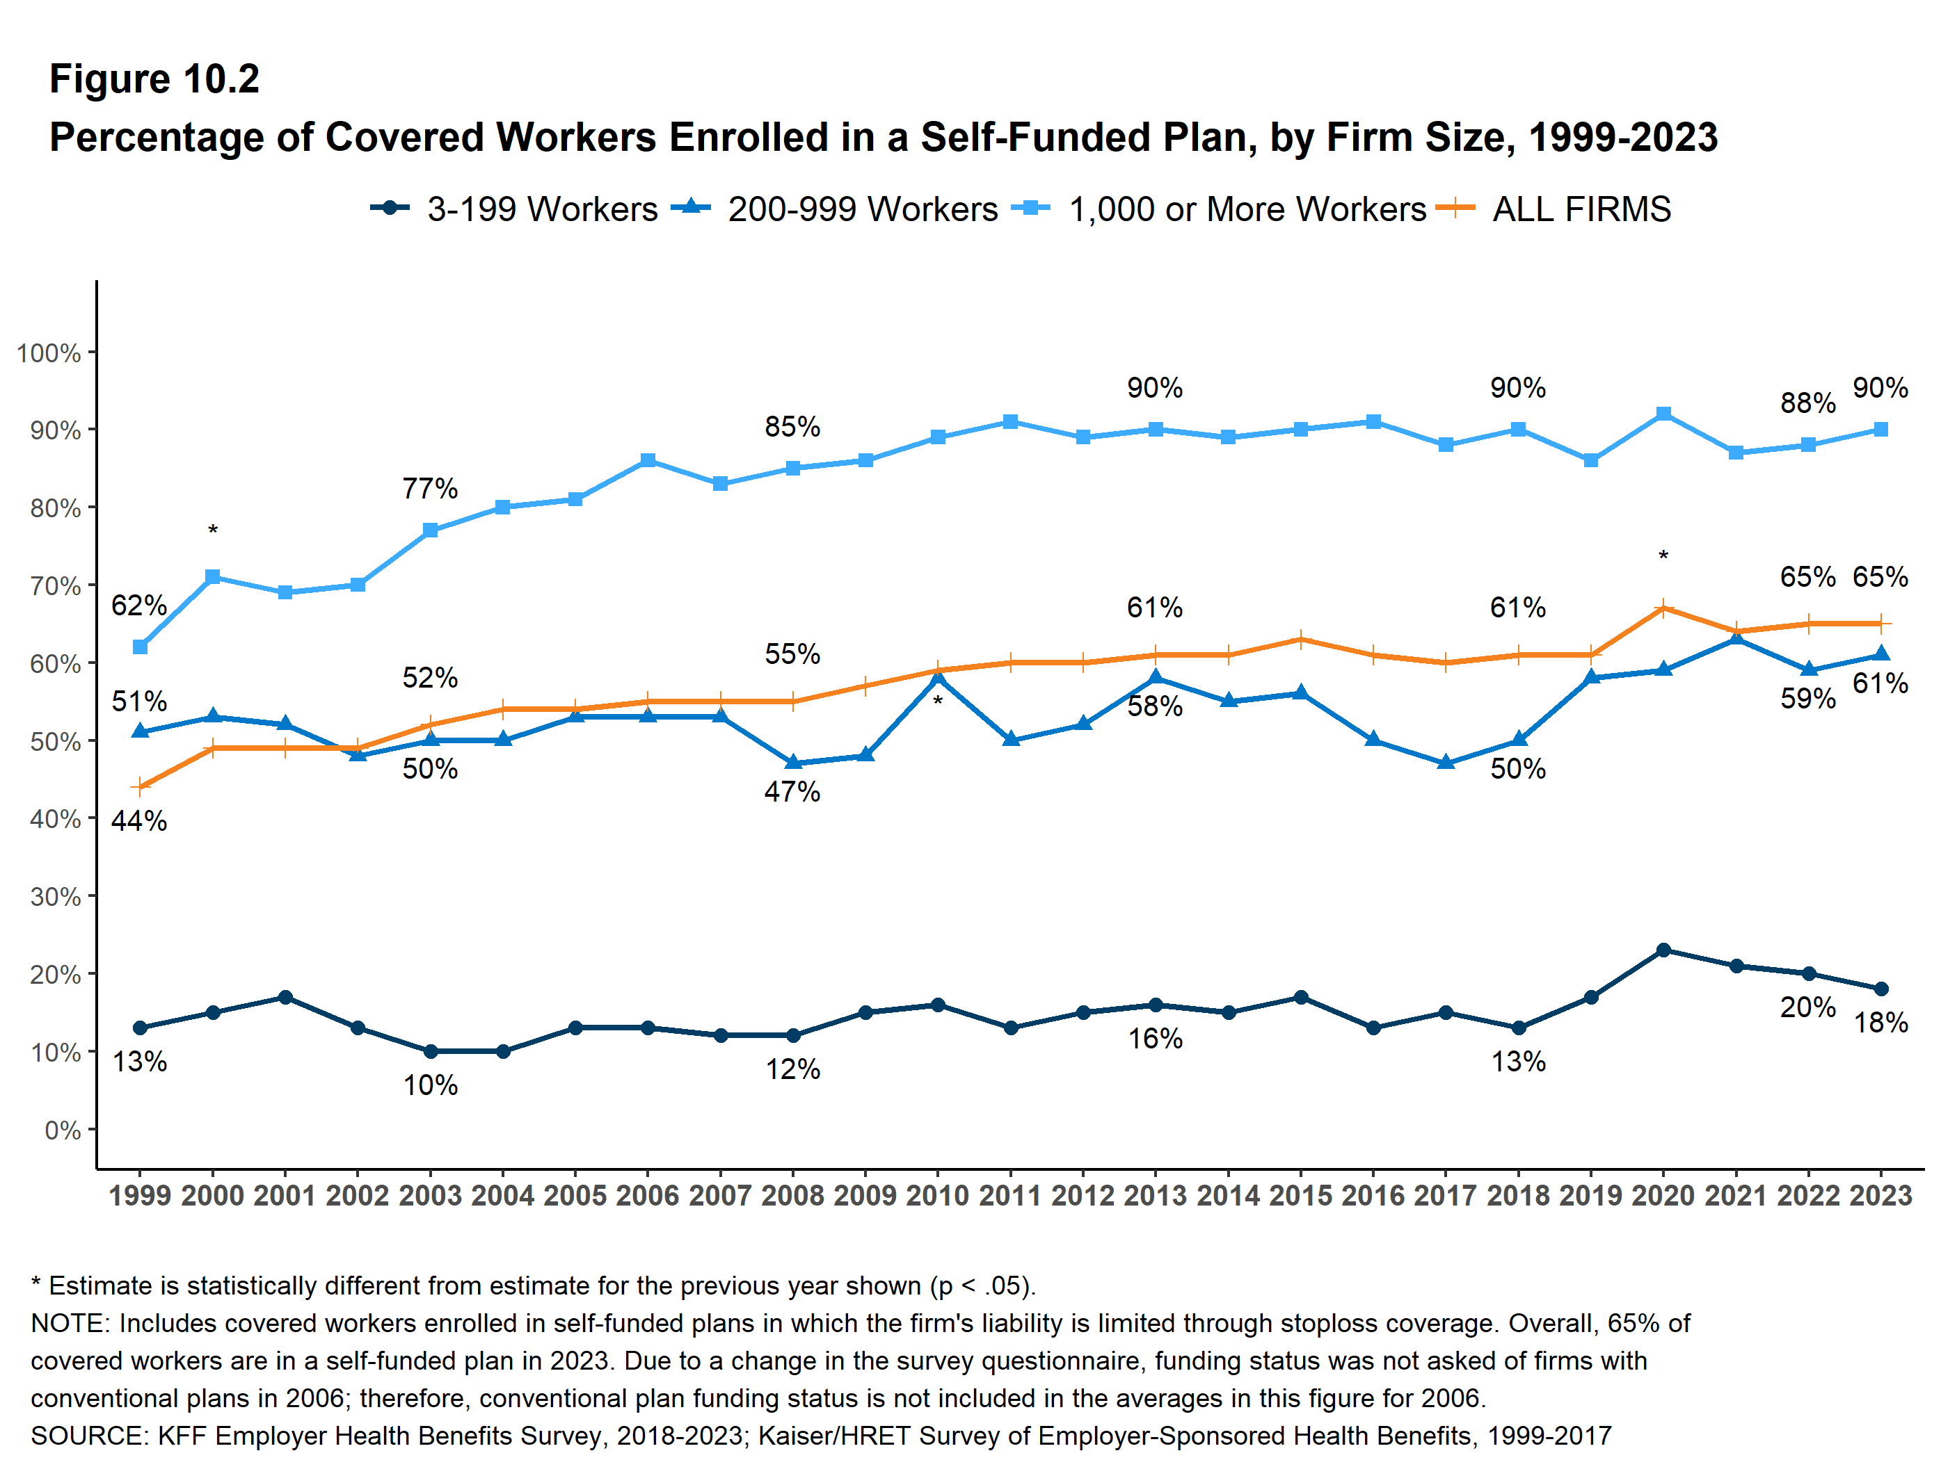
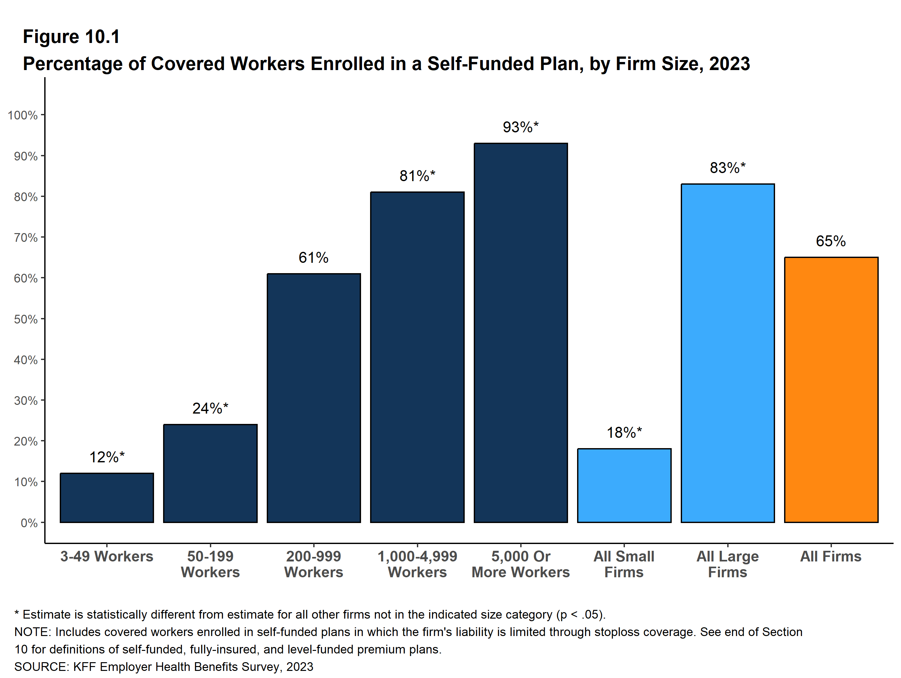
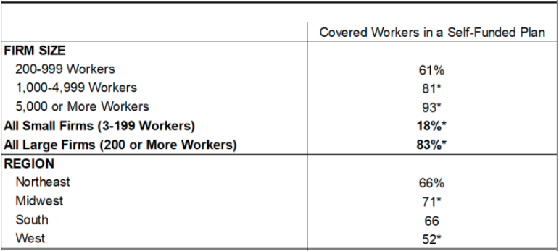
Self Funding Prevalence
Approximately half of U.S. workers are covered by some type of self-funded plan
The larger the company, the more likely it is to self-fund

Slide 13
Captive Insurance

Slide 14
How a Captive Works
A Captive insurance company is:
  A fully regulated and licensed insurance company
  Seeks to capture insurance carrier profit and insulate from changes in the markets
  Leverage new solutions
  Control claims costs across the spectrum of organizational exposures
1. Employer pays premium to carrier: $1.00
2. Carrier deposits premium minus reinsurance and expenses ($0.20) into a captive
3. Claims ($0.65) are paid out of the captive over time
4. Remaining profit is retained:
$1.00 - $0.20 - $0.65 = $0.15
Plus investment Income:
$0.15 + $0.04 = $0.19
Example of a carrier fronted captive transaction

Slide 15




Captive Structures
Captives can take several different structures depending on the specific needs
$$$$
$$$$
$$$
$$$
$$$
$$$
$$$
Commercial Insurer
Group Captive
Cell Captive
Single Parent Captive
15

Slide 16
Why Captives
Underwriting savings
  Captives allow a company to recapture administrative and profit charges that would have normally been retained by traditional insurers
Improved cash flow efficiency
  An insurance company may accrue and deduct certain reserves for losses that are not normally deductible until paid at a corporation
Investment income
  Earned on reinsured reserves
Increased control over claims
  Flexibility to address unintended consequences
  Additional control over costs, due to access to data
Tailoring plan designs to incentivize
  Desirable behaviors among employees, such as return to work, leading to lower costs

Slide 17
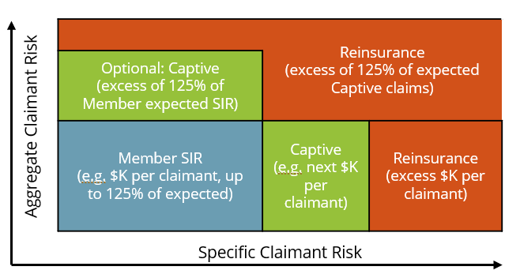
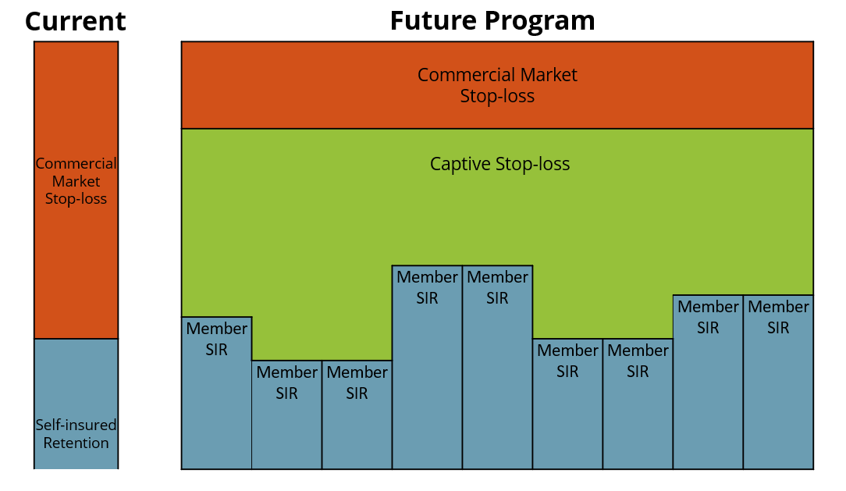
Group MSL Captive Illustrative
Each member pays a stop-loss premium, which are then unbundled between captive and commercial market
Each member chooses a self-insured retention (“SIR”)
Captive pays claims excess of SIR, purchases reinsurance for claims exceeding a pre-determined amount
Option for employer aggregate protection on claims exceeding 125% below the SIR (Spring’s projections do reflect members purchasing aggregate cover).
Captive layer claims will be adjudicated by the reinsurer. i.e. reinsurer will ensure large claims are legitimate before recommending captive payment and the captive purchases aggregate reinsurance to protect itself from a worst-case scenario
Notes:
NOTE: Create similar graphic for MSLA.

Slide 18
Captive Savings – Medical Stop Loss
Quantitative Advantages:
Lower stop-loss costs - elimination of carrier profit, premium taxes, administrative fees
Improved cash flow – employer holds on to the claim
Reduces reliance on commercial market renewals and trends
Creates a purchasing forum for addressing future needs
Qualitative Advantages:
Customized to meet unique needs of employers’ demographics
Reduced volatility and greater predictability via captive layer by mitigating the impact of claims unpredictability
Promotes long-term price stability and cost-savings potential
Stop-Loss in a captive can save money on average over commercial stop-loss insurance on a self-insured account
Average Savings

Slide 19
Total Cost of Risk Overview
Savings 1 – result of stripping away fully-insured carrier profits
Savings 2 & 3 – result of unbundling purchase of excess insurance and admin services
Savings 4 – result of reduced claims due to targeted interventions driven by transparent claims data
Savings 5 – result of the ability to implement tailored point solutions to reduce catastrophic claims exposure due to focused data analytics and claims management
Roadmap towards developing a long-term solution to help control insurance costs
Savings 1
Savings 1
Savings 1
Savings 2
Savings 2
XS insurance
XS insurance
Savings 5
XS insurance
Claims
Savings 4
Insurance
Premiums
Claims
Claims
Admin
Savings 3
Savings 3
Admin
Admin
Guaranteed Cost/ Fully Insured
Beginning Retention
Captive – Year 1
Captive – Year 2

Slide 20



Case Study: Medical Stop-Loss
A number of MA schools and colleges formed a captive for their health insurance in 2013
Group of 6 in 2013, 28 schools in 2025 with $300M+ of premium
  Close to $25M in captive layer stop-loss premium
  Average trend of 2-3% over the lifetime of the program
Initial rate savings of 8-10% against prior fully insured rates for participants
Over $25M in savings returned to members through captive surplus, since inception
Captive administrative costs per member and percent of premium reduced over time
Fully insured participants have benefited from tax savings under the ACA
Self-insured participants have benefited from lower administration and stop-loss costs

Slide 21
Other Coverage Opportunities

Slide 22

Captive Opportunities - Benefits
Retiree
Health & Welfare
Voluntary
Fringe
Pension
Health
Security
Time Off
Auto/
Home
Education Assistance
Defined Contribution
Medical
Life Ins.
Vacation
Financial Products
Transportation
Post-Ret Life
Drugs
STD¹
Holiday
Mortgages
FSA³
Post-Ret Medical
Dental
LTD²
Sick Leave
Investment Funds
EAP⁴, Work/Life
Disease Mgmt
Workers’ Comp
Other Leave
Life
Long Term Care
Critical Illness
Legal, Financial Planning
Executive Benefits
Typical Captive Opportunities
¹Short Term Disability
²Long Term Disability
³Flexible Spending Accounts
⁴Employee Assistance Programs (mental health, legal assistance, etc.)
Program | Potential Savings
Life Insurance | 15% to 35%
Retiree Medical | 10% to 25%
Disability | 15% to 35%
Voluntary Benefits | 35% to 55%
Typical Non-ERISA
Typical ERISA Plans

Slide 23

Structure of a Fronted Transaction
Claims
Employees
Employer
Carrier
Fronting Insurance Company
Premium
Premium
No impact on employees – merely a backend funding solution
Claims/Collateral
Captive

Slide 24



Case Study
Case
Global client with over 200,000 employees that went through the process and currently uses their captive for Life and LTD coverage lines
The program was experience rated
Spring Analysis
Spring completed feasibility study over 10 years ago and recommended the company move forward with added Life and LTD coverages to their captive
The premium levels at the time for the company were ~ $40M
Results
Generated over 12% in profits since the inception
Getter control of their loss / claims data
Instituted proactive claims management processes

Slide 25
Case Study
Case
Group with over 50,000 employees that went through the process and currently uses their captive for Life and LTD coverage lines
Spring Analysis
Spring completed feasibility study 5 years ago and recommended the company move forward with added Life and LTD coverages to their captive
The premium levels at the time for the company were ~ $14M
Results
Generated over $10M in profits over past 4 years
Getter control of their loss / claims data
Leveraged captive to provide additional benefits and coverages during Covid with no additional premiums

Slide 26
Voluntary or Worksite Programs
Employers are striving to maintain their current benefit offerings, despite increasing costs and the uncertainty of healthcare reform
Voluntary benefits have been becoming more popular as employers wish to supplement or provide coverage in areas that do not already exist or help employees complement their healthcare plans, where costs are rising at a fast pace
These programs are very profitable with a typical loss ratio between 35%-60% in most circumstances
Adding them to a captive allows employers to recapture dollars that would have gone to the insurance carriers
Creating greater value for employees by providing greater coverage for same premiums or same coverage for lower premiums
Captives can be used to reinsure voluntary benefits as, generally, they have very little chance of catastrophic loss

Slide 27
Captive Opportunities – P&C

Slide 28
Questions?

