Slide 1

Purpose to Power
Monday, October 27th | 1:15 PM

Slide 2


Our Purpose Our Promise
Hilary Shine, SGR

Slide 3

What is your Brand?
When is the last time you thought about it?
When is the last time you acted on it?
When is the last time you asked?

Slide 4


A Brand Is
The identity and story of a company that makes it stand out from competitors that sell similar products or services. The goal of branding is to earn space in the minds of the target audience and become their preferred option for doing business. Brands are an effective way for companies to communicate their vision.

Slide 5
Brands Include
Brands Create
Name
Design
Symbol
Logo
Slogan
Spokespeople
Identity
Reputation
Distinction
Pride
Influence
Actions
Loyalty

Slide 6


Brands Today
Two-way
Snapshots
Ratings
Image
Vibes & feels
Influencers and fans
Tools & weapons
Communities
Determine value

Slide 7

If Reduced to a Snapshot
How would you describe your brand?
Does it distinguish your services?
Do your employees embody it?
Do your members know it?

Slide 8
Branding vs. Marketing
Branding is the foundation upon which the structure of marketing is built; it’s the message that primes the target audience, while marketing refers to the channels and methods used to convey that message.

Slide 9



Best brands
Travel Industry
Food & Beverage
Non-Profits

Slide 10
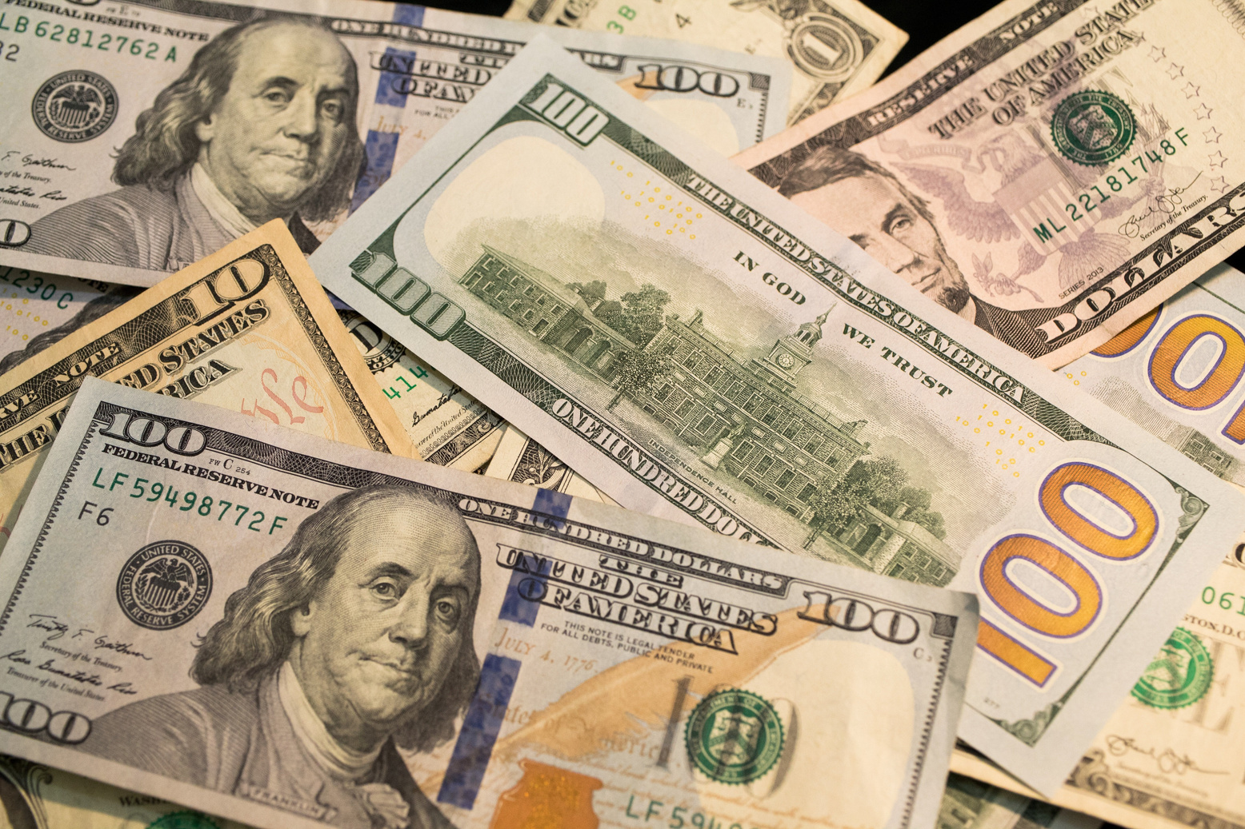

The Why
VALUE
It’s a good investment.
It’s a quality product.
I trust the organization.
Thinkers
VALUES
I’m making a difference.
I believe in the cause.
I trust the organization.
Feelers

Slide 11

Now More than Ever
Value
Politics
Disasters
Insurance
Workforce
Social Media

Slide 12
How Do Move From Purpose to Promise?
Defined Brand Identity
Clear Brand Image
Accurate Brand Perception
Actionable Brand Promise
Strong Brand Values
Quantifiable Brand Value
Intentional Brand Actions
Deliberate Brand Consistency

Slide 13

AddIng Risk to the brand
What is our brand promise?
What value do we add for our members?
Are we part of our members’ value statements?

Slide 14

Brand Management
Hiring and promoting
Training and retraining
Evaluating performance
Accepting criticism
Demonstrating value
Building brand ambassadors
Adapting

Slide 15

Credibility
Branding is the alignment between what you say, how you look and how you act.
When those don’t match, people see it and judge it.

Slide 16

It Is About Building Trust

Slide 17

Delivering our Brand Promise

