Slide 1

Public Safety Wellness Programs and
Why We Need Them
Monday, October 27th | 11:00 AM

Slide 2
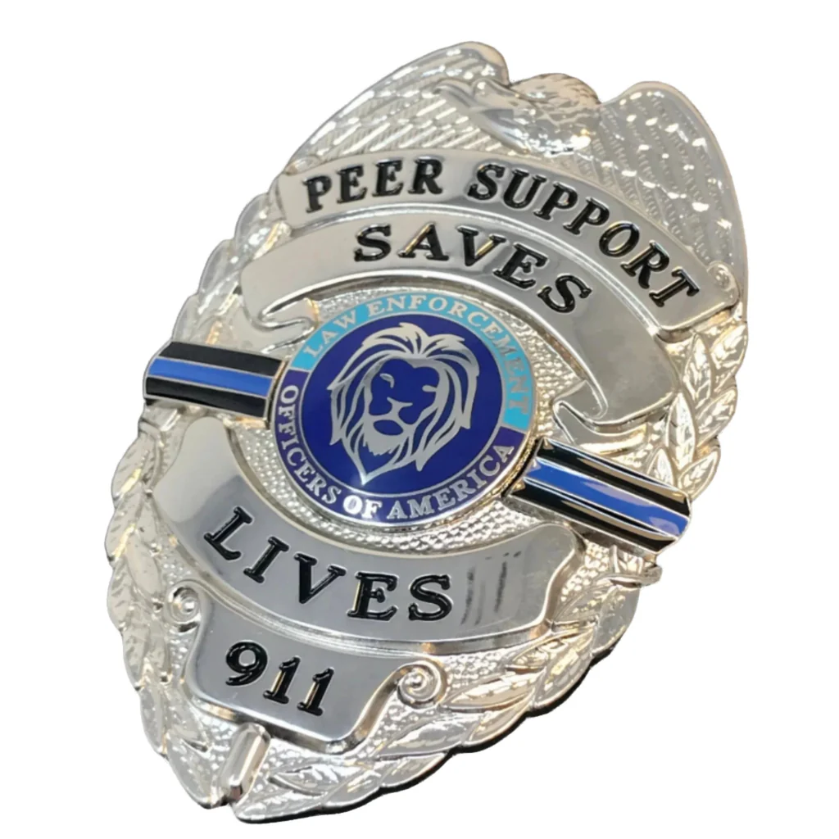
Public Safety Wellness Programs and Why We Need Them
First Sergeant Renee “Gunny” Plumb

Slide 3
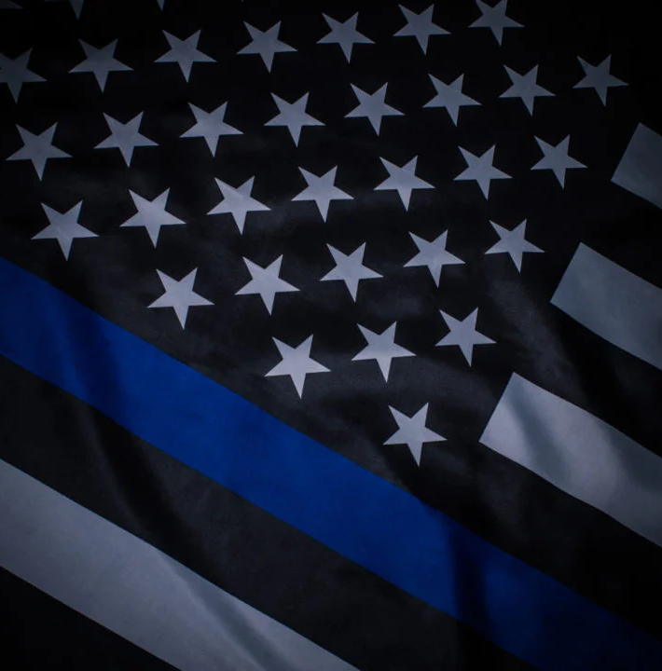
Introduction
Since 2018 law enforcement, as a profession, has undergone significant changes. The scrutiny of incidents as well as the actual officers involved in the incident have become national news.
As the demand for perfection from the humans that work as LEO’s has increased, with dire consequences for mistakes, fewer people are choosing the occupation.
This is causing staffing shortages.
Due to lawsuits and politics, budgets are being cut in most LEA.
At the same time, due to staffing shortages, overtime is becoming mandatory, shifts are changing to longer days or less time off.
The stress, the required time of work, and demands for flawless performance is impacting LEOs.

Slide 4
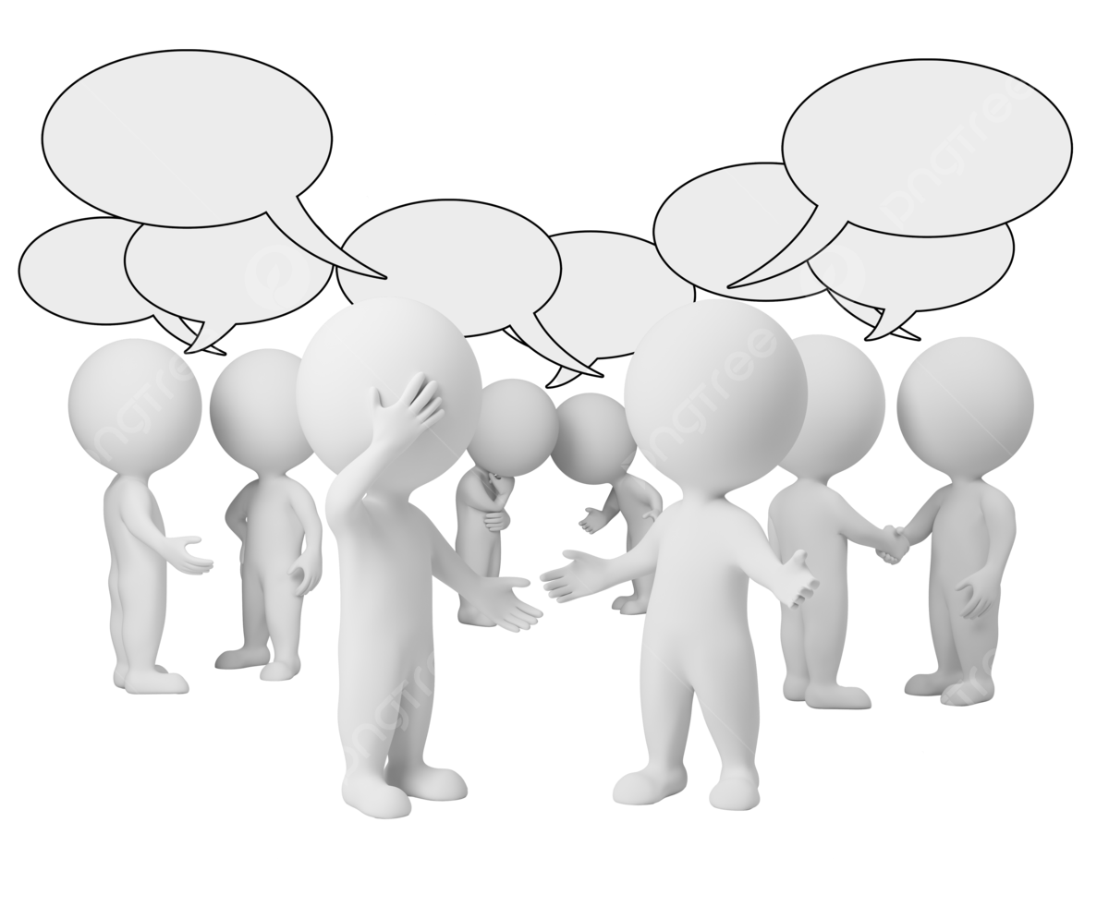
For Discussion…
What changes have you seen in law enforcement over the last few years?
What trends are you seeing with claims?
What is “society” looking for?
What are the risks or liabilities seen specifically with officer mental health and care post-critical incident?

Slide 5

Talking Points
What is Officer Wellness?
What is Peer Support?
The Buffet
What’s Better?
Advantages
Consequences of Inaction

Slide 6
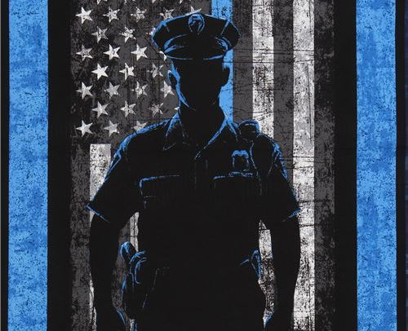
Officer Wellness
What is officer wellness?
How does poor wellness of an officer cause risk to the agency?

Slide 7


Slide 8
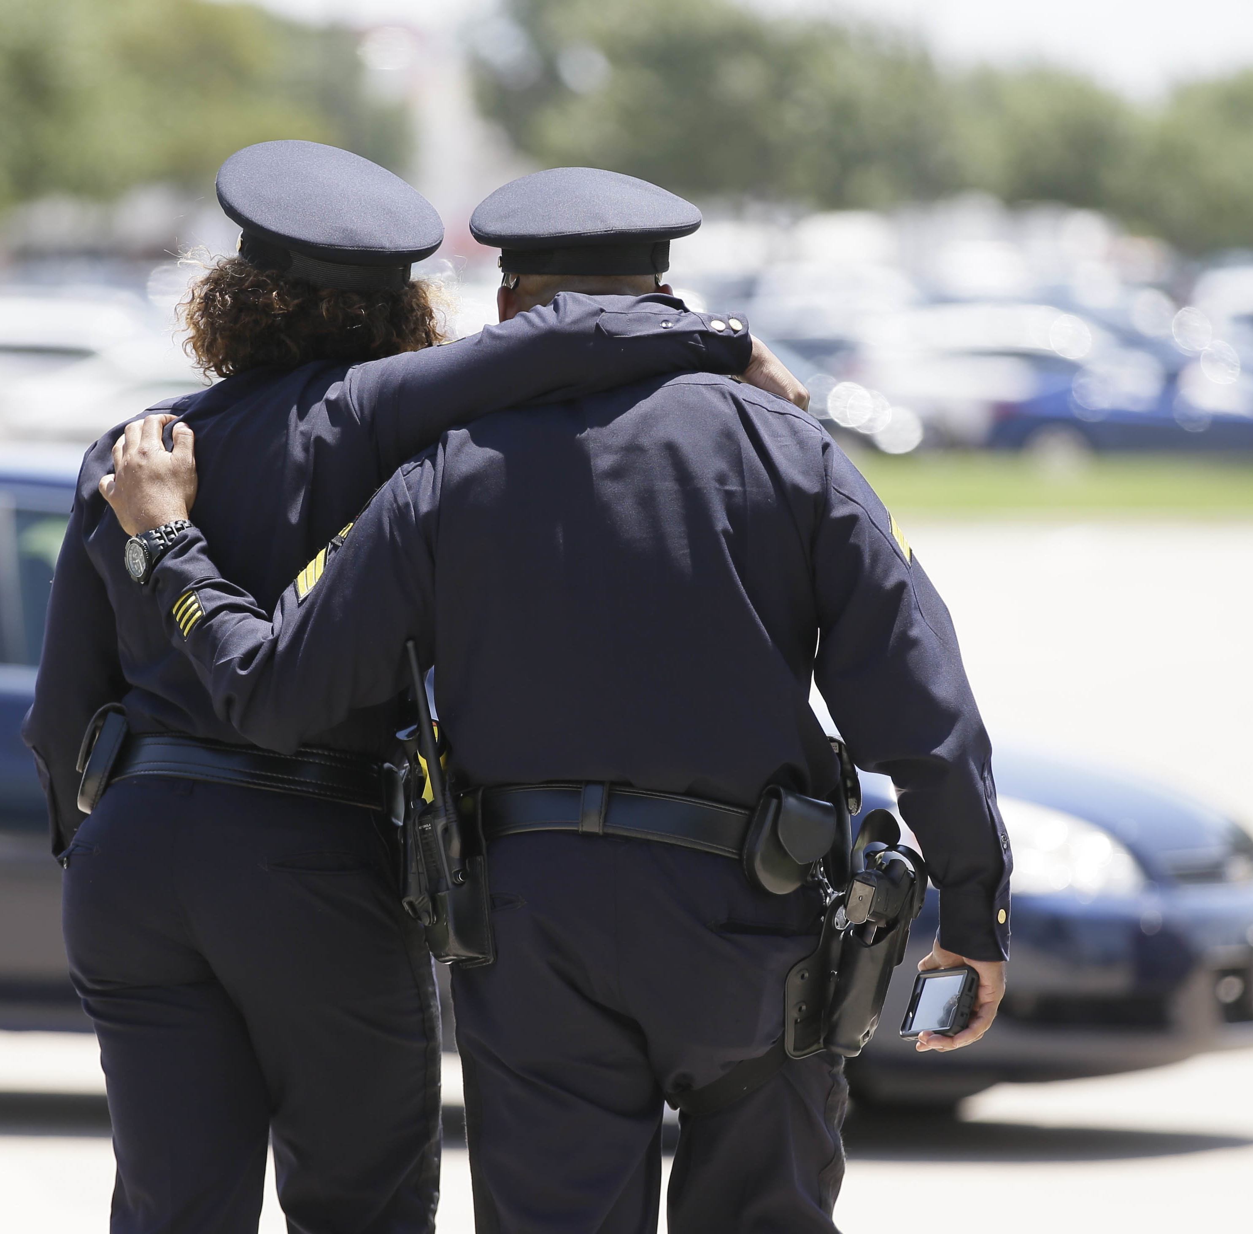
Peer Support
What is Peer Support?
How can it be implemented?
What’s the risk of an agency having nothing in place to assist officers?

Slide 9


The Buffet…
What is available?
Is it appropriate? Vetted?
How is that information shared with employees?
What’s the risk of an employee seeking help?
What’s the risk to the agency if an employee doesn’t seek help?

Slide 10
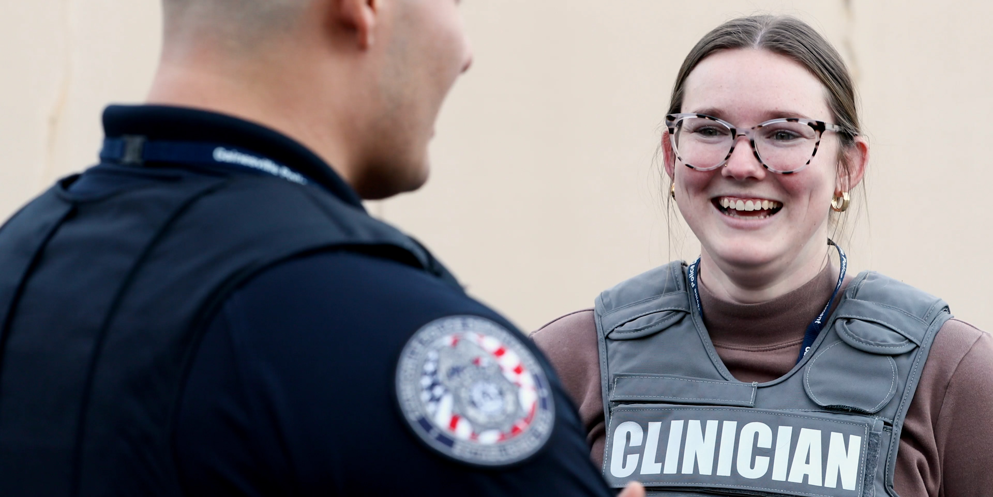
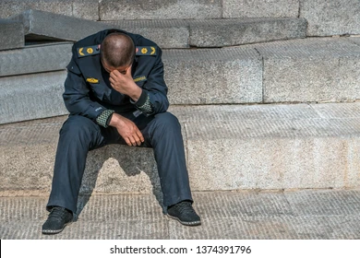

What’s Better
What is better than Peer Support or a vetted Resource List?
EAP / Insurance vs Embedded Clinical Staff?
How can a clinical presence decrease liability and risk for agencies?

Slide 11
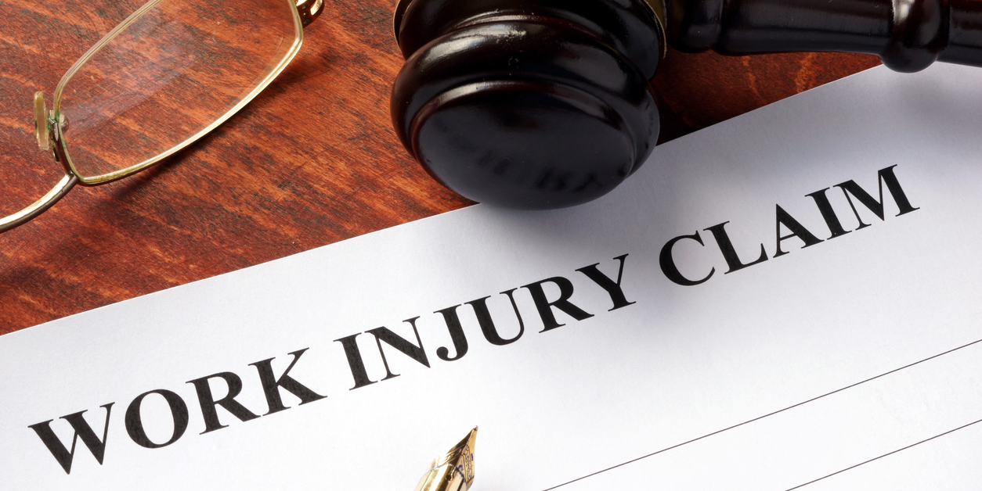

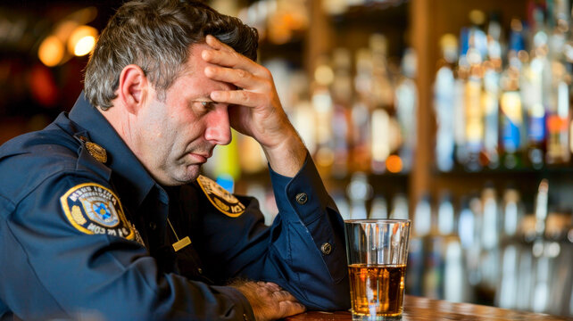
Advantages
Is keeping employees healthy and well “cheaper” than “fixing” impacted employees?
What was done post critical incident?… but BEFORE the employee was reintegrated?
What about mandatory MH evals?
What about concerns that are voiced internally? Help vs Discipline?

Slide 12
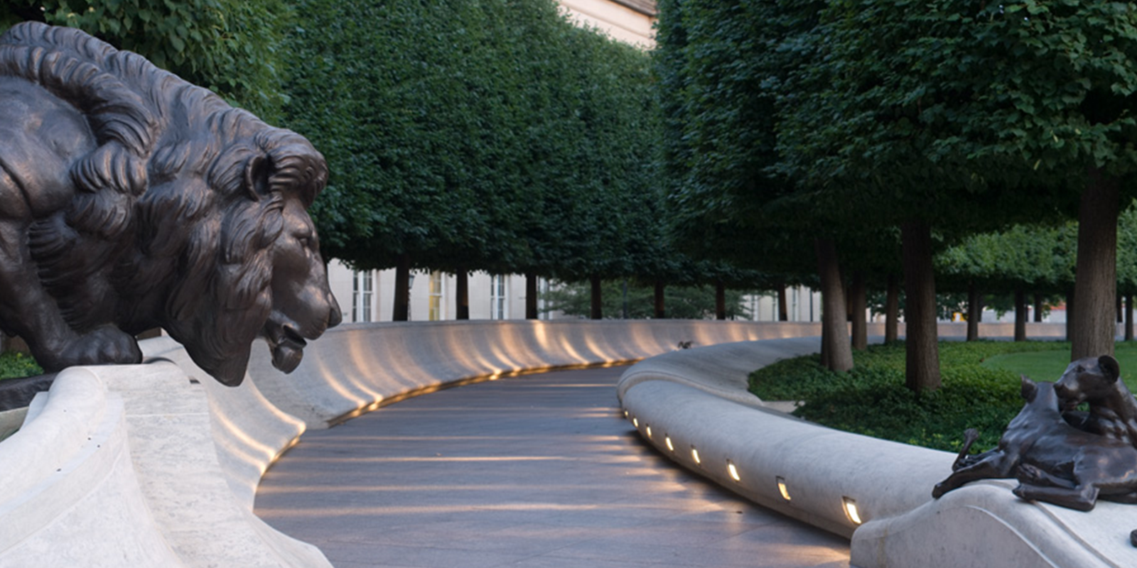
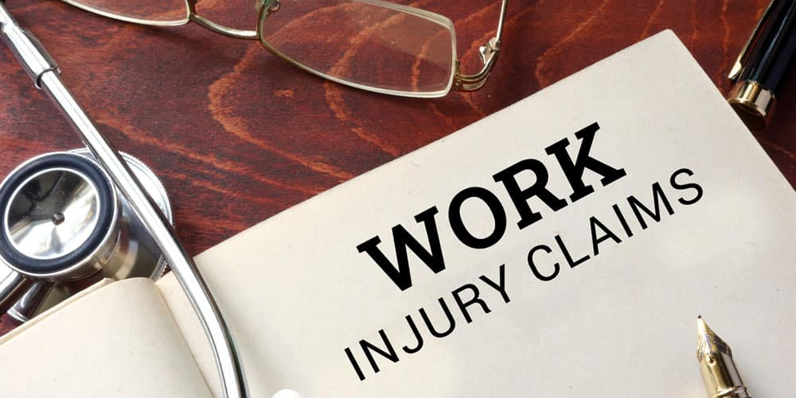
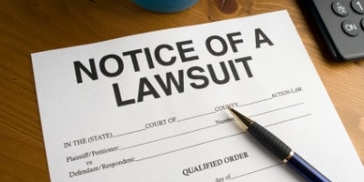
Consequences of Inaction
The Wall
Workmen’s Compensation
Lawsuits by Employee
Lawsuits by impacted persons or the surviving family
Does doing nothing or doing too much without policy and guidelines open the agency for risk?

Slide 13
Chart

Slide 14
Obstacles
Cost
Trust
Incident & Employee Management
Budgets are being cut
Staffing shortages = OT
Smaller agencies
EAP vs Embedded MHP
Workmen’s Comp
Wellness vs Fitness
How do Agencies KNOW they can trust the Mental Health Professional or the Peer Support Program?
PR vs Ofc support
Criminal Investigations
Admin Issues are public
Incident Management can be at odds with Ofc MH
Expectations of reintegration for Ofc and Dept
What are the risks or liabilities seen specifically with officer mental health and care post-critical incident?

Slide 15

1
Find what resources exist on agencies in your area.
2
3
Find and vet MH Professionals.
4
5
Put the resources out … (how?)
Build your program using what has proven to work to PREVENT the risk and liability.
Ask if they will share their knowledge and provide training to those without anything.
Start a resource list for your area.

Slide 16

Summary
Mental Health and COMPLETE wellness of law enforcement officers impacts how they perform their duties.
To decrease risk, agencies must get out in front of the incident to ensure the officers are well when they go through an incident.
Once involved in an incident, support and appropriate treatment needs to be implemented to ensure reintegration and restored wellness.
Agencies will have better results if we understand the human factor of critical incidents. Education is important for details and facts.

Slide 17
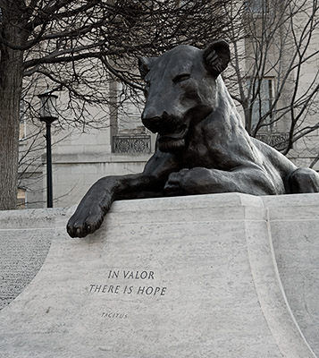
Thank you
1ST Sgt. Renee “Gunny” Plumb
Instructorplumb@gmail.com
202-497-8262
“In your darkest hour, when the demons come, call on me brother, and we will fight them together.”

