Slide 1

NLC-RISC
New Staff Workshop
OCTOBER 2025
Notes:
Open Slido on browser

Slide 2
Audience Poll
Notes:
Overview of your pool – when formed, coverages offered, number of members – All panelists
League/pool relationship
Governance & Staffing structures
Differences from insurance companies – All panelists
What makes these functions in a public entity risk pool different from those in traditional insurance companies?
Loss Control - Ian
How do you identify risks or trends among member entities?
Can you give examples of the types of services or programs loss control provides to members?
Claims - Lynn
What types of claims are most common for municipal entities?
How does the claims team balance supporting members with managing costs for the pool?
Underwriting - Halie
What types of information or data do underwriters review when evaluating risk? Explain experience mod
What are some unique underwriting challenges in the public sector?
Competition & Success of Pooling – All panelists
Where do they see the value of pooling in today’s market/environment?
What is the success of pooling today and looking ahead?
Where do we need to be focused.

Slide 3



From 1 to 5, what is your energy level today?
The Slido app must be instaled on every computer you’re presenting from

Slide 4

Do not edit
How to change the design
Using an emoji - what was your first job?
The Slido app must be installed on every computer you’re presenting from

Slide 5

Do not edit
How to change the design
How many years have you been in the pooling industry?
The Slido app must be installed on every computer you’re presenting from

Slide 6
Do not edit
How to change the design
How many years have you been in the insurance industry (pooling or traditional insurance)?
The Slido app must be installed on every computer you’re presenting from

Slide 7
Do not edit
How to change the design
How long have you been at your current organization?
The Slido app must be installed on every computer you’re presenting from

Slide 8
Do not edit
How to change the design
What is your job title?
The Slido app must be installed on every computer you’re presenting from

Slide 9

Do not edit
How to change the design
Please share any topics you hope to discuss or learn about today.
The Slido app must be installed on every computer you’re presenting from

Slide 10
About NLC-RISC
Notes:
Overview of your pool – when formed, coverages offered, number of members – All panelists
League/pool relationship
Governance & Staffing structures
Differences from insurance companies – All panelists
What makes these functions in a public entity risk pool different from those in traditional insurance companies?
Loss Control - Ian
How do you identify risks or trends among member entities?
Can you give examples of the types of services or programs loss control provides to members?
Claims - Lynn
What types of claims are most common for municipal entities?
How does the claims team balance supporting members with managing costs for the pool?
Underwriting - Halie
What types of information or data do underwriters review when evaluating risk? Explain experience mod
What are some unique underwriting challenges in the public sector?
Competition & Success of Pooling – All panelists
Where do they see the value of pooling in today’s market/environment?
What is the success of pooling today and looking ahead?
Where do we need to be focused.

Slide 11


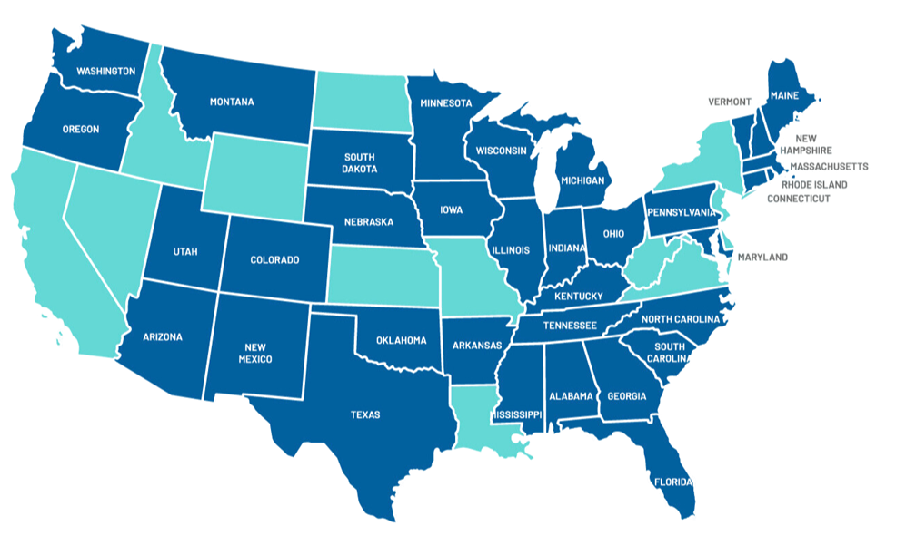
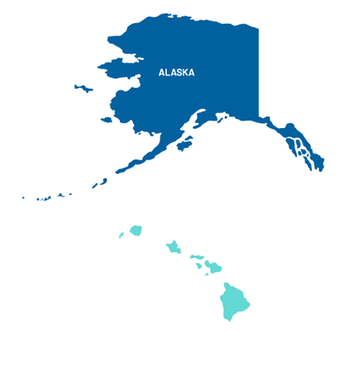
NLC-RISC Membership:
  Formed in 1982
  Program of the National League of Cities
  NLC-RISC members are risk pools endorsed by their state league
  38 members across the United States
  8 members represented on Board of Directors
    4 State League Directors
    4 Pool Administrators
Notes:
What is RISC?
Who do we serve?
What do we offer?

Slide 12
Member Offerings:
Events &
Training
Online
Communities
Networking Opportunities
Partnership
Initiatives
RISC eNews
  Staff Conference
  IT Symposium
  Trustees Conference
  Functional Area Meetings (virtual)
  Webinars
  Finance
  Health Pool
  Human Resources
  IT & Data Analytics
  Law Enforcement
  Legal
  Loss Control, Claims, and Underwriting
  Marketing
  Pool Administrators
  Racial Equity
  Mentor Program
  Young Pooling Professionals (in-person and virtual)
  NEW | Civility and Collaboration Working Group
  GatherGuard (special event coverage)
  NetDiligence eRiskHub
  Pooling Academy
  Ready Rebound
  Serve|Strong
  Monthly newsletter for members
  Includes:
    Announcements
    Upcoming Events
    Member Spotlights
    Job Postings & RFPS
    Resources & Links
Notes:
Mentor Program Notes: Opportunity for RISC-member staff who are new to pooling or to a specific functional area to meet informally and learn from a more experienced peer from a different pool
Benefits mentors as well as mentees
Builds connections, insights, information-sharing, and collegial networks among RISC member pools and their staffs

Slide 13

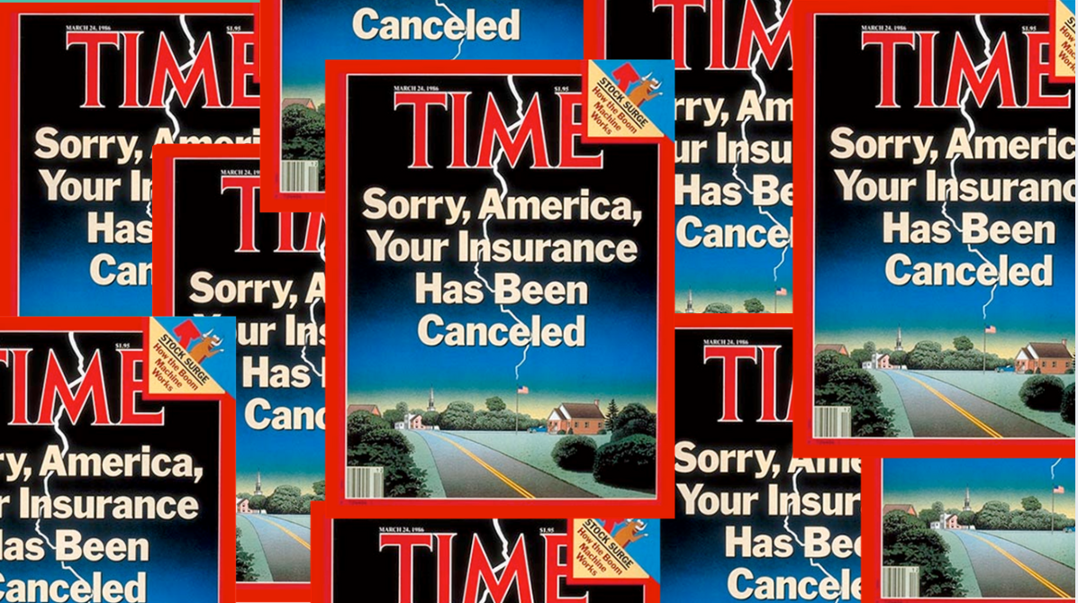
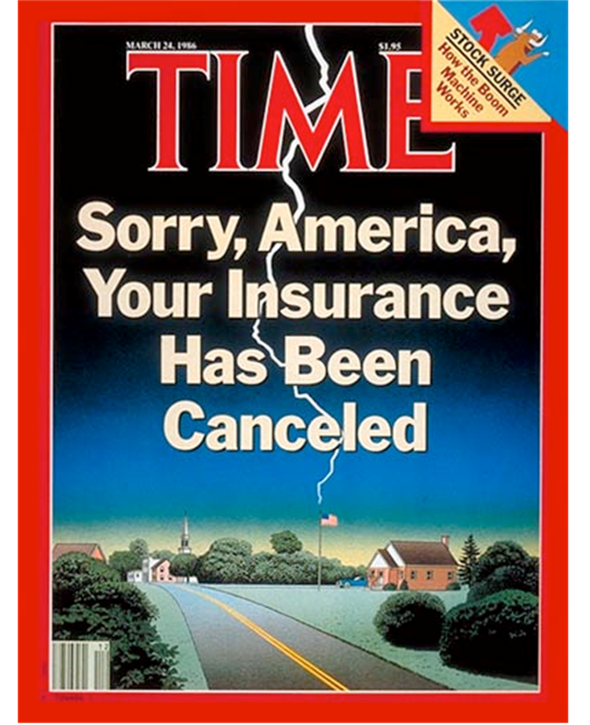
Why were pools created?

Slide 14
Risk Pools:
  United approach to risk management
  Promote loss control, financial stability, information-sharing, and collaboration between their members
State League Risk Pools:
  Member-owned, Member-driven
  Endorsed by their state municipal league
  Leverage collective efforts to respond to the unique needs of their member cities, towns, and villages
Notes:
Why and how pools were formed
State league involvement
Coverages provided by pools, including unique coverages that meet the needs of members
Include health pools
Comparison to commercial market
Regulation
some are highly regulated by insurance dept, some have oversight by SOS office, etc.
Roles of Pool Boards

Slide 15
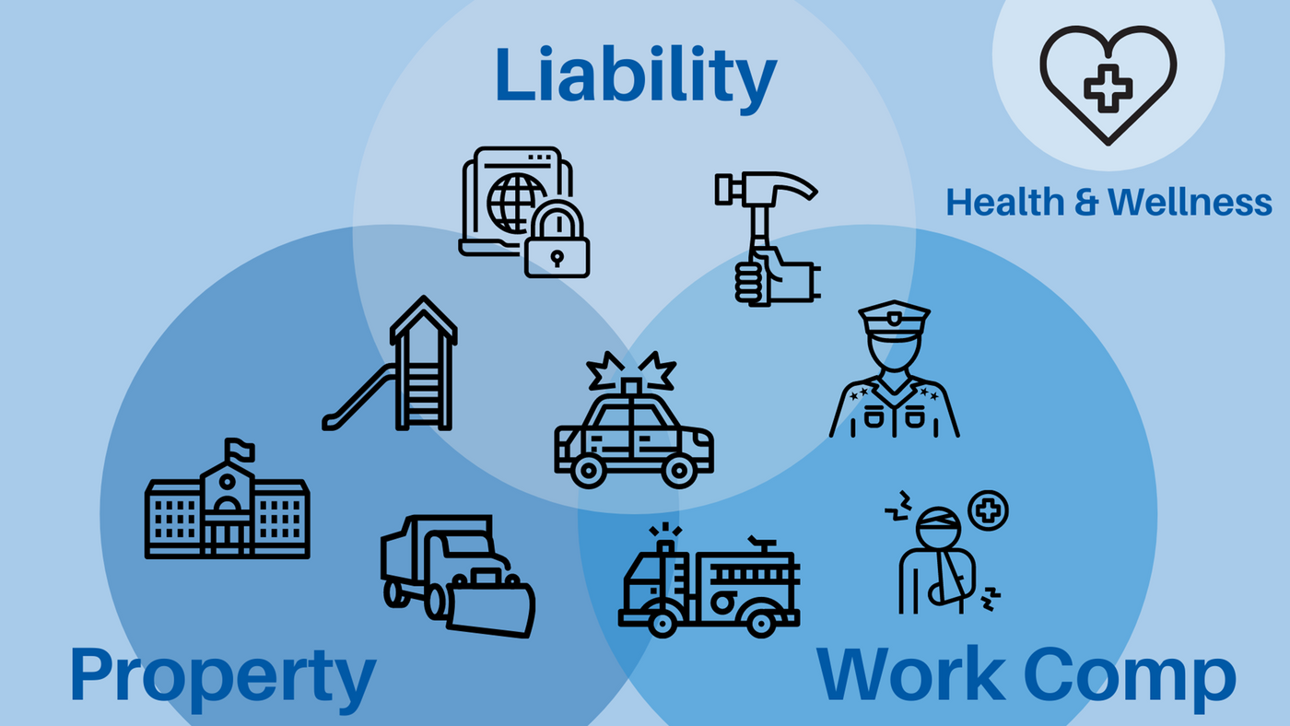
Notes:
Civility & Collaboration Group Webpage: https://risc.nlc.org/civility-collaboration-group/

Slide 16
Panel Discussion
Notes:
Overview of your pool – when formed, coverages offered, number of members – All panelists
League/pool relationship
Governance & Staffing structures
Differences from insurance companies – All panelists
What makes these functions in a public entity risk pool different from those in traditional insurance companies?
Loss Control - Ian
How do you identify risks or trends among member entities?
Can you give examples of the types of services or programs loss control provides to members?
Claims - Lynn
What types of claims are most common for municipal entities?
How does the claims team balance supporting members with managing costs for the pool?
Underwriting - Halie
What types of information or data do underwriters review when evaluating risk? Explain experience mod
What are some unique underwriting challenges in the public sector?
Competition & Success of Pooling – All panelists
Where do they see the value of pooling in today’s market/environment?
What is the success of pooling today and looking ahead?
Where do we need to be focused.

Slide 17
Small Group Discussion

Slide 18
Make the most of your
conference experience!
New(er) Staff Activities
Connect With
Peers
Networking Opportunities
Learn Best
Practices
Stay
Connected
  New Staff Workshop
  Attend Functional Area Roundtables
  Connect with Mentor or Mentee if in the program
  Enjoy YPP events
  Receptions and meals - talk to someone new!
  Attend sessions
  Attend events
  Make a Conference Connection & save contact information
  Connect with other attendees on LinkedIn
  Learn something new at a session; jot a few notes to take back each day
  Ask questions
  Exchange ideas with your peers
  Post on App & Social #riscstaff25
  Check conference app for resources
  Sign-up for the RISC eNews
  Join an Online Community
  Learn more at risc.nlc.org
Notes:
Mentor Program Notes: Opportunity for RISC-member staff who are new to pooling or to a specific functional area to meet informally and learn from a more experienced peer from a different pool
Benefits mentors as well as mentees
Builds connections, insights, information-sharing, and collegial networks among RISC member pools and their staffs

Slide 19
Do not edit
How to change the design
What is your key takeaway from this session?
The Slido app must be installed on every computer you’re presenting from

Slide 20
Do not edit
How to change the design
On a scale of 1–5, how helpful was this session?
The Slido app must be installed on every computer you’re presenting from

Slide 21
Thank you!
Learn more & connect with us:
  risc.nlc.org
  Follow NLC-RISC on LinkedIn
#nlcrisc #RISCstaff

