Slide 1



AI and the Future of
Municipal Risk Pools:
Preparing for What’s Next
October 28, 2025
COMPANY OVERVIEW | SPRING 2024

Slide 2




PRESENTER:
Anne Balduzzi
Executive Advisor – AI and Innovation
Anne Balduzzi is a renowned expert in the field of Artificial Intelligence (AI). Recognized as one of the region's Top Women in Tech, Anne is a respected speaker and author on AI and technology trends. She holds a patent in data match analysis and is the founder of SameGrain, an award-winning AI-enabled community engagement platform. At Hartman Executive Advisors, Anne helps clients harness the full potential of AI to optimize operational efficiency, spark innovation, and establish security to mitigate risks.
As an early pioneer of the Internet, she brings decades of technology expertise. Her background includes product development and marketing management roles at Apple, AOL (when it was a start-up), and Viewtron, the first consumer online service in North America. After working in Silicon Valley and launching Apple’s first online service, she returned to the East Coast and founded Accelerate Partners, where she mentored and advised a wide range of early stage and established technology companies.
abalduzzi@hartmanadvisors.com

Slide 3
Municipal AI
Present Day
Document & meeting packet summarization (ECM/records)
Citizen chat/translation; 311 triage & routing
Permit pre‑check and code enforcement prioritization
Records search and FOIA redaction assistance
Field inspection notes to structured checklists
Traffic/camera review assistance (with governance)
Cyber triage: log analysis and alert summarization
Emerging
General‑purpose AI (GPAI) embedded in everything (“AI is just another feature”).
Multimodal & voice assistants for field staff (inspections, work orders).
Asset failure prediction & risk‑based maintenance (CMMS)
Intelligent redaction & privacy filters by policy
Policy drafting with guardrails; bilingual services at scale
Small “pilots” tied to data: secure RAG against municipal repositories.
Regulatory tightening (early US state laws).

Slide 4

“Without an
AI Governance Model, an AI Roadmap is speed without steering.”
Created via DALL-E 3

Slide 5
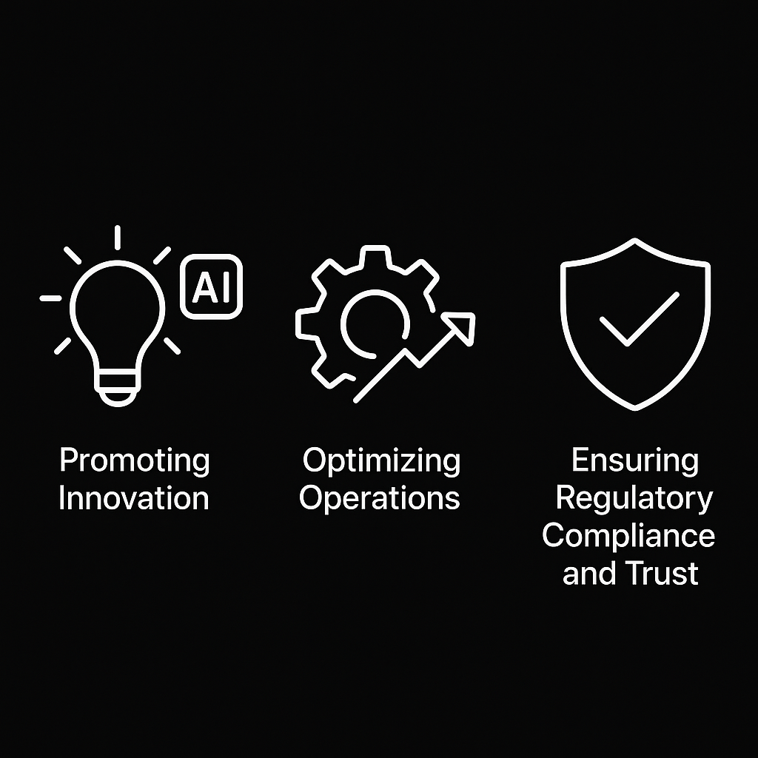
AI Governance Model Scope
Ensuring
Compliance
and Trust
Promoting
Innovation
Optimizing
Operations

Slide 6



What’s the Difference Between and AI Governance Model and an AI Employee Policy?
AI Employee
Policies
AI Governance Model
Updating + Training

Slide 7


AI Employee Policy
Always Have Your Legal Team
Review and Finalize

Slide 8
AI Employee Policies
Should Cover…
Purpose
Scope
Employee Responsibilities
Training and Certification
Consequences of Non-Compliance
Employee Acknowledgement

Slide 9
Employee Responsibilities
Ethical Use of AI: Know where AI can and cannot be used.
Data Privacy, Security, and Safety in AI Usage: AI systems must only use authorized and secure data sources, and any AI devices or software (e.g., smart glasses, transcription apps, autonomous agents, screensharing) must receive prior approval from the AI Governance Committee.
Transparency and Accountability: Prioritize human oversight.
Incident Reporting: Allow reports to be made confidentially without fear of reprisal.

Slide 10
Consequences of Non-Compliance
Mishandling of sensitive data, failure to report incidents, or failure to pass mandatory AI training may result in disciplinary action, up to and including termination of employment. Employees who commit minor violations may be required to complete remedial training programs to ensure compliance before escalating disciplinary measures.
Initial Warning: Formal warning and mandatory retraining.
Escalation: Suspension, reassignment, or increased supervision for continued non-compliance.
Termination: Severe or repeated violations may lead to termination.
Legal Implications: Violations may result in legal consequences, including fines, sanctions, or criminal charges.

Slide 11
Employee Acknowledgment
By signing below, I acknowledge that I have read, understood, and agree to comply. I also acknowledge that I will participate in and pass all required AI training and certification programs to ensure my ability to use AI systems responsibly and ethically.
I understand the importance of using AI responsibly, protecting sensitive data, and reporting incidents in a timely manner. I am responsible for reviewing and complying with updates to the AI Employee Policy and will re-acknowledge this policy annually or when significant changes are made.
Employee Name: ___________________________
Position: ___________________________________
Date: ______________________________________
Signature: _________________________________

Slide 12
AI Governance Model
Always Have Your Legal Team
Review and Finalize

Slide 13
“A solid AI Governance Model isn’t bureaucracy…it’s the foundation that ensures AI delivers value responsibly, predictably, and at scale.”
Created via DALL-E 3

Slide 14
Key Principles And Ethical Foundations
• Accountability
• Transparency and Explainability
• Data Privacy and Security
• Non-Discrimination and Fairness
• Human Oversight
• Regulatory Compliance
• Consent and Autonomy
• Sustainability and Continuous Improvement

Slide 15
Governance Structure
AI Governance Board: Responsible for overall governance, compliance, and ethical standards related to AI technologies. The board SHOULD include members from various departments.
AI Ethics and Compliance Subcommittee: Focuses on ensuring that AI systems align with ethical principles and legal frameworks.
Data Privacy and Security Subcommittee: Ensures compliance with data protection regulations, monitors for security breaches, and oversees data governance protocols.
AI Research and Innovation Unit: Explores new AI technologies, pilots AI projects, and ensures that innovations are ethical, effective, and aligned with companies' mission to improve safe, efficient, and sustainable distribution.

Slide 16
Risk Tiering Matrix
Criterion | Low | Medium | High
Data Sensitivity | Public/anonymous | Internal or limited PII | Personal/sensitive or regulated (e.g., health/financial)
Impact of Error | Minor inconvenience | Financial/reputational impact | Safety, rights, or regulatory harm
Decision Autonomy | Assistive; human approves | Partial automation | Fully automated decisions
External Exposure | Internal users only | Customer‑facing | Affects regulated customers/markets
Regulatory Triggers | None | Some (privacy, IP) | Strong (GDPR High Risk, HIPAA, AML/KYC)
Scale of Deployment | < 100 users / pilot | 100–10k users / non‑core | > 10k users or core process

Slide 17

Improving Data
in the Age of AI

Slide 18
“Align data across departments to enable safe AI use, faster open‑records responses, stronger underwriting analytics, and defensible claims.”
Created via DALL-E 3

Slide 19
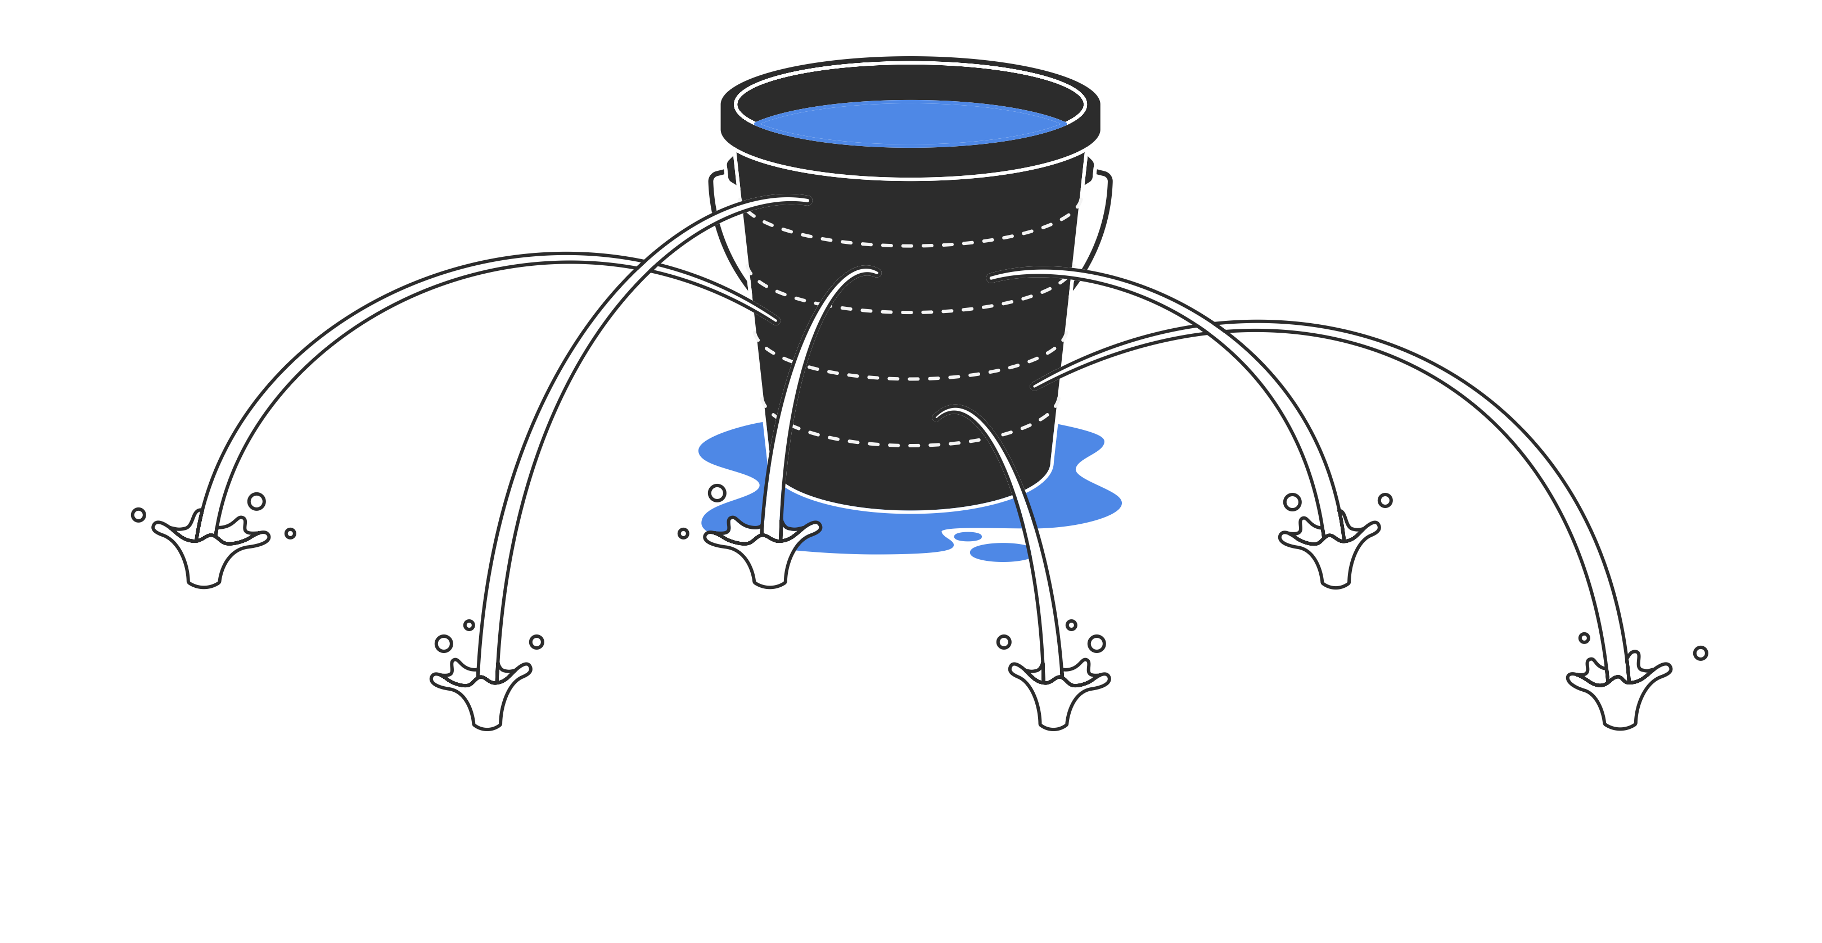
Common Data Challenges
Notes:
Experimentation is valuable—but time spent experimenting in a silo often leads to fragmented results and unclear outcomes.
Every month your competitors work with specialists, they’re directly implementing practical AI applications that boost their productivity, profitability, and market share.
Self-experimentation without structured guidance delays your opportunity to gain real, measurable results.
Partnering with experts today lets you leapfrog from uncertainty directly to ROI, turning experimentation into meaningful growth.
Education about AI is essential—but every month spent purely learning, rather than doing, puts you behind competitors who’ve already turned AI knowledge into action.
AI isn’t a static topic—by the time you’re ‘fully educated,’ the landscape will have changed significantly, leaving you to start learning again from scratch.
We offer a model of concurrent learning—implementing practical, low-risk projects as you build expertise. This means you can achieve tangible business results immediately, rather than playing catch-up later.
AI doesn’t have to be complex or costly to deliver immediate value.
Starting small, targeted projects can produce outsized returns quickly.
The real cost comes from waiting—because every day you delay adopting AI-driven efficiencies, you incur avoidable costs in inefficiency, lost productivity, or missed opportunities for new revenue streams.
Our job is to simplify AI, help you identify immediate gains, and ensure you start experiencing the benefits sooner rather than later.
AI technology matures rapidly—waiting for a ‘perfect’ moment means it will likely never come.
Your competitors aren’t waiting—they’re deploying practical AI solutions today, gaining significant competitive advantages.
Just as businesses who waited to adopt the internet or mobile computing found themselves far behind, businesses hesitating on AI will quickly face an insurmountable competitive gap.
The right approach is iterative and agile: get into AI now, incrementally building on early successes, keeping you at the forefront rather than left behind.
Every industry has room for immediate AI-driven improvement—whether automating repetitive tasks, gaining deeper customer insights, streamlining operations, or uncovering new market opportunities.
If you are unsure how AI applies to you, this is precisely the time to engage in an assessment. This clarity doesn’t come from reading articles or attending webinars—it comes from practical, hands-on assessments.
The sooner you understand precisely where AI fits, the sooner you reap the real-world benefits.
All innovation involves some level of uncertainty—but the biggest risk today is doing nothing.
Companies hesitant to embrace innovation in the past have found their market position eroded quickly.
The right strategy is not to avoid AI but to implement it strategically—start with small pilots, measure impact carefully, and scale confidently.
Controlled, phased adoption manages risk better than postponement. It ensures you remain relevant and competitive.

Slide 20
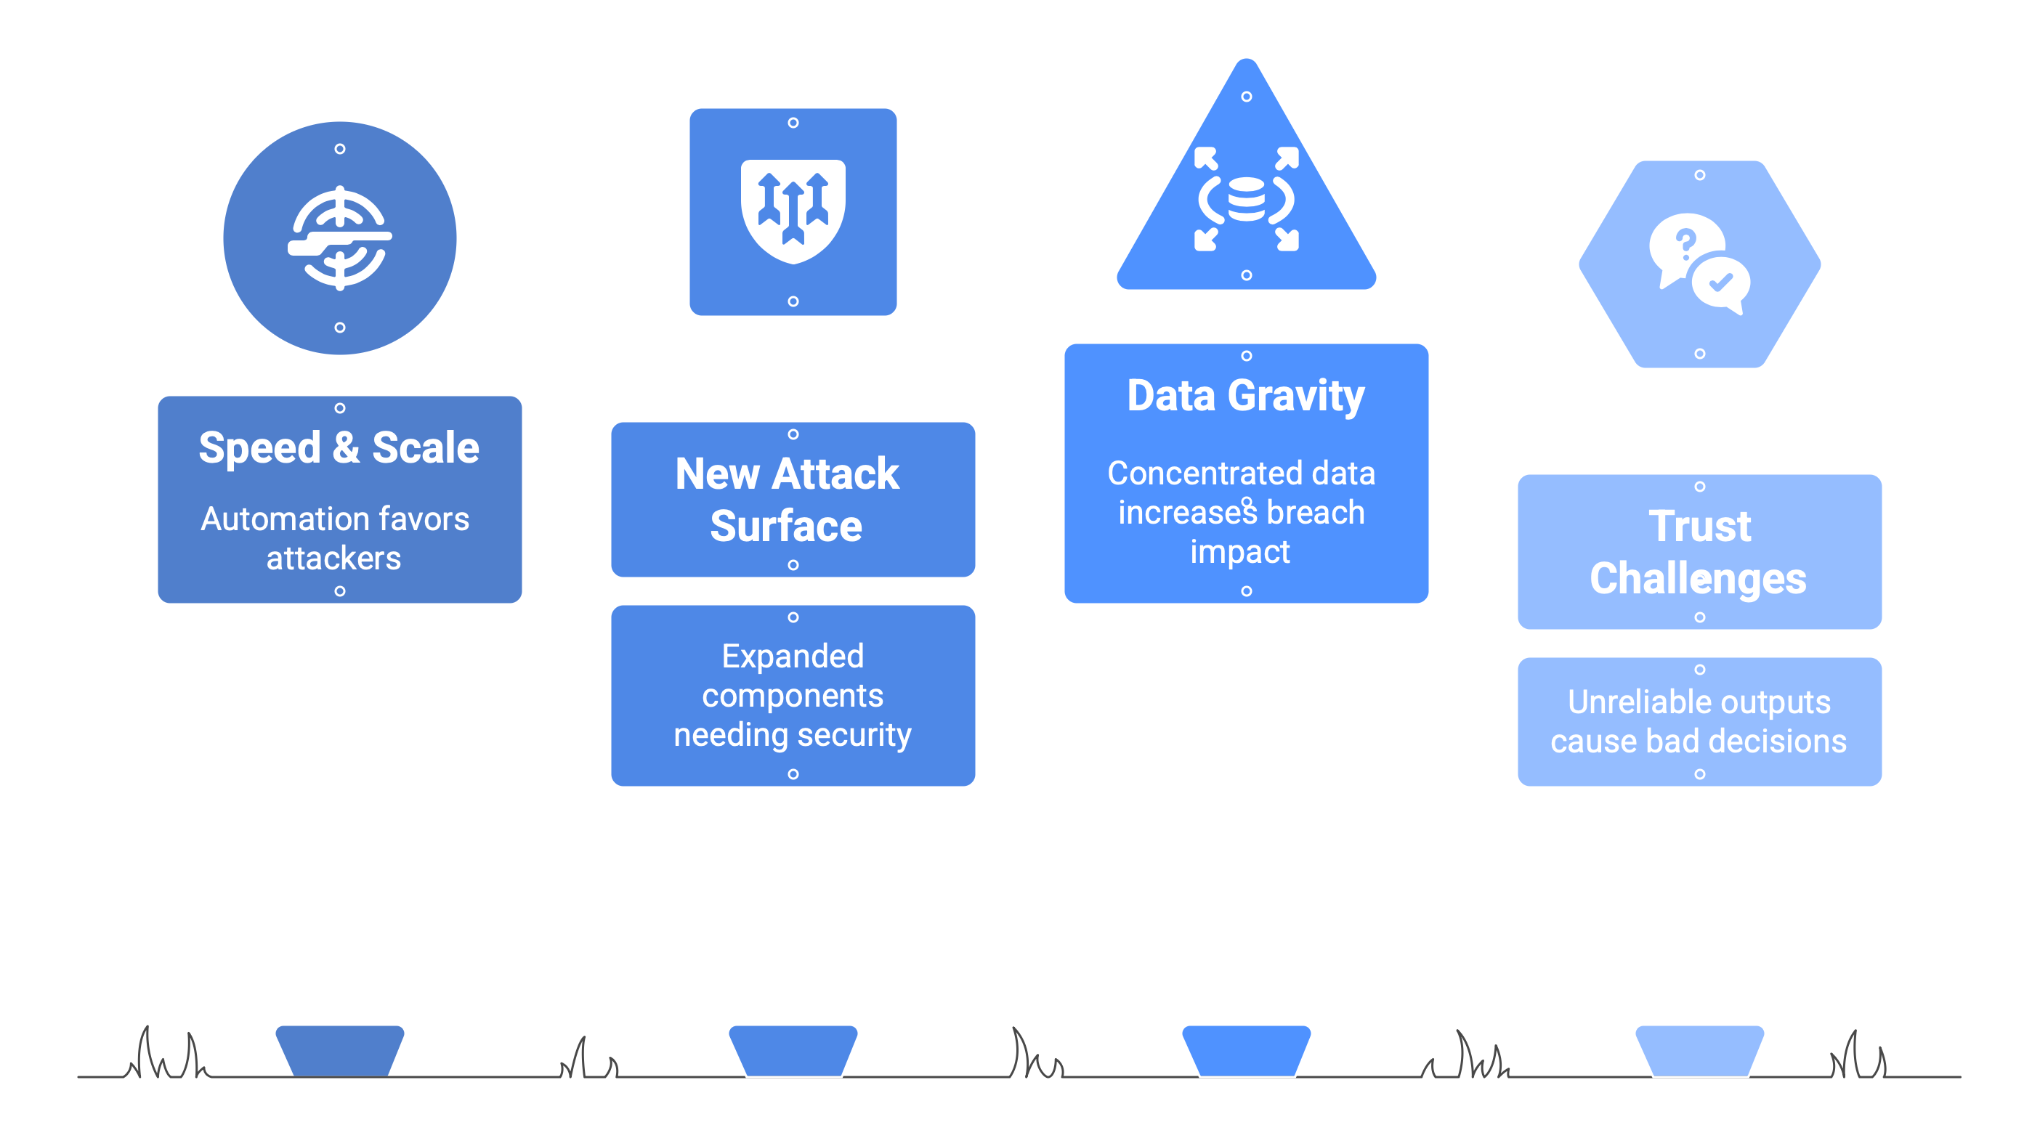
Common Security Concerns

Slide 21
10 Municipal
Data Hygiene Practices
for AI Readiness

Slide 22
Establish Clear Data Ownership and Governance
1
Assign data stewards in Police (CAD/RMS), Fire, Public Works (CMMS), Utilities (SCADA), Finance (ERP), HR/Payroll, Clerk/Records (ECM), Planning (GIS/permitting), etc.
Maintain a shared data dictionary and standards across member municipalities where feasible.
Map datasets to records‑retention schedules and open‑records laws.

Slide 23
Standardize Data Entry Processes
2
Use controlled fields for addresses, parcel IDs, offense codes, meter IDs, asset IDs, employee IDs in ERP/Finance, CAD/RMS, 311/CRM, permitting, and CMMS.
Enforce uniform formats (street types, dates/times, unit numbers, geo‑coordinates) and a master address/parcel key.

Slide 24
Regularly Audit and Clean Data
3
Schedule routine data quality checks to identify and remove duplicates, outdated entries, and inconsistencies.
Use automated data-cleaning tools to detect anomalies and enforce formatting standards.
Periodically validate external data against trusted sources or partner databases.

Slide 25
Integrate Systems and
Eliminate Data Silos
4
Connect systems (e.g., ERP/Finance ↔ 311/CRM ↔ permitting/ECM ↔ GIS ↔ CMMS/SCADA ↔ CAD/RMS) via APIs/integration hubs
Use MCP, APIs or data integration platforms to synchronize real-time updates across systems.
Use a municipal data hub (or secure lake/warehouse) as the “source of truth” for analytics and AI training.

Slide 26
Ensure Data Accuracy and Timeliness
5
Implement real-time or near-real-time data updates for key metrics.
When applicable, adopt new technologies and sensors to reduce human error in data capture.
Use automated validation checks to flag inconsistencies immediately (e.g., address must geocode; officer ID must exist; meter reads within tolerance).

Slide 27
Protect Data Integrity and Security
6
Enforce role‑based access, least privilege, and privileged activity logging across all systems.
Maintain immutable audit trails for changes to incidents, personnel actions, permits, and asset records.
Back up critical systems and test restores; include ECM/records and integration logs.

Slide 28
Manage Master Data
7
Stand up master records for people/organizations, master address table (MAT), parcels, assets/fleet, employees, and vendors with unique IDs.
Version and publish authoritative GIS layers (streets, parcels, facilities) to all departments.

Slide 29
Train Staff on Data Quality Practices
8
Annual data literacy plus open‑records/FOIA and confidentiality training tailored to each department.
Provide quick‑reference guides for system inputs and evidence handling (prompts/outputs, attachments, redactions).

Slide 30
Monitor Data Quality Metrics
9
Establish data quality KPIs such as accuracy, completeness, consistency, timeliness, and uniqueness.
Track address geocode match rate, NIBRS completeness, 311 closure accuracy, permit cycle‑time data completeness, work‑order reconciliation rate.
Use dashboards and alerts; perform root‑cause analysis on recurring issues.

Slide 31
Plan for Future AI Readiness
10
Log prompts, outputs, versions, and access for any AI tool used on municipal data; store in the records system with retention tags. Preserve prompts/outputs, versions, and audit trails
Maintain data lineage and provenance (dataset “cards”), de‑identify or use synthetic data for training, and document vendor data‑use, retention terms, and liability boundaries.
Keep a claims‑defense checklist: what to preserve, where it lives, who to notify. Also, consider a deepfake/impersonation playbook with notification timelines.
Learn more about AI Agents, A2A, and MCP (Model Context Protocol).

Slide 32
“Listen to your data.
The plot is in the patterns and the truth is in the trend.”
Created via DALL-E 3

Slide 33
Questions

