Slide 1

Lessons from the Field: Turning E-Learning Investments into Measurable Impact
Wednesday, October 29th | 10:45 AM

Slide 2
Lessons from the Field: Turning E-Learning Investments into Measurable Impact
October 29, 2025
Presenter: Marco DeLeon
Vice President,
Strategic Alliances

Slide 3

Introduction / Speaker Background
20+ years in law enforcement
Training, investigations, homicide, hostage negotiations
10 years w/Lexipol
Working directly with agencies, leading teams, & heading Strategic Alliances
Direct partnership with 12,000 agencies nationwide
Partnerships with 74 risk pools and private insurance groups
Why does this matter?
Officer-level view
Agency-level view
Risk Pool-level view
We see what works and what doesn’t!

Slide 4

Context: Why E-Learning?
Claims are skyrocketing — public actions, internal complaints, and nuclear verdicts are driving costs.
Consistent, documented training reduces liability and strengthens defensibility.
Builds better decision-making through scenario-based, policy-aligned learning.
Ensures compliance and accountability with records and audit trails.
Protects organizations from gaps caused by turnover, shift work, or budgets.
Drives a culture of continuous learning — linking policy, practice, and professionalism.
Proven impact: Over a decade of data shows reduced claims and stronger performance.

Slide 5

A Preventable Loss: The Price of a Missed Training Hour
A tragic pursuit ending in two deaths — and a $15 million potential lawsuit — stemming from one uncompleted hour of required training.

Slide 6
Common Pitfalls
‘Set It and Forget It’
Making e-learning “available” without narrative or plan
No adoption strategy = wasted investment
“If you just put it out there, it won’t be used.”
Lack of Cadence & Communication
Not reminding members of what’s available
No follow-up campaigns or usage nudges
“People don’t engage with what they forget exists.”
Stale or Irrelevant Content
Repetitive, outdated topics kill engagement
High-risk areas evolve: suicide prevention, bias, jail operations, etc.
New content = renewed interest

Slide 7
Common Pitfalls
No Tangible Benefit
Training that doesn’t count toward CEUs or POST credits = low value
Officers and agencies prioritize what advances their certifications
Accessibility Barriers
Long courses, no auto-save, desktop-only LMS
“Our users need to be able to stop mid-call, resume later, and learn on mobile.”
Lack of Accountability/Visibility
Leaders left unaware — chiefs, city managers, or risk managers don’t see who’s engaged or not.

Slide 8
Best Practices
CEU-Integrated Training
Ensure training counts toward mandatory continuing education
Highlight Lexipol’s approach: POST and CAPCE approvals nationwide
Even “non-traditional” training (e.g., harassment, slips/falls) can count
Marketing the Value
Treat e-learning like a product launch
Share success stories, highlight training completions
Use “champions” in agencies to promote adoption
Build Accountability Through Automated Reporting
Automate training reports to appropriate stakeholders to ensure visibility, follow-through, and true accountability.

Slide 9
Best Practices: A Standout Example
Co-Owned Annual Learning Plans
Pool identifies high-liability topics annually based on claims data and emerging risks.
Mandates member agencies require personnel to complete 6–8 hours of required e-learning in those focus areas — all CEU-eligible.
Partnership: Your provider should act as a strategic partner, helping with recommending available trainings to address identified risk.
In return, agencies gain access to a comprehensive training library supporting certification and professional development.
Positioning: Acknowledge that resources are tight and in-person training is always preferred. Present e-learning as a tool to meet mandates efficiently, so agencies can redirect time and budget toward hands-on, high-impact training.
This shared model reduces liability exposure and provides clear benefits to member agencies.
Pre-built learning plans can be easily assigned across member agencies — simplifying rollout and ensuring compliance.

Slide 10
Identifying Predictable Risks in Law Enforcement
University of Virginia & Lexipol Partnership
Partnership launched earlier this year to help risk pools identify predictors of law enforcement risk and develop data-driven mitigation strategies.
Phase One completed: A semi-systematic literature review examined 387 published studies, narrowing to 42 peer-reviewed articles that revealed clear, recurring themes around officer risk and liability.
These findings form the foundation for Phase Two, which will explore measurable interventions for agencies and risk pools.
Purpose: To move from reactive risk response to predictive risk prevention — identifying who, when, and why risk escalates before it becomes a claim.

Slide 11
What the Early Data Reveals
Potential Predictors
Prior History of Misconduct or Complaints – One of the strongest indicators of future claims or adverse incidents.
Tenure & Experience – Elevated risk at both ends of a career: early service years and around the 10-year mark, when complacency or burnout may rise.
Training –
Total training hours alone show little to no link to reduced complaints or misconduct.
However, ethics and de-escalation-focused training correlates with significant reductions in complaints and claims.
Self-Control – Officers with lower self-control scores (measured quantitatively) show higher rates of misconduct and claims.
Attitudes, Views & Perceptions – Negative organizational culture or poor perception of leadership increases risk-taking behaviors.
Mental Health & Stressors – Emotional fatigue, unmanaged stress, and lack of support resources strongly predict liability exposure.

Slide 12
The Predictors of Risk — and Where Training Can Make an Impact
Behavioral Factors
Prior Misconduct or Complaints
Self-Control & Emotional Regulation
Mental Health & Stressors
Organizational Factors
Tenure & Experience (early service and ~10-year mark)
Attitudes, Views & Perceptions of leadership and culture
Training Factors
Total Hours ≠ Lower Risk — volume alone shows no measurable link
Ethics & De-Escalation Training — strongest correlation with reduced complaints and claims
Key Insight: Predictable risk is multifactorial — behavior, culture, and training intersect. Targeted e-learning in ethics, communication, and decision-making addresses one of the most influential predictors.

Slide 13
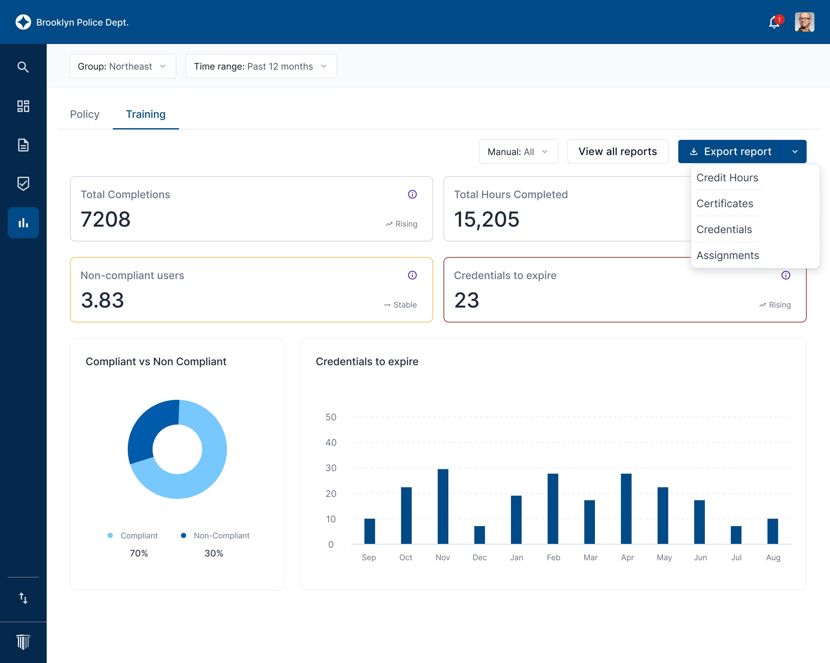
Measuring What Matters
What pools can track:
Claim trends by topic (before/after targeted training)
CEU completion rates & engagement
Cost avoidance through risk mitigation
What the data shows:
Training quality drives outcomes, not just quantity.
Ethics, de-escalation, and self-regulation training correlate with the greatest reductions in claims.

Slide 14
Turning Insight Into Action
E-learning delivers the greatest ROI when it’s intentional and strategic.
The most successful pools:
Plan around predictable risk.
Promote consistent participation.
Partner to align training with real-world exposure.
Prove the impact through data.
Bottom line: When we do these things together, training stops being a checkbox — it becomes a measurable shield against risk.

Slide 15
Partnering to Turn Insight into Prevention
Where We Go from Here:
The University of Virginia partnership is helping us uncover what truly drives risk — and how targeted, intentional training can change outcomes.
The next phase is about translating these insights into actionable strategies for risk pools: identifying specific predictors, building accountability, and using data to guide smarter training investments.
Your feedback and experience matter. Each pool’s data, claims trends, and lessons learned help refine this research and make it more predictive.
Invitation to Collaborate
How can we align this research with your goals?
Where do you see predictable risks emerging in your member agencies?
What support or data tools would help you measure impact more effectively?
The future of risk management isn’t just about reacting to losses — it’s about anticipating them and training to prevent them. Together, we can move from compliance to confidence — and from training completion to true risk reduction.

Slide 16
Questions

Slide 17
Marco DeLeon
Vice President, Lexipol
mdeleon@lexipol.com
940-594-8262

