Slide 1

Healthcare Costs – What’s Hidden and What’s Around the Corner
Monday, October 27th | 1:15 PM

Slide 2
Healthcare Costs
What’s Hidden and What’s Around the Corner

Slide 3
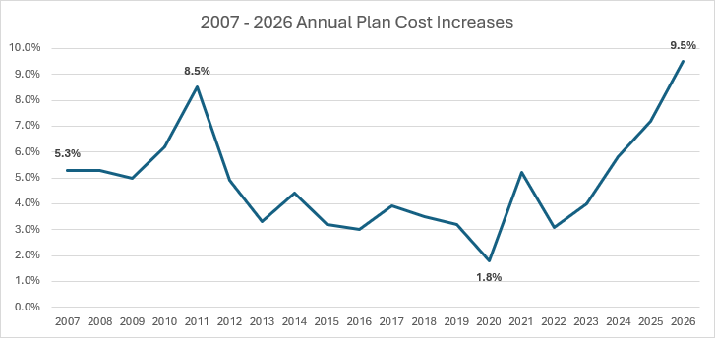

Underlying Health Care Trend Projected at 9.5% for 2026
Insights
Members
Providers
Prescription Drugs
Historical increases from Aon’s annual Health Value Initiative database, which takes actual plan and population changes into account. The 2026 increase is a projection of underlying health care trend, prior to any changes employers are considering.
Notes:
Move trend drivers details to speaker notes, look at the POV slide example

Slide 4


Addressing Lurking Costs In Your Current Health Plan Spend
ADMASTER-STAMP!2962090-NRC
Claims Payment Integrity Program Fees
No Surprises Act Unintended Consequence: Independent Dispute Resolution
AI-Driven Higher Intensity in Provider Service Coding
4
Notes:
Mike
Investigate to understand Claim and Fee Impacts
Request carrier reports on IDR arbitration claims for both open and resolved cases and regularly monitor these claims to identify any changing trends and repeat providers.
Review carrier contracts for fees and shared savings language associated with NSA negotiations and the IDR arbitration process.
Fees can include carrier administrative fees for NSA negotiations and third-party fees for the IDR arbitration entity.
Understand if and how shared savings fees and limits apply, negotiate changes if needed.
Consider the impact of these claims and fees on 2026 healthcare cost projections and budgets
If you’re planning on conducting an RFP in the near future, build fee protection into that process
Finally – Raise Awareness – discuss this issue with you network and ensure your leadership is aware of this evolving situation

Slide 5
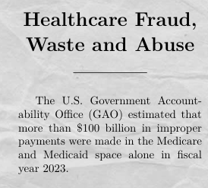

What is Claims Payment Integrity (CPI)?
CPI processes ensure healthcare claims are paid by the responsible party for eligible members according to contractual terms not in error or duplicate, free from fraud/waste/abuse, and consistent with market norms.
Simple enough, right?! If only...
Aon | Health Solutions | Proprietary & Confidential | 2025
Notes:
Mike – simplify the bullets
The U.S. Government Accountability Office (GAO) estimated that more than $100 billion in improper payments were made in the Medicare and Medicaid space alone in fiscal year 2023
The annual cost of wasteful spending in healthcare typically totals around $900 billion

Slide 6
Lifecycle of CPI Programs
Ensure claims are priced at contracted rates, services are grouped accurately
Recover costs from third parties who are responsible for the healthcare expenses
Check claims for errors/issues, verify coding accuracy and compliance
Examine claims to ensure they meet plan's criteria for payment
Reclaim funds that have been paid out incorrectly or in excess
Identify and prevent improper claims before service occurs
Cost Avoidance
Pricing and Grouping
Claim Editing
Claim Review
Subrogation
Recovery
Pre-Submission
Pre-Payment
Post-Payment
Aon | Health Solutions | Proprietary & Confidential | 2025
Notes:
Mike – simplify the bullets

Slide 7
Optimizing Other Percentage of Savings Program Fees
ADMASTER-STAMP!2962090-NRC
Programs that are generally paid by percentage of savings fees include:
Subrogation
Enhanced F/W/A Detection
Other Coverage Identification
Credit Balance Recovery
Hospital Bill Audit
Get reporting to understand program performance – and consider third-party approaches as alternatives to carrier programs
7
Notes:
Mike
Investigate to understand Claim and Fee Impacts
Request carrier reports on IDR arbitration claims for both open and resolved cases and regularly monitor these claims to identify any changing trends and repeat providers.
Review carrier contracts for fees and shared savings language associated with NSA negotiations and the IDR arbitration process.
Fees can include carrier administrative fees for NSA negotiations and third-party fees for the IDR arbitration entity.
Understand if and how shared savings fees and limits apply, negotiate changes if needed.
Consider the impact of these claims and fees on 2026 healthcare cost projections and budgets
If you’re planning on conducting an RFP in the near future, build fee protection into that process
Finally – Raise Awareness – discuss this issue with you network and ensure your leadership is aware of this evolving situation

Slide 8



Out-of-Network Price Negotiation Shared Savings Programs
ADMASTER-STAMP!2962090-NRC
Allowed Charges
Reasonable and Customary
Negotiated via Shared Savings Program
… but the devil is in the details!
8
Notes:
Carriers have programs that negotiate lower fees than billed charges for out-of-network medical and dental providers—and traditionally keep a percentage of the negotiated savings
On the surface, these programs generate lower claim spend than just paying from billed charges or a usual and customary charge for out-of-network care—but over time these arrangements have generated increased proportions of plan administrator revenue, compared to modest year-over-year increases in base administrative fees
While some administrators provide reporting on amounts generated by shared savings arrangements for negotiated provider fees, it can be infrequent and somewhat opaque to know how these administrator revenue flows are being produced.

Slide 9


Watch the Fees for Shared Savings Programs!
ADMASTER-STAMP!2962090-NRC
In 2024, of every in carrier/TPA fees were generated by out-of-network shared savings negotiation programs!
How can you right-size shared savings program fees?
Audit, audit, audit!!
Reduce the Shared Savings Percentage (15% to 20% Optimal)
Negotiate Fee Caps (PEPM and/or Per Claimant)
Negotiate High-Spend OON Providers into Primary Network
9
Notes:
High percentage of Aon clients (76%) do not have a Shared Savings fee cap in place

Slide 10
The No Surprises Act (NSA) Has a Surprise for Employers: Higher Out-of-Network Cost!
ADMASTER-STAMP!2962090-NRC
?
Higher Provider Reimbursement Rates
New Administrative Fees
Long-Term Stability
10
Notes:
Mike
Investigate to understand Claim and Fee Impacts
Request carrier reports on IDR arbitration claims for both open and resolved cases and regularly monitor these claims to identify any changing trends and repeat providers.
Review carrier contracts for fees and shared savings language associated with NSA negotiations and the IDR arbitration process.
Fees can include carrier administrative fees for NSA negotiations and third-party fees for the IDR arbitration entity.
Understand if and how shared savings fees and limits apply, negotiate changes if needed.
Consider the impact of these claims and fees on 2026 healthcare cost projections and budgets
If you’re planning on conducting an RFP in the near future, build fee protection into that process
Finally – Raise Awareness – discuss this issue with you network and ensure your leadership is aware of this evolving situation

Slide 11
The Culprit: NSA’s Independent Dispute Resolution (IDR) Process
ADMASTER-STAMP!2962090-NRC
NSA Goal:
Protecting Patients
Unexpected medical bills related to out-of-network:
Emergency services
Non-emergency services provided during a visit at an in-network facility
Air ambulance services
The Question:
How to Pay Providers Fairly?
NSA specifies two steps:
30-day open negotiation period between the health plan and the provider
If not resolved either party can request an Independent Dispute Resolution (IDR)
11
Notes:
Mike
Investigate to understand Claim and Fee Impacts
Request carrier reports on IDR arbitration claims for both open and resolved cases and regularly monitor these claims to identify any changing trends and repeat providers.
Review carrier contracts for fees and shared savings language associated with NSA negotiations and the IDR arbitration process.
Fees can include carrier administrative fees for NSA negotiations and third-party fees for the IDR arbitration entity.
Understand if and how shared savings fees and limits apply, negotiate changes if needed.
Consider the impact of these claims and fees on 2026 healthcare cost projections and budgets
If you’re planning on conducting an RFP in the near future, build fee protection into that process
Finally – Raise Awareness – discuss this issue with you network and ensure your leadership is aware of this evolving situation
Tiffaney – What additional insights would you add?

Slide 12
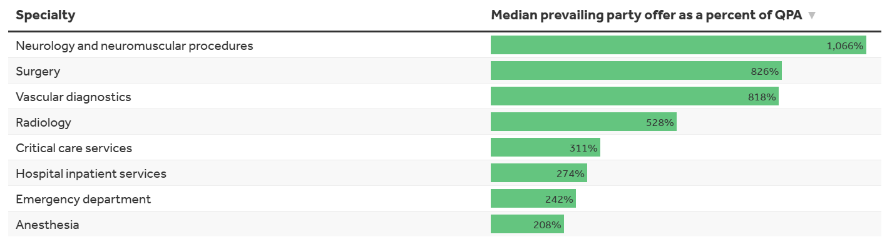
IDR Settlement Amounts as High as 1,000% the Qualified Payment Amount (QPA)
ADMASTER-STAMP!2962090-NRC
QPA = median contracted rate that a health plan has with providers for a specific service in a geographic area
Data from Q1 2023 through Q2 2024; source KFF analysis of CMS data
12
Notes:
Mike
Investigate to understand Claim and Fee Impacts
Request carrier reports on IDR arbitration claims for both open and resolved cases and regularly monitor these claims to identify any changing trends and repeat providers.
Review carrier contracts for fees and shared savings language associated with NSA negotiations and the IDR arbitration process.
Fees can include carrier administrative fees for NSA negotiations and third-party fees for the IDR arbitration entity.
Understand if and how shared savings fees and limits apply, negotiate changes if needed.
Consider the impact of these claims and fees on 2026 healthcare cost projections and budgets
If you’re planning on conducting an RFP in the near future, build fee protection into that process
Finally – Raise Awareness – discuss this issue with you network and ensure your leadership is aware of this evolving situation
Tiffaney – What additional insights would you add?

Slide 13
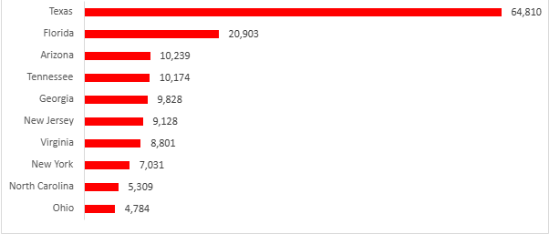
A Growing Number of IDR Disputes Are Increasingly Resolved in the Provider’s Favor
ADMASTER-STAMP!2962090-NRC
+186%
86%
Growth in IDR dispute closed cases between first quarter 2023 and first quarter 2024
Percentage of disputes settled in provider’s favor
States with the highest volume of closed IDR cases in Q1-2024
414%
Median payment of QPA
Source CMS data
13
Notes:
Mike
Investigate to understand Claim and Fee Impacts
Request carrier reports on IDR arbitration claims for both open and resolved cases and regularly monitor these claims to identify any changing trends and repeat providers.
Review carrier contracts for fees and shared savings language associated with NSA negotiations and the IDR arbitration process.
Fees can include carrier administrative fees for NSA negotiations and third-party fees for the IDR arbitration entity.
Understand if and how shared savings fees and limits apply, negotiate changes if needed.
Consider the impact of these claims and fees on 2026 healthcare cost projections and budgets
If you’re planning on conducting an RFP in the near future, build fee protection into that process
Finally – Raise Awareness – discuss this issue with you network and ensure your leadership is aware of this evolving situation
Tiffaney – What additional insights would you add?

Slide 14
Watch for Increasing Fees Due to IDR
ADMASTER-STAMP!2962090-NRC
Federal Agency Administrative Fee
$150 per dispute
IDR Entity Fee
Single disputes: $200 - $840
Batched disputes: $268 - $1,173
Potential Carrier and Other Administrative Fees
Shared Savings Program Fees
14
Notes:
Mike
Investigate to understand Claim and Fee Impacts
Request carrier reports on IDR arbitration claims for both open and resolved cases and regularly monitor these claims to identify any changing trends and repeat providers.
Review carrier contracts for fees and shared savings language associated with NSA negotiations and the IDR arbitration process.
Fees can include carrier administrative fees for NSA negotiations and third-party fees for the IDR arbitration entity.
Understand if and how shared savings fees and limits apply, negotiate changes if needed.
Consider the impact of these claims and fees on 2026 healthcare cost projections and budgets
If you’re planning on conducting an RFP in the near future, build fee protection into that process
Finally – Raise Awareness – discuss this issue with you network and ensure your leadership is aware of this evolving situation

Slide 15
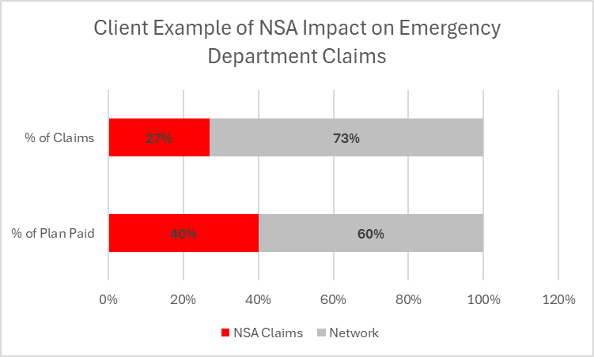
Network Considerations Given IDR Impacts
ADMASTER-STAMP!2962090-NRC
We are watching for whether providers are moving out-of-network to increase reimbursement levels given the IDR process
Considering the IDR results thus far, medical carriers are willing to negotiate higher payments to out-of-network providers to avoid it
Aon has seen a rise in payments for both IDR and negotiations
We suggest requesting carrier/TPA reporting on claims that recently have gone through the IDR process to understand if there is a resulting surge in your out-of-network spend
15
Notes:
Mike -
Investigate to understand Claim and Fee Impacts
Request carrier reports on IDR arbitration claims for both open and resolved cases and regularly monitor these claims to identify any changing trends and repeat providers.
Review carrier contracts for fees and shared savings language associated with NSA negotiations and the IDR arbitration process.
Fees can include carrier administrative fees for NSA negotiations and third-party fees for the IDR arbitration entity.
Understand if and how shared savings fees and limits apply, negotiate changes if needed.
Consider the impact of these claims and fees on 2026 healthcare cost projections and budgets
If you’re planning on conducting an RFP in the near future, build fee protection into that process
Finally – Raise Awareness – discuss this issue with you network and ensure your leadership is aware of this evolving situation
Tiffaney – What additional insights would you add?

Slide 16
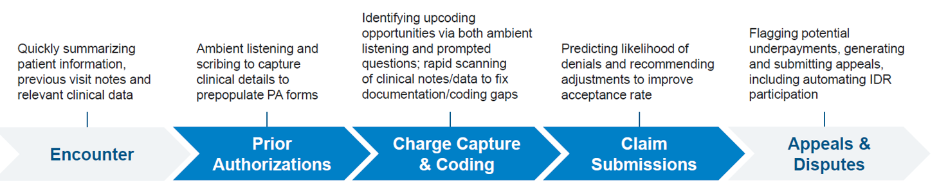
AI-Driven Escalation of Service Intensity in Provider Claim Submissions
ADMASTER-STAMP!2962090-NRC
Carriers and TPAs have recently informed clients and consultants of increased levels of claim submission intensity levels thought to be driven by use of Artificial Intelligence (AI) by providers in dictating care notes
Provider use of AI is also permeating other aspects of Payer interactions:
16
Notes:
Mike
Investigate to understand Claim and Fee Impacts
Request carrier reports on IDR arbitration claims for both open and resolved cases and regularly monitor these claims to identify any changing trends and repeat providers.
Review carrier contracts for fees and shared savings language associated with NSA negotiations and the IDR arbitration process.
Fees can include carrier administrative fees for NSA negotiations and third-party fees for the IDR arbitration entity.
Understand if and how shared savings fees and limits apply, negotiate changes if needed.
Consider the impact of these claims and fees on 2026 healthcare cost projections and budgets
If you’re planning on conducting an RFP in the near future, build fee protection into that process
Finally – Raise Awareness – discuss this issue with you network and ensure your leadership is aware of this evolving situation
Tiffaney – What additional insights would you add?

Slide 17
AI-Driven Escalation of Service Intensity in Provider Claim Submissions
ADMASTER-STAMP!2962090-NRC
AI-driven upcoding raises concern from multiple perspectives:
Financial impact: upcoding increases costs for payers and, ultimately, for patients and the healthcare system
Legal risks: deliberate upcoding can result in audits, fines, and criminal charges for providers
Ethical issues: it undermines trust in healthcare providers and the integrity of medical records
17
Notes:
Mike – combine next couple slides
Investigate to understand Claim and Fee Impacts
Request carrier reports on IDR arbitration claims for both open and resolved cases and regularly monitor these claims to identify any changing trends and repeat providers.
Review carrier contracts for fees and shared savings language associated with NSA negotiations and the IDR arbitration process.
Fees can include carrier administrative fees for NSA negotiations and third-party fees for the IDR arbitration entity.
Understand if and how shared savings fees and limits apply, negotiate changes if needed.
Consider the impact of these claims and fees on 2026 healthcare cost projections and budgets
If you’re planning on conducting an RFP in the near future, build fee protection into that process
Finally – Raise Awareness – discuss this issue with you network and ensure your leadership is aware of this evolving situation
Tiffaney – What additional insights would you add?

Slide 18
Addressing AI-Driven Upcoding
ADMASTER-STAMP!2962090-NRC
Addressing AI-driven upcoding requires a combination of strong governance, technical transparency, regular monitoring, education, and careful vendor management.
Strategy | Purpose | Demanding action from your carriers
Governance & Oversight | Prevent misuse, ensure accountability | Create AI oversight committee
Transparency & Explainability | Enable audits, build trust | Require algorithm documentation
Audits & Monitoring | Detect and correct upcoding | Routine claims review
Training & Education | Reduce errors, increase awareness | Coding compliance workshops
Vendor Evaluation | Ensure ethical AI use | Demand third-party audits
Feedback Loops | Improve accuracy, catch errors | Anonymous reporting hotline
Regulatory Compliance | Avoid fines and legal issues | Update policies per CMS rules
18
Notes:
Mike
Investigate to understand Claim and Fee Impacts
Request carrier reports on IDR arbitration claims for both open and resolved cases and regularly monitor these claims to identify any changing trends and repeat providers.
Review carrier contracts for fees and shared savings language associated with NSA negotiations and the IDR arbitration process.
Fees can include carrier administrative fees for NSA negotiations and third-party fees for the IDR arbitration entity.
Understand if and how shared savings fees and limits apply, negotiate changes if needed.
Consider the impact of these claims and fees on 2026 healthcare cost projections and budgets
If you’re planning on conducting an RFP in the near future, build fee protection into that process
Finally – Raise Awareness – discuss this issue with you network and ensure your leadership is aware of this evolving situation
Tiffaney – What additional insights would you add?

Slide 19
What’s coming section

Slide 20


Future Employer-Provided Healthcare Costs
Market
GLP-1s Gene and Cell Therapy Cancer
Menopause Medications
Government
No Surprises Act Inflation Reduction Act Expanded ACA Premium Tax Credits Expiring
Trump Administration Prescription Drug Policies Tariffs OBBBA Transparency Initiatives: Machine Readable Files (MRFs)
Imminent
Near Term
Notes:
We’ll now transition to What’s Around the Corner
Left-hand side – I’ll spend some time talking about the Market Impacts, and Molly and Colleen will talk about governmental impacts on ER HC costs.
On the following pages, I will specifically talk about GLP1s, gene and cell therapy, and cancer in more detail.
One that we won’t get into detail on, but is worthy of a mention here is Women’s Health
Menopause medications is one therapeutic area that has not received much attention for decades
There’s 1 drug already on the market as a non-hormonal treatment option for menopause
Another drug is coming soon and we’re expecting it to have high cost and prevalence, similar to the GLP-1s
Time will tell but it is an area that we are watching
Right-hand side
Mike just touched on the No Surprise Act
While we are not going to discuss today, Medicare Part D improvements due to Inflation Reduction Act could result in additional cost for employer-sponsored group health plans (e.g., negotiation of the 15 highest cost drugs)
Molly and Colleen will discuss the other topics in more detail including:
the expanded ACA credits expiring
the Trump administration prescription drug policies
tariffs
The One Big Beautiful Bill Act
Transparency initiatives
To jump into the first one:

Slide 21
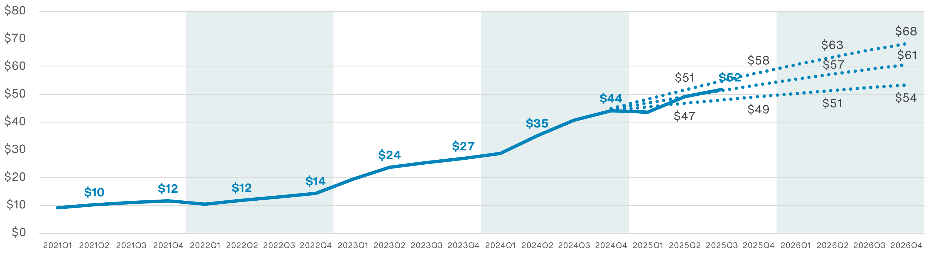
GLP-1 Cost Projection
GLP-1 Gross Cost Average PMPM Projection
Aon projection performed early 2025 using data through Q4 2024 ($44 PMPM): dotted lines represent range of possible projected costs, ranging from $54 PMPM for best case scenario, $61 PMPM for most likely scenario, and $68 PMPM for worst case scenario for Q4 2026
Actual costs just added through August 2025 are tracking right at the most likely scenario leading to $61 PMPM for Q4 2026
Note: Data above reflects Aon client averages from PBM reporting.
Notes:
Explain the graph / projection
By 2026, costs projected to have grown 5 times cost levels from 2021
Growth in 2024 and 2025 driven by increased use for weight loss, more drugs on the market, and expanded indications like Cardiovascular disease, sleep apnea, chronic kidney disease, and MASH
THINGS TO WATCH IN THE FUTURE
Growth tailwinds for latter part of 2025 and into 2026 include expected release of oral formulations for obesity and expected approvals for new indications including Alzheimer’s, Osteoarthritis of the knee, and Polycystic Ovary Syndrome, to name a few that are expected.
Growth headwinds for 2026 which may lead to lower pricing:
New pricing schemes (e.g., direct-to-consumer)
Pressure from payors
Employer perspective: generally understand the benefit of these drugs
But some ERs are dropping coverage for weight loss due to the direct costs associated w/ them
Others are focused on how GLP-1s can reduce their overall healthcare costs by improving other health conditions
Some Ers are thinking about dollar limits and time limits (e.g., cvg for 2 years)
A newer approach to covering these include a defined contribution approach through an integrated HRA or excepted benefit HRA
MOLLY COMMENT: Cost containment strategies have compliance considerations and while we don’t have time to address all of the considerations, here, Aon does have a GLP-1 compliance POV that we can share. For example, if an employer would like to offer GLP-1 coverage (e.g., subsidizing the cost of the GLP-1 and/or clinical care such as writing a prescription or monitoring use of the GLP-1) then, it creates a medical plan and all of the requirements under ERISA and in some instances, the Code, that goes with such coverage. It’s not as simple as just saying the employer will reimburse GLP-1 independent of the medical plan. Instead, options exist such as integrated HRAs or an excepted benefit HRA but with an EB HRA reimbursements cannot exceed $2,200 in 2026. This could be its own webinar, but Aon consultants are available to help offline.
Some Ers are thinking about dollar limits and time limits (e.g., cvg for 2 years) – MOLLY COMMENT: generally dollar limits are okay under the ACA prohibition on dollar limits on essential health benefits if the designated benchmark plan does not consider GLP-1s to be an EHB; also fill limits arguably will work.

Slide 22
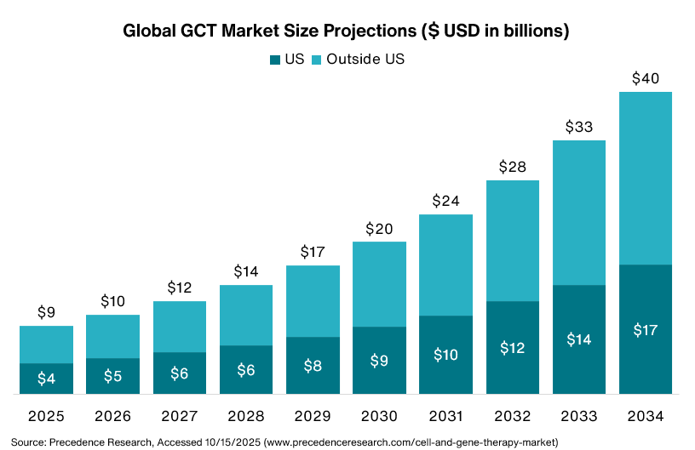
Gene and Cell Therapy (GCT) Market
Gene and cell therapy costs in the US expected to grow at more than
4 Times
2025 levels by 2034
Employers should understand their potential exposure to plan for these costs
Notes:
Gene therapy – treat rare diseases that are very high cost...typically several million dollars plus hospitalization and follow up treatment. Ex are hemophilia and rare genetic disorders
Cell therapy – treat more common diseases and are therefore used more frequently...typical cost hundreds of thousands. Ex. Is cancer.
While the pipeline of new drugs for 2026 is only slightly higher than 2025, this is certainly an area to watch as the pipeline of these drugs is expected to grow substantially over the next decade. In the US, costs are expected to grow at more than 4 times 2025 levels by 2034.
These projections were recently scaled back significantly based on latest market expectations. There’s a limited # of authorized treatment centers & there are manufacturing challenges that hamper large-scale production. In addition, participants hesitant to take due to large OOP costs, uncertain outcomes, cumbersome pre and post regimens associated with them, and many of them only offer one chance at taking in a lifetime.
Given the substantial cost of these therapies, it is important for Ers to understand potential exposure to plan for these costs. Exposure varies by demographics, disease prevalence, and drug pipeline.
There are lots of mechanisms Ers can use to pay for these including stop-loss, a credit line or loan specific to GCT, single-parent captive, group captive, or a VEBA trust, to name a few.

Slide 23
Top Trends Fueling Increased Cancer Spend
Cancer Remains The Top Condition Driving Cost
Increasing Cancer Risk and Incidence
Rising Cost of Cancer Treatments
42% of men and 40% of women will develop cancer in their lifetime¹
Median annual treatment cost of new medicines for oncology is nearly $300,000 per patient²
Variable Cost and Quality/Access
Complex Cancer Experience
74% of care is delivered in settings that have the lowest survival rates³
Number of cancer survivors is projected to increase from 22.5M by 2032 to 26M by 2040⁴
Sources: 1. ACS Cancer Facts & Figures (2024) 1. BMJ Oncology 2. The Use of Medicines in the U.S 2024, IQVIA 3. Memorial Sloan Kettering Direct, Based on Medicare 2006-2011, CRG adjusted, Refined Provider Algorithm Published in JAMA Oncology, October 2015 4. DCCPS NIH NCI
Notes:
Cancer is the top condition driving costs, representing 10.5% of all medical claims
Increased Risk
The American Cancer Society predicts 42% of men / 40% of women will develop cancer in their lifetime
Prevalence currently growing around 4% annually across our clients
Also seeing increased prevalence in younger populations
This is particularly an area to watch due to the Rising Costs
New treatments continue to come to market, including therapies just referenced, where the median annual treatment cost is nearly $300K per patient
Of course, Quality and Access continue to be concerns with 74% of care delivered in setting with low survival rates
Cancer is complex to navigate, but fortunately outcomes are improving with # of survivors expected to grow
What Can Ers do:
Stratify population risk and target engagement; its no surprise many lifestyle behaviors are associated with preventable cancers
Improve screening and early detection; Note that screenings are increasing but still below goals. Some Ers are removing age requirements (for ex. Covering all breast exams at 100% regardless of age)
Steer to high quality & cost-effective providers
Simplify complex cancer experience (there are a number of point solution vendors in this space)
With that, I’ll hand it over to Molly and Colleen to talk about impacts the government has on employer health care costs.

Slide 24
Trump Administration’s Executive Orders to Lower Prescription Drug Cost
Healthcare Transparency: Machine Readable Files
Title: Making America Healthy Again by Empowering Patients with Clear Accurate and Actionable Healthcare Pricing Information
Develop Domestic Pharmaceutical Manufacturing
Title: Domestic Production of Critical Medicine
Date Issued: 2/18/2025
Date Issued: 4/15/2025
Date Issued: 5/12/2025
Date Issued: 5/5/2025
Date Issued: 2/25/2025
Protecting IVF Access & Reducing Cost
Title: Expanding Access to IVF
PBM Fee Disclosure and Drug Importation
Title: Lowering Prescription Drug Prices by Once Again Putting Americans First
Most Favored Nation Drug Pricing and Direct to Consumer Purchasing Programs
Title: Delivering the Most Favored Nation Prescription Drug Pricing to American Patients
Notes:
Thank you Debbie.
The Trump Administration outlined many of its initiatives in EOs that we’re now seeing develop re: how it intends to REDUCE THE COST of prescription drugs. Executive Orders are a bit like presidential wishes that give us insight, like a crystal ball, into what a particular administration’s intentions are in the future. Often, an Executive Order will develop into regulations OR an ask of Congress and in this case, we’ve seen the Trump Administration use tariffs and negotiations to implement the administration’s health care goals.
1. The first EO that we’re going to discuss was issued on 2/18/2025 & directed the Domestic Policy Advisor to make recommendations on protecting access and reducing health plan costs for In Vitro Fertilization (IVF) treatment. On Oct. 16, the Trump Administration issued FAQs Part 72 which reinforced historic rules that would allow IVF to be offered as a stand-alone benefit IF (i) fully-insured or (ii) through an excepted benefit HRA (of course, an EB-HRA cannot reimburse more than $2,200 in 2026). Nothing in the guidance requires additional IVF coverage by employers. More to come on IVF drug pricing in a minute.
2. The second EO issued on 2/25/2025 continued to emphasize the need for health care price transparency through disclosure of MEDICAL negotiated rate and allowed amount PUBLIC machine readable files (MRFs) that the industry can read, so that prices, in theory, will decrease. The EO indicated that the MRFs should disclose ACTUAL prices of medical items and services, instead of estimates, as well as implement the PHARMACY MRF – So, stay tuned.
As an aside, Aon provides a service that can read these files which also should reduce employers’ fiduciary governance risk. The idea is that through transparency the market should in theory, see medical costs decrease or become more competitive.
3. The EO issued on 4/15/2025, indicates that PBMs should provide more details regarding their compensation (fee transparency); we are anticipating guidance in November. As part of this same, EO, the Trump Administration has indicated that it would like to see a pathway to more simplified importation of medications that were manufactured for Canada – those medications that are outside of the legitimate US FDA drug supply chain again, to provide lower cost medications to Americans. Generally, drug importation outside of the FDA drug supply chain is not legal. (stay tuned on this one)
4. And perhaps, the last two EOs on this page are of the most significant interest today – with so much activity over the past 2 weeks – the first one indicated that the Trump Administration intends to work with the FDA to streamline rules related to domestic pharmaceutical manufacturing & to establish Most Favored Nation (MFN) drug pricing from prescription drug manufactures for medications sold to Americans and to allow consumers to purchase prescription drugs directly from drug manufacturers at MFN prices. In other words, Americans should not pay more than other developed nations.
Candidly, I wasn’t sure how this was going to work when these EOs were issued last spring, since there wasn’t a statutory mechanism to make this happen.
But we now understand! (Turn the slide … )

Slide 25
Trump Administration Begins to Implement Executive Order on MFN and Trump Rx through Negotiations
5/12/25: EO No. 14297 | White House Initiative | “Deal” with Pharma in Lieu of Tariffs
Federal government to obtain MFN pricing from Rx manufacturers Allow consumers to purchase Rx directly from manufacturers at MFN prices | 8/21/25: Federal government intends to apply higher of the U.S. MFN tariff rate or a tariff rate of 15% for Europe and Japan 9/26/25: Trump Administration announces a 100% tariff on branded or patented medication unless breaking ground or under construction | 9/30/25: MFN deal with Pfizer for Medicaid recipients Pfizer to use direct to consumer platform (TrumpRx) to sell discounted Rx Additional pharmaceutical manufacturers engaged in negotiations

Slide 26
Tariff Effects- Rising Costs and Supply Chain Disruption
Impact on drugs and medical supplies appear limited relative to the impact of labor growth
Labor Constitutes Largest Percentage of Hospital Expenses (in billions)¹
Healthcare staffing growing faster than other sectors
September 1 ruling
15% tariff on brand drugs from the European Union
Generic drugs to receive Most Favored Nation pricing
Cost stability and supply chains in jeopardy
¹ Source: Average expenses estimated by Strata Decision Technology median 2023 values across all hospital spending. Labor is inclusive of purchased services and professional fees. From the American Hospital Association “2024 Cost of Caring” report https://www.aha.org/guidesreports/2025-04-28-2024-costs-caring
²Source: Association for Accessible Medicines “The U.S. Generic & Biosimilar Medicines Savings Report” https://accessiblemeds.org/resources/reports/2024-savings-report/
Notes:
COLLEEN
As Molly described the executive orders and goal of reducing the cost of prescription drugs through leveraging tactics such as tariffs, one concern that Aon is monitoring is the overall impact tariffs could have on rising healthcare costs and supply chain distribution. At this point, we believe the impact on drugs and medical supplies will be limited in the near future. As you can see in the pie chart, labor costs are 60% of hospital expenses:
Even before tariffs, healthcare staffing was growing faster than other sectors
And we’re seeing hiring gaps persists so growth is expected to continue
Medical Supplies – account for 13% of hospital costs
Medical supplies, devices, and equipment include everything ranging from basic supplies (syringes, needles, IV bags, gauze, surgical instruments, PPE) to more complex devices (pacemakers, imaging machines, glucose monitors).
Many of these supplies and devices rely on globally-sourced components which could be impacted by tariffs
Drugs account for approximately 8% of hospital costs¹
Generic drugs, accounting for 90% of all prescriptions but only 13% of Rx spending in the US², were initially expected to be impacted due to low margins and reliance on imports
The U.S. recently ruled that, starting September 1, most goods sourced from the European Union would have a 15% tariff (impacting brand drugs) but that generic drugs would receive Most Favored Nation pricing (a tariff of “effectively zero”)
Again as we look to the short term implications, we believe:
Health systems are likely to absorb any immediate cost increases. The nature of their contracts are multi-year so it may take several years before they can pass on the costs.
Also, unclear if tariffs will be applied on the medical device industry, but they would be unlikely to take effect before mid-2026 and trade groups are seeking exemptions
Limited impact on pharma trends due to stockpiling and latest guidance around EU tariffs at manageable rates, which allows manufacturers to move forward with planning
However, as we look to medium- to long-term:
Increased pressure to diversify supply chain and prioritize US-domestic manufacturing
Manufacturers may ultimately pass costs onto payers and patients to avoid margin impact
Procurement slowdowns may cause longer lead times, supply shortages, or hoarding (reminiscent from COVID era)
Potential cuts elsewhere such as labor (which could decrease patient access) or medical technology (which could slow advances in research and development)
Medical device industry is under investigation through Section 232 (designed to assess national security risks tied to importing items in medtech)

Slide 27
With September Pharma Tariff Announcement, Many Details Remain Undefined
Effective October 1, branded pharmaceutical products may face a 100% tariff unless the manufacturer is actively building a U.S.-based facility.
— Trump Administration announcement, Sept. 2025
Key Questions Remain¹
Industry Impact
Large pharmaceutical companies²
Smaller biotech firms³
Biotech stocks
¹ STAT News, https://www.statnews.com/2025/10/01/trumps-delays-pharmaceutical-tariffs-continues-pressure-lower-prices/
² AbbVie, Amgen, AstraZeneca, Biogen, Bristol Myers, Eli Lilly, Gilead, GSK, Johnson & Johnson, Merck, Novartis, Novo Nordisk, Regeneron, Sanofi, among others
³ Biotechnology Innovation Organization 3/26/2025 press release https://www.bio.org/press-release/new-survey-us-biotechs-warn-tariffs-could-impede-access-cures-stifle-innovation
Health Solutions | Proprietary & Confidential
27
Notes:
Key Questions:
Does every drug sold need to be manufactured in the U.S.? Is simply having one U.S. facility enough?
Do pilot plants qualify? Are there specific size and facility type requirements?
How is “under construction” defined (and enforced)?
With October 1 effective date already delayed, when will this rule go into effect?¹
Most large pharmaceutical companies appear insulated:
Many² have already announced plans to expand U.S.-based manufacturing
Many maintain inventory stockpiles of brand drugs sufficient for 18+ months
With latest announcement, generic drugs are no longer targeted by tariffs (account for 90% of US script volume)
Existing trade agreements may cap tariffs well below 100% (e.g. European Union’s 15% tariff rate, etc.)
Smaller biotech firms are more vulnerable to tariff-related disruptions:
These firms often depend on international manufacturing partnerships and operate with tighter capital constraints
According to a survey, 80% of biotech firms may need at least a year to find alternative suppliers, while 44% may require 2+ years³
Biotech stocks initially dipped after the administration’s announcement on Sept. 25, 2025; however, they have since rebounded
With most large manufacturers insulated and generics excluded, the overall impact of pharma tariffs is likely to be more limited than anticipated after the initial tariff announcements earlier this year

Slide 28
Implications on Medical / Pharmacy Trend
Minimal near-term trend impacts expected; costs may shift in long-term as industry re-aligns
Implications
Short-Term: Health systems Medical device industry Pharma trends Long-Term: Prioritize domestic manufacturing Costs likely passed onto payers and patients Supply shortages or hoarding Potential cuts elsewhere
Aon Trend Team’s Quick Poll on Tariffs
Survey Scope: Conducted August 2025 Medical carriers and PBMs 17 responses, including all major carriers The Results: Most carriers have not (or have not yet) incorporated tariff impacts into 2026 projections
Health Solutions | Proprietary & Confidential
28
Notes:
Short-Term Implications:
Health systems are likely to absorb any immediate cost increases in the near-term, due to the multi-year nature of contracts, but medical pharmacy price may be on more flexible negotiating terms
Unclear if tariffs will be applied on medical device industry, but they would be unlikely to take effect before mid-2026 and trade groups are seeking exemptions
Limited impact on pharma trends due to stockpiling and latest guidance around EU tariffs at manageable rates, which allows manufacturers to move forward with planning
Medium- to Long-Term Implications:
Increased pressure to diversify supply chain and prioritize US-domestic manufacturing
Manufacturers may ultimately pass costs onto payers and patients to avoid margin impact and may refocus forward-looking efforts on high-margin products
Procurement slowdowns may cause longer lead times, supply shortages, or hoarding (reminiscent from COVID era)
Potential cuts elsewhere such as labor (which could decrease patient access) or medical technology (which could slow advances in research and development)
Medical device industry is under investigation through Section 232 (designed to assess national security risks tied to importing items in medtech)

Slide 29
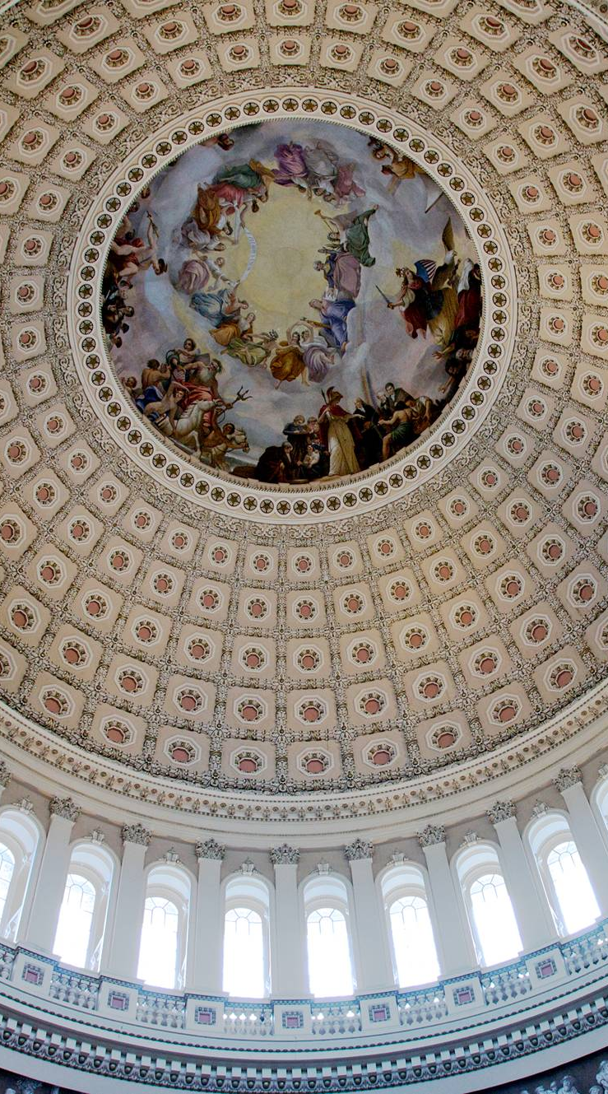
119th Congress — Legislation
Senate
53 Republicans
47 Democrats¹
House of Representatives
219 Republicans
213 Democrats
3 Seats Vacant
¹ Includes 2 Independents who caucus with Democrats.

Slide 30



Bi-Partisan Federal Legislation? Regulation?
Topics Under Consideration in Congress and Administration
PBM Reform
Using outline of legislation from 12/2024
Reinstating ACA Subsidies Set to Expire 1/2026
Government shutdown as of midnight on 9/30/2025
One Big Beautiful Bill Act
Direct Impact Minimal: Telehealth, Direct Primary Care
Indirect Impact: Medicaid Cuts

Slide 31


One Big Beautiful Bill Indirect Impacts- ACA marketplace
The OBBB Act tightens premium tax credit eligibility for individuals who are not citizens
Advance premium tax credits for all individuals will require enhanced verification of eligibility
ACA individual marketplace:
Increase in premiums
Lower enrollment due to eligibility and affordability
Potentially leading to millions losing coverage
The law does not extend the ACA subsidies that are due to expire at the end of 2025
Notes:
COLLEEN
The CBO projects that 4.2 million more people will be uninsured in 2034 if enhanced ACA tax credits expire.
The expiration of the enhanced tax credits is expected to cause ACA enrollees’ out-of-pocket premium payments to increase by over 75% on average, with people in some states seeing their payments more than double on average. Lower-income and older enrollees, as well those who live in states that have not expanded Medicaid, are expected to see the most significant premium payment increases.

Slide 32

ACA exchange enrollment
How will expiration of enhanced
premium tax credits and new enrollment restrictions affect 2026 enrollment, insurer
participation and premium rates?
Enrollment relatively stable as new ACA market settles in
Increasing enrollment driven largely by enhanced premium tax credit formula
Notes:
COLLEEN (line graph)
ACA enrollment was very stable from 2015 to 2021…then PTC enhancements

Slide 33



One Big Beautiful Bill Indirect Impacts - Medicaid
Change
System Impact
Employer Impact
Loss of Medicaid Coverage | Many employees in low-wage industries who rely on Medicaid may turn to employer-sponsored group health plans. | Increased enrollment and cost pressures for group health plans.
Provider Cost-Shifting | Hospitals burdened by uncompensated care will seek to recoup their losses by negotiating higher reimbursement rates with commercial insurers. | Increased health plan cost pressures for employer sponsored group health plans. Possible provider consolidation.
Access Challenges | Rural and underserved communities will be disproportionately affected as providers cut service lines or close entirely due to unsustainable finances. | Could create new healthcare access issues for employees in these areas.
Higher Provider Reimbursement Rates
Long-Term Stability
New Administrative Fees
Notes:
The OBBBA will impact Medicaid the most, with significant funding cuts and reduced eligibility scheduled to take effect on January 1, 2028 (unless a new bill is passed to restore funding or the effective date is further extended).
Medicaid’s decentralized, state-by-state structure means the impact will be uneven, but the overall trend is clear: millions will lose coverage, particularly in low-income and rural areas.
Massive decrease in Medicaid funding, leading to 10-11M Americans losing coverage
Work Requirement
Parents of children over age 14 must be working in order to receive Medicaid
A large segment of this group are women taking care of elderly parents or young children and don't have ability to work
Provider Tax
Hospitals and other facilities pay a federal tax, federal government roughly doubles it, then sends it back to the states to be re-distributed to hospitals
Safe Harbor - if your tax is up to 6% of revenue,

Slide 34
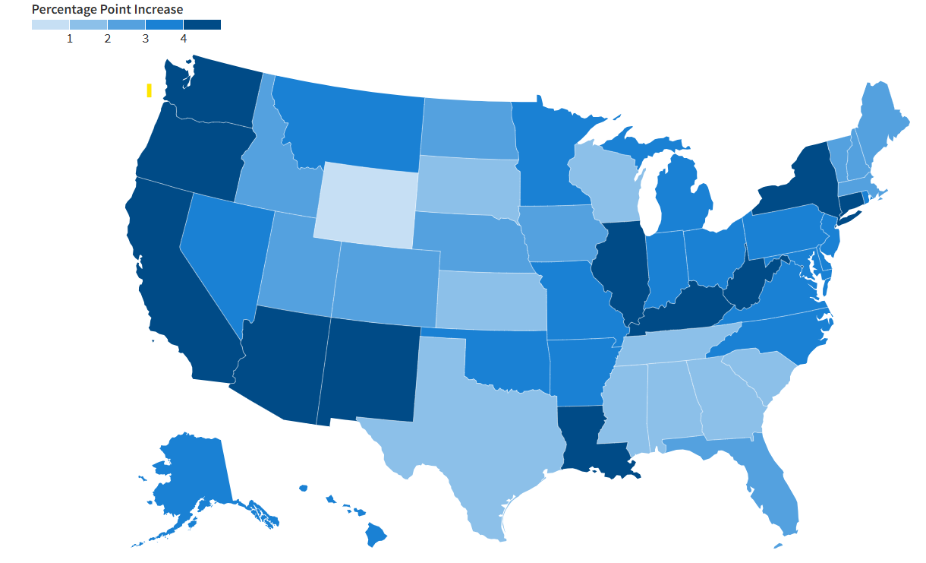






OBBBA Impact on Commercial Employer Sponsored Health Insurance
The indirect results will vary by:
Percentage Point Increase in the Uninsured Population due to the Budget Reconciliation package (formerly known as the ‘’One Big Beautiful Act’’) Based on National CBO Estimates, by States
Location
Utilization of hospital type
Average employee wage
Long-Term Stability
New Administrative Fees
Medical carrier
Age of workforce
Funding type
Source: https://www.kff.org/medicaid/how-will-the-2025-reconciliation-law-affect-the-uninsured-rate-in-each-state/
Notes:
COLLEEN
The impact of OBBB will vary across employers and plan sponsors. As Molly mentioned earlier, we see the impact to be an indirect result of individuals going uninsured as the level of uncompensated care will increase. The health system and providers may look to the commercial market to make up for this.
Some of the variables that could indicate the indirect level of trend increases are:
Location- As Medicaid differs state to state so does the impact of the number of uninsured
Hospital type- rural v. urban and how much the hospital covers Medicaid
Lower wage employees may be impacted more as they typically utilize less efficient place of service
Medical carrier- if the medical carrier loses a large number of members in ACA exchange or Medicaid, they may try to pass their fixed costs to the commercial side
Age of workforce could increase if employees have to work lower to have access to healthcare as ACA might be less affordable to them
Funding type- goes back to medical carrier and network implications

Slide 35


Key Actions
ADMASTER-STAMP!2962090-NRC
Understand your data. Pinpoint cost drivers specific to your organization.
Negotiate contract terms. Ensure PBM fee disclosure and assistance from PBMs to host Machine Readable Files when guidance is issued.
Stay Tuned. Subscribe to Aon’s Washington Report for the latest.
Register here via Aon’s Preference Center
35
Notes:
No 2 employers are the same
Continues to evolve
Include language in PBM agreement related to updated fee disclosure requirement, Machine Readable File compliance requirements, and continue to monitor MFN arrangements

Slide 36
Thank you
For more information, please contact: hr.support@aon.com
Notes:
LISA:
Thank you for attending today’s Trend Cast. We’ll be sharing materials as a follow up to today’s discussion. Please look out for an invitation to our upcoming October Trendcast. Thank you and have a nice day.

Slide 37
APPENDIX

Slide 38
Inflation Reduction Act Overview
2023
2024
2025
2026+
Eliminates cost share on adult vaccines under Part D
Implements a beneficiary cost maximum on Insulin of $35 a month — Deductible does not apply
Requires drug manufacturers to pay rebates to Medicare if prices increase faster than inflation for certain Part D and Part B drugs starting in 2023
Extends ARPA subsidies through 2025
Expands Low Income Subsidy (LIS) to full benefit for those 135% – 150% of the Federal Poverty Level (FPL)
Establishes “Premium Stabilization,” which allows no more than 6% in average beneficiary premium growth for years 2024 – 2030
Eliminates beneficiary cost sharing in the catastrophic coverage layer
Modest impact to Creditable Coverage test
Eliminates the Coverage Gap
Establishes a $2,000 beneficiary out-of-pocket maximum
Significant impact to Creditable Coverage test
Restructures the Manufacturer Discount Program and Federal Reinsurance
Allows smoothing of out-of-pocket Part D costs across the year for retirees
ARPA subsidies
Allows Federal Government to negotiate drug costs for Medicare starting with 10 Part D drugs in 2026 + 15 Part D in 2027 + 15 Part D or Part B in 2028 + 20 in 2029
Delays point of sale rebate rule until 2032
$2,100 beneficiary out-of-pocket maximum
The IRA improves the Standard Part D Benefit to an ~85% actuarial value*. In 2023 the actuarial value* of the Standard Part D benefit for RDS and Creditable Coverage testing purposes is ~65% – 70%.
Actuarial values will vary by plan and population
Notes:
Remove this slide, add a bullet about this on the indirect section (under Medicare section)

Slide 39

What is an Executive Order?
An Executive Order (EO) is a signed directive by the President of the United States
An EO:
Often expresses a President’s intent on policy or how the President might like the law to change either through Congress (statutory change) or the Agencies (regulatory or sub-regulatory guidance)
Must be within the scope of the President’s powers under Article II of the U.S. Constitution or as provided by Congress
Cannot override the U.S. Constitution or existing law
Generally, has the force of law but can be challenged in court
Note: If an EO is specifically tied to federal funding or federal contracting, an EO can be very impactful
But again, cannot go beyond the President’s powers delegated by the U.S. Constitution or Congress
As always, employers should work with legal counsel when determining the impact of an Executive Order. Aon is not in the practice of law.
Notes:
Combine 31 (speak to this one only) and 32

Slide 40
Executive Orders
Impacting Healthcare Initiatives
Topic: Family Building
Name of EO: Expanding Access to In Vitro Fertilization (IVF)
EO Number: 14216
Date Issued: 2/18/2025
Summary: Directs the Domestic Policy Advisor to the President to make recommendations on “protecting IVF access and aggressively reducing out-of-pocket and health plan costs for IVF treatment” within 90 days of EO. EO states that a single IVF cycle can range from $12K to $25K.
Employer Action: No action needed until/unless Congress changes law. Trump Administration may attempt to shape IVF-related requirements by regulatory or sub-regulatory guidance which could be a stretch.
Notes:
delete

Slide 41
Executive Orders
Impacting Healthcare Initiatives
Topic: Transparency
Name of EO: Making America Healthy Again by Empowering Patients with Clear, Accurate and Actionable Healthcare Pricing Information
EO Number: 14221
Date Issued: 2/25/2025
Summary: Directs the Departments to improve medical Machine-Readable Files (MRFs) to:
Disclose actual prices of items and services, not estimates of prices
Provide updated guidance for standardizing price disclosures for easy comparison across health plans and hospitals; and,
Issue guidance to update enforcement policies for compliance
Including implementing the Rx MRF which is not yet effective
Employer Action: No action currently required; monitor regulatory or sub-regulatory guidance. Work with medical Third-Party Administrator (TPA) and Pharmacy Benefit Manager (PBM) to host MRFs. Medical TPA generally should have been hosting MRFs on behalf of plan since 7/2022.
New Aon solution “Price Transparency Analysis” to read MRFs!
Notes:
Debbie and Molly and Colleen connect on what’s coming to connect the dots

Slide 42
Executive Orders
Impacting Healthcare Initiatives
Topic: Prescription Drugs
Name of EO: Lowering Prescription Drug Process by Once Again Putting Americans First
EO Number: 14273
Date Issued: 4/15/2025
Summary: Directs the Secretary of the Department of Health and Human Services (HHS) and other officials to make recommendations including:
Medicare Part D. Improve Medicare Part D, including more transparency and updates to the Medicare Drug Price Negotiation Program while not impacting pharmaceutical innovation and to reduce Medicare Part D premiums.
PBMs. Re-evaluate the role of the “Middleman” or “PBMs” and provide the President with ideas regarding PBM transparency, including updates to the Section 408(b)(2)(B) of Employee Retirement Income Security Act (ERISA) disclosure to explicitly impact PBM compensation. Note: Guidance anticipated by 11/2025.
Drug Importation. With limited exceptions, the importation of prescription drugs that are (1) outside of the legitimate Food and Drug Administration (FDA) drug supply chain and (2) originally intended for foreign markets is not legal. A pathway was developed in 2020 to allow for limited importation of these types of drugs from Canada following amendments to Section 804 of the FD&C act. The EO directs HHS through the U.S. FDA to streamline this Section 804 “drug importation program” to make it easier for states to obtain approval without sacrificing quality.
Employer Action: No action currently required; monitor regulatory or sub-regulatory guidance.

Slide 43
Executive Orders
Impacting Healthcare Initiatives
Topic: Prescription Drugs
Name of EO: Regulatory Relief to Promote Domestic Production of Critical Medicine
EO Number: 14293
Date Issued: 5/5/2025
Summary: Directs the Secretary of HHS with the U.S. FDA to make recommendations to review regulations and guidance that pertain to the development of domestic pharmaceutical manufacturing, take steps to streamline domestic pharmaceutical manufacturing, and enhance inspection of foreign manufacturing facilities.
Employer Action: No action currently required; monitor regulatory or sub-regulatory guidance.

Slide 44
Executive Orders
Impacting Healthcare Initiatives
Topic: Prescription Drugs
Name of EO: Delivering Most-Favored-Nation Prescription Drug Pricing to American Patients
EO Number: 14297
Date Issued: 5/12/2025
Summary: Trump Administration seeks to establish Most-Favored-Nation (MFN) pricing from prescription drug manufacturers for prescription drugs sold to Americans and to allow consumers to purchase prescription drugs directly from drug manufacturers at MFN prices.
MFN Drug Price Targets. Appears to apply to both public and private payers, including Medicare, Medicaid, employer-sponsored group health plans and individuals — but no clear legal mechanism if prescription drug manufacturers fail to offer MFN prices.
Personal Drug Importation. The HHS is asked to consider issuing a certification to Congress under FD&C Act that would ease “personal” prescription drug importation from other developed nations.
Direct to Consumer Sales. HHS is directed to facilitate direct-to-consumer purchasing programs from pharmaceutical manufacturers at the MFN price.
Employer Action: No action currently required; monitor statutory or regulatory changes.

