Slide 1

From Peer to Leader: Strategies for a
Successful Transition
Tuesday, October 28th | 12:30 PM

Slide 2


FROM PEER TO LEADER: Strategies for a Successful Transition
Lori Mueller, OMAG People & Culture Program Manager

Slide 3
WHAT’S IN IT FOR YOU
Learn why developing supervisors internally improves culture, retention, and risk outcomes, while modeling best practices for your member communities.
Explore how to navigate the emotional and professional shift from peer to leader, balancing relationships with authority and setting clear boundaries.
Identify skills critical to effective team leadership and risk mitigation.
Discover replicable strategies your pool can share with member municipalities.

Slide 4



MUNICIPAL CULTURE

Slide 5

STRONG, EFFECTIVE LEADERS
Are culture carriers, they:
Model effective communication
Hold themselves and others accountable
Lead with care and consistency

Slide 6


EFFECTIVE LEADERS BECOME THE BRIDGE THAT PRESERVE YOUR CULTURE

Slide 7
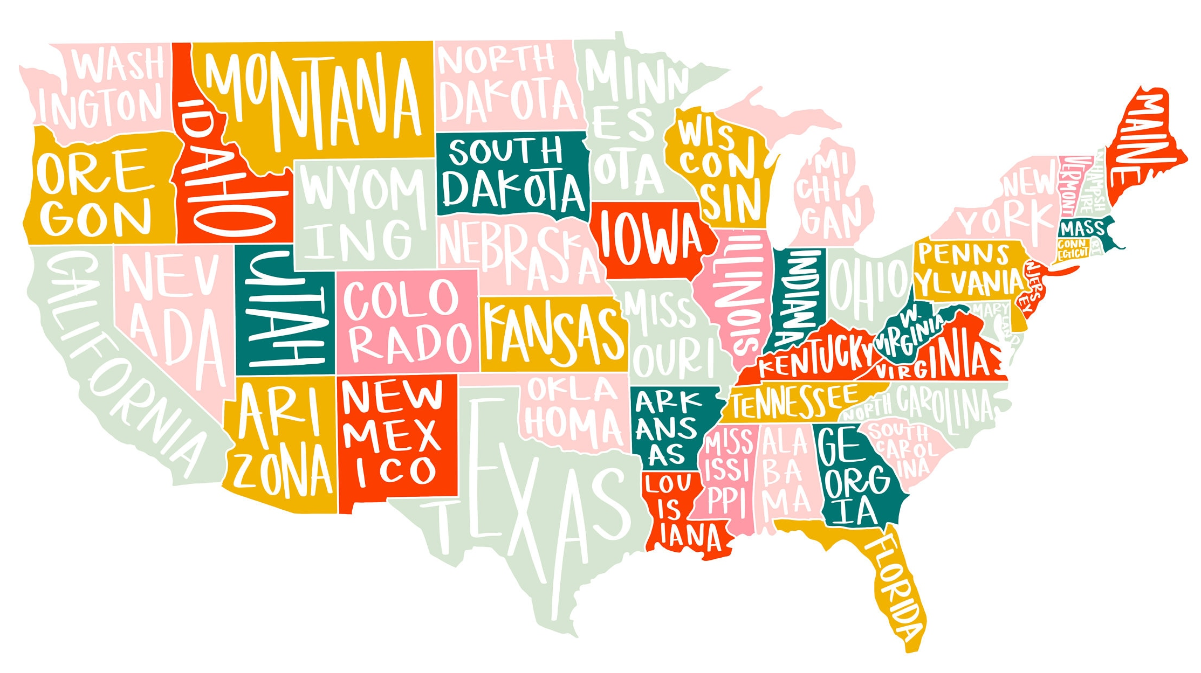
THE COST OF DISENGAGEMENT
Between $450 and $550 billion in the United States

Slide 8
EFFECTIVE LEADERS
Possess Critical Skills
Are consistent
Communicate clearly and confidently
Spot issues and act (early intervention)

Slide 9

RISK & EFFECTIVE LEADERS
Incidents go down
Staff satisfaction goes up
The member experience improves

Slide 10
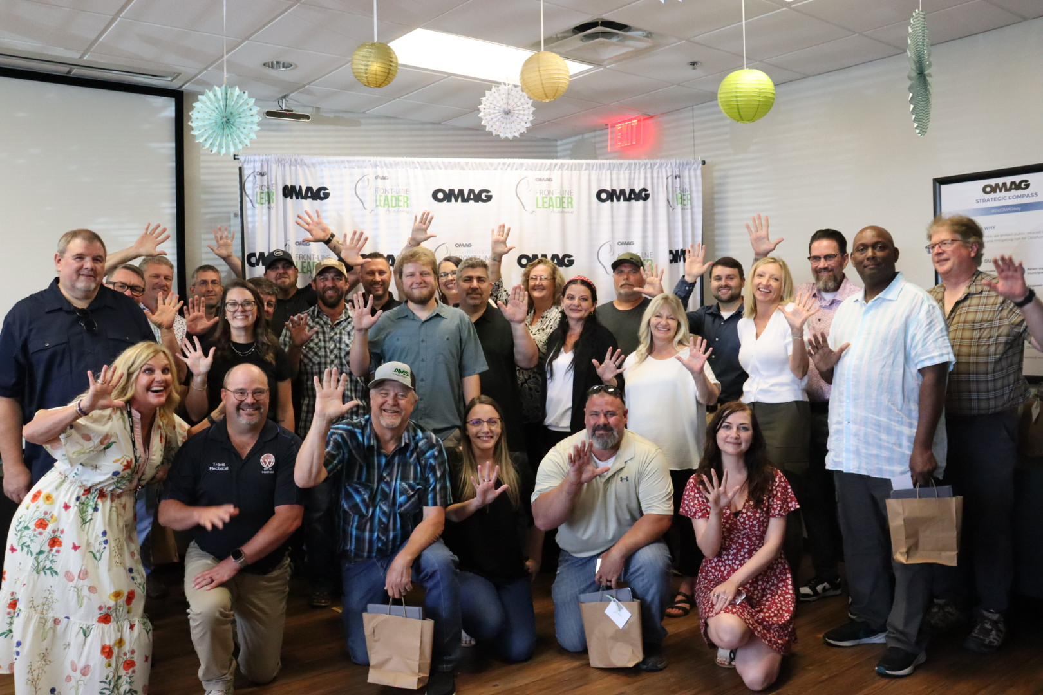
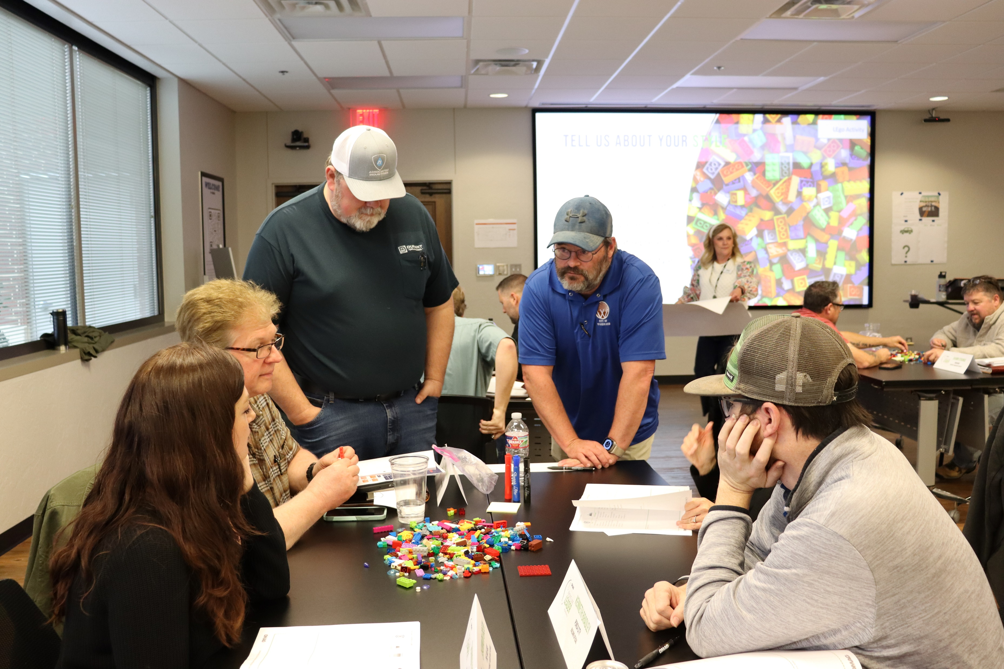

OMAG LEADERSHIP DEVELOPMENT
OMAG Municipal Leader Academy
Seven-month cohort experience
Current and emerging municipal leaders
Builds confidence and competence
Hands-on, practical learning

Slide 11

OMAG LEADERSHIP DEVELOPMENT
Municipal Supervisor Bootcamp
two-day, interactive experience
equips supervisors with essential tools, strategies, and resources to lead their teams with clarity, accountability, and impact

Slide 12


Leadership is not about being in charge. It’s about taking care of those in your charge.
Simon Sinek

Slide 13



QUALITIES OF GREAT LEADERS
LOVE Love what you do, don’t settle | Serve Put the needs of your team before your own | Care Make people feel important and let them know that they matter

Slide 14

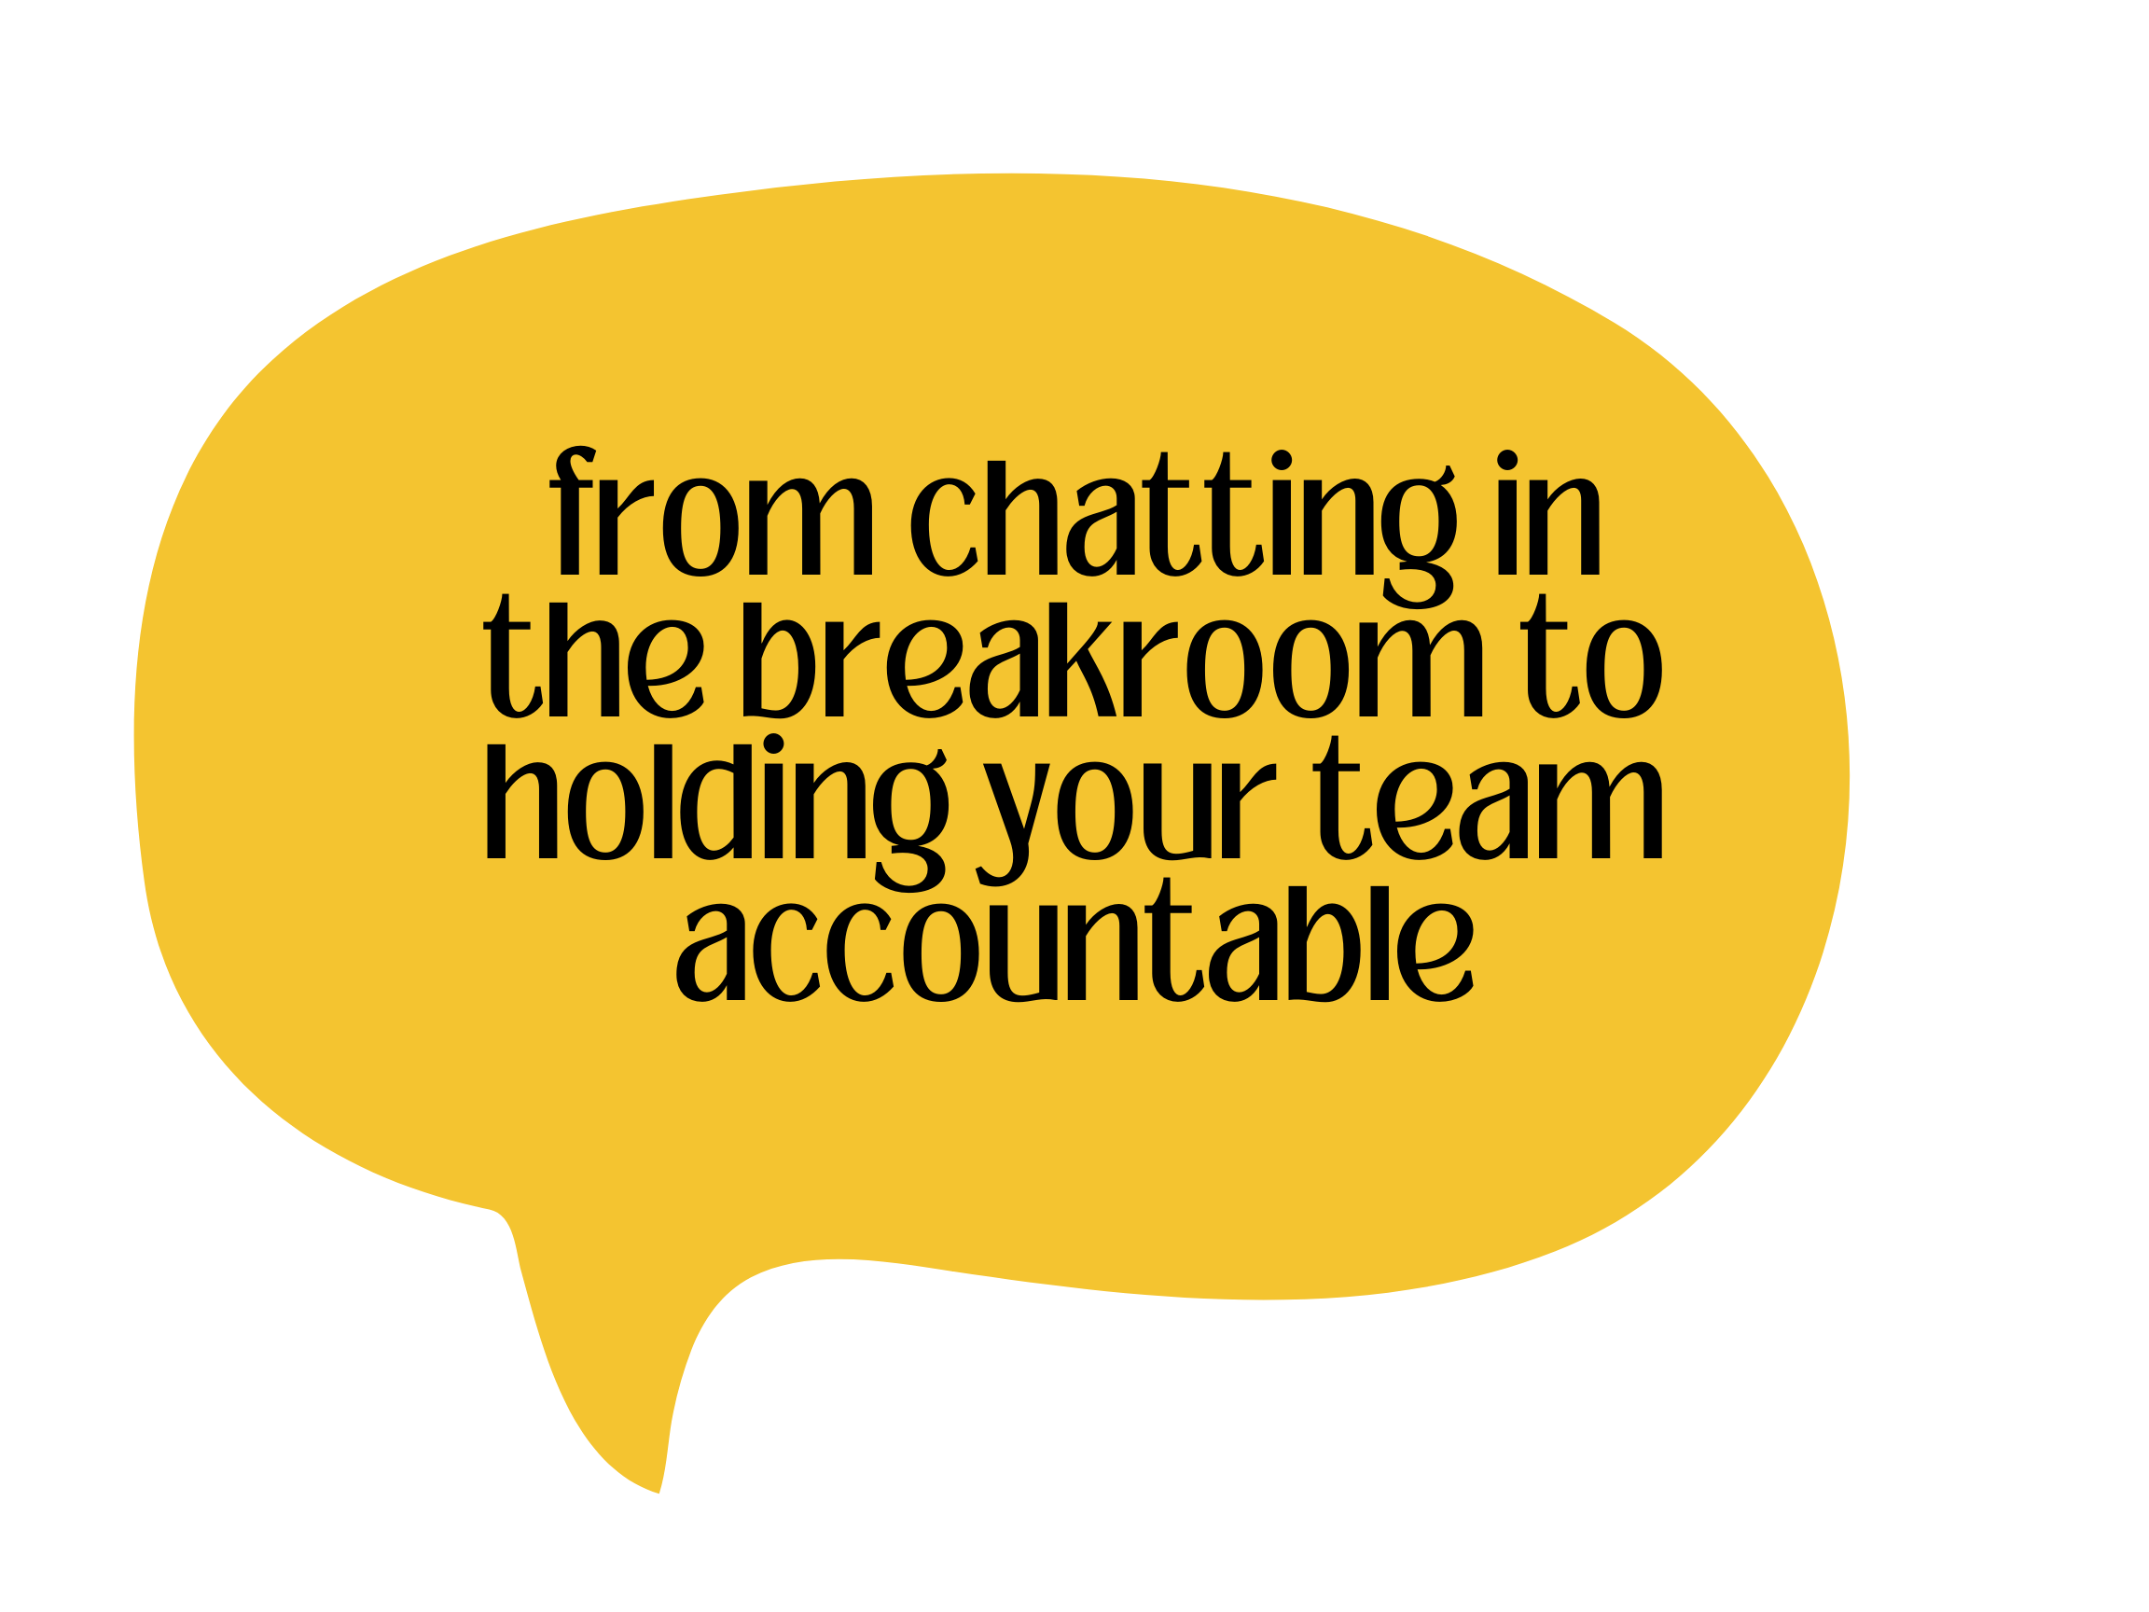
BUDDY TO BOSS
Mindset Shifts:
Emotional
Professional

Slide 15
BUDDY TO BOSS
 | Buddy | Boss
Information Sharing | Peers gossip, make assumptions, question leadership decisions | Leaders maintain confidentiality, are impartial, don’t assume, support leadership
Performance Management | Peers can turn a blind eye to poor performance | Leaders are consistent in holding everyone accountable; maintaining performance standards
Conflict Resolution | Peers can avoid conflict | Leaders resolve conflict
Professional Behavior | Peers are more accepting of bad days | Leaders handle stress professionally and model expected behaviors

Slide 16

EMOTIONAL SHIFT #1
Navigating Friendships
Be honest
Be direct
Overcommunicate approachability

Slide 17

EMOTIONAL SHIFT #2
Feeling Isolated
Develop a leadership network
Find a mentor
Engage in learning, like OMAG’s Municipal Leadership Academy

Slide 18

EMOTIONAL SHIFT #3
Imposter Syndrome
Focus on learning and service
Replace “I don’t know” with “I am learning to lead”

Slide 19

EMOTIONAL SHIFT #4
Being Liked vs. Leading
Shift your mindset from being liked to being trusted
Lead for outcomes, not approval

Slide 20
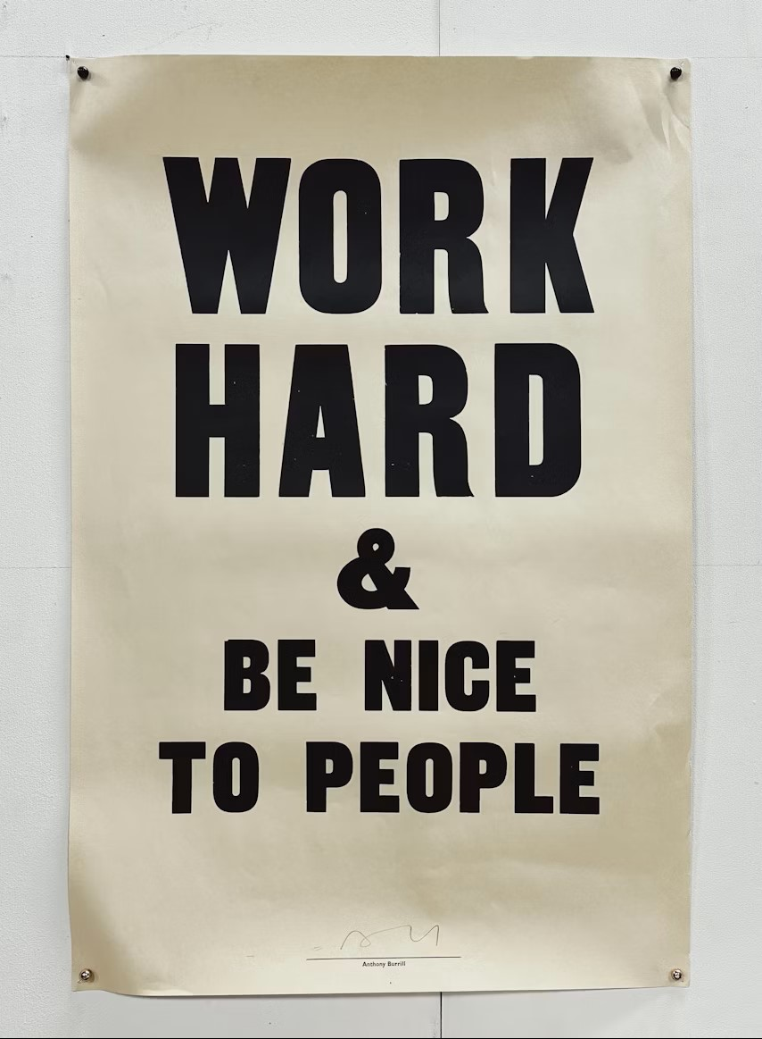
PROFESSIONAL SHIFT #1
Setting and Enforcing Boundaries
Be clear
Be kind
Be consistent

Slide 21

PROFESSIONAL SHIFT #2
Leading Former Peers
Don’t pretend nothing has changed
Acknowledge the shift
Outline your expectations

Slide 22

PROFESSIONAL SHIFT #3
Be the Example, Not the Exception
Lead Loudly
Mirror What You Expect
Own Your Mistakes Publicly

Slide 23

PROFESSIONAL SHIFT #4
Giving Feedback and Discipline
Use the 3 C’s, be:
Clear
Calm
Constructive

Slide 24
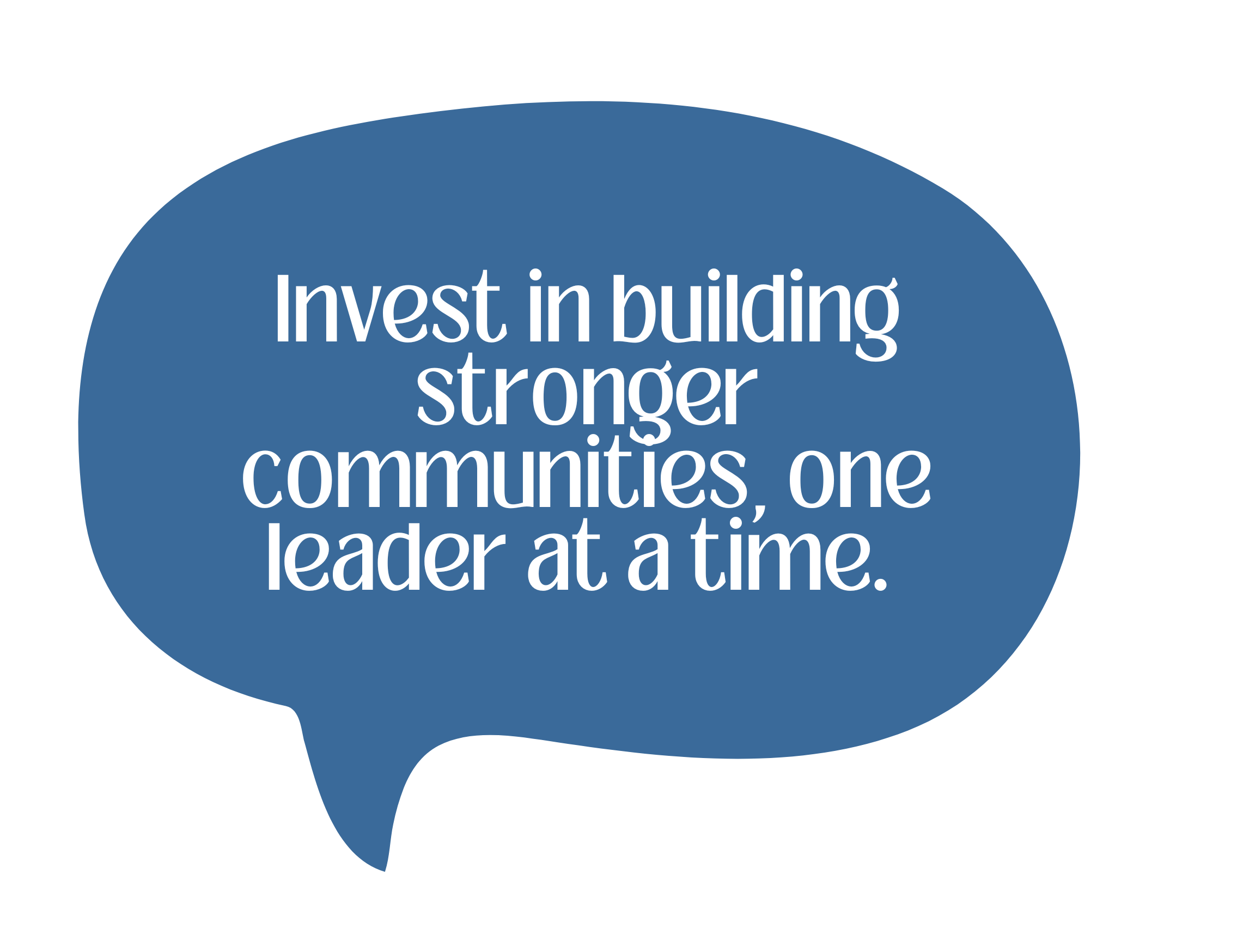

Slide 25

THANK YOU
QUESTIONS?
Contact Lori Mueller, OMAG
People & Culture Program Manager
lmueller@omag.org
omag.org/

