Slide 1

Empowering Member Engagement: Leveraging AI, Data, & Design
Speakers:
Lena Scarpulla, Senior Member Engagement Specialist, RISC & Mutual
Mark Snodgrass, Director of Business Intelligence, NLC Mutual
Notes:
Member engagement is evolving—and so are the tools that we use to support it. This session explores how technology, data, design, and AI are converging to empower deeper, more personalized engagement with members.

Slide 2
Session Overview
1. Member Engagement Foundations
3. Marketing Strategies & Tools
6. Leveraging AI, Data & Design for Storytelling
5. Member Dashboards & Data Visualizations
4. CRM & Technology Integration
8. Q&A
7. Key Takeaways
2. Member Touchpoints & Key Benefits Discussion

Slide 3
Build Member Experiences
Meaningful Touchpoints
Relevant Resources
Track Member Participation & Feedback
Turn Interactions into Insights
CRM
Member Dashboards
Surveys & Informal Feedback
3 Key Components
Design Professional Communications
Highlight Brand, Mission & Values
Storytelling using Data, Design & AI
Notes:
To deliver meaningful member engagement you need to start with creating offerings and touchpoints that deliver value for members. If you are not tracking these engagements you have no way of sharing key insights & data with your board, other members, and staff to determine if you should make changes to your offerings. It is also important to create pathways for members to share feedback both formally through the use of surveys and reviews as well as informal conversations & communications. The last component is actually designing the professional communications that are going to help you tell your organization’s brand story. Highlighting the company’s mission & values as well as key initiatives and member engagement opportunities. We can leverage the power of AI, Data & Design to develop well rounded communications that showcase value.

Slide 4
Member engagement is the foundation of trust, collaboration, and shared success. When members feel valued, they participate more, contribute ideas, and champion your mission. Engaged members are more likely to utilize resources, attend events, and share feedback—helping your organization stay relevant and responsive. Engagement isn’t a one-time effort—it’s an ongoing process of listening, learning, and evolving to meet members where they are.
Key Member Engagement Principles

Slide 5
What are some examples of member touchpoints?

Slide 6

Member Touchpoints
Events & Engagement
Conferences & Member Events
Member Visits
Education & Support
Training & Webinars
Risk Management Reviews
Claim Audits
Direct Communication
Phone Calls
Emails
Newsletters & Surveys
Digital Presence
Social Media
Website Resources
Notes:
Member events and communications are designed to reinforce key opportunities & benefits which ultimately cultivate deeper understanding and member relationships.

Slide 7
What offerings & benefits resonate the most with your members?
Notes:
Discuss how our team realized that our functional area meetings were a member highlight – worked to expand program. Gained feedback from members and now we deliver more value to members and can develop more relevant and enriching content

Slide 8


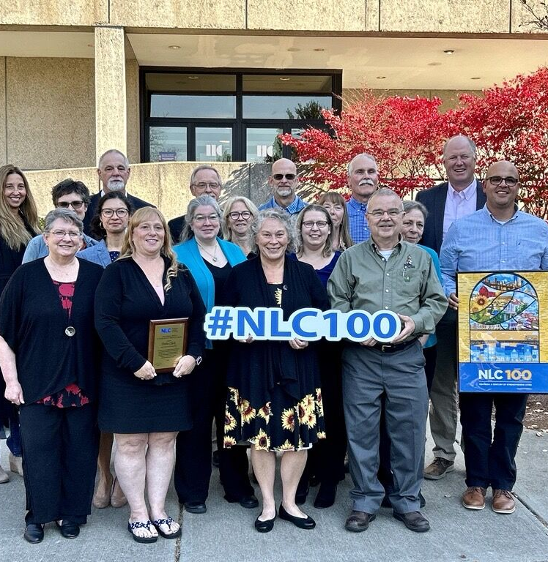

Why Member Engagement Matters?
Generates Value
Shapes Member Experience
Brand Advocacy
Growth & Retention
Offer Unique Experiences & Service
Solve Key Problems with Thoughtful Solutions
Share Feedback to Enhance Offerings
Deeper Relationships & Increased Participation
Every Touchpoint Develops Brand Experience
Recommend your service & programming
.
Better Retention Rates
Gain New Members
Notes:
Engagement builds trust & collaboration among your membership. Encourages deeper more meaningful relationships with stronger outcomes.
Creating unique member experiences ultimately generate value. Members see you as a key source for solutions to their biggest problems. And When members feel valued & can receive true benefits from your services their commitment to your mission will be fostered
Engaged members participate in your programs & initiatives and share feedback which allows you to enhance programming to meet member needs as they evolve. As you all know if a member is not happy they will let you know. Obtaining feedback and tracking member engagement will allow you to review program data to evaluate needs going forward. Effective engagement turns members into advocates, expands your reach, and strengthens your organization’s collective voice.
All team members can create a positive member experience. Every member touchpoint is an opportunity to gain a brand advocate.

Slide 9

Highlighted Marketing Initiatives
Social Media – Building Community & Brand
Foster Member Connections
Share updates and event highlights
Promote annual themes and campaigns
Member Spotlights & Partnership Initiatives
Feature member achievements
Highlight successful collaborations
Share diverse member stories
Careers That Strengthen Communities
Video & Resource Page
Collaboration with CGI Digital & Recruitment Advisory Group
Other Marketing Initiatives
RISC eNews
Mutual Matters
Annual Report

Slide 10

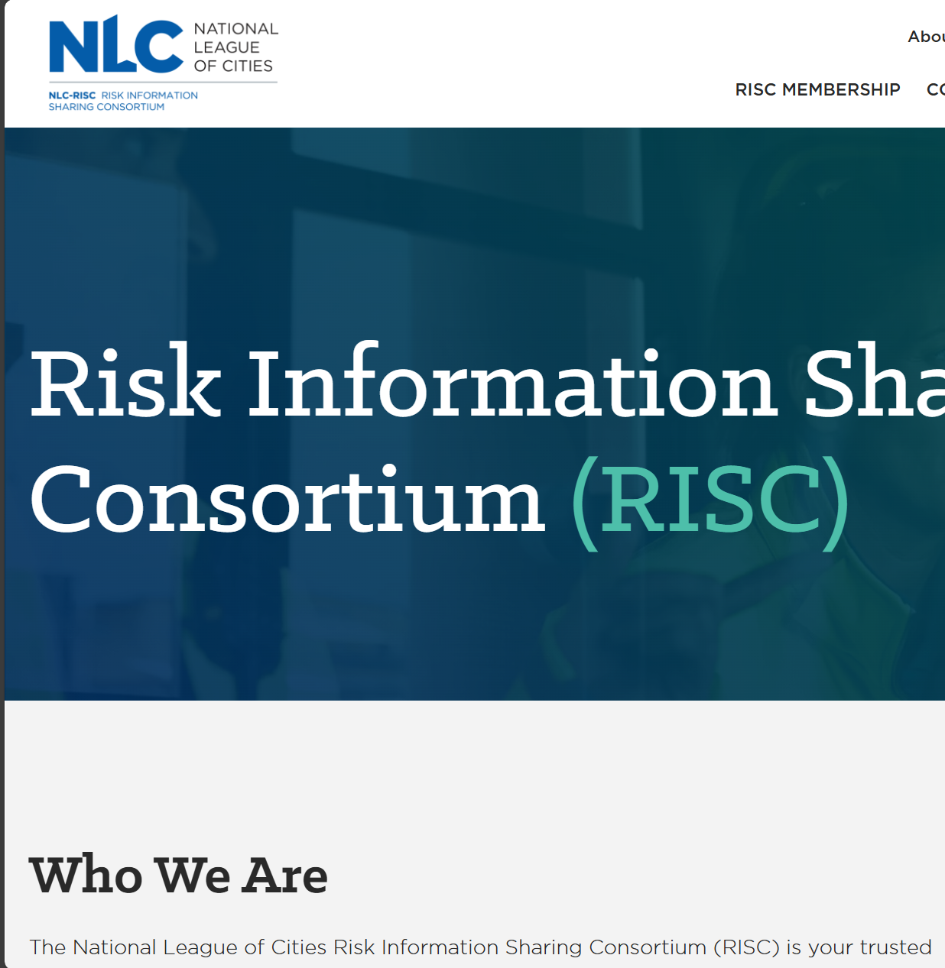


Marketing Strategies & Tools
This Photo by Unknown Author is licensed under CC BY-ND
Content Planning
Website & Resources
Social Media
Branding & Image Generation
Tools: Planner & CoPilot
Annual Content Themes
National Campaigns
Industry Trends
Tools: CoPilot & Canva
Members Only Resource Library
Topical & Timely Content
Cybersecurity Awareness
National Preparedness
Tools: CoPilot & Canva
LinkedIn Strategy
Hashtag & Digital Marketing Campaign Research
Content Drafting
Brand Voice
Tools: Canva & Canva AI
Brand Kit: Logos, Colors, Fonts, Templates
Image Generation to support Graphic Needs

Slide 11

CRM & Technology Integration
Replaced CRM using AI
Integrated with Domo
Improved Engagement Tracking
Secure Environment
Notes:
Talk about pain points about previous CRM
How I went about building a CRM via CoPilot
Talk about the benefits of the new system and integration points

Slide 12

CRM Pain Points
New features didn’t apply to us
We are only using a portion of a larger system
Lacked integration with other systems
Required double entry into other systems
Difficulty handling changes over time
Struggled to adapt to fields that needed to be added or removed
Difficult interface to make basic updates
Simple contact changes required navigating to multiple screens
Notes:
Talk about pain points about previous CRM
How I went about building a CRM via CoPilot
Talk about the benefits of the new system and integration points

Slide 13

Benefits of New CRM
Created a system that fits our needs
New system has only the features we need and can be expanded as needed
Improved engagement tracking
Hosted in Microsoft Azure; uses SSO
Secure environment
Added modules to track staff interaction with members; committee involvement; event attendance
Modern interface
Built using the latest web technologies
Notes:
Talk about pain points about previous CRM
How I went about building a CRM via CoPilot
Talk about the benefits of the new system and integration points
Highlight Member Dashboards & Visualizations in Domo note how these visualizations can be used for various reporting needs set-up wrap up with annual report and OMAG stewardship report

Slide 14
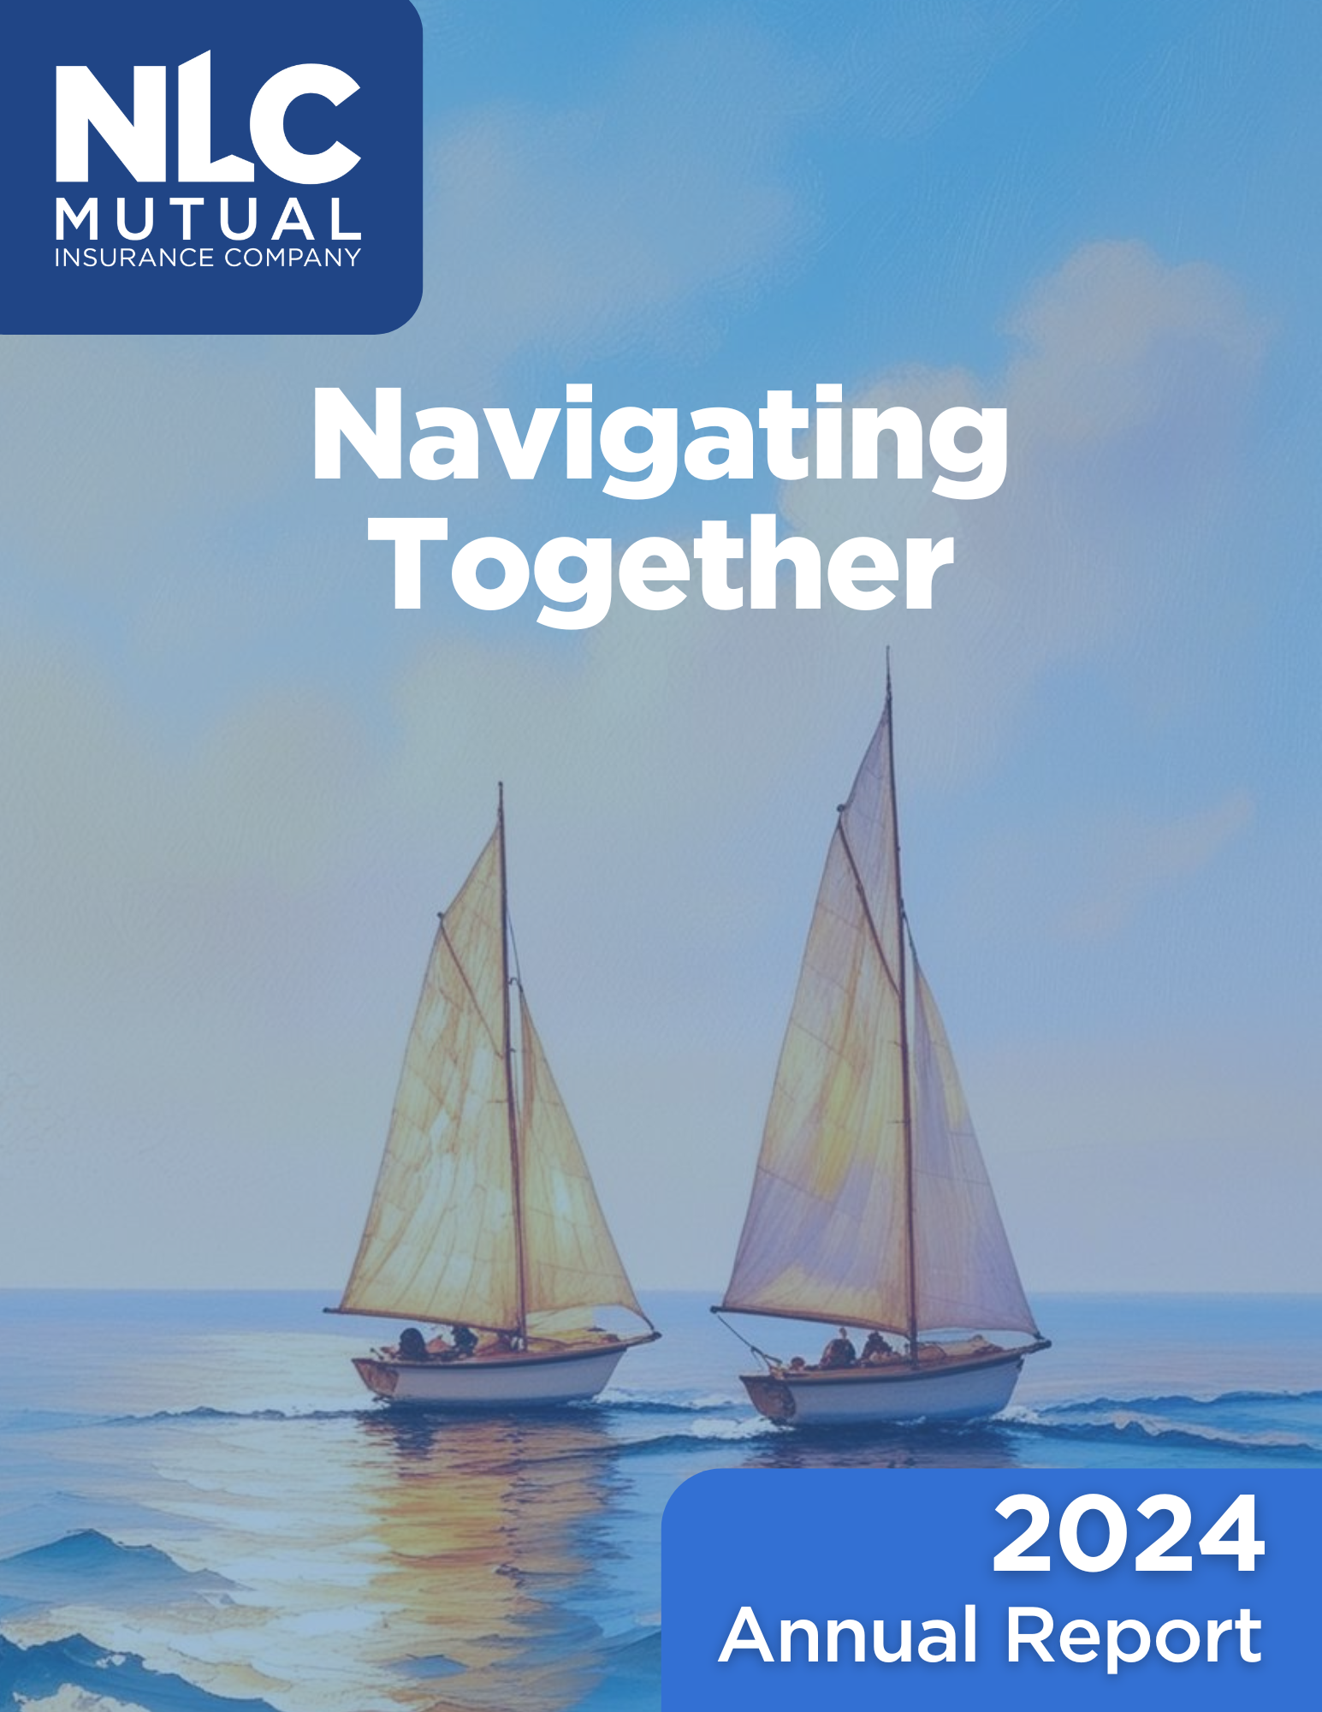
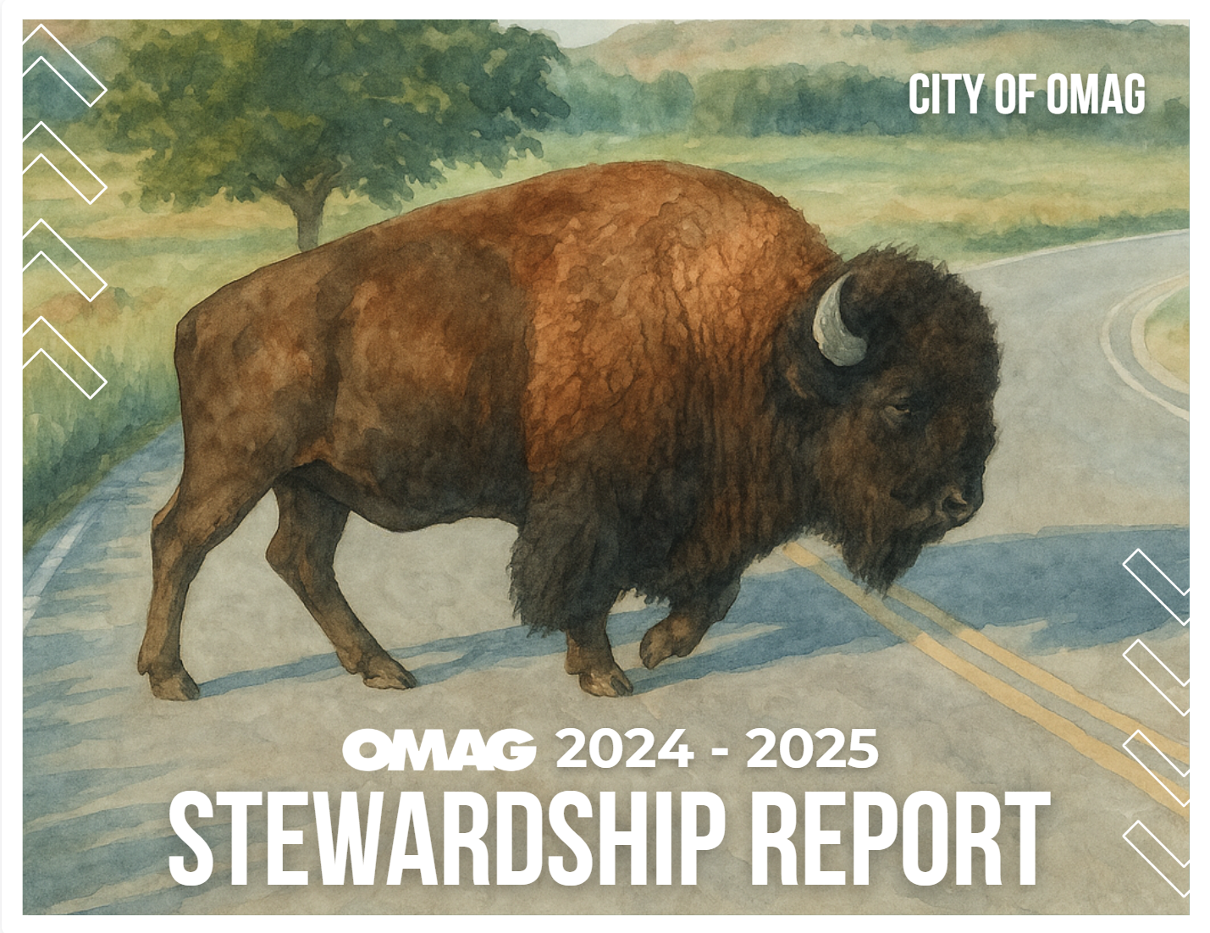
Leveraging AI, Data, & Design
The 2024 Annual Report and OMAG Stewardship Report are powerful examples of how AI, data, and design come together to elevate member engagement. These professionally branded publications showcase how thoughtful communication and visual design can reinforce mission, highlight key initiatives, and build lasting member trust.
Notes:
2024 Annual Report - NLC Mutual Learn About Stewardship Report — OMAG

Slide 15
Member Engagement is Evolving
Technology, data, and design are transforming how we connect with members—enabling more personalized, impactful experiences.
Collaboration & Touchpoints Matter
Every team member and every interaction helps build trust, advocacy, and shared success within our member community.
Integrated Tools Drive Results
Leveraging AI-powered solutions like Rooster CRM, Domo dashboards, and Canva AI streamlines engagement and design while delivering actionable insights.
Key Takeaways
Resources Create Real Value
Curated website pages, campaign resources, and accessible content empower members to solve challenges, grow, and maximize their membership.
Continuous Improvement is Essential
Tracking engagement and gathering feedback ensures our strategies remain relevant and responsive to evolving member needs.

Slide 16
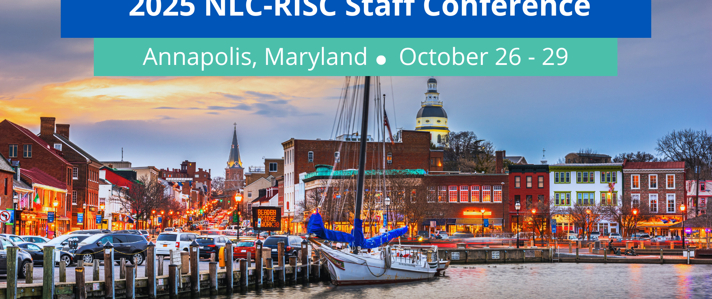
Q&A

