Slide 1

Effective Communication for Leadership and Team Alignment
Monday, October 27th | 11:00 AM

Slide 2

NLC-RISC STAFF CONFERENCE
Effective Communication for Leadership and Team Alignment
October 27, 2025
Facilitated by Mali Phonpadith
Founder & CEO, SOAR Community Network
Certified Talent Optimization Leader
Notes:
Hello everyone and thank you for joining us today! I’m excited to be here with you as we explore strategies toward effective communication to support your leadership and team alignment goals and build cohesive, high-performing teams.

Slide 3

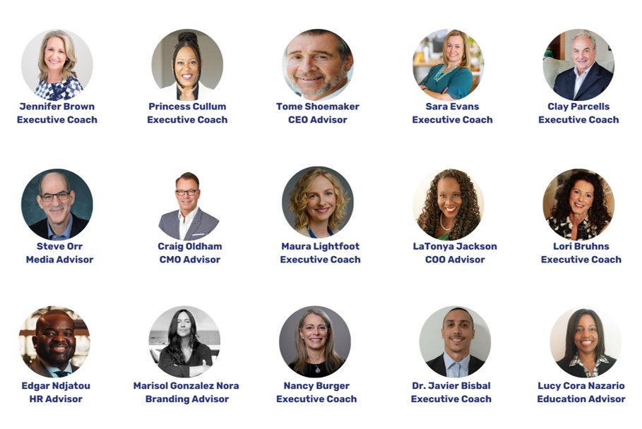

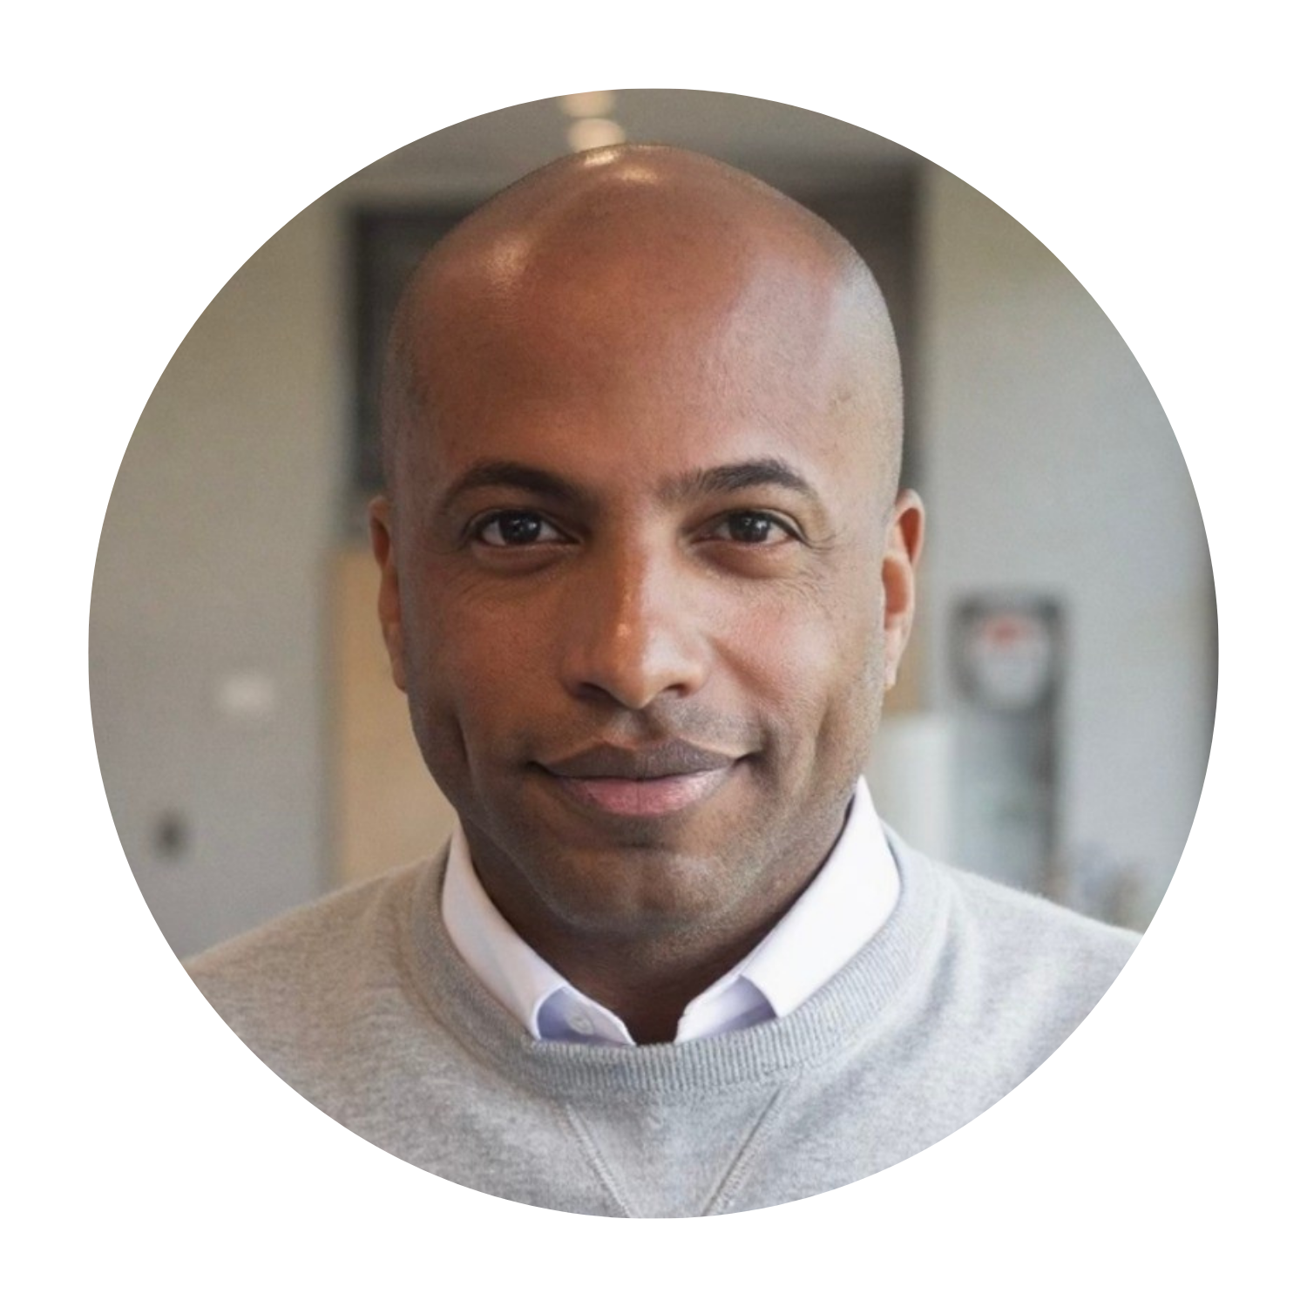
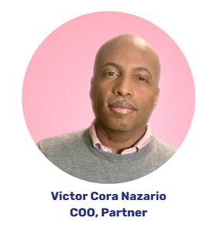

SOAR Team
Notes:
SOAR works with Senior Leaders, Chief Human Capital, People, Talent, Culture and Learning and Development Officers to increase engagement and elevate employee experience using our C3 Culture Building Framework. We organizational leaders elevate employee experience through ongoing human, leadership and culture development programs to:
Develop Compassionate leaders to thrive at every level of your organization
Design Cohesive teams that are high performing, innovative and motivated to drive results
Foster Collaboration as a consistent practice throughout the organization

Slide 4
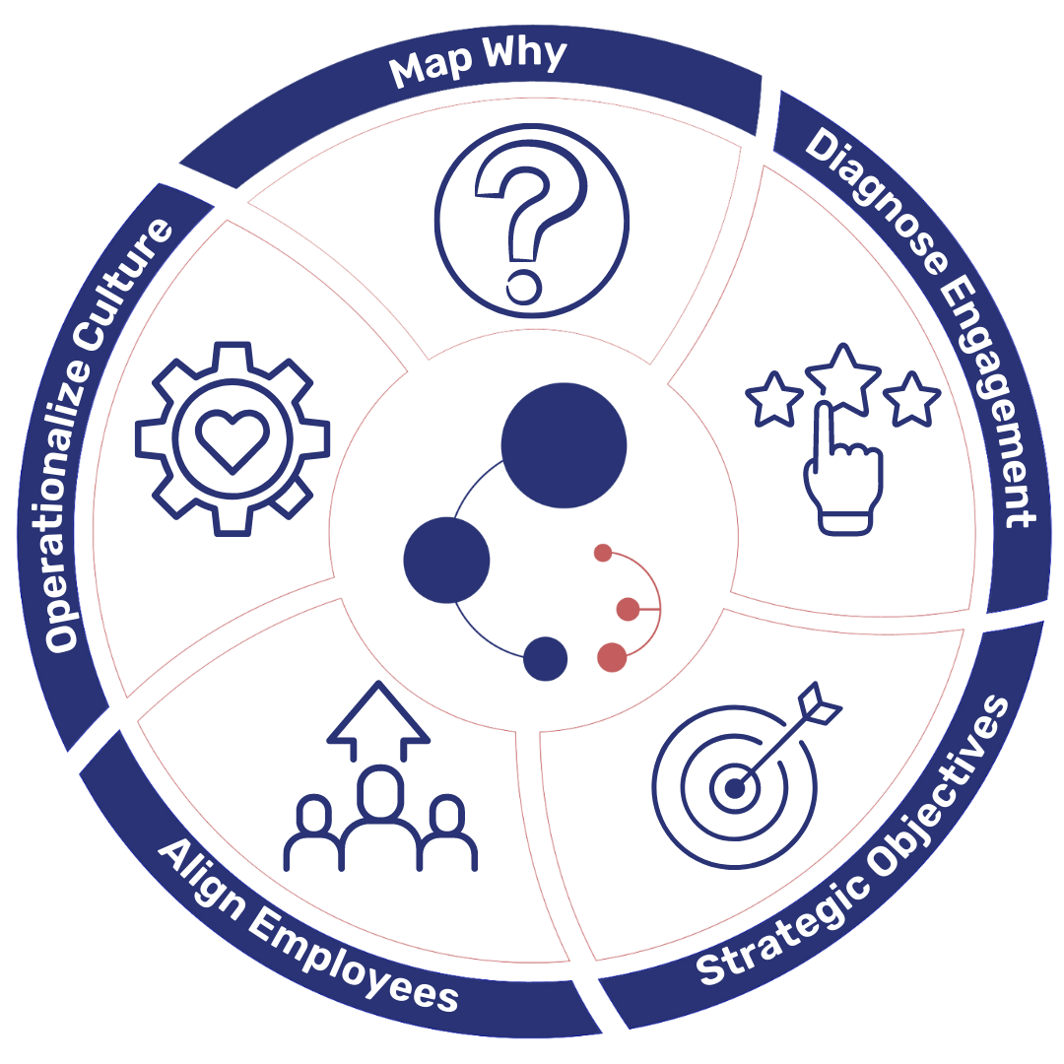
SOAR’s C3 Framework
Compassionate Leaders
Cohesive Teams
Collaborative Culture
Notes:
Our C3 model to not only guide our team when working with clients but to also provide a framework for our clients and empower them to keep the work going once we've help them Map their purpose, diagnose their employee engagement and experience, prioritize their strategic objectives, align their employees using behavioral insights and provide ongoing resources and tools to operationalize their organizational values so that they can continue calibrating their organizational culture - as they grow and evolve. We use this framework to help shape and sustain healthy organizational teams and cultures.

Slide 5
Today’s roadmap
Welcome and Introduction
Key Components to Effective Communication
Understanding Your Behavioral Drivers, Strengths and Caution Areas
Strengthening Communication, Team Dynamics and Collaboration
Closing – Key Takeaways – Next Steps
Notes:
To give you a quick overview of today’s webinar, we’ll focus on three main objectives:
What to Expect:
In this engaging session, you’ll gain practical tools to:
Learn the keys to Effective Communication
Identify and adapt your behavioral communication style to improve collaboration and trust.
Strengthen team dynamics by fostering psychological safety and high performance.
Enhance your skills in managing up, ensuring your insights align with leadership priorities.
These topics will not only help you understand your team better but also provide you with actionable insights to create a more harmonious and productive environment. By the end of this session, you’ll have practical tools to apply within your own teams. So, let’s dive in!"

Slide 6
Key Components of Effective Communication
Notes:
Now, let’s start by looking at Behavioral Styles.
Each of us has a unique way of communicating, making decisions, and taking risks.
For today, we’ll reference the Predictive Index (PI) framework. It breaks down behaviors into four key factors. Understanding these factors helps us recognize how individual differences can enhance or hinder team dynamics.

Slide 7

1. Self Awareness and Emotional Intelligence
Self-awareness is the foundation of communication. Leaders and team members must understand their own emotional and behavioral drivers, values, and communication styles before they can truly engage with others.
90% of top performers have high emotional intelligence, while just 20% of low performers do.
This means emotionally intelligent individuals are more likely to adapt communication styles, reduce misunderstandings, and foster stronger relationships.
Source: TalentSmartEQ, 2023
Notes:
Self-awareness is the foundation of communication. Leaders and team members must understand their own emotional and behavioral drivers, values, and communication styles before they can truly engage with others.
90% of top performers have high emotional intelligence, while just 20% of low performers do.
This means emotionally intelligent individuals are more likely to adapt communication styles, reduce misunderstandings, and foster stronger relationships.
“Nurturing emotional intelligence allows leaders to connect with their team on a deeper level.” — Mali Phonpadith

Slide 8

2. Active Listening
Active listening is not just about hearing words—it’s about understanding the underlying emotions and motivations.
Effective listening skills are the most important predictor of leadership success, cited by 74% of employees as essential to performance.
True communication is a two-way street. Active listening shows care, builds trust, and ensures that each voice is valued.
Source: Forbes, 2024
Notes:
“Active listening is not just about hearing words—it’s about understanding the underlying emotions and motivations.” — Mali Phonpadith
True communication is a two-way street. Active listening shows care, builds trust, and ensures that each voice is valued.
Effective listening skills are the most important predictor of leadership success, cited by 74% of employees as essential to performance. (Forbes)
Teams that feel heard are more likely to contribute authentically, increasing collaboration and innovation.

Slide 9

3. Nonverbal Communication and Body Language
Over 70% of communication is nonverbal. Eye contact, posture, tone, and facial expressions deeply influence how messages are received—even more than words themselves.
55% of communication is body language, 38% is tone of voice, and only 7% is the actual words we use.
Compassion is not just heard—it’s felt in your presence, your energy, and how you show up in a room.
Source: Albert Mehrabian’s Communication Theory
Notes:
Over 70% of communication is nonverbal. Eye contact, posture, tone, and facial expressions deeply influence how messages are received—even more than words themselves.
55% of communication is body language, 38% is tone of voice, and only 7% is the actual words we use.
Compassion is not just heard—it’s felt in your presence, your energy, and how you show up in a room.

Slide 10
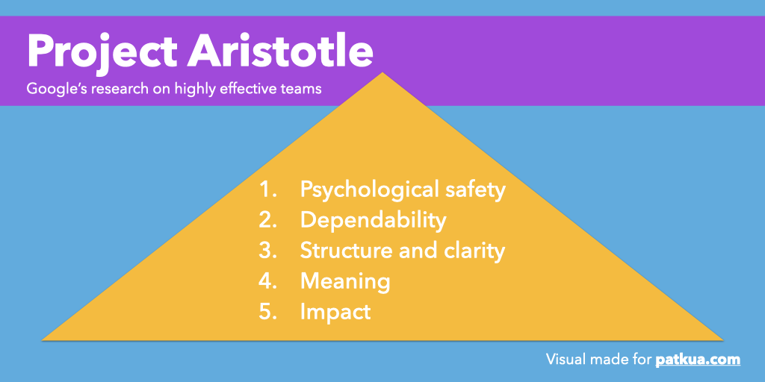
4. Psychological Safety and Trust
Google's Project Aristotle was a research initiative launched in 2012 to identify what makes teams effective.
According to this research, psychological safety is the #1 factor in fostering high-performing teams.
Team members need to feel they can speak up without fear of ridicule or punishment. This is where compassionate leadership plays a vital role.
Source: Google Project Aristotle. Image from https://www.patkua.com/blog.
Notes:
Google's Project Aristotle was a research initiative launched in 2012 to identify what makes teams effective.
According to this research, psychological safety to be the #1 factor in high-performing teams.
Teams need to feel they can speak up without fear of ridicule or punishment. This is where compassionate leadership plays a vital role.

Slide 11

5. Clarity and Consistency in Messaging
Communication must be transparent and repeated across channels to reduce ambiguity.
Miscommunication often stems from unclear direction or misaligned values. Clarity enhances alignment, reduces rework, and fosters purpose-driven work.
Companies with effective communication programs are
3.5 times more likely to outperform their peers.
Vision, mission and values must be communicated clearly and consistently to unify teams and guide action.
Source: Towers Watson Research
Notes:
Communication must be transparent and repeated across channels to reduce ambiguity.
Miscommunication often stems from unclear direction or misaligned values. Clarity enhances alignment, reduces rework, and fosters purpose-driven work.
Companies with effective communication programs are 3.5 times more likely to outperform their peers.
Vision, mission and values must be communicated clearly and consistently to unify teams and guide action.

Slide 12
Understanding
Behavioral Styles
Notes:
Now, let’s start by looking at Behavioral Styles.
Each of us has a unique way of communicating, making decisions, and taking risks.
For today, we’ll reference the Predictive Index (PI) framework. It breaks down behaviors into four key factors. Understanding these factors helps us recognize how individual differences can enhance or hinder team dynamics.

Slide 13
Understanding Behavioral Styles
Reference Profiles
Four Factors
Patterns
Gain insight into individual work styles such as communication, decision making and risk taking.
Describe preferences for how a person communicates, makes decisions, delegates, regards rules and takes action.
Interpret factors based on how far away they are located from the midpoint.
Notes:
Next, we'll have a closer look into what motivates and drives you as individual leaders. We'll go over your Predictive Index reference profiles, help you better understand the Four Factors – our motivational drivers - and show you the importance of understanding your behavioral patterns.

Slide 14
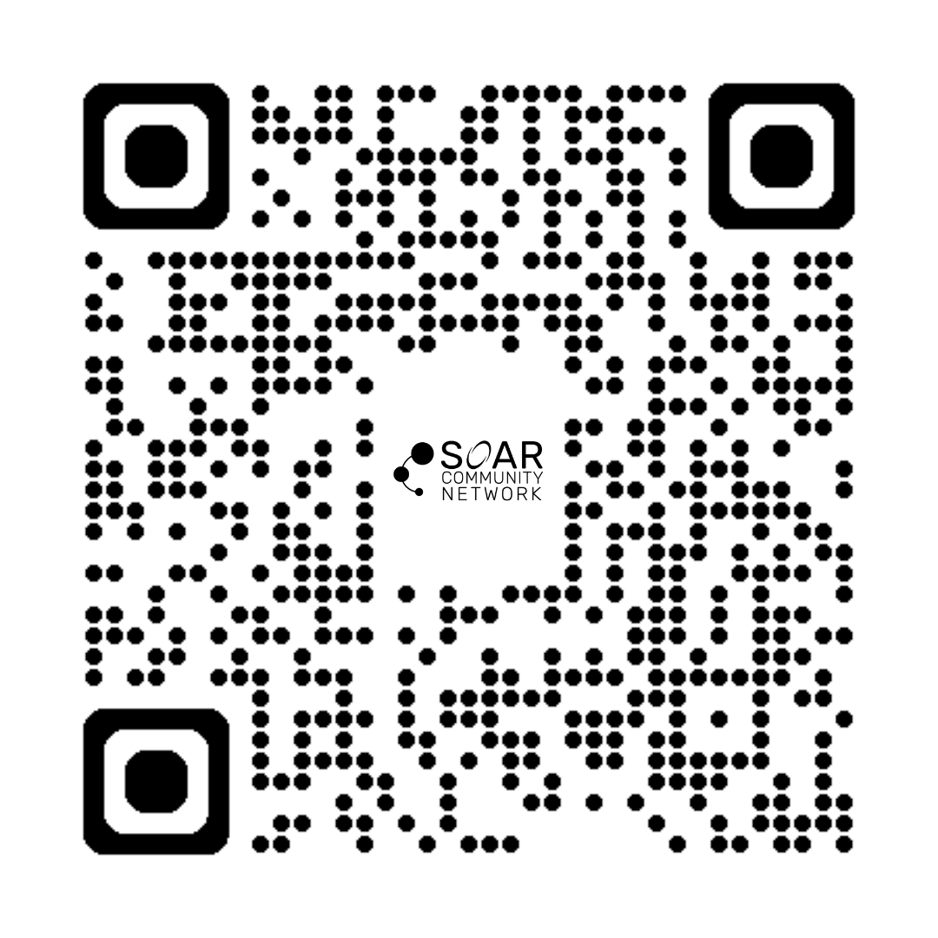
Take the
PI Assessment
Notes:
Let's take a moment to have you identify what your reference profile is. Use the link to take a 3 to 5 minutes behavioral assessment:
https://assessment.predictiveindex.com/bo/e8A/Event-BA

Slide 15








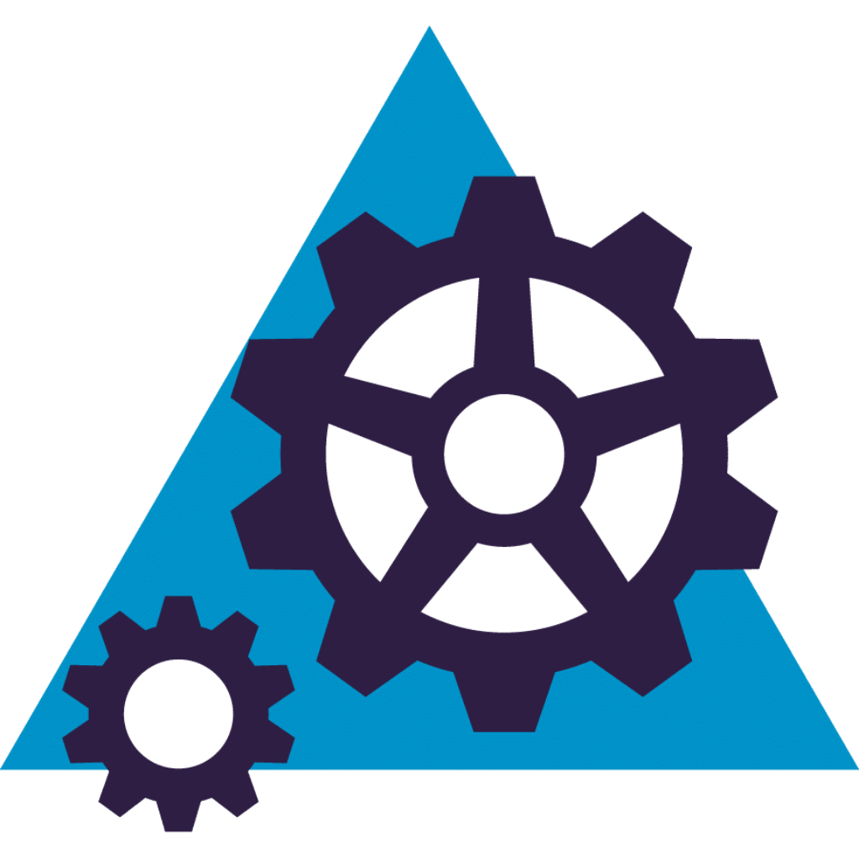

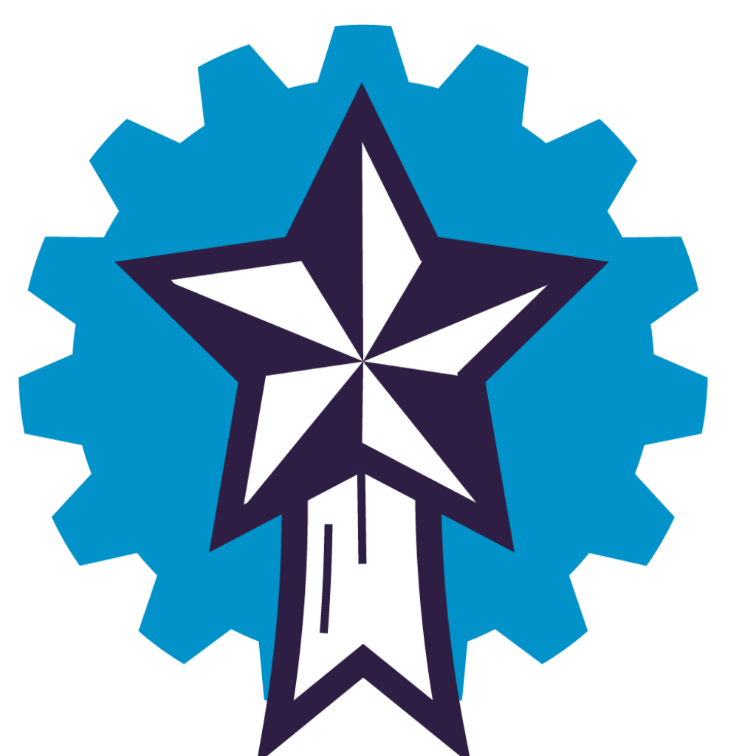






Understanding Your Reference Profiles
Once you know someone’s Reference Profile, you gain insight into their work styles such as communication, decision making, and risk taking. This quick understanding allows people to work with each other more effectively.
Notes:
Whether you have taken PI's behavioral assessment or DISC, Strength Finders, Kolbe or others, the research comes from the same sources – their applications and the models developed from this research is what makes them different. We chose PI because of their validity – with over 300+ independent validity studies done – AND the fact that their model allows us to not only use it to coach individuals but also helps develop and coach teams.
There are 17 different reference profiles within the PI model. If someone shares your same reference profile type, think of them as living in the same neighborhood as you, not necessarily in the same home. You will have the same zip code and natural tendencies but even those tendencies will be unique to you. Your reference profile will help you better understand your preferred workstyles related to how you communicate, make decisions and take risks.

Slide 16
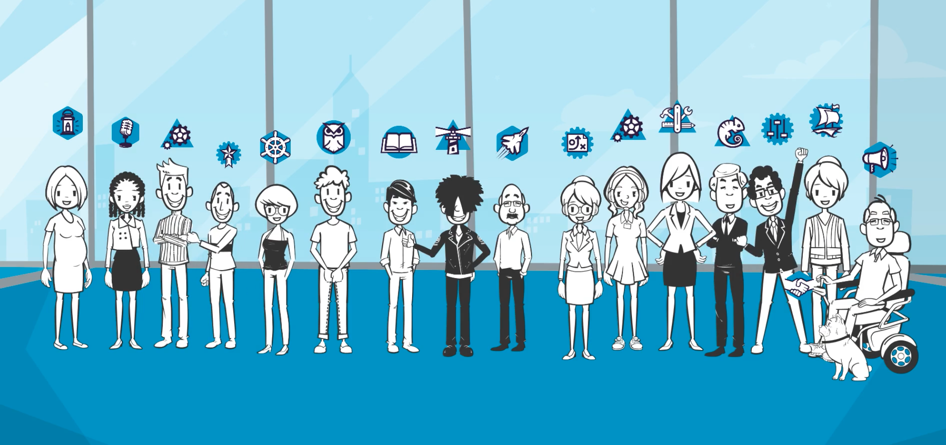
Notes:
These reference profiles are used to align talent with roles that match their natural tendencies, enhancing engagement and productivity. These Reference Profiles are a set of behavioral archetypes used to describe how individuals typically respond to workplace environments and tasks. They help in understanding employee behavior, team dynamics, and leadership styles.

Slide 17
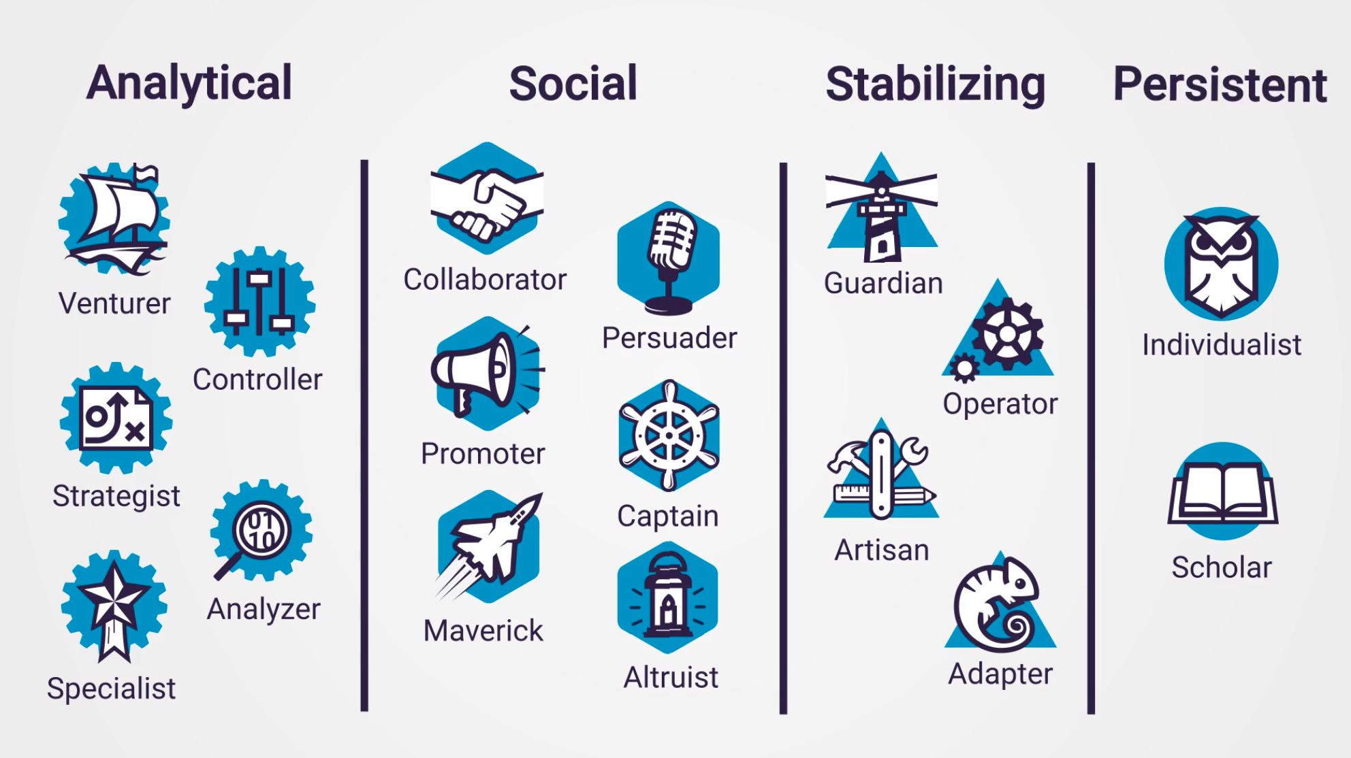
Notes:
The 17 profiles are grouped into four categories:
Analytical Profiles: Include These individuals tend to focus on data, precision, and independent work. They prefer structure and are often problem-solvers.
Social Profiles: These individuals excel in roles that require teamwork, communication, and influencing others. They are often people-oriented and thrive in dynamic environments.
Stabilizing Profiles: These individuals value stability, consistency, and practical solutions. They prefer steady workflows and reliable processes.
Persistent Profiles: These individuals are typically self-motivated, goal-oriented, and driven by personal achievement. They enjoy working autonomously and influencing outcomes.

Slide 18
What is your PI Reference Profile?
1) Take the 5-minute assessment by using the QR code
2) Submit your responses
3) Check your email
4) What is your reference profile?
5) Which category are you in? (Analytical, Social, Stabilizing or Persistent)
Notes:
Let's take a moment to have you identify what your reference profile is. Use the link in the chat to take a 3 to 5 minutes behavioral assessment:
https://assessment.predictiveindex.com/bo/e8A/Event-BA

Slide 19
Understanding the Four Factors
Notes:
Let's explain the four factors and share why they matter when it comes to team cohesion and collaboration.

Slide 20
These Drives, or Factors, provide insight into how someone will behave.
People
have
drives
Drives create needs
Behavior is a response to needs
DRIVES
NEEDS
BEHAVIOR
Before assigning intention, let’s first get curious.
Notes:
We meet each other here (point at Behaviors) and we have a tendency to believe that how others show up behaviorally defines their identity when in actuality, our needs influence our behaviors. When our needs, including preferred workstyles and emotionally needs such as feeling seen, heard and valued are met, we may show up as open, warm, enthusiastic and even vulnerable. When such needs are not met, we may show up as being distant, short, uncaring or indifferent. So we often encourage our clients not to assign intention around a behavior but rather get curious!
So... what shapes our needs which then influences our behaviors? Our motivational drivers do!
Next, we'll look at the Four Factor – or motivational drivers.

Slide 21
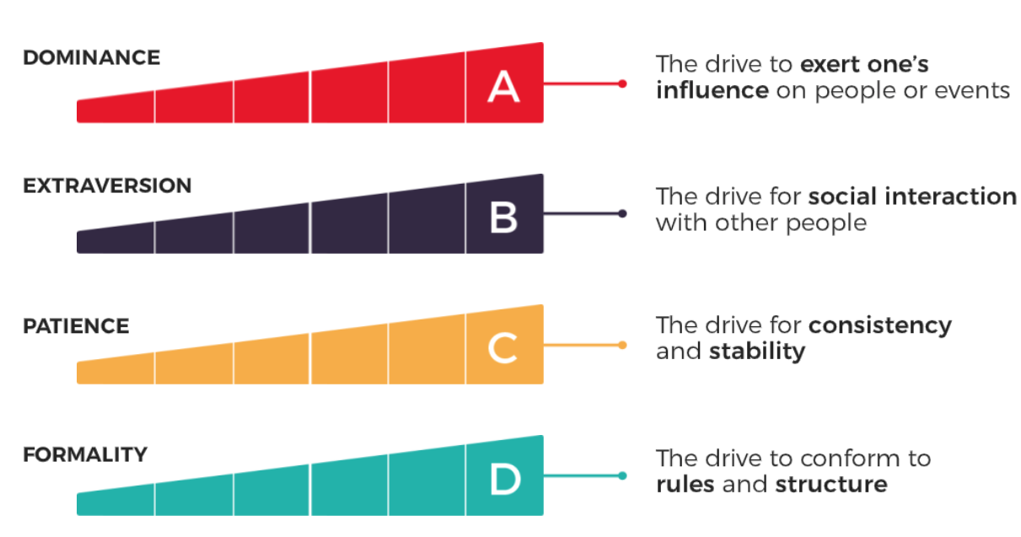
Four Factors
Notes:
The four factors, or motivational drivers are Dominance represented by A, Extraversion, represented by B, Patience represented by C and Formality, represented by D.
When your "A" drive is high this means you care to exert your influence on people or events – you can move forward independently with your ideas to create impact and make a difference.
When your "B" drive is high, you gain energy from surrounding yourself with people and enjoy social interactions.
When your "C" drive is high, you prefer consistency and stability – you need familiar surrounding and have a certain pace and cadence that allows you to work effectively.
When your "D" drive is high, the more you prefer rules, policies, procedures and structure – your tolerance for error is low so having rules and structure allows you operate and complete tasks more effectively.

Slide 22
Understanding
Your Patterns

Slide 23
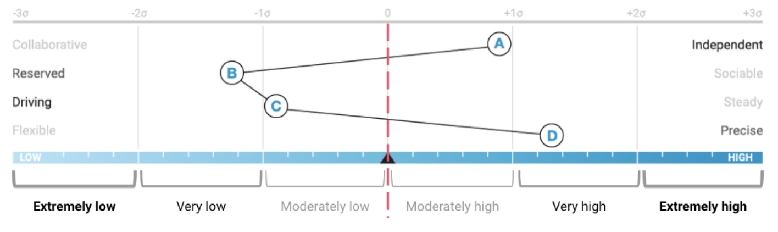
Pattern Intensity in the Continuum
Notes:
This is a sample pattern to help you understand how to read your individual behavioral patterns based on your motivational drivers.
If your four factors fall between –1 delta and +1 delta, that's considered the MODERATE zone. Moving away from midpoint, if your factors fall between 1 and 2 delta on either side of the continuum, that's considered the VERY zones. As you move farthest away from the center, between 2 and 3 delta on either side, they would be considered the EXTREME zones.
Now let's have a look at what all of this actually means in the context of your NEEDS and BEHAVIORS.

Slide 24
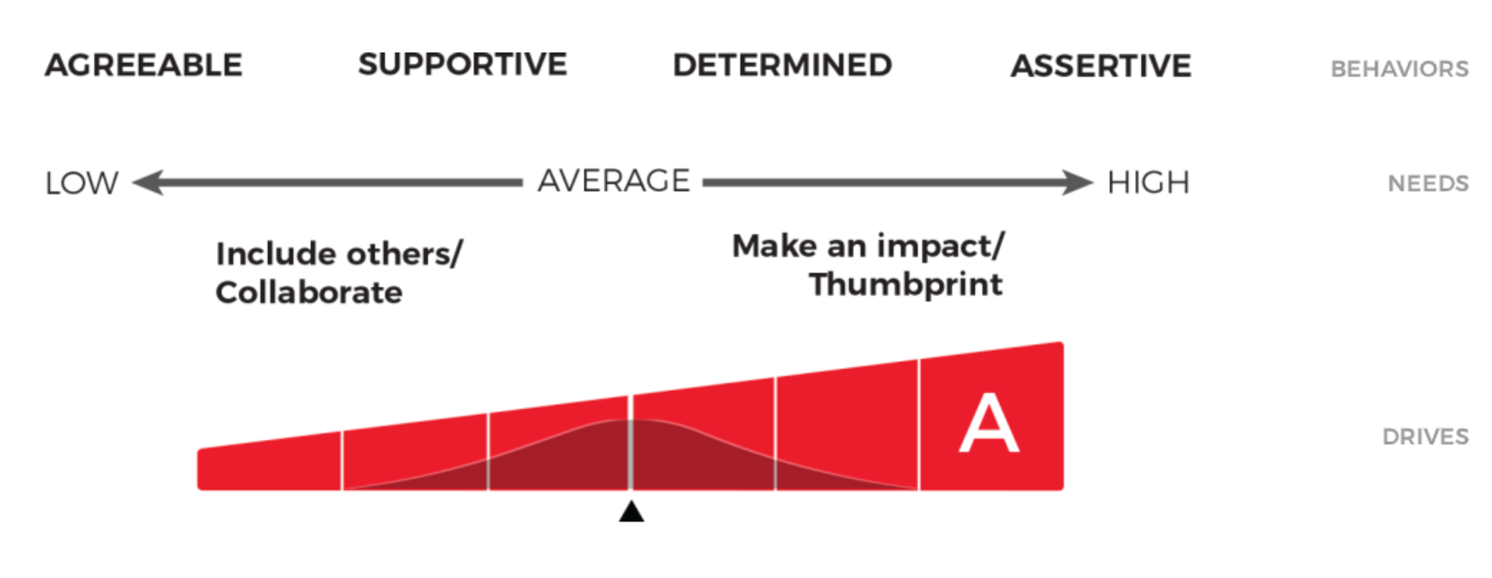
Factor A Pattern (Dominance)
Notes:
If your Dominance drive is high – to the right of the continuum – your need is that you want to make an impact and have influence. Behaviorally, you will likely show up as determined and assertive.
If your Dominance drive is low – to the left of the continuum – your need is that you prefer to collaborate and allow others to be included in dialogue and decision-making, allowing others to influence outcomes. Behaviorally, you'll likely show up as supportive or agreeable.

Slide 25
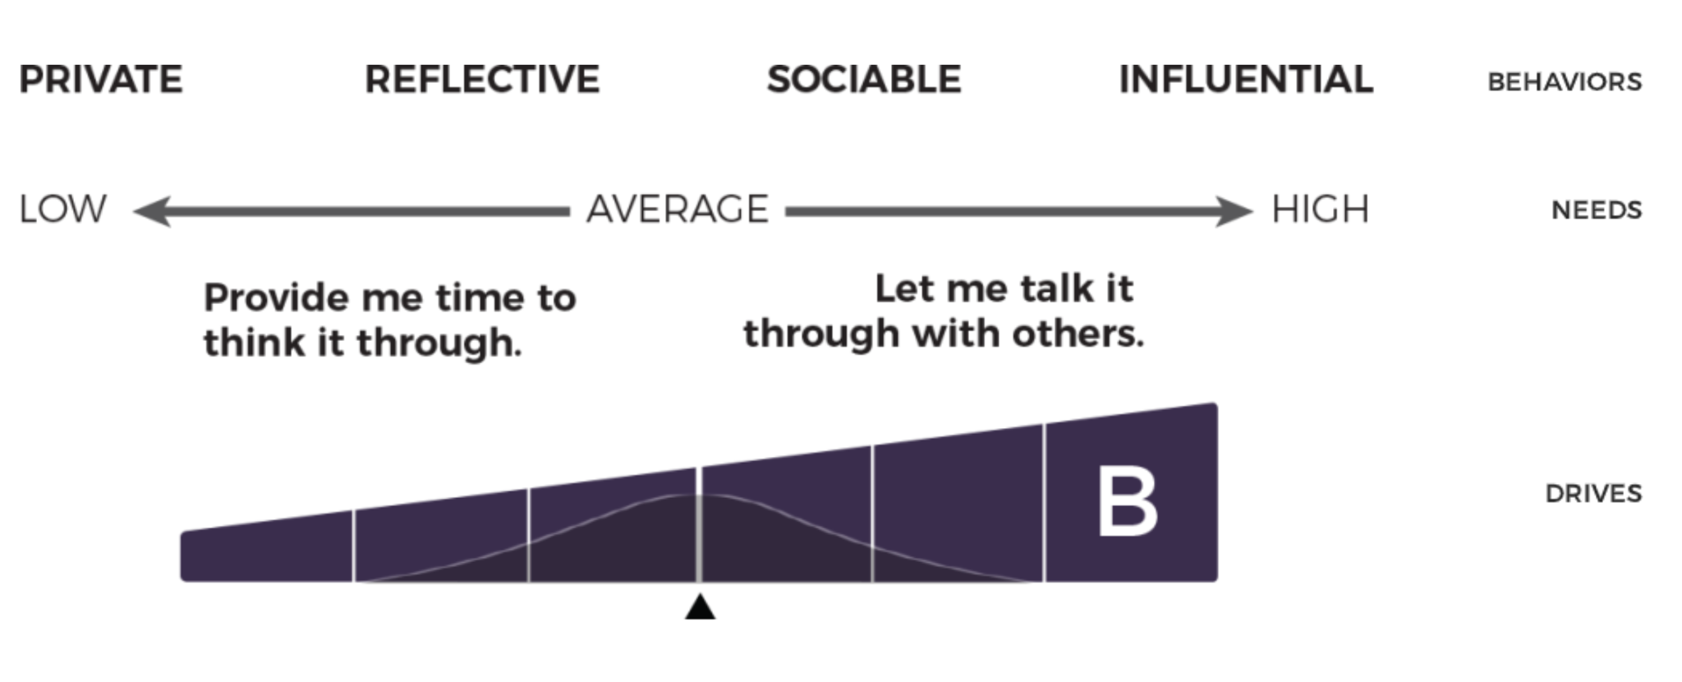
Factor B Pattern (Extraversion)
Notes:
If your Extraversion drive is high – to the right of the continuum – you need to talk things through with others. Behaviorally, you will likely show up as sociable or influential.
If your Extraversion drive is low – to the left of the continuum – you need time to think things through and process information, first on your own. Behaviorally, you'll likely show up as reflective or private.

Slide 26
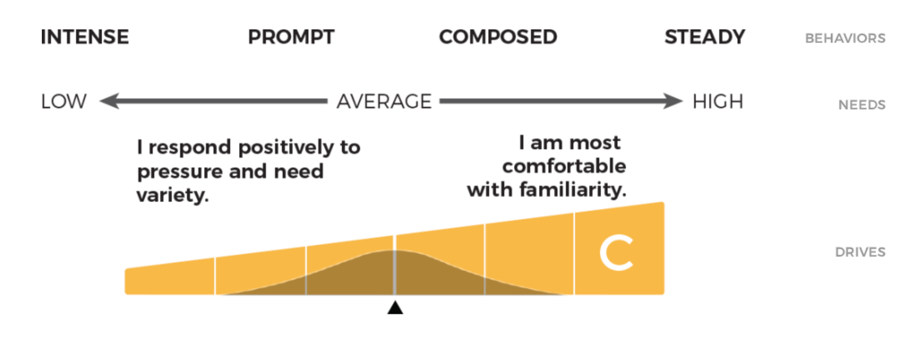
Factor C Pattern (Patience)
Notes:
If your Patience drive is high – to the right of the continuum – you are more comfortable with familiarity and have a thoughtful and patient approach to people and situations. Behaviorally, you will likely show up as composed or steady.
If your Patience drive is low – to the left of the continuum – you need variety and will respond positively to pressure, preferring to work at a faster than normal pace. Behaviorally, you'll likely show up as prompt or intense.

Slide 27
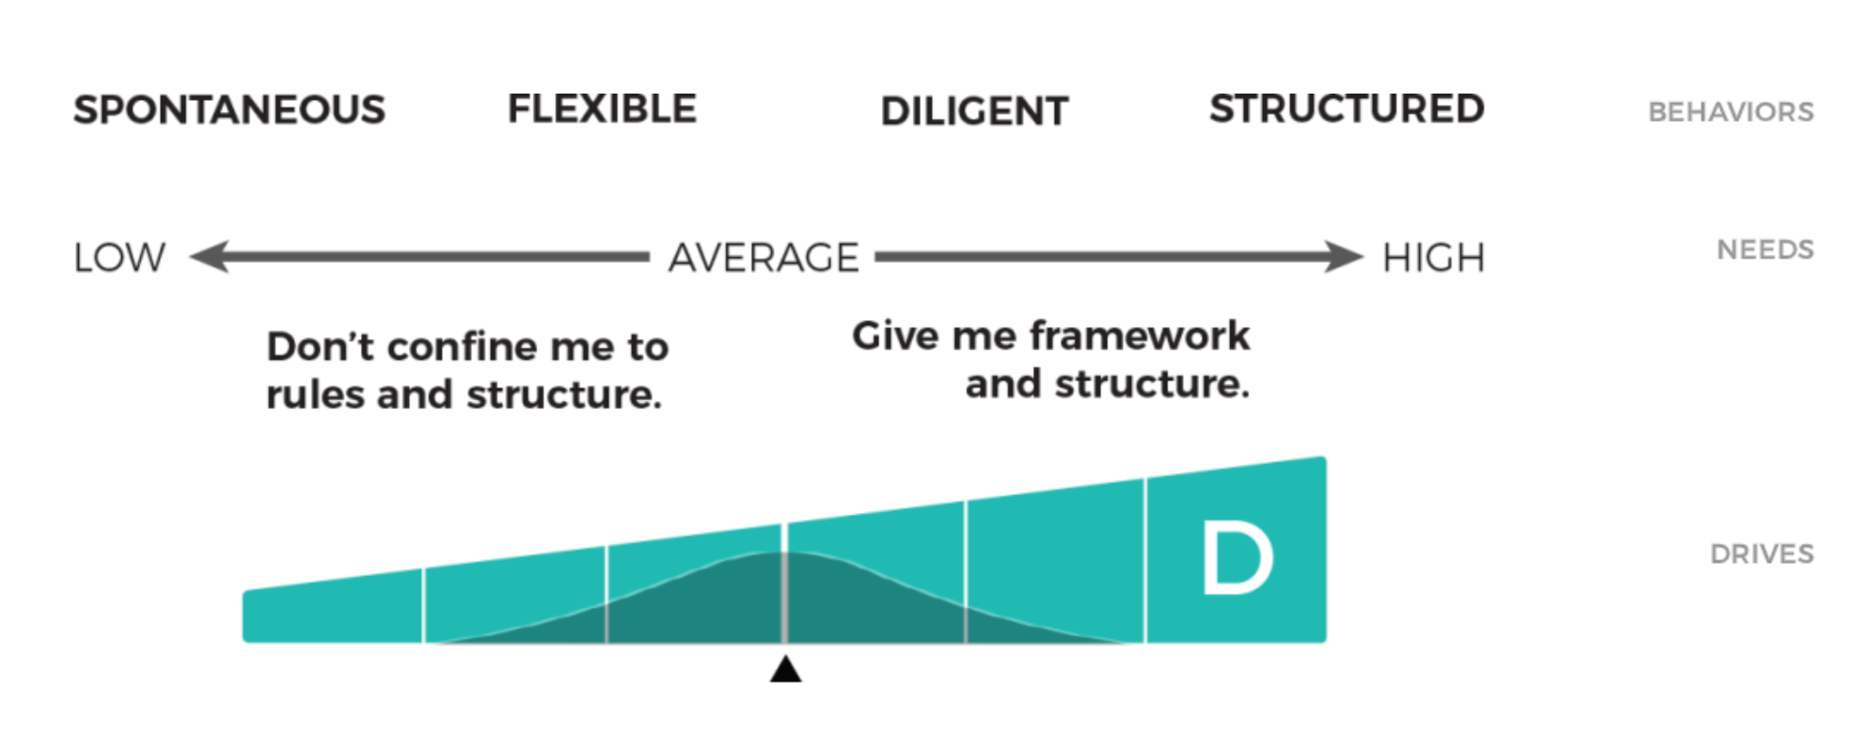
Factor D Pattern (Formality)
Notes:
If your Formality drive is high – to the right of the continuum – you need more structure and good frameworks to guide your efforts. You prefer that strong policies and procedures are available to guide you and others. Behaviorally, you will likely show up as diligent and structured.
If your Formality drive is low – to the left of the continuum – you don't want to be confined to rules and structure and do not work well when you're being micromanaged. Behaviorally, you'll likely show up as flexible, spontaneous and less detailed oriented.

Slide 28


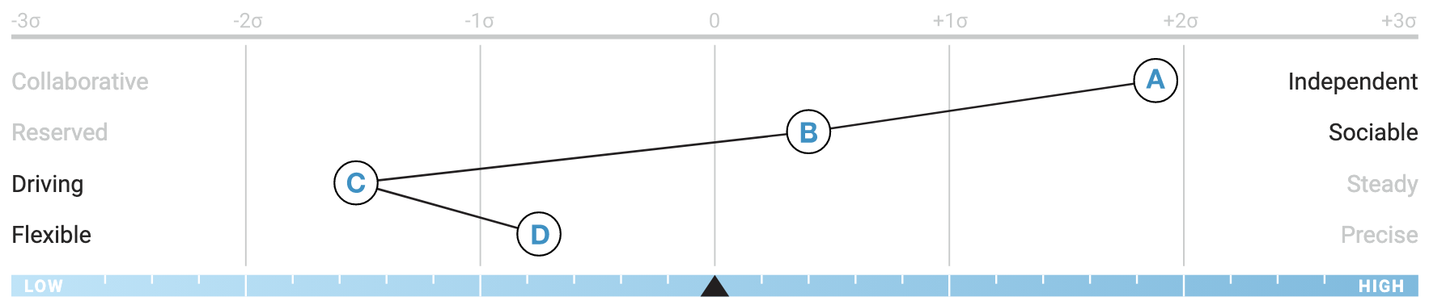
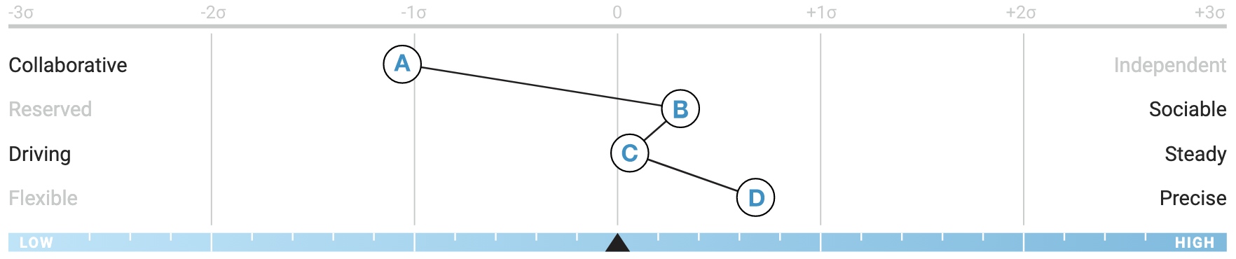
Pattern Descriptions and Needs
Is very…
Independent
Assertive
Self-confident
Is very…
Cooperative
Accepting of company policies
Accommodating
Needs lots of…
Independence
Control of own activities
To be challenged
Needs lots of…
Encouragement
Reassurance
Harmony
Notes:
Let's have a look at these two unique patterns. These patterns tell us a lot about a person's needs and behavioral tendencies.
Knowing your team members' or direct reports' needs will also help you set clearer accountability charts and delegate tasks and details appropriately.

Slide 29
Why measure patterns?
Fosters greater self-awareness and team awareness
Communicate
Interact
Engage
Motivate
Notes:
Measuring patterns can help you better communicate, interact, engage and motivate your team members, colleagues, direct reports and partners.

Slide 30
Strengthening Communication,
Team Dynamics and Collaboration
Notes:
Moving on to Team Collaboration, let’s explore how understanding these behavioral styles can lead to more effective teamwork.
When you know each person’s behavioral style, you can tap into their strengths and align team roles accordingly. For example, someone with high extraversion can take the lead in brainstorming sessions, while someone with high formality might excel in tasks requiring detailed planning and structure.
By acknowledging and respecting these differences, you can create an environment where every team member feels valued, which naturally reduces friction and boosts productivity.
Let’s consider a real-life scenario: Think about a time when a project went off track due to miscommunication or conflicting work styles. How could understanding your team’s behavioral dynamics have prevented that? Feel free to jot down any thoughts or share them in the chat.

Slide 31



Using a Common Language
Individual Strengths
What you bring to the team.
Complimentary Strengths
From 1:1 Relationships
Team Strengths
Combination of the full group
Notes:
When we go into organizations to help them design cohesive and high performing teams, we focus on helping them acknowledge individual strengths, highlight complimentary strengths and uncover the collective team strengths.

Slide 32



Work styles in relationships
Decisions
Collaboration
Independence
Ideas
Talk it through
Reflect
Conflict
Task focused approach
People focused approach
Notes:
People make decisions differently. They process ideas differently and they resolve conflict differently. Just like we have different love languages - some prefer words of affirmation will others show their care through actions.

Slide 33

The “World of Work” Wheel
In which quadrant would you place yourself?
Teamwork and Employee Experience
Innovation
and Agility
Process
and Precision
Results
and Discipline
Notes:
Let's take a moment to have you identify what your reference profile is. Use the link in the chat to take a 3 to 5 minutes behavioral assessment:
https://assessment.predictiveindex.com/bo/e8A/Event-BA

Slide 34
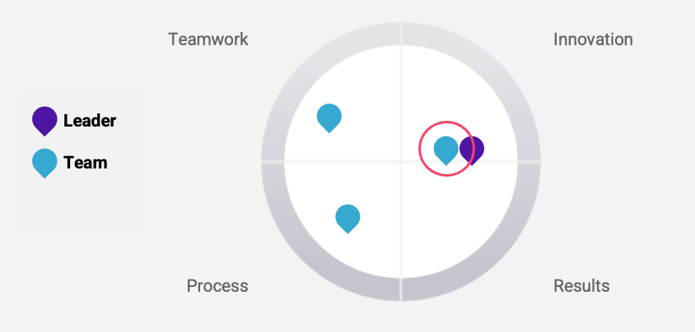
Who’s on my team?
Notes:
It's important to fully understand who's on your team and how they are motivated to drive results.

Slide 35
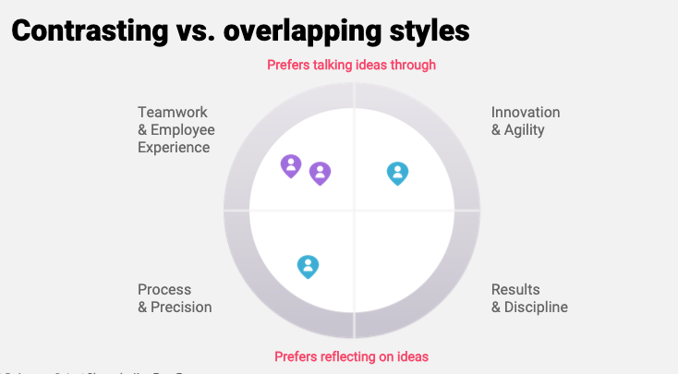
Notes:
There will be contrasting styles and overlapping styles.
In this example, those in the, what we call, norther hemisphere of this work wheel typically prefer to talk their ideas through while those in the southern hemisphere prefer to reflect on their own first when processing and coming up with ideas.
Also, those two people, represented in purple, even though they are in the same quadrant, their similarities may also become tension points - such as talking over each other and not actively listening to one another.

Slide 36
The World of Work Wheel
TEAMWORK & EMPLOYEE EXPERIENCE
TEAM MEMBERS TEND TO:​
Focus on collaboration and relationship building​
Be socially and interpersonally sensitive​
Prefer to support others to grow and develop​
Communicate by talking things through and brainstorming out loud​
Make decisions collaboratively, seeking input from each involved team member​
Resolve conflict by focusing on the people involved
INNOVATION & AGILITY
TEAM MEMBERS TEND TO:​
Focus on pursuing new innovations​
Be open to risk and experimentation​
Prefer to act quickly and assertively​
Communicate by talking things through and brainstorming out loud​
Make decisions independently, without waiting for consensus​
Resolve conflict by focusing on the people involved​
PROCESS & PROCESSION
TEAM MEMBERS TEND TO:​
Focus on process and predictability​
Be well-organized and efficient​
Prefer analytical decision making​
Communicate concisely, after thorough reflection on their own​
Make decisions collaboratively, seeking input from each involved team member​
Resolve conflict by focusing on the task involved
RESULTS & DISCIPLINE
TEAM MEMBERS TEND TO:​
Focus on results and goal achievement​
Be driven and competitive​
Prefer a focus on tasks and execution​
Communicate concisely, after thorough reflection on their own​
Make decisions independently, without waiting for consensus​
Resolve conflict by focusing on the task involved
Notes:
10 minutes
The Predictive Index talent optimization model highlights the 4 quadrants of the World of Work Wheel.
a. Innovation & Agility is about creativity and risk
b. Results & Discipline is about competition and metrics
c. Process & Precision is about predictability and efficiency
d. Teamwork & Employee Experience is about engagement and commitment

Slide 37
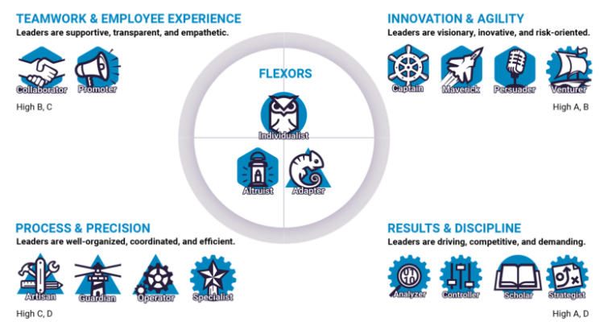
Where does your PI reference profile fall on the 4 quadrants?
Notes:
5 minutes
Based on your reference profile type, locate where you are likely to sit within the work wheel.
We are going to use these quadrants to better understand the individual strengths of the members of this team.
Would you like to see how you all are plotted in these quadrants based on your Behavioral Assessment results?

Slide 38
Utilizing Evidence-Based and Validated Behavioral Models Improves Leadership and Team Development Outcomes
Preview of Sample Team
Notes:
Let's take a moment to have you identify what your reference profile is. Use the link in the chat to take a 3 to 5 minutes behavioral assessment:
https://assessment.predictiveindex.com/bo/e8A/Event-BA

Slide 39
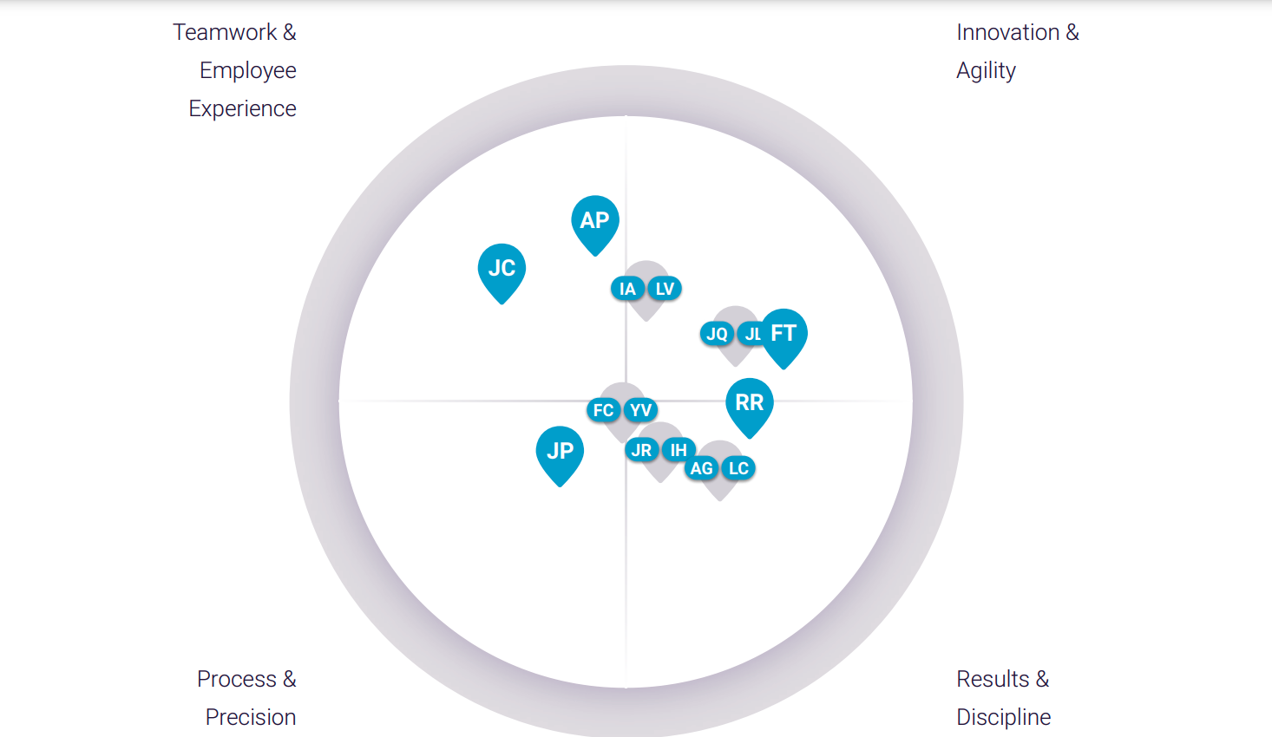
The World of Work
Notes:
Here is an example of a real team. You just never know where each team member will fall in the work wheel, so we encourage leaders not to make assumptions when delegating work.

Slide 40
Group Discussion
1. Review the Sample Team’s PI Work Wheel.
2. What stands out to you about this team?
3. What are possible strengths?
4. What might be some caution areas or tension points?
Notes:
If you were to roll these behavioral assessments out for your team, these are some exercises that could help you better work together.

Slide 41
Considerations to help improve communication for leadership alignment and team collaboration
Is there clarity and consistency in how the organization’s mission, vision, and values are communicated at every level?
Are individual goals regularly aligned and realigned with organizational values and strategic objectives?
How does your organization ensure upward feedback is safe, welcomed, and acted upon?
How are cross-functional teams encouraged and supported in solving complex challenges?
How do your leaders actively demonstrate empathy and compassion in daily operations and decision-making?
Notes:
To resolve conflict effectively, it’s essential to recognize and adapt to the behavioral dynamics of your team. SHRM reports that 57% of employees prefer leaders who are transparent and address issues directly, but how you approach communication matters. For highly extroverted teams, open, verbal discussions work well, whereas for more introverted teams, written communication can give them time to reflect before responding.
When mediation is necessary, Harvard Law research shows that 80% of conflicts are resolved through this process. However, mediation isn’t one-size-fits-all. For someone with high dominance, ensure they feel their influence is acknowledged, but also guide them toward a collaborative solution. For those with high formality, providing a clear, structured mediation process will help them feel comfortable and in control.
Finally, emotional intelligence is key. Leaders who understand both the emotional and behavioral drivers behind conflicts are far more effective at resolving issues and fostering an environment of collaboration.
By aligning your conflict resolution approach with team dynamics, you create a culture where conflicts are addressed constructively, and diverse behavioral styles are leveraged for the benefit of the team.

Slide 42
What you learned today!
1
2
3
Key Components of Effective Communication
Understanding Behavioral Styles
Enhancing Team Communication, Cohesion and Collaboration

Slide 43
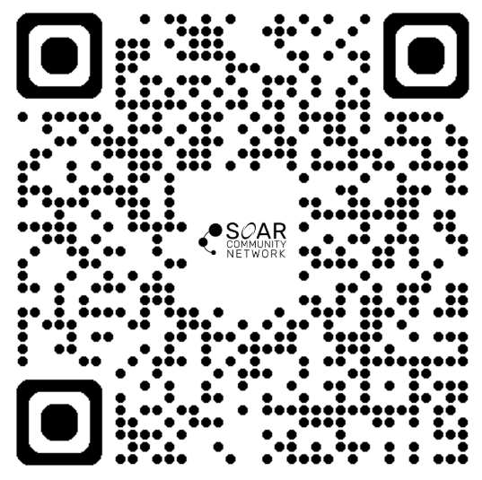

Thank You!
Book your complimentary strategy session to unlock a free team demo site and a mini coaching session with your behavioral reports.
Notes:
Thank you again for the opportunity to share with you today. Please reach out to us, schedule your complimentary Predictive Index read back, coaching session and let's explore ways of working together in future!

Slide 44

Mali Phonpadith
CEO, SOAR Community Network
Mali@soarcommunitynetwork.com
mali@soarcommunitynetwork.com
Contact me to learn more about SOAR’s:
Purpose Mapping Process for Executives, Teams or Individuals
C3 Framework: Develop compassionate, cohesive and collaborative organizations and teams
Coaching Programs for Executives and Groups
Workshops and Retreats - strategic mapping, team building, leadership development, effective communication, etc.
Small Business/Entrepreneur Support Programs
soarcommunitynetwork.com

