Slide 1

Curious About Financial Reporting? Explore the Power of Interim Reporting
Tuesday, October 28th | 12:30 PM

Slide 2

Curious about Financial Reporting?
Michael R. Raigosa
Deputy Chief Financial Officer & Chief Analytics Officer

Slide 3

Influences and References
Austin, Texas

Slide 4

Influences and References
Austin, Texas
Pool Finance, Tigers and Bears…Oh My!, Presentation by Chris Krepcho at May 2025 NLC-RISC Trustees Conference. Excellent primer on Finance at Risk Pools.
Viking Cruises Commercial – Be Curious Travel Theme
My journey over 32 years – from reinsurance accountant to data guy

Slide 5

Be Curious
Klementinum Library
Prague, Czech Republic

Slide 6

Be Curious
Klementinum Library
Prague, Czech Republic
How does my role influence financial reporting?
Curiosity is viewed as initiative leading to career growth and development.
More insights positively impact Pool’s success.

Slide 7

Topics / Roadmap
Financial Reports (Balance Sheet & Income Statement)
Annual Reporting vs. Interim Reporting
Rule of Conservatism
Types of Interim Reporting
Challenges with Interim Reporting
Investment Income
Seasonal Reported Losses
Rowena Crest Loops
Columbia River Gorge, Oregon

Slide 8

Financial Reporting
Milan Cathedral
Milan, Italy
Luca Pacioli – Father of Modern Accounting

Slide 9

Financial Reporting
Milan Cathedral
Milan, Italy
Luca Pacioli – Father of Modern Accounting
Balance Sheet & Income Statement
Chris Krepcho’s presentation

Slide 10
Income Statement Variations

Slide 11
Balance Sheet Variations

Slide 12

Rule of Conservatism
Accountants apply this rule to avoid overstating net income or net position.
Beverly Hills, California
Rule of Conservatism
Is not the middle of the road.

Slide 13

Rule of Conservatism
Rule of Conservatism
Beverly Hills, California
Accountants apply this rule to avoid overstating net income or net position.
Accountants apply this rule to avoid overstating net income or net position.

Slide 14
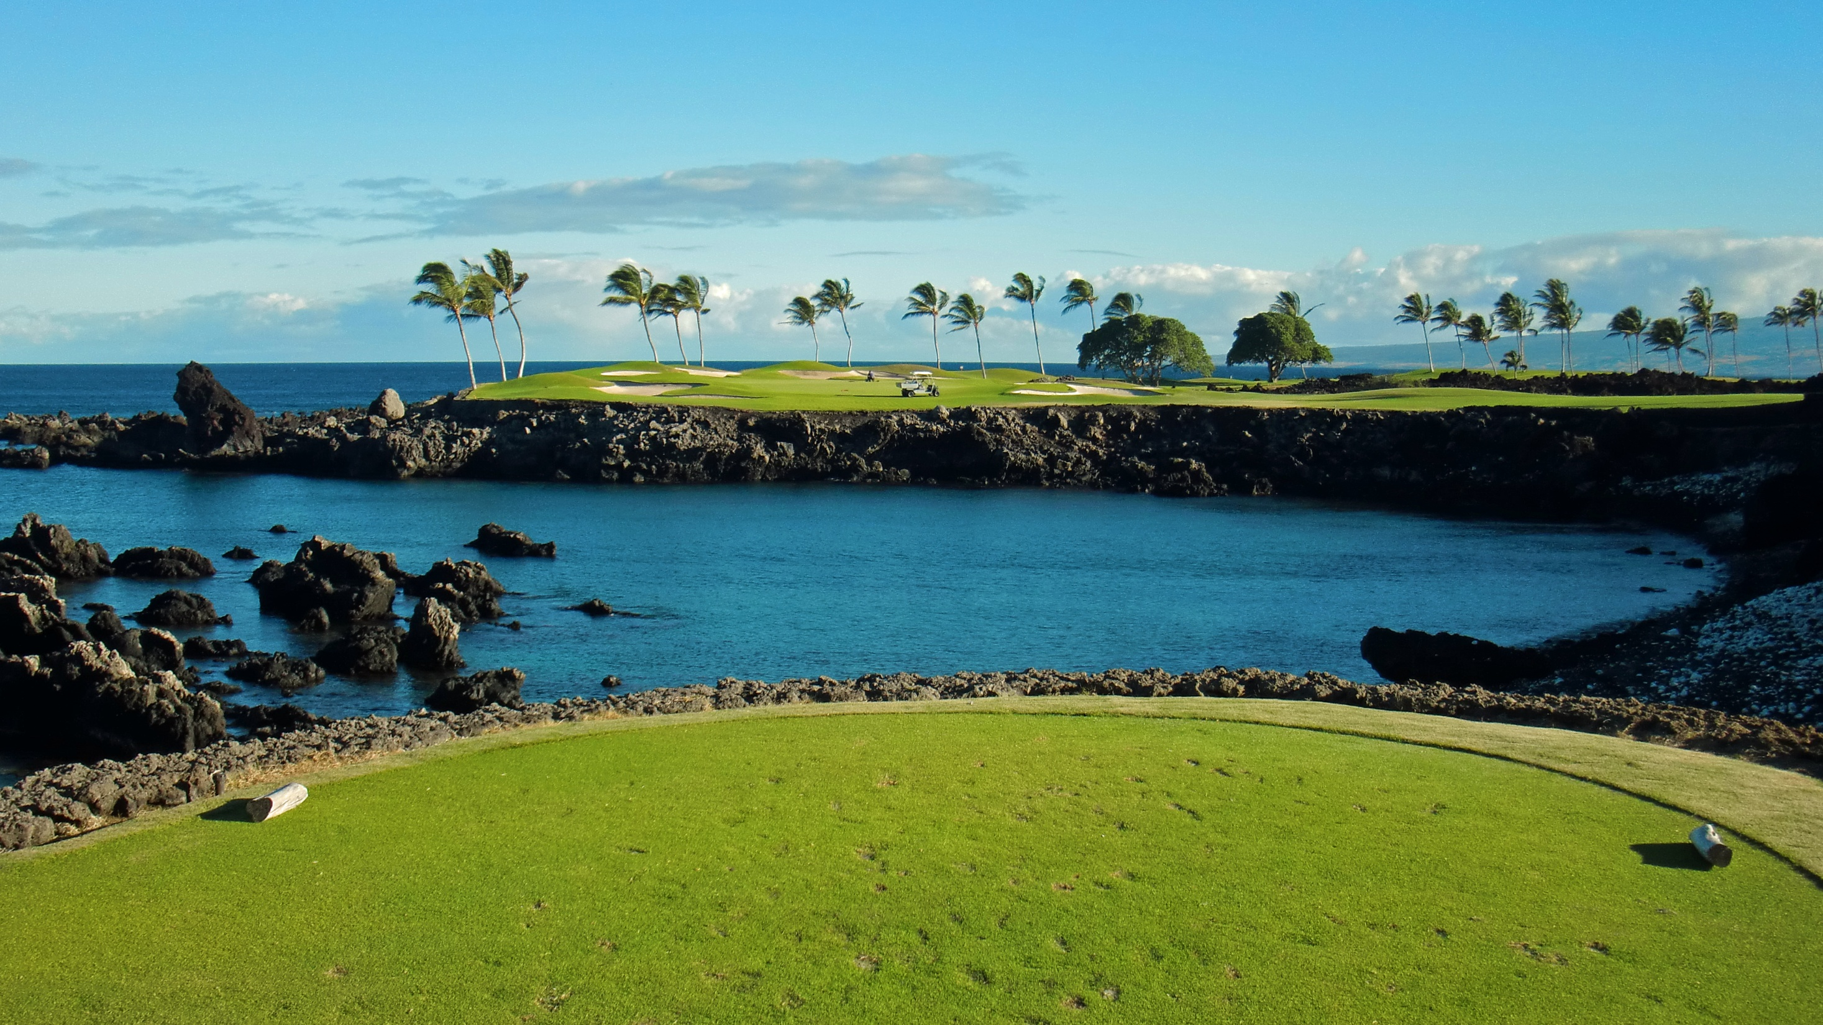
Interim Reporting
Mauna Lani, Hawaii Island
South Course, Hole 15

Slide 15

Interim Reporting
Mauna Lani, Hawaii Island
South Course, Hole 15
Emphasis on providing timely information for decision making.
Condensed – fewer disclosures and more summarized.
More use of estimates and approximations.
Unaudited with primarily internal distribution.
Dashboards are another form of real-time interim reporting.

Slide 16
Interim Reporting - Extrapolating

Slide 17
Interim Reporting - Extrapolating

Slide 18
Interim Reporting - Recognition
Is interim reporting of claim losses just reported losses, or do they also include some adjustment for IBNR (incurred but not reported) losses?

Slide 19
Interim Reporting – Seasonal Variation
Texas Property Reported Losses
Most hail-storms occur in late spring and early summer

Slide 20
Interim Reporting – Seasonal Variation
Texas Property Reported Losses
$101.3 million estimate for year end
Cumulative Reported Loss Total

Slide 21
Interim Reporting – Seasonal Variation
Texas Property Reported Losses
$101.3 million estimate for year end
3 mos. cumulative extrapolated total is $47.8 million below year end estimate
Cumulative Reported Loss Total
3 mos. cumulative $13 .4 million total extrapolated to $53.6 million

Slide 22
Interim Reporting – Seasonal Variation
Year End IBNR = Incurred But Not Reported
Interim IBNR = Interim adjustment for straight line recognition ultimate loss estimate
Texas Property Reported Losses
$101.3 million estimate for year end
3 mos. total loss of $25.3 extrapolates to $101.3 million
Cumulative Reported Loss Total
Stright-line recognition of a $101.3 interim ultimate loss estimate would result in a IBNR reserve of $12 million resulting in a total loss of $25.3 at 3 months into the fiscal year
IBNR

Slide 23
Interim Reporting – Seasonal Variation

Slide 24

Now Go
Be Curious
Near Southern Most Point in United States
Island of Hawaii

