Slide 1

Bridging the Gap Building the Future: Compassionate Leadership for a New Era
Monday, October 27th | 9:15 AM

Slide 2

Bridging the Gap Building the Future Compassionate Leadership for a New Era
Facilitated by Mali Phonpadith
Founder and CEO, SOAR Community Network
Leadership and Talent Development Advisor
Certified Talent Optimization Leader

Slide 3
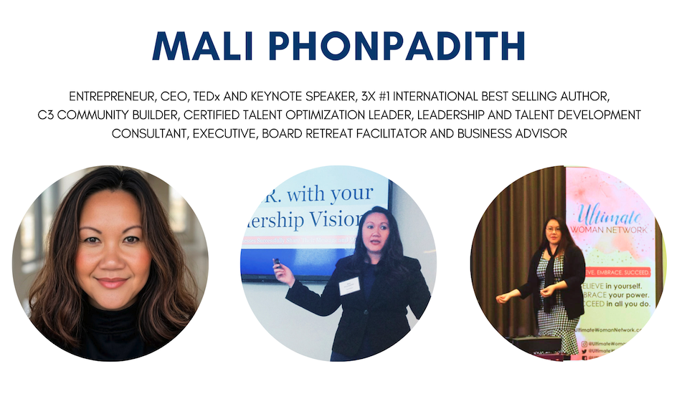

Slide 4


Laos

Slide 5
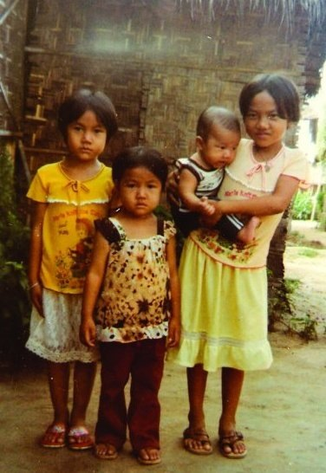
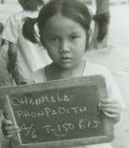
Refugee Camp
Ubon Ratchathani, Thailand

Slide 6
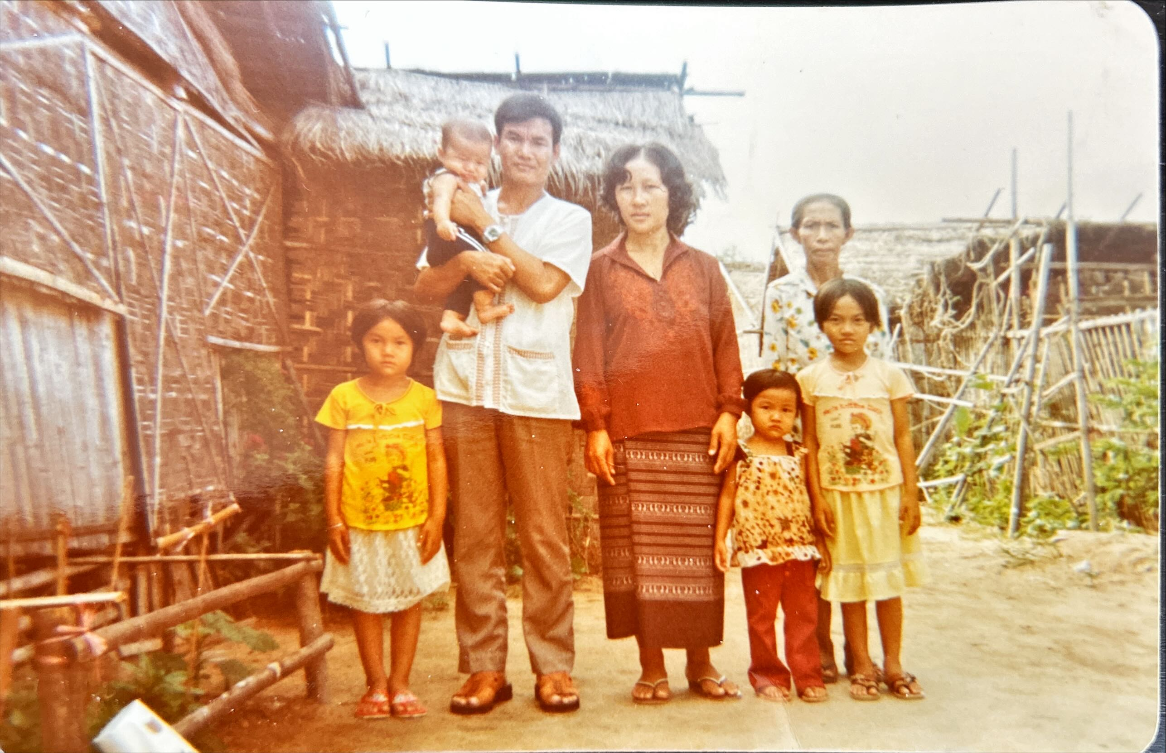

Slide 7


Slide 8


Slide 9


Slide 10
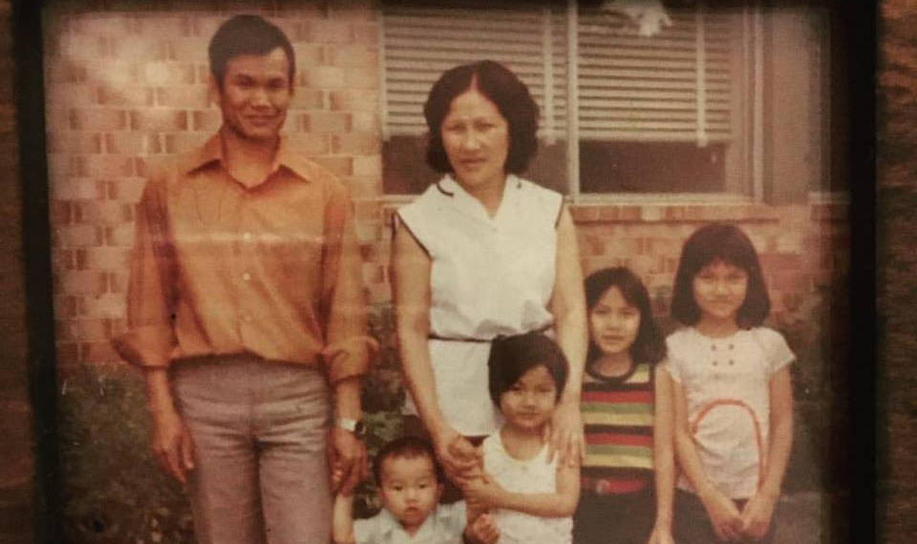

Slide 11

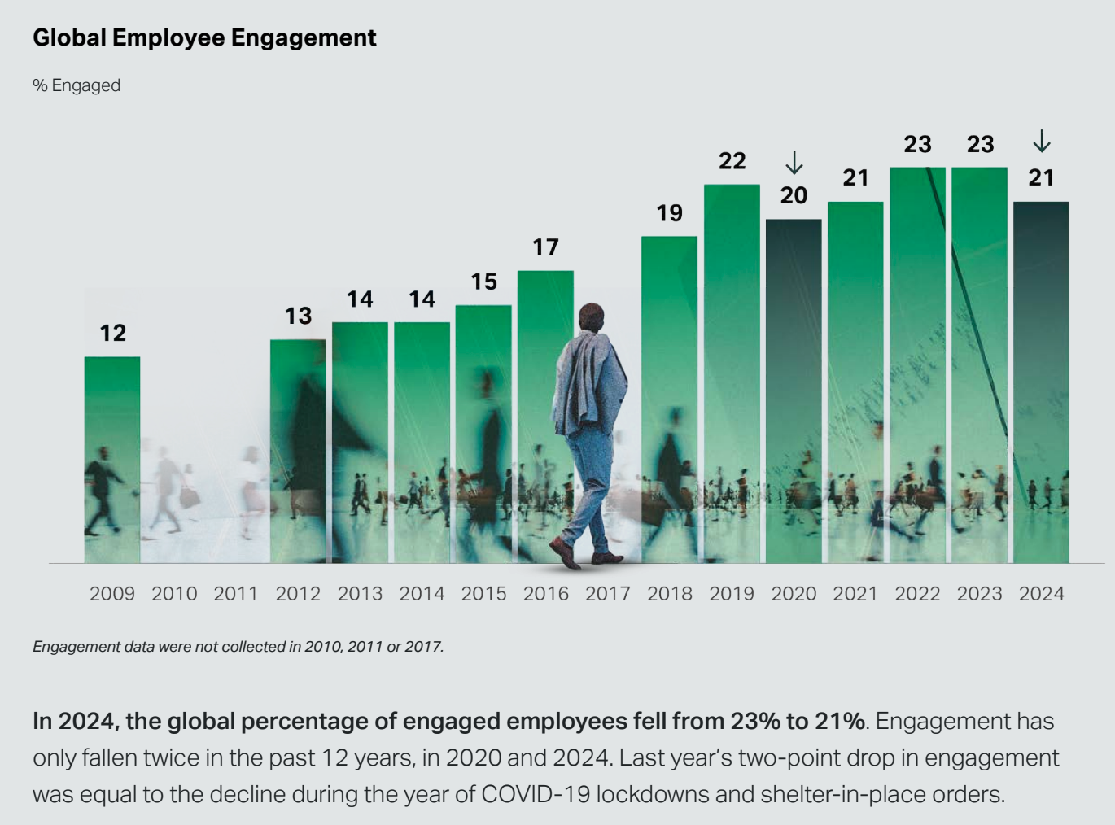
Source: Gallup State of the Workplace Report 2025

Slide 12
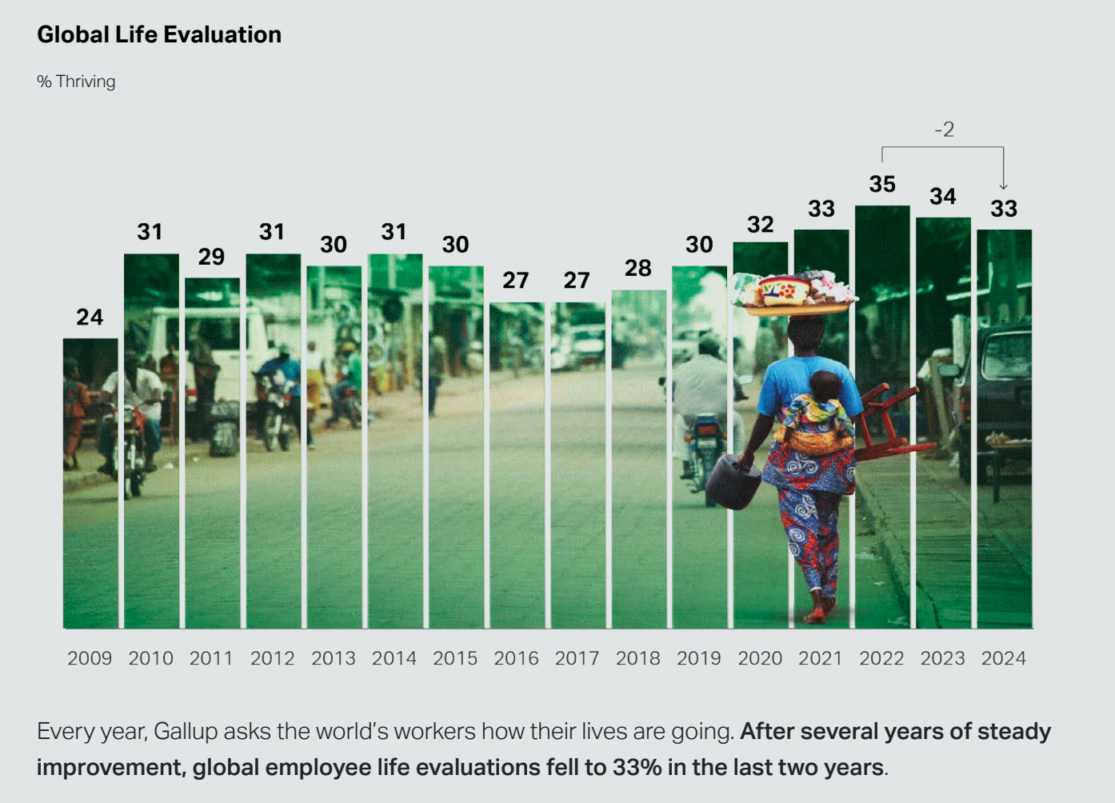
Source: Gallup State of the Workplace Report 2025

Slide 13
Trust and Retention: A Closer Look
Trust
Retention
Declining Trust (Inaction)
A review of 87,000 leadership assessments identified the three key elements driving trust in leaders: consistency, good judgment, and positive working relationships.
(Harvard Business Review 2025)
Social factors—not money or workload—are the biggest predictors of employee engagement and retention: specifically, respect, inclusion, and pride in work.
*Leadership clarity, communication effectiveness and kudos/recognition also improves retention.
(HBR 2025 article: “Why Kindness Isn’t a Nice to Have”)
70% of employees don’t trust their company’s leadership to follow through on commitments - a level indicating stagnant or declining trust.
(2024 PwC survey)
Engagement surveys are ineffective unless followed by meaningful action through dialogue and responsiveness. (Share the action plan with employees!)
(Business Insider)

Slide 14

Leading in a Time of Profound Transition
Generational Impacts
Millennials are now the largest group in the workforce. More than one in three (35 %) of U.S. labor force participants is a Millennial
Gen Z is growing fast. Some demographic estimates place Gen Z currently between 20–25 % of the U.S. population and forecast continued growth in workforce share.
Nearly half of our experienced public sector leaders will retire in the next decade.
Source: Pew Research and Center for State and Local Government Excellence

Slide 15

Empathy + Integrity = Trust
Trust grows when leaders pair competence with character.
Empathy = understanding people’s needs.
Integrity = aligning words with consistent actions.
Empathy communicates “I see you.”
Integrity communicates “You can count on me.”
When either is missing, trust erodes quickly.
Source: Stephen Covey – The Speed of Trust

Slide 16
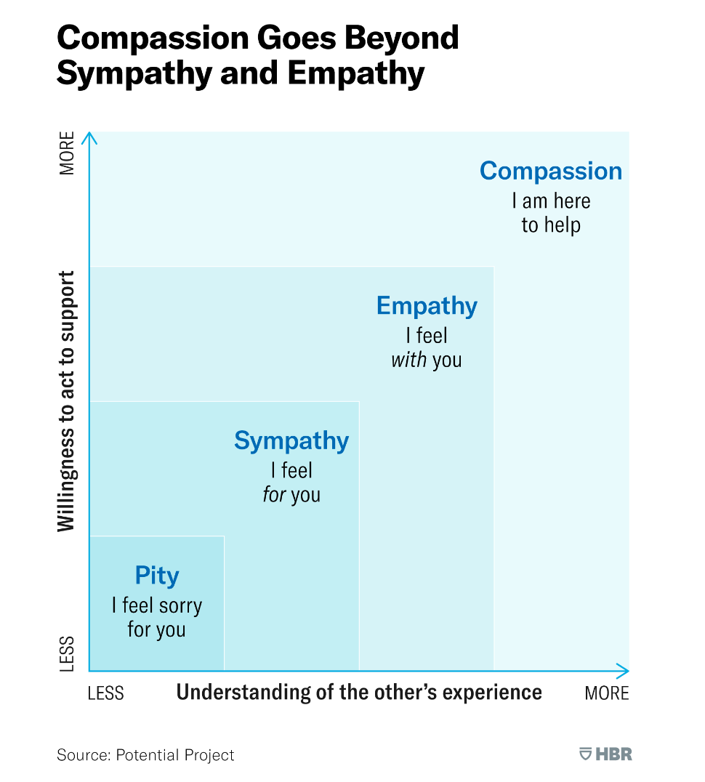
Empathy vs. Compassion

Slide 17

Compassionate Leadership
Compassionate leadership is a leadership style focused on empathy, understanding, and support for employees, leading to a more positive and productive work environment.
It involves actively listening to employees' concerns, understanding their challenges, and providing support to help them succeed.

Slide 18

Compassion = Sustainable Connection
Compassion creates a culture where people want to stay because they feel valued beyond their output.
Compassionate Leadership:
Drives higher engagement & loyalty
Improves leadership effectiveness
Reduces turnover
.
Source: CCL, Empathy in Leadership: Is it Possible to Care Too Much?

Slide 19
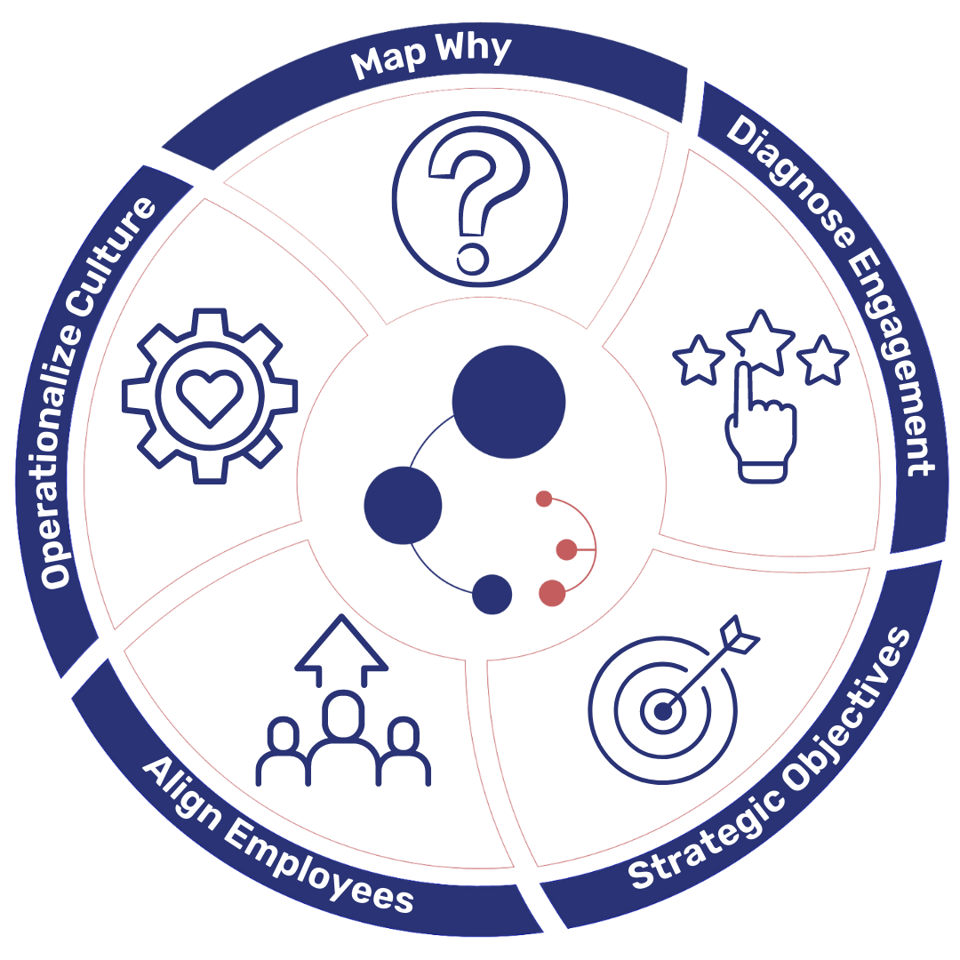
SOAR’s C3 Framework
Compassionate Leaders
Cohesive Teams
Collaborative Culture

Slide 20
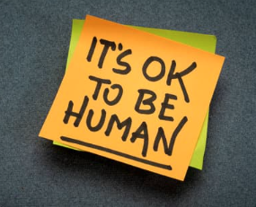
Bridging the Divide Getting Back to the Basics of Being Human
Behavioral tools help team members across generations and functions:
Communicate preferences
Understand each other’s decision-making styles
Uncover natural strengths and behavioral drivers
Address or minimize friction points
Create team awareness maps
Celebrate your differences as assets not obstacles

Slide 21
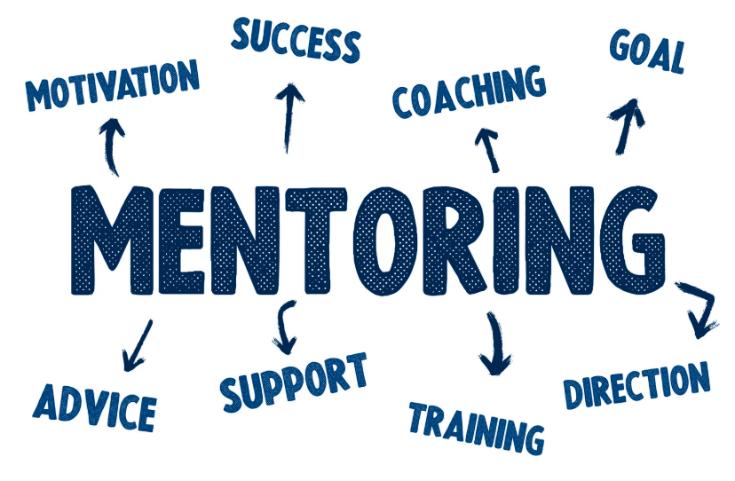
Mentorship
Mentorship fills the gap between experience and innovation. It connects generations and when paired with real-time feedback and data, it becomes a lever for strategic growth.
Mentorship boosts retention by 72%. (Deloitte)
Teams with strong coaching cultures outperform peers in engagement and productivity. (Gallup)

Slide 22

Metrics and Culture Strategy
Create systems of ongoing learning and development:
Identify internal mentors and match them across generations, leadership levels and diverse skillsets.
Track culture metrics: engagement, inclusion, and alignment.
Integrate mentoring conversations into succession planning and career development goals.

Slide 23


Leading with Humanity
Prioritize people, honoring their well-being, dignity, and inherent worth, at the center of every decision.
Leadership isn’t about going it alone. It’s about creating space for others to lead alongside you.
When we lead with compassion, courage, and curiosity, we activate purpose—and inspire aligned action toward a shared mission.

Slide 24

Key Considerations: Your Leadership Journey and Team Contribution
How will you create a workplace where every voice matters, regardless of age, title or behavioral drivers?
What conversations do you need to have to create alignment and shared purpose?
How will you adjust your preferred work style to better collaborate with team members across generations, leadership levels and business functions?
How can you bring more compassion to your leadership, starting this week?

Slide 25
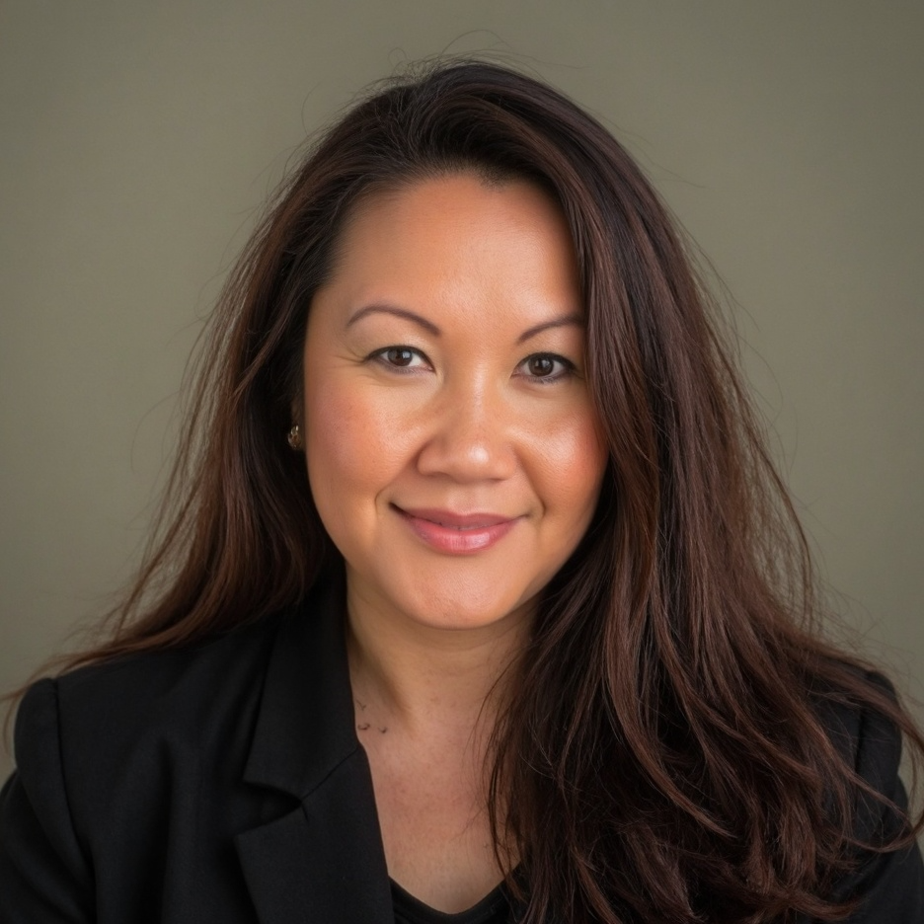
Mali Phonpadith
CEO, SOAR Community Network
mali@soarcommunitynetwork.com
Contact me to learn more about SOAR’s:
Purpose Mapping Process for Executives, Teams or Individuals
C3 Framework: Develop compassionate, cohesive and collaborative organizations and teams
Coaching Programs for Executives and Groups
Workshops and Retreats - strategic mapping, team building, leadership development, effective communication, etc.
soarcommunitynetwork.com

