Slide 1
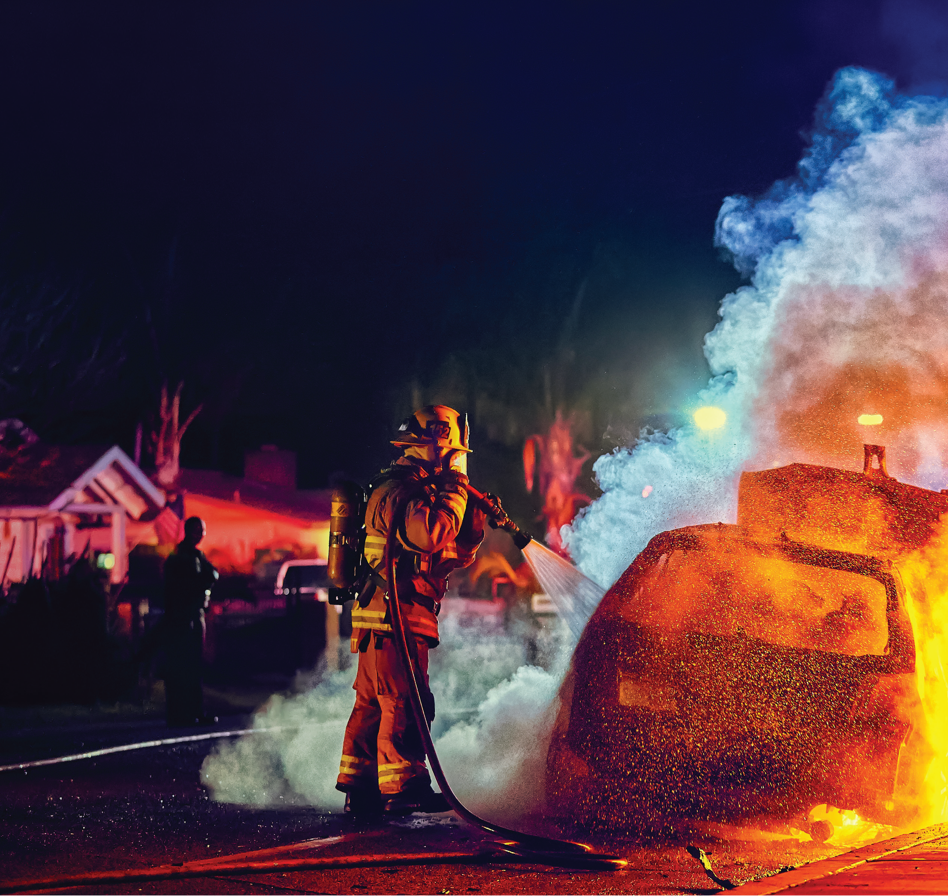
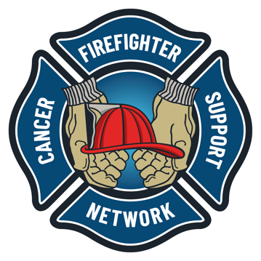
DOING IT RIGHT
Reducing Cancer in the Fire Service
Occupational Cancer Prevention
Notes:
Title Slide

Slide 2
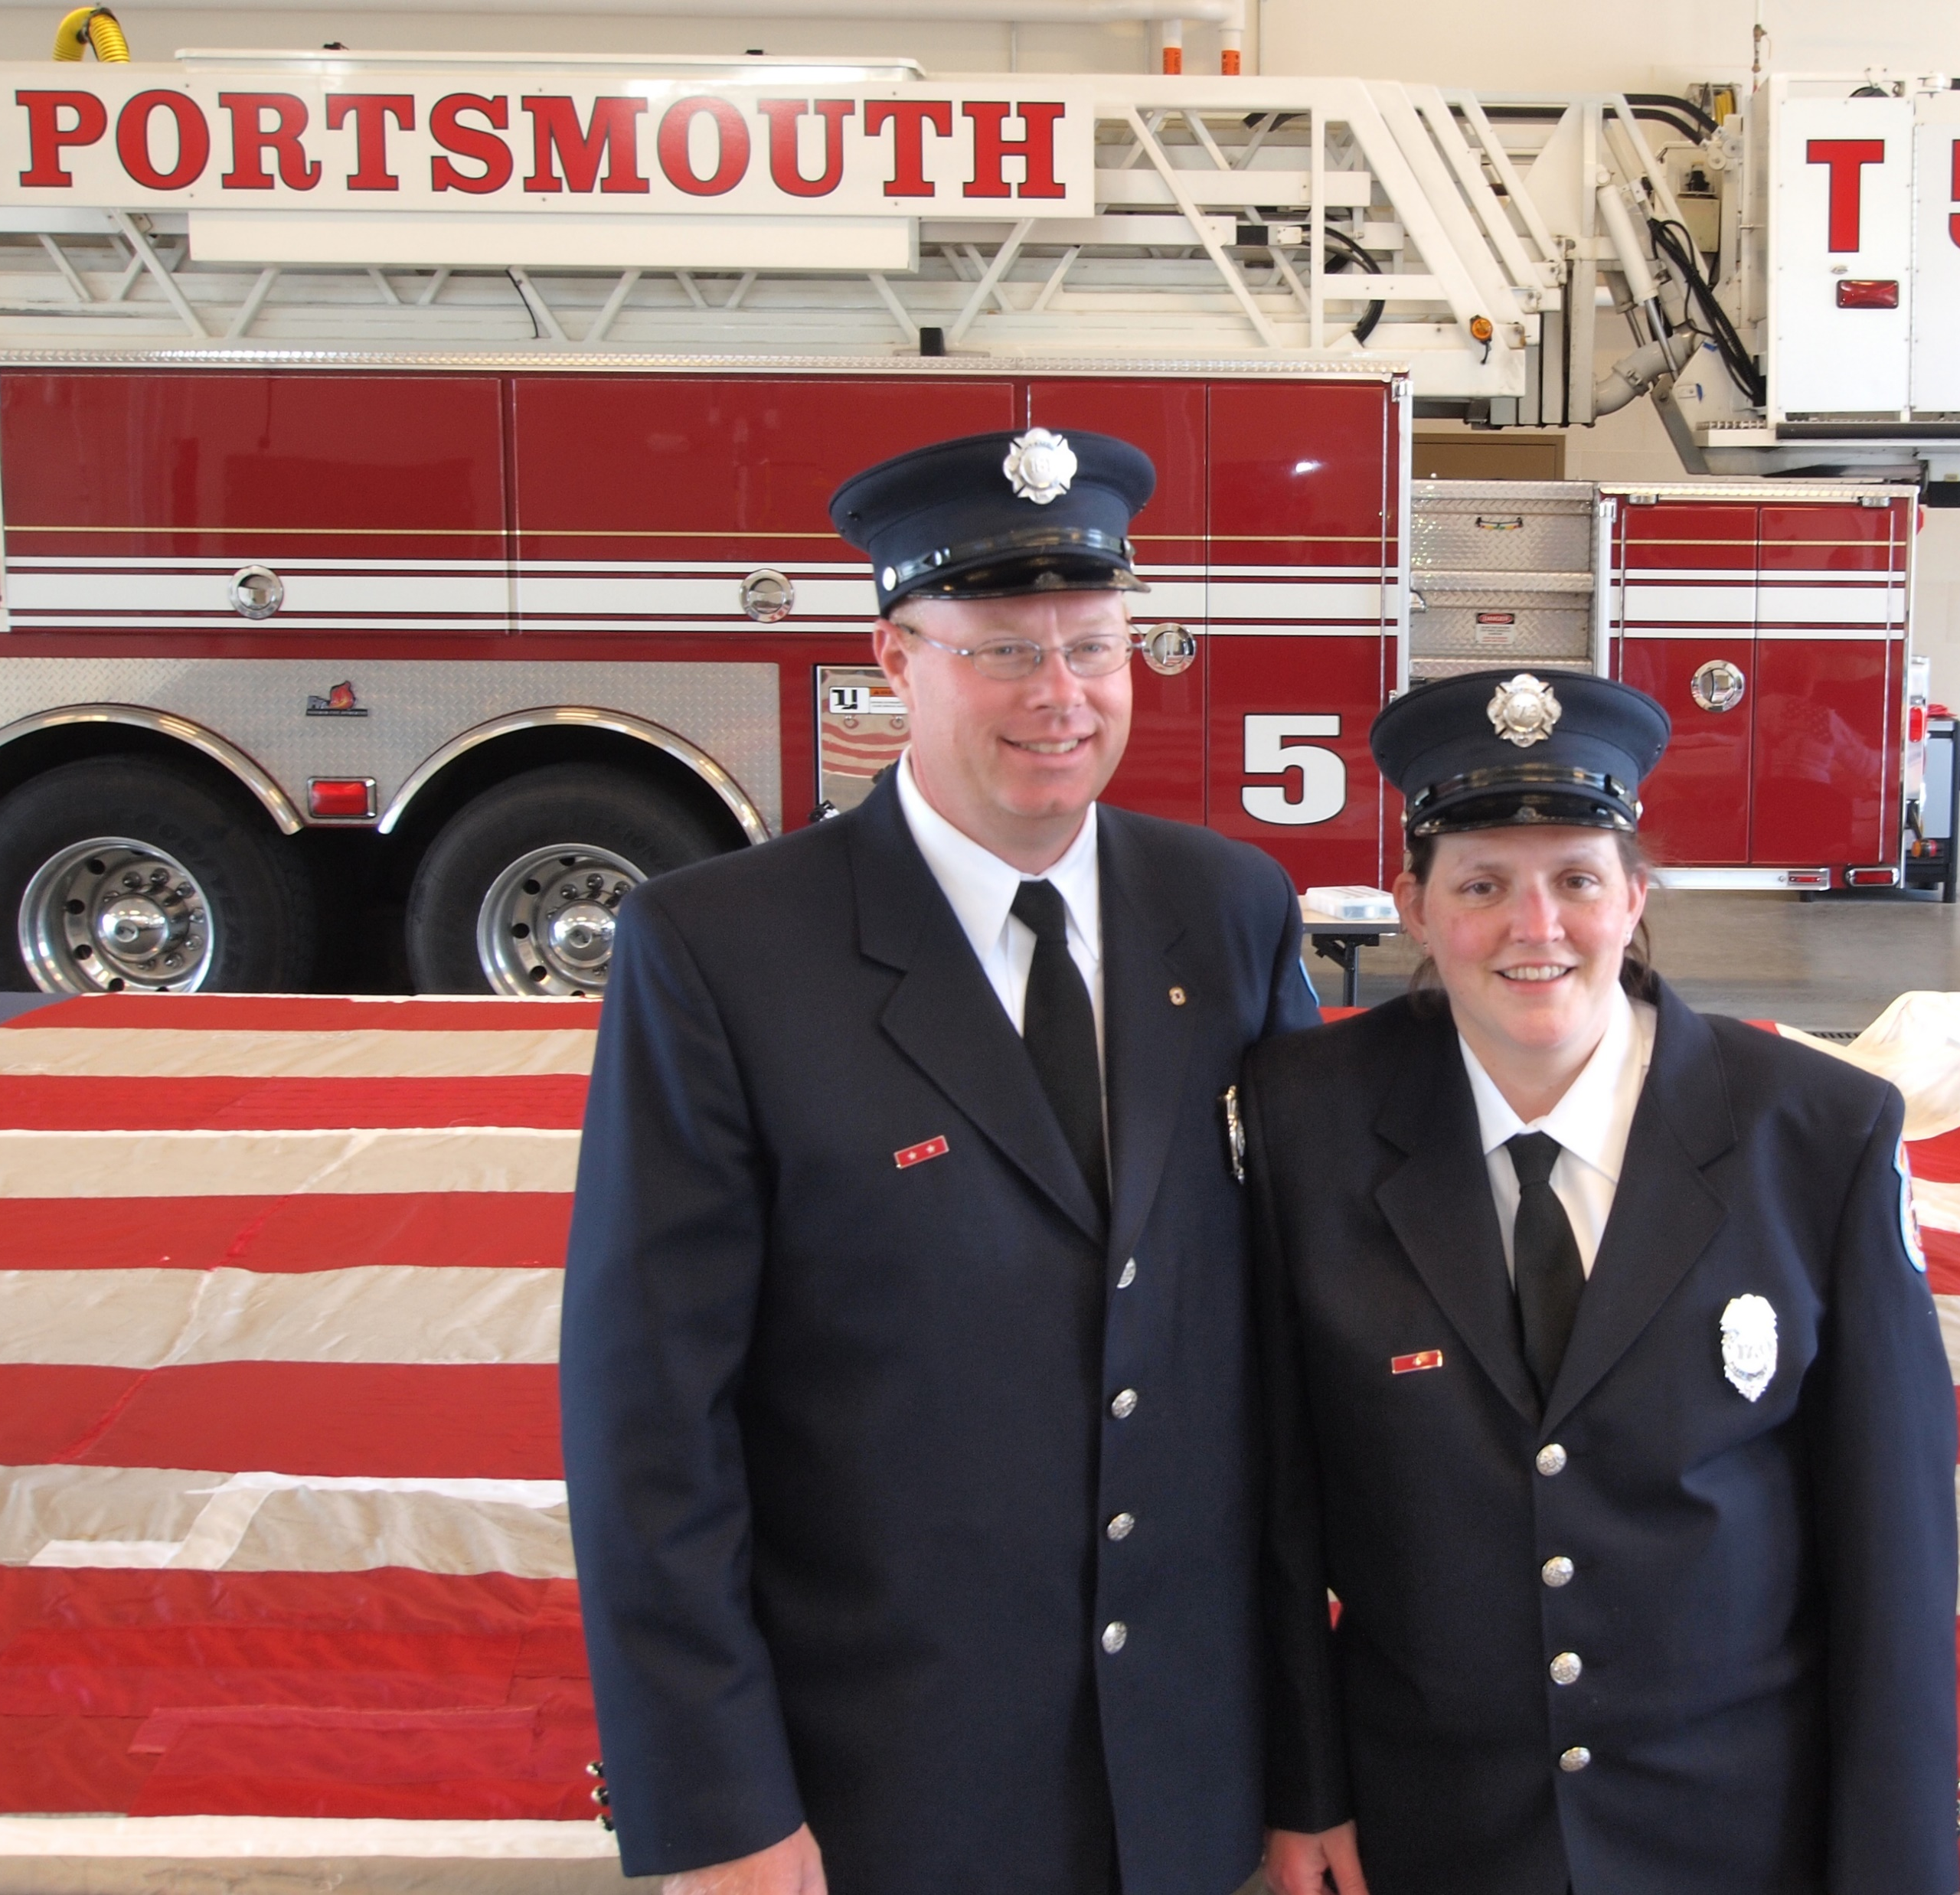
Russell F. Osgood
Vice President
Education, Outreach & Research
Chief of Department Ogunquit, Maine
Lieutenant Portsmouth NH Fire Department (ret) 1995-2021
CO-Chair FFCCS Oversite Committee
NFR Advocate
IAFC Human Relations Committee
Notes:
Introduce yourself.. Please include a short why story. Tell the audience why this is important to you and them.

Slide 3
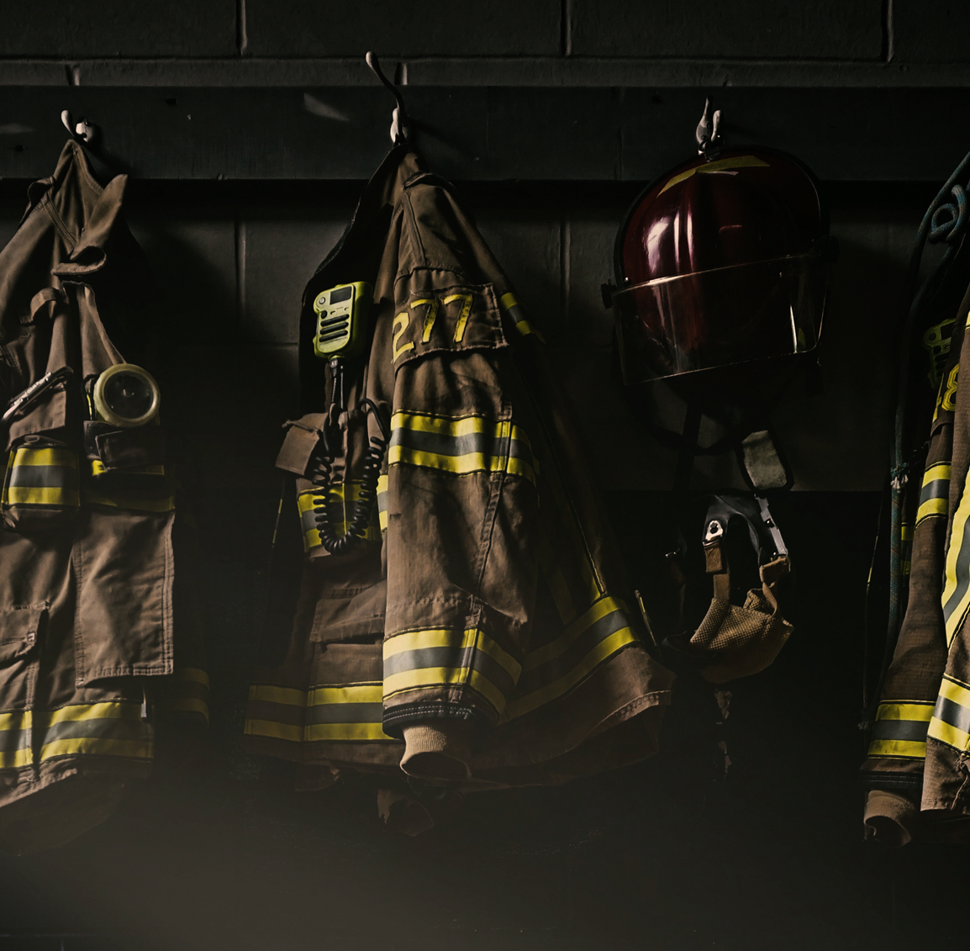
Objectives
Review the Scientific Research
Understand Occupational Exposure
Learn the everyday asks
Identifying Best practices in the Fire Service
Understand Presumptive Legislation & Exposure Reporting.
Understand the Importance of Screenings, Annual Medical Exams & Early Detection
Discover the importance of Culture Change
Learn the FCSN Survivorship
Notes:
Objectives are:
Review the Scientific Research
Understand Occupational Exposure
Learn the everyday
Identifying Best practices in the Fire Service
Understand Presumptive Legislation & Exposure Reporting.
Understand the Importance of Screenings, Annual Medical Exams & Early Detection
Discover the importance of Culture Change
Learn the FCSN Survivorship

Slide 4
Scientific Research

Slide 5
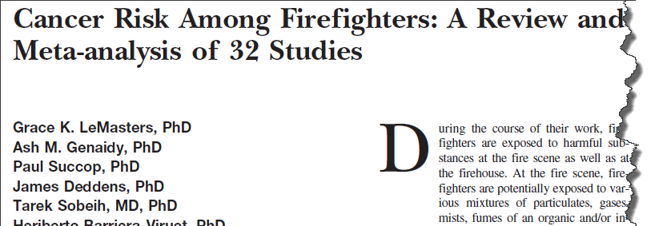

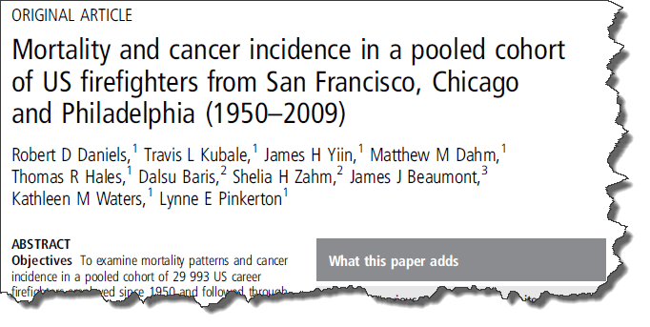
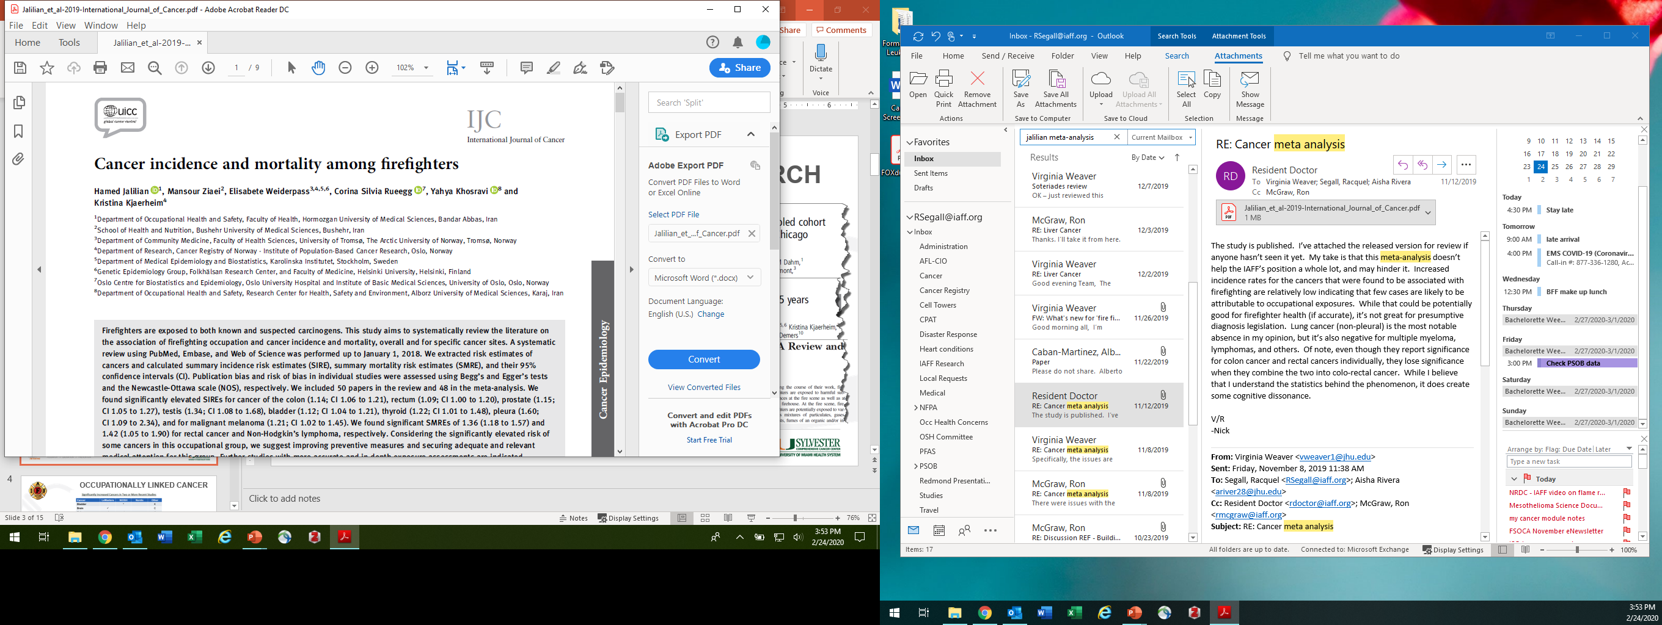
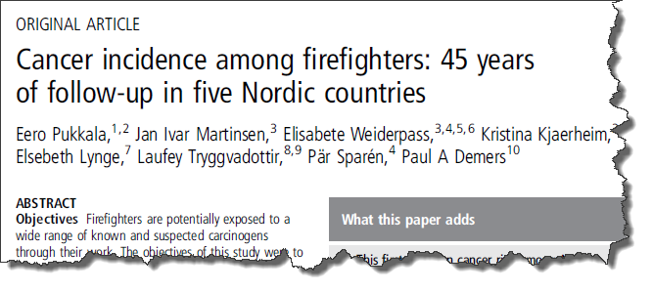
Brain 32%
Oral Cavity 39%
Esophageal 62%
Mesothelioma 129%
Lung 29%
Kidney 27%
Testicular 102%
Multiple Myeloma 53%
Leukemia 14%
Prostate 28%
Intestine 21%
Non-Hodgkin’s Lymphoma 51%
Notes:
Numerous studies indicate that cancer prevalence in firefighters is higher than that of the general population
Studies vary; some examine both mortality and incidence.
Relative risk is a measurement of the strength of the relationship between cancer and a given risk factor. It’s comparing the risk of developing cancer in people with certain
exposure traits to people without. Example: Male smokers are 23 times more likely to develop lung cancer than a nonsmoker. ²⁰

Slide 6
40%
Forty Percent of the general population
will be diagnosed with cancer.
9%
Firefighters have a Nine Percent higher risk being diagnosed.
14%
Firefighters have a Fourteen Percent higher mortality rate than the general population.
Notes:
We know that 40% of Americans will be diagnosed with cancer in their lifetime.
Firefighters are at a 9% increased risk of being diagnosed with cancer a 14% increased risk of dying from cancer.
Firefighters should focus on both on and off the job reduction tools. This way we can reduce both the risk of getting and risk of dying from cancer.

Slide 7
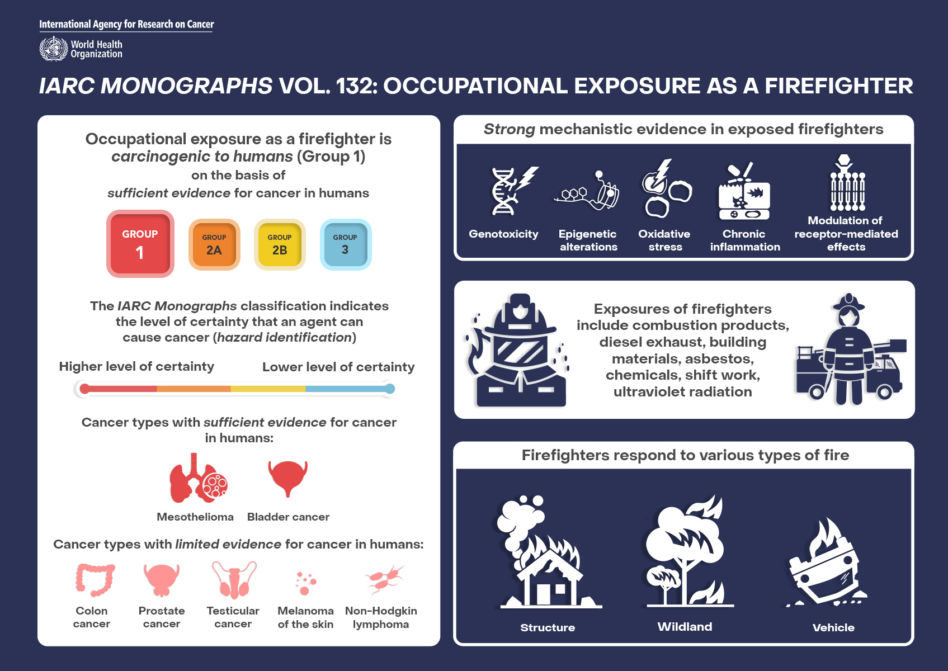
https://www.iarc.who.int/wp-content/uploads/2022/07/Q-A-Mono132.pdf
Notes:
June of 2022, a working group of 25 international experts from 8 countries evaluated the carcinogenicity of occupational exposure to firefighters in Lyon France. These discussions led to updating the international agency for research on cancer monographs on firefighting that will be published in volume 132 of the IRC monographs in 2023.
Researchers determined that the occupational exposure as a firefighter that firefighting will be classified as carcinogenic to humans (Group 1) a change to the 2007 classification as Group 2B.
The researchers demonstrated that there was sufficient evidence for cancer in humans for mesothelioma and bladder cancer. There was limited evidence for cancer in humans for colon cancer, prostate cancer, testicular cancer, melanoma of the skin, and non-Hodgkin lymphoma.
There was also strong mechanistic evidence in exposed humans that occupational exposure as a firefighter exhibits 5 of the 10 key characteristics (KCs) of carcinogens:2 “is genotoxic” (KC2), “induces epigenetic alterations” (KC4), “induces oxidative stress” (KC5), “induces chronic inflammation” (KC6), and “modulates receptor-mediated effects” (KC8). sufficient evidence that the occupational exposures to firefighters lead to cancer. The IARC monographs or reflect a Group One classification
https://www.iarc.who.int/wp-content/uploads/2022/07/Q-A-Mono132.pdf

Slide 8
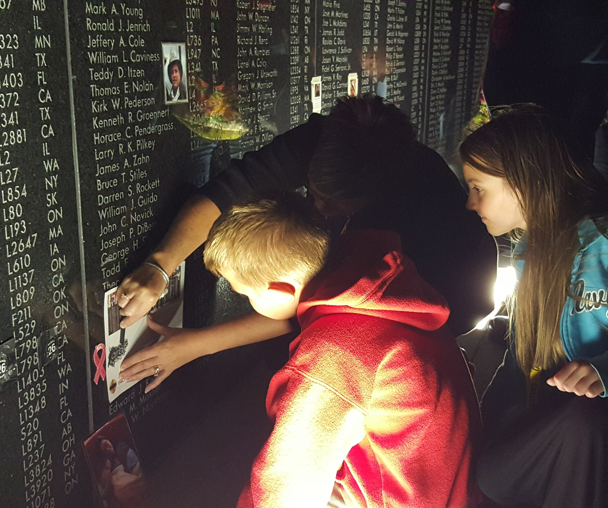
At the 2022 IAFF Fallen Firefighters Memorial 75% of the names honored were Cancer related deaths
Notes:
This is a staggering statistic ….If 75% of the IAFF LODD’s are from Cancer what do you think the statistics are nationally (Non-Union Firefighters)

Slide 9
Occupational Exposure

Slide 10
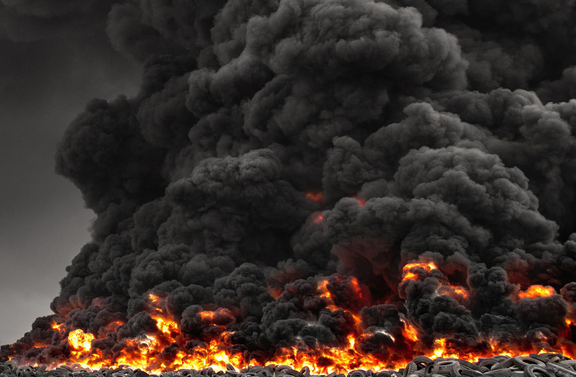
Occupational Exposures
Carbon monoxide (CO)
Hydrogen cyanide (HCN)
Hydrogen sulfide
Asbestos
Nitric oxide (NO)
Ammonia (NH₃)
Methyl isocyanates
Benzene
Styrene
Toluene diisocyanate
Sulfur dioxide
Phosgene (COCI₂)
Formaldehyde
Cadmium
Chloroform
Perfluoroisobutylene (PFIB)
Polychlorinated dibenzofurans (PCDFs)
Arsenic
Acrolein
Hydrogen chloride (HCI)
Oxides of nitrogen (NO_{x})
Chlorine
Crystalline
Hydrogen bromide (HBr)
Hydrogen fluoride (HF)
Polychlorinated dibenzo-p-dioxins (PCDDs)
Sulphur dioxide (SO₂)
Polycyclic aromatic hydrocarbons (PAHs)
Trichloroethylene
Tetrachloroethylene
Carbon dioxide (CO₂)
Hydrochloric acid
Notes:
Firefighters have an occupational exposure to fire smoke that the general public does not.
Smoke from fires includes suspended liquid and solid particulate matter, as well as gases and vapors that result from the combustion of material. There are very large numbers of toxic components in smoke.
Carbon monoxide and hydrogen cyanide are highlighted on the slide. It’s easy to monitor them with instruments. We urge firefighters not to use the metered levels of these two to indicate the air is clear and signal that the removal of SCBA is acceptable.
We cannot or do not monitor for dozens of other toxins that may be present.
Compounds such as benzene, styrene, formaldehyde, acrolein, arsenic, and polycyclic aromatic hydrocarbons are all known to be cancer-causing among humans. All can be present in fire smoke at varying levels.
Just because carbon monoxide and hydrogen cyanide have reached certain levels does not mean it’s safe to remove your mask.
Bolstad-Johnson, D. M., Burgess, J. L., Crutchfield, C. D., Storment, S., Gerkin, R., & Wilson, J. R. (2000). Characterization of firefighter exposures during fire overhaul. AIHAJ-American Industrial Hygiene Association, 61(5), 636-641. Retrieved from: http://www.firefightercancersupport.org/wp-content/uploads/2013/06/characterization_of_firefighter_exposures_during_fire_overhaul.pdf
FCSN urges the use of SCBA from initial fire attack to the end of overhaul!
Palmer, K. (2011). IARC Monographs on the Evaluation of Carcinogenic Risks to Humans. Volume 98: Painting, Firefighting and Shiftwork. International Agency for Research on Cancer. Occupational Medicine, 61(7), 521-522. Retrieved from: http://monographs.iarc.fr/ENG/Monographs/vol98/mono98.pdf

Slide 11
Occupational Exposure
CARBON MONOXIDE
IDLH=1200 PPM | NIOSH REL 35 PPM
HYDROGEN CYANIDE
IDLH = 50 PPM | NIOSH REL = 5 PPM
ZERO
There is ABSOLUTELY NO CORRELATION between the levels found from air monitoring for CO and HCN and cancer-causing toxins found at a fire.
There are many other gases that are
undetectable without monitors and are
FAR MORE DANGEROUS than CO or HCN!
Notes:
Carbon monoxide and hydrogen cyanide are highlighted on the slide. It’s easy to monitor them with instruments. We urge firefighters not to use the metered levels of these two to indicate the air is clear and signal that the removal of SCBA is acceptable.
We cannot or do not monitor for dozens of other toxins that may be present.
Compounds such as benzene, styrene, formaldehyde, acrolein, arsenic, and polycyclic aromatic hydrocarbons are all known to be cancer-causing among humans. All can be present in fire smoke at varying levels.
Just because carbon monoxide and hydrogen cyanide have reached certain levels does not mean it’s safe to remove your mask.¹⁸
Bolstad-Johnson, D. M., Burgess, J. L., Crutchfield, C. D., Storment, S., Gerkin, R., & Wilson, J. R. (2000). Characterization of firefighter exposures during fire overhaul. AIHAJ-American Industrial Hygiene Association, 61(5), 636-641. Retrieved from: http://www.firefightercancersupport.org/wp-content/uploads/2013/06/characterization_of_firefighter_exposures_during_fire_overhaul.pdf

Slide 12
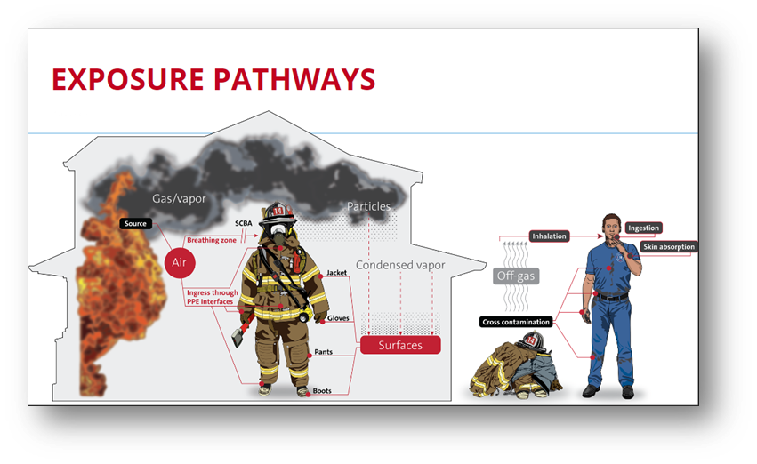
Routes of Exposure
  Chronic exposure to heat, smoke, and toxins put firefighters at very high risk for developing cancer.
  Inhalation, ingestion, and absorption , of these toxic substances that make their way into the bloodstream and are transported and stored in fat cells and organs.
Notes:
Absorption: Firefighters are exposed to carcinogens found on the fireground through dermal exposure.
Particulates are absorbed through the skin.
Inhalation: Firefighters are exposed to toxic gases, vapors and particulates through inhalation. This is especially true during the overhaul phase and not wearing a SCBA. Inhalation can also occur through inhalation from off-gassing of contaminated equipment and diesel exhaust.
Ingestion: Transfer of contaminants from contaminated PPE or equipment to the skin. These contaminants are ingested at the incident scene through nutrition.
The by-products of combustion of ordinary household items such as cabinets, mattresses, curtains, insulation, and porch materials can be very carcinogenic.
Daily exposure to diesel exhaust in the firehouse can also precipitate cancer. Analysis of the kitchen and bunkroom walls and furniture in firehouses reveals a tremendous amount of diesel exhaust particles. These dangerous particles are inhaled and absorbed every shift and cause significant harm to firefighters
https://www.ncbi.nlm.nih.gov/pmc/articles/PMC7323473/
Inhalation on the fireground
Dermal absorption, especially in areas with thin skin (e.g. wrist, neck)
Secondary exposure and/or contaminated dust from particulates post incident
Semi-volatile off gassing of gear?

Slide 13
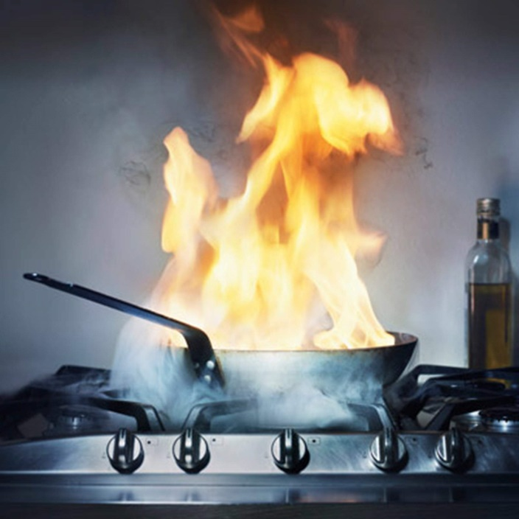
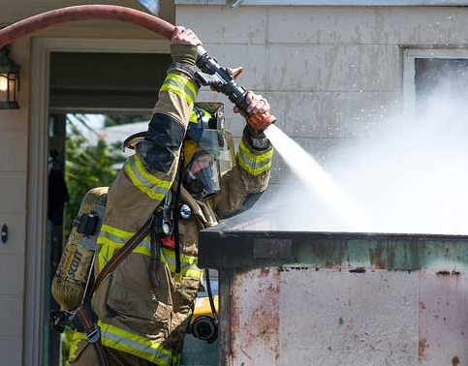
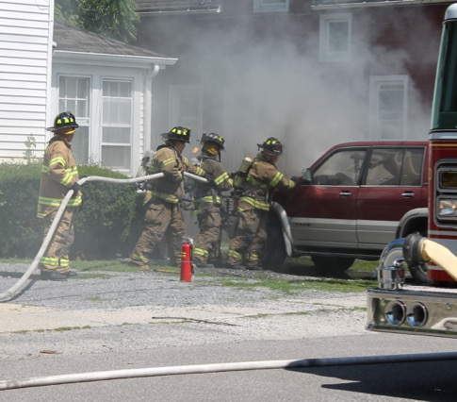
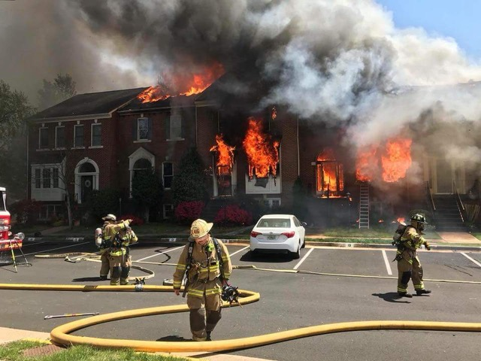
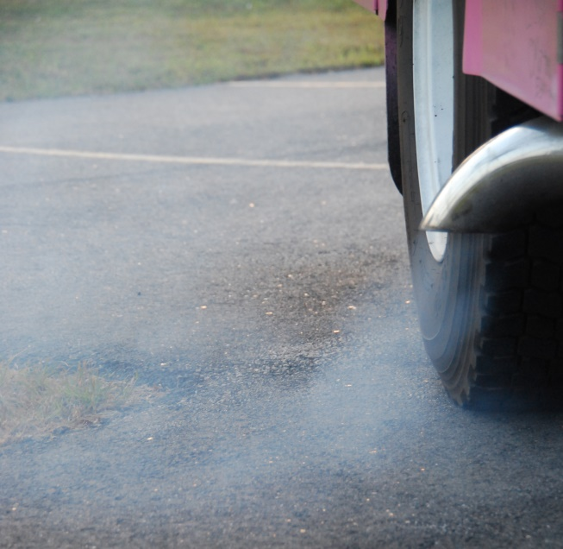
Occupational Exposure
“Pinpointing the cause of cancer is extremely difficult because firefighters are not exposed to just one agent. They are exposed to multiple cancer-causing agents. Because of the multiple exposures and the multiple routes of exposure” - Grace LeMasters Ph.D.
Notes:
Chronic exposure to heat, smoke, and toxins put firefighters at very high risk for developing cancer. The by-products of combustion of ordinary household items such as cabinets, mattresses, curtains, insulation, and porch materials can be very carcinogenic. Inhalation, ingestion, and absorption of these toxic substances that make their way into the bloodstream of the firefighter are transported and stored in fat cells and organs. It is here where cell damage occurs that may lead to cancer.
Daily exposure to diesel exhaust in the firehouse can also precipitate cancer. Analysis of the kitchen and bunkroom walls and furniture in firehouses reveals a tremendous amount of diesel exhaust particles. These dangerous particles are inhaled and absorbed every shift and cause significant harm to firefighters

Slide 14
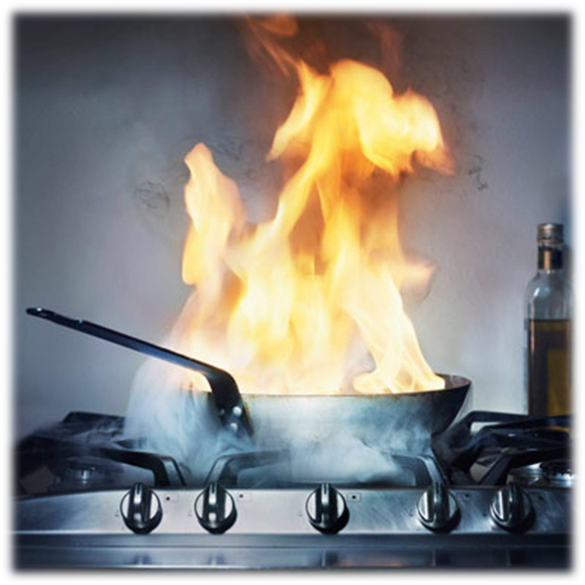
Occupational Exposure
Telltale odor leads to a reduced concern “It’s just food on the stove” mindset.
Produces airborne particulate matter, including ultrafine and fine particles, including polycyclic aromatic hydrocarbons (PAHs) and heterocyclic, acetaldehyde, acrylamide and acrolein.
Notes:
Pot-on-the-stove is a common response for firefighters.
Firefighters respond to many calls that include food or fires from cooking.
It also can generate certain gaseous pollutants, such as formaldThese fires produce an acrid smoke that has a telltale odor leading to a reduced concern about toxins and the “It’s just food on the stove” mindset.
Cooking, in particular high-temperature frying, generates substantial amounts of airborne particulate matter, including ultrafine and fine particles.
These can include polycyclic aromatic hydrocarbons (PAHs) and heterocyclic amines ehyde, acetaldehyde, acrylamide and acrolein.¹⁸
Firefighters who do not wear SCBA on these calls are getting unnecessary exposures to several carcinogenic toxins.
One or two exposures may not be a problem; it’s the repeated exposures that can lead to an issue with elevated cancer risks.¹¹
Straif, K., Baan, R., Grosse, Y., Secretan, B., El Ghissassi, F., Cogliano, V., & WHO International Agency for Research on Cancer Monograph Working Group. (2006). Carcinogenicity of household solid fuel combustion and of high-temperature frying. The lancet oncology, 7(12), 977-978. Retrieved from: http://monographs.iarc.fr/ENG/Monographs/vol95/mono95-7.pdf

Slide 15
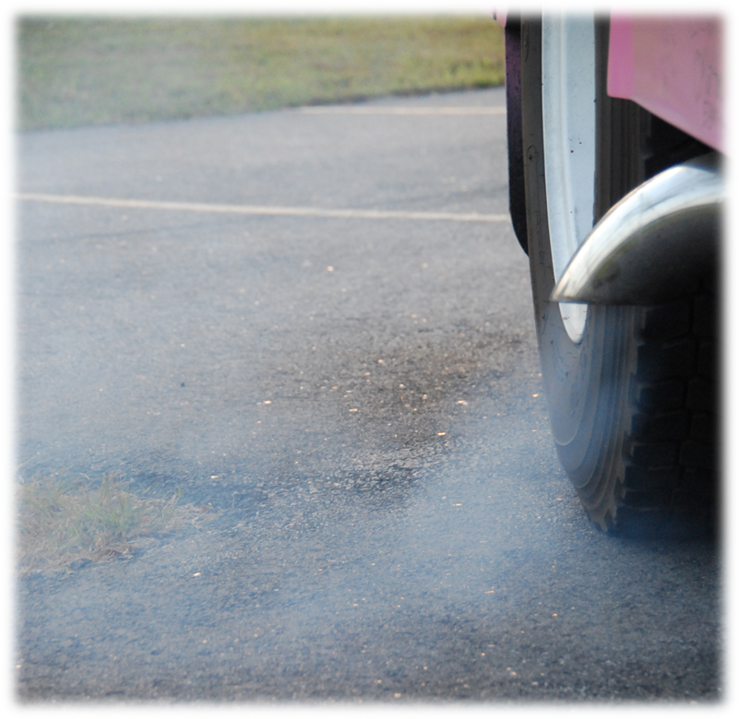
Occupational Exposure
Diesel exhaust is a known carcinogen and is linked to clear increased risk of lung cancer, bladder cancer, as well as cardiovascular disease and chronic obstructive pulmonary diseases.
Notes:
In 1987, the IAFF funded a studied conducted by the University of California Los Angeles (UCLA) School of Public Health. It was the first study that measured firefighters’
diesel exhaust exposure in fire stations in New York, Boston and Los Angeles. The study found a strong association between increased call volumes and higher levels of diesel
exhaust exposure, and that exposure occurred even after the apparatus returns to the station and is shut down.
Diesel exhaust was found in many locations, including in the firehouse and elsewhere during operations.
More-recent studies have found significant increases of lung cancer in populations
occupationally exposed to diesel exhaust levels that are much lower than those the IAFF and UCLA measured in the 1987 study.
There is a clear increased risk of lung cancer for firefighters exposed to diesel exhaust. Exposure to diesel fumes can also lead to other cancers, including bladder cancer, as well as cardiovascular disease and chronic obstructive pulmonary diseases.
Froines, J. R., HINDS, W. C., DUFFY, R. M., LAFUENTE, E. J., & LIU, W. C. V. (1987). Exposure of firefighters to diesel emissions in fire stations. The American Industrial Hygiene Association Journal, 48(3), 202-207. Retrieved from: http://www.iaff.org/HS/Media/UCLA_IAFF_Diesel_Study.pdf
http://www.iaff.org/12News/061312Diesel.htm
International Agency for Research on Cancer (IARC). (2012). IARC: Diesel engine exhaust carcinogenic. Press release, (213). Retrieved from: http://www.iarc.fr/en/media-centre/pr/2012/pdfs/pr213_E.pdf

Slide 16
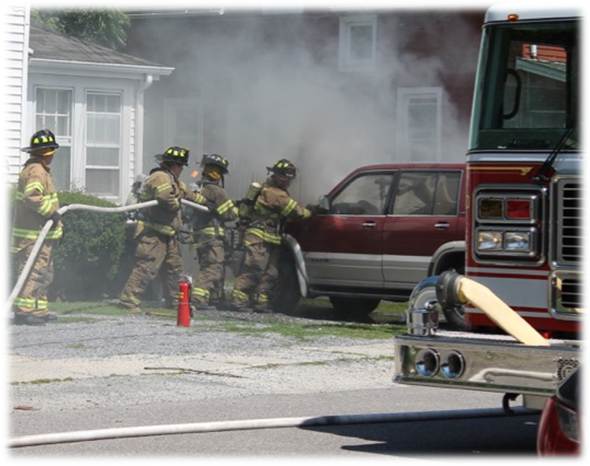
Occupational Exposure
Cars are constructed with many plastic and synthetic materials that produce toxins when burning.
PHOTO BY DENISE CIVILETTI
Notes:
Cars are constructed with many plastic and synthetic materials that produce toxins when burning.
Smoke color is not an indication of the types of toxins off gassing.
Note the firefighters here are not wearing SCBA during fire attack. Firefighters cannot rely on holding their breath or hoping the smoke is moving away from them.
Being outdoors does not mean you avoid the carcinogens in fire smoke!

Slide 17
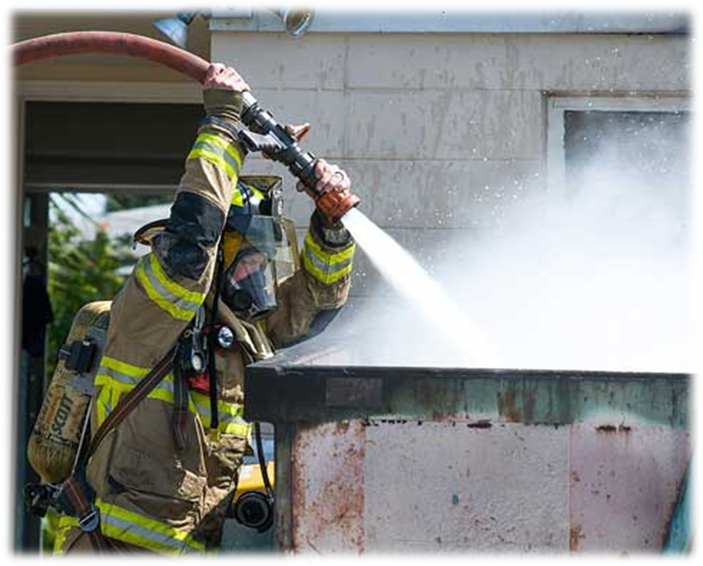
Occupational Exposure
Exterior firefighting in general may be perceived as safe. It’s important to understand that fire smoke is fire smoke whether it is inside or outside. All fire smoke contains products of combustion that can be carcinogenic.
PHOTO BY MICHAEL MOORE II
Notes:
Dumpster fires represent another outside suppression function, but they can contain unknown products.
Again, smoke color is not an indication of the types of toxins off gassing.
Many times, you'll have no idea what’s in that dumpster.
Exterior firefighting in general may be perceived as safe. It’s important to understand that fire smoke is fire smoke whether it is inside or outside. All fire smoke contains products of combustion that can be carcinogenic.17
Wearing an SCBA is a great way to reduce your exposure.
Note that the firefighter is wearing a mask but is not on air. It’s white smoke, not black smoke, but there’s roofing material or asphalt burning in the dumpster. Wearing your mask is great, but if you are going to dress out, use the air to protect your respiratory system!

Slide 18
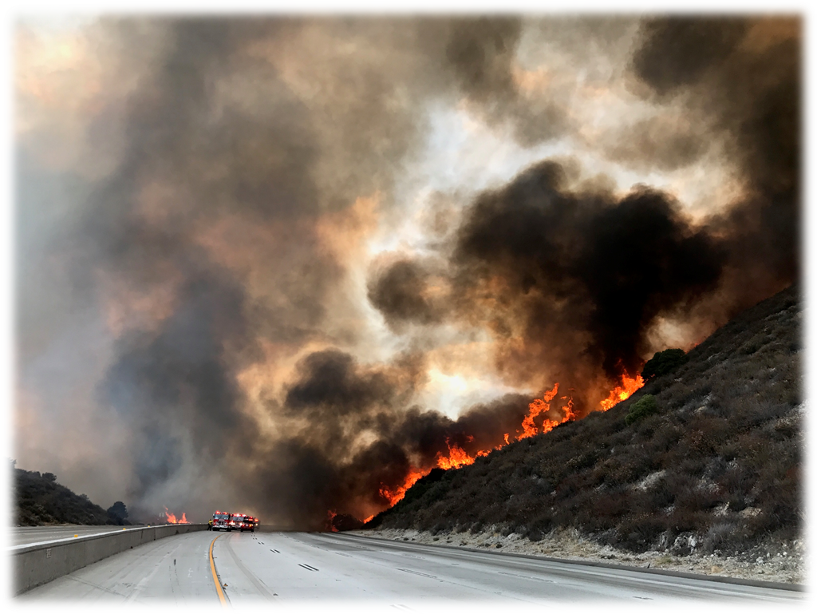
Occupational Exposure
Although the adverse health effects of smoke from biomass fuel are not well studied, the IARC has found sufficient scientific evidence to classified smoke from wildfires as “probably carcinogenic to humans.”
PHOTO BY BRYAN FRIEDERS
Notes:
Wildfire environments are comprised of gases, organic compounds, and particulates, many which are known to be carcinogenic in humans.
Studies show smoke from wildfires is toxic. Although it may be less toxic than smoke from municipal fires, epidemiological studies have demonstrated an association to exposures and increased respiratory system problems. The possible synergistic effects resulting from a mixture of toxins and wildlands is unknown.
Although the adverse health effects of smoke from biomass fuel are not well studied, the IARC has found sufficient scientific evidence to classified smoke from wildfires as “probably carcinogenic to humans.”
across all exposure scenarios (49 and 98 fire days per year) and career durations (5-25 years), we estimated that wildland firefighters were at an increased risk of LC (8 percent to 43 percent) and CVD (16 percent to 30 percent) mortality.
Wildland firefighter smoke exposure and risk of lung cancer and cardiovascular disease mortality
pnw_2019_navarro001.pdf

Slide 19
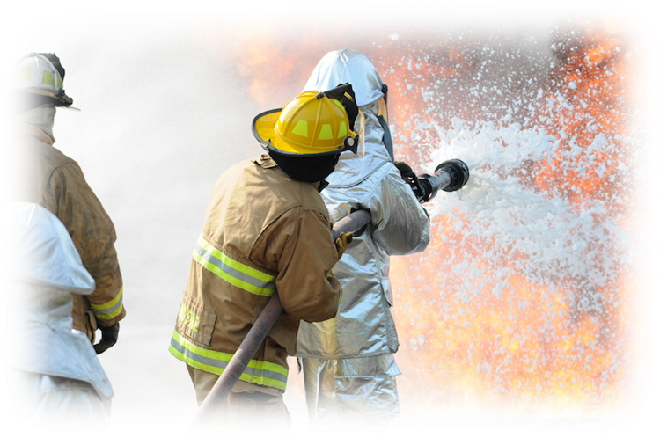
Occupational Exposure
PFAS compounds are found in some AFFF foam, turnout gear and hundreds of consumer products.
Certain PFAS chemicals have been linked to several cancers impacting the fire service
In 2023 IARC listed PFOA as carcinogenic to humans (Group 1) and PFOS as possibly carcinogenic to humans (Group 2B).
Per- and Polyfluoroalkyl Substances (PFAS) are a large group of man-made chemicals that have been used in industry and consumer products worldwide since the 1950s.
Notes:
Perfluoroalkyl and Polyfluoroalkyl (PFAS) are chemicals that are not naturally occurring, are stable and persistent in the environment, biaccumulative, toxic at low concentrations, and easily transferred to groundwater and other media. The chemicals perfluorooctanoic acid or PFOA, and perfluorooctanesulfonate or PFOS are man-made chemicals that became widely used in household products and industrial settings as early as the 1950's. PFOA and PFOS are sometimes referenced in a group of similar chemicals call PFAS.
Both PFOA and PFOS were historically used in firefighting foams due to their effectiveness at quickly extinguishing petroleum based fires. Because they have a unique ability to repel oil, grease, water and heat, these two substances are used in many common products that we use regularly. PFOA and PFOS have been used to make non-stick cookware, stain-resistant carpets and furniture, water-resistant clothing, heat-resistant paper/cardboard food packaging (like microwave popcorn and pizza boxes), and some personal care products.
https://pubs.acs.org/doi/pdf/10.1021/acs.estlett.0c00410

Slide 20
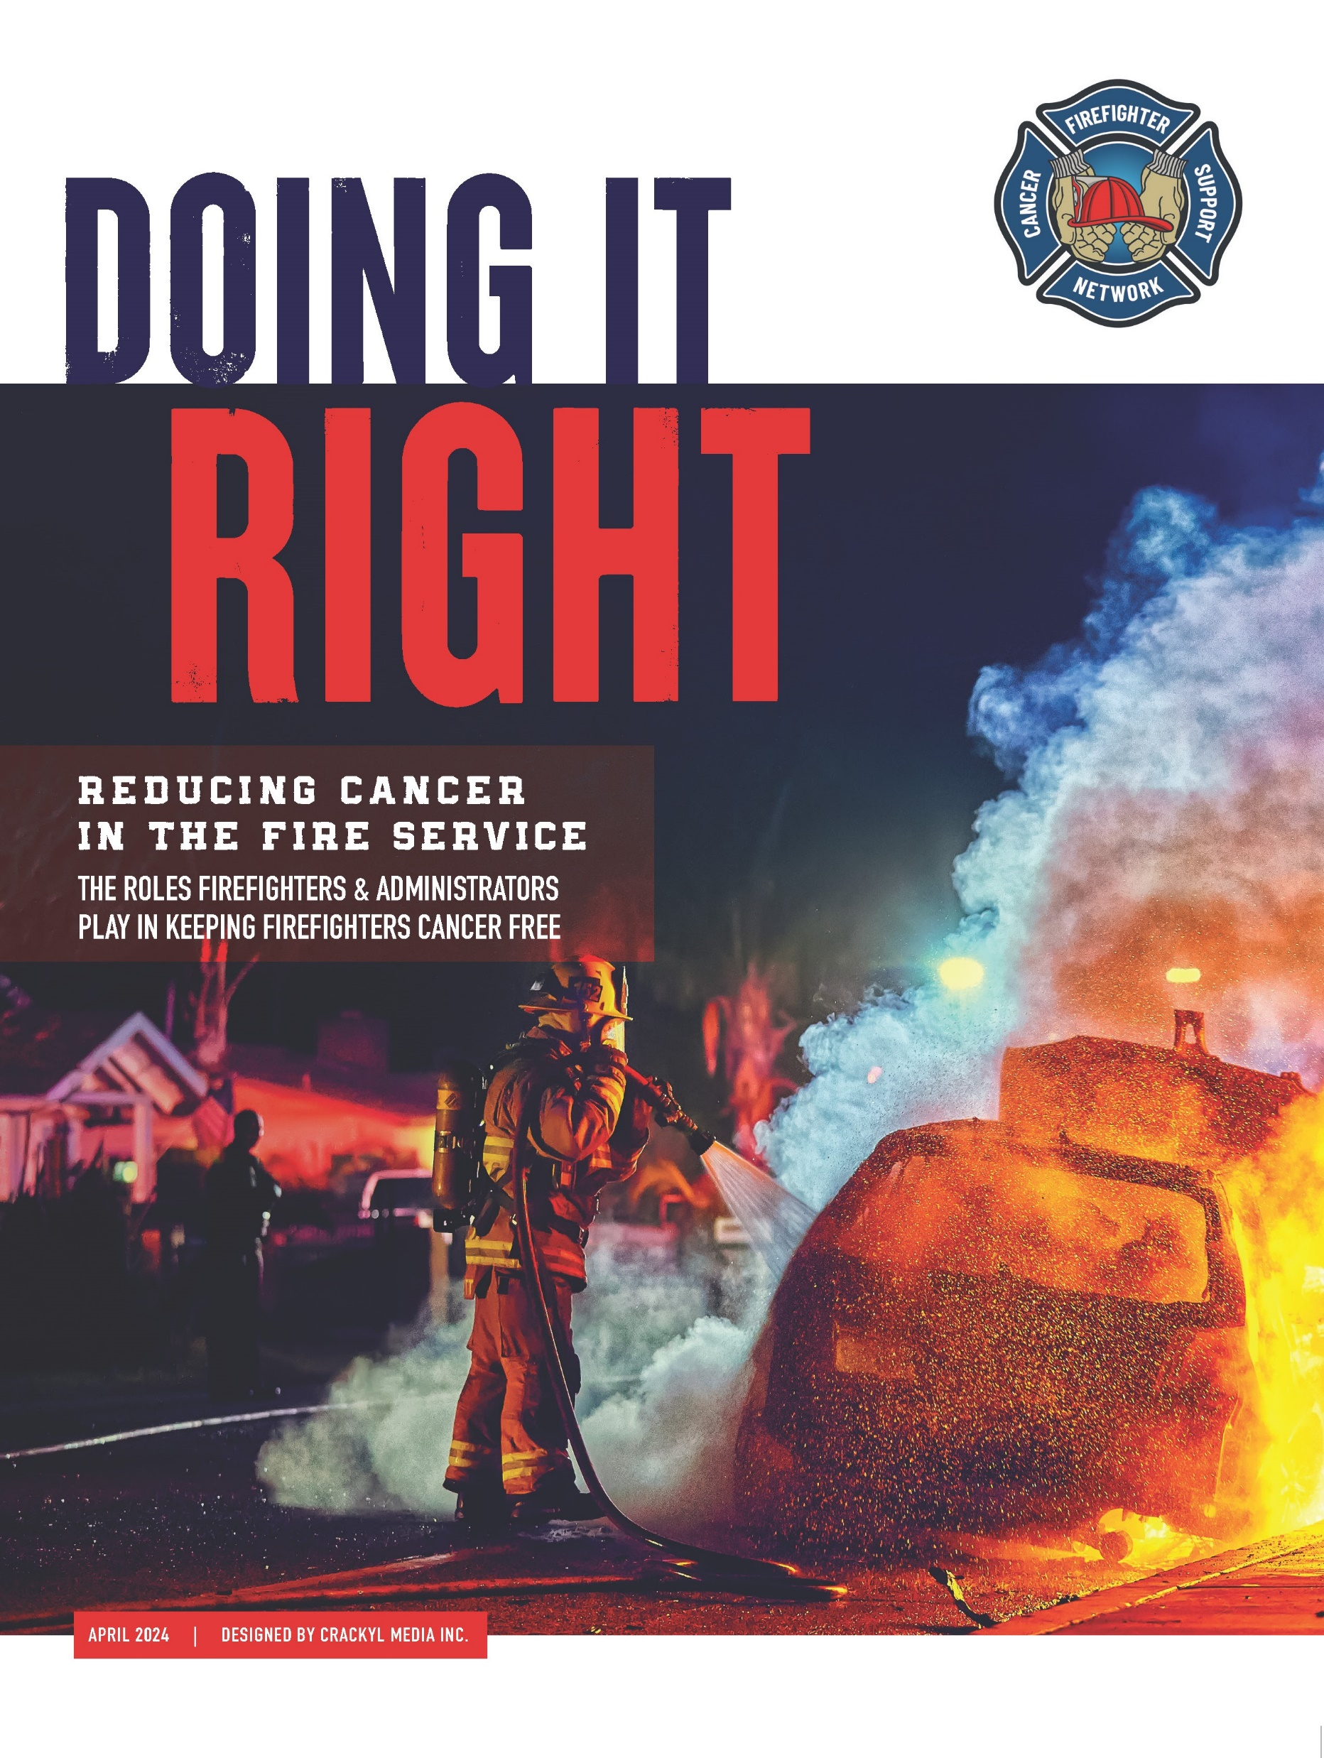
1
WHAT FIREFIGHTERS
CAN DO ON AND OFF
THE JOB TO REDUCE
THEIR OWN RISKS.
2
WHAT FIRE DEPARTMENT
LEADERS AND LOCAL
GOVERNMENT LEADERS
CAN DO TO REDUCE
THEIR FIREFIGHTERS’
CANCER RISKS.

Slide 21
Firefighters have a Nine Percent higher risk being diagnosed.
Notes:
As demonstrated earler in their presentation firefighters have a nine percent higher risk of being diagnosed. The good news is that there are things that we can do both everyday and on calls to reduce the risk of getting cancer.

Slide 22
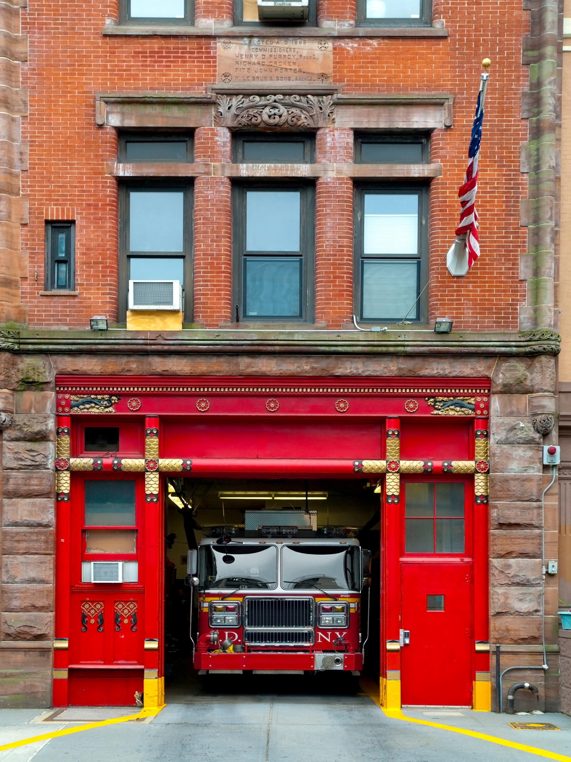
AWAY FROM THE STATION
Healthy behaviors, have a positive multiplying effect on overall health.
Every day asks ….
Curb Alcohol
Be Sun Smart
Prioritize Sleep
Get Physical
Eat Right And Hydrate
Tamp Out Tobacco
De-stress
Access Healthcare Regularly
Notes:
We are learning more and more about the interrelatedness of illnesses and injury. Cancer, heart disease, mental health injury, physical injury and other serious illnesses are increasingly linked as contributing factors to one another.2
The bad news is that unhealthy behaviors have a compounding risk for multiple problems beyond cancer.
The good news is that when we change to healthy behaviors, they have a positive multiplying effect.
The big hitters in the lifestyle category are alcohol use, unprotected sun exposure, inadequate sleep and exercise, unhealthy diet, tobacco use, obesity and stress.

Slide 23
Every day asks ….
CURB ALCOHOL
The International Agency for Research on Cancer (IARC) classifies alcohol as a cause of human cancer group 1 carcinogen, as it now does the occupation of firefighting.
The safest bet is to not drink any alcohol
If you do drink, limit the amount per session to one drink if you are female, and two drinks if you are male.
Notes:
The International Agency for Research on Cancer (IARC) classifies alcohol as a cause of human cancer group 1 carcinogen3, as it now does the occupation of firefighting4 — both are listed as Group 1 carcinogens. For the past decade, scientists have collected data on alcohol consumption among firefighters. There is a high rate of heavy use and binge drinking.5 Alcohol metabolizes into acetaldehyde, which most researchers say is the leading cause for the increase in risk.5
The safest bet is to not drink any alcohol.6 If you do drink, limit the amount per session to one drink if you are female, and two drinks if you are male. One drink is 12 ounces of beer, 5 ounces of wine or an ounce of spirits. Keeping a drink diary helps you track and reduce how much you drink each day.
Be intentional about how much you intend to drink and compare that with what you actually drank. It can be difficult to change what you don’t measure. Importantly, support your fellow firefighters when they choose to drink less alcohol — or none at all.

Slide 24
Every day asks ….
BE SUN SMART
IARC also classifies ultraviolet radiation as a cause of skin cancer (melanoma and malignant non-melanoma cancer).
Firefighters have a 21% greater risk of melanoma, the most serious form of skin cancer.
Limit the amount of time spent in the sun and protect your skin by using sunscreen with sun protection factor (SPF) of at least 15.
Notes:
IARC also classifies ultraviolet radiation as a cause of skin cancer (melanoma and malignant non-melanoma cancer). The sun, sunlamps and tanning booths are all sources of ultraviolet radiation that damages the skin. The risk for melanoma, the most serious form of skin cancer, is increased with exposure to UV radiation from all sources.7 Taking steps to protect ourselves against UV can be difficult on the job. That makes it doubly important to mitigate the risks when off duty.
Limit the amount of time spent in the sun and protect your skin by using sunscreen with sun protection factor (SPF) of at least 15 — some doctors recommend a minimum 30 SPF. In addition to your face, apply sunscreen to all exposed areas, which may include ears, neck and hands. Reduce your time in the sun, especially b etween mid-morning and late afternoon, and avoid other sources of UV radiation, such as tanning beds. Keep in mind that UV radiation is reflected by sand, water, snow and ice, and can pass through windshields and windows.
Wear clothing that protects your skin. This includes hats, long sleeved shirts and long pants made from tightly woven fabric or fabrics rated with an ultraviolet protection factor. Wear sunglasses that block UV radiation to protect the skin aro und your eyes.
The NFPA recommends that firefighters get screened for skin cancer once a year. This is a simple and effective tool for reducing the risk of dying from skin cancer. Melanoma found early is highly treatable. To locate a dermatolo gist in your area, visit the American Academy of Dermatology.

Slide 25
Every day asks ….
PRIORITIZE YOUR SLEEP
Research is showing a link between poor sleep and cancer — as well as heart attacks, obesity, anxiety, depression and suicide.
  Make your bedroom dark, quiet and at a cool temperature.
  Limit exposure to bright light in the evenings and turn off electronic devices 30 minutes before bedtime.
  Do not eat a large meal before bedtime
  Avoid consuming caffeine in the afternoon or evening.
  Avoid consuming alcohol before bedtime.
  Keep a consistent sleep schedule with a bedtime that is early enough for you to get at least 7 to 8 hours of sleep.
Notes:
Sleep disruption is part of the job, and a part that many of us take home after the shift or call. Research is showing a link between poor sleep and cancer — as well as heart attacks, obesity, anxiety, depression and suicide.9 A cancer research center in Seattle found that patients who slept less than 6 hours per night before their cancer diagnosis were 50% more likely to die from the disease than people who slept 7 to 8 hours per night.9
Here is a list of good sleep hygiene habits from the Mayo Clinic:
Make your bedroom dark, quiet and at a cool temperature.
Limit exposure to bright light in the evenings and turn off electronic devices at least 30 minutes before bedtime.
If you cannot sleep, do not use electronics.
Do not eat a large meal before bedtime: if you are hungry, eat a light, healthy snack.
Exercise regularly and maintain a healthy diet.
Avoid consuming caffeine in the afternoon or evening.
Avoid consuming alcohol before bedtime.
Keep a consistent sleep schedule.
Get up at the same time every day, even on days off and during vacations.
Set a bedtime that is early enough for you to get at least 7 to 8 hours of sleep.
After a night of sleep deprivation researchers found a reduction of natural immune responses as measured by NK cell activity. Partial night sleep deprivation reduces natural killer and celhdar immune responses in humans - Irwin - 1996 - The FASEB Journal - Wiley Online Library

Slide 26
Every day asks ….
GET PHYSICAL
The National Institute of Health lists seven types of cancer where there is strong evidence linking increased incidence with lower physical activity.
Aim for a minimum of 150 to 300 minutes of moderate exercise, 75 to 150 minutes of high-intensity exercise, or an equivalent combination of the two each week.
Fitness is about creating sustainable lifestyle changes that will improve the quality of life, reduce cardiovascular risk up to 26% and lower the risk for many cancers by 10 – 50%.
Notes:
The popular saying among health advocates is that “sitting is the new smoking.” We’ve known for a long time that a sedentary lifestyle was bad for overall health. Recent research is linking low levels of activity with increased risks of, among other things, shortened lifespan, cardiovascular disease and some types of cancers.11 Hence, the comparison to smoking.
In fact, the National Institute of Health lists seven types of cancer where there is strong evidence linking increased incidence with lower physical activity.11 The collateral benefit of being more physically active is that it improves other cancer risk factors. For example, more active people are less likely to be overweight and more likely to have better sleep patterns.
The minimum weekly amount of activity adults should hit is 150 to 300 minutes of moderate exercise, 75 to 150 minutes of high-intensity exercise, or an equivalent combination of the two.11 Some firefighters should be able to hit those numbers on shift. For those at busy houses, those without fitness equipment or those who are part time or paid on-call, those exercise targets will need to be hit off duty.
Exercise works, NIH says, by reducing obesity, reducing inflammation, preventing high blood levels of insulin and by improving the immune system.11
There is no shortage of plug-and-play fitness programs to meet almost every fitness level and goal. Many of those are tailored to firefighters. One example is IAFF’s Fit To Thrive program.12 That program grew out of the IAFF and IAFC Wellness Fitness Initiative and the two groups’ Peer Fitness Trainer program.
These data implicate sleep in the modulation of immunity and demonstrate that even a modest disturbance of sleep produces a reduction of natural immune responses and T cell cytokine production.—Irwin, T., McClintick, J., Costlow, C., Fortner, M., White, J., Gillin, J. C. Partial night sleep deprivation reduces natural killer and cellular immune responses in humans. FASEB J. 10, 643-653 (1996)
https://faseb.onlinelibrary.wiley.com/doi/abs/10.1096/fasebj.10.5.8621064

Slide 27
Every day asks ….
EAT RIGHT AND HYDRATE
The prevalence of overweight and obesity in firefighters exceeded that of the US general population.
Making smart food choices about what you eat and how much you eat is critical to keeping weight off and eliminating the increased cancer risk.
A low nutritional-quality diet will eventually lead to cellular damage and eventually organ damage
“Eat food. Not too much. Mostly plants”. – Michael Pollan
Notes:
A healthy diet provides your body with the nutrients you need to thrive physically and mentally. It also means you are not consuming things harmful to your health and that increase your risk for some types of cancer. The gold standard is a diet made up of vegetables, leafy greens, fruit, nuts and beans, whole grains, lean proteins, high-quality fats and water.8 On the opposite end of the scale are highly processed foods, s ugar, red and highly processed meats, white-flour carbohydrates, fast food and sweetened beverages.8
A low nutritional-quality diet will eventually lead to cellular damage and eventually organ damage. It also contributes greatly to poor cardiovascular health, poor brain function and, of course, cancer. An unhealthy diet can also lead to weight gain, which itself is tied to increased risk of cancer.
And the fire service has a weight problem. Firefighters are more likely than the general population to be overweight or obese.14 According to the Centers for Disease Control and Prevention, being overweight or obese increases your risk of getting cancer. Overweight people are twice as likely to develop many cancers, including k idney and liver. As weight goes up, so too does the correlation to cancer. For example, en dometrial cancer is seven times more likely in obese individuals.15 One US study looking at new cancer incidents between 2011 and 2015 found that excess weight was the cause in 4.7% of men and 9.6% of women.15
There are theories about why those who are overweight are more likely to develop cancers. Fat tissue and fat cells play a role in hormone production, cel l growth and metabolic regulators, increased inflammation and increased blood insulin levels.
Making smart food choices about what you eat and how much you eat is critical to keeping weight off and eliminating the increased cancer risk.
https://www.ncbi.nlm.nih.gov/pmc/articles/PMC5826653/

Slide 28

Every day asks ….
TAMP OUT TABACCO
Tobacco is the leading cause of cancer and death from cancer in the general population.
There is no safe level of tobacco use.
Even those who quit smoking at the time of a cancer diagnosis reduce their risk of dying from the cancer.
Don’t use tobacco — at all, ever!
Firefighter tobacco use is an argument made to show that firefighting was not a primary cause of cancer and that benefits should be denied.
Need Help Quitting?
Notes:
Tobacco is the leading cause of cancer and death from cancer in the general population. There is no safe level of tobacco use. Immediately quitting tobacco use reduces cancer risk and increases life expectancy. These facts hold true for smoked and smokeless tobacco (such as chew and spit), the latter being related to increased risk of mouth, esophageal and pancreatic cancers. Even those who quit smoking at the time of a cancer diagnosis reduce their risk of dying from the cancer.16
Firefighters are less likely to smoke cigarettes than the general population but are more likely to smoke cigars or use smokeless tobacco.
This is not squishy science or uncertain findings. Tobacco will give you cancer. Don’t use tobacco — at all, ever.
Accepting that is easy; acting on it after years or decades of tobacco use can be difficult. There is help. Tobacco addiction is treatable and curable.
Firefighters who are diagnosed with cancer could be at greater financial risk if they are tobacco users. Firefighting cancer presumption laws vary by state. Yet, firefighter tobacco use is an argument made to show that firefighting was not a primary cause of cancer and that benefits should be denied.

Slide 29
Every day asks ….
DE-STRESS
Stress hormones could wake up dormant tumor cells and provide the right environment for their growth.
Live in a healthy way, rather than turning to alcohol, excessive eating or other behaviors that may do long-term harm.
There is no magic solution for stress relief .
  Physical fitness activities
  Therapy
  Pets
What do you do to reduce stress?
Notes:
Stress, especially chronic stress, is less tangible regarding its role in firefighter cancer than the more hard-and-fast facts related to tobacco use. Like tobacco use, poor diet and sedentary lifestyle, chronic stress contributes to other poor health outcomes that can contribute to cancer. For example, stress may lead you to smoke or drink, which will increase your cancer risks.17
While this topic has been studied by scientists, researchers have struggled to find the mechanism necessary for stress to cause cancer. A promising 2019 study did show that stress hormones could wake up dormant tumor cells as well as provide the right environment for their growth.17
As research continues, firefighters should focus on ways to reduce stress when off duty. That is, live in a healthy way, rather than turning to alcohol, excessive eating or other behaviors that may do long-term harm.
As with exercise programs, there is no shortage of stress relief and stress reduction options. Some, such as engaging in regular physical fitness activities, will have added benefits to protecting firefighters from cancer. Other options range from therapy sessions with a certified professional counselor – to even owning a dog.17, 18
There is no magic solution for stress relief and some firefighters may need to try multiple options to get the results they need.

Slide 30
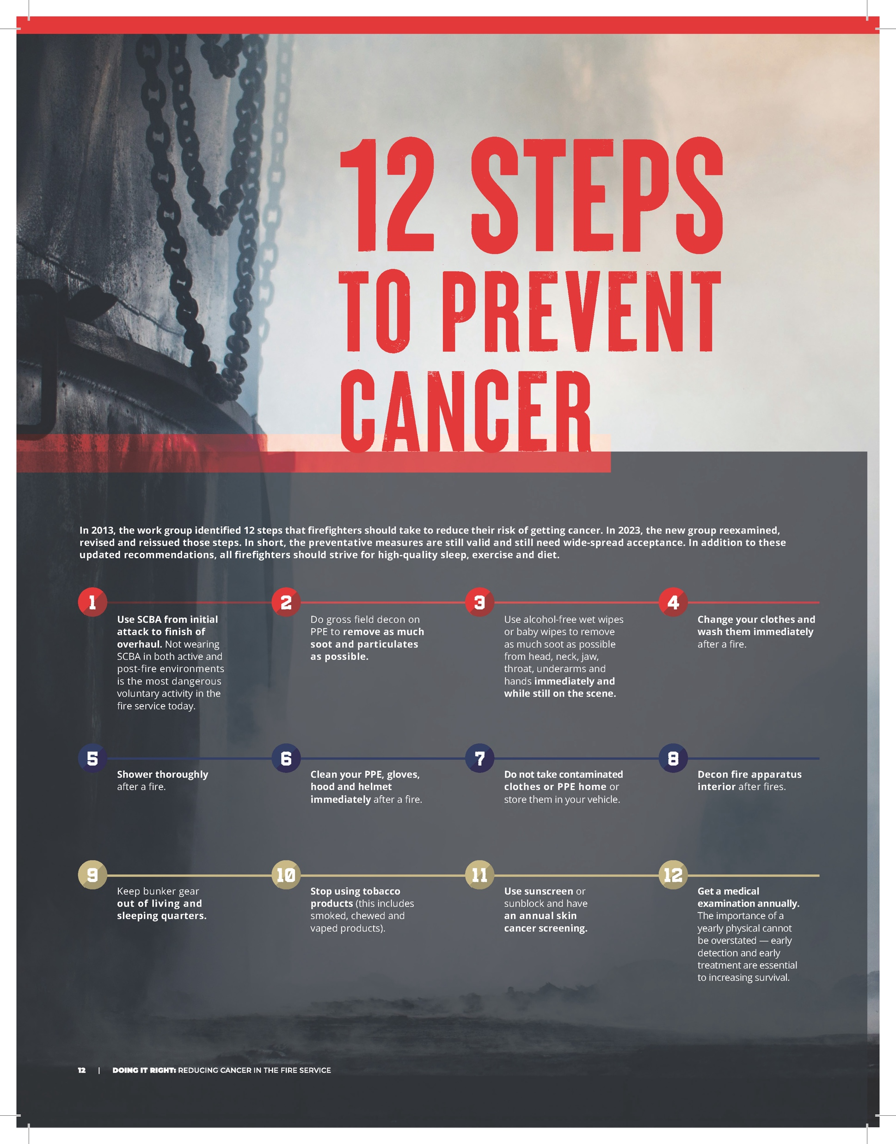
ON SHIFT OR
ON CALL
1
BEFORE THE TONE DROPS
2
ON SCENE
3
AFTER THE CALL

Slide 31
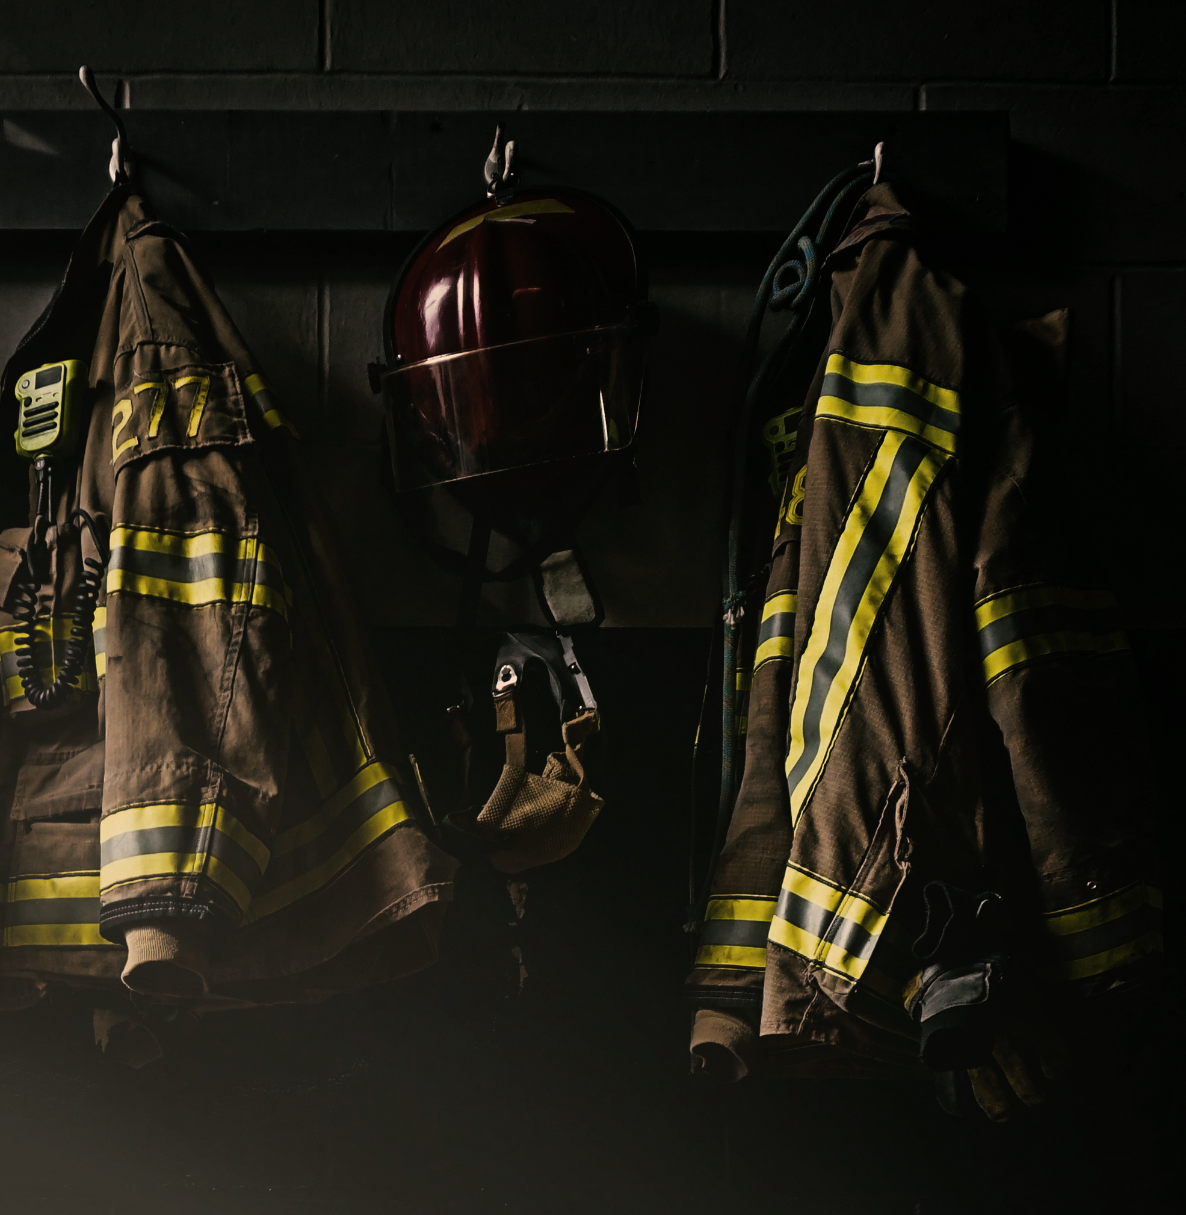
ON SHIFT OR
ON CALL
1
BEFORE THE TONE DROPS
Follow the FCSN everyday asks by making good choices.
Respect your gear (maintain PPE, isolate PPE when you can, wear only, when necessary, clean station and gear room)
Avoid transporting PPE in personal vehicles.
Keep cabs of apparatus clean
Use exhaust capture systems in your stations.
Notes:
For all firefighters, the preventative measures are much the same as they are for off-duty. That means making good diet choices, prioritizing sleep and exe rcise, reducing stress where possible and taking a hard pass on all tobacco products.
Both career and noncareer firefighters need to ensure their PPE is clean and in proper working order. This task is likely more regimented for career firefighters who should be checking their gear at the start of the shift. Noncareer firefighters need to make a routine for checking their PPE — and should avoid transporting their PPE in personal vehicles, or, when they must transport it, keeping it in a tightly sealed container.
ON
Diesel exhaust has been classified as a known carcinogen and is linked to many cancers.
Open all apparatus doors when returning to the station, leave them open for ten minutes.
Do not use air blowers or leaf blowers to clean apparatus floors. This stirs up diesel particulates.
Use a dry mop and wet mop on the floors.
https://www.cancer.org/cancer/cancer-causes/diesel-exhaust-and-cancer.html
https://www.iarc.who.int/wp-content/uploads/2018/07/pr213_E.pdf

Slide 32
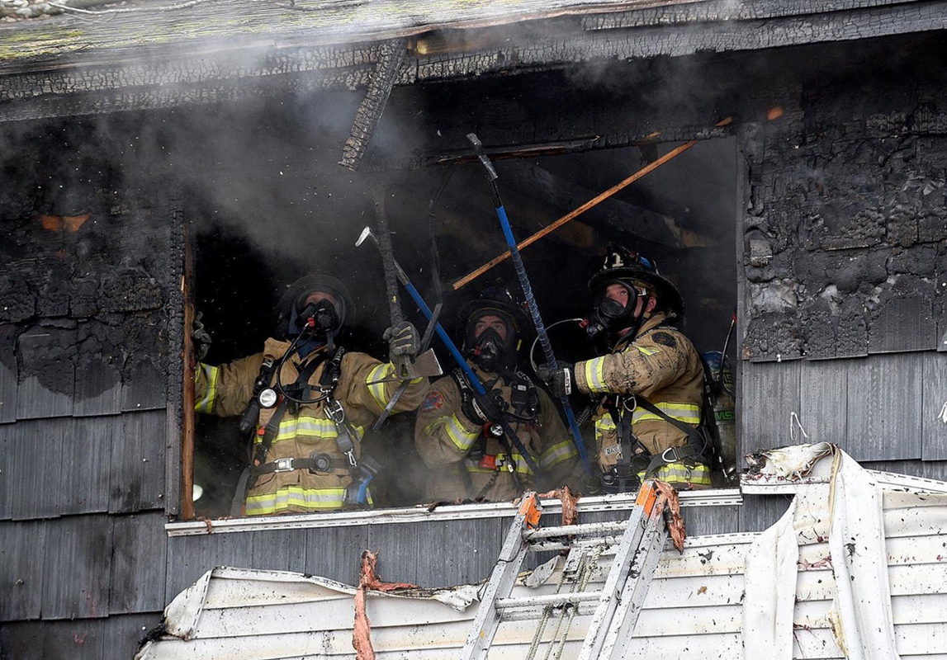
ON SHIFT OR
ON CALL
2
ON SCENE
Reduce the exposures you can.
Wear Full PPE appropriate for the task…. Hood (Particulate Preferred) Gloves, Helmet, No Exposed Skin !!
Use SCBA from initial attack to finish of overhaul. (Not wearing SCBA in both active and post-fire environments is the most dangerous voluntary activity in the fire service today.)
Set up a hot zone, warm zone, and cold zones.
Notes:
Wear full PPE throughout the entire call. It takes courage to do this when others on the department are not wearing SCBA during overhaul (or during the fire). It takes courage to set the example — to be the change.
Another change many departments will want to look at is having breathing protection for engineers and pump operators and for investigators picking through the debris. We are now seeing signs that both those roles are at an increased risk from cancer due to the smoke and material off-gassing on the fireground.20
This applies to vehicle fires as well. Researchers are still working to understand the toxicity of smoke and fumes from battery-powered vehicle fires. The best practice is full protection.
Whenever operation at a fire incident it is recommended to set up a hot zone, warm zone, and cold zones.
If you're operating in the hot zone you should be wearing your SCBA and be on air. It is recommended for Fire Investigators as well. The SCBA is the gold standard of respiratory protection.
Personal Hazard Reduction (PER) occurs in the warm zone, again using your SCBA and be on air. The firefighter with the lowest air should go through PER first.
No nourishment occurs in either the hot or warm zones to decrease ingestion to carcinogens. Nourishment occurs in the Rehab area or cold zone.
The cold zone or rehab area should be located away from any products of combustion and runoff.

Slide 33
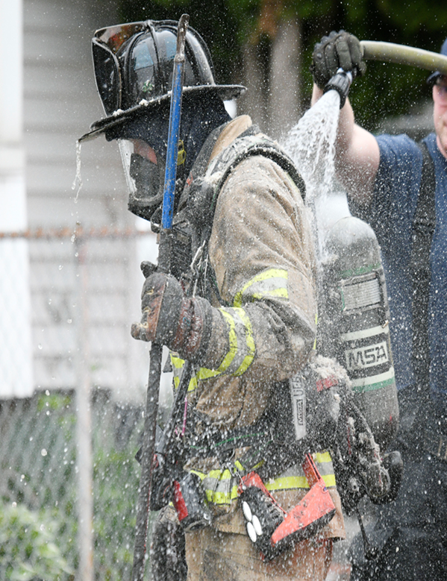
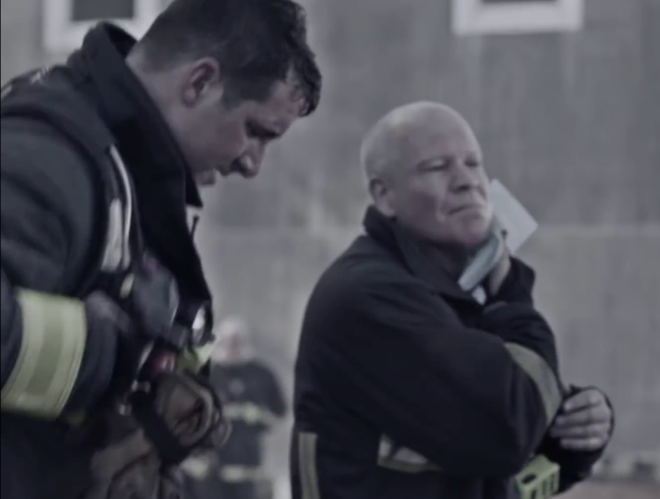
ON SHIFT OR
ON CALL
2
ON SCENE
Decontaminate what you can’t eliminate. (on scene Preliminary Exposure Reduction should be the standard)
Wet decon reduces surface PAH’s by 85%, dry up to 23%
Using a nonalcohol wet wipe on face, neck and hands can remove 54% of PAHs from skin surface.
Keep soiled gear out of the cab of the apparatus
Notes:
Post-fire, on-scene gross decontamination has gone from a novel idea to an easy and widely used practice. Hosing off PPE, gently scrubbing using soap with surfactants (chemicals that cut grease) and rinsing the soap off the fully donned firefighter before leaving the scene can remove 85% of polycyclic aromatic hydrocarbons (PAHs) deposited on PPE surfaces as well as other fireground materials such as flame retardants.21
Using a nonalcohol wet wipe on face, neck and hands can remove 54% of PAHs from skin surface.21
Some recommendations call for removing and bagging the dirty gear prior to getting back on the apparatus, then stowing it in rear compartments away from crew members. This is the time to ditch the hood as well, as toxins have been shown to move from the dirty hood and where they can be absorbed

Slide 34
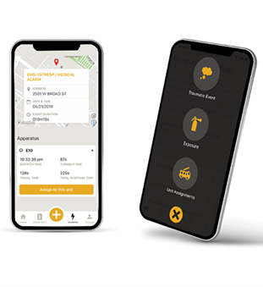
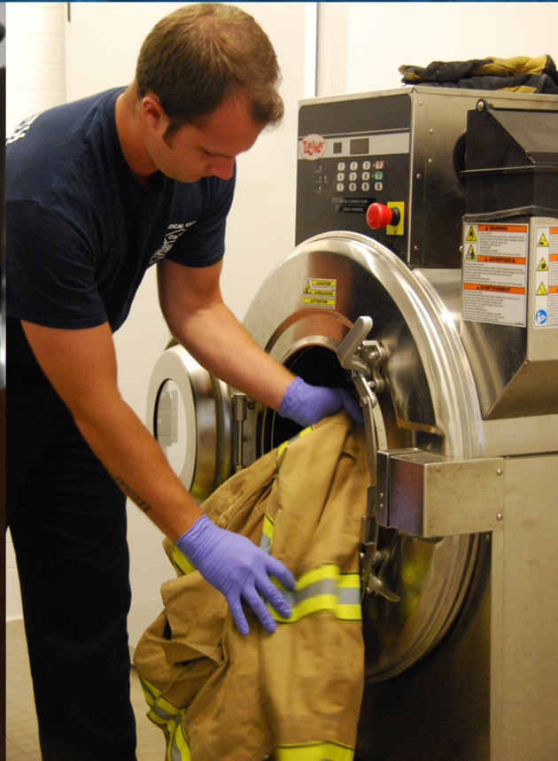

ON SHIFT OR
ON CALL
3
AFTER THE CALL
Clean what you can when you can (doffing/donning, equipment, shower, etc.)
Clean the PPE in a washer/extractor with approved detergent
Clean your body. “Shower within the hour” is catchy and easy to remember.
Document your exposures with an exposure-tracking system.
Notes:
Clean the PPE in a washer/extractor with approved detergent or use an independent service provider that cleans and repairs PPE. Follow the guidance in NFPA 1851, 1852 and 1585.
Clean your body. “Shower within the hour” is catchy and easy to remember. The goal is to clean yourself head to toe as soon as possible after completing fireground tasks. That cleaning interrupts the transfer — through inhalation, ingestion or absorption — of the stuff on your body that is trying to get in your body where it can really do some damage.
Document your exposures with an exposure-tracking system. While exposure trackers are designed to help you prove a cancer diagnosis is work-related, it can have an unintended benefit for prevention. By recording each exposure, you will be more aware of the contaminants that you work in — chemicals that can eventually get on and in you. That measurable knowledge, like counting calories or hours of sleep, may further motivate you to take additional precautions on scene.
Exposure tracking can be done old school with a handwritten journal where firefighters log the time and place of each exposure incident, including the work they performed. In the event of a cancer diagnosis, this can be cross referenced against fire department incident data.
Exposures can also be tracked on various apps. The National Fire Operations Reporting System and the International Public Safety Data Institute have an app backed by both the IAFC and IAFF.23 Using both an electronic record keeping app and a handwritten journal can be a useful backup in case something happens to one.

Slide 35
Firefighters have a Fourteen Percent higher mortality rate than the general population.
Notes:
Now that there's been a discussion about what you can do both off and on the job to reduce your risk of cancer we need to talk about reducing the risk of dying from cancer because we do have a 14% higher rate of mortality than the general population. This makes finding cancer early and treating it in the early stages critical because we know the best chance of survival is catching cancer early.

Slide 36
How do I find cancer early?
SCREENINGS
Are the presumptive identification of unrecognized disease in an apparently healthy, asymptomatic population
Includes physical exams, blood testing, imaging or other procedures that can be applied rapidly and easily to the target population.
EARLY DETECTION
Finds cancer symptoms at earliest possible stage.
Setting benchmarks for your health so you can recognize changes.
Tracking health changes and knowing when to seek medical attention.
Working with your doctor by asking questions, voicing concerns, sharing everything, and following up.
Notes:
Prevention & Early Detection
There are a few things you can do to fight back against cancer.
PREVENTION is taking steps to reduce your risk of getting cancer.
This includes using protective equipment - as well as cleaning and properly storing it -, washing off carcinogens as quickly as possible, and maintaining healthy lifestyle habits.
These practices are important and will help, but they will not make you immune to cancer.
EARLY DETECTION is the piece you have the most control over. It is recognizing the warning signs of cancer and knowing when to act.
YOU have the power when it comes to early detection - you are the expert on your body, and noticing early symptoms is key. 3 Steps Detect is the best tool to detect cancer early!

Slide 37
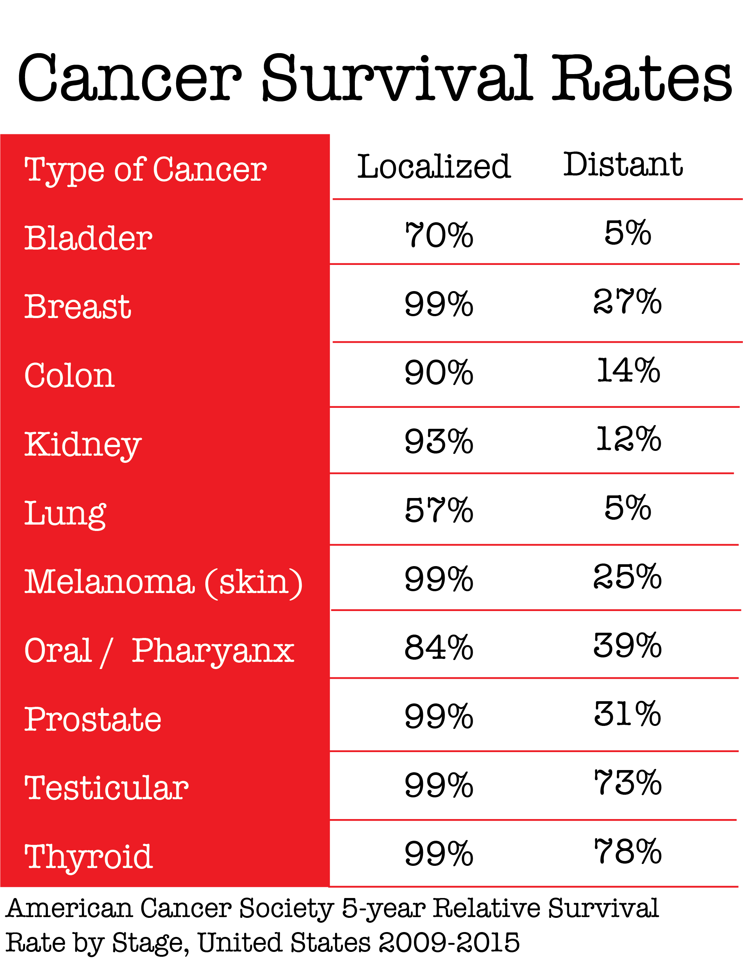
Why is it so important to treat cancer early?
“Much like arriving on-scene to an incipient stage fire. Cancer is easier to manage, uses less resources and has less of a damaging impact when found early”. Heather Makel, DetecTogether
Notes:
While we can’t change what happened to firefighters we have lost to cancer, but we can change how this plays out for the rest of you.
This chart displays the power of early detection, the cancers listed here are prevalent cancers that occur in the US and the Fire service each year. The Localized numbers are survival rates when the cancer is diagnosed early (stage 1), you can see how high those numbers are. Cancer can be both treatable and survivable when caught early. Then we need to look at those Distant numbers, they reflect cancer survival rates for those same types of cancer when it is diagnosed late (stage 4).

Slide 38

Get back to basics with your health first!
Before opting for a screening make sure to have a therapeutic relationship with a primary care physician.
Get annual physicals, they play a crucial role in preventive healthcare, early disease detection, and the overall maintenance of health.
Have a conversation about the risks from firefighting.
Make necessary adjustments to lifestyle to reduce risks.
Notes:
Annual physicals and making lifestyle changes that improve health outcomes not only for cancer but for many health conditions facing the Fire Service. This is likely the most important step you can take to reduce your risk for many health problems.
Throughout childhood most of our parents took us to the dr regularly for annually check up or physicals. What happened to continuing on as adults?
Most annual exams focus on the basics, like blood pressure, weight, smoking status, alcohol use, and asking about relationships and lifestyle habits. You may feel healthy, but your doctor can often discern additional signs and knows how to address them before they become serious issues. The baseline information helps establish a point in time that can be referred back to, in case there are any changes in your health.
Annual physicals are important for several reasons:
Preventive Care: Regular check-ups allow healthcare professionals to detect and address potential health issues before they become more serious. This proactive approach helps in preventing the development of chronic conditions and promotes overall well-being.
Early Detection of Diseases: Annual physicals often involve screenings and tests that can identify the early signs of various diseases, such as diabetes, high blood pressure, and certain cancers. Early detection enables timely intervention and improves the chances of successful treatment.
Health Maintenance and Monitoring: These check-ups help healthcare providers monitor an individual's health status over time. By tracking changes in vital signs, blood tests, and other health indicators, they can make necessary adjustments to lifestyle or medication, promoting long-term health.
Establishing Baseline Health Data: Regular physicals provide a baseline for an individual's health metrics. This baseline is valuable for comparing future results and identifying deviations that may indicate health issues or changes in overall well-being.
Opportunity for Health Education: Annual physicals offer an opportunity for healthcare providers to educate patients about healthy lifestyle choices, disease prevention, and the importance of self-care. This guidance empowers individuals to take an active role in maintaining their health.
Building a Doctor-Patient Relationship: Regular check-ups contribute to the development of a strong doctor-patient relationship. This rapport facilitates open communication, allowing individuals to discuss health concerns, ask questions, and work collaboratively with their healthcare team to achieve and maintain optimal health.
Mental Health Assessment: Annual physicals often include discussions about mental health. This provides an opportunity to address issues such as stress, anxiety, or depression, and ensures that both physical and mental well-being are considered integral components of overall health.
In summary, annual physicals play a crucial role in preventive healthcare, early disease detection, and the overall maintenance of one's health. They provide a comprehensive approach to well-being, emphasizing the importance of regular check-ups and proactive health management.
n’t see on a screen.

Slide 39
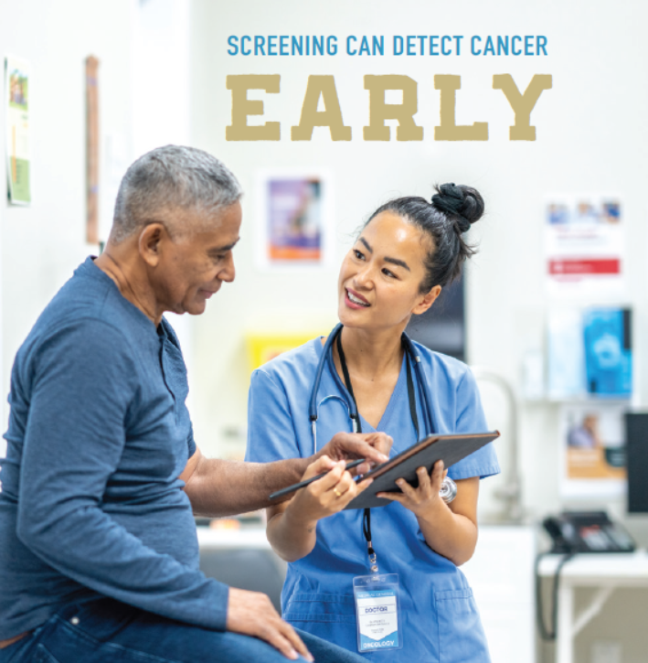
Make a plan & follow it!
Talk to your physician about what screenings and tests can identify the early signs of various diseases, such as diabetes, high blood pressure, and certain cancers.
Make a plan that focuses on your health and wellness.
Follow the plan!

Slide 40
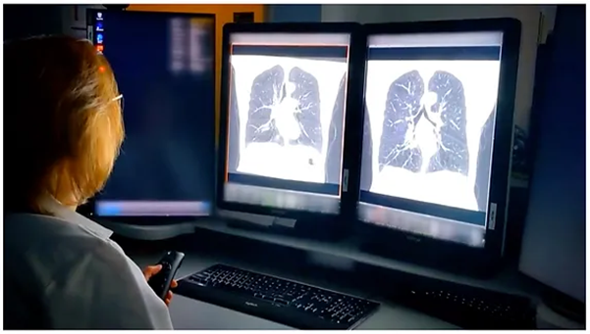
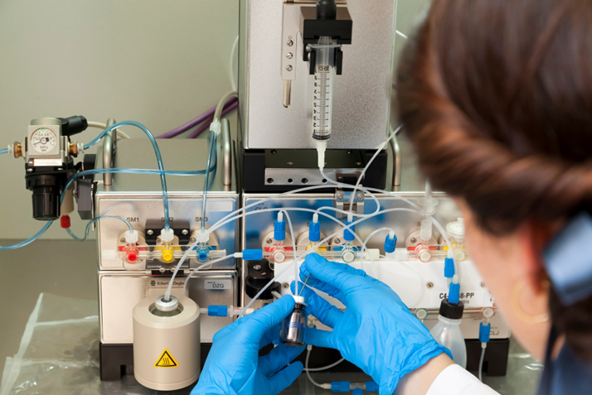
Screening Types
Physical examinations
Healthcare Provider Exam or Self
Direct Observation
Laboratory tests
Blood
Urine
Tissue
Imaging tests
X -ray
Ultrasound
Computed Tomography (CT)
Magnetic Resonance Imaging (MRI)
Notes:
There are many ways to screen, and each have varying levels of cost and risk.
Physical examinations occur when healthcare providers examine the body for any physical changes such as unusual lumps. These may also be completed at home as a self-examination, such as the case for breast or testicular cancer.
Laboratory tests include blood, tissue, or urine tests often ordered by health care providers for patients at risk of cancer. Pap smears are an example of a laboratory test.
Imaging tests occur when areas inside the body of viewed using various medical technology. Mammograms, ultrasounds, computed tomography (CT) scans, and magnetic resonance imaging (MRI) are common imaging tests. More recently, multi-cancer early detection (MCEDs), a form of a liquid biopsy, have been developed as an additional category of cancer screenings.

Slide 41
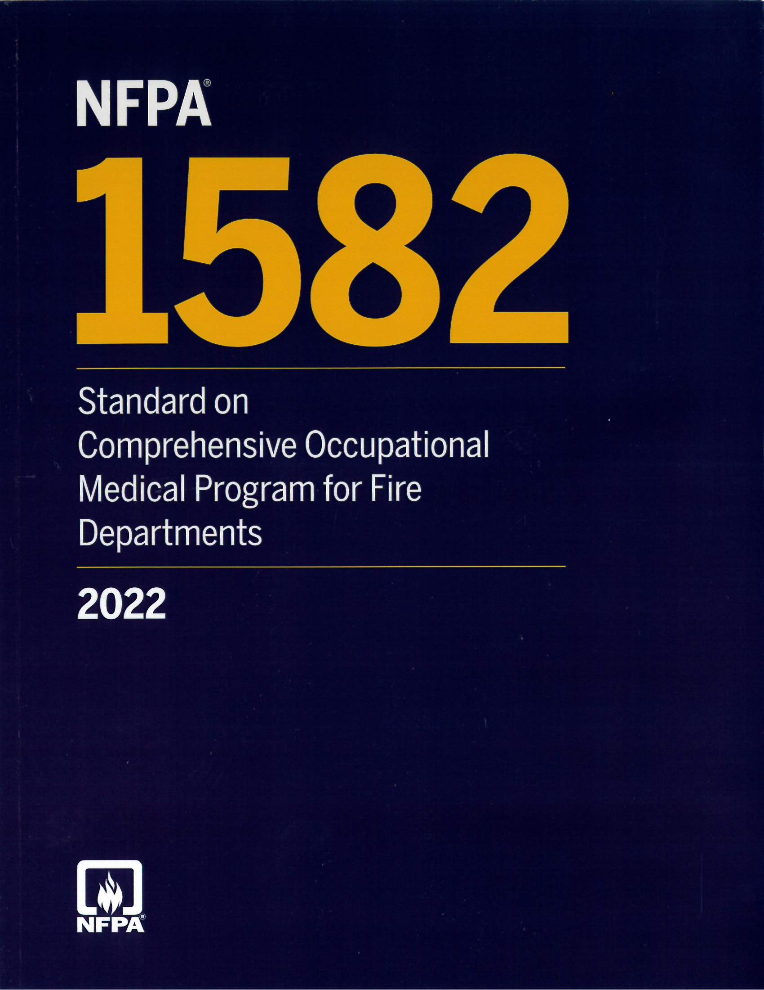
NFPA 1582 Physicals
Designed to ensure the firefighter is ready for duty and to catch potential health issues early on.
NFPA 1582 physicals include:
Health history and physical exam
Blood analysis
Urinalysis
Infectious disease screening (tuberculosis and hepatitis)
Pulmonary function test (spirometry)
Chest X-ray
EKG and cardiac risk assessment
Cancer screening
Audiometric exam
Vision testing
Clinical guidance on sleep apnea
Vaccination review/update
Medical clearance to wear a respirator.
Notes:
The firefighter's capacity to fight fires and rescue others directly related to their health and fitness . NFPA 1582 physical is designed to ensure firefighters are ready for duty, reducing riak to tnemselfs and the public they serve, as well as catching a potential health issue early on, before it becomes larger or life-threatening.
FIREFIGHTERS SHOULD ALWAYS GET ANNUAL EXAMS!!
NFPA 1582 physical should be performed once a year and it must be performed
Under NFPA 1582 the firefighter should receive the following:
Health history and physical exam
Blood analysis (complete metabolic profile with lipid profile)
Urinalysis
Infectious disease screening (tuberculosis and hepatitis)
Pulmonary function test (spirometry)
Chest X-ray
EKG and cardiac risk assessment
Cancer screening
Audiometric exam
Vision testing
Clinical guidance on sleep apnea
Vaccination review/update
Medical clearance to wear a respirator.

Slide 42
USPSTF Screening Recommendations
Breast
Cervical
Colorectal
Lung
Annual screening for lung cancer with low-dose computed tomography (LDCT) in adults aged 50 to 80 years who have a 20 pack-year smoking history and currently smoke or have quit within the past 15 years.
Biennial screening mammography for women aged 50 to 74 years
Adults age 45 to 75 be screened for colorectal cancer. The decision to be screened between ages 76 and 85 should be made on an individual basis. If you are older than 75, talk to your doctor about screening.
Women who place a higher value on the potential benefit than the potential harms may choose to begin biennial screening between the ages of 40 and 49 years.
Screening for cervical cancer every 3 years with cervical cytology alone age 21 to 29.
30 to 65 years, every 3 years with cervical cytology alone, every 5 years with high-risk humanpa pillomavirus (hrHPV) testing alone, or every 5 years with hrHPV testing in combination with cytology (cotesting).
Prostate
The decision to undergo periodic prostate-specific antigen (PSA)-based screening for prostate cancer should be an individual one for men aged 55 to 69 years,.
Notes:
Currently there are 4 recommended screenings Breast , Cervical, Colorectal and lung.
The decision to undergo periodic prostate-specific antigen (PSA)-based screening for prostate cancer should be an individual one for men aged 55 to 69 years,.
USP
Women aged 50 to 74 years
The USPSTF recommends biennial screening mammography for women aged 50 to 74 years. B
Women aged 40 to 49 years The decision to start screening mammography in women prior to age 50 years should be an individual one. Women who place a higher value on the potential benefit than the potential harms may choose to begin biennial screening between the ages of 40 and 49 years.
For women who are at average risk for breast cancer, most of the benefit of mammography results from biennial screening during ages 50 to 74 years. Of all of the age groups, women aged 60 to 69 years are most likely to avoid breast cancer death through mammography screening. While screening mammography in women aged 40 to 49 years may reduce the risk for breast cancer death, the number of deaths averted is smaller than that in older women and the number of false-positive results and unnecessary biopsies is larger. The balance of benefits and harms is likely to improve as women move from their early to late 40s.
In addition to false-positive results and unnecessary biopsies, all women undergoing regular screening mammography are at risk for the diagnosis and treatment of noninvasive and invasive breast cancer that would otherwise not have become a threat to their health, or even apparent, during their lifetime (known as "overdiagnosis"). Beginning mammography screening at a younger age and screening more frequently may increase the risk for overdiagnosis and subsequent overtreatment.
Women with a parent, sibling, or child with breast cancer are at higher risk for breast cancer and thus may benefit more than average-risk women from beginning screening in their 40s.
All women
The USPSTF concludes that the current evidence is insufficient to assess the benefits and harms of digital breast tomosynthesis (DBT) as a primary screening method for breast cancer.
Women with dense breasts
The USPSTF concludes that the current evidence is insufficient to assess the balance of benefits and harms of adjunctive screening for breast cancer using breast ultrasonography, magnetic resonance imaging, DBT, or other methods in women identified to have dense breasts on an otherwise negative screening mammogram.
Women aged 75 years or older
The USPSTF concludes that the current evidence is insufficient to assess the balance of benefits and harms of screening mammography in women aged 75 years or older.
Cervical
Women aged 21 to 65 years
The USPSTF recommends screening for cervical cancer every 3 years with cervical cytology alone in women aged 21 to 29 years. For women aged 30 to 65 years, the USPSTF recommends screening every 3 years with cervical cytology alone, every 5 years with high-risk human papillomavirus (hrHPV) testing alone, or every 5 years with hrHPV testing in combination with cytology (contesting
Women younger than 21 years
The USPSTF recommends against screening for cervical cancer in women younger than 21 years
Women who have had a hysterectomy
The USPSTF recommends against screening for cervical cancer in women who have had a hysterectomy with removal of the cervix and do not have a history of a high-grade precancerous lesion (ie, cervical intraepithelial neoplasia [CIN] grade 2 or 3) or cervical cancer.
Women older than 65 years
The USPSTF recommends against screening for cervical cancer in women older than 65 years who have had adequate prior screening and are not otherwise at high risk for cervical cancer.
Colorectal
Adults aged 50 to 75 years
The USPSTF recommends screening for colorectal cancer in all adults aged 50 to 75 years.
Adults aged 45 to 49 years
The USPSTF recommends screening for colorectal cancer in adults aged 45 to 49 years.
Adults aged 76 to 85 years
The USPSTF recommends that clinicians selectively offer screening for colorectal cancer in adults aged 76 to 85 years. Evidence indicates that the net benefit of screening all persons in this age group is small. In determining whether this service is appropriate in individual cases, patients and clinicians should consider the patient's overall health, prior screening history, and preferences.
Patient Population Under Consideration
This recommendation applies to asymptomatic adults 45 years or older who are at average risk of colorectal cancer (ie, no prior diagnosis of colorectal cancer, adenomatous polyps, or inflammatory bowel disease; no personal diagnosis or family history of known genetic disorders that predispose them to a high lifetime risk of colorectal cancer [such as Lynch syndrome or familial adenomatous polyposis]).
Assessment of Risk
Age is one of the most important risk factors for colorectal cancer, with incidence rates increasing with age and nearly 94% of new cases of colorectal cancer occurring in adults 45 years or older.2 Rates of colorectal cancer incidence are higher in Black adults and American Indian and Alaskan Native adults,2 persons with a family history of colorectal cancer (even in the absence of any known inherited syndrome such as Lynch syndrome or familial adenomatous polyposis),8 men,2 and persons with other risk factors (such as obesity, diabetes, long-term smoking, and unhealthy alcohol use).9 However, all adults 45 years or older should be offered screening, even if these risk factors are absent.
Screening Tests
The risks and benefits of different screening tests vary. See Table 1 for characteristics of recommended screening strategies, which may include combinations of screening tests. Because of limited available evidence,9,10 the USPSTF recommendation does not include serum tests, urine tests, or capsule endoscopy for colorectal cancer screening. Recommended stool-based and direct visualization screening tests are described below.
Stool-Based Tests
Stool-based tests include the high-sensitivity guaiac fecal occult blood test (gFOBT), fecal immunochemical test (FIT), and stool DNA test. Both high-sensitivity gFOBT and FIT detect blood in the stool; however, they use different methods. High-sensitivity gFOBT is based on chemical detection of blood, while FIT uses antibodies to detect blood.11 Stool DNA tests detect DNA biomarkers for cancer in cells shed from the lining of the colon and rectum into stool.11 Currently, the only stool DNA test approved by the US Food and Drug Administration is a multitarget stool DNA test that also includes a FIT component, referred to as sDNA-FIT in this recommendation. When stool-based tests reveal abnormal results, follow-up with colonoscopy is needed for further evaluation. Among the stool-based tests, screening with annual FIT or annual sDNA-FIT provides an estimated greater life-years gained than annual high-sensitivity gFOBT or sDNA-FIT every 3 years.12,13 Additionally, modeling estimates that screening with sDNA-FIT annually would result in more colonoscopies than annual screening with FIT.12,13 However, sDNA-FIT every 1 to 3 years is estimated to provide a reasonable balance of life years gained per estimated follow-up colonoscopy compared with no screening. Currently, there is uncertainty around the accuracy of high-sensitivity gFOBT to detect colorectal cancer and advanced adenomas, although it is likely lower than the accuracy of FIT and sDNA-FIT, and high-sensitivity gFOBT is more difficult for patients to administer.9,10 However, randomized trials demonstrate direct evidence of decreased deaths from colorectal cancer when screening with non–high-sensitivity gFOBT is performed.9,10
Direct Visualization Tests
Direct visualization tests to screen for colorectal cancer include colonoscopy, CT colonography, and flexible sigmoidoscopy. All 3 screening tests visualize the inside of the colon and rectum, although flexible sigmoidoscopy can only visualize the rectum, sigmoid colon, and descending colon, while colonoscopy and CT colonography can generally visualize the entire colon. For colonoscopy and flexible sigmoidoscopy, a camera is used to visualize the inside of the colon, while CT colonography uses x-ray images. When abnormal results are found on flexible sigmoidoscopy or CT colonography, follow-up with colonoscopy is needed for further evaluation. Among the direct visualization tests, a colonoscopy every 10 years or CT colonography every 5 years have greater estimated life-years gained than flexible sigmoidoscopy every 5 years.12,13 Unlike colonoscopy and flexible sigmoidoscopy, CT colonography may reveal extracolonic findings that require additional workup, which could lead to other potential benefits or harms.9,10
Starting and Stopping Ages
The USPSTF recommends offering colorectal cancer screening starting at age 45 years. Although the absolute risk of developing colorectal cancer is much lower in adults younger than 50 years (20.0 new colorectal cancer cases per 100,000 persons aged 40 to 49 years, 47.8 new cases per 100,000 persons aged 50 to 59 years, and 105.2 new cases per 100,000 persons 60 years or older14), age-period-cohort analysis indicates a recent trend for increasing risk of colorectal cancer in birth cohorts of adults younger than 50 years.15 The benefit of reducing colorectal cancer deaths by screening for colorectal cancer in adults 50 years or older is well established through trial data. Some of these trials16-18 also included adults younger than 50 years, although results are not reported separately for younger age groups. Additionally, modeling performed by the Cancer Intervention and Surveillance Modeling Network (CISNET) suggests that starting colorectal cancer screening at age 45 years may moderately increase life-years gained and decrease colorectal cancer cases and deaths compared with beginning screening at age 50 years.12,13
In adults aged 76 to 85 years, the age at which the balance of benefits and harms of colorectal cancer screening becomes less favorable and screening should be stopped varies based on a patient’s health status (eg, life expectancy, comorbid conditions), prior screening status, and individual preferences.19 Limited evidence suggests that harms from colonoscopy, such as perforation and bleeding, and extracolonic findings on CT colonography increase with age.9,10 Modeling studies estimate that generally, few additional life-years are gained when screening is extended past age 75 years among average-risk adults who have previously received adequate screening.12,13
In adults 86 years or older, evidence on benefits and harms of colorectal cancer screening is lacking, and competing causes of mortality likely preclude any survival benefit that would outweigh the harms of screening.
Screening Intervals
Recommended intervals for colorectal cancer screening tests include
High-sensitivity gFOBT or FIT every year
sDNA-FIT every 1 to 3 years
CT colonography every 5 years
Flexible sigmoidoscopy every 5 years
Flexible sigmoidoscopy every 10 years + FIT every year
Colonoscopy screening every 10 years
Treatment or Interventions
Localized cancer is generally treated with surgical resection.20 Depending on cancer location and stage/progression, additional treatment options may include adjuvant chemotherapy, neoadjuvant chemotherapy, chemoradiation, and targeted therapies.20,21
Screening for Colorectal Cancer in Black Adults
Colorectal Cancer Burden
Black adults have the highest incidence of and mortality from colorectal cancer compared with other races/ethnicities. From 2013 to 2017, incidence rates for colorectal cancer were 43.6 cases per 100,000 Black adults, 39.0 cases per 100,000 American Indian/Alaska Native adults, 37.8 cases per 100,000 White adults, 33.7 cases per 100,000 Hispanic/Latino adults, and 31.8 cases per 100,000 Asian/Pacific Islander adults.22 Colorectal cancer death rates in 2014 to 2018 were 18.0 deaths per 100,000 Black adults, 15.1 deaths per 100,000 American Indian/Alaska Native adults, 13.6 deaths per 100,000 non-Hispanic White adults, 10.9 deaths per 100,000 Hispanic/Latino adults, and 9.4 deaths per 100,000 Asian/Pacific Islander adults.23
The causes for these health disparities are complex; recent evidence points to inequities in the access to and utilization and quality of colorectal cancer screening and treatment as the primary driver for this health disparity rather than genetic differences.24,25 The recent trend for increasing colorectal cancer incidence in adults younger than 50 years has been observed in White and Hispanic/Latino adults but not Black or Asian/Pacific Islander adults.26 However, despite these trends, Black adults across all age groups, including those younger than 50 years, continue to have a higher incidence of and mortality from colorectal cancer than White adults.
Available Evidence
The USPSTF sought evidence on the potential benefits and harms of colorectal cancer screening in Black adults; however, little empirical evidence was identified. Although some studies on the effectiveness of colorectal cancer screening included non-White participants, no studies reported results of screening by race/ethnicity.9,10 Few studies on screening accuracy reported findings by race; however, those studies that did generally found no difference in accuracy to detect colorectal cancer in Black adults compared with White adults for FIT (in 1 study27) or sDNA-FIT (in 1 study28). The 4 studies of screening colonoscopy that reported harms by race/ethnicity had inconsistent findings. No other studies on harms reported results by race/ethnicity. Modeling studies that assume perfect adherence to screening and no racial differences in screening accuracy or natural history of colorectal cancer (ie, no biological differences in the risks of adenoma onset and progression to colorectal cancer),25 but lower relative colorectal cancer survival rates29 and increased all-cause mortality in Black adults vs White adults,30 estimate similar life-years gained from screening Black adults and White adults and a similar balance of the benefits and harms for each screening strategy.12,13
Advising Black Adults
Based on the limited available empirical evidence, the USPSTF is not able to make a separate, specific recommendation on colorectal cancer screening in Black adults. Results from CISNET modeling also do not support different screening strategies by race.12,13 Other organizations such as the US Multi-Society Task Force recommend starting screening in Black adults at age 45 years while starting screening at age 50 years for persons of other races.31 The current USPSTF statement recommends starting screening for everyone at age 45 years, including Black adults.
The USPSTF recognizes the higher colorectal cancer incidence and mortality in Black adults and strongly encourages clinicians to ensure their Black patients receive recommended colorectal cancer screening, follow-up, and treatment. The USPSTF encourages the development of systems of care to ensure adults receive high-quality care across the continuum of screening and treatment, with special attention to Black communities, which historically experience worse colorectal cancer health outcomes.
Implementation
Maintaining comparable benefits and harms of screening with the various strategies requires that patients, clinicians, and health care organizations adhere to currently recommended protocols for screening intervals, follow-up colonoscopy, and treatment. Each screening test has different considerations for implementation that may facilitate patient uptake of and adherence to screening or serve as a barrier to screening (see Table 1 for additional details). Implementation considerations include where the screening test is performed, who performs the screening procedure, the need for preprocedure bowel preparation, the need for anesthesia or sedation during the test, and follow-up procedures for abnormal findings on a screening test. These considerations have implications for how feasible and preferable a given screening test is for an individual. Discussion of implementation considerations with patients may help better identify screening tests that are more likely to be completed by a given individual.
Stool-Based Tests
Stool-based screening requires persons to collect samples directly from their feces, which may be unpleasant for some, but the test is quick and noninvasive and can be done at home (the sample is mailed to the laboratory for testing), and no bowel preparation is needed to perform the screening test. The benefits of stool-based testing accrue over frequent, repeated testing, thus requiring commitment and adherence to screening intervals to achieve a substantial benefit in decreased colorectal cancer mortality.
Positive results on stool-based screening tests require follow-up with colonoscopy for the screening benefits to be achieved. Screening with high-sensitivity gFOBT requires some dietary and medication restrictions prior to collecting stool samples,32 while FIT and sDNA-FIT33,34 do not. Test specimens can be collected from a single stool sample with FIT and sDNA-FIT33,34 (sDNA-FIT involves collecting an entire bowel movement), while collection of samples from 3 separate bowel movements is required for high-sensitivity gFOBT screening.32
Direct Visualization Tests
Screening by direct visualization tests must be performed in a clinical setting rather than in the home. When performed alone, direct visualization tests allow for a much longer time between screenings compared with stool-based screening. Colonoscopy has the longest length between screenings (10 years when screening results are negative), whereas flexible sigmoidoscopy and CT colonography allow 5 years between screenings if performed alone. Direct visualization tests all require bowel preparation prior to the screening test, although specific regimens may depend on the specific screening test being performed.35 The use of sedation or anesthesia during the procedure also varies by screening test. Sedation or anesthesia is usually used during colonoscopy; hence, assistance with transportation home and recovery time after colonoscopy is required.36 Abnormal findings identified by flexible sigmoidoscopy or CT colonography screening require follow-up colonoscopy for screening benefits to be achieved.
Additional Tools and Resources
The National Cancer Institute and the Centers for Disease Control and Prevention have developed patient and clinician guides on screening for colorectal cancer:
Lung
Adults aged 50 to 80 years who have a 20 pack-year smoking history and currently smoke or have quit within the past 15 years
The USPSTF recommends annual screening for lung cancer with low-dose computed tomography (LDCT) in adults aged 50 to 80 years who have a 20 pack-year smoking history and currently smoke or have quit within the past 15 years. Screening should be discontinued once a person has not smoked for 15 years or develops a health problem that substantially limits life expectancy or the ability or willingness to have curative lung surgery.

Slide 43
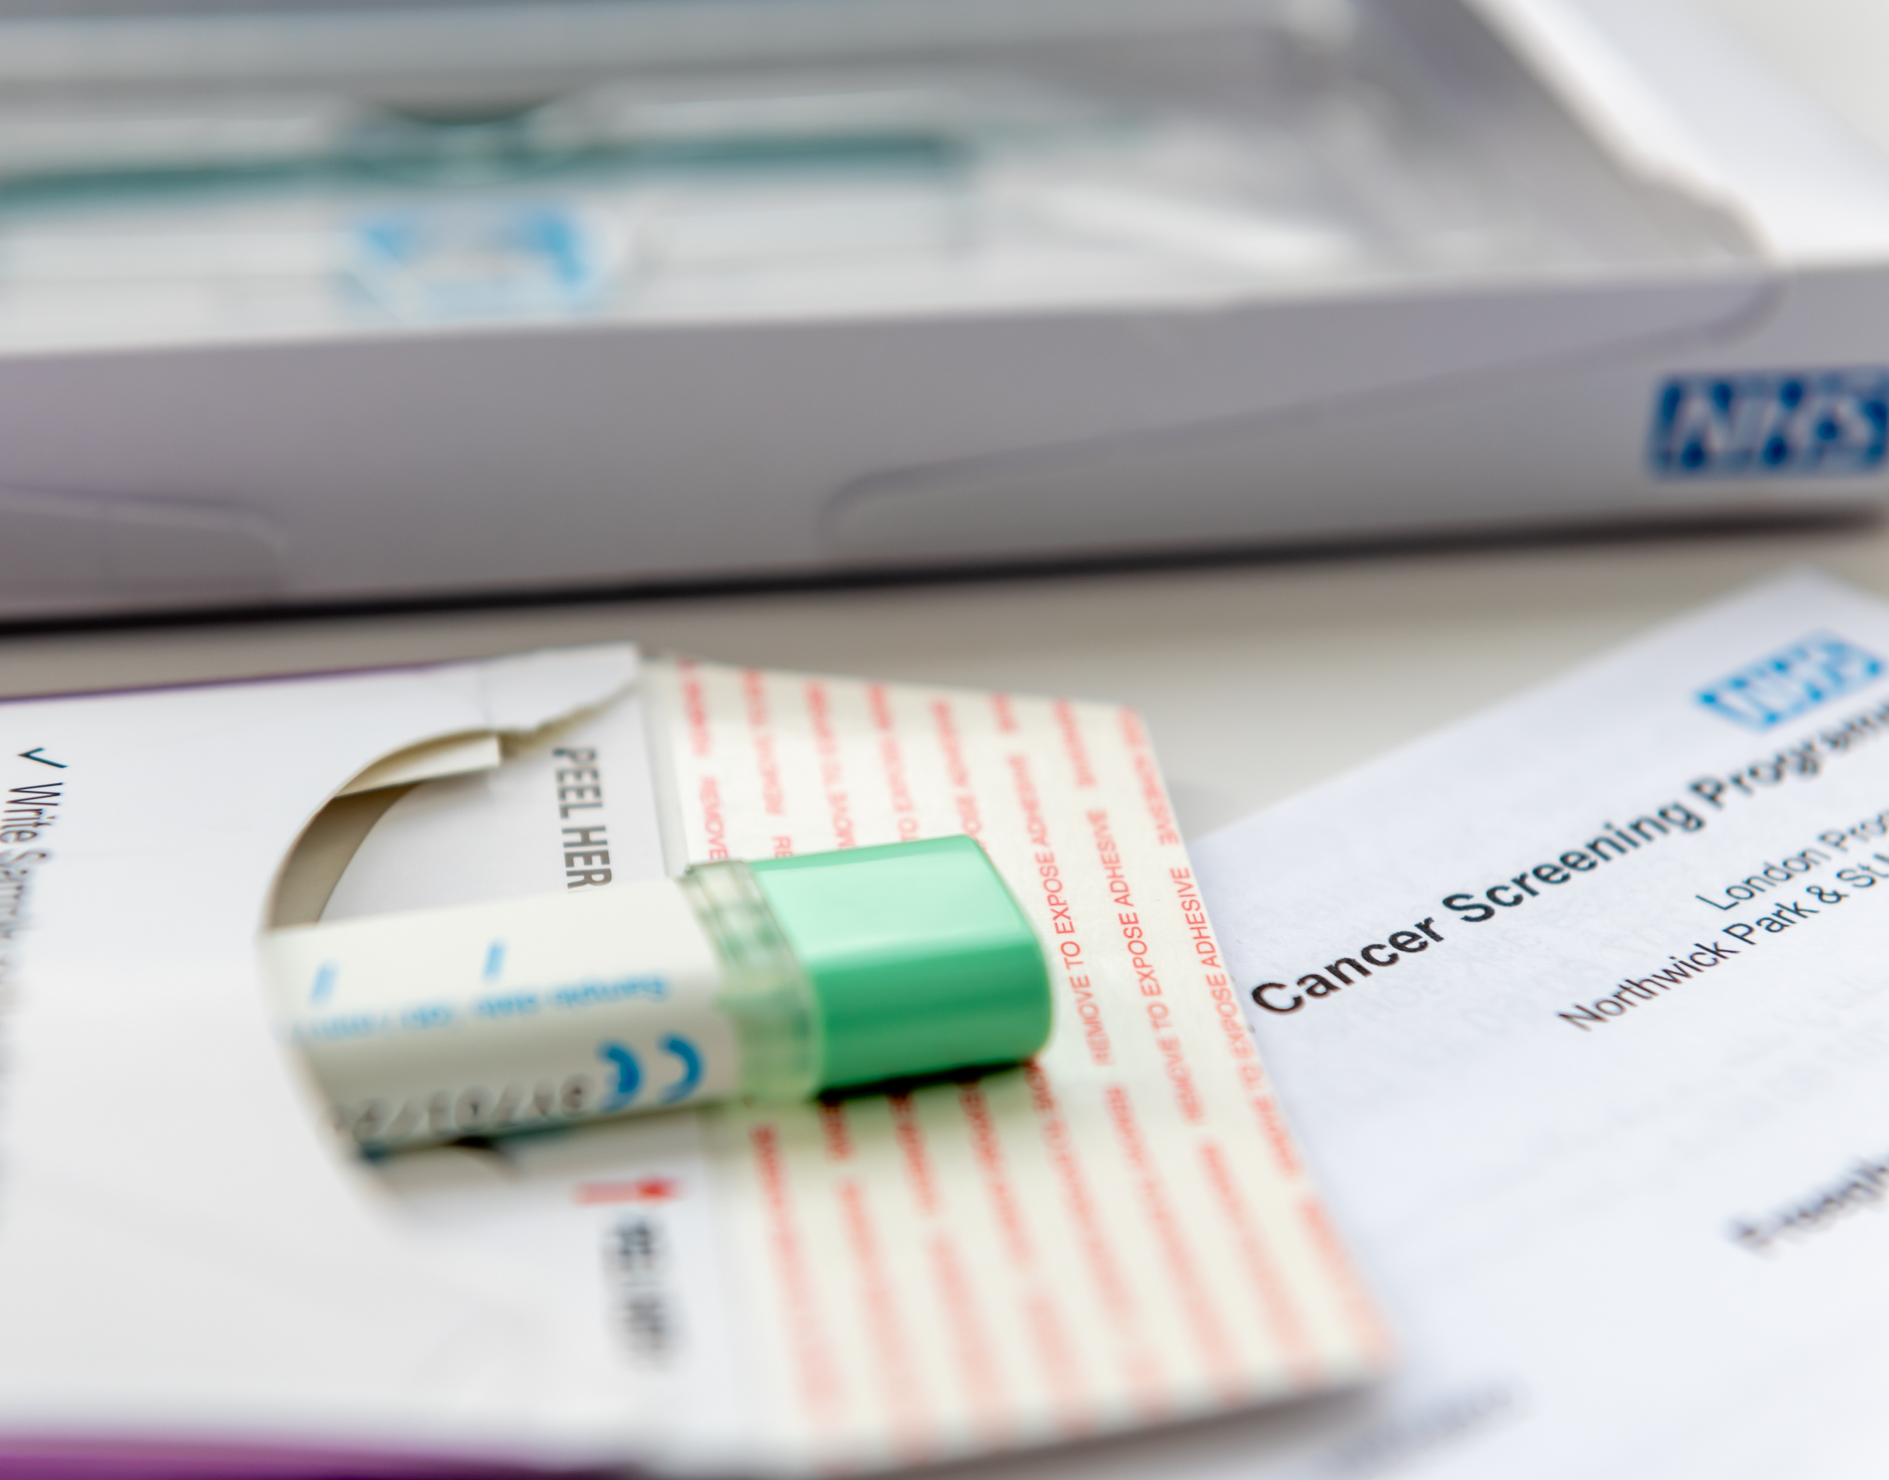
Choosing Screening program
Takeaways for Firefighters
Evidence-based screening programs have great potential to improve health outcome.
Your healthcare provider should be involved in the process.
False positives or false negatives can result in emotional, financial, and resource risks associated with additional testing.
Firefighters must understand that a screening is not a replacement for a therapeutic relationship with a physician.
Notes:
Choosing a cancer screening program is a personalized decision.
Know Your Risk Factors:
Understand your family history of cancer.
Consider your personal medical history, including any previous cancer diagnoses.
Understand Available Screening Tests:
Be aware of the screening tests available for different types of cancer.
Learn about the benefits and limitations of each screening method.
Consult with Healthcare Providers:
Schedule regular check-ups with your primary care physician or a specialist.
Discuss your individual risk factors and concerns about cancer screenings.
Ask about recommended screening tests based on your age, gender, and risk profile.
Follow Recommended Guidelines:
Adhere to established guidelines and recommendations for cancer screenings based on your demographic and risk factors.
Different organizations may have slightly different recommendations, so discuss these variations with your healthcare provider.
Consider Your Age and Gender:
Certain cancers have specific screening recommendations based on age and gender.
For example, mammograms for breast cancer screening are commonly recommended for women starting at a certain age.
Evaluate Benefits and Risks:
Understand the potential benefits of early detection through screening.
Be aware of the risks, including false positives, overdiagnosis, and potential complications from follow-up procedures.
Participate in Routine Health Check-ups:
Attend routine health check-ups and screenings as recommended by your healthcare provider.
Stay Informed about Advances in Screening Technology:
Stay updated on advancements in cancer screening technologies.
New and improved screening methods may become available, and your healthcare provider can guide you on their appropriateness for your situation.
Maintain a Healthy Lifestyle:
Adopt a healthy lifestyle to reduce your overall risk of cancer, including a balanced diet, regular exercise, avoiding tobacco, and limiting alcohol consumption.
Ask Questions and Communicate:
Don't hesitate to ask questions about the screening process, potential outcomes, and any concerns you may have.
Communicate openly with your healthcare team to ensure you make informed decisions.
Remember that each person's situation is unique, and your healthcare provider will help tailor a screening plan based on your specific circumstances and risk factors. Regular communication with your healthcare team is essential for making well-informed decisions about cancer screenings.

Slide 44
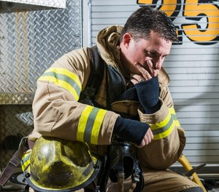
Early Cancer Detection
What is the most common cancer symptom?
Subtle and persistent
health change lasting
2 weeks or more.
Notes:
A big part of early detection is the ability to recognize potential cancer symptoms. With over 100 different types of cancer, you’re probably thinking how do I know what to look for? When we think of cancer symptoms, we often think of fatigue, skin changes, lumps/ bumps, sudden changes to our weight. The truth is, with the 100 different types of cancer there are 100s of cancer symptoms.
Although cancer symptoms come in many different forms they all have one thing in common. The most common cancer symptom is just not ONE symptom, it is a definition. The most common cancer symptom is a subtle and persistent change in your health that lasts for 2 weeks or more. It’s important to point out that we are talking about subtle symptoms that are easy to ignore, not acute symptoms that need immediate medical attention. If you have severe health changes like trouble breathing, confusion, or intense pain or bleeding go to the doctor right away.
Cancer symptoms don’t usually start out that obvious, but you can identify them before they progress if you know what to look for. Now that you know the definition for the most common cancer symptom, we are now going to walk you through HOW to detect cancer early.

Slide 45



Early Cancer Detection
1
Remember what GREAT feels like.
2
Use the 2-WEEK rule.
3
Share with your DOCTOR.
Notes:
3 Steps was developed by DetecTogether and a team of medical experts. 3 Steps Detect will teach you how to recognize health changes and what to do about them.
We’re going to walk through each of these 3 Steps, and I’ll explain some easy tools you can use to put them into action. We will also be hearing from members of the fire service who will share their experience with occupational cancer.

Slide 46

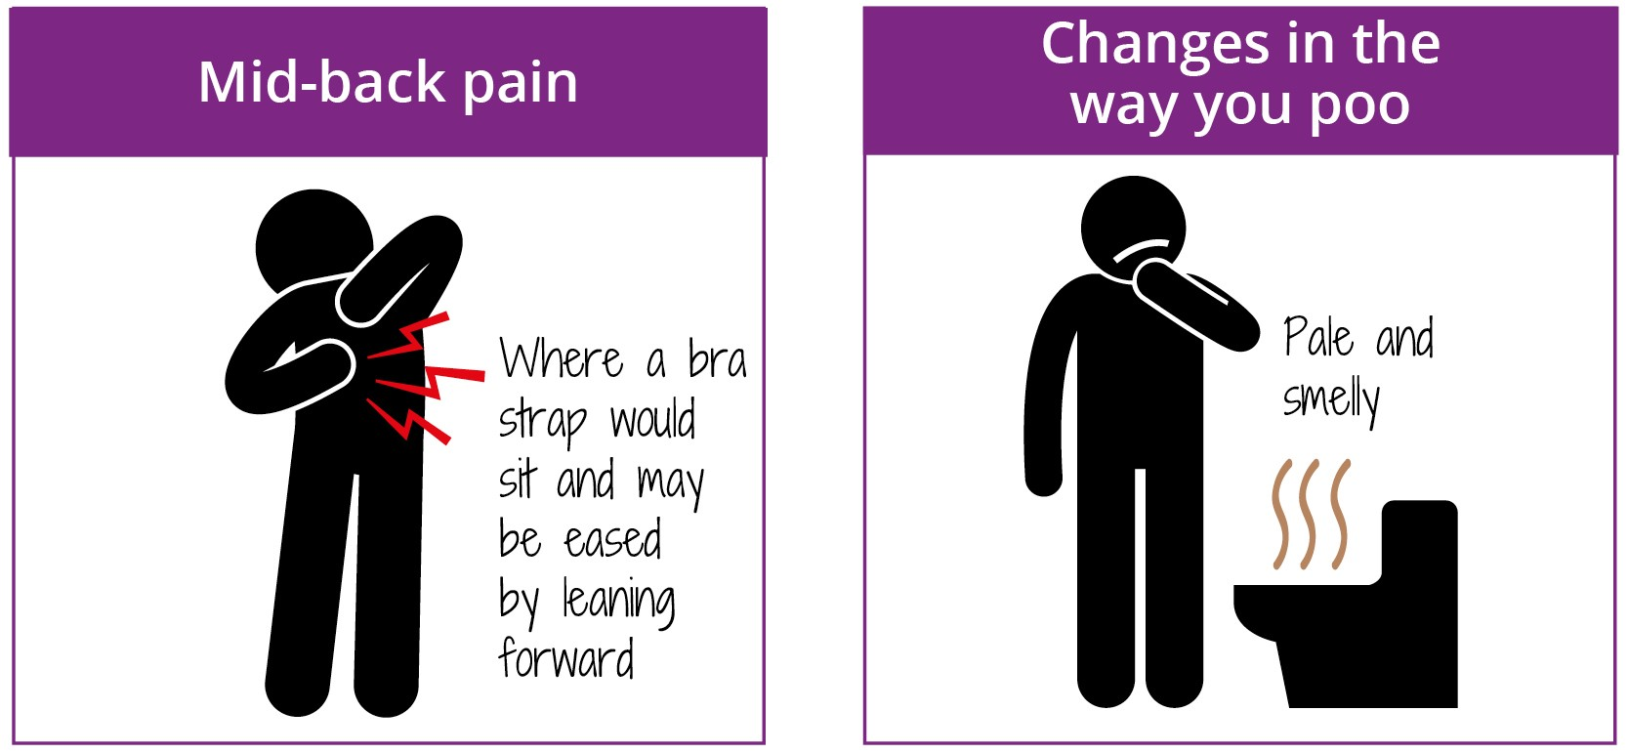
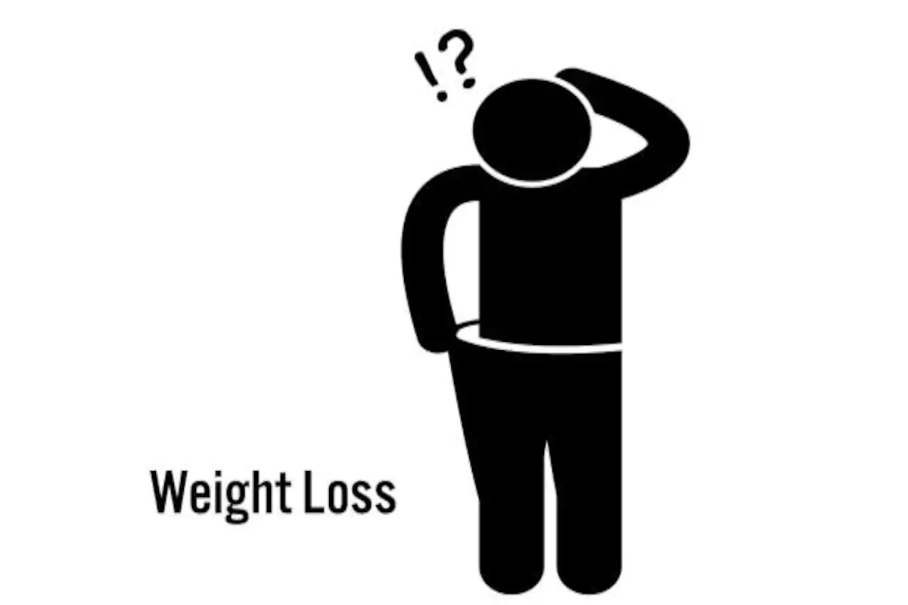
Early Cancer Detection
STEP
1
Energy Level
Pain
Remember what GREAT feels like.
Visible Changes
Bathroom Habits
Notes:
Slide 12: Step 1 - Remember What Great Feels Like
Early detection starts by recognizing subtle and persistent health changes. To do that, you need to know what your “great” feels like, or what is normal for your body. Obviously everyone is different, but there are a few categories you can use to start setting your own benchmarks for health.
Pain – we all have different thresholds for pain some people have high thresholds for pain and are very calm about it, others have a bit more dramatic reaction when they get hurt. Pay attention to any clues your body is sending you, if something seems like it is taking longer to heal, or has come out of nowhere take note.
Energy level/ Sleep patterns – we all have days where we could use an extra cup of coffee, or extra hour of sleep, but what is your usual energy level? How much rest (or caffeine) do you need to get through your day? Are you an early bird or a night owl? Are you a heavy sleeper or do you toss and turn all night? Think about when you usually go to bed, and how many times you have to hit the snooze button to get up in the morning, these are important patterns to note.
Visible changes – Keep an eye on your body’s visible clues if a mole or a freckle changes in color, shape, or size take note and keep an eye on it. Make skin self-exams part of your weekly routine; and while you’re at it check for lumps and bumps.
Bathroom habits – I know this is not the most pleasant subject. But doctors say we can learn a lot about our bodies based on what happens in the bathroom
When you remember what Great feels like in these and other categories, you will be able to recognize changes in your health more easily.

Slide 47
Early Cancer Detection
Use the 2-Week Rule the same way you track other important dates
and information.
STEP
2
Use the 2-Week rule.
Notes:
Our bodies will find a way to tell us when something is wrong. That’s why we have Step 2 - “Use the 2-Week Rule”. It's up to you to recognize when something’s not normal, and to share that with your doctor before it's too late. Don’t feel like you are “bothering” your doctor with a “minor issue” - they want to see you before that issue gets worse.
Two Weeks is that key benchmark. If any health change is still there 2-weeks later, that’s your body’s way of saying it needs some help. The Advil/ Tylenol regiment you’re taking isn’t doing the trick. The heating pad/ ice pack isn’t working and you need to get a professional involved.
We recommend track health changes the same way you track everything else in your life. Use your phone, write yourself a note. TELL a loved one, friend, or spouse. This timeline is critical for early detection.

Slide 48
Early Cancer Detection
Prepare
STEP
3
Share with
Your Doctor
Share
Be aware
Notes:
Slide 18: Step 3 - Share with your Doctor
I am sure you all have big plans for retirement, right? Well Eddie and Kimberly had planned to take an RV across the US. You want to be able to be here for those plans, and that starts NOW. Eddie had 5 children, the youngest was 6 when he passed. You want to be here for your families. See your children grow up, graduate, get married, become a grandparent. Enjoy the life you have worked so hard for.
We know that time is a huge factor for early detection. You have to know what to look for, as well as when to seek medical advice. And, you have to know how to talk to your doctors to get the best care. That’s Step 3 - Share with your Doctor.
This step is not just about walking into the doctor’s office and waiting for them to magically figure out what’s wrong and how to fix it. Your doctor holds the medical degrees, but you are the expert on your own body. You have a big role to play at your appointments, it’s important you work with your doctor and come up with a plan that works for you.
Let’s break it down into what to do before, during and after your appointment to make sure you are doing all you can to help your healthcare provider diagnose you quickly and accurately.
PREPARE: Take some time the day or two before your appointments to think about any questions you might have about symptoms, medication, or advice. Write notes for yourself and bring them to the appointment.
SHARE: While you are with your healthcare provider, it’s important to share your questions and concerns. Prioritize what you want the doctor to know, starting with the most important information. There is nothing too embarrassing or too small. Your doctor has heard it all before - they won't be surprised by anything you share with them. Don’t down-play anything that is bothering you, or avoid tough topics with your doctor.
BE AWARE: If your doctor gives you a diagnosis, prescribes you a medication make sure you understand the treatment plan. If you don’t feel better when your doctor said you should, or you notice any new symptoms, let your doctor’s office know. Continue to advocate for yourself and the care you need.

Slide 49
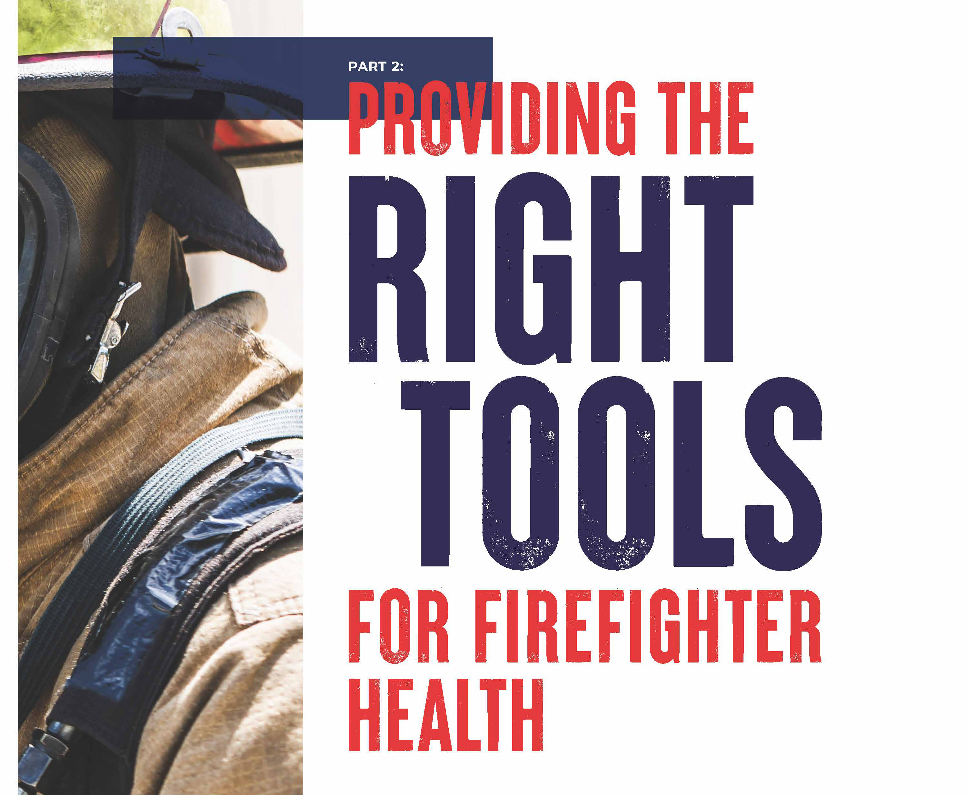

Slide 50
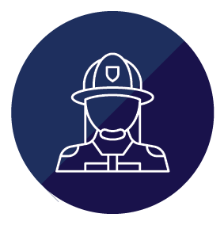
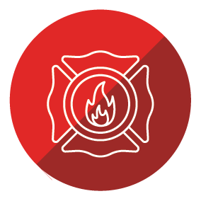
Assuming Responsibility
Organizational Culture Change Starts With Leadership
Company officers have the most profound impact on firefighters’ cancer risk.
Enforce the policy
Mentor firefighters on the best practices.
Set the cultural tone in the firehouse and on the fireground
Of all the officials from local to federal, chiefs and chief officers have a profound impact on firefighters’ cancer risk.
Set the policies
Set the culture
Engineer for prevention
Notes:
Company officers have the most profound impact on firefighters’ cancer risk. They not only enforce the policy, but they have a unique opportunity to mentor firefighters on the best practices. Street level officers are the first link in the chain, setting the cultural tone in the firehouse and on the fireground, guided by the chief officers who have the opportunity to direct the change needed to reduce the cancer epidemic.
Of all the officials from local to federal, chiefs and chief officers have a profound impact on firefighters’ cancer risk. They set both the policies and examples. They set the leadership and cultural tone. Two ways chiefs and chief officers prevent firefighter cancers are:

Slide 51
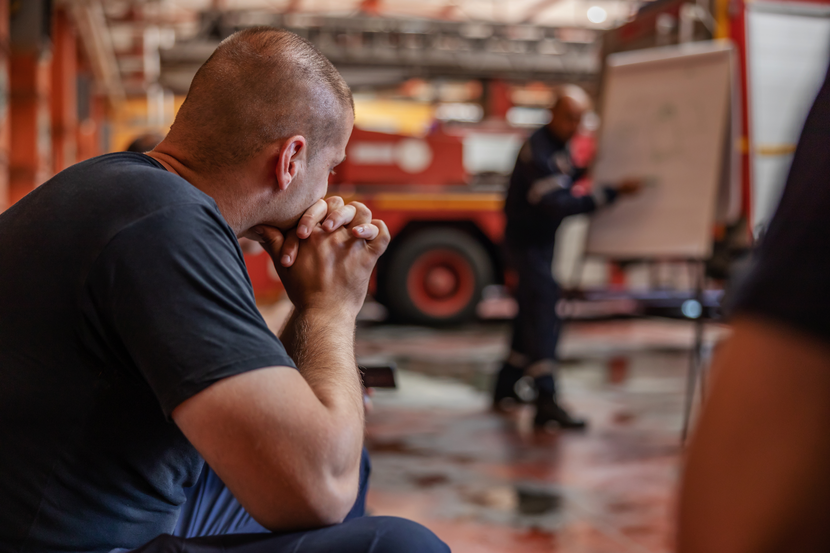
SET THE POLICIES
SET THE CULTURE
Fire department leaders who want policy to become practice must hold firefighters accountable for following them. That’s step one for going from policy as an idea to policy as a practice.
“A team should be involved in new company policies from the creation phase,” Tiersa Smith-Hall of the Hartling Group wrote in Forbes. “Statistics and surveys show that employees are more willing to accept and support policies in which they are involved. This can be done through surveys and focus groups where input is welcomed.”
Notes:
Policies are not a bag of magic dust that makes everything perfect and grand. But they are a necessary building block for running the department the correct way.
Chiefs need to review all existing policies and update where necessary to ensure those that can focus on cancer prevention, actually do. For example, a policy could require post-exposure decontamination be incorporated into training and all fire responses. Or an apparatus daily inspection policy should include requirements to pull the rig out of the bay while it is running, to connect the exhaust capture system (if applicable) when it is in the bay. This will reduce firefighters’ exposure to diesel exhaust, a known carcinogen.24
These policies should include paid access to early-detection cancer screening and annual physicals for both career and volunteer firefighters.

Slide 52

SET THE POLICIES
SET THE CULTURE
THE AVERAGE COST OF CANCER TREATMENT AND DRUGS PER PATIENT WAS MORE THAN $42,000, WITH SOME TREATMENTS EXCEEDING MORE THAN $1 MILLION.
Chiefs need to review all existing policies and update where necessary to ensure those that can focus on cancer prevention, actually do.
Consider policies that impact other factors that influence cancer risk including alcohol use, tobacco use, physical activity and diet.
Notes:
Chiefs need to review all existing policies and update where
necessary to ensure those that can focus on cancer prevention,
actually do. For example, a policy could require post-exposure
decontamination be incorporated into training and all fire responses.
Or an apparatus daily inspection policy should include requirements
to pull the rig out of the bay while it is running, to connect the
exhaust capture system (if applicable) when it is in the bay. T his will
reduce firefighters’ exposure to diesel exhaust, a known carcin ogen.24
These policies should include paid access to early-detection cancer
screening and annual physicals for both career and volunteer firefighters.
As we stated in Part 1, both the U.S. Preventative Services Task Force and
the NFPA have recommendations for cancer screenings for some of the
cancers that firefighters have a greater risk of getting. Some examples
include colon, prostate and melanoma.
Perhaps

Slide 53



ENGINEER FOR
PREVENTION
THE 3 E’S OF MAKING CHANGE
Engineering is one of the often used three E’s of making changes to worker health and safety — the other two being education and enforcement. Where we can use engineering or design to mitigate cancer risks, we must.
ENGINEERING
EDUCATION
ENFORCEMENT
As an investment, new or retrofitting makes financial sense. The national cancer institute’s recent estimate of the average cost of cancer treatment and drugs per patient was more than $42,000, with some treatments exceeding more than $1 million.
Fire department leaders who want policy to become practice must hold firefighters accountable for following them. That’s step one for going from policy as an idea to policy as a practice.
We must continue to educate members on the risks to them and how to mitigate the risks. Prevention programing need to taught across all levels of the fire service and our community leaders.

Slide 54
LOCAL, STATE AND FEDERAL
RESPONSIBILITIES
We must work across all political levels to obtain the funding, research and equipment needed. Working together with state. local and federal government we provide the fire service with the best solutions to fight this disease.
No firefighter would have to suffer financial trauma after a cancer diagnosis. Prevention and early detection can reduce the financial impacts of cancer.
Together funding measures designed to reduce the risk of cancer among firefighters is a life-or-death issue.

Slide 55
Survivorship

Slide 56
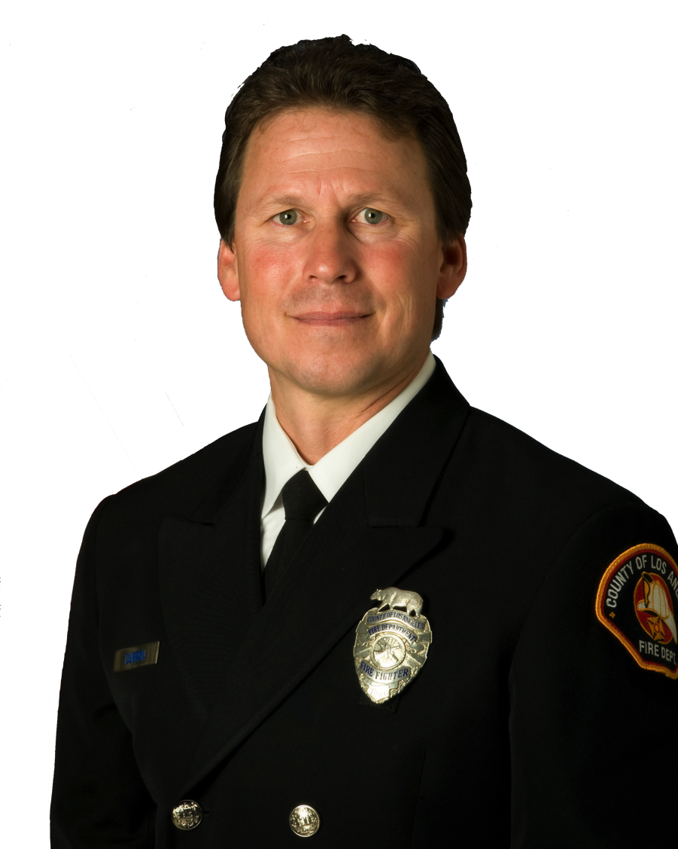
Survivorship
The Role of the Firefighter Cancer Support Network
Now in our 19th year, FCSN has active operations in 44 states and parts of Canada.
The International Association of Fire Fighters online cancer awareness and prevention course, created in cooperation with FCSN, launched in May 2016
The Firefighter Cancer Awareness Month in Collaboration with the IAFF and FCSN was created in January 2020
Michael A. Dubron, an L.A. County firefighter and cancer survivor, founded FCSN in 2005 to support cancer-stricken firefighters and their families.
Notes:
Since 2005, the nonprofit Firefighter Cancer Support Network has helped thousands of firefighters and their immediate families cope with cancer.
Our primary mission is to support firefighters who have been diagnosed with cancer.
Firefighters who have received a cancer diagnosis should contact FCSN.
We can start helping immediately with an FCSN cancer-support toolbox.
FCSN’s signature toolbox is full of tested, proven resources to help firefighters and their families cope with the cancer diagnosis, treatment, and recovery phases.
We will send a toolbox to the firefighter free of charge. It gives you a place to keep all of your records, test results, and insurance forms together in one place. You’ll need to take those with you to multiple doctors. We hear all the time the toolbox is really helpful.
Many FCSN peer-support mentors started their relationship with FCSN asking for assistance. They’re survivors, and they’re giving back by helping others through the
process.
We can help: Call 1-866-994-FCSN (3276) – or click the assistance request link at www.firefightercancersupport.org

Slide 57
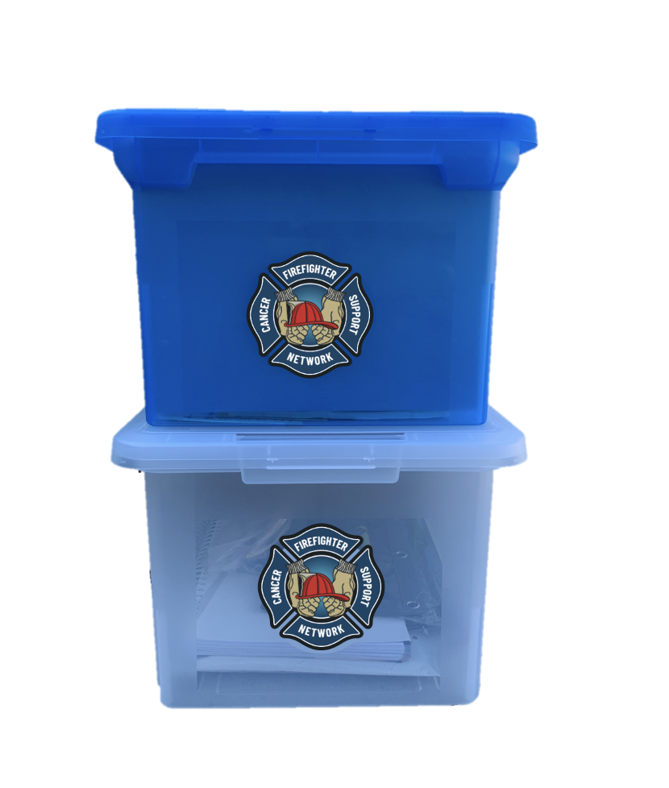
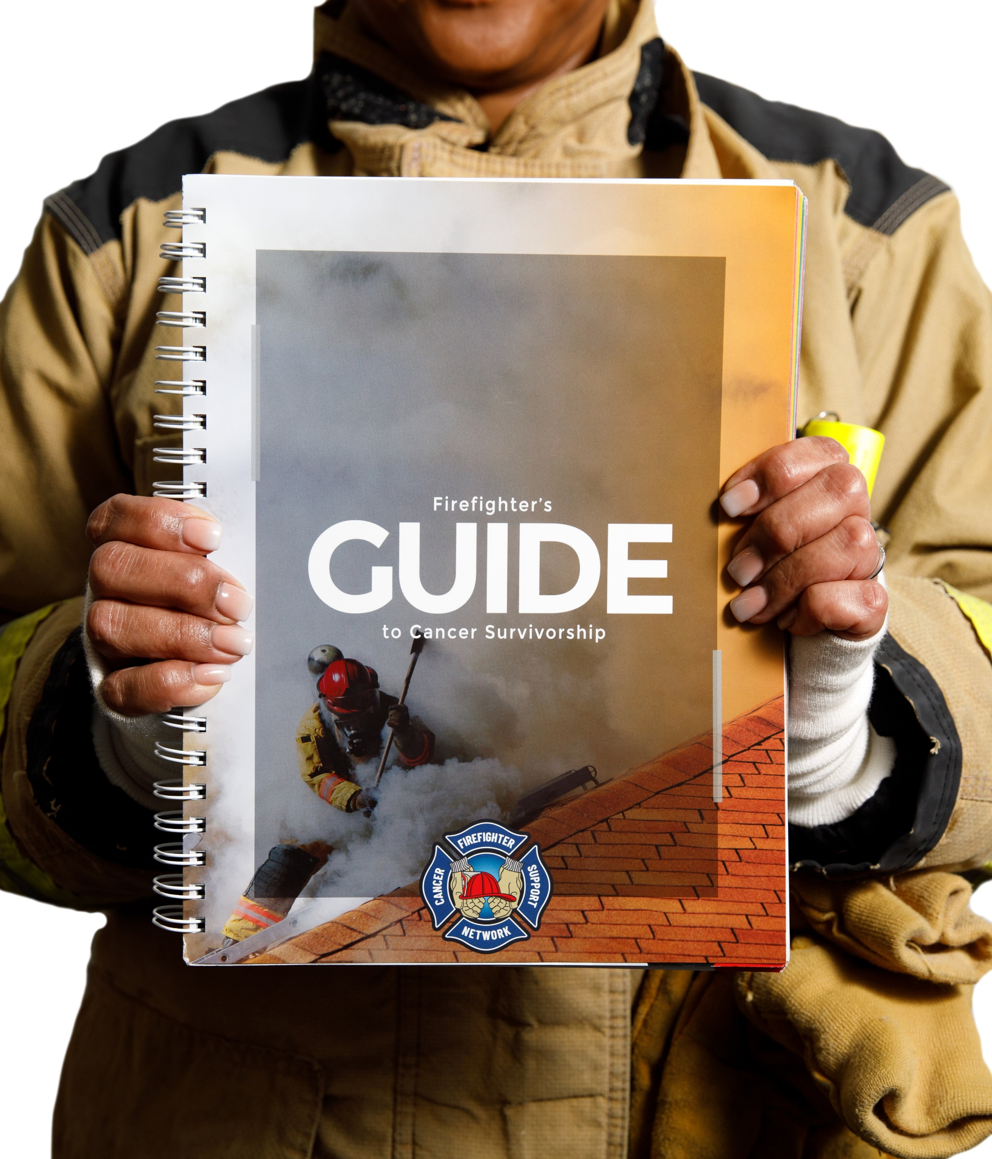
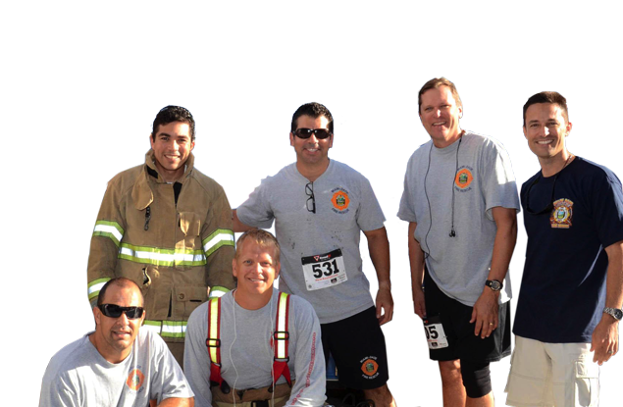
Survivorship
The Role of the Firefighter Cancer Support Network
A FCSN signature toolbox is offered free of charge to firefighters and their family members who are diagnosed with cancer.
Next, FCSN provides free, badge-to-badge peer support to fire/EMS members and their immediate families. FCSN maintains a unique network of more than 220 volunteer peer-support mentors. Nearly all are firefighters and paramedics who are cancer survivors themselves.
Notes:
FCSN can start helping immediately following a cancer diagnosis with an FCSN cancer-support toolbox. FCSN’s signature toolbox, delivered free of charge, contains tested, proven resources to help firefighters and their families cope with the cancer diagnosis, treatment, and recovery phases. The signature tool box has file folders to keep all EOB’s, paperwork from doctor visits, a business card holder for all of the doctors you visit.
The box also has a Survivors handbook to guide those diagnosed through their treatment and recovery.
FCSN’s unique network includes more than 130 volunteer peer-support mentors—nearly all are firefighters and paramedics who are cancer survivors themselves. FCSN’s network also includes mentors for spouses and children. Many mentors started their relationship with FCSN seeking assistance for themselves. Now they’re giving back by helping others through the process.

Slide 58
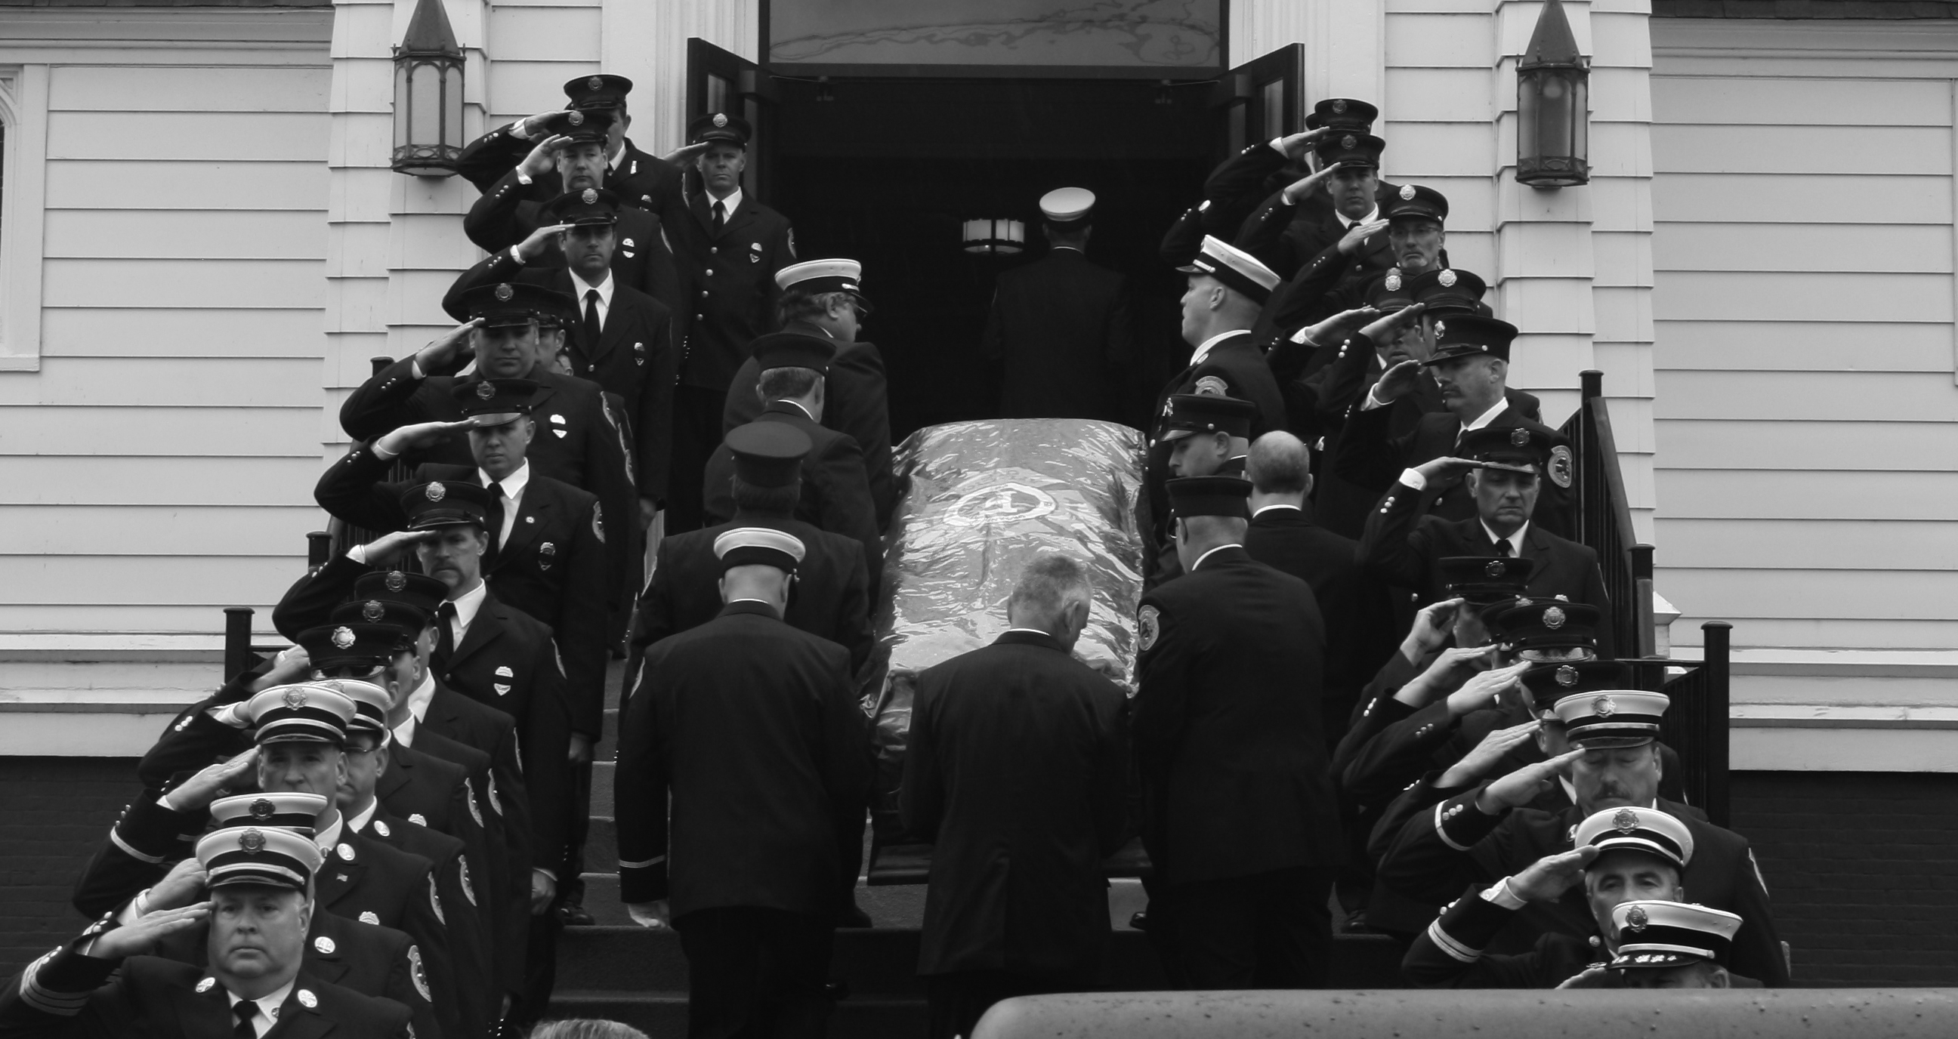
The choices you make in this career will affect you and your family in the future!

Slide 59

We hope you found this presentation to be valuable for you and your brother and sister firefighters and EMS providers.
If you did, please consider making a small donation to help FCSN continue to spread the word nationwide about the dangers firefighters face and the precautions they can take to reduce their chances of getting cancer
THANK YOU!

Slide 60
Contact Info:
firefightercancersupport.org
866-994-FCSN (3276)
Russell F. Osgood
Vice President of Education, Outreach and Research
rosgood@fcsn.net
204-451-3052

