Slide 1

Rebuilding Your City’s Municipal Workforce
Thursday, May 11th | 3:00 PM

Slide 2
Rebuilding Your City’s Municipal Workforce

Slide 3
Welcome & Agenda
Introductions
Research Presentation
Municipal Workforce Trends
Local Public Safety Workforce Trends
Municipal BIPOC Representation Analysis
Municipal Solutions
Table discussion
Q&A Discussion
Closing Remarks

Slide 4
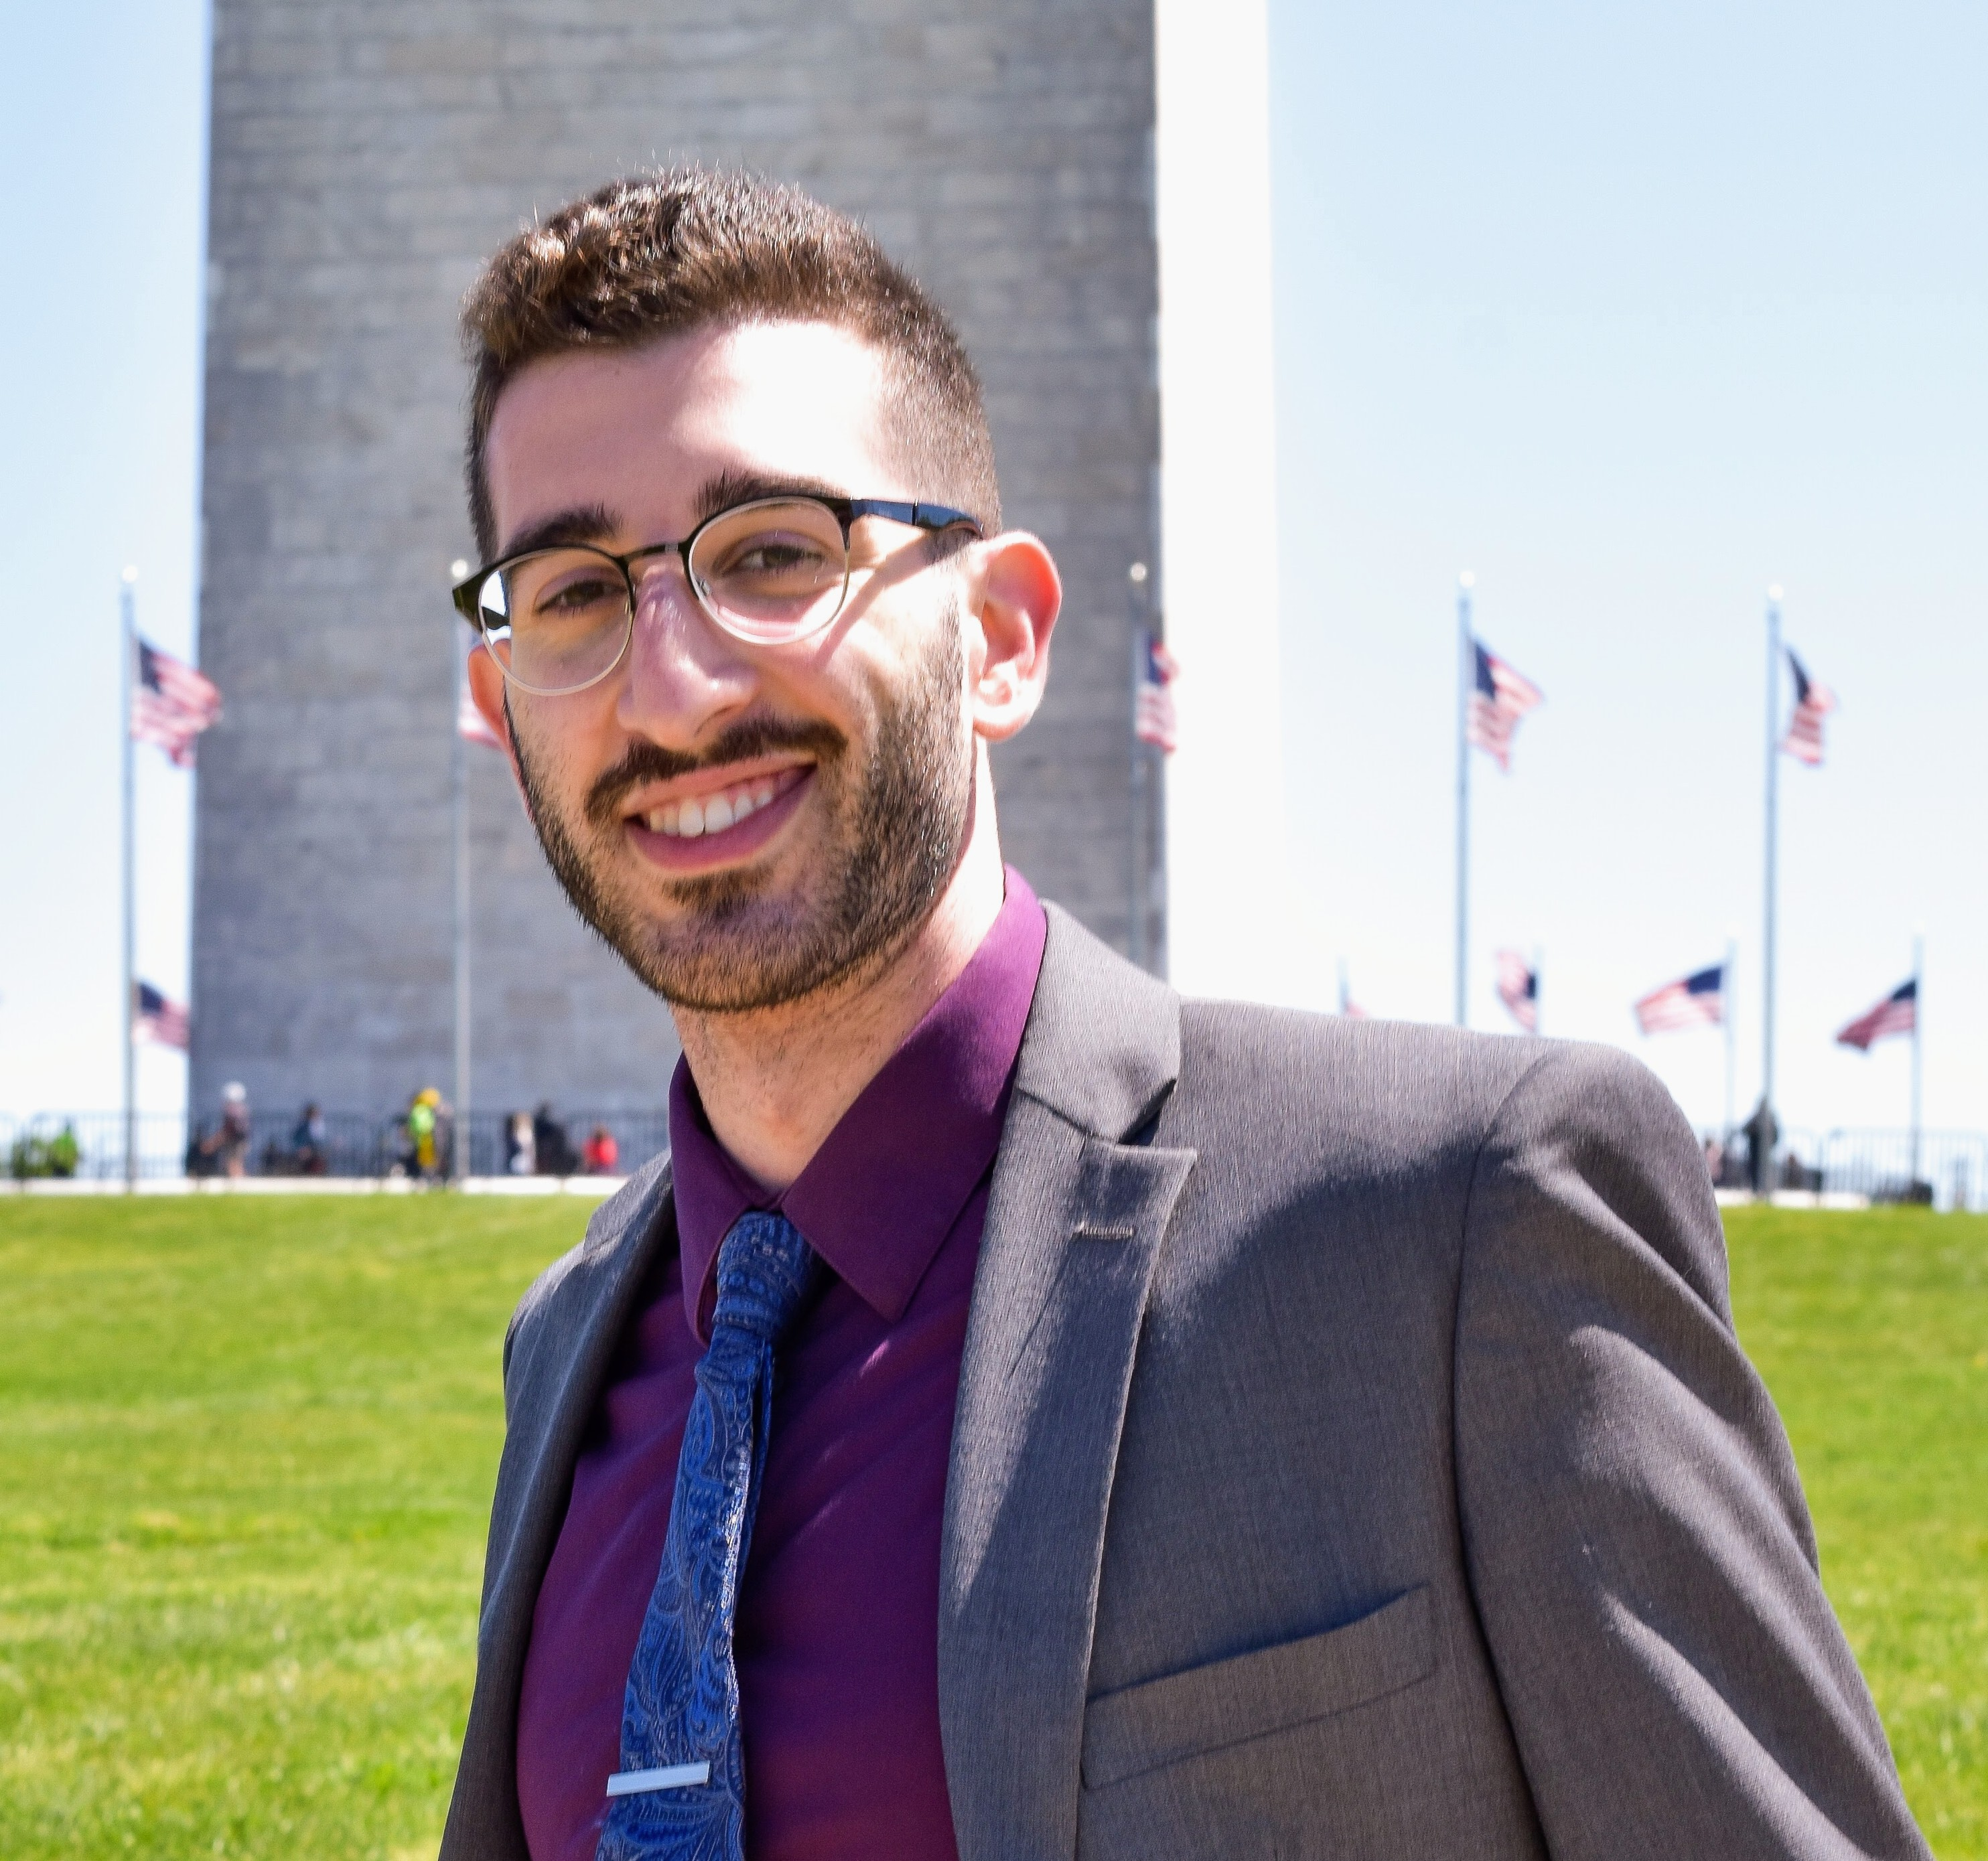

Municipal Workforce Research By NLC
Jacob Gottlieb
Julia Bauer
Senior Research Analyst
SRI International, Center for Innovation, Strategy and Policy
Program Manager
National League of Cities, Center for Research and Data Analysis

Slide 5
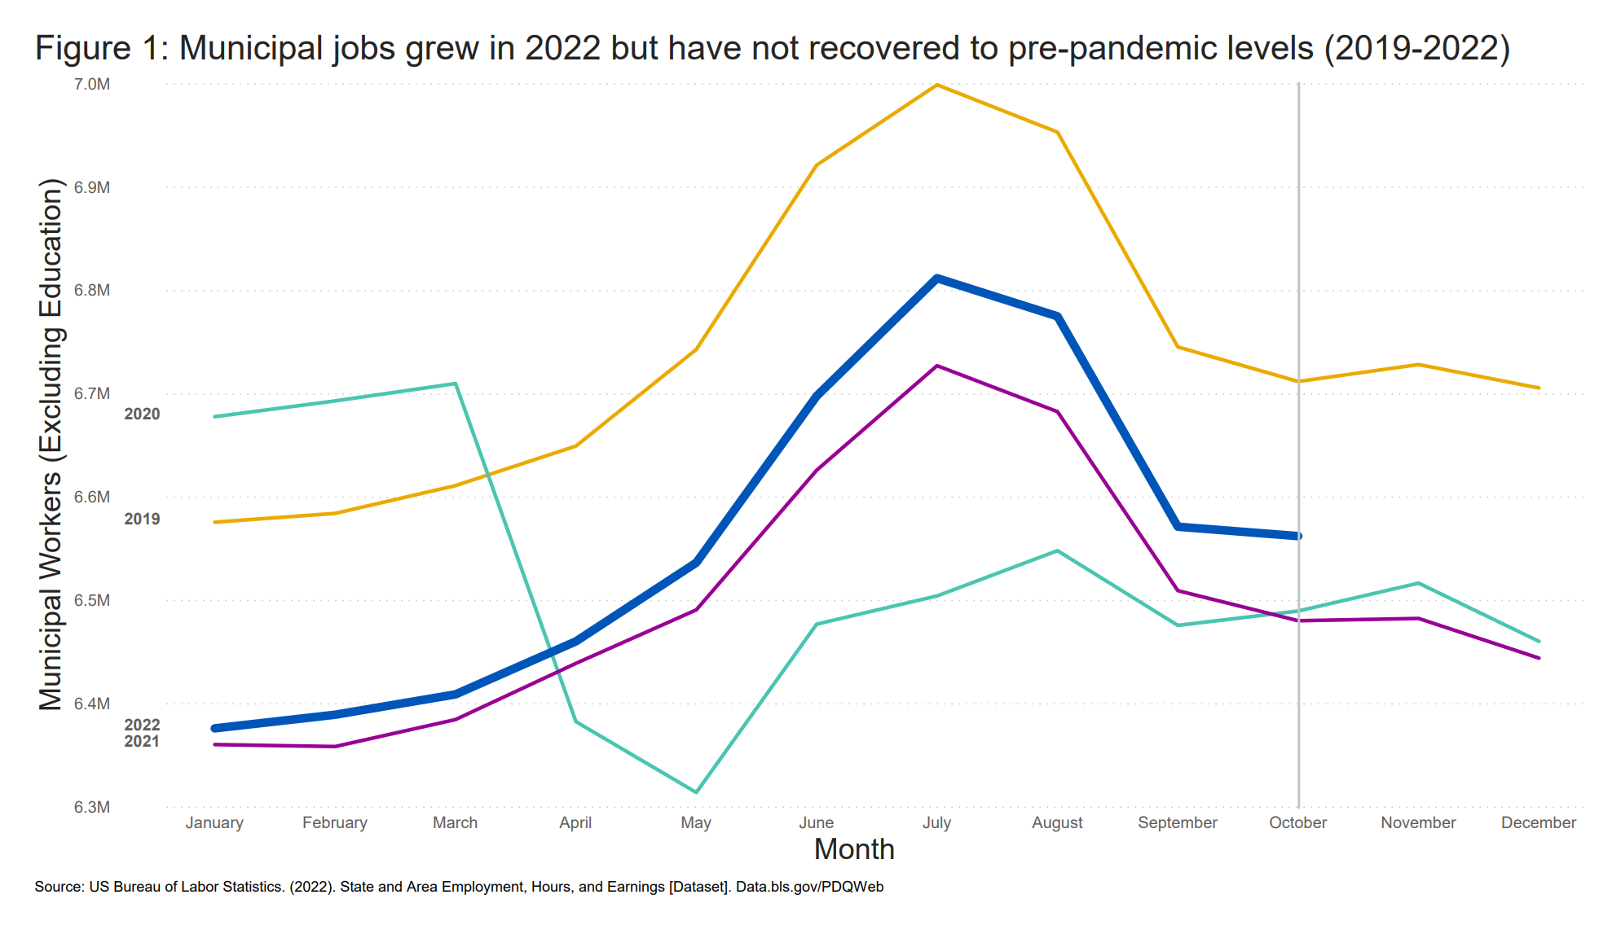
Municipal jobs grew in 2022 but have not recovered to pre-pandemic levels
(2019-2022)
How have municipal labor levels changed since the COVID-19 Pandemic?

Slide 6
Why Employees Are Leaving
Retirement
Advancement with another public employer
None-competitive compensation
Lack of internal advancement opportunities
Advancement with a private employer
*These are results from a 2021 MissionSquare Research Institute survey of State and Local Government Workforce managers.

Slide 7
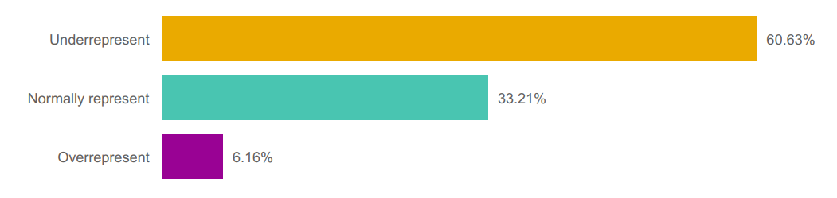
BIPOC Representation in the Local Government Workforce
Most local governments underrepresent BIPOC people in their workforce
Percent of cities by representation level of BIPOC people

Slide 8
Public Safety Workforce Trends
From 2020-2021:
Policing hirings declined by 5 percent
Police resignations increased by 18 percent
Police retirements increased by 45 percent
Reason for leaving:
Job dissatisfaction related to COVID-19
Fatigue/stress
Negative public perceptions about police/policing
*These are results from a 2021 Police Executive Research Forum survey of the public safety workforce.

Slide 9
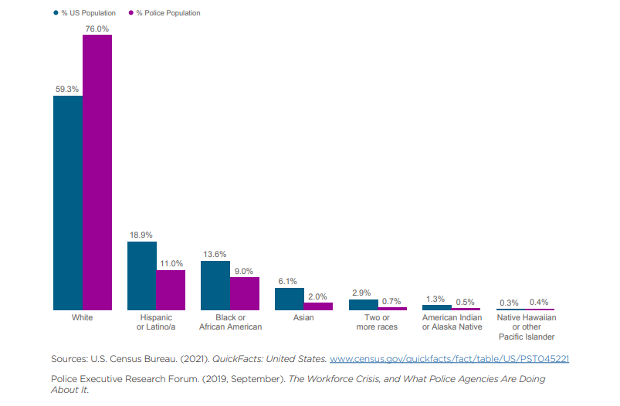
Police departments do not adequately represent the communities they serve
Percent of US and Police Population by Race/Ethnicity
BIPOC Representation in the Local Public Safety Workforce

Slide 10
What All of This Means for Local Governments
Loss and Delay of Vital Services
Leadership and Knowledge Loss
Inequitable Local Government Outcomes

Slide 11
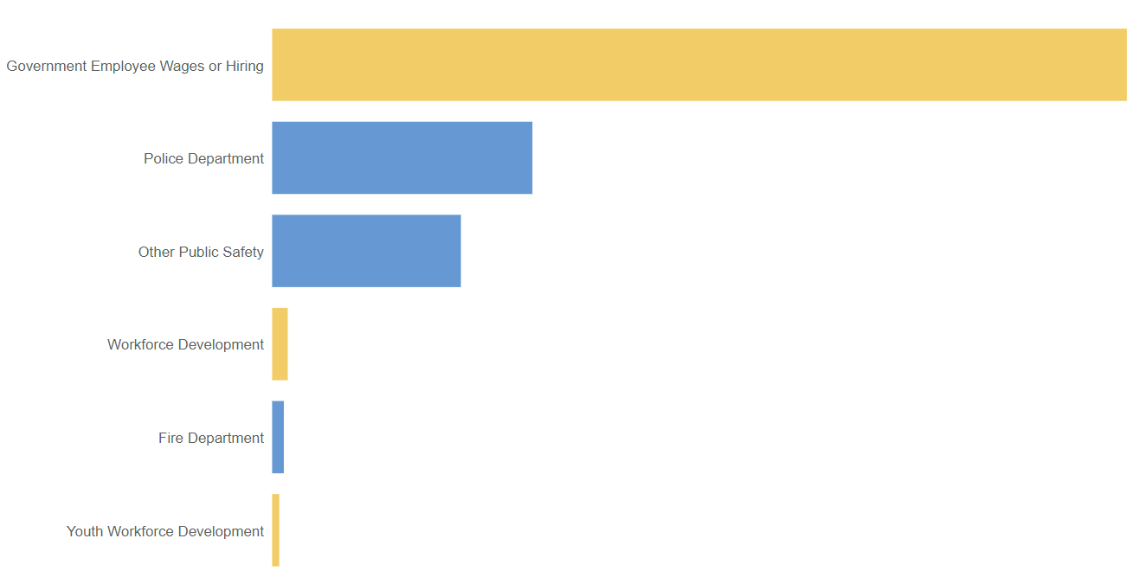
Local governments spent SLFRF on municipal wages and hiring
How have local governments used SLFRF to stabilize their employment levels?
$1.6B
$481M
$349M
$28.8M
$21.6M
$13.1M
Legend
Other municipal workforce
Public safety workforce

Slide 12

Monticello, IN
Employee attraction, retention & support
Retention & support: Mental health benefits
Address stigma
Ensure access to and knowledge of services
Attraction & retention: Application processes
Consider barriers to entry
Evaluate efficacy of questions

Slide 13

Greensboro, NC
Employee retention & training
Invest in workforce development
Provide opportunities for cross-department knowledge sharing
Reward employees seeking development opportunities

Slide 14
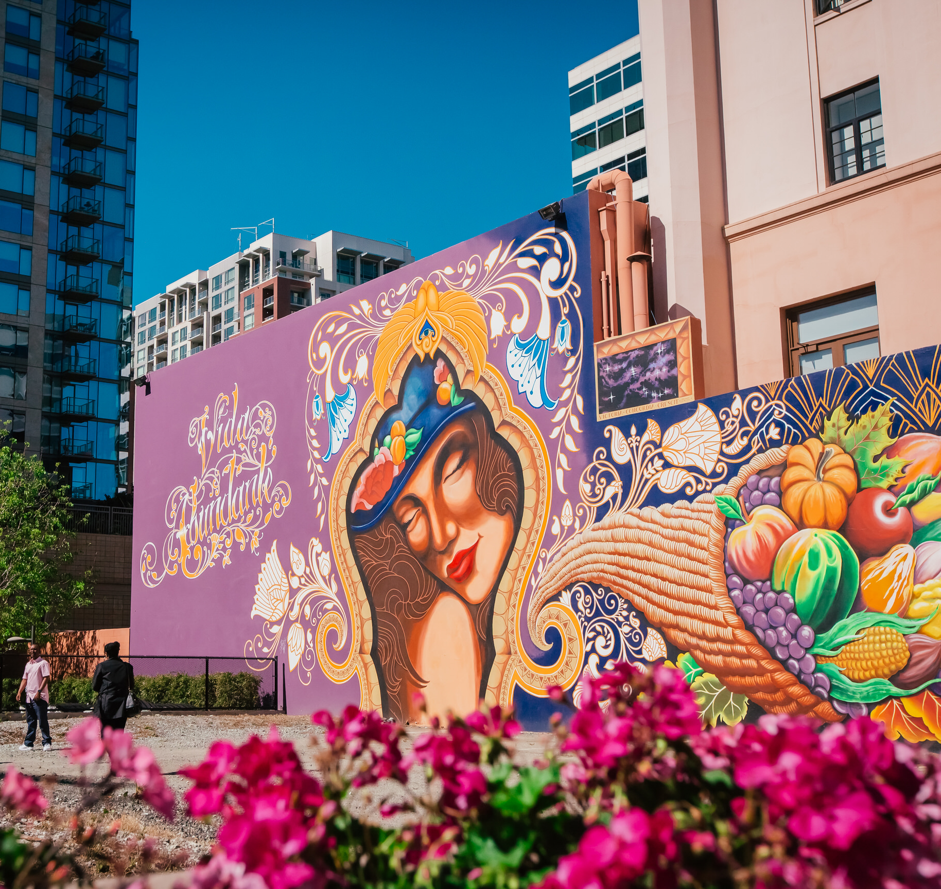
Invest In:
Career pathways across sectors
Opportunities for advancement
Leadership development
Training for diverse groups of workers
Systems that support employees outside of work

Slide 15

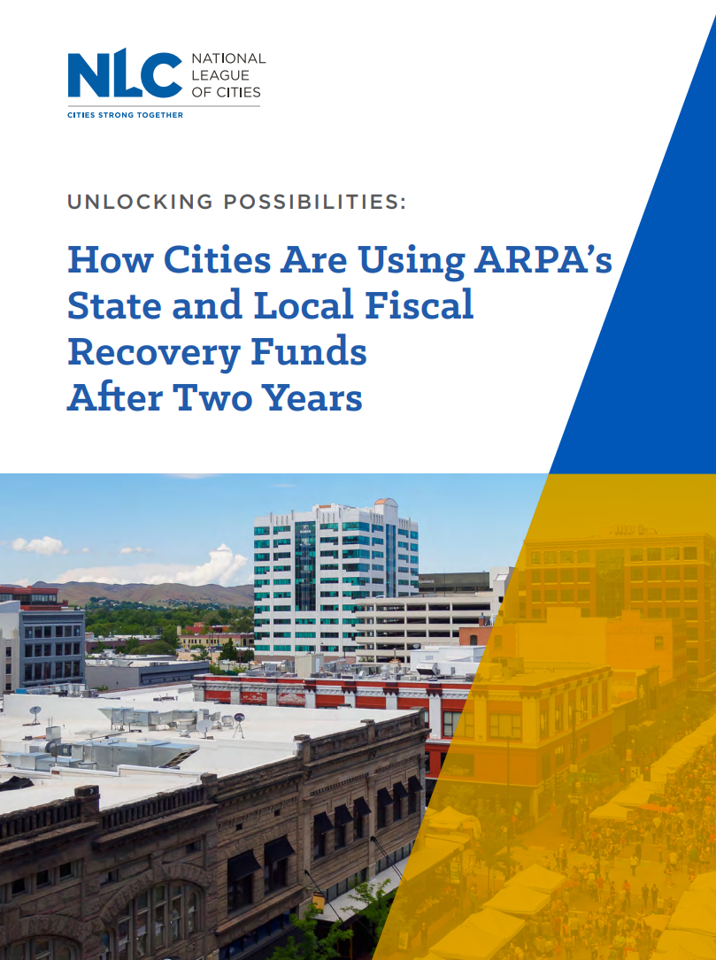
Municipal Workforce & ARPA Research By NLC
Unlocking Possibilities: How Cities Are Using ARPA’s SLFRF After Two Years
Building a Municipal Workforce for the Future

Slide 16
Activity: Table Discussion
What workforce challenges are you experiencing in your state?
What strategies have you used to address these challenges or historic challenges?
What challenges did you face in the implementation or execution of these strategies?
What other information would be helpful for you to address these challenges?

Slide 17
Q&A Discussion
Jacob Gottlieb
Julia Bauer
Senior Research Analyst
SRI International, Center for Innovation, Strategy and Policy
Program Manager
National League of Cities, Center for Research and Data Analysis

