Slide 1
Homelessness, Cities, and the Changing
Legal Landscape
Friday, May 12th | 1:00 PM

Slide 2
Homelessness, Cities, and the Changing Legal Landscape
Aaron Hisel
Law Offices of Montoya, Hisel and Associates
Capitol Legal Services
aaron@capitol.legal

Slide 3
Homeless and Unsheltered
Homeless and Sheltered
Subsidized Housing
Market Rate Housing

Slide 4
Definitions of Homeless (Federal Government)
What you likely Picture: Individual or family that lacks a fixed, regular, nighttime residence or resides in a public or private residence that is not designed for regular sleeping accommodations for human beings (examples in statute are in a car, park, abandoned building, airport, etc.)
What you May Not Picture: Lives in a supervised shelter designed to provide temporary living arrangements (examples in statute are in a hotel, motel paid by taxpayer funds or other shelters or transitional housing even when run by charitable organizations)
What you are even less likely to Picture: Imminent risk of losing housing and those fleeing domestic violence. Within 14 days the individual or family is going to be evicted or run out of money and has no subsequent residence identified or resources to obtain other permanent housing.
Children and youth who are sharing housing of other persons due to loss of housing, economic hardship or similar reasons, which expressly includes any children living in motels, hotels, and trailer parks
42 U.S.C § 11302
42 U.S.C § 11434a

Slide 5
Homeless and Unsheltered
Homeless and Sheltered
Subsidized Housing
Market Rate Housing

Slide 6
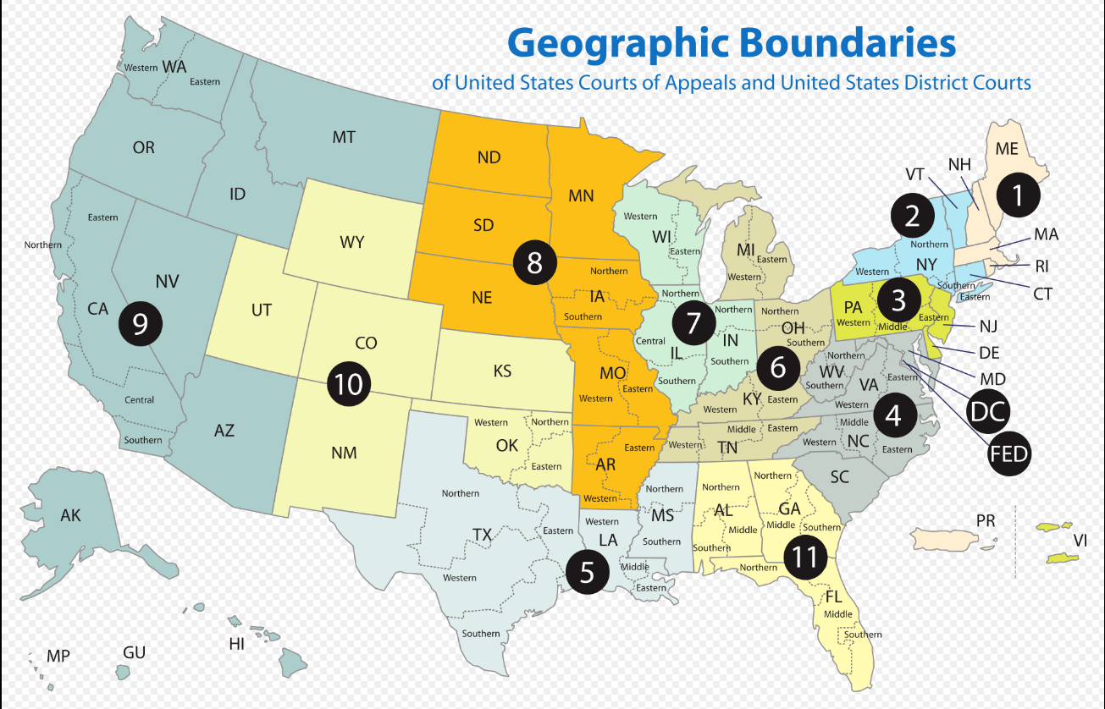

Slide 7
Jones v. City of Los Angeles
Jones, 444 F.3d 1118 (9th Cir. 2006)

Slide 8
Boise (9th Cir. Decision Sep. 2018) | Grants Pass (9th Cir. Decision Sep. 2022)
Holding: If available shelter beds < homeless in jurisdiction (per most recent P.I.T. count) = the homeless in that jurisdiction are “involuntarily homeless” and once deemed “involuntary” individuals cannot be criminally “punished” for the acts of sleeping or resting on public property. | Holding: Class action case expanding on Boise. City's “anti-camping” ordinance precluding the use of bedding supplies, such as a blanket, pillow, or sleeping bag, when sleeping in public violated the Cruel and Unusual Punishments Clause as applied to individuals who were involuntarily experiencing homelessness and who had no shelter in which to lawfully sleep. The possibility of a fine was unconstitutional “punishment” under this ruling for which pre-enforcement class action lawsuit could be maintained.
Status: Petition made to Supreme Court for review but it was denied. | Status: Petition for Rehearing en banc pending; likely to be appealed to the United States Supreme Court no matter what happens at the Ninth Circuit.
 | Note: Issues in these cases relate to Federal Constitution Only
The mathematical formula created here is difficult, if not impossible, to meet; and This type of affirmative action on the part of those experiencing homelessness is novel to the law and therefore almost no jurisdiction had these types of carve outs in their ordinances.

Slide 9
State Law Changes: For Those in the Ninth
“Codifying Boise”
“Reasonable Time, Place and Manner Restrictions
Examples from Oregon:
ORS 195.505, ORS 195.530

Slide 10
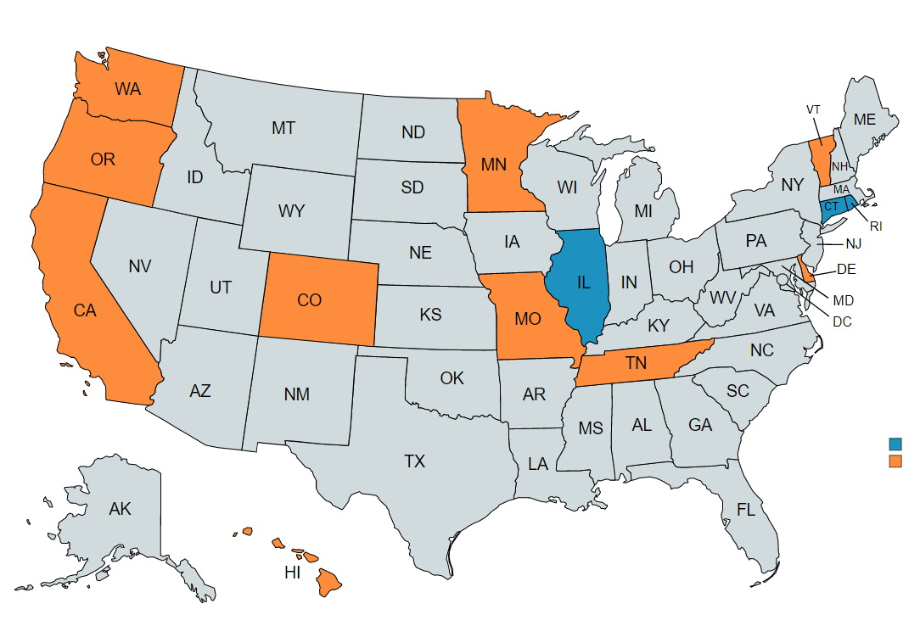
State Law Changes: Right to Rest Act and/or Homeless Bill of Rights
Advocacy group tracking progress of these efforts: Western Regional Advocacy Project (wraphome.org)
Blue = Passed legislation
Orange = Have introduced legislation

Slide 11
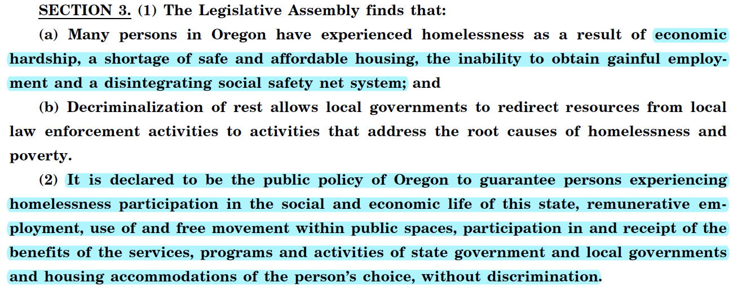
State Law Changes: Right to Rest Act (Policy)
HB 3501 – Oregon Right to Rest Act
Previously HB 2367 (2021)
Renumerative = “financially rewarding; lucrative”

Slide 12
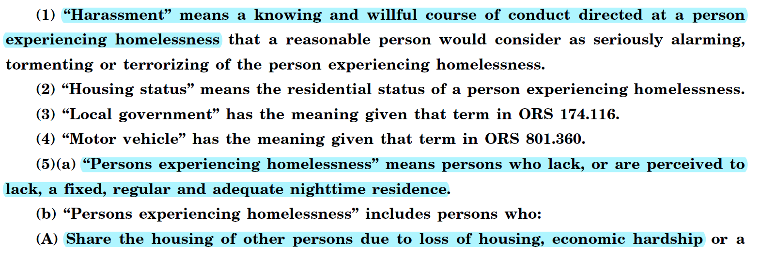
State Law Changes: Right to Rest Act (Definitions)
The “harassment” is tied to a new cause of action that has attorney fee award

Slide 13
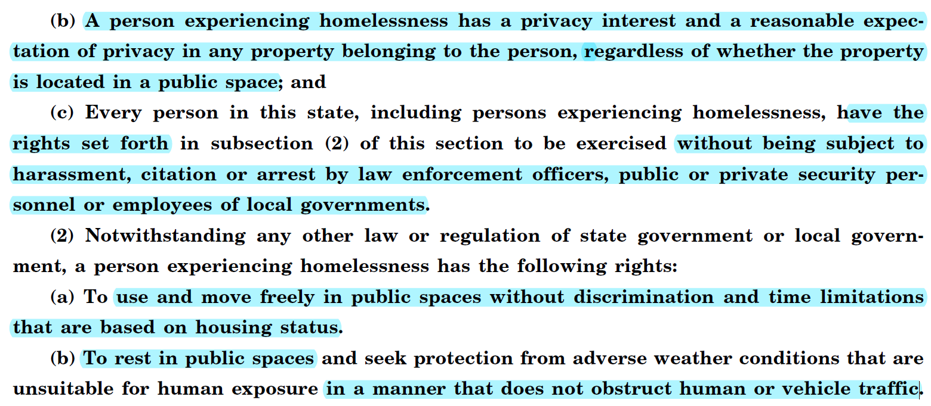
State Law Changes: Right to Rest Act (Rights)

Slide 14
The Future and Perfect Solutions
Homeless and Unsheltered
Homeless and Sheltered
Subsidized Housing
Market Rate Housing
Neither a prophet nor a genie but….
Creation of rights of action to challenge homeless policies and public regulations
State-created danger lawsuits
Supreme Court will eventually have to weigh in on the 8th Amendment Cruel and Unusual Punishment Issues
Reasonable Time, Place and Manner Restrictions as opposed to wholesale bans on certain conduct
Designated response teams

Slide 15
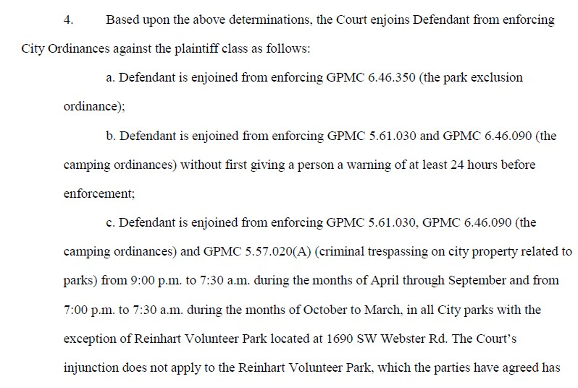

Slide 16
Questions
Aaron Hisel
Law Offices of Montoya, Hisel and Associates
Capitol Legal Services
aaron@capitol.legal

