Slide 1
Welcome to the 2022 Trustees Conference!
Download PheedLoop Go!
Follow us @NLCRISC | #RISCTrustees
Notes:
Play: Walking on Sunshine

Slide 3
WELCOME TO PITTSBURGH!

Slide 4
NOW
THEN

Slide 5
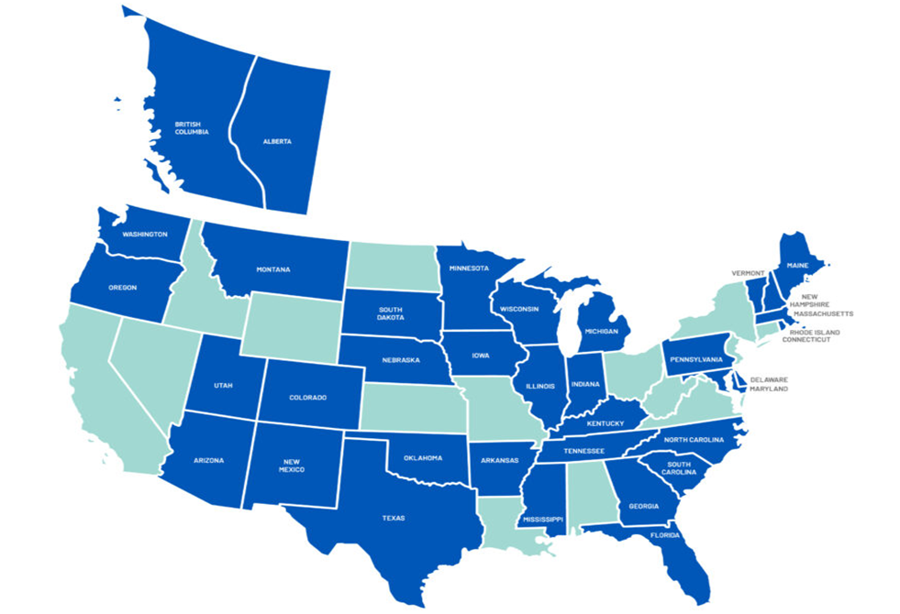
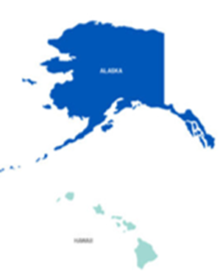

Slide 6
Health & Wellness
PTSD for Public Safety
Disaster Recovery
Cyber Security

Slide 10
