Slide 1
NLC-RISC ORIENTATION
Your trusted resource for information sharing, expertise, and thought leadership in pooling.

Slide 2
NLC-RISC:
Is a member-driven, member-focused organization dedicated to the success and support of State League Risk Pools.
Creates a space for State League Risk Pools to share information, ideas, resources and solutions to help them address the needs of their cities, towns, and villages.
Program of the National League of Cities, founded in 1982.

Slide 3
History of Risk Pools & NLC-RISC

Slide 4
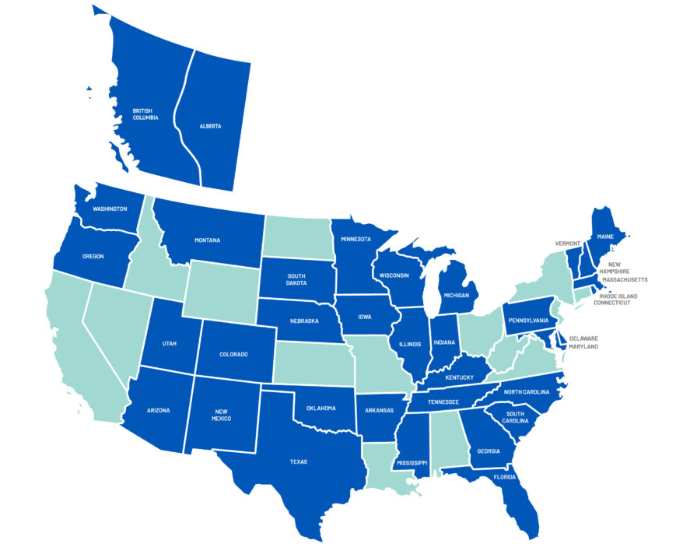
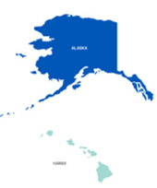
NLC-RISC Membership:
NLC-RISC members are risk pools endorsed by their state league
38 members across the United States and two Canadian provinces
8 members represented on Board of Directors
4 State League Directors
4 Pool Administrators

Slide 5
Programs & Initiatives
NEW RISC Programs:
Rebound Ready | Public Safety Care Navigation
Cities|Strong |First Responder Behavioral Health Program
COMING SOON:
Racial Equity Advisory Group
Cyber Security Resources
Pooling Academy

Slide 6
Notes:
EP

Slide 7
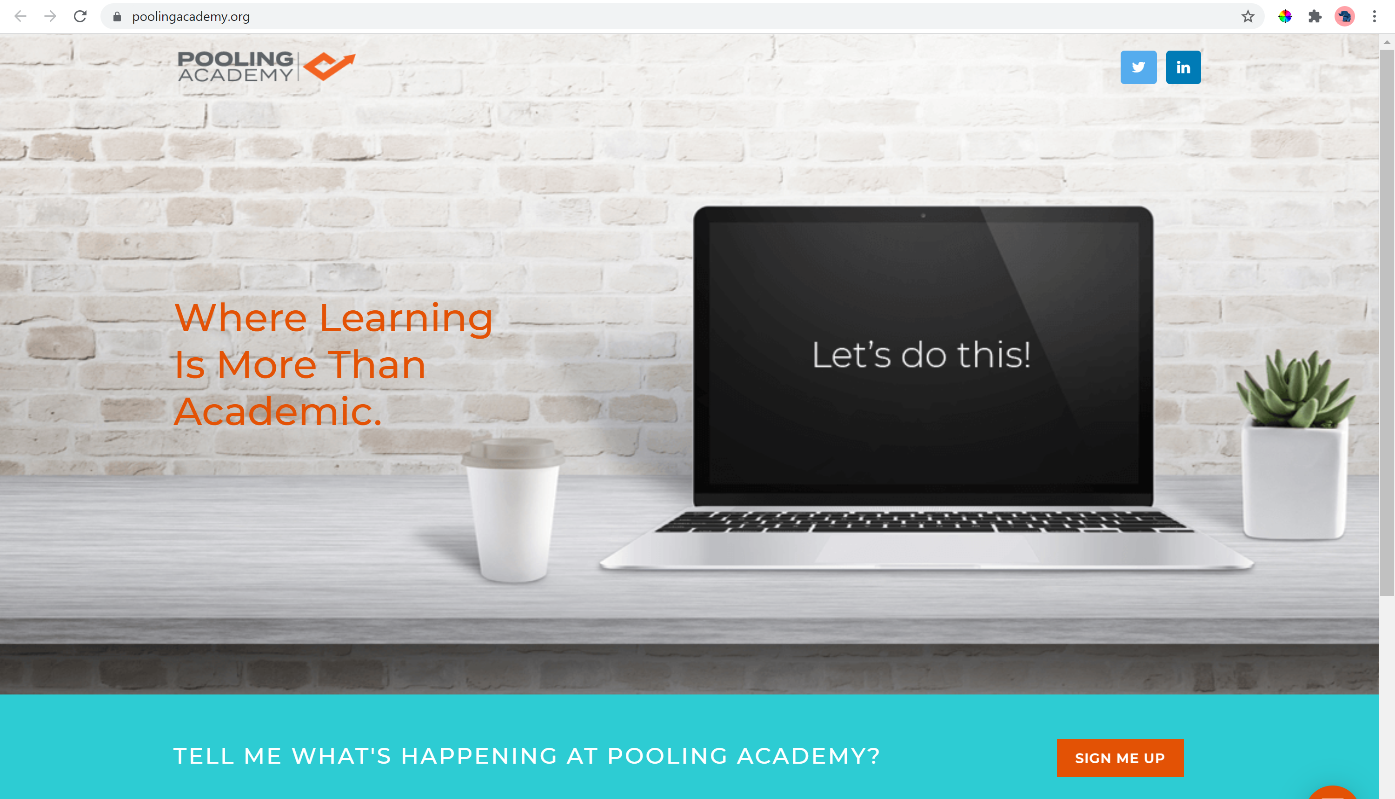
Notes:
Pooling Academy is the first and only interactive, comprehensive, online learning center for the public entity pooling community. It delivers educational content in seven core pooling functions and, when fully complete, will offer over 100 courses including introductory and advanced curriculum, and hot topics about current issues and trends.
Pooling Academy will help pools:
• Strengthening the talent pipeline by introducing key pooling concepts to anyone new to pooling
• Providing a leadership development resource to train up-and-coming pool leaders
• Providing continuing education for experienced pool professionals
POOLING BASICS AVAILABLE IN MARCH 2022
If you are new to public entity pooling or looking to expand your familiarity in new pooling functions, Pooling Basics provides a comprehensive review of all the key operational and governance areas of pooling and how they work together. You’ll explore the creative coverage programs and specialized services pools provide in support of public entity services.
This eight-course learning path offers a functional understanding of pooling concepts and how public entity pooling differs from traditional insurance with subjects such as:
• An Introduction to Pooling
• Finance
• Risk Management
• Member Services
• Underwriting
• Claims
• Employee Benefits
• Governance

Slide 8
Member Convenings:
Trustees Conference
Pittsburgh, PA
May 11-13, 2022
Staff Conference
Austin, TX
October 16-19, 2022
Upcoming Webinar:
Succession Planning & Recruitment
Past Topics:
Pandemic Response
Qualified Immunity
Law Enforcement Training
Law Enforcement
Loss Control
Claims
Underwriting
Marketing
Health & Wellness
NEW: Human Resources
Host monthly meetings for pool leadership
Roundtable discussions on timely topics
Promotes resource sharing among members

Slide 9
Additional Member Offerings:
Inaugural year – great success, retention, and positive feedback
Second Program Year
Kickoff in November
Promotes leadership & learning among member pools
Pool Administrator
Health Pool
Loss Control, Claims, and Underwriting
Newly Added:
IT & Data Analytics
Law Enforcement
Human Resources
Pool Administrator & Staff Compensation Surveys
Financial Ratio Benchmarking
Agility
Lexipol
TULIP
NetDiligence eRiskHub
Pooling Academy
Rebound Ready
Cities|Strong
Monthly newsletter for ALL members
Includes:
Announcements
Upcoming Events
Member Spotlights
Job Postings & RFPS
Resources & Links

Slide 10
Learn more & connect with us:
risc.nlc.org
Follow @NLCRISC on Twitter

